Slide 1
HR Digital Transformation
Confidential
Please do not circulate & distribute

Slide 2
Over half of SMEs in Singapore blame digitalisation delay on coronavirus

Slide 3
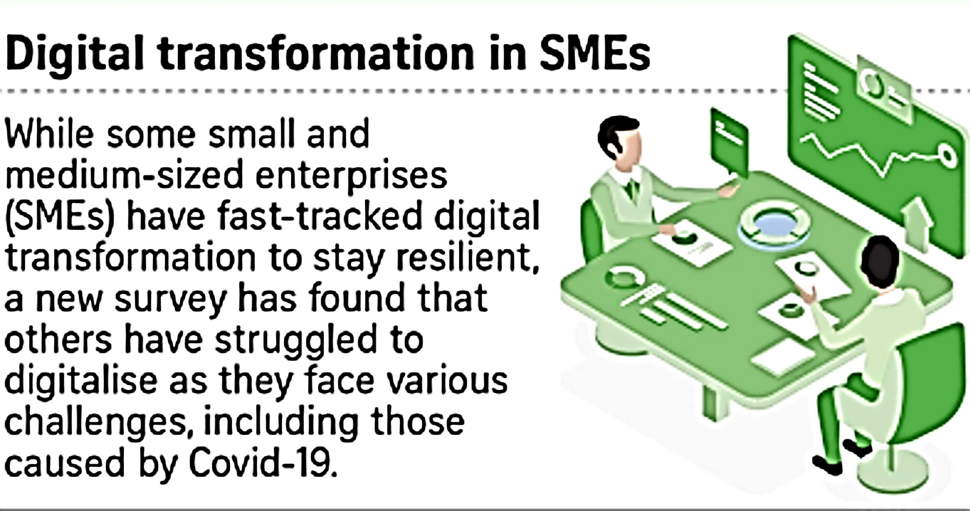

Slide 4
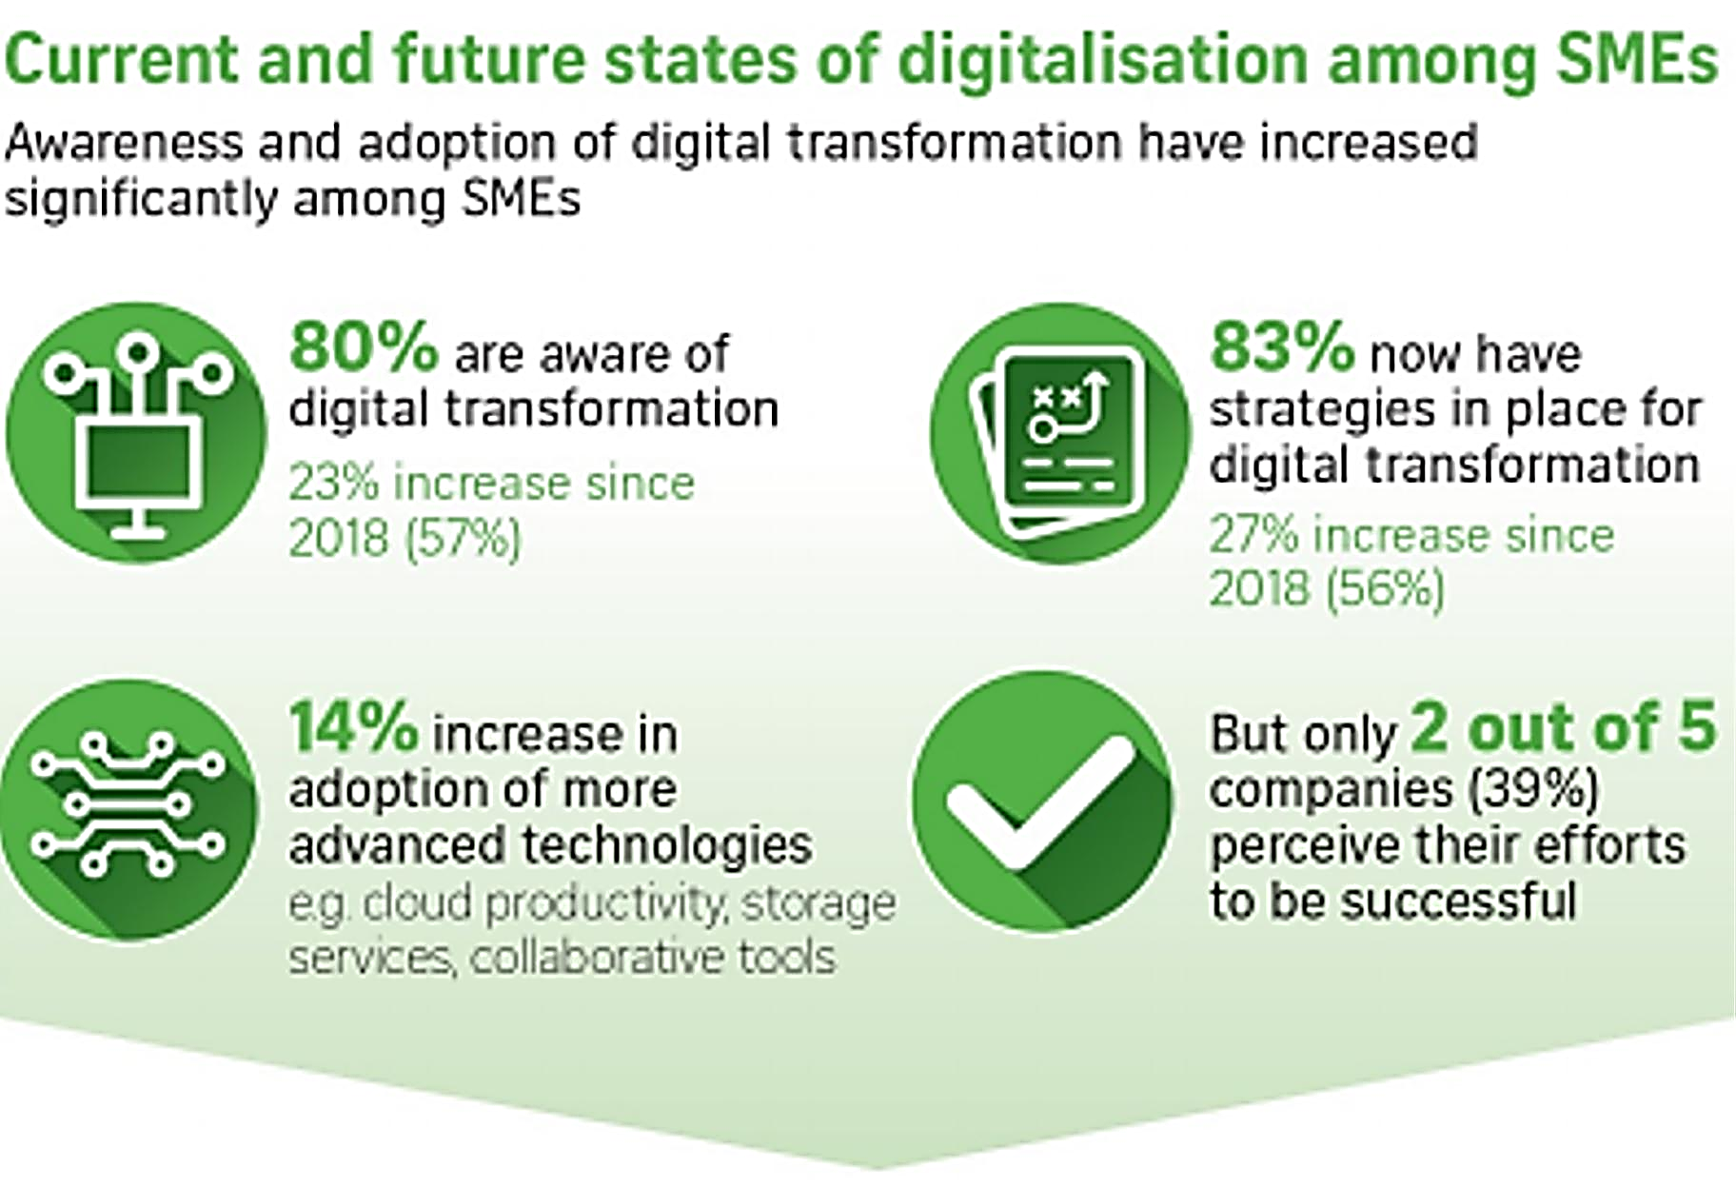

Slide 5
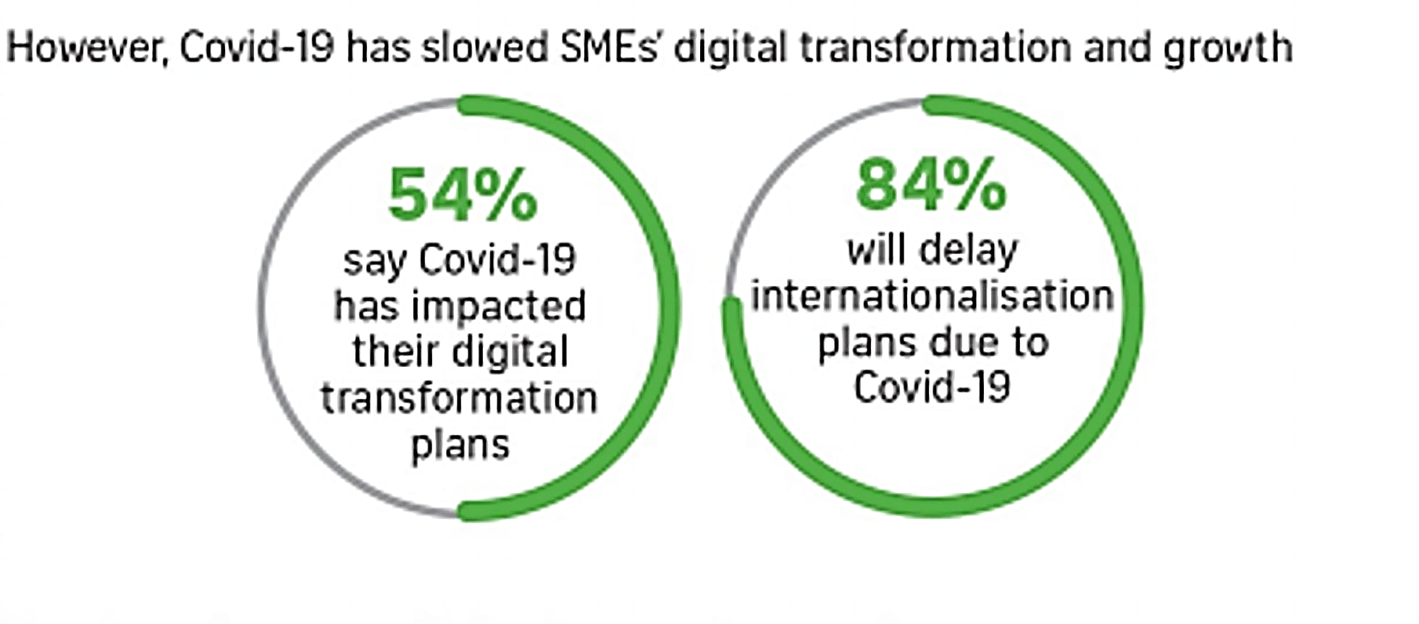

Slide 6
Top barriers to digital transformation
© 2021 IHRP. Copyright reserved.

Slide 7
“Due to their size and structure, SMEs have unique needs and some may lack the resources to digitally transform.”
Mr Vivek Chatrath, small, medium and corporate lead for Microsoft Singapore

Slide 8
“While SMEs implemented digital solutions that have been approved by government grants, they failed to consider if such solutions are the best to meet their needs.”
Irene Boey, vice-president of membership and training for ASME

Slide 9
5. Not having the right technology partner

Slide 10
“…estimates that poor quality software cost US companies $2.84 trillion in 2018.”
report from the Consortium of IT Software Quality

Slide 11
Repercussions
Damage To The Employee Experience
Lower Profits
Exponential Losses
Notes:
Cloud and SaaS technology boast easy implementation, low costs and quick employee buy-in. While those benefits are true in many cases, they don’t hold true if you make a technology purchase that simply doesn’t fit with your needs. How much does a poor technology purchase cost you? A report from the Consortium of IT Software Quality estimates that poor quality software cost US companies $2.84 trillion in 2018.
The long-term effects of a poor tech choice go beyond losing the cost of the software, canceling a subscription and repurchasing something else. Many times companies get stuck. It’s never a good time to switch again. Organization’s often push forward, reasoning “it’s working well enough.” Meanwhile, poor quality tech is crippling the company’s strategic growth. Consider how a bad tech purchase affects an organization.
Damage To The Employee Experience
Getting your stack choices wrong can leave your team working through processes and practices they dislike, every single day. And this will make it harder for them to achieve great results, let alone their existing targets.
You can guess the domino effect this has. Unhappy employees lead to disengagement. Less engaged employees are less productive. The quality of their work and their loyalty to the organization plummets. Ultimately, productivity and profits suffer.
Even more shocking, the same study found that 25 percent of employees say the software they are using made them consider leaving their job, and one in eight employees actually did leave over a poor software experience. Can your organization operate at peak performance under these conditions? Can you innovate and meet customer demands if the people you rely on don’t want to be there or are leaving altogether? Simply put, no. The time and energy that is required to replace key workers is often higher than the cost of the software itself, or the cost of replacing the software.
Does this sound familiar? You’ll love this interview with Blake Johnston on the Best & Worst B2B Tech Buying Experiences he’s had!
What’s the solution? When making software selections, focus on how the tech affects the employee experience. While there is always a learning curve when new tech is introduced, it should fit organically into an employee’s day. The new tech must specifically address needs or pain points of your employees. For example, if communication is an issue, find a tool that allows employees to send quick updates, track projects and increase their overall engagement. Is your sales team in need of tech that can take over some of their mundane tasks? Do they need better communication with accounting and marketing? Do they need a more efficient way to schedule meetings? Does your sales force need more training? Focus on these key needs instead of the software that just has the best “bells and whistles.”
Lower Profits
Investing in the wrong software lowers overall profits in a few different ways. First, you may have the scenario where you are still paying for a subscription and no one is using the software. We have all seen companies invest in the latest trend only to find employees just stop using it a few months in. It happens more often than you might think. What’s worse than making a poor tech investment choice? Investing and not even using it. Profits lower because it’s as if you are throwing money away.
Another issue is productivity. As productivity decreases, so do profits. Quality is often jeopardized, as well as customer service. The above-mentioned data source also found that 95 percent of employees said the right software can make them more productive. However, 65 percent felt they were not reaching their potential because of ineffective software.
Productivity can also be slashed if there is an issue with duplicative programs. Are employees losing time because they are forced to duplicate tasks by entering the same information into multiple programs? Is the tech actually slowing down your workforce?
Lastly, inefficiencies directly impact your ability to meet customer needs. The results could be a drop in customer loyalty, missed sales opportunities or damage to your reputation in the industry. All these factors affect profits, and trace directly back to your choice in software.
Exponential Losses
The last thing you want to do when you have invested in a new technology is to abandon ship. However, the negative effects described above only continue to increase exponentially over time. Whether it’s a slow leak in performance or a massive hemorrhage, continuing to use ineffective technology will further harm employee engagement and continue to lower profits. In addition, you will likely face these challenges.
Your IT department will need to invest time to facilitate adoption, implementation, training and monitoring.
Users will invest time in training.
IT will have to spend time on updates to keep the software secure and current.
You might face a situation where the software is no longer supported or finding experienced developers is difficult. This might lead to additional maintenance costs and technology debt.
The software may just become an unsustainable part of your tech stack, forcing you to make another rushed decision to replace it.
In short, the longer you leave bad tech in place, the greater the long-term impact.
Making The Right Choice
The Small Business Chronicle boasts that “technology in the workplace has helped workers become more efficient than ever before.” This is certainly true, but hinges on selecting the right technology.
Every investment comes with risks. Mitigating those risks and weighing them against the perceived benefits of a certain technology is vital. Before making a decision, create a team for gathering input. Select members from throughout your organization that bring a unique perspective and area of expertise. As each member focuses on their specific business requirements, you’ll increase the likelihood that the proposed tech solution will meet all the company’s requirements, as well as have employee buy-in.

Slide 12
How to choose the right technology partner for you
References
Expertise
Ask for evidence
Ask their customers what they think
Check how long the potential partner has been in business
Should focus on outcomes, people, productivity and process improvement, not IT
Don’t be swayed by flashy tech
Support and beyond
Culture
How well their availability dovetails with your business hours
Get a clear picture of what happens after you go live
You need to be certain that their people will work well with yours

Slide 13
4. Low awareness of government grant

Slide 14
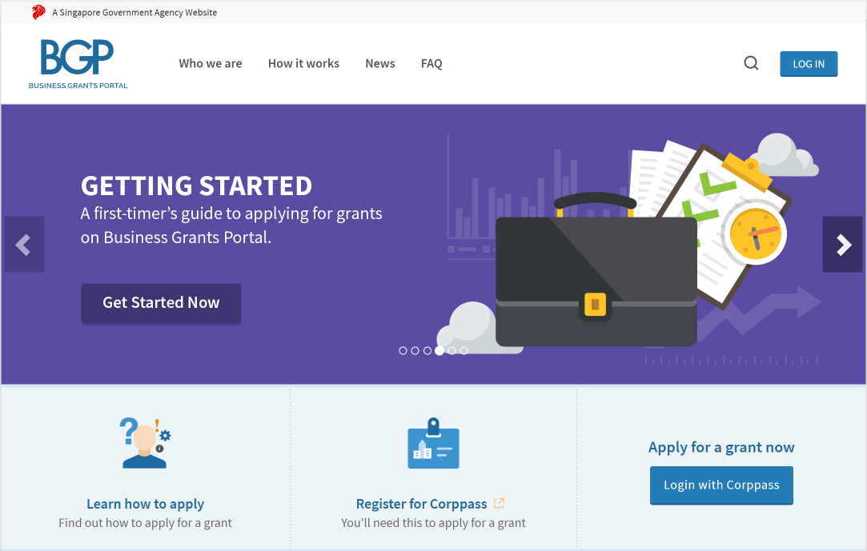

Slide 15
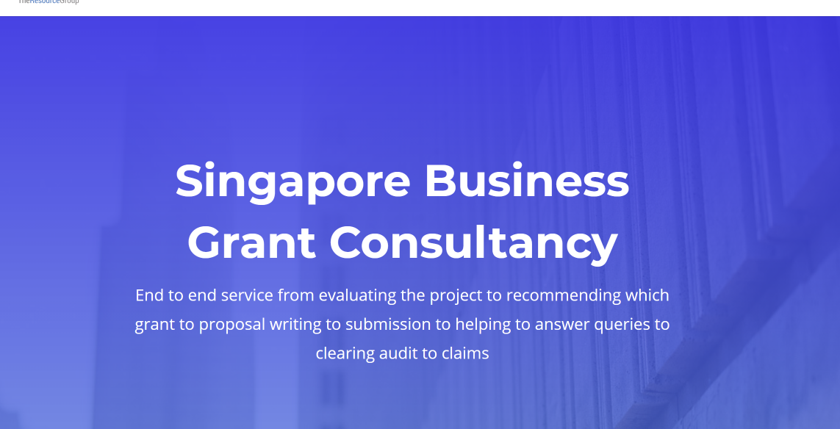

Slide 16
Takeaways
Don’t expect things to fall onto your lap. If it is that easy, it won’t be a unique competitive advantage.
Speak with consultants that have their finger on the pulse.

Slide 17
3. Uncertain economic environment

Slide 18
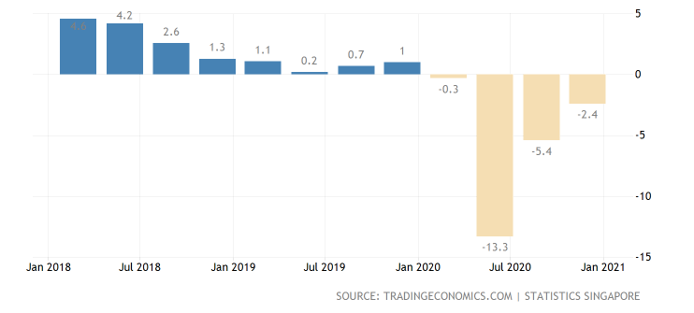

Slide 19
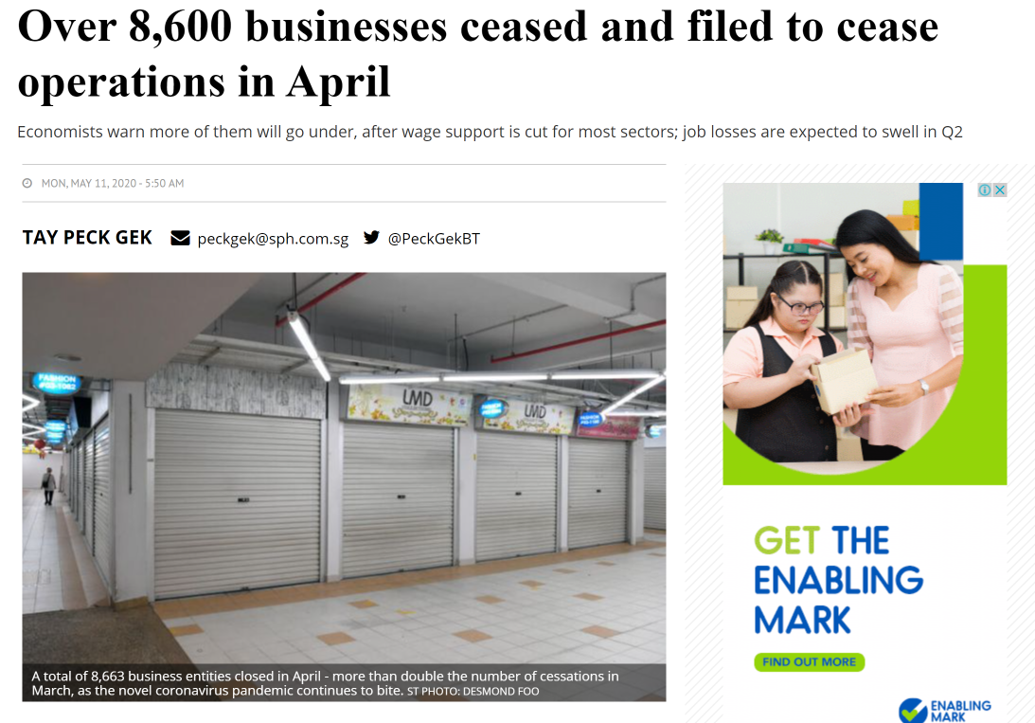

Slide 21
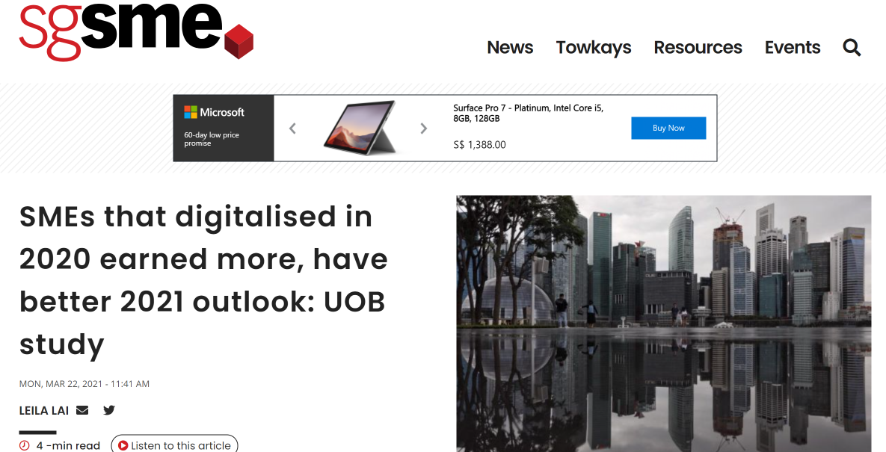

Slide 22
SMEs that digitalised in 2020 earned more, have better 2021 outlook: UOB study
The UOB SME Outlook 2021 Study published on Monday found that two in five SMEs that implemented digitalisation initiatives in 2020 had stronger revenue growth than non-adopters, with those who digitalised their entire business or multiple areas outperforming those who digitalised only one area.
Among non-adopters, six in 10 saw their 2020 net revenue decline from 2019.
The businesses that digitalised are also more optimistic about 2021 - three in five are expecting revenue to grow this year, and seven in 10 feel more prepared for a post-Covid-19 business recovery.

Slide 23
2. Lack of digitally skilled workforce

Slide 24
How hair-care product firm with older staff took digitalisation plunge
The company, which sells and distributes hair-care products and tools, consists of a five-person team. All except one are aged between 50 and 60.
Revamp its back-end processes as most operations were still being done manually. For example, the company was still issuing cheques and hard-copy payslips and recorded each employee's annual leave allowance in notebooks.
Adopting human resource management software and digital stock management inventory software helped it to reduce long administrative hours, which resulted in time-saving costs of about 20 per cent.

Slide 25
"It's natural for them to have this fear of digital tools. They were afraid of memorising the steps on how to use these new solutions. It took a lot of trial and error and now they are slowly building up confidence."
Mr Simon Lee, director of Synergetic Beauty System

Slide 26
Takeaways
People can be trained, whether they think it is possible or not.
Don’t reinvent the wheel. Find companies that have done it successfully and see how they did it.
Success leave clues.

Slide 27
1. High cost

Slide 28
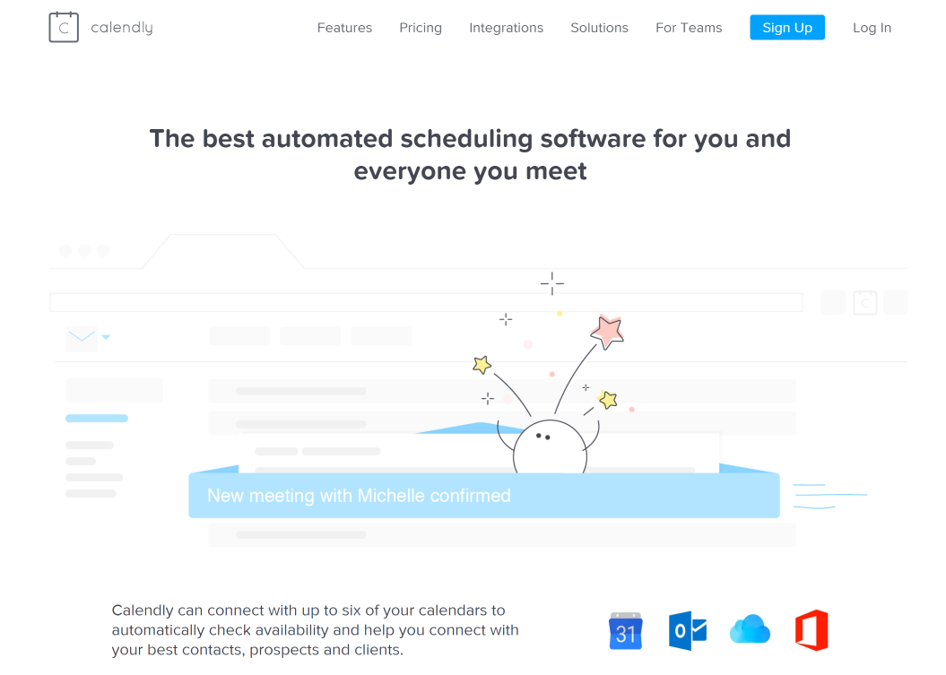
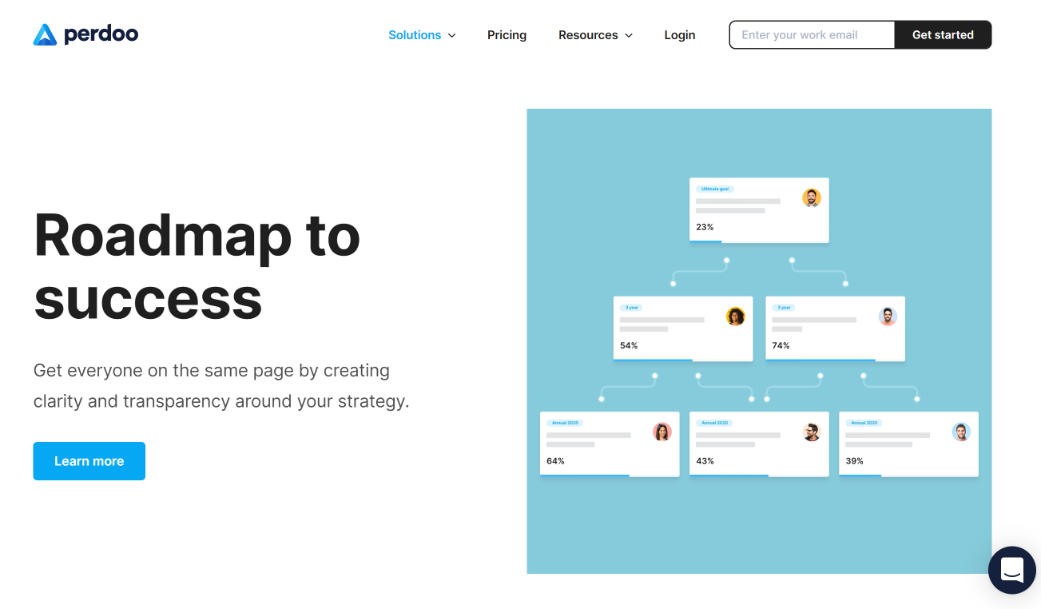
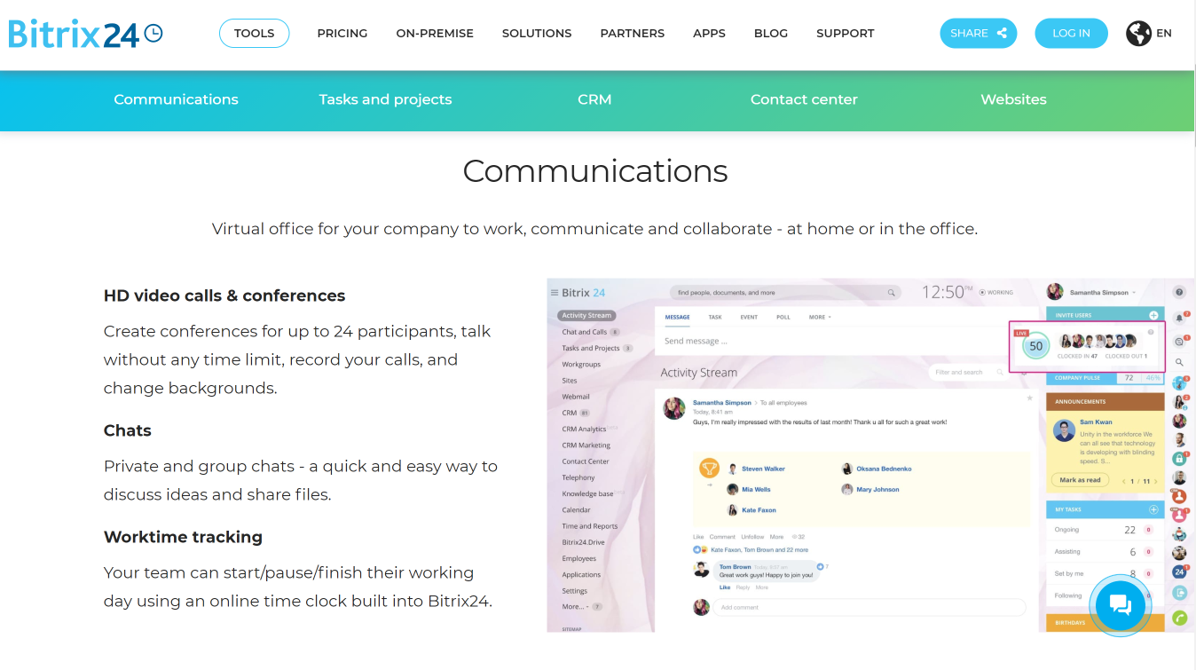

Slide 29
How much do you think these software costs?
A: $5 to $10 per user per month
B: $11 to $15 per user per month
C: $15 and above per user per month

Slide 30
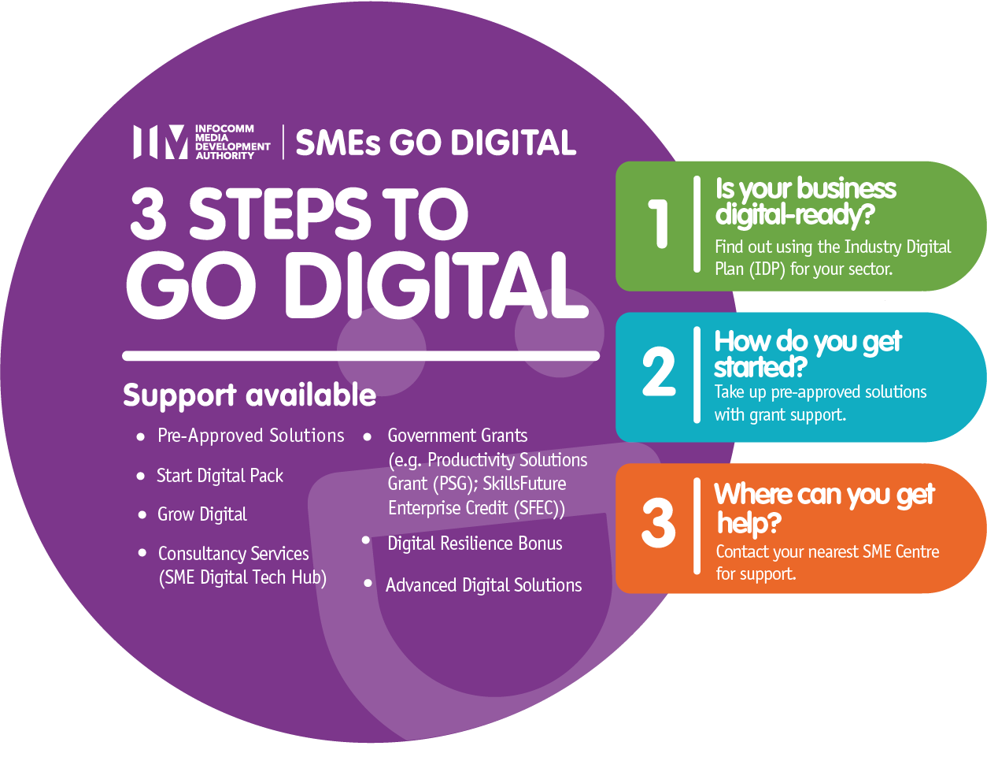
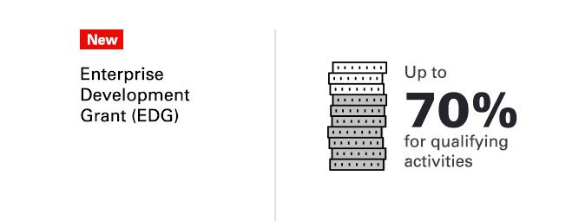

Slide 31
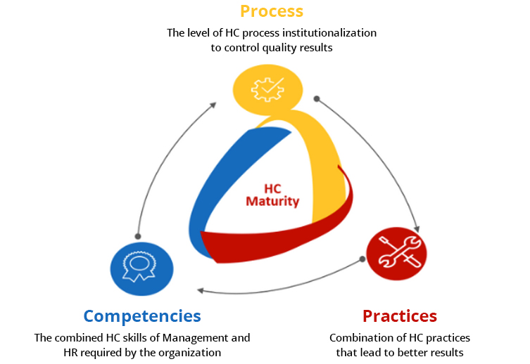

Slide 32
Takeaways
Costs of business failure is most expensive than costs of acquiring tech solutions
Leverage on the right grant to support your transformation initiatives
Use IHRP HCDT to do a free diagnostic health check.

Slide 33
