Slide 1
What do Mexican Clinical Engineers Publish?
Fabiola M. Martinez-Licona
Universidad Autonoma Metropolitana - Mexico

Slide 2
The Team / Workgroup
Fabiola Martinez Licona
Electrical Engineering Depto.
National Center for Research in Medical Imaging and Instrumentation
Universidad Autonoma Metropolitana

Slide 3
Description
Analysis of the publications of articles in the Mexican Journal of Biomedical Engineering (RMIB) and papers in the Mexican National Biomedical Engineering Congress (CNIB).
Period of reviews:
RMIB.- 2010-2020
CNIB.- 2015-2019
The analysis included
authors' participation nature of the work
origin number of references
methodology used thematic coverage

Slide 4
Goals of the project and final users that will benefit
Goals:
To acknowledge the Clinical Engineering contribution to the Mexican Biomedical Engineering community.
To identify the fortress and weakness of the Clinical Engineering document publishing process.
Benefits:
In general, the Clinical Engineering community

Slide 5
Results
RMIB Articles
Type of article |  | Nature of article
Research | 7 | Theoric | 10
Review | 8 | Practical | 5
Technical Note | 2 | Theor/Prac | 2
Author profile | University | University/Hospital | University/Other | Other
2015 | 3 | 3 | 0 | 0
2016 | 3 | 2 | 0 | 1
2017 | 3 | 0 | 0 | 0
2018 | 1 | 3 | 1 | 0
2019 | 9 | 2 | 0 | 2

Slide 6
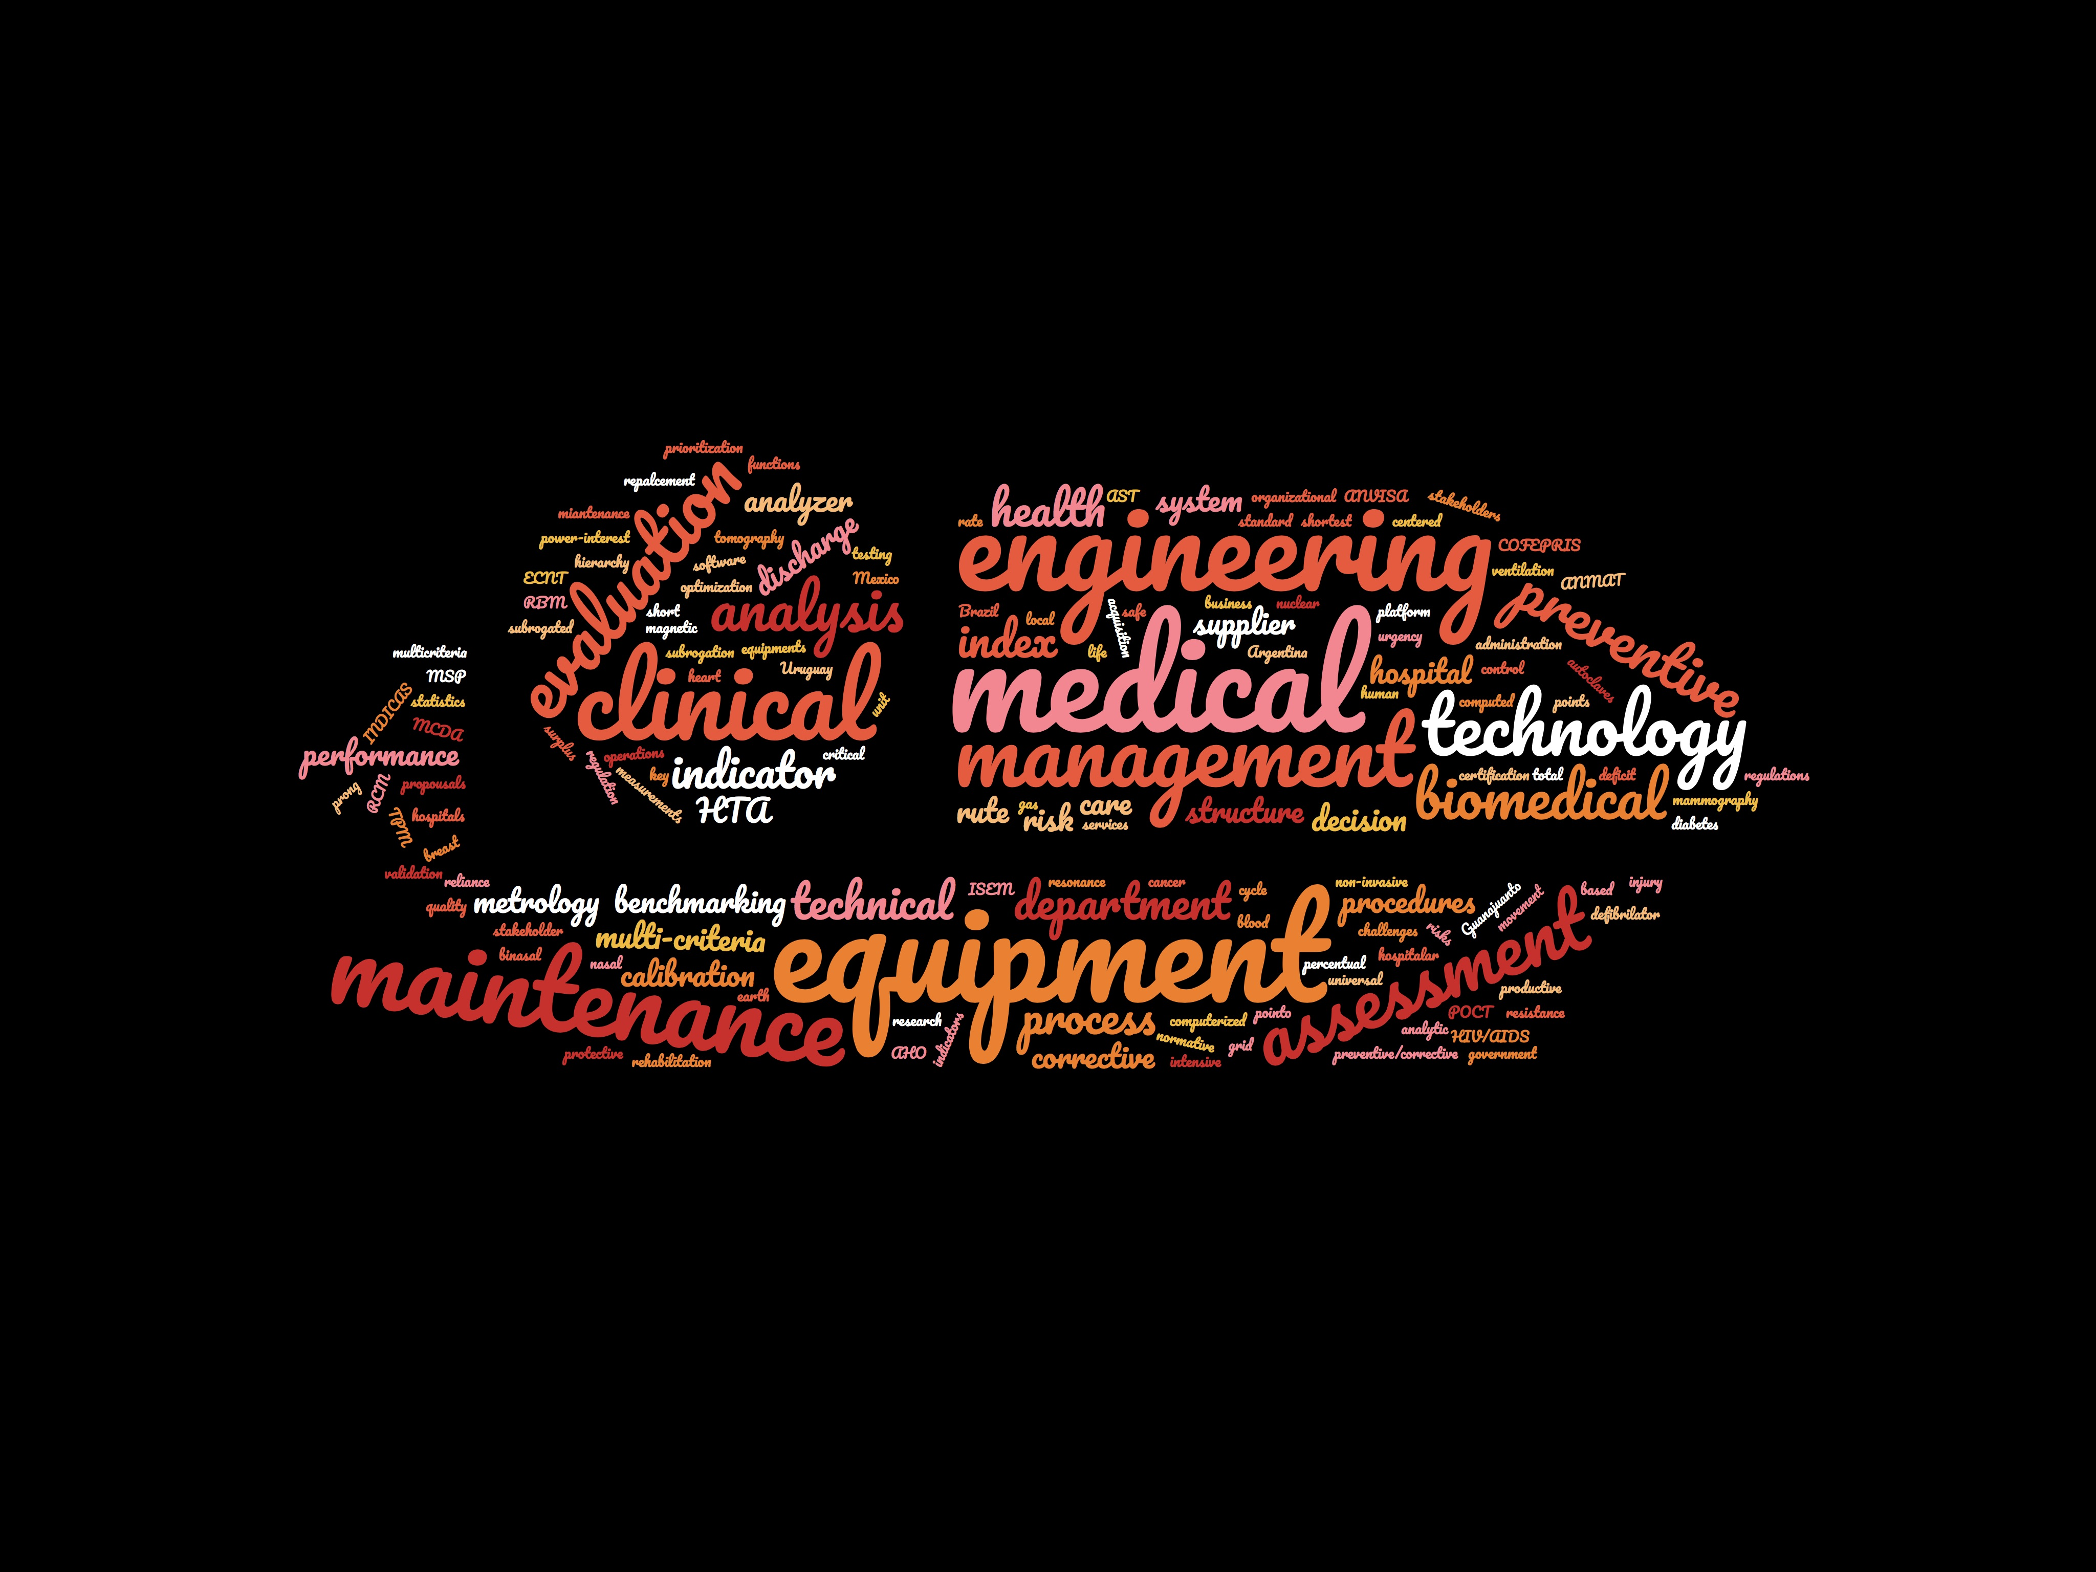
Results
Issues to address:
Writing Skills
Publish Process
Struct. Design
Ref. Manag.

Slide 7
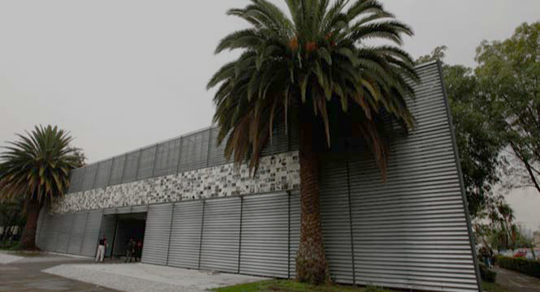
Fabiola M. Martinez-Licona
fmml@xanum.uam.mx
Universidad Autonoma Metropolitana
Mexico

