Slide 1

Technical Due Diligence Team
Lessons learnt establishing the national team to evaluate 'exotic' ventilators and infusion devices at the peak of the covid pandemic in the UK
Prof Dan Clark OBE
Nottingham University Hospitals NHS Trust, UK

Slide 2
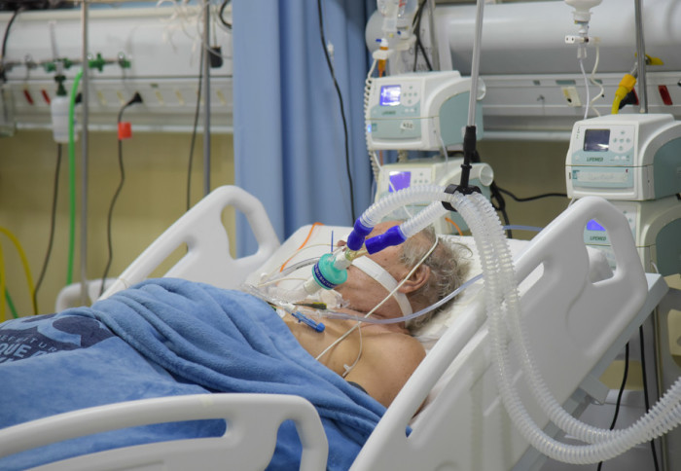
Background – why did we need a national ventilator programme?

Slide 3

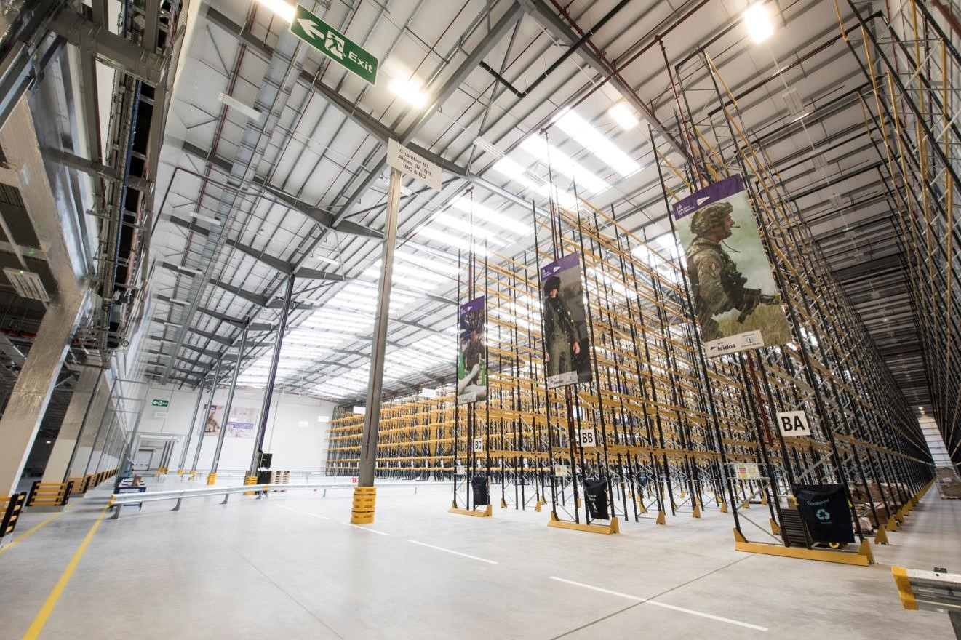

National Ventilator Allocation Panel
SitRep Data

Slide 4
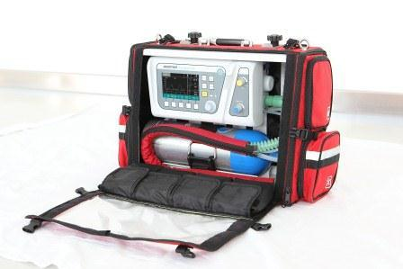
National Ventilator Allocation Panel
SitRep Data

Slide 5
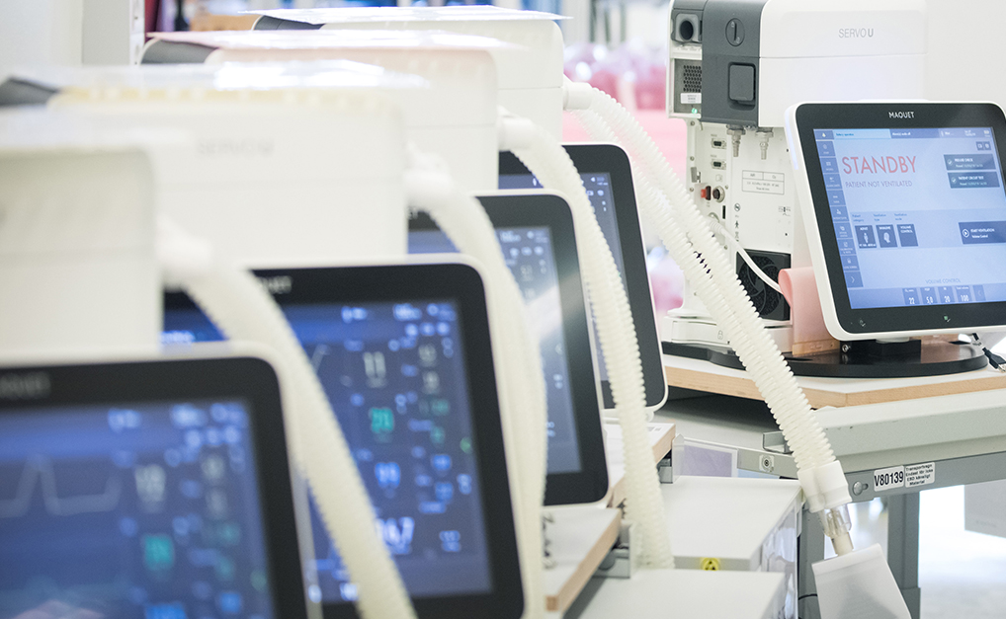
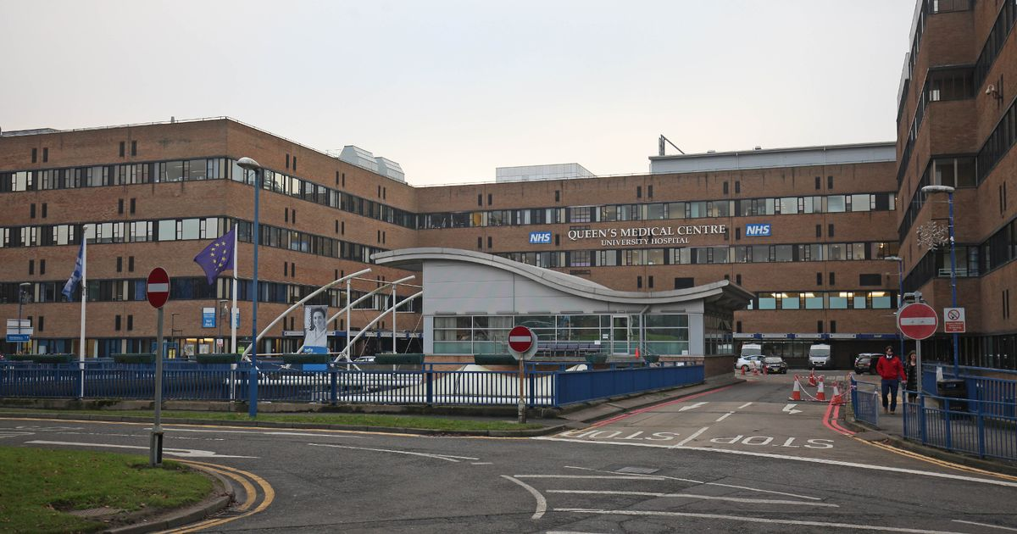
Due Diligence Overview
  Worldwide acquisitions > RAF Donnington
  Clinical Due Diligence Team – initial report
  Technical Due Diligence (Nottingham)
  National Ventilator Panel (NVAP)
  RAF Donnington > NHS distribution
CDD Report
National Ventilator Allocation Panel
TDD Report
SitRep Data

Slide 6







The Team / Workgroup
Dan Clark, Clinical Engineering, NUH
RAF Logistics
NHS Chief Scientific Officer

Slide 7
Prof Dan Clark OBE
daniel.clark@nuh.nhs.uk
Nottingham University Hospitals NHS Trust

