Slide 1
Research on after-sales service of medical devices in 148 medical institutions in Zhejiang Province, China
Jingyi Feng, Wei Xiong, Jing Sun, Yingying Lv, Jin Pan
First Affiliated Hospital, Zhejiang University School of Medicine

Slide 2
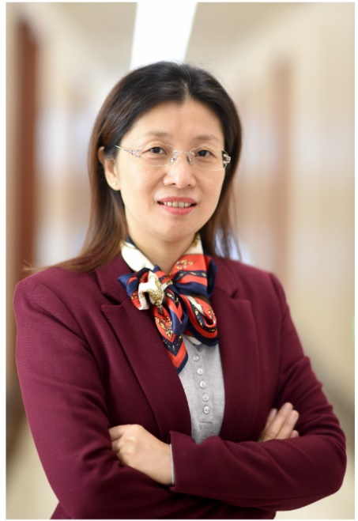
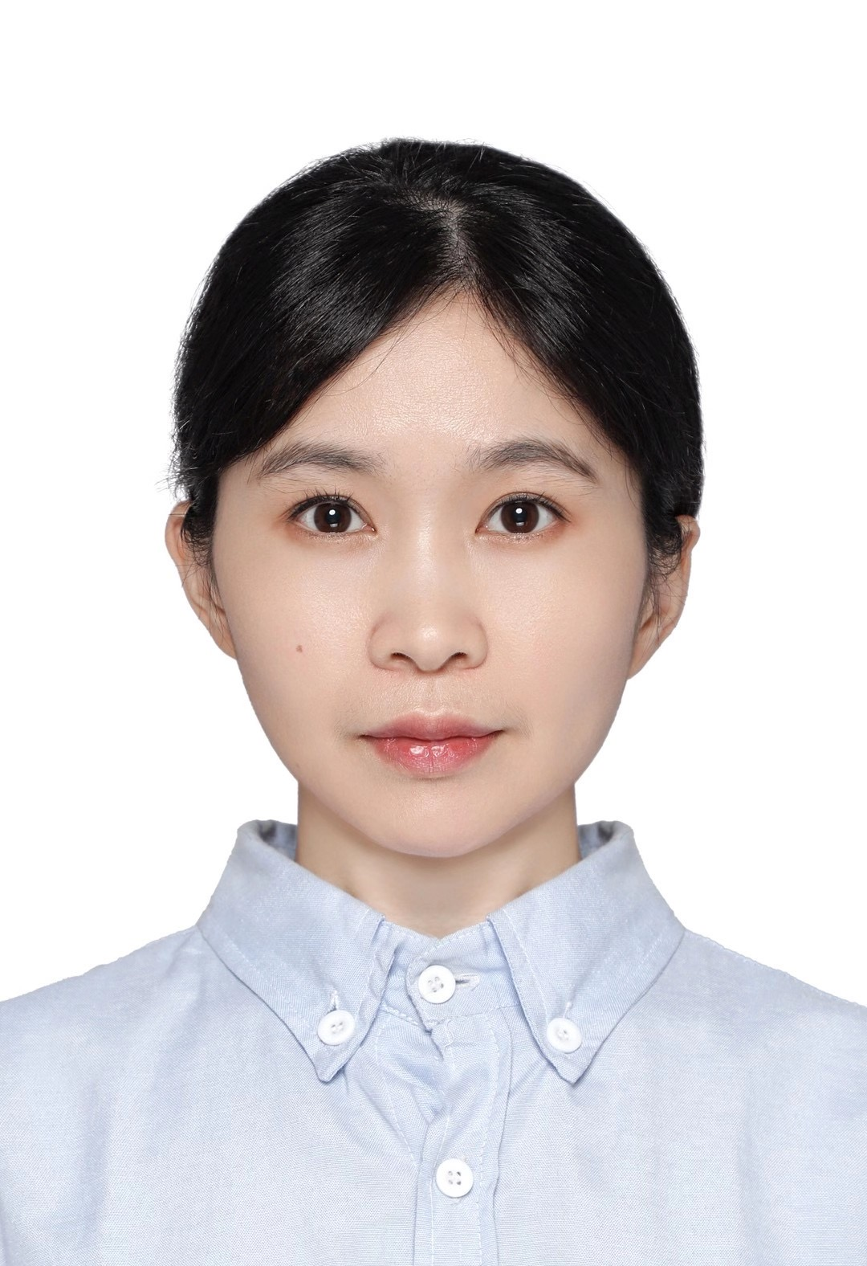
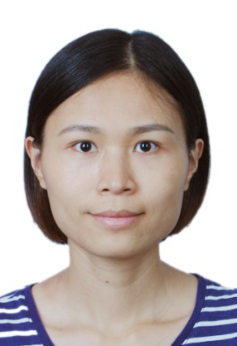
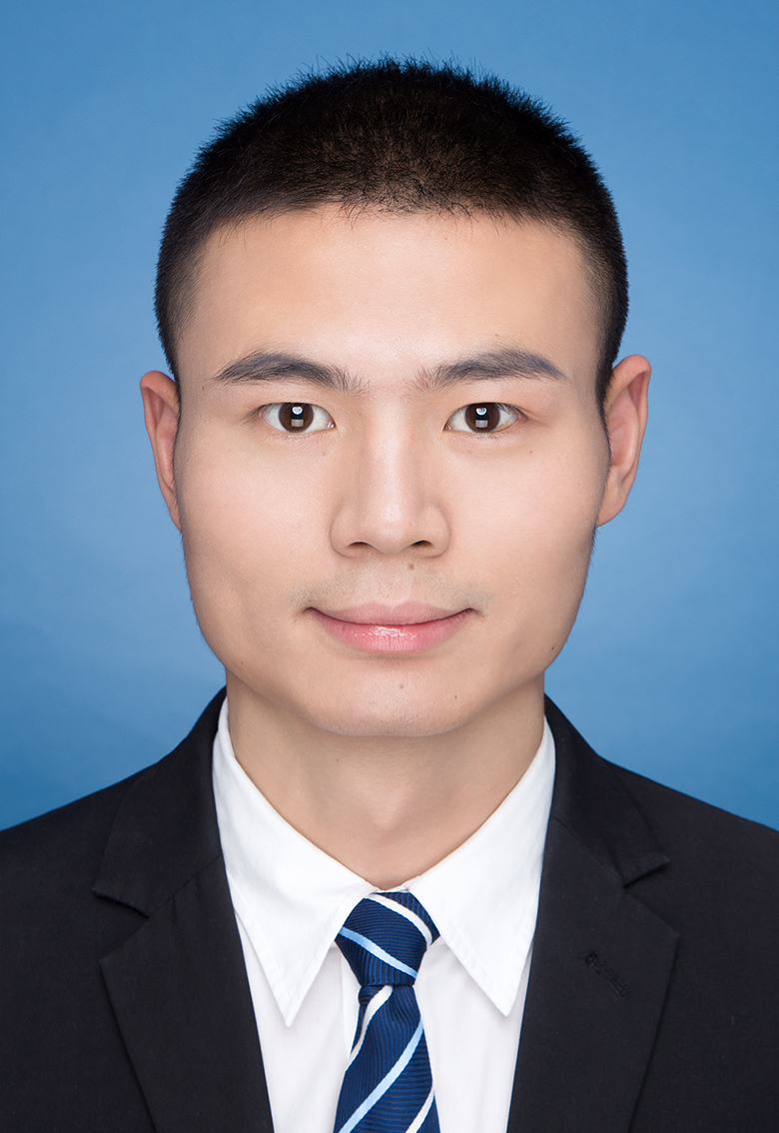
The Team / Workgroup
The team leader is the head director of Clinical Engineering and Information Technology Department, Jingyi Feng, who is also a member of China Medical Association, Clinical Engineering Department.
The team built Key Laboratory of Clinical Evaluation Technology for Medical Devices of Zhejiang Province to develop evaluation system for healthcare technologies. The laboratory is a research platform for the clinical evaluation of medical devices and promote collaboration among medical institutions, universities, and medical device companies.
Jingyi Feng, PI
Yingying Lv
Jing Sun
Wei Xiong
Jin Pan

Slide 3
Description
The hierarchy structure of medical system in Zhejiang Province leads to the diverse medical device management in hospital of different levels. But what the difference is, where the similarity lies and how to deal with related problems are hardly studied.
To dig into the situation of after-sales service for medical device in Zhejiang Province, we surveyed 148 medical institutions (81 tertiary hospitals,43 secondary hospitals and 24 primary hospitals) about after-sales service performers, and collect the main problems disturbing hospital engineers.

Slide 4
Goals of the project and final users that will benefit
Learn the situation of after-sales service for medical device in Zhejiang Province
Establish a method for medical device management evaluation
A
B
Goals
C
D
Provide solution to the problems exists in primary medical institution
Enhance the after-sales service quality for healthcare facilities in Zhejiang Province

Slide 5
Results
Average number of clinical engineers in different levels of medical institution shows a significant quality difference in management department.
Background of engineers | tertiary hospitals | secondary hospitals | primary hospitals
Graduated from BME | 48.80% | 35.90% | 13.20%
Bachelor's degree and above | 78.50% | 63.60% | 68.80%
Senior engineer and above | 12.60% | 9.70% | 9.20%

Slide 6
Results
Quality control work of medical devices
tertiary hospitals - hospital engineers
secondary hospitals - hospital engineers + factory engineers
primary hospitals - factory engineers

Slide 7
Results
Problems that make hospital engineers unable to complete maintenance on their own:
Lack of spare parts; Lack of professional tools; High equipment integration; Lack of formal maintenance training and knowledge of confidential core technology

Slide 8
Wei Xiong
Thank you!
xwsoberpower@163.com
Department of Clinical Engineering and Information Technology, The First Affiliated Hospital, Zhejiang University School of Medicine, Hangzhou Zhejiang 310003, China

