Slide 1
Lessons Learnt during COVID-19 pandemic for improved emergency medical equipment procurement
Claudio Meirovich
SEIB

Slide 2









The Team / Workgroup
Claudio Meirovich owns
Meirovich Consulting was contracted by:
to provide technical assistance for the procurement of medical equipment part of the COVID-19 response each one of these organization funded in different countries.

Slide 3

Identified Challenges
Slow procurement process
Lack of detailed facilities information for installations
Gaps in technical info required / provided
No link between needs and requests
No distributors to provide technical assistance
Limited information on the experience with “new” equipment

Slide 4

Seven proposals for improved procurement
Planning Guidelines for Facilities and technology
Needs Assessment Tools
Market research studies
Harmonized Technical specifications
Guidelines for Minimum Rehabilitation Works
Testing and Commissioning templates
Post Market Surveillance

Slide 5


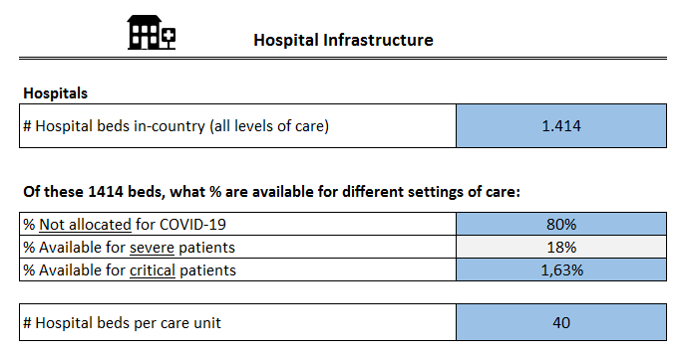
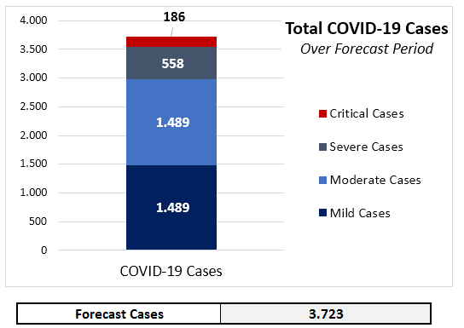
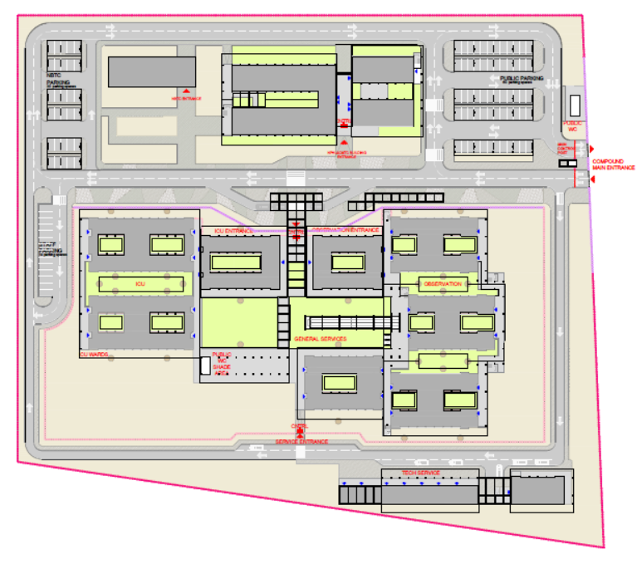
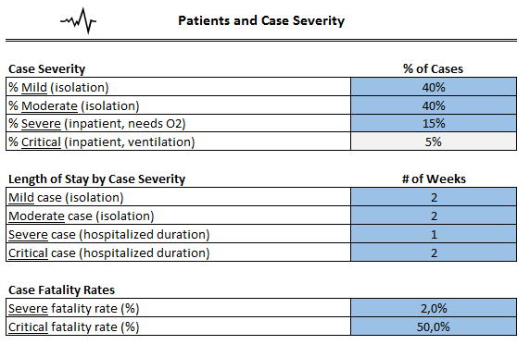
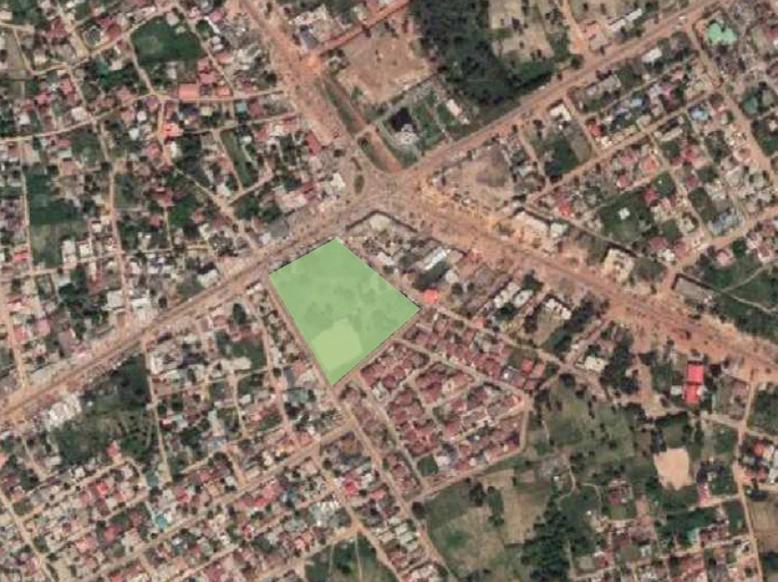
1. Planning Guidelines for Facilities and technology

Slide 6

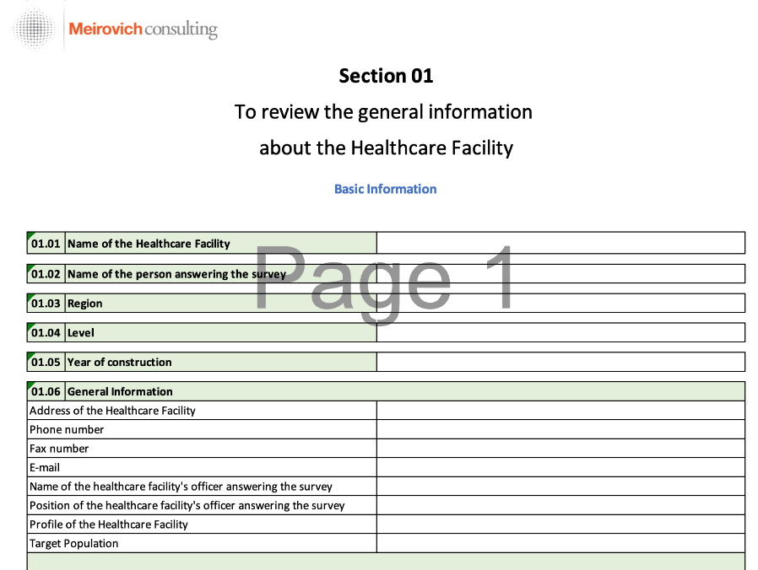
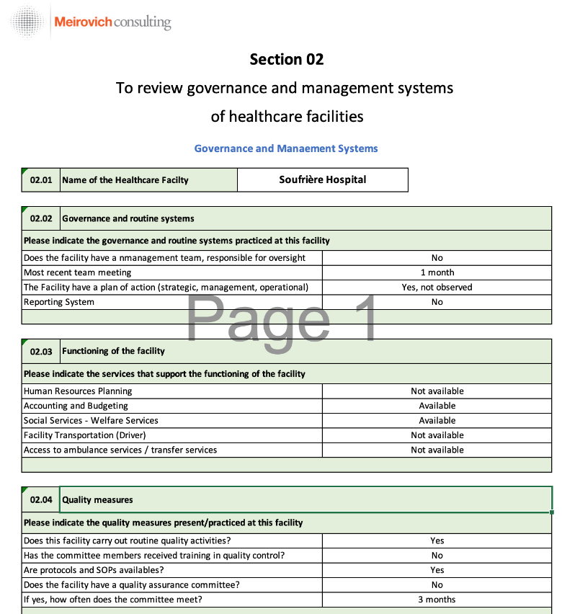
2. Needs Assessment Tools

Slide 7

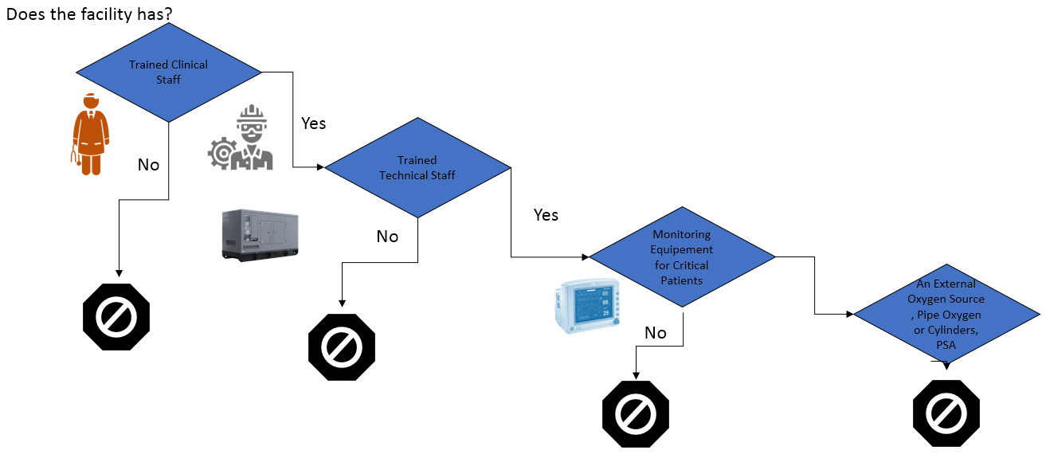
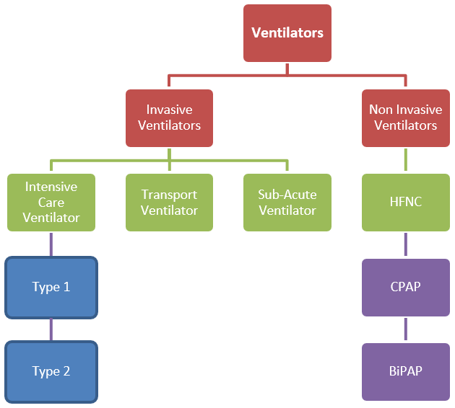
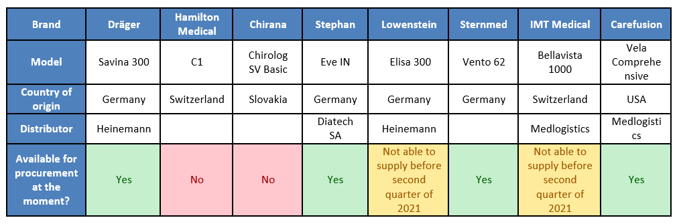
3. Market research studies

Slide 8

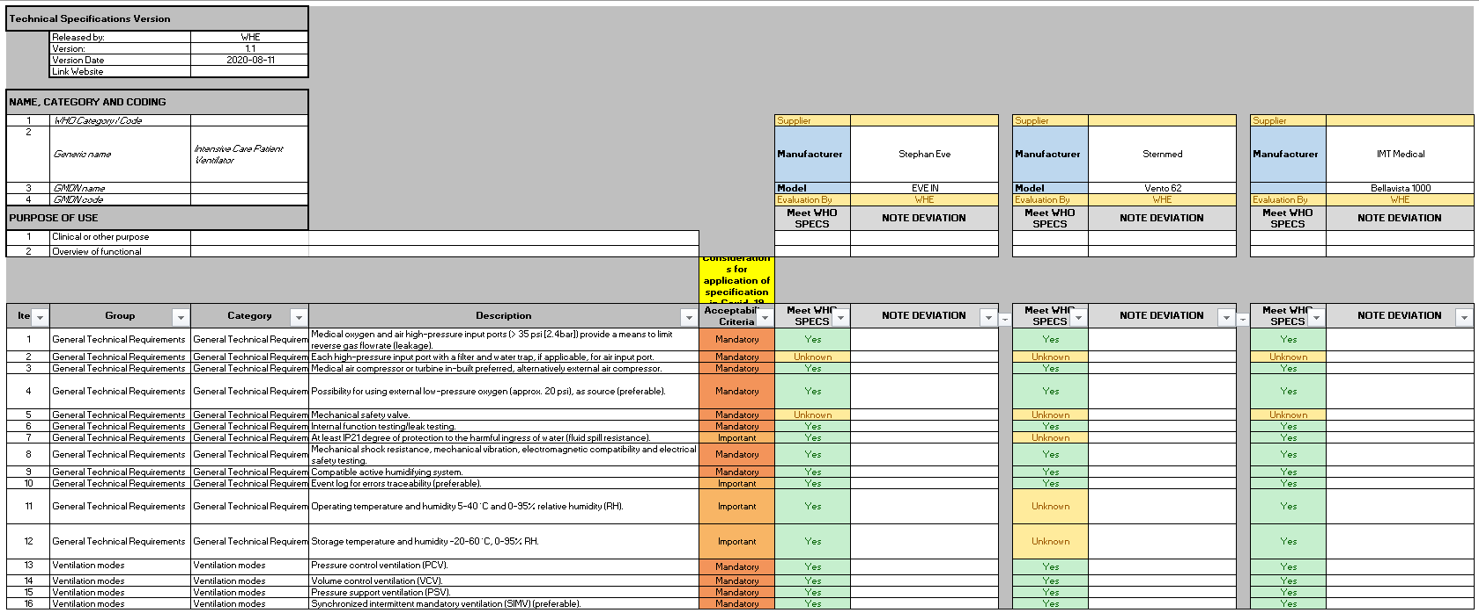
4. Technical specifications

Slide 9

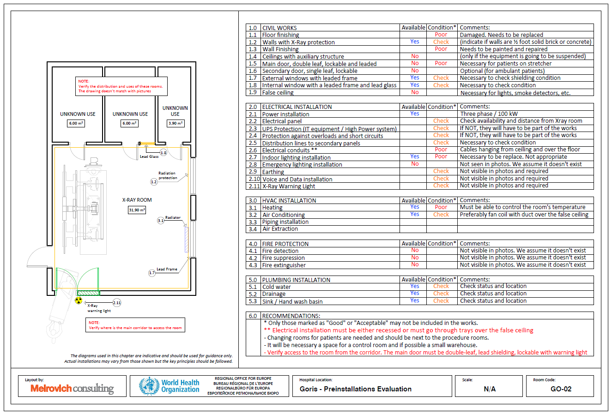
5. Guidelines for Minimum Rehabilitation Works

Slide 10

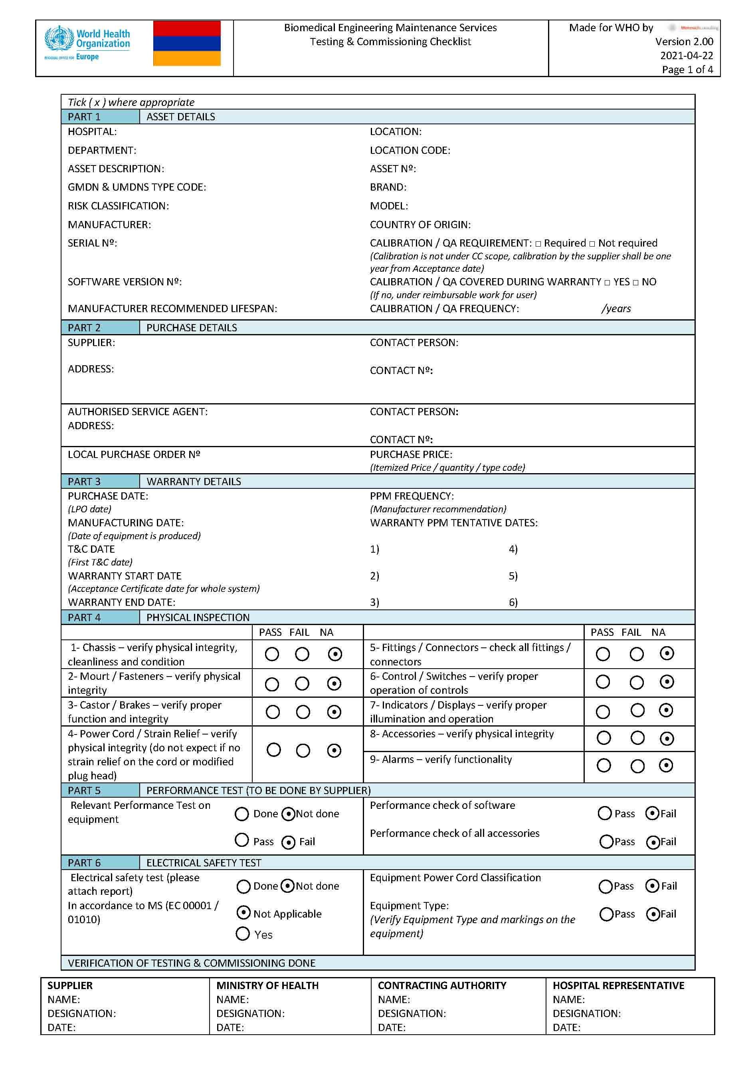
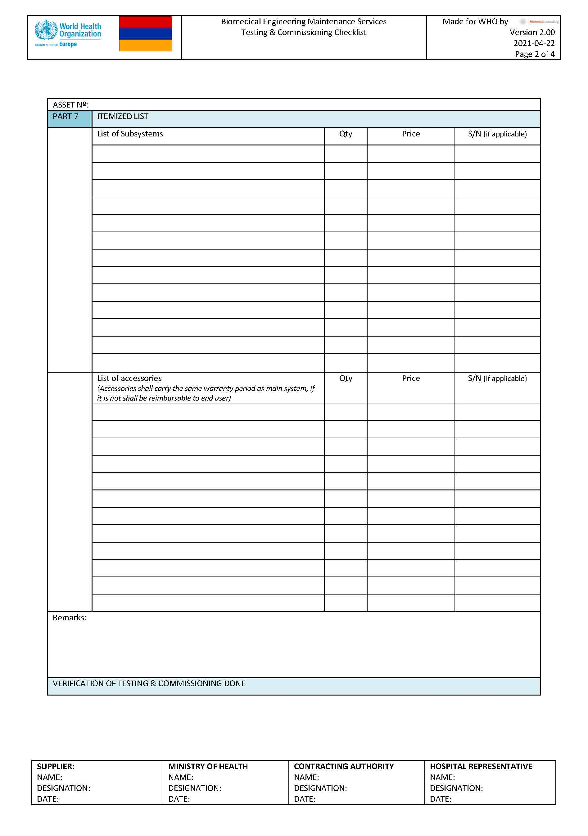
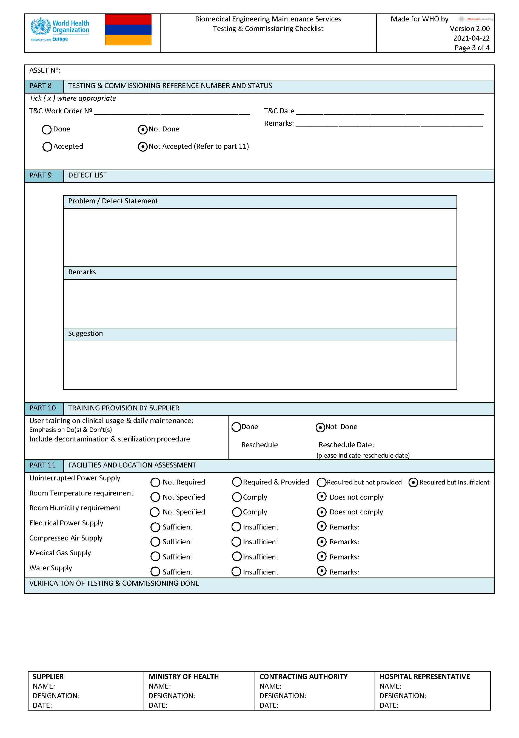
6. Testing and Commissioning templates.

Slide 11

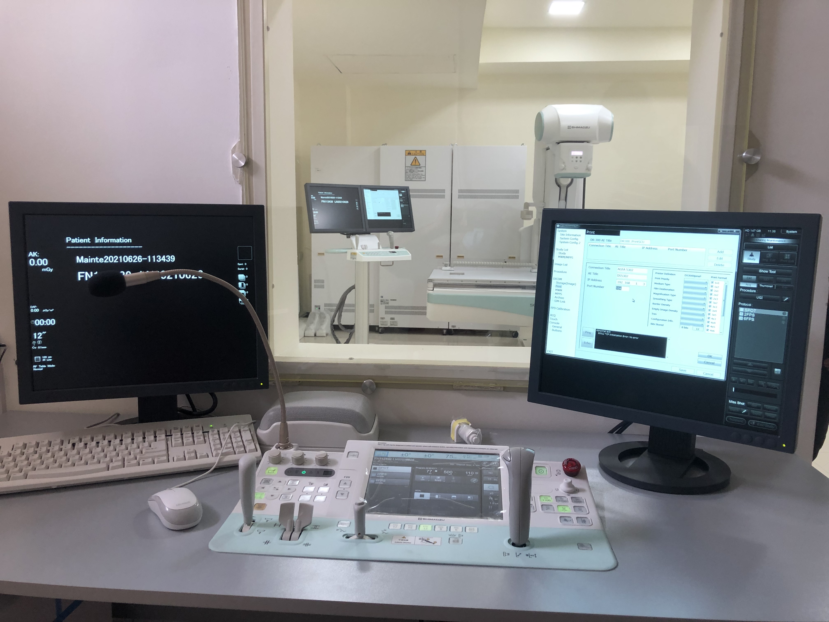
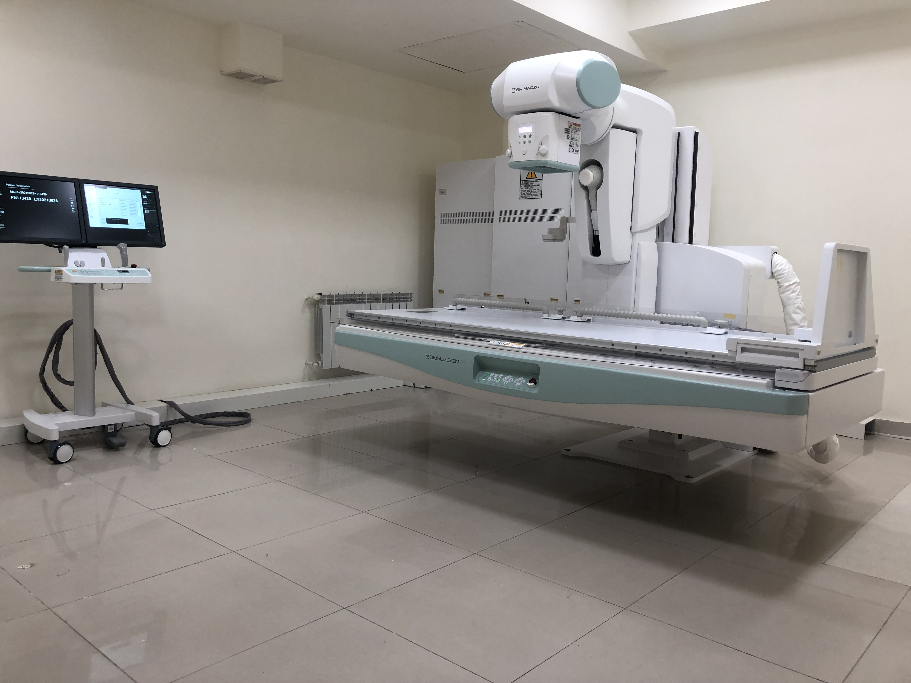
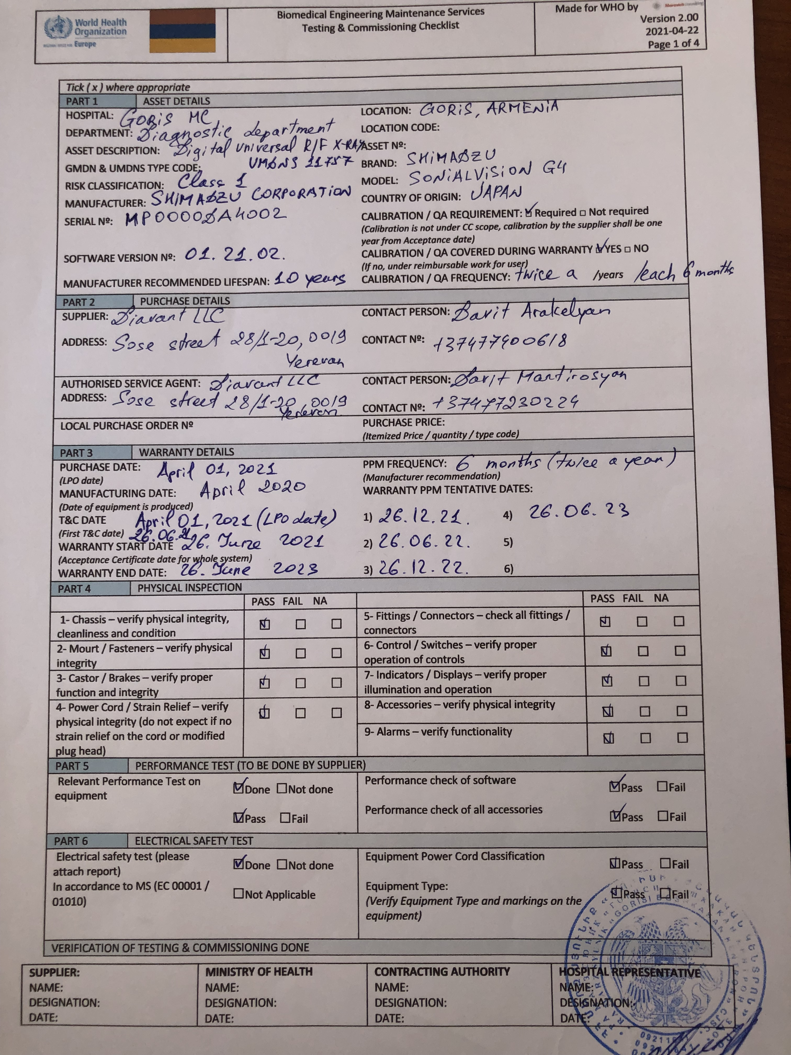
7. Post Market Surveillance

Slide 12

Way Forward
1- To develop a compendium of tools for data collection / healthcare facilities assessment and rehabilitation guidelines
2- To propose the development of an ISO standard for technical specifications

Slide 13

Way Forward
3- To set up an international database with relevant information with the results of public procurement with global funds (WB, ADB, AFD, etc.) to assist other organizations in future procurement processes.

Slide 14

Claudio Meirovich
claudio@meirovichconsulting.com
Meirovich Consulting, Spain

