Slide 1
Health Technology Management Reengineering: Improving Quality and Sustainability of Healthcare system in Peru
Luis Vilcahuaman – Rossana Rivas
Pontifical Catholic University of Peru / APBIO – Cayetano Heredia Peruvian University / APBIO

Slide 2
The Team / Workgroup
Luis Vilcahuamán¹, PhD. MSc. Eng.; Rossana Rivas², PhD Candidate, MSc.
¹ Professor and Researcher, Pontifical Catholic University of Peru (PUCP) Bioengineering Laboratory, APBIO, ACCE Member. lvilcah@pucp.edu.pe
² Clinical Engineering Head, Biomedical Engineer undergraduate Program, Cayetano Heredia Peruvian University (UPCH), PUCP Bioengineering Laboratory, APBIO, ACCE Member. rossana.rivas@upch.pe

Slide 3
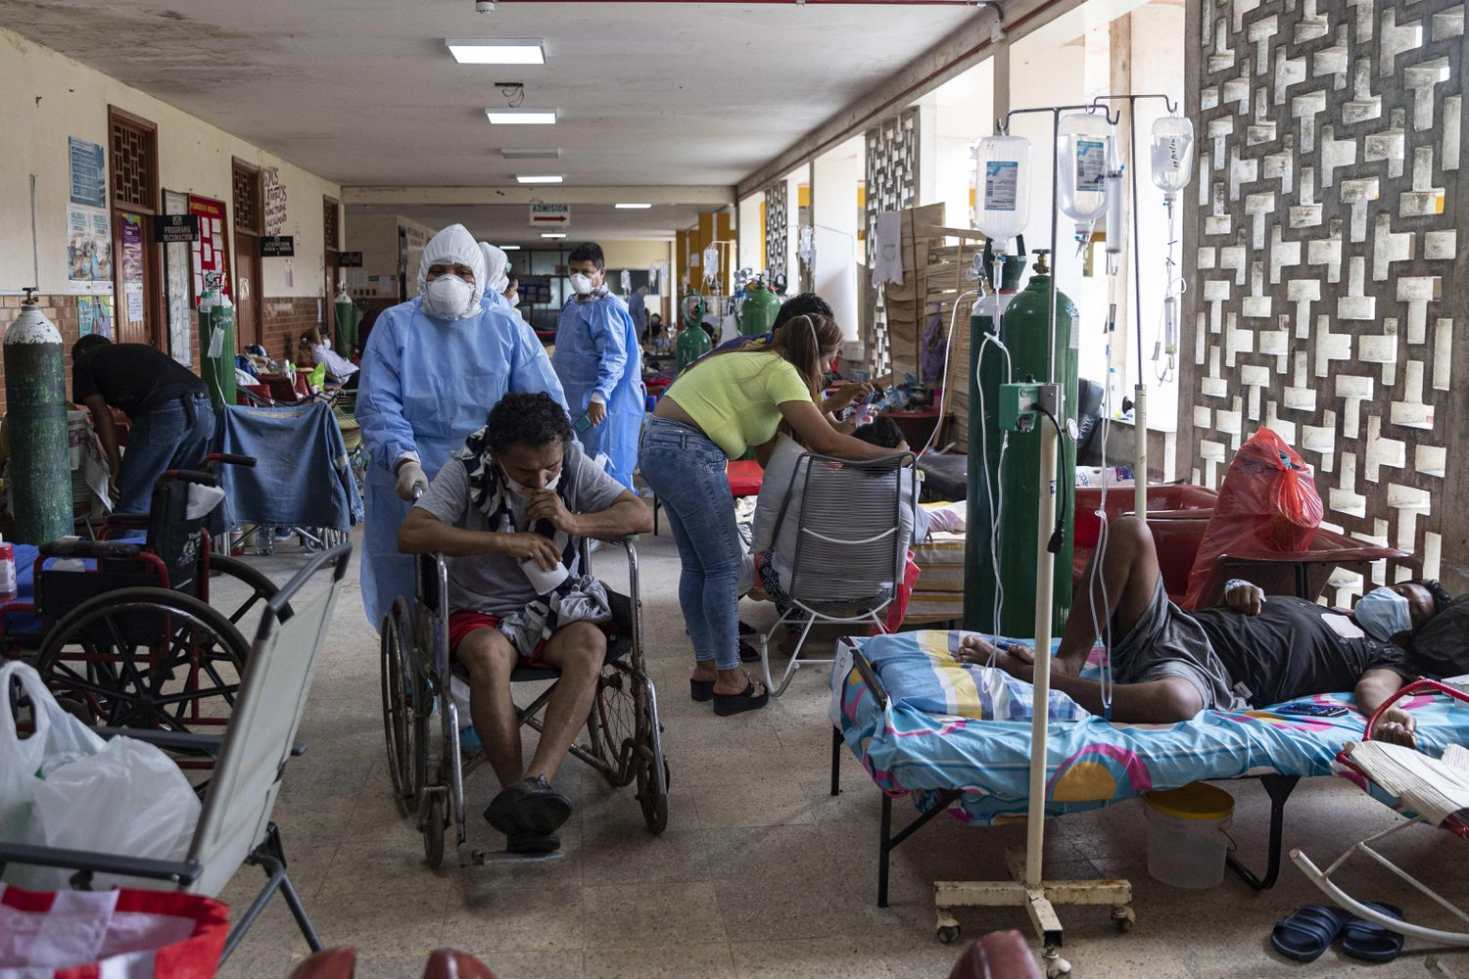
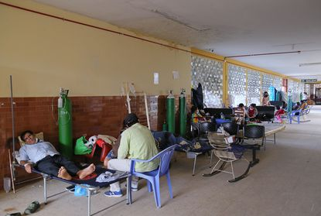
Description
Reengineering applied to healthcare organization is pertinent when:
1: The hospital infrastructure presents an acceptable state of conservation equivalent to less than 69% and the conservation/operational degree of equipment and furniture is less than 59%;
2: Health sector presents difficulties due to: low quality of infrastructure and biomedical equipment, inappropriate supply and low level of quality of medicines, poor level of management, insufficient capacity and training of personnel, and shortage of budget;
3: Lack of equipment in the hospital.
Change proposed for health sector is highly required, it is also focused on reengineering.
Peruvian hospital – July 2020

Slide 4
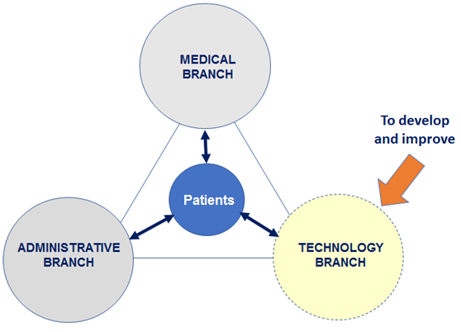
Goals of the project and final users that will benefit
To provide appropriate health services from a comprehensive, clinically effective, efficient, safe and cost-effective health technology approach.
Benefits
To ensure technological updating, appropriately incorporate new technologies, be valid counterpart to providers, and support medical staff in achieving clinical procedures aligned to the increasing complexity of health technology resources.
To contribute to improve the quality and coverage of healthcare services.
To determine opportunities to improve Patient and User Safety from a multidisciplinary and global perspective.

Slide 5
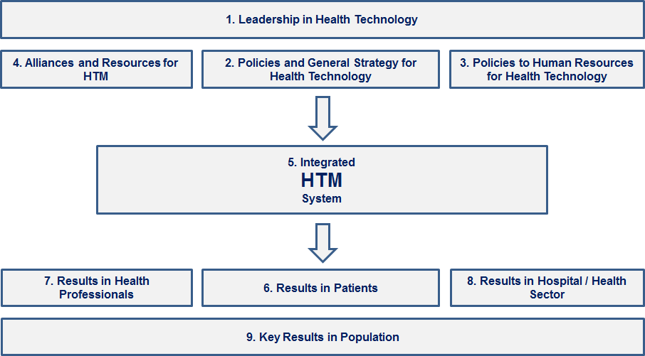
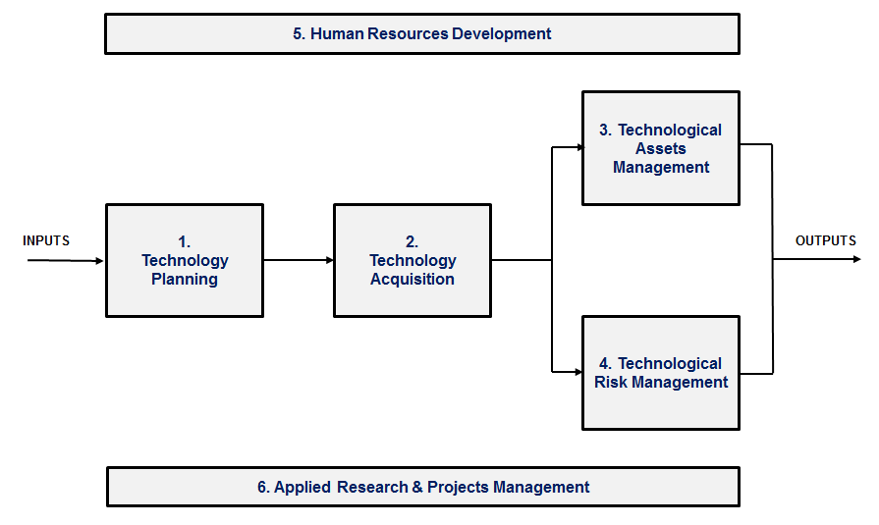
Results
Healthcare Technology Management Reengineering model aimed to increase hospital’s capacity and sustainability; main actions are:
At the government level: to strength HTM’s capacity;
At the Hospital level and its Integrated Networks: to strength CE/Health Technology Management Units to manage HT’s life cycle.
A change in the management of Technology will reduce the current waste of economic resources it also will guarantee the feasibility of the proposal.
HTM processes for technology branch

Slide 6
Luis Vilcahuaman – Rossana Rivas
lvilcah@pucp.edu.pe - rossana.rivas@upch.pe
Pontifical Catholic University of Peru / APBIO – Cayetano Heredia Peruvian University / APBIO

