Slide 1
Distribution and Utilization of CT & MRI in Greece
Aris Dermitzakis
Institute of Biomedical Technology, INBIT

Slide 2
The Team
Aris Dermitzakis
Nicolas Pallikarakis

Slide 3
High Capital Value Imaging Modalities
Biomedical Engineering is playing a leading role in the development of medical technology which is one of the pillars of Modern medicine.
This study focuses to high-tech imaging modalities that are of high capital value in terms of:
initial investment and operation, requiring specially trained personnel for its use
needs of regular quality control
preventive maintenance and
management procedures, to function properly and safely.

Slide 4
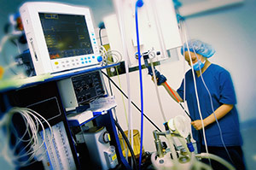
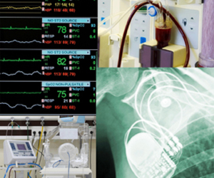
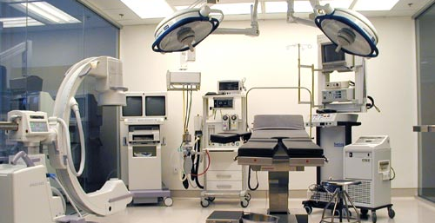
Clinical Engineering in HCVIM
Clinical Engineers have a key role in facing the afore mentioned challenges.
Among other, they are the ones responsible for the correct management of all Medical Devices in a HealthCare Unit, during the whole life cycle from acquisition planning to disposal.

Slide 5
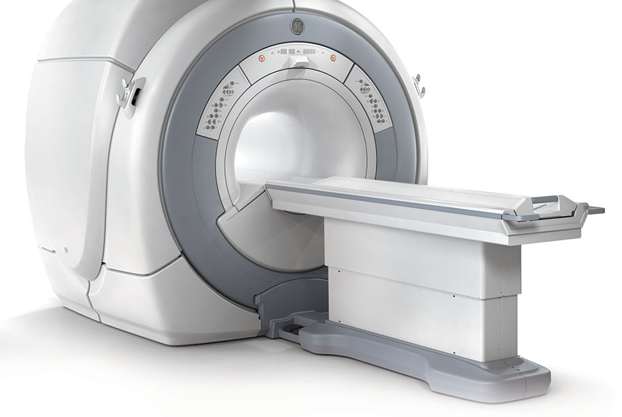
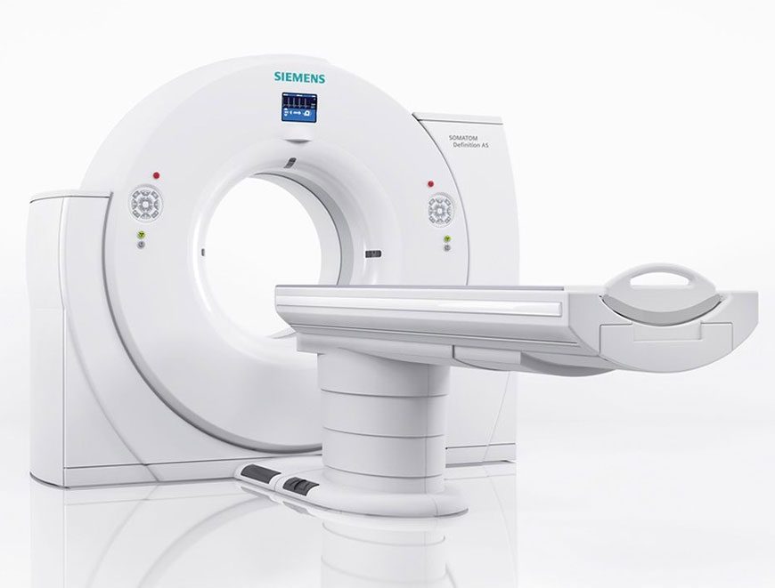
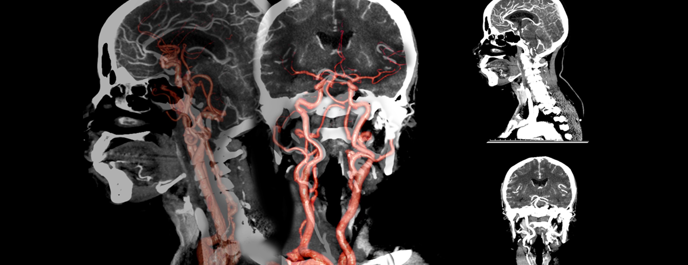
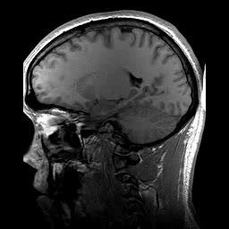
Modern Medical Imaging
The positive impact of modern medical imaging modalities in early diagnosis of serious health diseases and the resulting improvement in the quality of care is widely acknowledged.
In this study, the following High Capital Value Imaging Modalities
are considered:
MRI: Magnetic Resonance Imaging
CT: Computed Tomography

Slide 6
Goals of the project and final users that will benefit
The present paper provides an overview of the situation in Greece up to 2017, aiming to:
Assess the sufficiency and equity in the distribution
Identify eventual inequalities in terms of geographical coverage, specific needs and lack of HCVIM
Estimate the costs of use
Since a country-wide medical equipment inventory for Greece does not exist, various sources were used to obtain a clear picture of the installed units in public hospitals and private clinics.

Slide 7
﻿Distribution of CT and MRI
Distribution of CT units
Distribution of MRI units

Slide 8
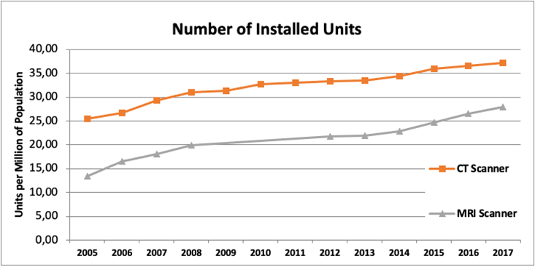
Results
The two modalities present a good installation base in Greece.

Slide 9
Results
However only a few new, high-end scanners are available
20% of the installed CT base being over 15 years old
25% of the installed MRI base being over 20 years old
Distribution of installed CT units, by number of slices
Distribution of installed MRI units based on magnetic field strength

Slide 10
Distribution of CT Units
In several areas no CT scanner is available, mostly islands, which means that patients that need a scan must travel.
Regional sector distribution of CT exams per 1000 inhabitants, 2016

Slide 11
Distribution of MRI Units
In several areas where MRI scanner is available, mostly islands, which means that patients that need a scan must travel.
Regional sector distribution of MRI exams per 1000 inhabitants, 2016

Slide 12
Expenditure for CT
Year | Total EOPYY expenditure per year (€) |  |  |  |  | EOPYY charges per exam (€)
 | Public |  | Private |  | Total | Public | Private
2013 | 13 069 053 | 15% | 75 531 702 | 85% | 88 600 755 | 236 | 152
2014 | 13 958 605 | 15% | 81 694 905 | 85% | 95 653 510 | 234 | 153
2015 | 13 766 343 | 14% | 85 126 315 | 86% | 98 892 659 | 237 | 153
2016 | 14 053 203 | 15% | 76 843 713 | 85% | 90 896 916 | 236 | 125
Source: data provided by EOPYY (National Organization for Healthcare Provision)

Slide 13
Expenditure for MRI
Year | Total EOPYY expenditure per year (€) |  |  |  |  | EOPYY charges per exam (€)
 | Public |  | Private |  | Total | Public | Private
2013 | 17 470 577 | 33% | 35 009 926 | 67% | 52 480 503 | 68 | 44
2014 | 18 495 464 | 33% | 36 723 221 | 67% | 55 218 685 | 68 | 44
2015 | 17 636 519 | 33% | 35 674 458 | 67% | 53 310 977 | 68 | 45
2016 | 16 908 803 | 30% | 38 753 036 | 70% | 55 661 839 | 67 | 46
Source: data provided by EOPYY (National Organization for Healthcare Provision)

Slide 14
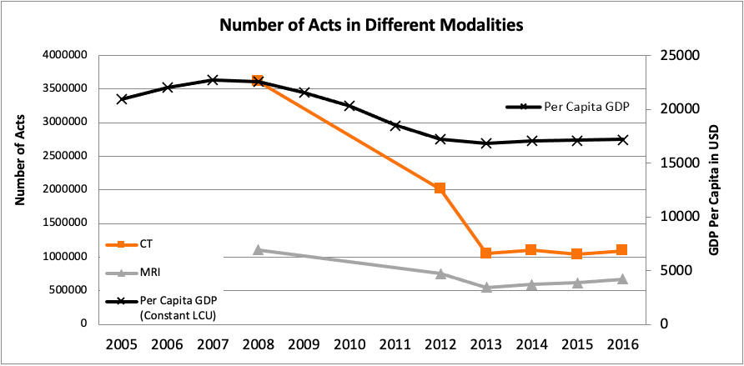
Results
In terms of number of acts
since 2008 a great reduce was seen due to the economic crisis
from 2013 to 2017 a general increasing trend is noticed in the case of MRI, resulting to a total cost increase of 22%, while in the case of CT the number of exams remains stable.

Slide 15
Conclusion
Private/Public Sector:
Private sector is more present than the public
Private Sector is the only provider of CT and MRI diagnostic imaging services in some smaller cities in central Greece and some islands
Coverage:
Particularly poor in the Aegean Sea islands
Most islands lack modern diagnostic imaging equipment
Cost of Use:
Large discrepancies in the number of exams performed per 100 000 inhabitants in the different regional sectors
There are some indications of overuse

Slide 16
Aris Dermitzakis
Arisderm@gmail.com
Institute of Biomedical Technology, INBIT, Greece

