Slide 1
Device acceptance in unregulated environment
Umberto Nocco
Associazione Italiana Ingegneri Clinici - Italy

Slide 2
The Workgroup
Umberto Nocco – Associazione Italiana Ingegneri Clinici
Daniele Megna – Associazione Italiana Gas Medicinali
Roberto Belliato – Associazione Italiana Ingegneri Clinici
Vincenzo Ventimiglia – Associazione Nazionale Tecnici Verificatori
Lorenzo Leogrande – Associazione Italiana Ingegneri Clinici
Costantino Carraro – Associazione Nazionale Tecnici Verificatori
Fabio Valentini – Associazione Nazionale Tecnici Biomedici
Alberto Lanzani – Associazione Italiana Ingegneri Clinici
Elio Patetta - Associazione Italiana Gas Medicinali
Massimo Giuliani – Associazione Nazionale Tecnici Biomedici

Slide 3
Description
During the Covid-19 outbreak in February 2000 the need for helpful COVID medical devices in Italy became extreme. In such environment, devices were collected throughout the world and many times devices not usually marketed in the European Community were proposed. Such devices didn’t carry a regular CE mark, so a waiver to the CE mark was needed to pass acceptance.
Such waiver didn’t come, so the major Italian associations gathering technical professionals (CEs, biomeds, etc.) ofthe healthcare system tried to propose a possible solution.

Slide 4
Goals of the project and final users that will benefit
Main goal
Design a simple procedure to evaluate the correspondence of medical device to the EU regulatory framework in order to put them in use even though they might not be certified in accordance to the regulation.
Users who will benefit
Professionals working in an emergency situation where shortage of medical equipment might be led to consider non-certified devices;
Patients who will be treated with devices with a certain degree of correspondence to the security and efficacy standards required by regulation
CEs who will not be left alone in a responsability assumption in accepting non certified devices

Slide 5
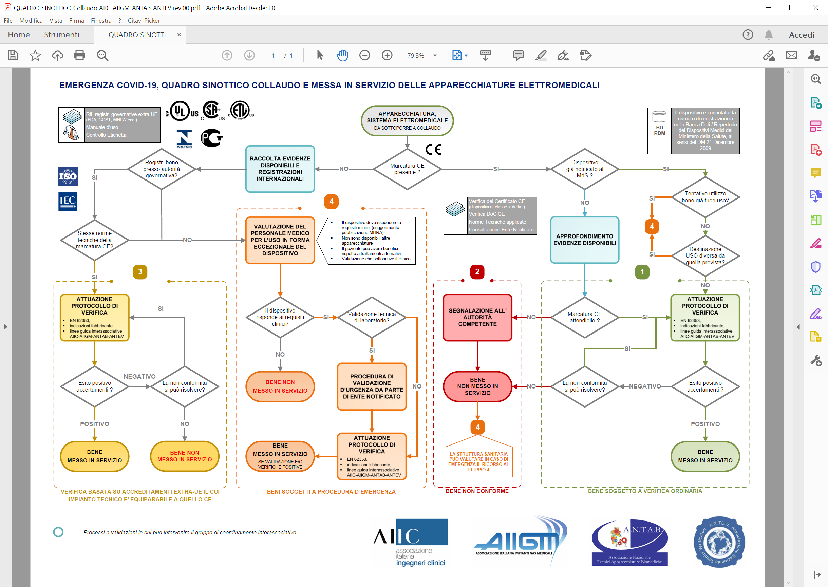
Results
Flowchart and procedure were proposed.
Four possibile scenarios

Slide 6
Results
Not CE marked but with no other option available.
Requires evalutation of the need by a clinician and specific testing by CEs.Could be used only if it is the last option and then dismissed
Not CE marked but compliant to other national standards that have same requirements as CE
Should be used or not depending on final test
CE marked and fully compliant to regulation. To be used
CE marked but not compliany. Fake CE Mark!!!

Slide 7
Umberto Nocco
umberto.nocco@aiic.it
Associazione Italiana Ingegneri Clinici – Italy
umberto.nocco@asst-settelaghi.it
A.S.S.T. dei Sette Laghi – Varese - Italy

