Slide 1
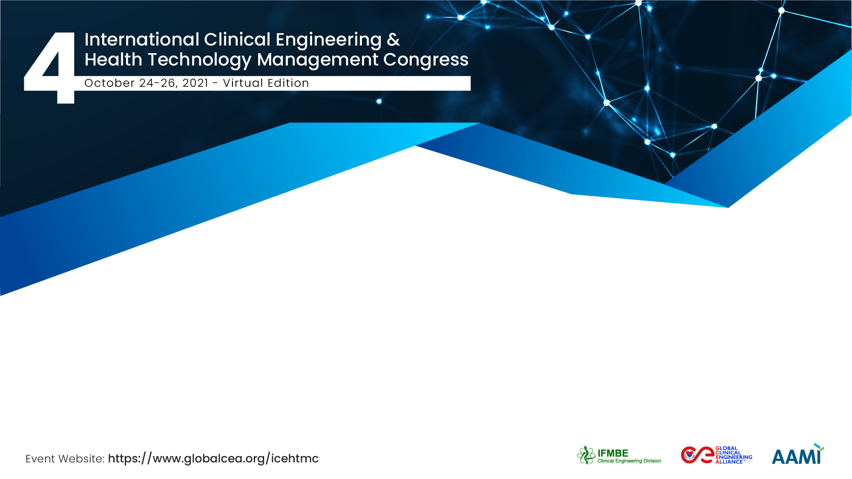
Description of the latest generation equipment in radiotherapy and the technological needs and challenges in radiotherapy in Bolivia
Eng. Andrés Javier Oliver Zapata
CAJA BANCARIA ESTATAL DE SALUD

Slide 2
The Team / Workgroup
Andrés Javier Oliver Zapata
Isabel Morales Ledezma

Slide 3
Description
Bolivia during the COVID-19 pandemic, the epidemiological monitoring and control of new incidences of coronavirus, including the availability of routine medical consultations, has allowed maintaining access to these services. Major cities have made a leap in terms of patient care. Remote consultations, assistive technologies and digital health projects that converge in future telemedicine systems, influence oncological treatments with the appropriate support and necessary technological equipment would make remote consultations a possibility of scientific exchange.

Slide 4
Goals of the project and final users that will benefit
Describe the new technology in radiotherapy treatment in Bolivia in order to propose to identify its needs and challenges.
Three teams were selected: linear accelerator, PET and SPECT, four types of cancer (24% cervix, 17% breast, and 17% prostate and 8% stomach, 34% others).
ABEN (Bolivian Nuclear Energy Agency), builds three comprehensive nuclear medicine specialization centers, this entire network is called the Network of Nuclear Medicine and Radiotherapy Centers.

Slide 5
Results
Three teams were selected: linear accelerator, PET and SPECT, four types of cancer (24% cervix, 17% breast, and 17% prostate and 8% stomach, 34% others). Between 2011 and 2016 there are 18,600 new patients with some type of cancer. Today, 2020, 20,000 patients (65% women, 35% men), that is, requiring surgical treatment, chemotherapy, radiotherapy and complementary situations such as pain treatment.ABEN (Bolivian Nuclear Energy Agency), builds three comprehensive nuclear medicine specialization centers. Two in the city of La Paz and one Santa Cruz de la Sierra. With a capital of USD 165,000,000.00, this entire network is called the Network of Nuclear Medicine and Radiotherapy Centers.

Slide 6
Eng. Andrés Javier Oliver Zapata
oliverandres38@gmail.com
IFMBE, Bolivia

