Slide 1

Clinical engineering, knowledge of the organization and holistic thinking as a strategy for decision making.
Paula Andrea Berrio
CCE-US, Clinical engineering Department Chief, Pablo Tobón Uribe Hospital

Slide 2
The Team / Workgroup
Pablo Tobón Uribe Hospital, Clinical engineering department:
Paula Berrio, Clinical engineering Department Chief
Daniela Bayona, Biomedical engineer
Tatiana Sierra, Biomedical engineer

Slide 3
Description
A clinical engineer is “a professional who supports and advances patient care by applying engineering and managerial skills to health care technology." [1]. Based on the definition, the clinical engineer is requested to solve problems and needs that arise during the lifetime of the technology. This could be accomplished with activities as technology management, risk management, project management, and the effectiveness of use and allocation of resources, looking for patient safety and the contribution to the achievement of the organization's objectives.
For the 2020 technology strategic planning the Pablo Tobon Uribe Hospital, included the needs for replacement of vital sign monitoring technology in areas such as adult hospitalization, endoscopic procedures recovery area and interventional radiology.
Within the framework of the technology evaluation process, a review of the current and new needs of the services was carried out, for an adequate incorporation of technology. The technical specifications of the equipment were complemented with technical specifications for connectivity and automation of clinical deterioration early warning response team, as a product of technological surveillance processes. Finally the use of information systems and knowledge of the needs of the entire organization, allowed the realization of an innovative replacement proposal of the technology.

Slide 4
Goals of the project and final users that will benefit
Awareness of the importance of clinical engineers holistic vision and understanding of the general operation of the organization and its vision to improve decision making in HTM.
Guarantee achievement of organizational objectives during healthcare technology evaluation process, with the upgrading of technology specifications, optimization of resources allocation, standardization of technology and added value on patients safety.
Inclusion of technology surveillance process in healthcare technology management cycle, as a tool for continuous knowledge actualization and processes improvement.
Development of tools as technology maps overview, to support the decision making in HTM.
This would benefit the entire clinical engineering community as clinical engineering professionals and students.

Slide 5
Results
Medical equipment planned replacement needs
Medical Technology evaluation process
Technical specifications
Quotation
Analysis
Demo
Recommendation
Service | Quantity
Endoscopy room and recovery area | 15
Adult inpatient units | 15
Hemodialysis | 8
Radiology | 4
Oncology | 2
Vaccination area | 1
Emergency room | 1
Total | 60
Vital sign monitors basic specifications :
EKG, NIBP, SPO2, RR
Technological Surveillance
“Organized, selective and systematic process, to capture information from abroad and from the organization itself on science and technology, select it, analyze it, disseminate it and communicate it to turn it into knowledge in order to make decisions with less risk and to anticipate the changes". (UNE 166000: 2006)
Endoscopy equipments: continuous monitoring with central monitor, parameter record every 15 minutes (institutional sedation polity), desiderable integration to EHR
Adult inpatient units equipments: Automation of early detection of patients deterioration supported by vital sign monitors , technology standarization need.

Slide 6
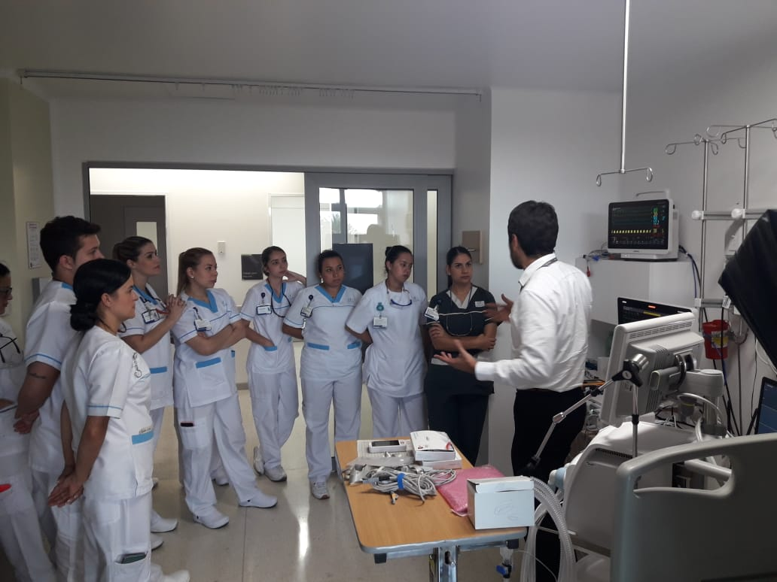
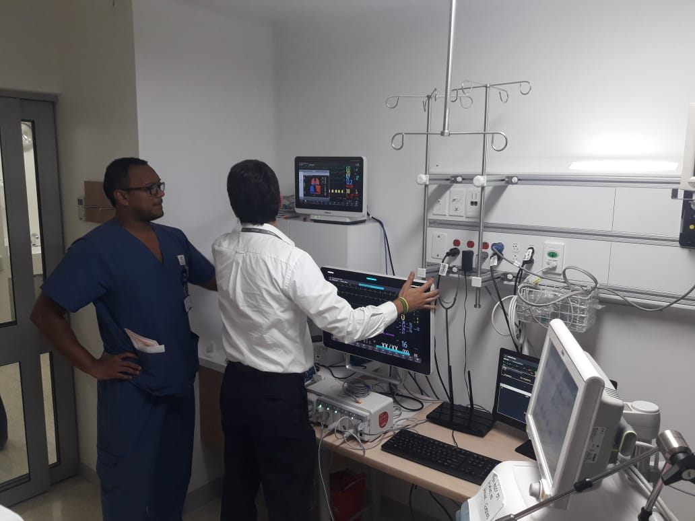
Results
Usabilty tests of automation of early detection of patients deterioration

Slide 7

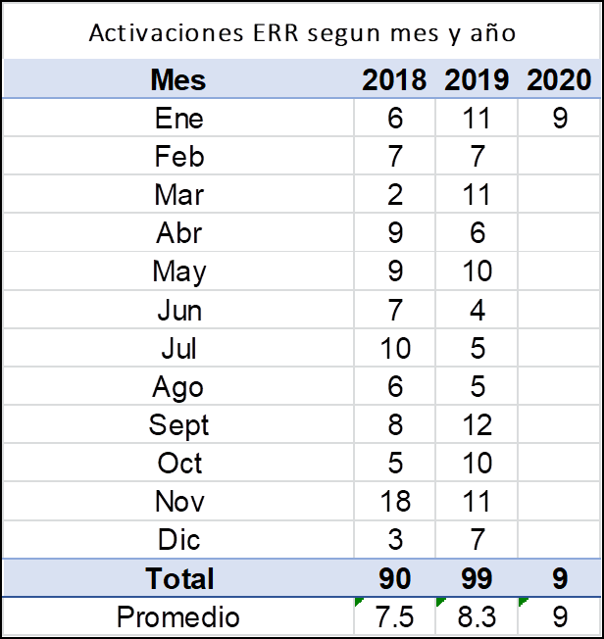
Results
Objective: To evaluate the improvement in the activation and early detection of deterioration of patients through
the use of technology.
Total Activations 69
Total CPR Patient Activations 30
On average there are 10 activations per month only on inpatient unit 5

Slide 8
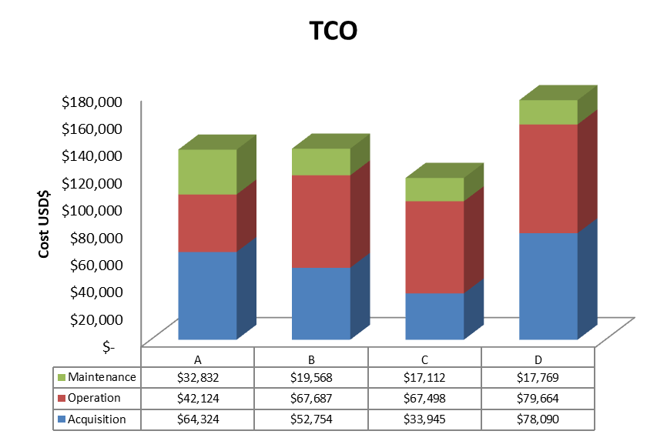
Results
This cost let only 18% (7) of replacement of technology and the partial implementation of the project, 18% of inpatient units (2)

Slide 9
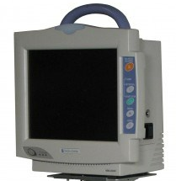
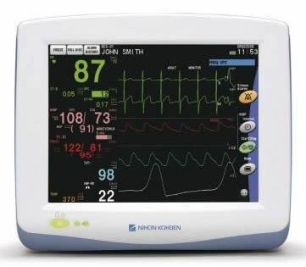
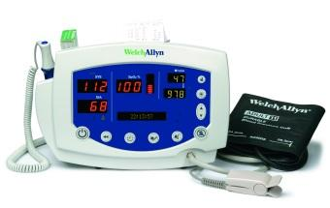
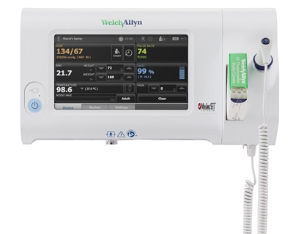
Results
Technology overview map
Critical data of different groups of biomedical equipment (which are distributed in several areas, are critical for the provision of services, difficult to achieve and high cost) such as type of technology (manufacturer and model), physical location and age, schematized in a way summarized and concrete, which allow rapid review of information and decision-making regarding the use of technology during expansions, emergencies, contingencies, failures and technology renewal.
MODEL | ADULT INPATIENT | ENDOSCOPY
2353 | 7 | 0
VSM300 | 0 | 13
75WT | 10 | 0
PVM2707 | 13 | 0
Complete understanding of technology in place and replacement needs

Slide 10
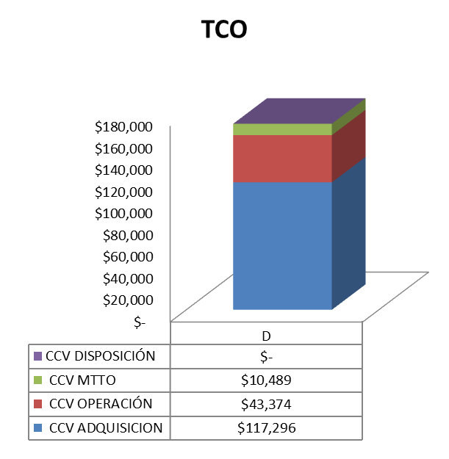
Results
 | Total $miles | Budget $miles | Difference | Comments
1 | $ 218,719 | $ 251,838 | $ 33,119 | 100% (11) unidades con ERR, 30 Monitores VISMO EOS,
2 | $ 228,768 | $ 251,838 | $ 23,070 | 55% (6 unidades) con ERR, 30 Monitores VISMO EOS
3 | $ 252,010 | $ 251,838 | -$ 172 | 100% (11) unidades con ERR, 21 Monitores VISMO EOS
4 | $ 293,333 | $ 251,838 | -$ 41,495 | 100% (11) unidades con ERR, 17 Monitores VISMO EOS
Redistribution of technology would be carried out, and the concentration of renovation efforts in the hospitalization area would be better for organizational objectives achievement.
All the needs of the different services were solved
Optimization of the resources allocated.
Standardization of technology
Optimization of early detection of patients deterioration, and the impact on patient’s safety.

Slide 11
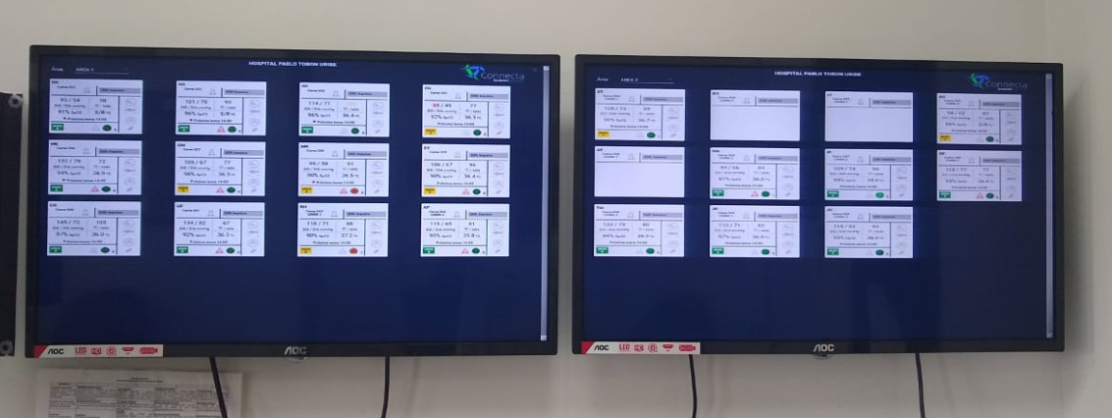
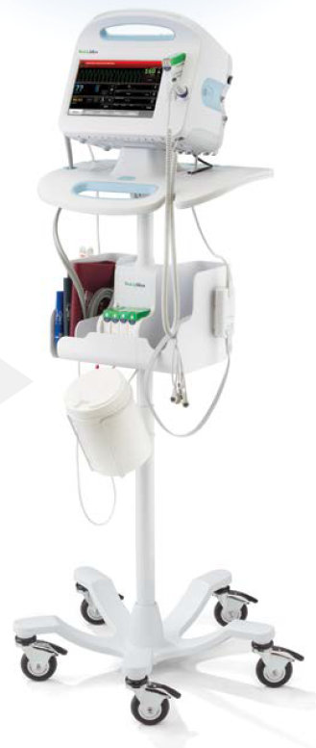
Results
11 Adult inpatient units with standarized technology and automation of early detection of patients deterioration
Acquisition and implementation of:
28 vital sign monitors
21 Screens
38 Barcode readers

Slide 12
Conclusions
The holistic vision and understanding of the general operation of the organization, let clinical engineers to propose and develop projects to improve patient safety, quality and resources allocation.
The technological surveillance process and the continuous knowledge actualization is fundamental healthcare technology management and decision making due to the constant and dynamic changes of healthcare sector

Slide 13
Paula Andrea Berrio
pberrio@hptu.org.co
Pablo Tobón Uribe Hospital, Colombia

