Slide 1
Clinical Engineering in Support of the Healthcare Delivery Organizations’ Mission and Vision
Don Morge, Sigma Health Consulting
Jessyka Wright, Crothall Healthcare
Jennifer DeFrancesco, DHA, FACHE, Dayton VA Medical Center

Slide 2
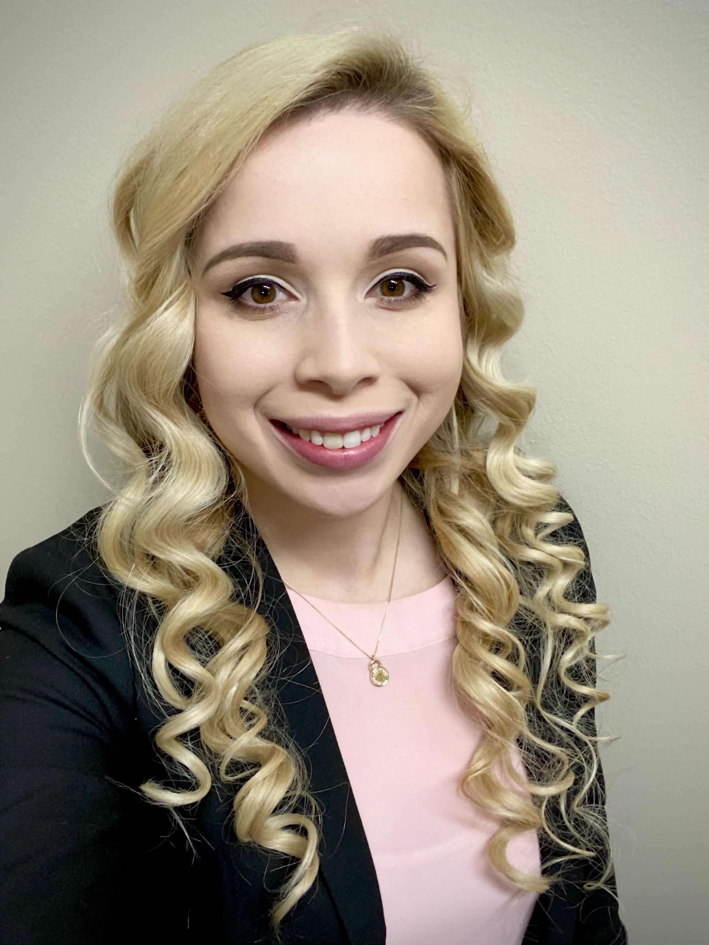
The Team / Workgroup
Jessyka Wright, CBET
Unit Director III – Biomedical Engineering
Jennifer DeFrancesco, DHA, FACHE
Associate Director

Slide 3
Description
This discussionwill illustrate the perspective of healthcare delivery organization executives and their view of the real and potential value of Clinical engineering in their organizations. The conversation Will move us beyond our comfort zone, allowing us to immerse ourselves into the world of our administrative customers so we hear what they want and need from us – rather than speculating amongst ourselves. Participants and panelists Will walk away with 1-2 ideas to take back to their work and organizations.

Slide 4
Facilitated Discussion
What is the #1 thing that hospital administrators need right now from Clinical engineers?
What is the biggest long-term need for healthcare administrators and leadership from Clinical engineers?
How do service models and Clinical engineering offerings differ in terms of meeting the needs of healthcare executives- in-house, independent service organization and consultants?
What is the biggest change in healthcare delivery that you see occurring in 2022?
How do you suggest that Clinical engineers best engage with healthcare leadership right now?

Slide 5
Jennifer DeFrancesco
jdefrancesco21@gmail.com
CED Collaborator, USA

