Slide 1
CE Credentialing - as a challenge and for encouraging development
Prof. Ewa Zalewska, PhD, DSc
Regional Consultant in Medical Engineering, Polish Academy of Sciences, Warsaw, Poland,

Slide 2
International Credentialing – a current goal in CE education
International credentialing in clinical engineering (CE) is a very important project developed by CED IFMBE aimed to establish a high-level international standard of knowledge and competencies and is expected to have great significance and impact on international CE community.
Rationale behind CE credentialing:
The worldwide common market of medical equipment requires the same standards and similar levels of professional technical assistance in each country.
Intensive development of medical equipment demands well organized international collaboration, knowledge and experiences exchange between clinical engineering practitioners.
The international community of certified CE practitioners may serve as consultants and experts to ensure the high quality of safe and effective use of medical equipment.

Slide 3
Goals and benefits of international CE credentialing
to establish a high-level standard of CE competencies accepted internationally
to establish requirements for national programs of CE specialization necessary for applying for international credentialing
to establish procedures and regulations for verification and certification of competencies based on appropriate professional criteria
to have certification honored in as many countries as possible mainly associated in IFMBE – in collaboration with national authorities, organizations i.e. WHO
to ensure possibility of employment in any country that honors CE international certificate
to make CE profession well recognized all over the world
to increase the prestige of CE profession
to increase the role of CE professionals in the healthcare system

Slide 4
Ways to achieve the goal
Activities must be carried out in 3 areas in parallel:
promotion of CE credentialing:
employment of certified CE guarantees highest level of competencies
showing the economic benefits
recommendation of how to organize CE department in hospital to increase the effectiveness of management
showing benefits for applicants and to authorities how it will increase an outcome for healthcare system
preparing the procedures of international certification
legislation
all efforts to ensure that CE certificates will be honored by authorities in various countries
possibility of employment in various countries.

Slide 5
CE Credentialing – as a stimulation of development
The set of CE international requirments is a challenge and the reference.
Since various countries will start at different level of preparation, the process of credentialing should stimulate development to meet international requirements by:
adjusting the national specialization/certification programs to meet the requirements of the international certification in CE
showing to the authorties the benefits of developing CE and application of HTM
identifying the CE-HTM gaps in the healthcare system
preparing projects for regulations that will define the role of CE professionals in the healthcare system. Regulations should be developed towards indication of obligatory tasks and responsibilities of CE in healthcare and introduction of HTM organization and procedures
increasing interest of candidates in obtaining national CE certificate with perspective of an international one

Slide 6
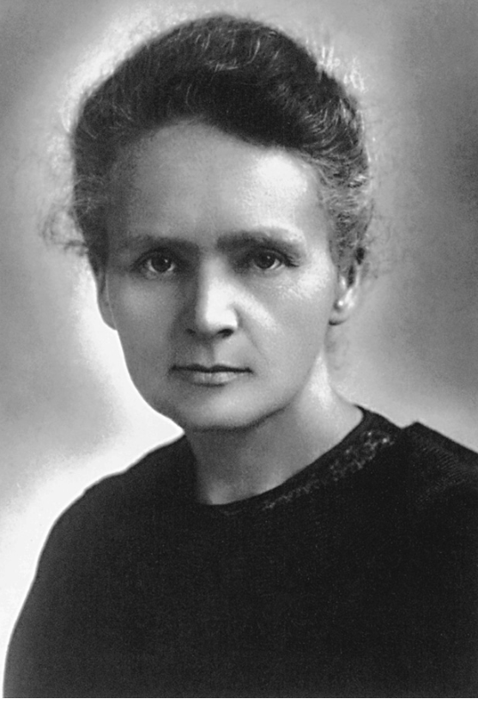
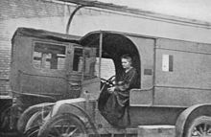
First steps in medical engineering education and organization were taken by women
Maria Skłodowska-Curie (1867-1934) was the initiator and organizer of mobile radiological service at battlefields (petite Curie) during the
I World War in 1914.
Maria Skłodowska-Curie set up a training program and organized courses to teach women to operate the mobile X-ray equipment in vehicles at battlefield.
1946 - The world’s first regular academic courses on electromedical engineering at the Warsaw University of Technology were organized by prof. Cezary Pawłowski, assistant and collaborator of Maria Skłodowska-Curie.
Maria Skłodowska-Curie
in a mobile X-ray vehicle
Maria Skłodowska-Curie
was not only the famous
scientist….
https://spectrum.ieee.org/the-institute/ieee-history/how-marie-curie-helped-save-a-million-soldiers-during-world-war-i

Slide 7
Final remarks
International CE credentialing will have a major impact on international CE community’s development.
This is a challenge and a chance for development for countries which have no CE certification system, yet.
Education and development of this profession is also a field of women’s contribution.
This is worth to remember that women’s contribution to shaping heath tech world started more than 100 years ago by first steps done by Maria Skłodowska-Curie.
The women’s perspective takes into account the idea of helping others and the humanitarian aspect of this profession. These together with women’s creativity in any activities, that help to improve the quality of human life, enrich CE profession and help in making important achivements.

Slide 8
Ewa Zalewska
e.a.zalewska@gmail.com
Polish Accademy of Sciences, Poland

