Slide 1

Economic
Outlook

Slide 2
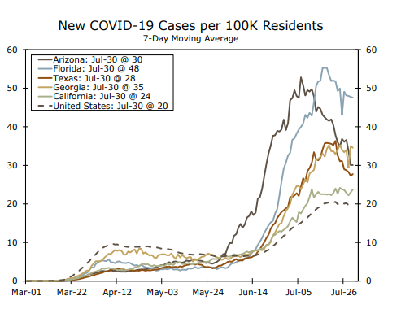
General Market Commentary
First wave of economic recovery has exceeded expectations…policy interventions have prevented household and business failures.²
Risk remains, worst appears to be behind us… for now¹
Resurgence of COVID cases in sunbelt appears to have crested, cases rising faster now in mid-atlantic¹. States pausing or reversing re-opening plans risk losing momentum

Slide 3
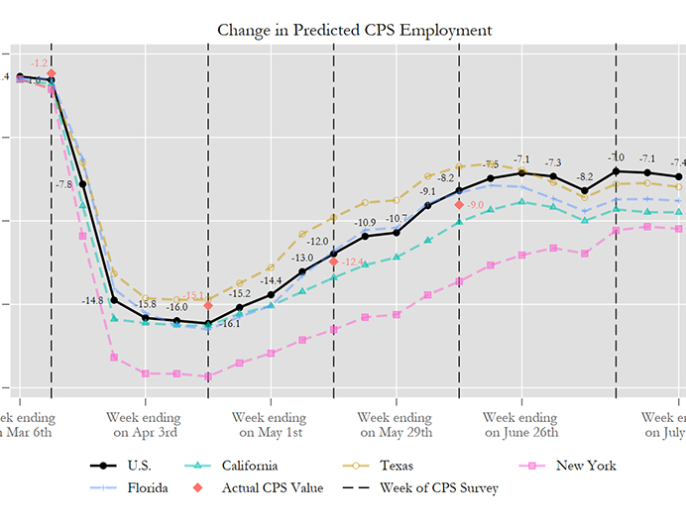
General Market Commentary
Tradeoffs that prioritize safety today will pay dividends in economic activity in the future.²
2nd Quarter Real GDP declined at an annual rate of 32.9%, in line with expectations¹
Expectation for real GDP to return to growth in Q3, but not recover all lost output until well into 2021.²
Consumer confidence faltered as COVID resurgence trigged spending pullback¹
1 - Wells Fargo Securities Weekly Economic & Financial Commentary – July 31, 2020
2 – Risk of Retreat, Northern Trust Global Economic Outlook – July 2020

Slide 4
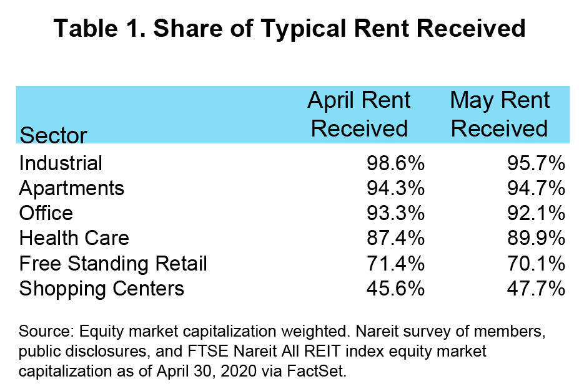
The Good
Flare up of COVID in the sunbelt appears to have crested – 7 day moving average has fallen 40%, 19%, and 13.9% for Arizona, Texas and Florida, respectively¹
Third quarter GDP growth poised to for a “blowout to the upside.¹”
Goldman Sachs economists estimate GDP rising at an annualized rate of 25% in 3rd Quarter 2020⁴
Mortgage rates continue to fall, 2.99% for the 30-year fixed rate, among the lowest recordings on record
Total unemployment rate fell from 14.7% in April to 11.1% in June²

Slide 5
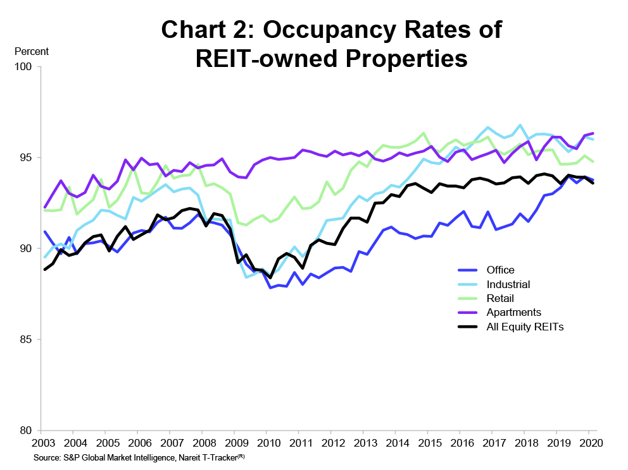
The Good
Federal Reserve indicates continued willingness to keep rates at 0.00% for as long as needed³
Second quarter ended with an increase in consumer confidence of 12.2 points⁵
Federal Reserve extended 11 of 13 emergency credit programs for 3 months – through fall 2020⁶
Multifamily rental collection rates remain high, one of the strongest categories⁷
In addition, multifamily occupancy rates for REIT owned properties remain high at ~95%
1 - Wells Fargo Securities Weekly Economic & Financial Commentary – July 31, 2020
2 – United States Bureau of Labor Statistics
3 – Rock Bottom Interest Rates May Be Here to Stay, New York Times, May 2020
4 – Business Insider, July 2020
5 – The economy’s second quarter high may turn into a third quarter hangover, usnews.com, July 8, 2020
6 – Bankrate.com, July 29, 2020
7 – The Economy at a Turning Point: REIT and Commercial Real Estate Outlook at Mid-Year 2020, Nareit, July 2020

Slide 6
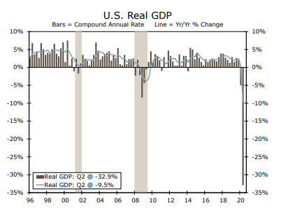
The Bad
GDP annualized contraction of 32.9%, the highest ever recorded¹
As of 7/31/20, jobless claims rose for second consecutive week – 4-week average of 1.36 million – double the worst week of the Great Recession¹
5.8 million jobs available, 17.8 million unemployed workers¹

Slide 7
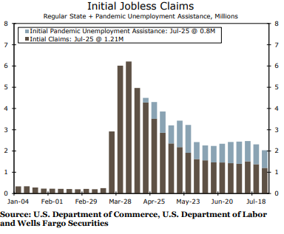
The Bad
Consumer services spending plunged 43.5%, while residential investment spending fell 39%.
Expiration of $600 supplemental unemployment benefit on 8/1
Commerce department confirms two consecutive quarters of contraction, the formal definition of a recession
1 - Wells Fargo Securities Weekly Economic & Financial Commentary – July 31, 2020

Slide 8
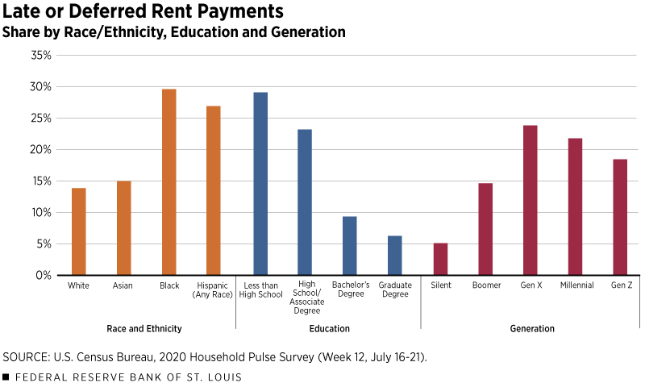
The Uncertain
Extension of $600 unemployment benefit / next round of stimulus. Senate recess begins 8/10 and goes until Labor Day.¹
2nd direct payment to consumers still under negotiation
Coming wave of evictions? 25 million people report little to no confidence in their ability to pay August rent²

Slide 9
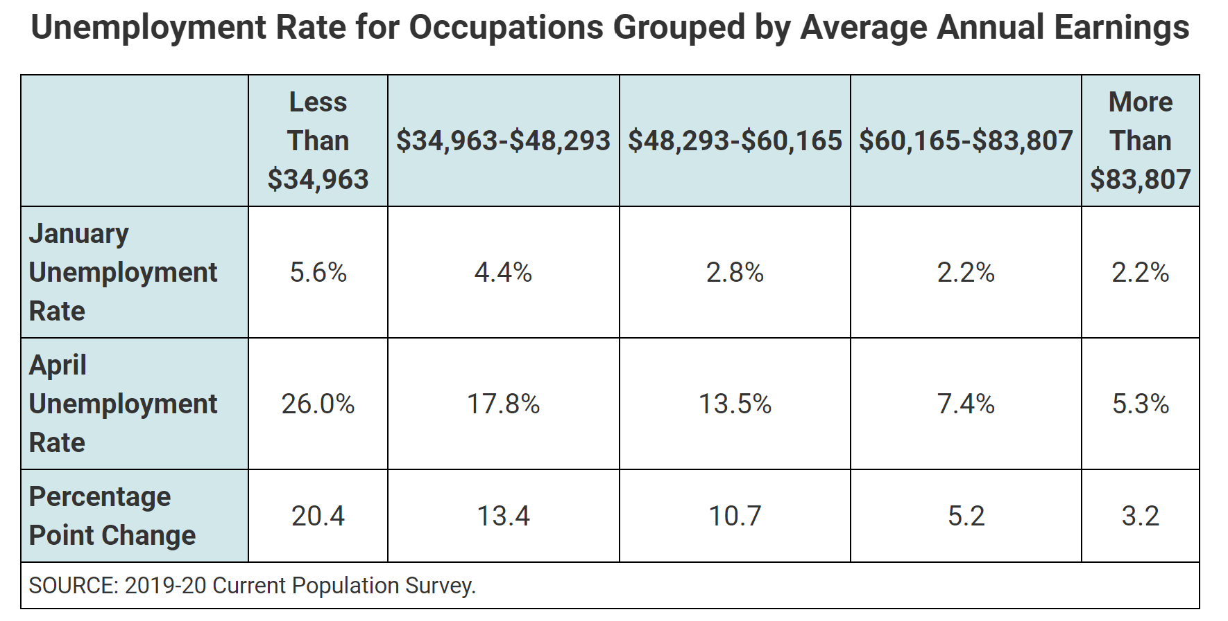
The Uncertain
Can extension of eviction moratoriums mitigate the risk of the coming wave?
Political uncertainty / potential election chaos could cause negative economic impacts
Second wave of COVID in the fall, combined with flu season presents downside risk³

Slide 10
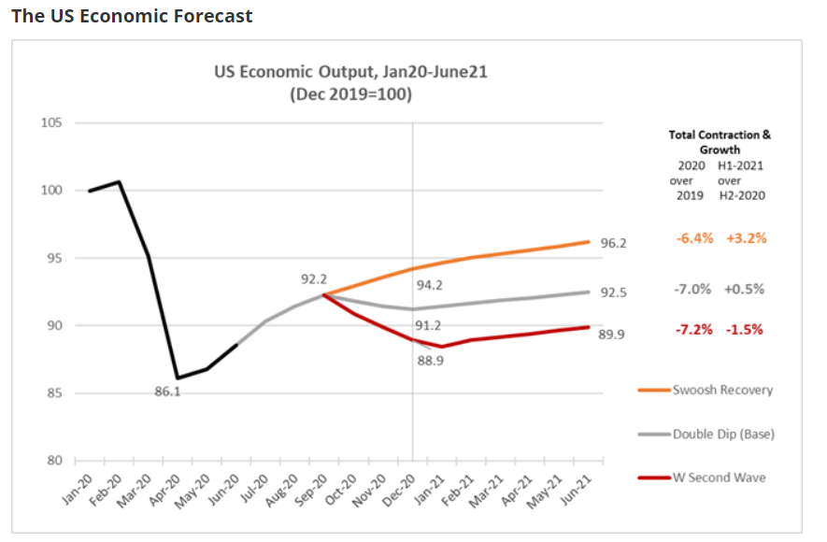
The Future
“The Path of the economy will depend significantly on the course of the virus.” - Federal Reserve, July 2020
First ring suburbs are the new urban centers¹

Slide 11
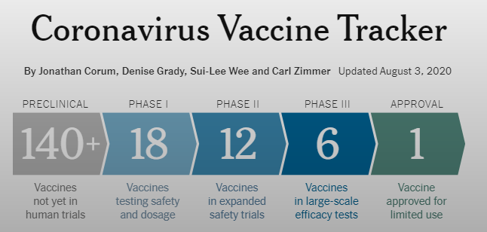
The Future
CEO confidence reading for second half recovery rose to 44 points² (reading above 50 indicates positive outlook). 70% see improvement by 2021.
Rapid progress on Covid vaccine. 165+ under development, 6 in Phase III clinical trials³
Record low interest rates are here to stay⁴
1 – The Post-Pandemic Outlook for CRE in the US, Civitas Capital, July 2020
2 – CEO Confidence Climbs in 2nd Quarter, with 70% Expecting Economic Improvement by 2021
3 – Coronavirus Vaccine Tracker, New York Times, August 2020
4 – 6 Mortgage and real estate trends for the third quarter of 2020, bankrate.com, July 2020

