Slide 1
Ways to Make Money in Multifamily Investing
Cash Flow
Depreciation and Other Tax Benefits
Appreciation
Principle Reduction
Acquisition Fees
Asset Management Fees
Property Management Fees
Why this Business is
Awesome!
Copyright © 2019 Lifetime CashFlow Academy LLC

Slide 2


Achieve Your Goals FAST
For example, say you want income of $20,000 per month
  $200 cash flow per unit per month
  $2,400 cash flow per unit per year
You need 100 units yourself to achieve your goal

Slide 3
The Multifamily Investing Process
Pick
Pick a Market
Put
Put Together Your Team
Find
Find Private Money for Your Deals
Evaluate
Evaluate Deals
Make
Make Offers
Negotiate
Negotiate Deal
Sign
Sign Contract
Copyright © 2019 Lifetime CashFlow Academy LLC
Manual Page 17
Notes:
Call chamber of commerce and/or economic development office. Jobs? Businesses moving in? Get copy of master plan, What’s coming in? Any areas being revitalized? Areas where city is investing? Areas gentrifying?
Retrading….

Slide 4
Contact
Equity Investors/Private Lenders
Hire
Attorney to Prepare Syndication
Receive
Sellers Documents in Due Diligence
Engage
Lender
Perform
Onsite Inspect, Leases/Docs/Units
Sign
Term Sheet with Lender (lock rate?)
Close
Close on Deal
The Multifamily Investing Process
Copyright © 2019 Lifetime CashFlow Academy LLC
Manual Page 17
Notes:
Call chamber of commerce and/or economic development office. Jobs? Businesses moving in? Get copy of master plan, What’s coming in? Any areas being revitalized? Areas where city is investing? Areas gentrifying?
Retrading….

Slide 5


Establishing Your
Investment Criteria

Slide 6
Investment Criteria Should Include:
  Size
  Location (area)
  Class
  Type of Area
  Stabilized or Value Add
  Price Range

Slide 7

Investment Criteria Needed For:
  Credibility with Brokers
  Credibility with Sellers
  Credibility with Investors
  Staying on Track
  Becoming an Expert
  in a Market

Slide 8
Other Things to Take Into Consideration When Establishing Your Criteria Initial Investment
Management
Loans that are available
Target area…how far from where you live?
How much time you have
Your resources

Slide 9
Self Evaluation
What real estate experience you have, even if it’s buying your primary residence?
Your current financial status?
Current employment status?
How many hours do you work a week?
How much time can you dedicate to investing a week?

Slide 10

What is your Risk Tolerance?
Are you Conservative or Aggressive?
You can’t have an Employee Mindset
Must be a Business Mindset
Remember Multifamily is less subjective….
It is more empirical
Your Investor Identity will change as you mature in this business.
You may start smaller and then move into larger

Slide 11

Self Evaluation (continued)
How is your credit?
What is your net worth?
Investment capital
Possible potential Investors
Family/friends
Mentor or Coach that
can help guide you

Slide 12

What Type and Size of
Multifamily Will You Target?

Slide 13


Classification
Properties are
broken up by:
Size
Class

Slide 14

Residential Multifamily
2-4 units
Duplex
Triplex
Quad-plex

Slide 15
Advantages of 2-4 Unit Properties
Less intimidating
Mentally it’s often easier to start small
If you make a mistake, it’s smaller
Residential Lending
Low Down Payment Options
Lower Interest Rates
Long Term Fully Amortized Financing

Slide 16

Potential Challenges of 2-4 Unit Residential Multifamily
Sometimes more competitive
FNMA has 10 property mortgage cap which includes primary residence
Harder to get economies of scale
More management intensive

Slide 17

Commercial Properties
5 units and up
Valued based upon NOI

Slide 18

Commercial Multifamily Properties
Value is based on net operating income
Economies of scale
Can be large enough to outsource day to day operations
If large enough….can hire onsite management

Slide 19

Building Your Team
Copyright © 2017 Lifetime CashFlow Academy LLC

Slide 20

Property Manager
Manage several size and class of properties you’re targeting
Not a company that manages A Class properties for your C Class
CPM designation (Certified Property Manager) helpful
IREM (Institute of Real Estate Manager)
Have office well located in area
Embraced Technology (mobile web presence)

Slide 21

Commercial Real Estate Brokers
You want brokers that work RE full time
You want brokers that specialize in the size/type apartments you’re targeting
As a newbie the best brokers are often the youngest and most motivated who will work the hardest to get deals
Deep relationships

Slide 22

Real Estate Attorney
Attorney who specializes in commercial real estate
One that owns their own commercial real estate is even better
Always have contracts reviewed

Slide 23
Real Estate Litigation Attorney
To Handle Slip and Falls
Great for Questions
SEC Attorney
For Syndicating Deals

Slide 24

Commercial Lenders
Commercial bankers and brokers
For small apartments and complexes local and regional banks
For loans over 1mm good FNMA/Freddie Broker

Slide 25
Accountant
Understands Cost Segregation
Help with Projections
Insurance Broker
Can write Insurance anywhere in the US
Property Inspector
Get Referrals from Property Manager or Broker

Slide 26
Advantages of Creating a Partnership for your Multifamily Investing
You can divide up the responsibilities
Combine an analytical person with an outgoing personality
Help you reach out to investors for equity
Help you obtain financing. Strength in numbers

Slide 27
Partner Considerations
A partnership is a like a marriage. You can’t fire them.
Trust your intuition.
You want complimentary skill sets. You do NOT want to be alike!
Try to explore their past work ethic.
Have the difficult conversations up front!
1. What happens if things don’t work out.
2. Exit plan for death or dissolution. (buy sell)
3. Who is responsible for what duties?
4. How is decision making handled?
5. Salaries if any?

Slide 28
Partners and Investors:
Joint Ventures vs. Syndication
Joint Venture
Members take part in management, sign on debt etc.
Syndication
Members do not take part in management.
It becomes a security and subject to SEC

Slide 29
Equity Investors
(Equity = Down payment/up front monies for closing costs, cap X)
Get a piece of the equity in the deal
Get their proportionate share of cash flow and profits from sale
The split between you and your Equity Partners is determined by the numbers of the deal
Typically stay in the deal if you refinance
(Recommend higher minimum investments. IE: 50k plus)

Slide 30

Funding Sources for Equity
Friends and Family
Credit Cards
Equity LOC
Roth Self-Directed IRA’s
Private Money from Investors
Crowd Funding
Family Offices

Slide 31

Debt Investor
They do not receive equity
They are like a bank
More difficult to raise debt than equity. (people like upside)
Can refinance them out of the deal
(Paid in full upon refinance or sale)

Slide 32

How to Find
Investors /Partners
Everywhere people gather and meet
Church
Sporting Events
Health Club
Meetup Groups
(create your own)
REIA Meetings
Networking Events
Do Real Estate Investing Presentations to groups
(BECOME A GREAT ASKER OF QUESTIONS)

Slide 33

Elevator Pitch
(What Do You Do?)
I’m investing in Multifamily Properties in markets that are economically growing. We look for properties we can add value to, and force appreciation. Who do you know who might be interested in partnering with me or investing?
We help people like you invest in Multifamily Properties
We put together groups of investors to invest in Multifamily Properties

Slide 34
When Getting to Know
Find out their investment goals
Long term cash flow vs. 5-7 year horizon for highest return
When do they need capital back?
Pay attention to personality. Will you like working with them?
If interested have them
fill out questionnaire

Slide 35

Private Money from Investors
Remember managing your investors is usually harder than managing the asset. (property)
If they nitpick about your acquisition or other fees get rid of them. “If you’re more worried about what I’m making than what you are then this probably isn’t a good fit.”

Slide 36
Nurturing Relationships with Investors
Phone calls
Emails
Newsletters
Articles touting the area you’re targeting
Group Meetings
Powerpoint Presentations
Gifts
Must keep your investors warm
with monthly contact

Slide 37

Brand Yourself
Pick a Company Name
Ending in (Holdings, Group, Equity, Capital, Properties, Partners, etc.)
Logo
Create Website
Business Cards
Check name with:
Secretary of State
Godaddy.com for domain name
Do trademark search

Slide 38
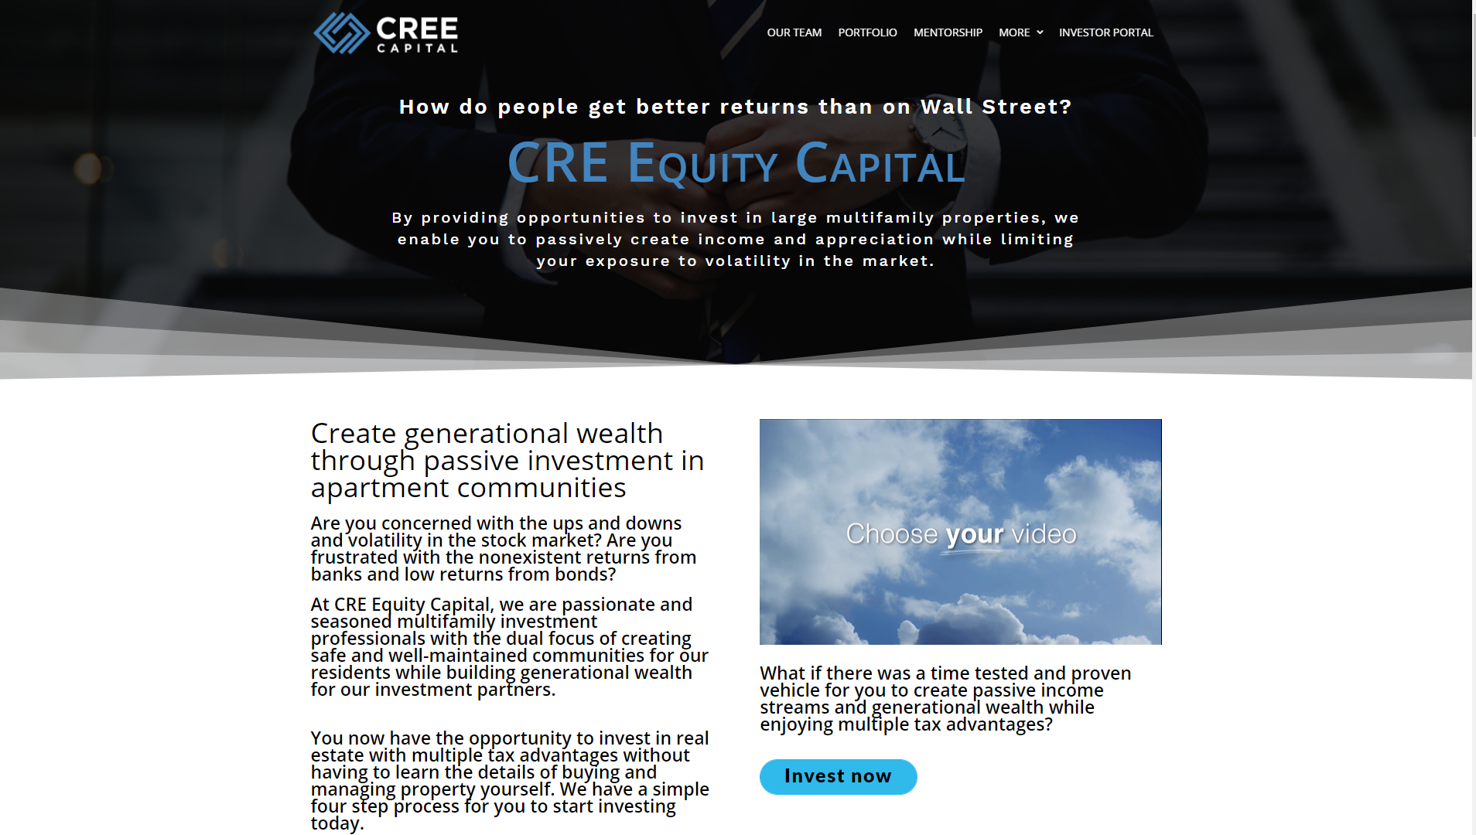

Slide 39
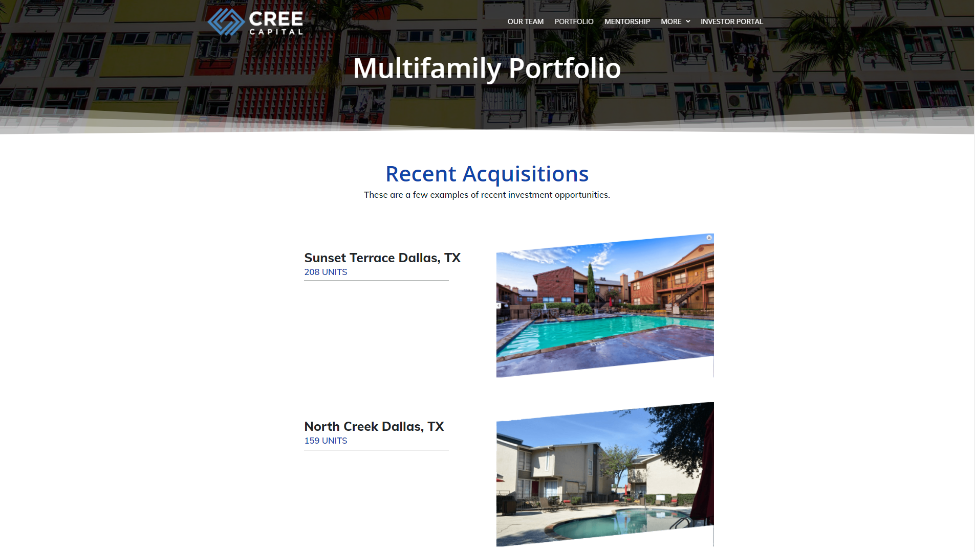

Slide 40
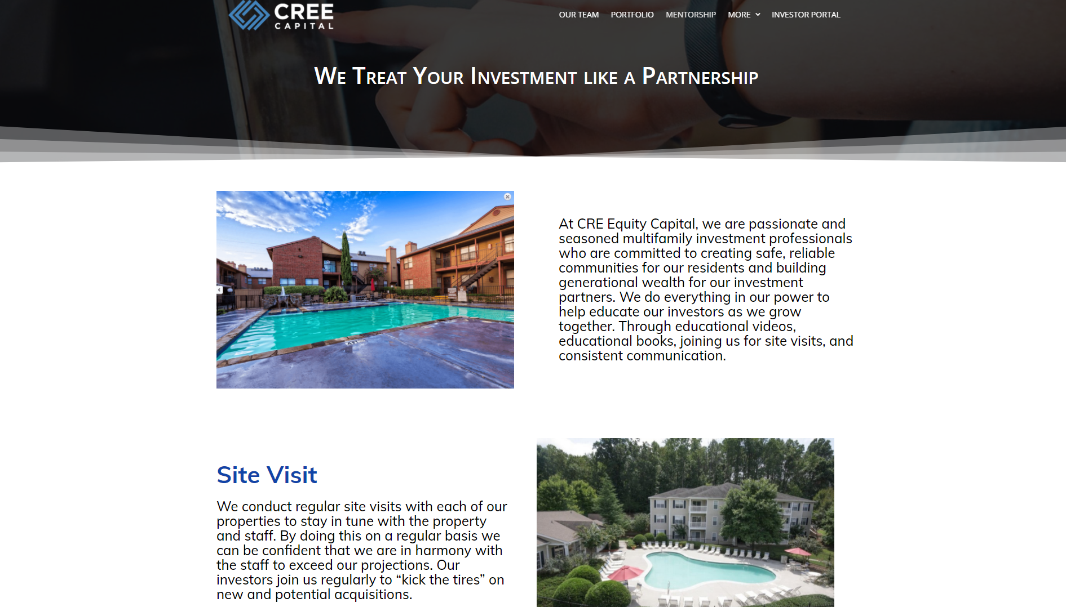

Slide 41
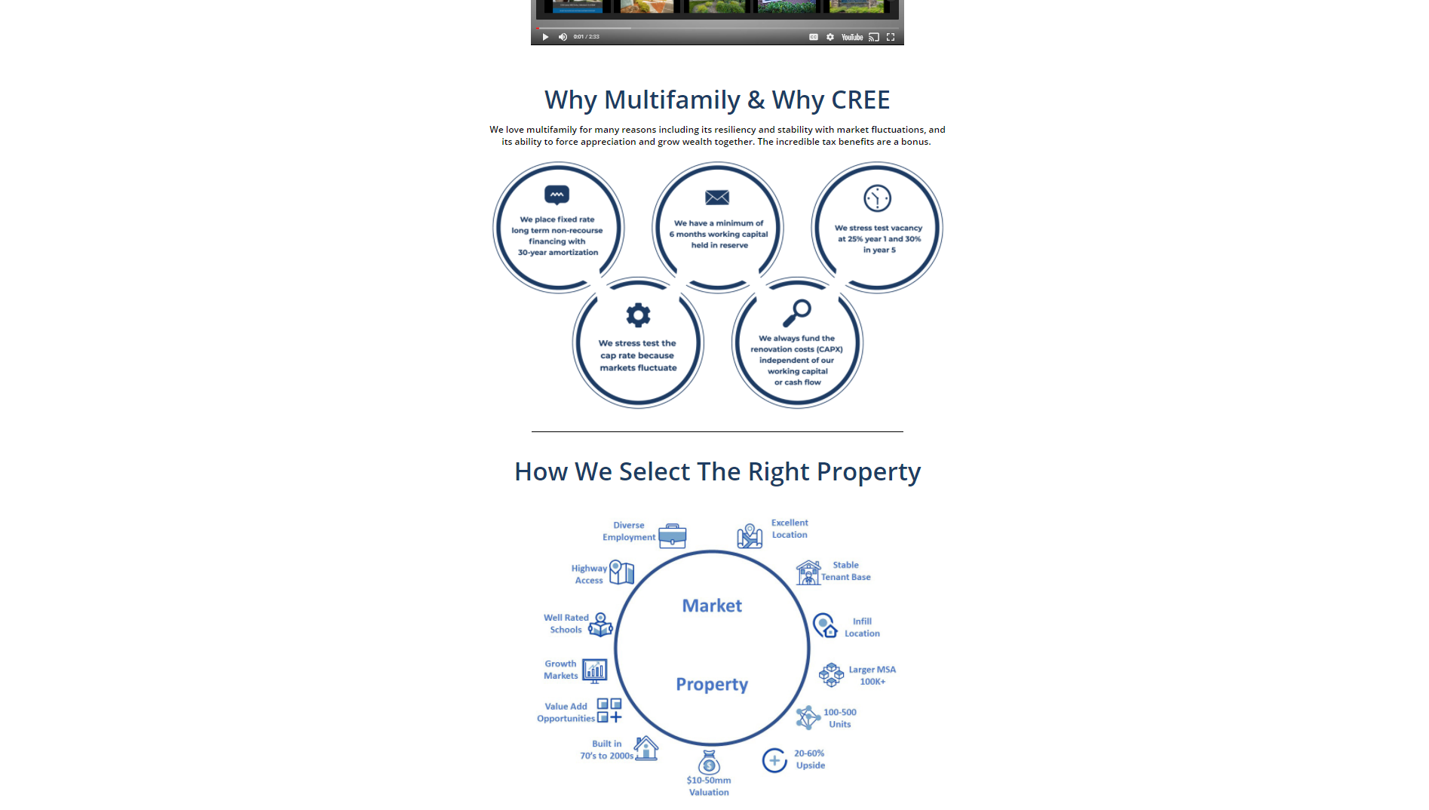

Slide 42
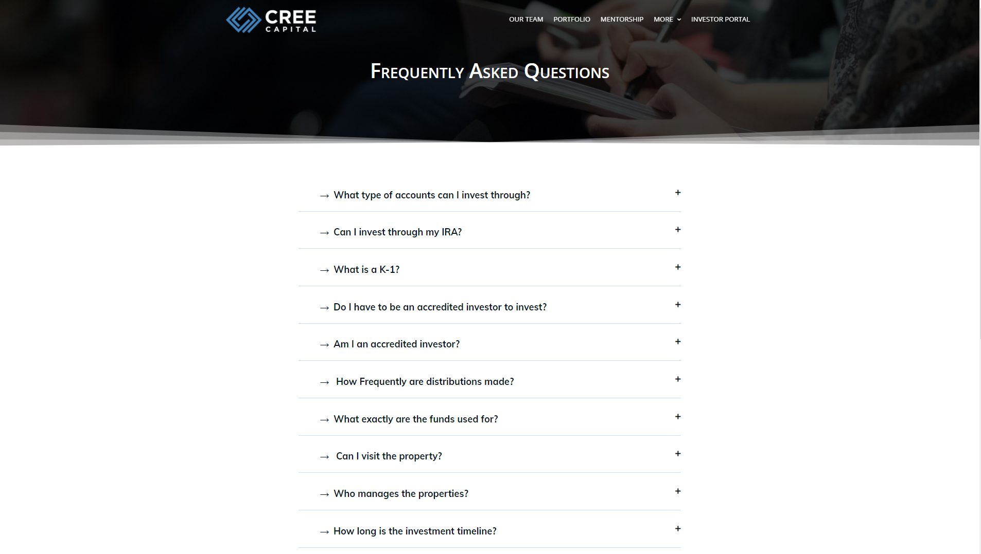

Slide 43


