Slide 1
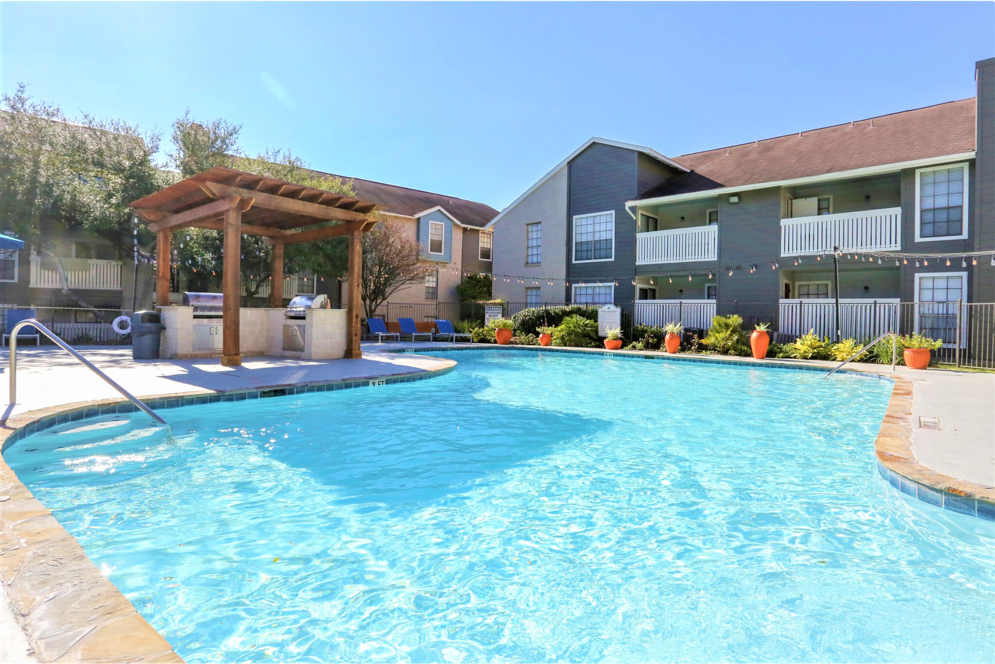

Sedona Canyon, San Antonio
A Multifamily Investment Opportunity

Slide 2
CONFIDENTIALITY DISCLAIMER
No information provided on this presentation shall constitute an offer to sell or a solicitation of an offer to make an investment in any securities or ownership interests in Sedona Canyon LLC (the “Opportunity”). This presentation does not constitute an offer to sell or buy any securities or ownership interests of the Opportunity (“Interests ”). There shall be no offer or sale of the Opportunity’s Interests without:
Securities offered through the Opportunity are only suitable for Accredited Investors, who are familiar with and willing to accept the high risk associated with private investments. Investing in private placements requires high -risk tolerance, low-liquidity concerns and long-term commitments. Investors must be able to afford to lose their entire investment. Investors must carefully consider their investment objectives along with the risks, charges, expenses and other factors of any investment product prior to investing.
A prospective investor first completing the Opportunity’s questionnaire, pursuant to which that prospective investor will attest that he or she is an Accredited Investor, as defined by Rule 501 of the Securities Act of 1933, as amended (the “1933 Act”); and
After it receives a completed Accredited Investor Questionnaire from a prospective investor, the Opportunity completing its investigation to determine that the prospective investor does satisfy the Accredited Investor standard and is there fore qualified to invest in the Opportunity.
All in formation contained on this presentation (including this disclaimer language) is qualified in its entire ty by and subject to the information contained in the Offering Materials. As explained in detail in the Offering Materials, Interests in the Opportunity are not registered (nor is there any present intention to have them registered) under the 1933 Act, or the securities laws of any states, and will only be offered and sold in reliance on exemptions from the registration requirements of the 1933 Act and requisite state laws. The Interests in the Opportunity, once acquired, may not be transferred or resold except as permitted by the 1933 Act and requisite state laws pursuant to registration or an exemption therefrom . Neither the Securities and Exchange Commission (the “SEC”) nor any state securities regulatory authority has expressed any approval or disapproval of the Interests in the Opportunity, nor have any of the foregoing authorities passed upon or endorsed the merits, accuracy or adequacy of the Offering Materia ls. Any representation to the contrary is unlawful.
No communication, through this presentation or in any other medium, should be construed as a recommendation for any security offering. This presentation provides general and preliminary information about the Opportunity and is intended for initial reference purposes only. It is not a summary or compilation of all applicable information and is not complete . It is subject in its entire ty to the Offering Materials , which will only be provided to qualifying Accredited Investors.
Neither the Opportunity nor any of its affiliates is a registered investment adviser or registered under the Investment Company Act of 1940.
Prospective investors should not construe the contents of this presentation as legal, tax, investment or other advice. Each prospective investor should make his or her own inquiries and consul this or her own advisors as to the appropriateness and desirability of an investment in the Opportunity and as to legal, tax and related matters concerning an investment in the Opportunity. All prospective investors are strongly advised to consult with their own tax, legal and financial advisors.

Slide 3

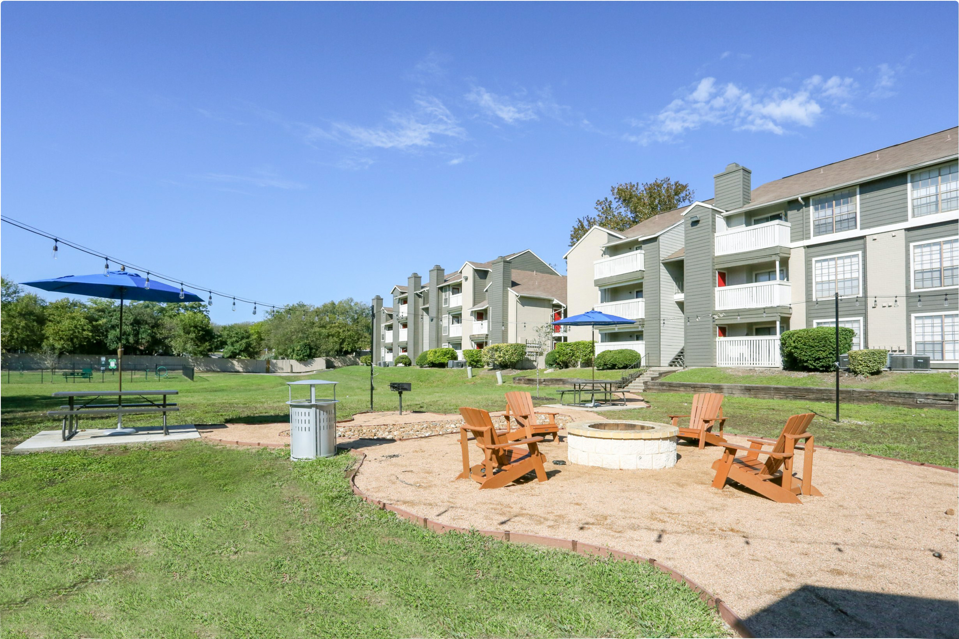

Sedona Canyon
296 units 1982 vintage, outstanding core-value opportunity in ideal Northeast San Antonio location;
Proximate to major employers, expansive retail, medical centers and first-class entertainment venues;
Strong market fundamentals and rent growth;
10.17 Acres - 204,004 sf Rentable Area;
Located at 4620 Thousand Oaks Dr
San Antonio, TX 78233.
97%
Occupancy
100%
As May 2021

Slide 4
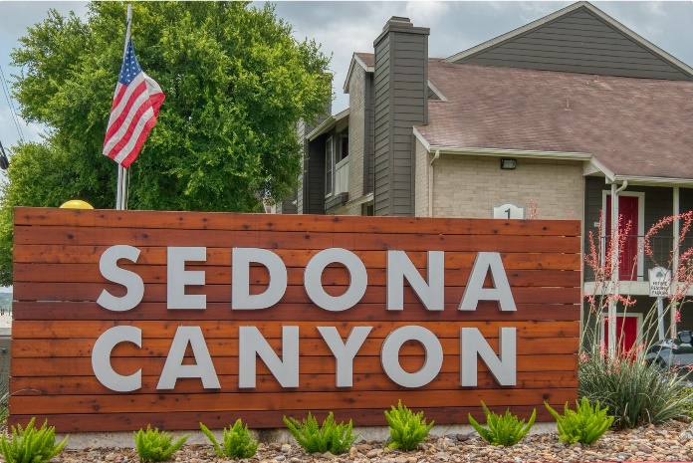
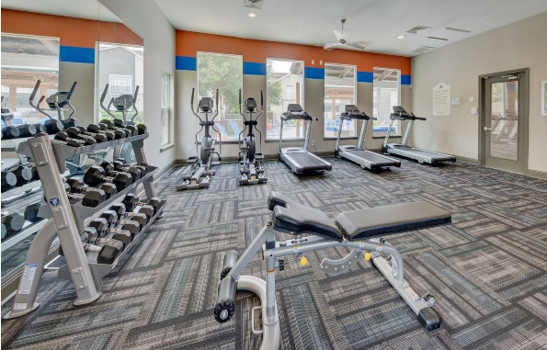
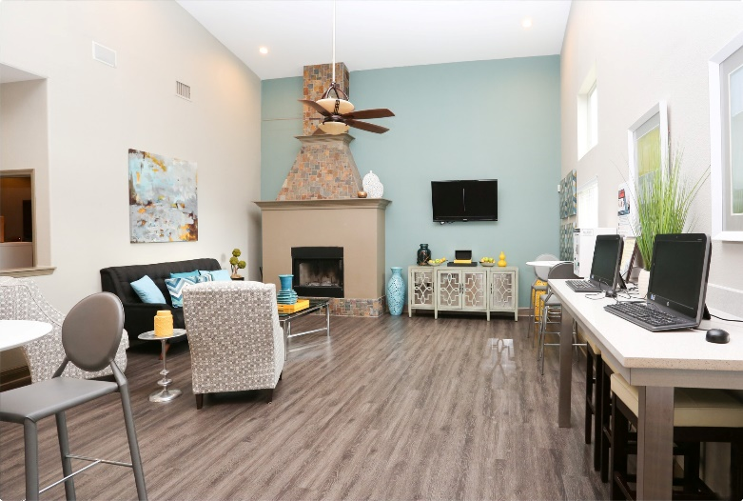
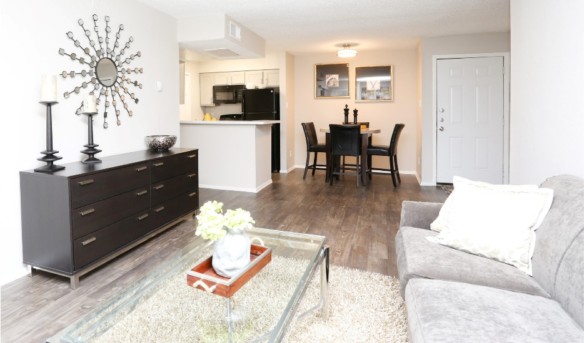
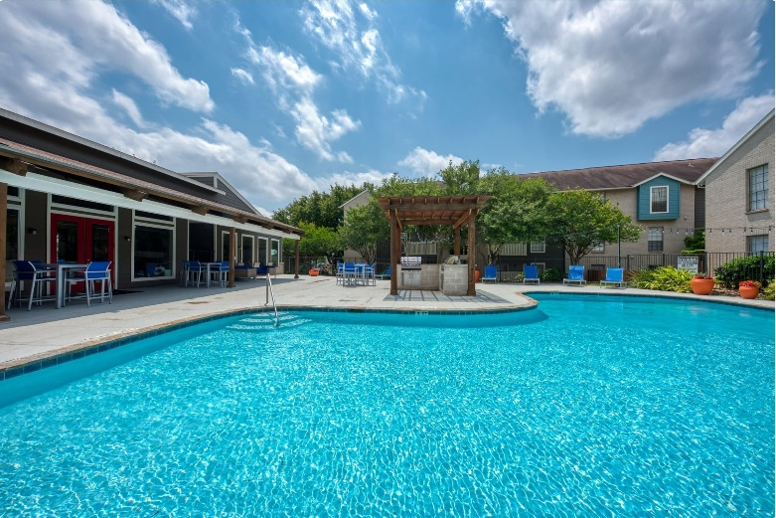
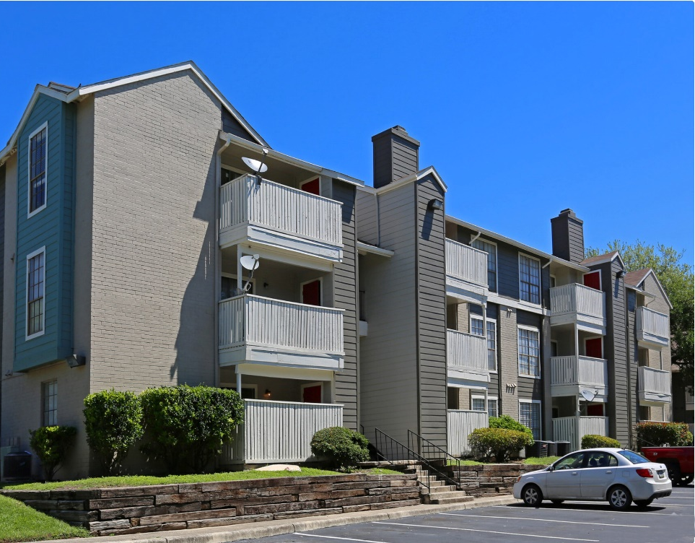
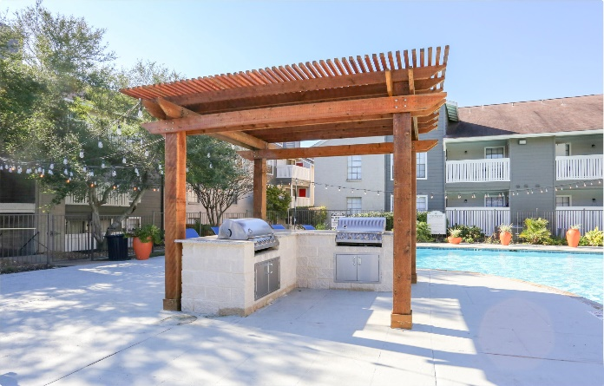
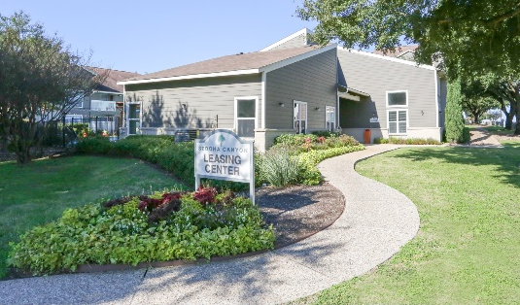
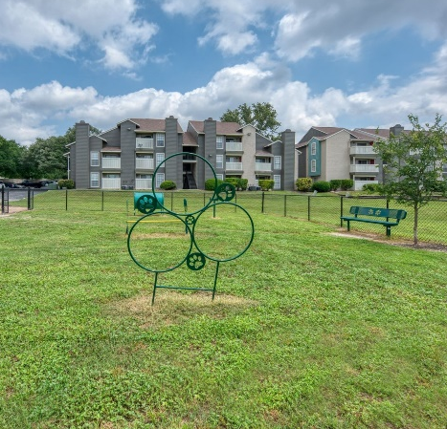

Slide 5
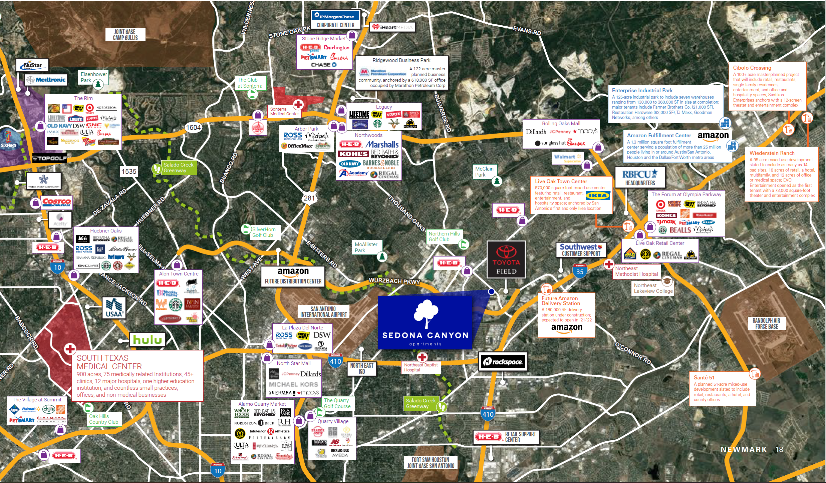
Notes:
Amazon to open 3 new delivery stations in San Antonio, Schertz (ksat.com)
Amazon announces plans for 3 new facilities, 1,500 jobs in San Antonio (ksat.com)

Slide 6

Topics
Sedona Canyon Executive Summary
  Investment Highlights
  Equity Investment
  Projected Returns
  Business Plan
San Antonio Market Overview
  Market Fundamentals
  Economic Base
  Major Industries
  Rental Market
CREE Capital
  Sponsor Team

Slide 7
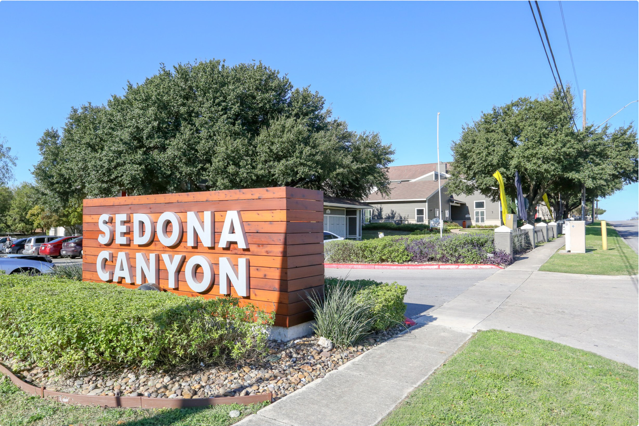
EXECUTIVE SUMMARY

Slide 8
Investment Highlights
Preferred
Return
Projected Annual Cash on Cash
Investment
Term
Projected
IRR
8%
10-12%
5 years
15%
DISCLAIMER
This preliminary information package offers only limited descriptive material regarding a Limited Liability Company investment in Cottonwood at Park Central. This summary does not purport to be complete and will be supplemented with additional information in a Private Placement Memorandum and at such time as it is requested, in writing, by interested investors. The use of this material is authorized only for those for whom it was originally provided. This is for informational purposes only and it is not a solicitation or offering to the recipient.

Slide 9
Equity Investment
Purchase Price | $27,750,000
USES
Purchase Price | $27,750,000
Operational Capital | $815,000
Capital Improvements | $2,088,000
Closing Costs | $1,387,000
TOTAL USES | $32,040,000
SOURCES
Debt Financing | $19,700,000
Equity Investment | $12,340,000
TOTAL SOURCES | $32,040,000

Slide 10
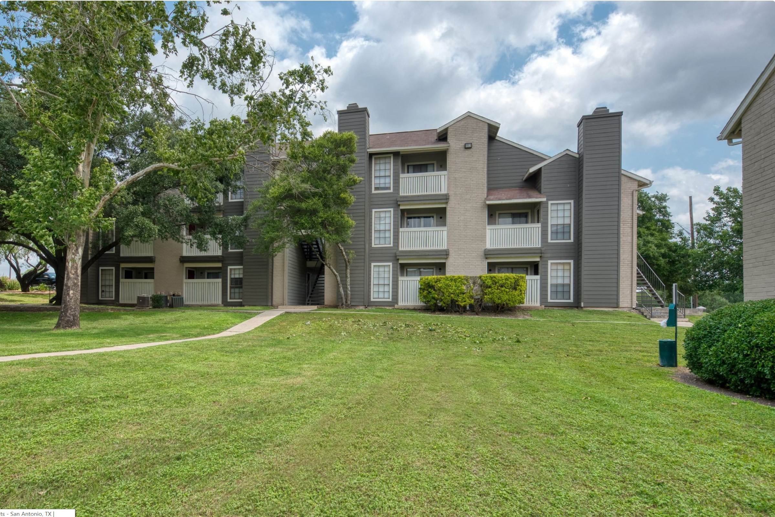
Conservative Financing
Conservative Underwriting
Freddie Mac Agency Debt
Low Leverage: 70% LTV
5 Years Interest Only
Interest Rate ~3.25%
30 Year amortization
Conservative assumptions of sale value based on reversion cap rate increase by 10 basis points per year.

Slide 11

Projected Returns*
(based on $100K investment)
 | Year 1 | Year 2 | Year 3 | Year 4 | Year 5
CoC Return** | 6.3% | 8.2% | 9.1% | 13.9% | 13.9%
Return of Capital |  |  | 68%
Retained Capital |  |  |  |  | 67%
Cumulative Return | $6,266 | $14,422 | $91,294 | $95,782 | $167,321
*We anticipate a long-term hold of (5-10 years) but are showing the returns and retained equity in 5-year for example purposes only. The hold period depends on the market, and the final decision about when to sell will be reviewed on a yearly basis in consideration of market and property performance. 10-year hold returns 10.8% average COC.
** COC based on invested capital

Slide 12



Business Plan
Professional
Management
Property
Improvements
Increase NOI &
Reduce Expenses
Experienced Property & Asset management with full adoption of technology and deliberate focus on San Antonio market.
$2M in capital and property improvements to interiors, exteriors and various amenities.
Increase efficiency and implement other sources of revenue while improving operating expenses.

Slide 13




Sedona Canyon Timeline
Continue pushing rents on renewals to catch up to market rents.
Supplemental loan (75% LTV) to return maximum capital back to investors.
0 - 6 months
18 - 24 months
36 - 60 months
12 - 18 months
24 - 36 months
Continue focus on cash flowing.
As units turn, roll out Premium interior upgrades.
Implement Other Revenue streams.
Continue stable operations.
Begin testing higher upgraded units to see what the maker will bear.

Slide 14
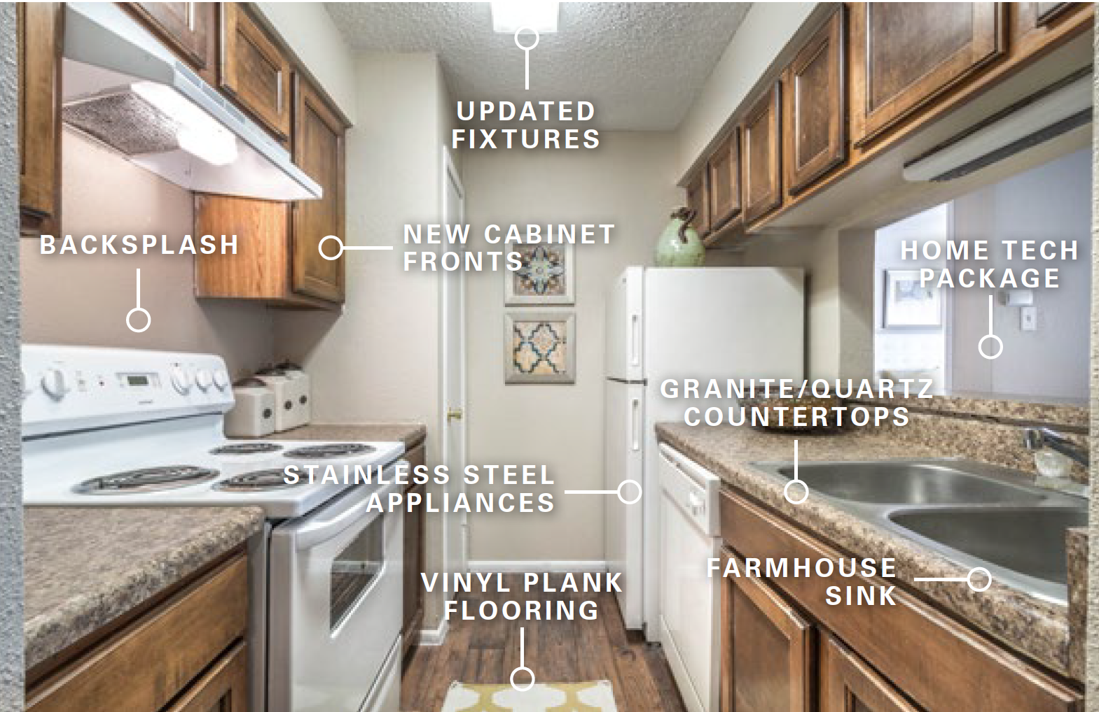
Classic to Premium Units
141 units require full renovation to achieve B-Class level. These have outdated interiors with older classic looking cabinets, flooring, appliances, tub surrounds, etc.
155 units require light renovation to achieve B-Class level. These have recently been renovated with flooring, cabinets, lighting, appliances and paint.

Slide 15
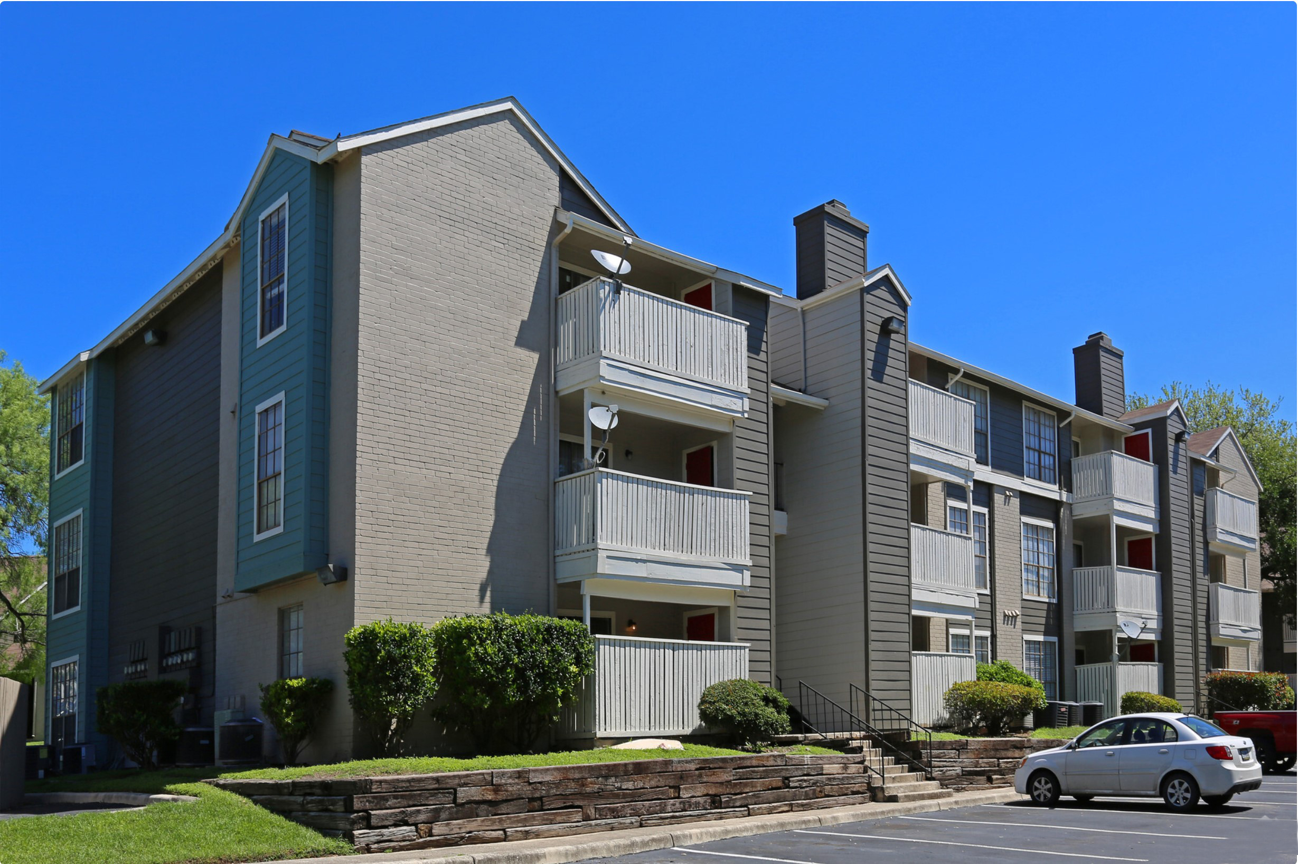
Premium Units Rents
Unit Size | # of Units | Premium Year 1 | Premium Year 2 | Income Increase Year 1 | Income Increase Year 2
A1 | 81 | $46 | $91 | $ 44,226 | $ 88,452
A2 | 111 | $47 | $93 | $ 61,938 | $ 123,876
B1 | 72 | $41 | $81 | $ 34,992 | $ 69,984
B2 | 32 | $39 | $78 | $ 14,976 | $ 29,952
TOTAL INCREASE REVENUE | $156,132 | $312,264

Slide 16
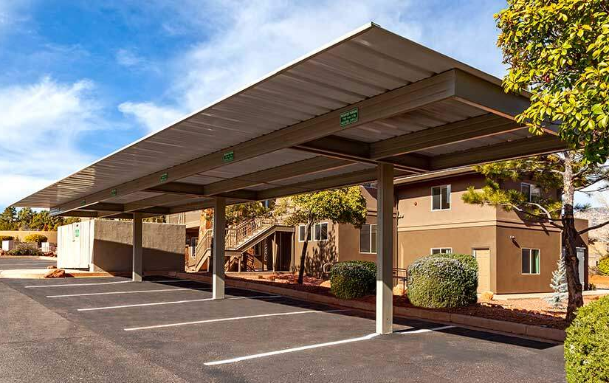
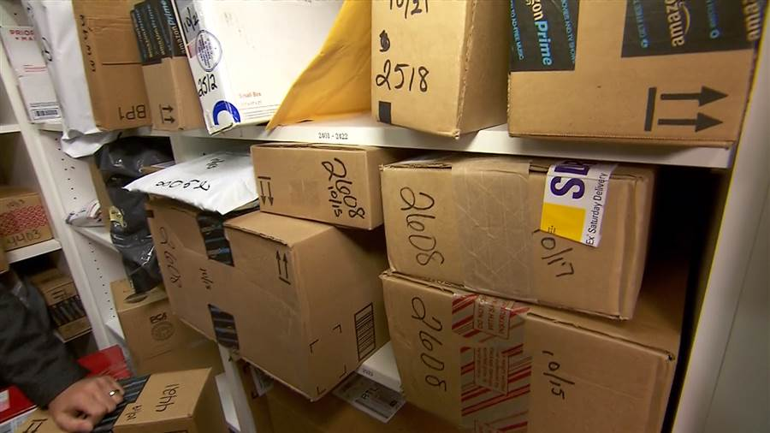

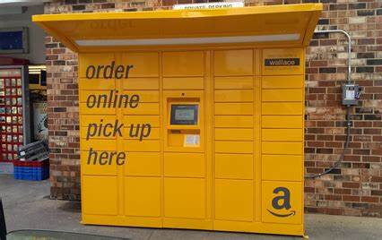


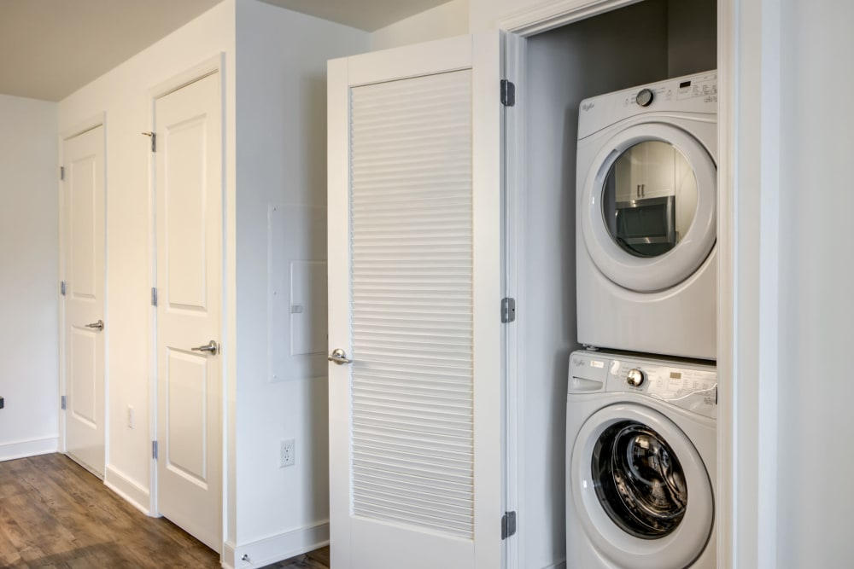
Other Revenue Streams
Preferred and Covered Parking & Washer / Dryer
Package Handling Fee & Amazon Locker
Door Trash Valet &
Home Tech Package

Slide 17
Other Revenue Streams
Other Potential Revenue | Premium | Units | Income Increase Year 1 (50%) | Income Increase Year 2
Covered Parking | $35 | 40 (10%) | $8,400 | $16,800
Preferred Parking | $25 | 40 (10%) | $6,000 | $12,000
Door Valet Trash | $10 | 296 | $17,760 | $35,520
Home Tech Package | $30 | 30 (10%) | $5,400 | $10,800
Package Handling Fee | $3 (1 pkg /year) | 148 (50%) | $2,664 | $5,328
Amazon Locker | $15 | 30 | $2,700 | $5,400
Washer / Dryer (remaining units) | $40 | 66 | $15,840 | $31,680
TOTAL INCREASE REVENUE | $58,764 | $117,528
Conservative Total* | $40,000 | $80,000
*Numbers used in our underwriting

Slide 18

Capital Improvements Summary & Value Add
Interior Upgrades
Flooring | $276,500
Kitchen countertops | $311,750
Resurface/replace Kitchen Cabinets | $140,000
Appliances | $210,000
Paint Unit | $105,000
Bathroom vanity | $75,250
Resurface bathtub | $88,800
Lighting Fixtures | $29,600
Hardware's Kitchen / Bathroom | $10,500
Sub-Total | $1,247,400
Exterior Upgrades
Landscaping | $30,000
Roofing | $570,000
Parking Lot | $20,000
Office Decoration | $5,000
Kids Playground | $5,000
Siding repairs | $25,000
BBQ / Sitting Area | $18,000
Covered Parking | $41,000
Home Tech Package | $7,000
Amazon Locker | $20,000
Contigency | $100,000
Sub-Total | $841,000
Total Capex Budget | $2,088,400
Revenue | Income Increase Year 1 | Income Increase Year 2
Premium Rents | $156,132 | $312,264
Other Income (conservative) | $58,764 | $117,528
TOTAL | $196,132 | $392,264
$40,000
$80,000
18% ROI
PROPERTY VALUE INCREASE YEAR 2*
$8,346,042
Value add
*Based on 4.70% CAP Rate Year 2
Total Capex Budget | $2,088,400

Slide 19
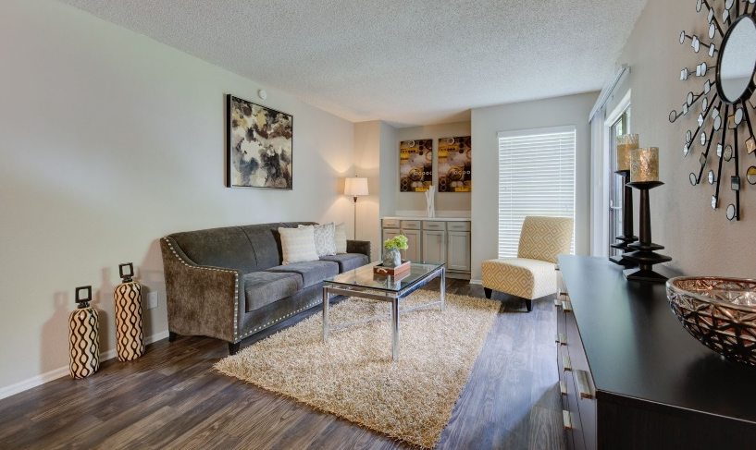
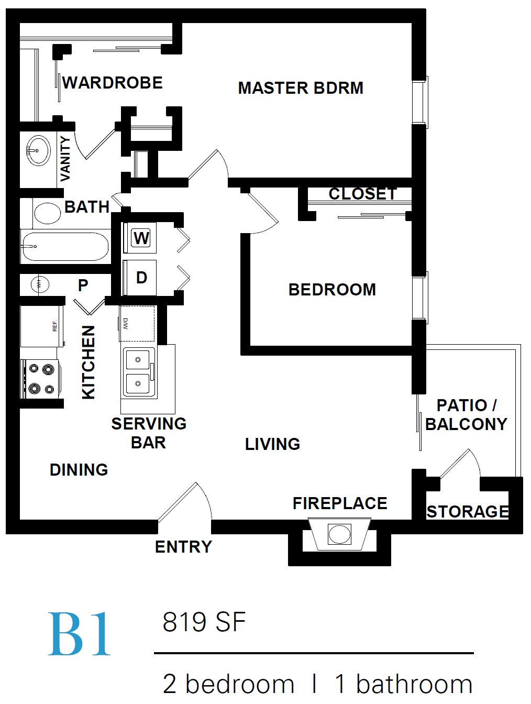
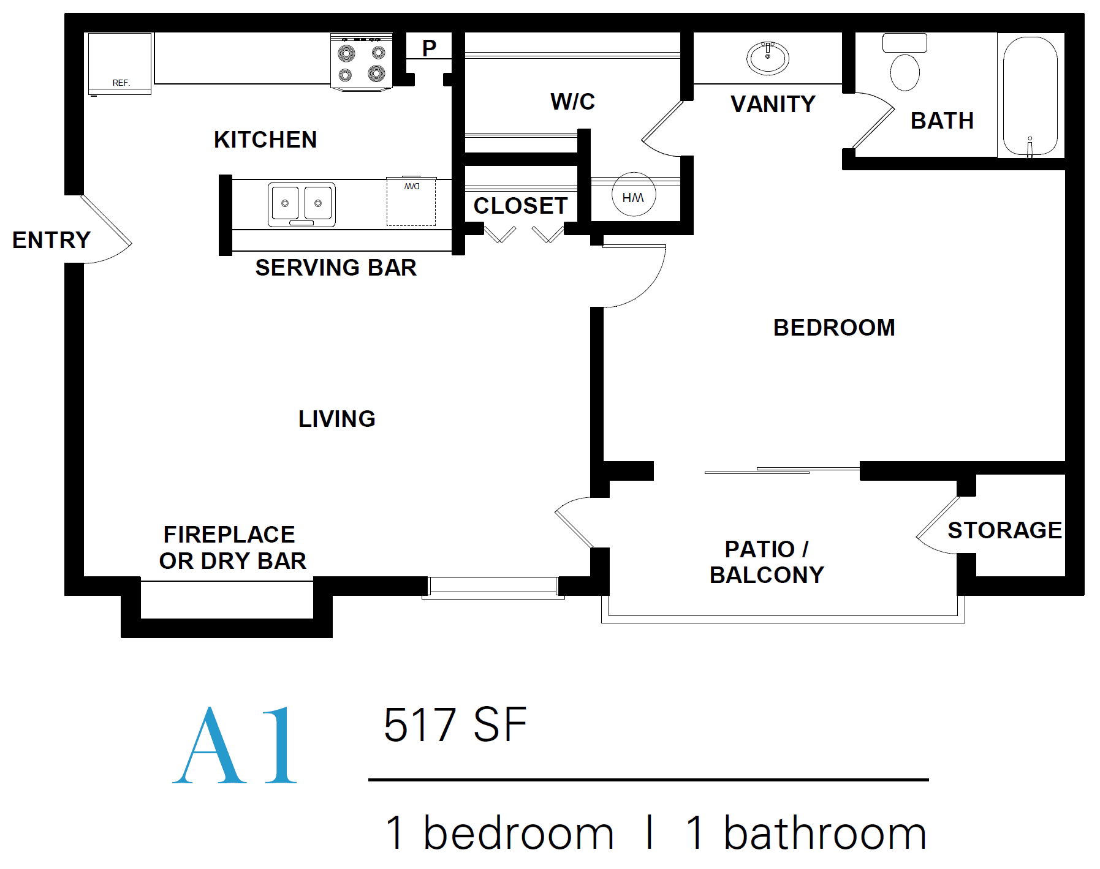
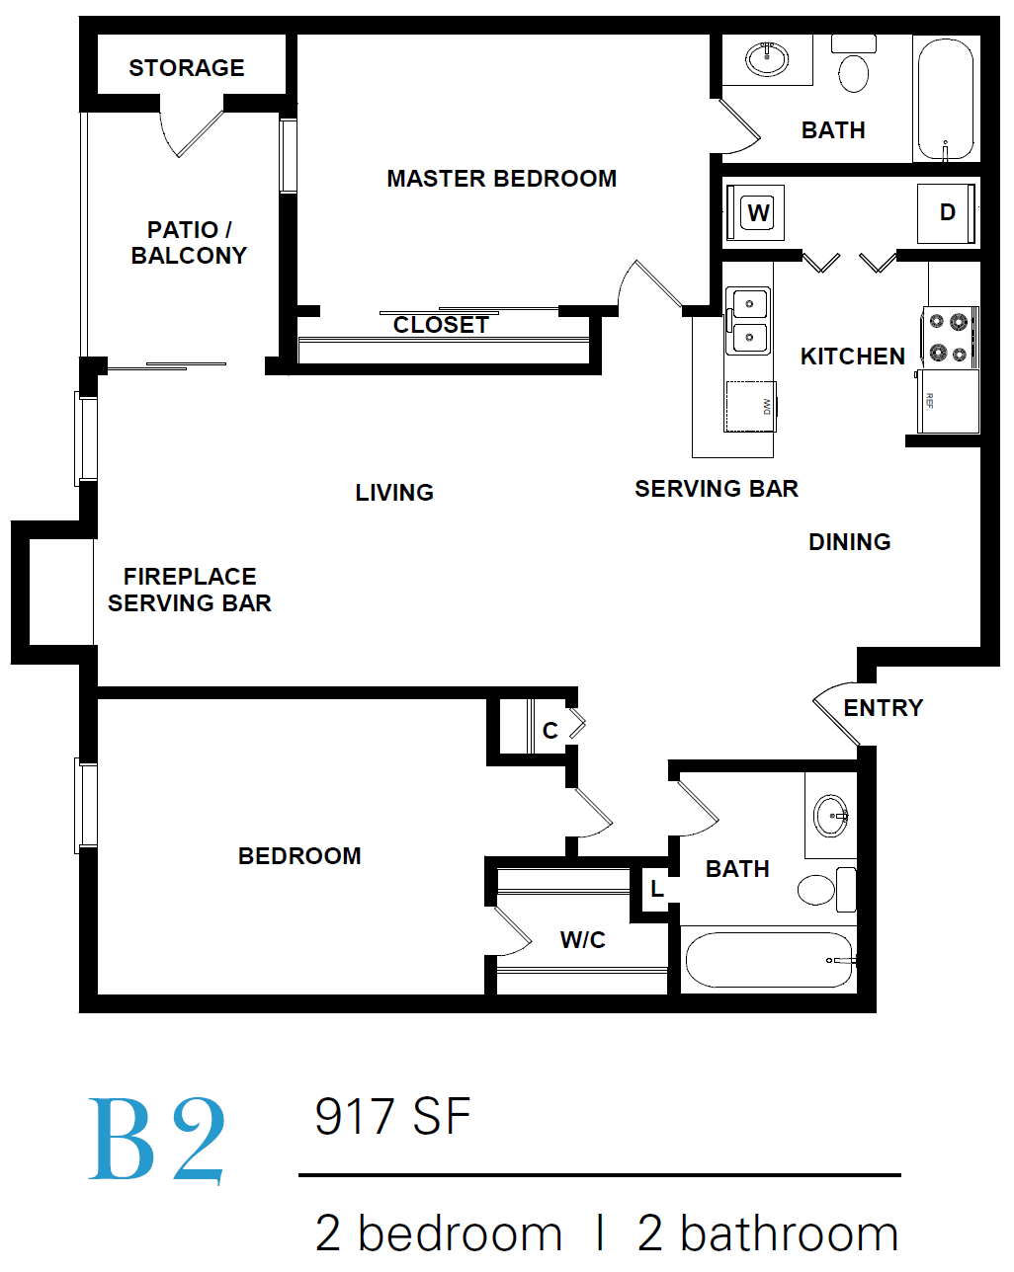
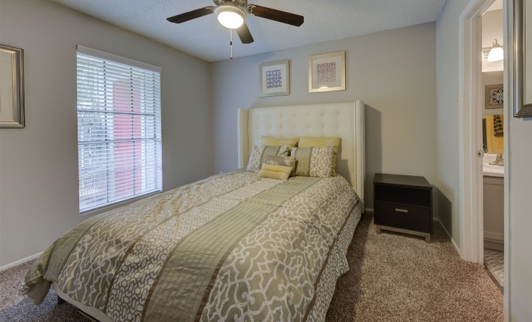
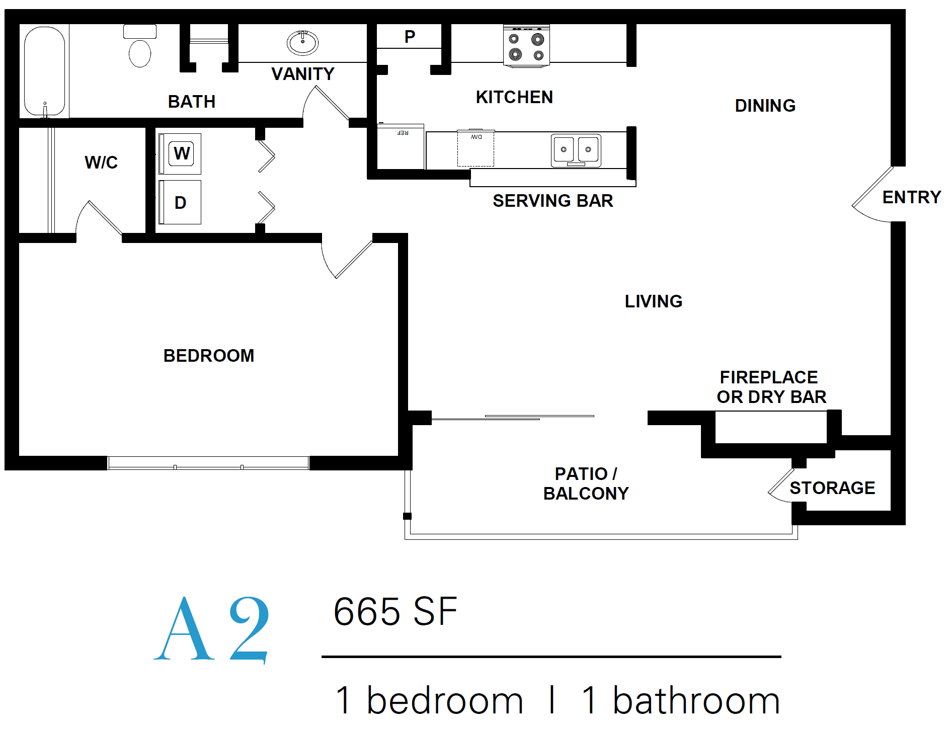
81 units
72 units
111 units
32 units

Slide 20

Unix Mix
Unit Size | # of Units | SF | Avg Rent | Rent / SF
A1 | 81 | 517 | $745 | $1.44
A2 | 111 | 665 | $835 | $1.26
B1 | 72 | 819 | $935 | $1.14
B2 | 32 | 917 | $1040 | $1.13
Total / Avg | 296 | 730 | $889 | $1.24

Slide 21
Rent Comparable
Comp
Comp-1
Comp-2
Comp-3

Slide 22
FINANCIALS

Slide 23
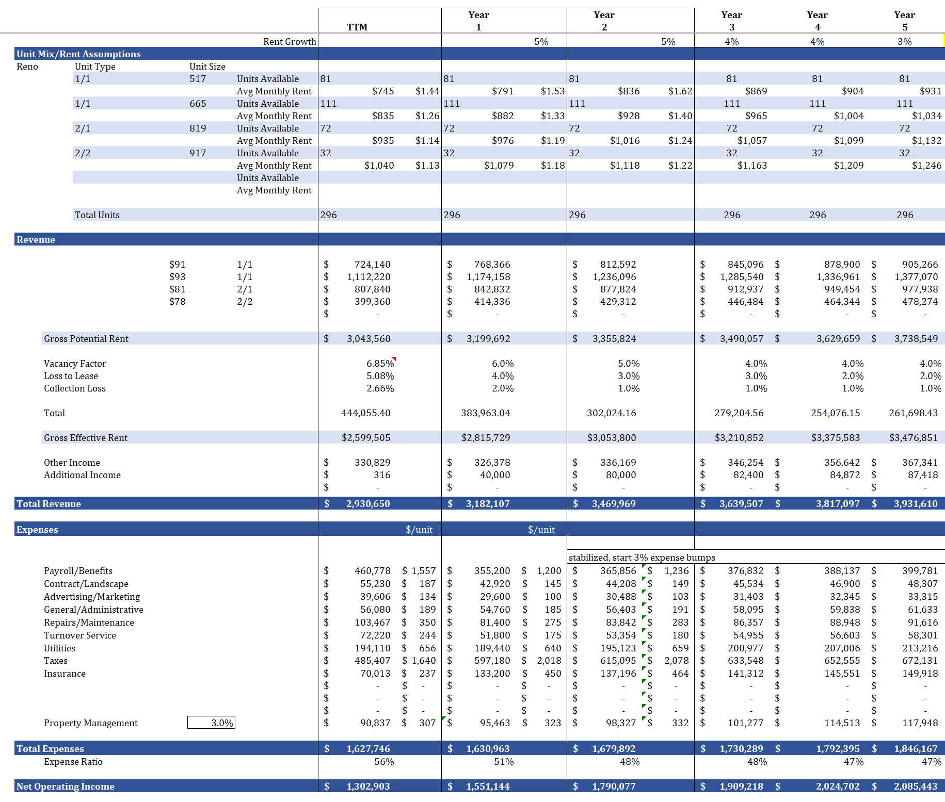
5 Year Projected Proforma

Slide 24

Pro Forma Assumptions
EXPENSES
Repairs & Maintenance: Includes expenses associated with the repairs and maintenance of the interior and exterior of the property and projected at $275 per unit which is lower than historical, but we will renovate units as they turn with new flooring, lighting, appliances, etc. most of the repairs are coming from our capex renovation budget.
Advertising: Includes advertising, leasing costs, resident retention and other marketing expenses. Based on our analysis, current owner is doing good on the marketing, but we believe we will get better results with slightly less budget by applying aggressive leasing strategy, different marketing channels and efficiency.
INCOME
Turnover: Includes the expenses associated with making a vacant unit ready for the next move-in and is projected at $175 per unit, lower than historical performance and more within our typical budget for a similar type property managed by our chosen property management.
Administrative: Includes computer maintenance and supplies, evictions, telephone, answering service, website & support, office equipment, training & travel, and other office expenses. Pro forma expense of $185 per unit in line with our standard / expectations.
Gross Scheduled Rent: Based on occupied units at leased rent and vacant units at market rent from the most recent roll. Average turn is 10-12 units per month. We are allowing 2 years to bring rents up to market across the entire complex. Afterwards, we assumed annual 3% increases for both income and expenses.
Taxes: The amount represented is an estimated value based on 80% of the new purchase price and using Bexar County Tax mill rate. The new Taxes will be confirmed and re-assessed using a local tax appraiser but for this underwriting we are using our own research from comps in the area and the valuation increases they are incurring upon sale.
Payroll: Year 1 payroll is set to $1,200 per door - a total payroll budget of $355k, which is almost $100k lower than current budget for the staff provided by current management. We believe in efficiency and power of technology to substitute operational activities normally done by onsite staffs by leveraging technology and virtual assistants. We will have 7 employees working in this property - (2) full-time onsite office staff and (3) full-time onsite maintenance plus (2) virtual assistant staff for Backoffice activities.
ECONOMIC LOSS
Utilities: Includes electricity for vacant units and common areas, gas, water and sewer. Tenants are sub-metered for electric, but we pay for all the water and it is partially billed back to the tenants, and we have not anticipated this changing materially. We will also save on utilities with water efficient faucets and led lighting.
Loss-to-Lease: The difference between market and contract/actual rents. Year 1 Loss-to-Lease is projected at 4%.
Vacancy: Pro forma vacancy loss is projected at 6% which is slightly lower than the recent historical of the property at 6.85%. Average historical vacancy in the immediate area is closer to 3%, and we believe this is achievable with pro-active management and better marketing but are allowing room for turnover.
Insurance: We are bumping insurance from historical because of current instability in the Texas insurance market. Even though we have a rough quote, this could be higher - $450/door.
Management Fee: Management fee is 3% of the collected revenue. We are hiring Disrupt Management, local property management company to manage the asset. We believe this is the best fit for the asset given the size, unique market, and need for quality employees.
Contract Services: Pro forma expense of $145 per unit is based on the historical performance of surround properties managed by our chosen property management, its $12k lower than historical due to some reclassing to R&M as well as savings on trash contract. This includes landscaping, trash, pest control, and pool servicing.
Capital Reserves: Capital reserves are projected at $250 per unit, as is typical with this type of a project.
Collection Loss: Collection loss is projected at 2%, based on market comparables, but slightly lower than historical which has run closer to 2.66%.
FEES. We like to keep it simple. Projected returns already factor in our fees. We charge a one-time 3% acquisition fee and a quarterly 2% asset management fee (based on revenue collected). Our deals have no construction management fees, no disposition fees, no refinance fees, and no loan guaranteefees.

Slide 25
FAQ
What are the investor requirements to invest in this deal?
  ALL investors must be accredited investors.
What is the minimum/ maximum amount I can invest?
  The minimum investment will be $100k.
Can I invest money from my IRA?
  Yes, we are taking IRA and/or Solo 401(k) funds.
What is the time horizon for this investment?
  We’re set to close in August 2021. Shares in our investments typically go quickly, so please register on our portal and commit your investment as soon as possible.
How will profits be distributed to investors?
  This deal has an 8% preferred return to investors plus a 50% split for profits in excess of the preferred return. Distributions will start in September 2021 and be paid monthly.
Is due diligence complete?
  We will conduct unit-by-unit inspection from June 21st to June 30th, 2021.

Slide 26












Risk Based Investing
Stress testing
01
Identify risks
02
03
04
High Risk
Risk 100%
Return 30%
Low Risk
Risk 10%
Return 15%
Lower leverage
05
Industry experts
Conservative underwriting

Slide 27
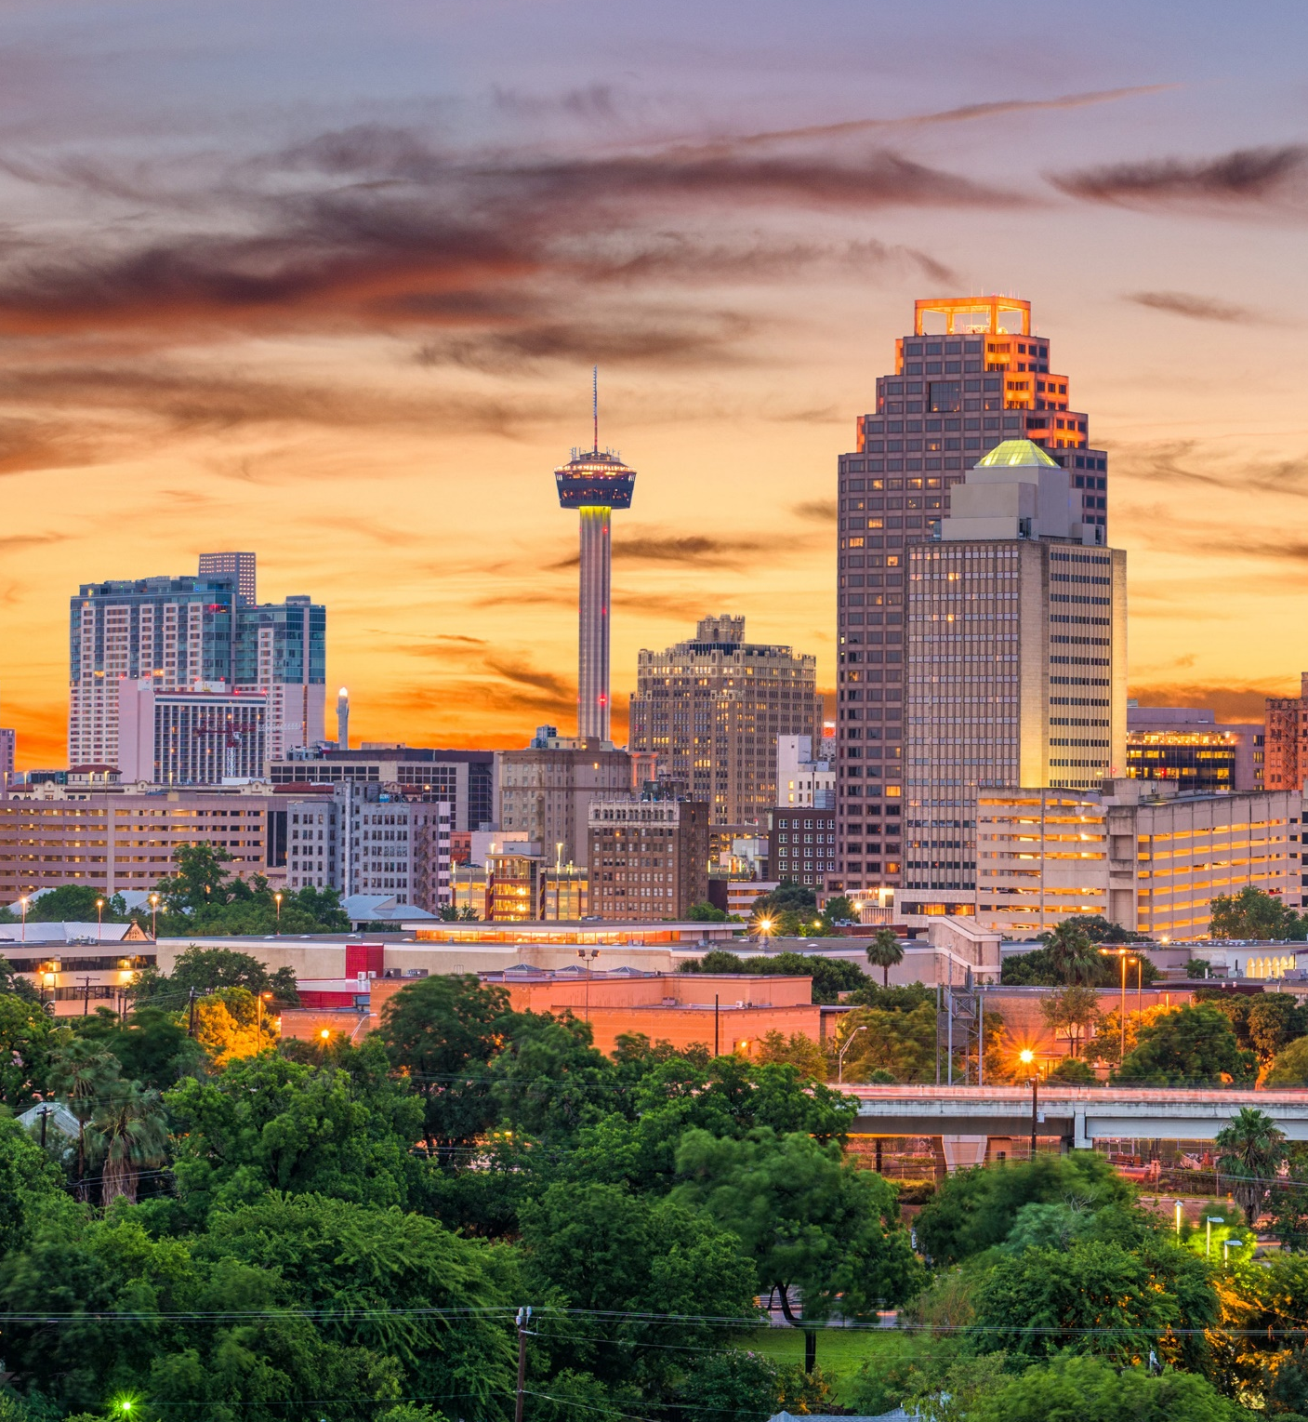
San Antonio
Texas
Market overview

Slide 28
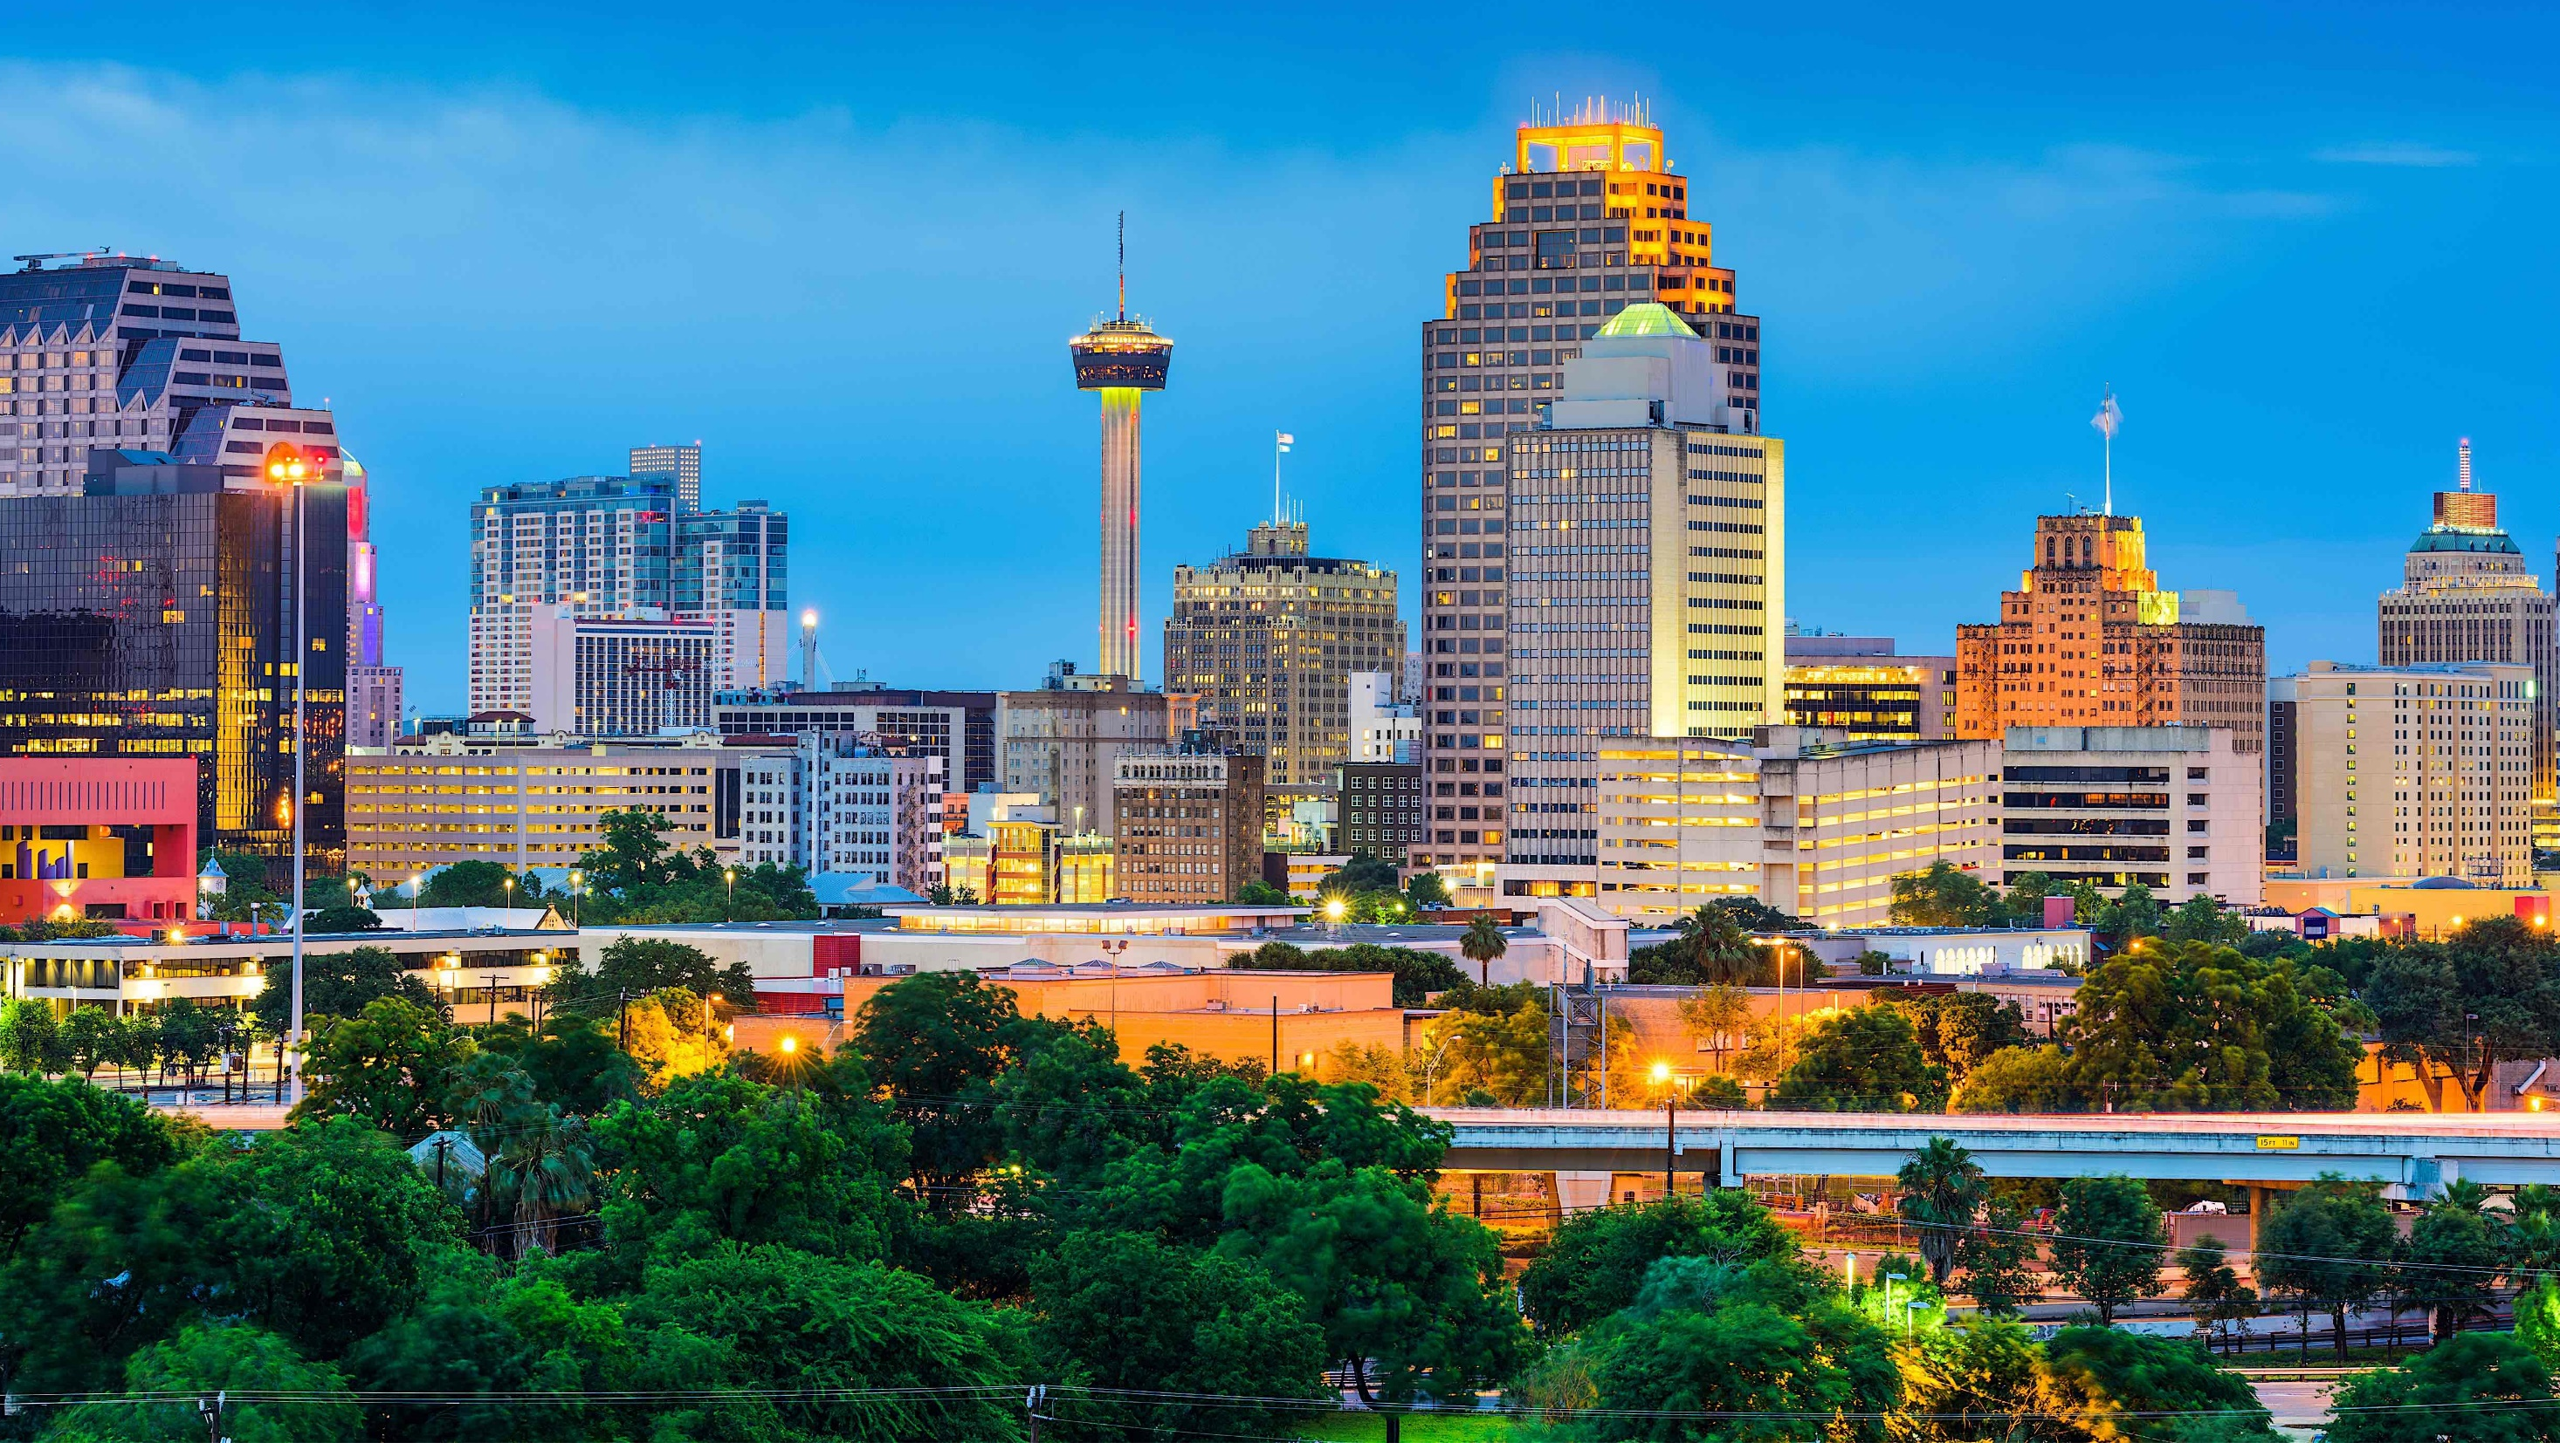
Strong MARKET FUNDAMENTALS
Positive job growth
Cheaper cost of living
Strategic location
Balanced Workforce
Entertainment City
Source: Source: Site-to-Do-Business (STDB Online) 2020
Notes:
San Antonio, the second largest city in the state, enjoys a diverse economy with continued growth in the fields of healthcare, biotechnology, telecommunications, higher education and an expanding tourism market, a developing oil/gas industry and continued job growth.
The location of San Antonio at the crossroads of three interstate highways and its proximity to Mexico are expected to increase San Antonio’s role in international trade in the future because of the North American Free Trade Agreement (NAFTA).
The economic outlook for San Antonio is for continued above-average growth due to low business costs, a young bilingual workforce, and proximity to Mexico.
Source: Site-to-Do-Business (STDB Online)

Slide 29


San Antonio is the second largest city in the state, enjoys a diverse economy with continued growth in the fields of healthcare, biotechnology, telecommunications, higher education and an expanding tourism market, a developing oil/gas industry and continued job growth.
The location of San Antonio at the crossroads of three interstate highways and its proximity to Mexico are expected to increase San Antonio’s role in international trade in the future because of the North American Free Trade Agreement (NAFTA).
The economic outlook for San Antonio is for continued above-average growth due to low business costs, a young bilingual workforce, and proximity to Mexico.
Source: Source: Site-to-Do-Business (STDB Online) 2020
Notes:
San Antonio, the second largest city in the state, enjoys a diverse economy with continued growth in the fields of healthcare, biotechnology, telecommunications, higher education and an expanding tourism market, a developing oil/gas industry and continued job growth.
The location of San Antonio at the crossroads of three interstate highways and its proximity to Mexico are expected to increase San Antonio’s role in international trade in the future because of the North American Free Trade Agreement (NAFTA).
The economic outlook for San Antonio is for continued above-average growth due to low business costs, a young bilingual workforce, and proximity to Mexico.
Source: Site-to-Do-Business (STDB Online)

Slide 30

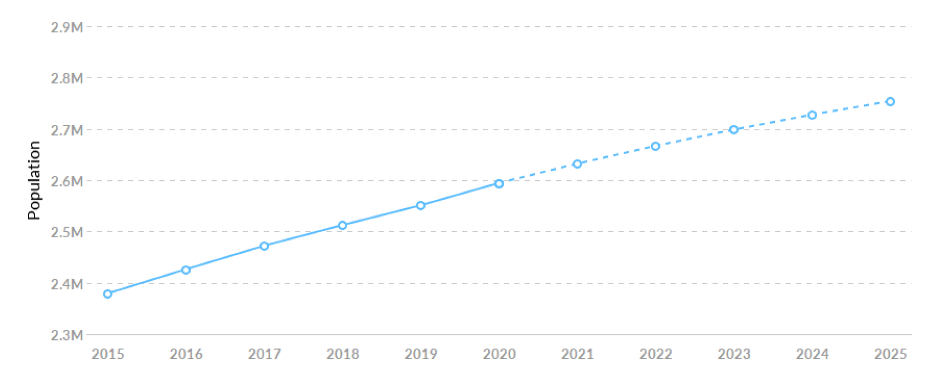
Population
2nd
Most Populated
City in Texas
7th
Largest City
in the nation
3rd
Largest Population Growth in Texas
+6.2%
2,594,487
9%
growth in last
5 years
Expected growth
by 2025, out pacing
national rate at 4%
adding +95,198 people
Source: EMSI – Economic Overview SAT MSA 2020
Notes:
Source: EMSI – Economic Overview SAT MSA 2020
Population grew by 215,227 (9%) over the last 5 years and is projected to grow by 6.2% (159,597) over the next 5 years.

Slide 31

Cost of Living
$89.70
Compared to $119.30
in Austin, TX
US Average = $100
Jobs Expect to
growth
+8%
Until 2025
Jobs
Increased by 9.5%
from 2015, outpaced
the national growth
rate of 6.2%
Median
Household
Income
$58.2K
Oct-2020
Unemployment
Rate
6.4%
Dec-2020
Source: EMSI – Economic Overview SAT MSA 2020 / BestPlaces.net
Notes:
Sources:
San Antonio-New Braunfels, TX Economy at a Glance (bls.gov)
Site-to-Do-Business (STDB Online)
EMSI

Slide 32





Economic Base
CORPORATE
INSURANCE
HEALTHCARE
MILITARY
TOURISM
Large number of corporations such as USAA, Valero, H-E-B, Frost Bank, Rackspace etc. have headquartered in San Antonio.
Amazon has recently announced expansion of a $200 million fulfillment center.
Several major insurance companies have operations located in San Antonio - including USAA.
USAA is primary employer in the city and 5th largest insurer of auto and 4th largest homeowner insurer.
The estimated annual economic impact of the city’s medical community exceeds $6 billion.
There are several major research organizations located in the city, including Southwest Research, The University of Texas and others.
San Antonio is “home” to three major military bases, including Randolph Air Force Base, Fort Sam Houston and Lackland Air Force Base, however, several major functions of the base are used for privatization.
~34.4 million people visits San Antonio annually;
$13.6 billion in revenue and employs 130,000 people;
Raises $375 million in taxes and fees;
New construction hotels;
Source: Source: Site-to-Do-Business (STDB Online) 2020
Notes:
The major industries in San Antonio include tourism, insurance, healthcare/ biotechnology, military and telecommunications/telemarketing. The oil and gas industry has become a newly created economic driver for San Antonio and South Texas.
Tourism
San Antonio is a year-round tourist destination; tourism remains one of San Antonio's most important industries. Approximately 34.4 million people visit San Antonio annually. The direct impact of the tourism industry is over $13.6 billion annually. The economic impact rose by 46% in a decade. The industry employs over 130,000 people and raises over $375 million in taxes and fees for local governments. San Antonio has also developed into a major convention city. Several new hotels have recently been completed or are under construction in downtown San Antonio to host convention visitors.
Insurance
Several major insurance companies have operations located in San Antonio, including United Services Automobile Association (USAA). USAA is a primary employer in San Antonio and is the fifth largest insurer of private automobiles in the country and the fourth largest homeowner insurer. It is noted that the USAA headquarters are approximately 1.7 miles from the subject site.
Healthcare/Biotechnology
The estimated annual economic impact of the city’s medical community exceeds $6 billion. The healthcare/biotech industry has grown significantly in the recent past and has become increasingly important in the health services industry. There are several major research organizations located in the city, including Southwest Foundation for Biomedical Research, Southwest Research Institute, The University of Texas Health Science Center, and the University of Texas at San Antonio.
Military
San Antonio is “home” to three military bases, including Randolph Air Force Base, Fort Sam Houston and Lackland Air Force Base. Kelly Air Force Base closed in 2001 (now Port San Antonio); however, several major functions of the base are used for privatization. The City of San Antonio purchased the base from the United States Air Force to redevelop Kelly for use by private industry. Brooks Air Force Base has also been reformatted into Brooks City Base.
Corporate Influence
While a number of large corporations such as USAA, Valero, H-E-B, Frost Bank, etc. have headquartered in San Antonio, AT&T, the nation’s largest telecommunications company, announced in early 2008 its decision to move its corporate headquarters along with 700 employees to Dallas, Texas. A statement released by AT&T stated that “San Antonio will continue to be a major operations and employment center” with approximately 5,300 telecom operations division employees remaining in the city; about 1,700 more than was originally relocated to the city from St. Louis in 1992.

Slide 33
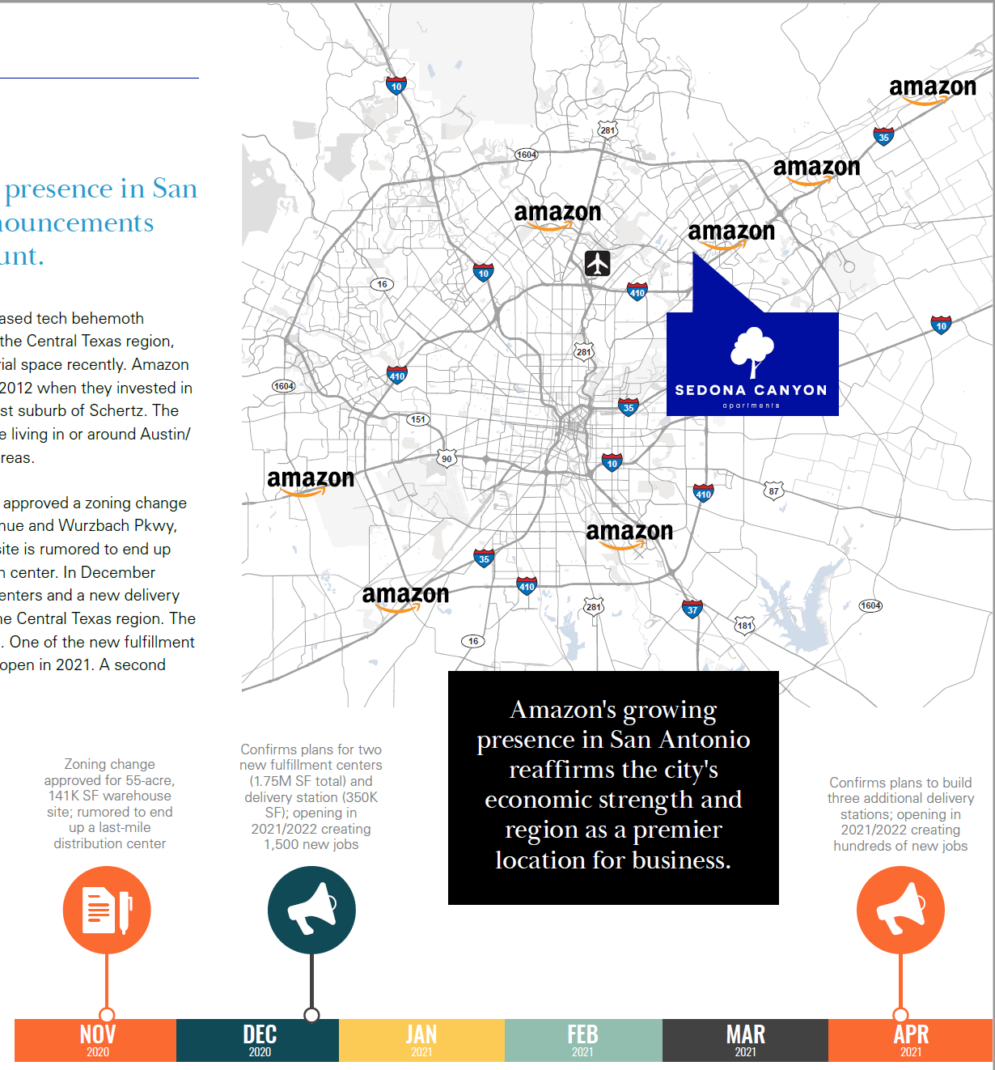
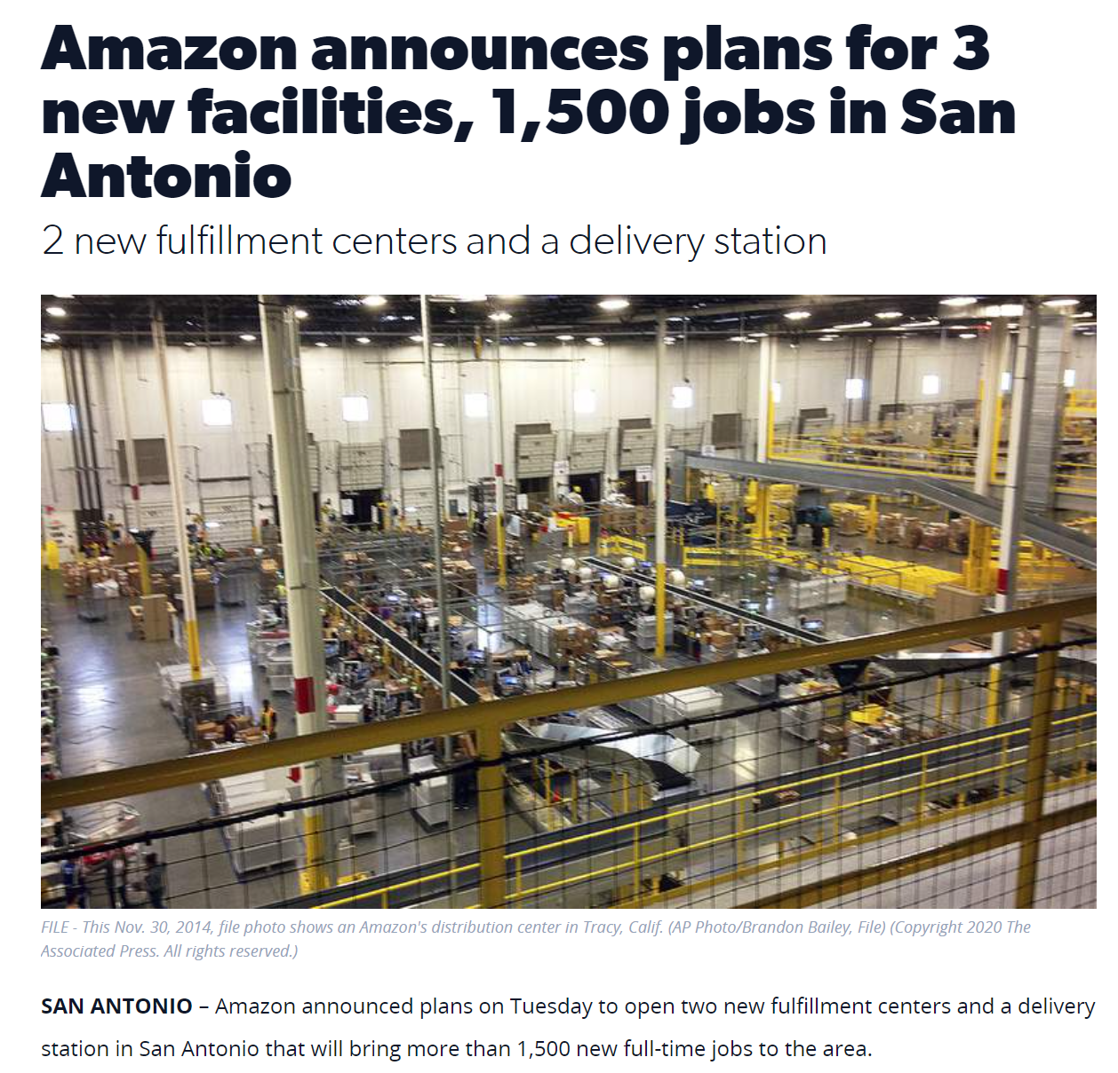
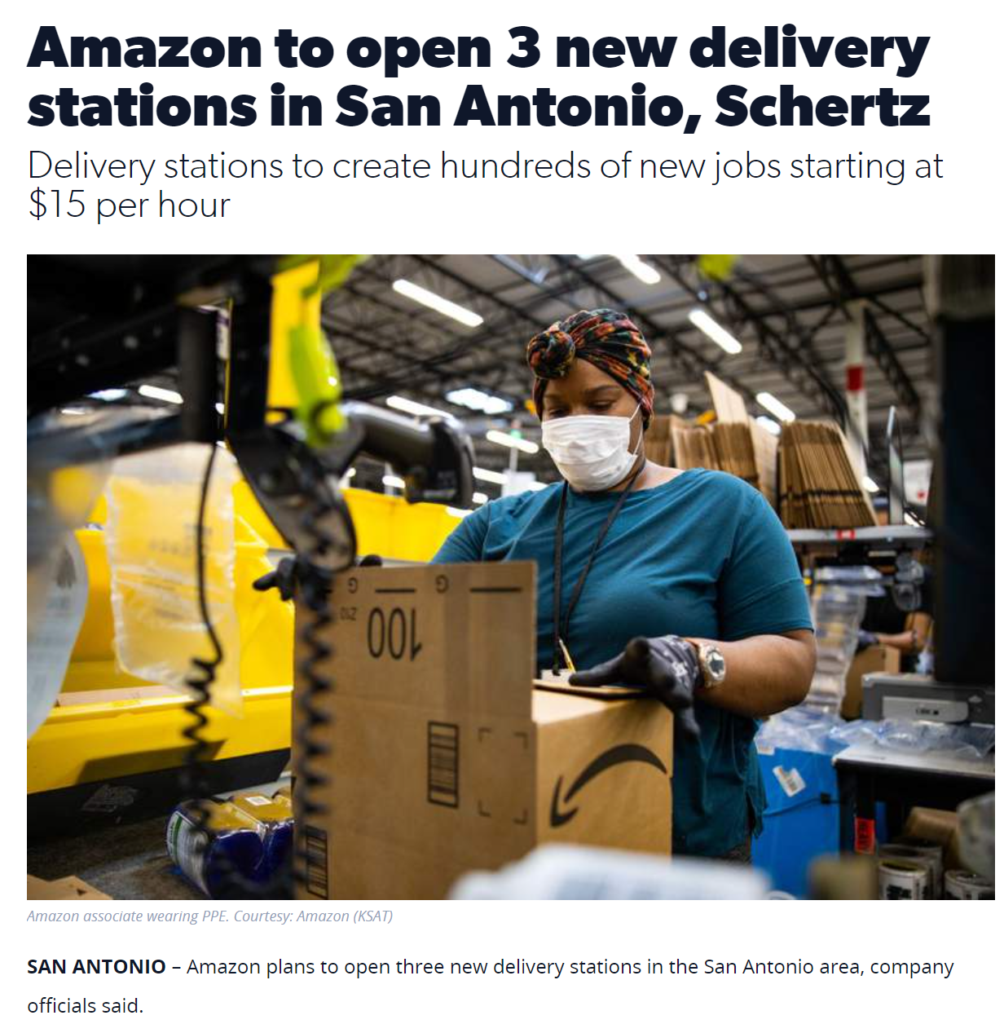
Amazon
SEDONA CANYON
Dec-2020
April-2021
Notes:
Amazon to open 3 new delivery stations in San Antonio, Schertz (ksat.com)
Amazon announces plans for 3 new facilities, 1,500 jobs in San Antonio (ksat.com)

Slide 34
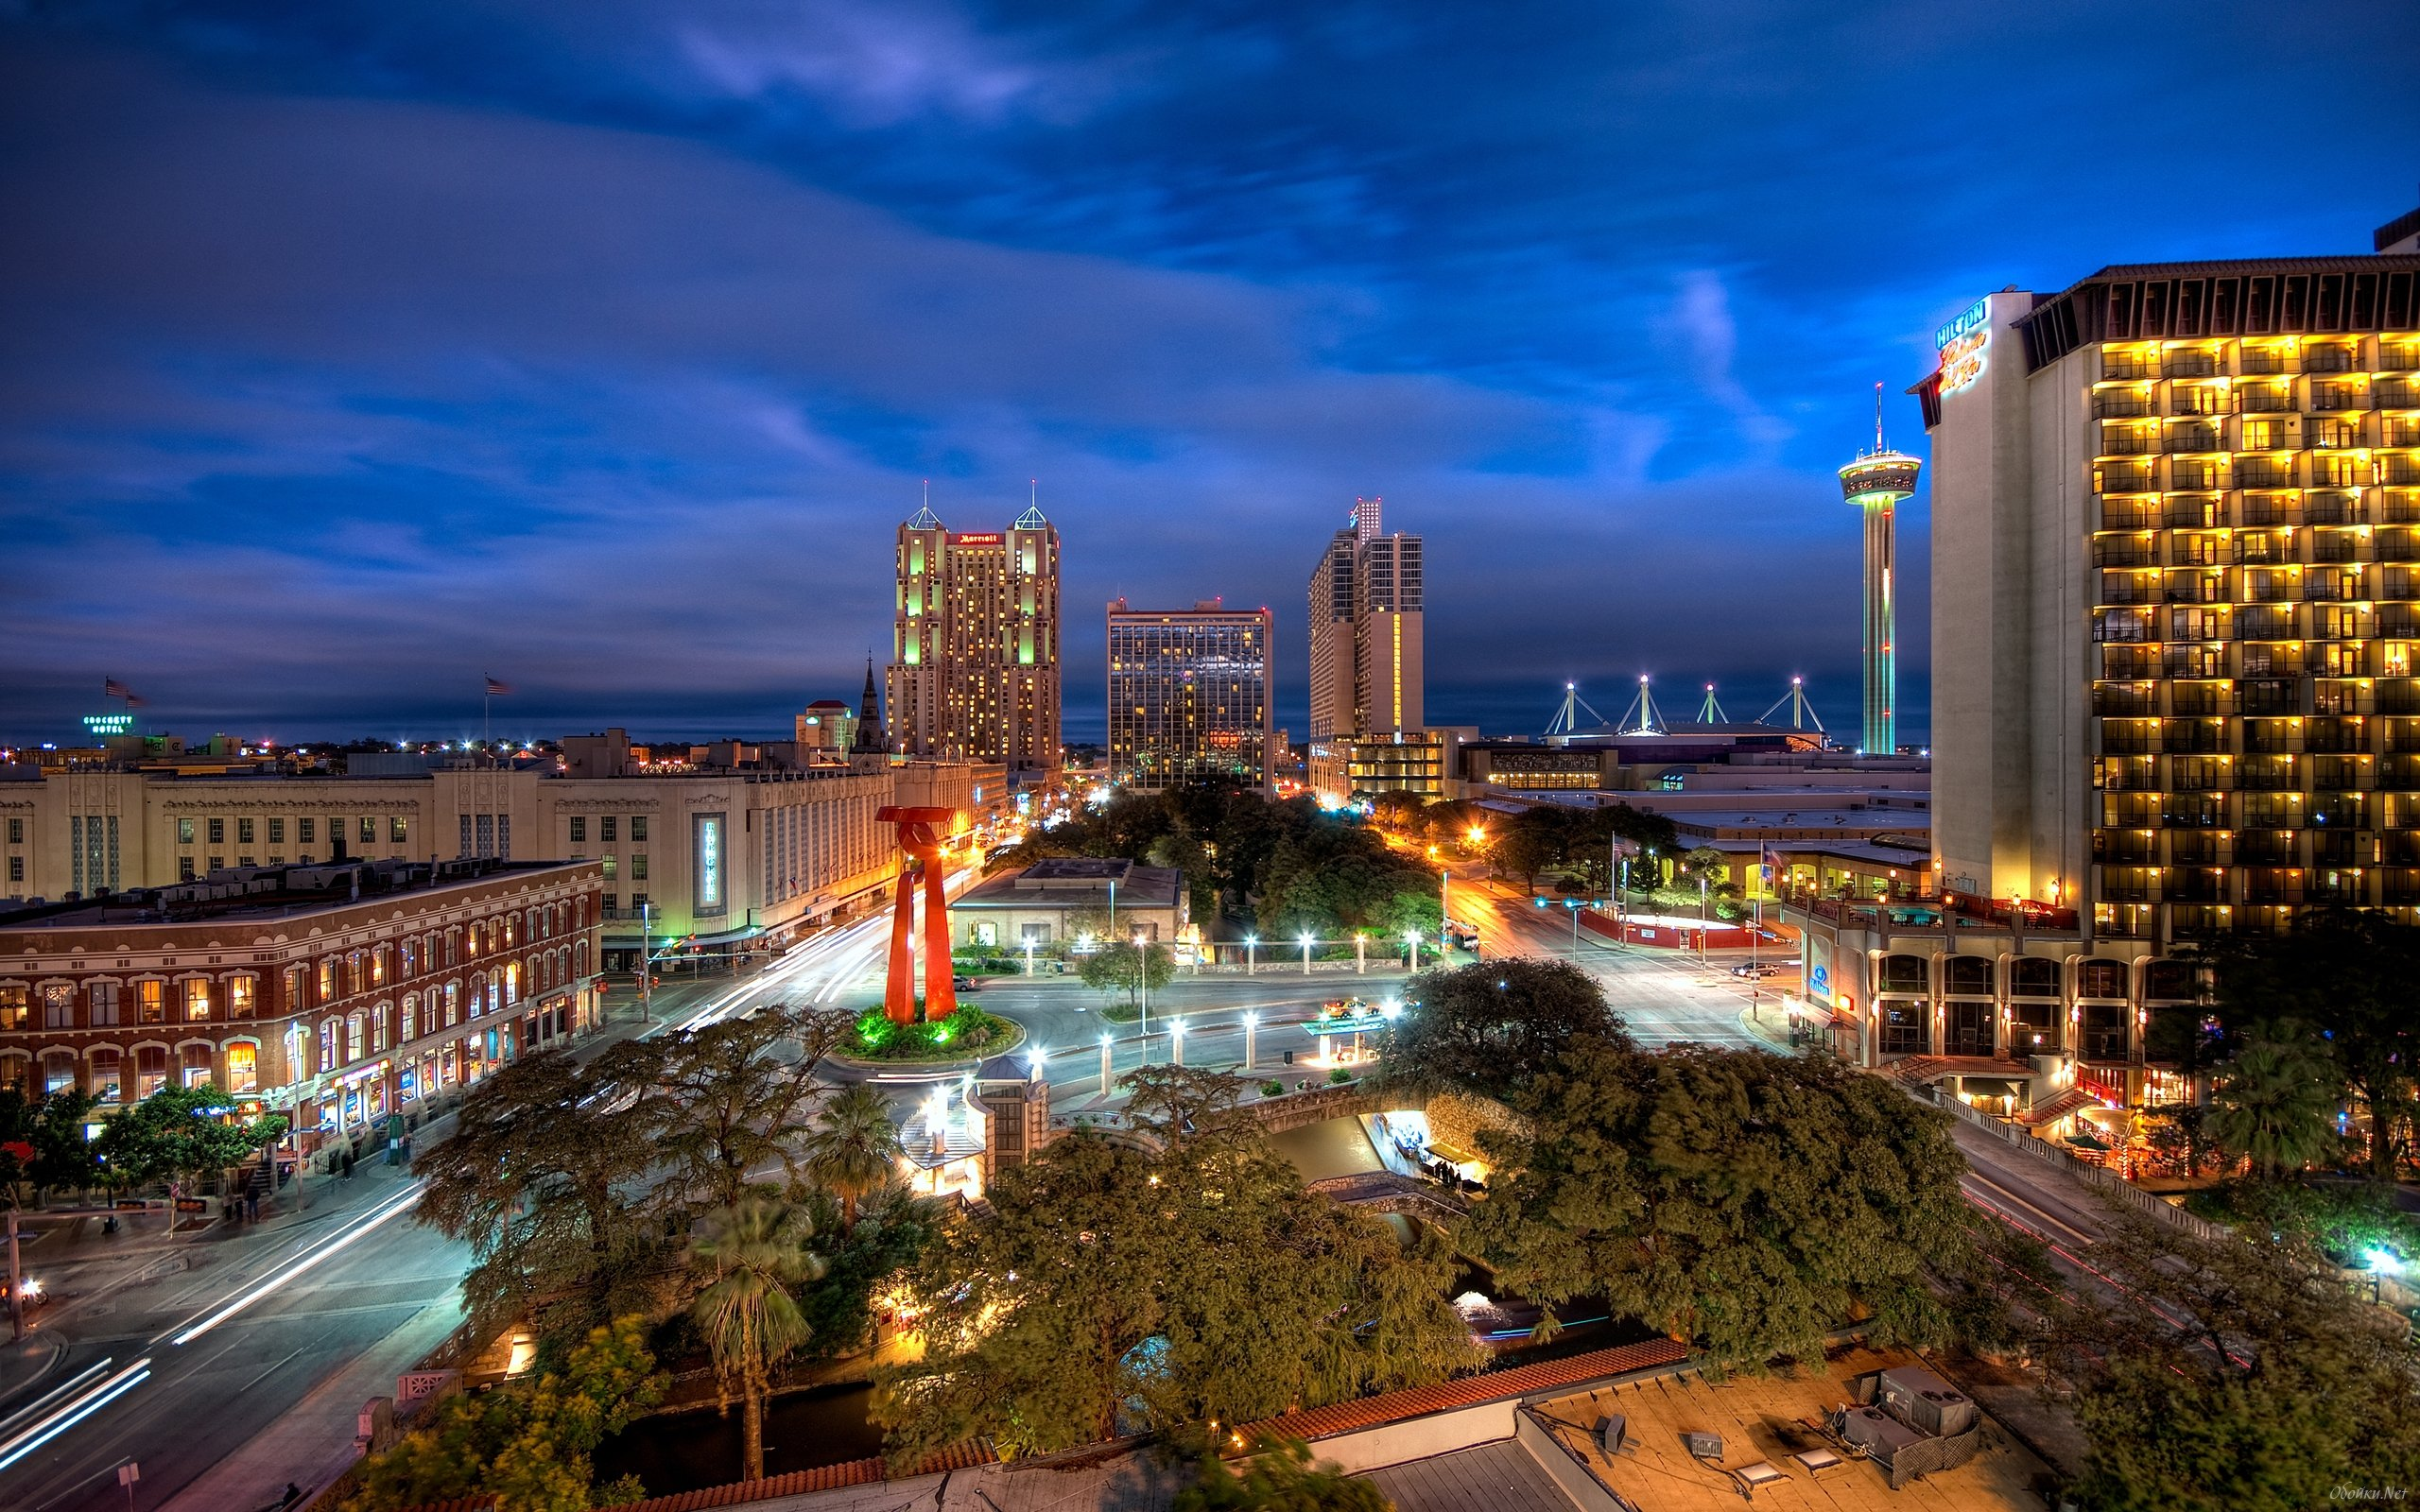
400+
Companies Headquartered in San Antonio
Top Companies | # of Employees
Fort Sam Houston (U.S Army) | 32,000
H-E-B | 20,000
USAA | 17,000
Methodist Healthcare System | 9,851
Baptist Health System | 6,371
JPMorgan Chase & Co. | 5,000
Wells Fargo | 4,357
Cullen / Frost Bankers | 4,270
Christus Santa Rosa Healthcare | 3,3360
Rackspace | 3,300
CPS Energy | 3,022
Clear Channel Communications | 2,800
NuStar Energy | 1,694
Valero Energy | 1,653
Marathon Petroleum Corporation | 1,300
Source: EMSI Q1 2020

Slide 35
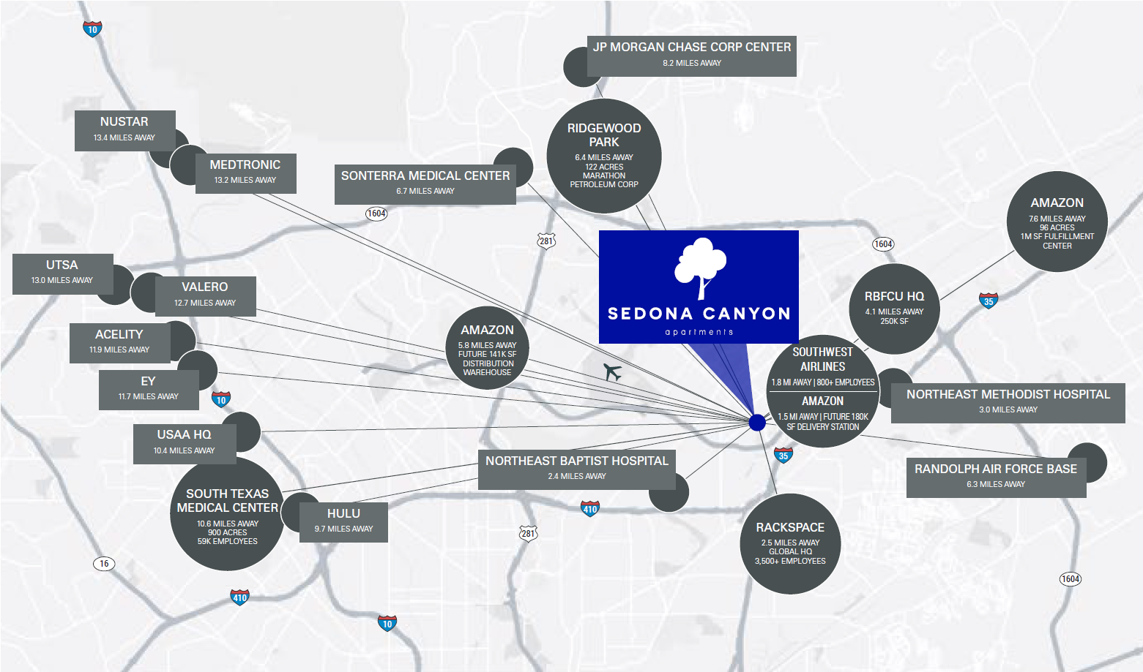

Slide 36
Rental Market
Renters make up
40.9%
of the population
`
Rental Vacancy
3.5%
of all houses
and apartments
MEDIAN MONTHLY RENT BY NUMBER
OF BEDROOMS
HOUSING BY YEAR BUILT
Source: BestPlaces.net

Slide 37
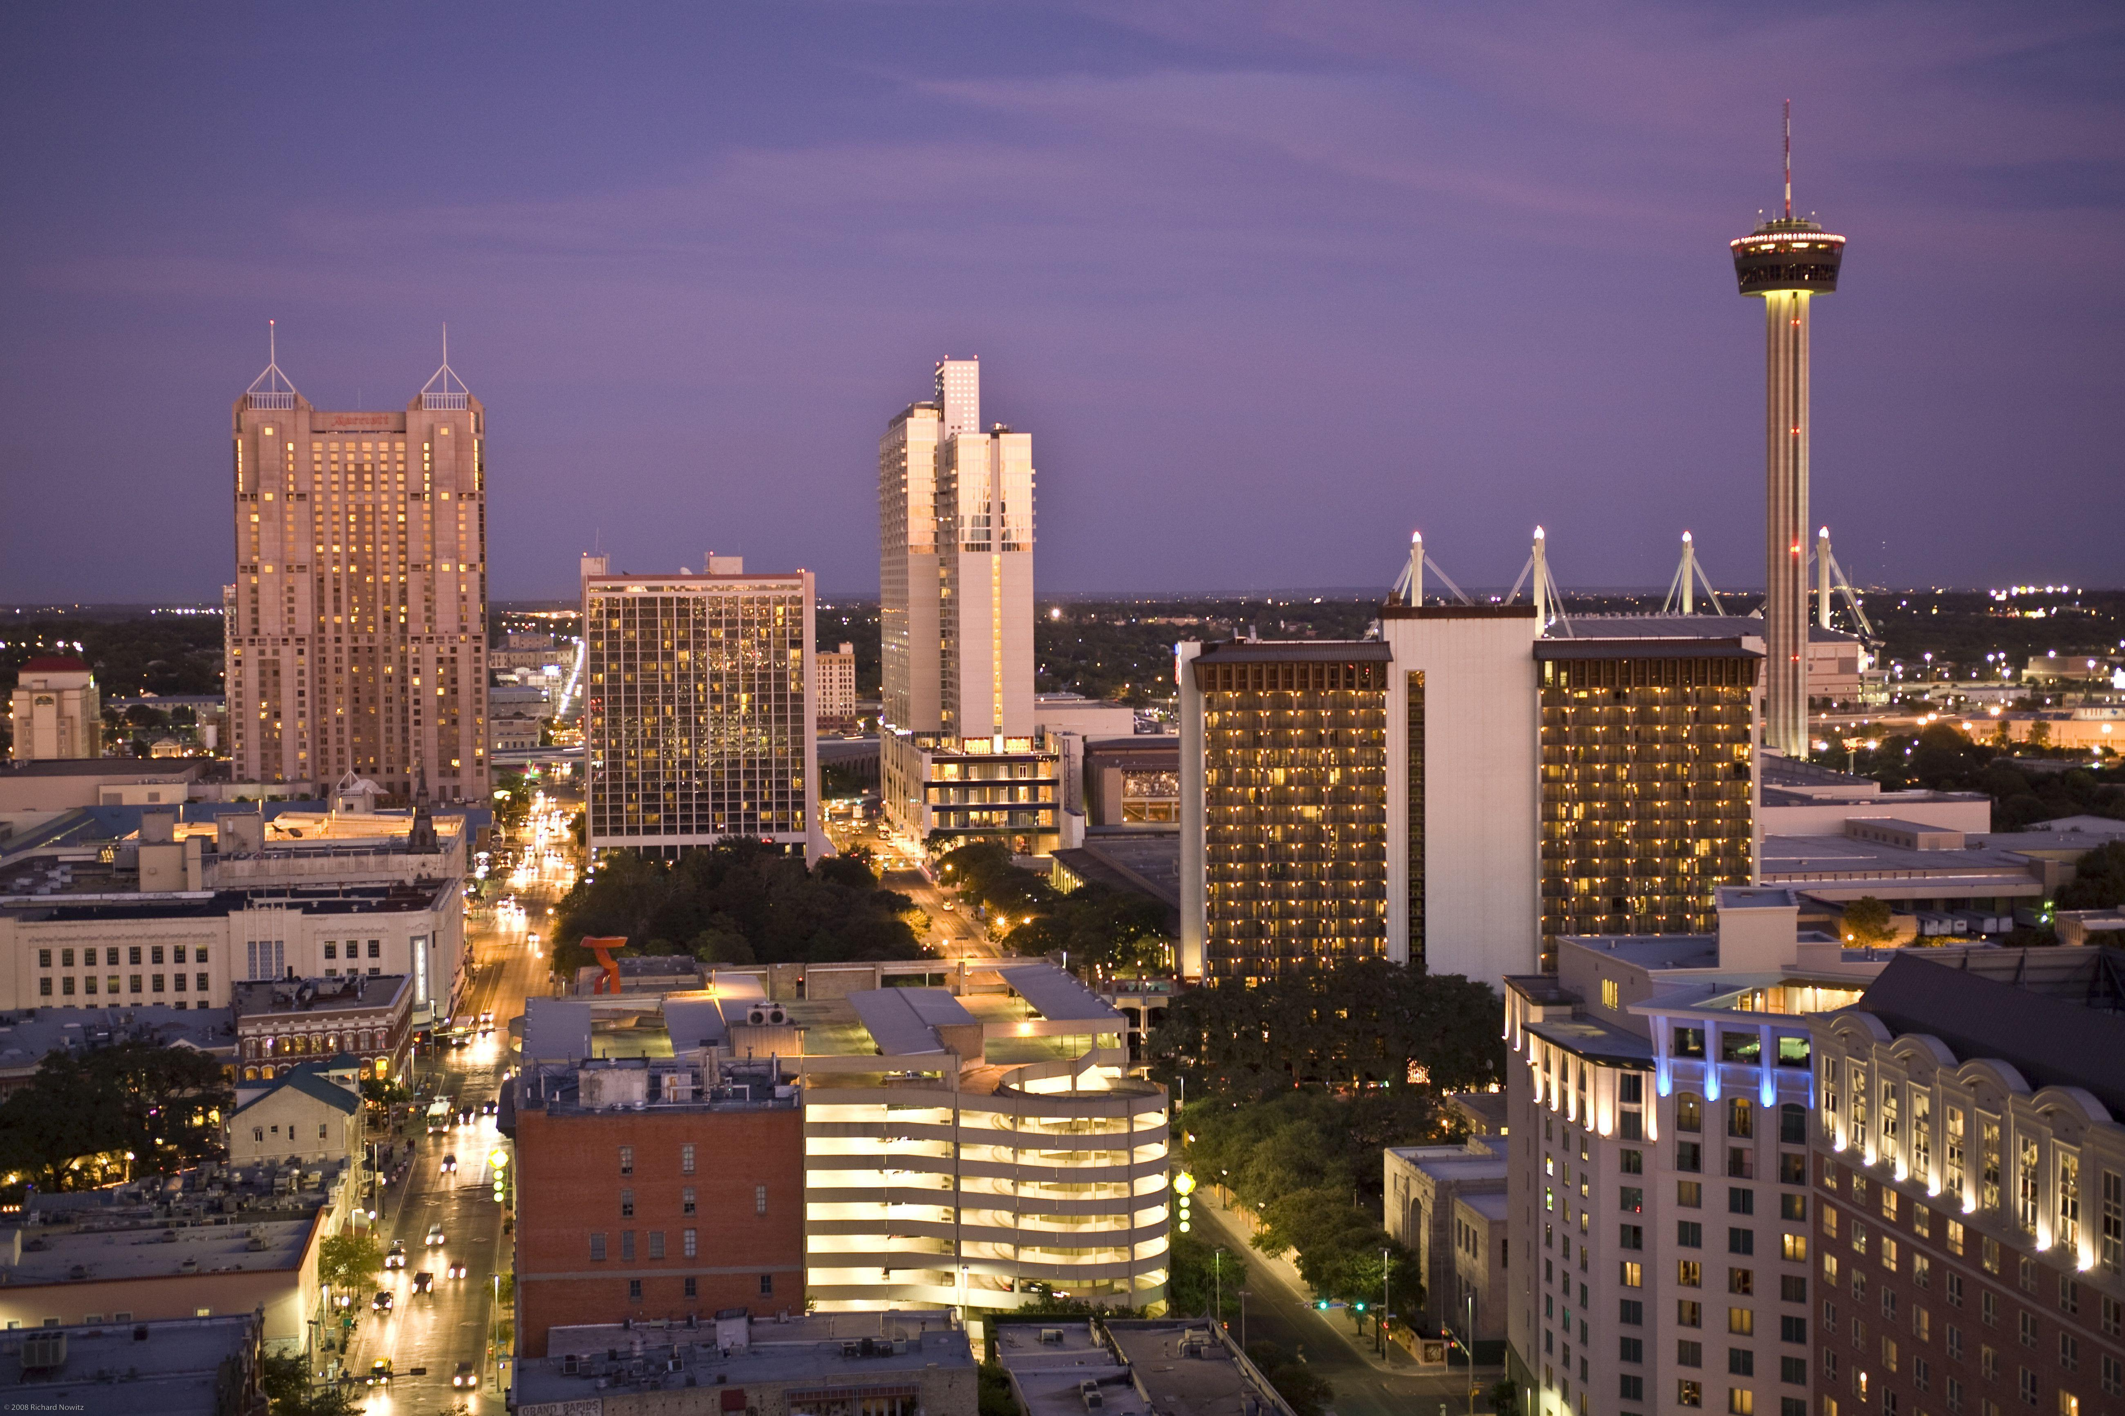
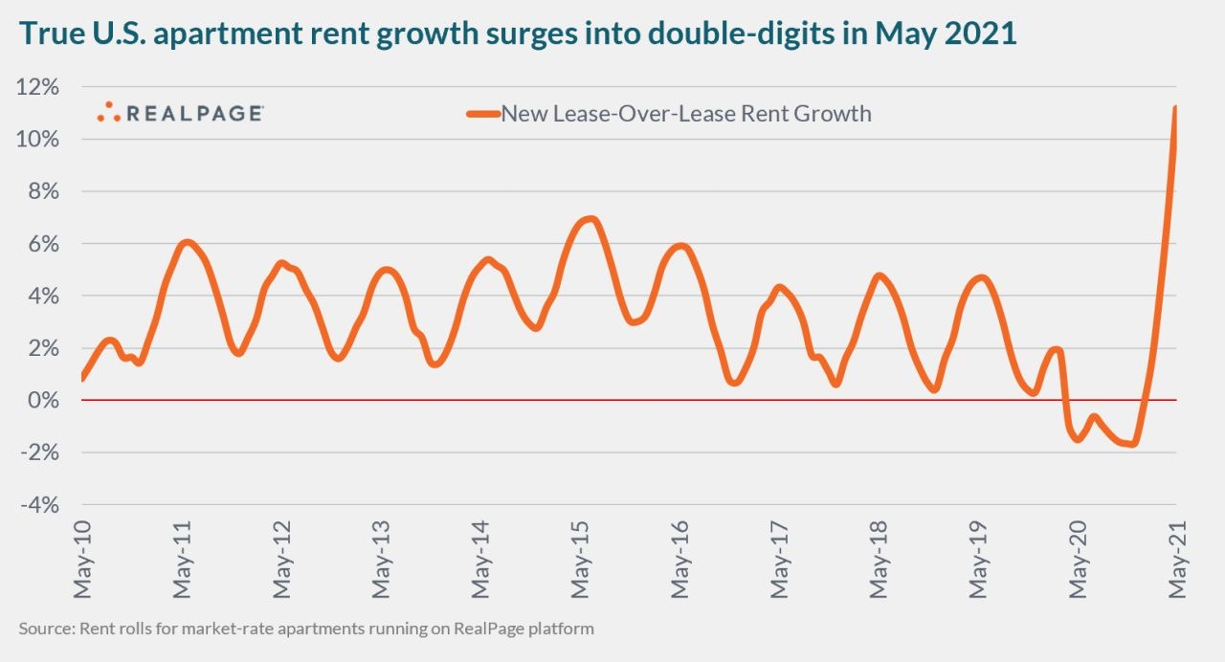
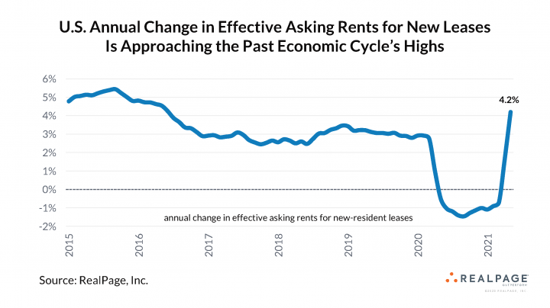
Rental Market
Source: RealPage.com

Slide 38
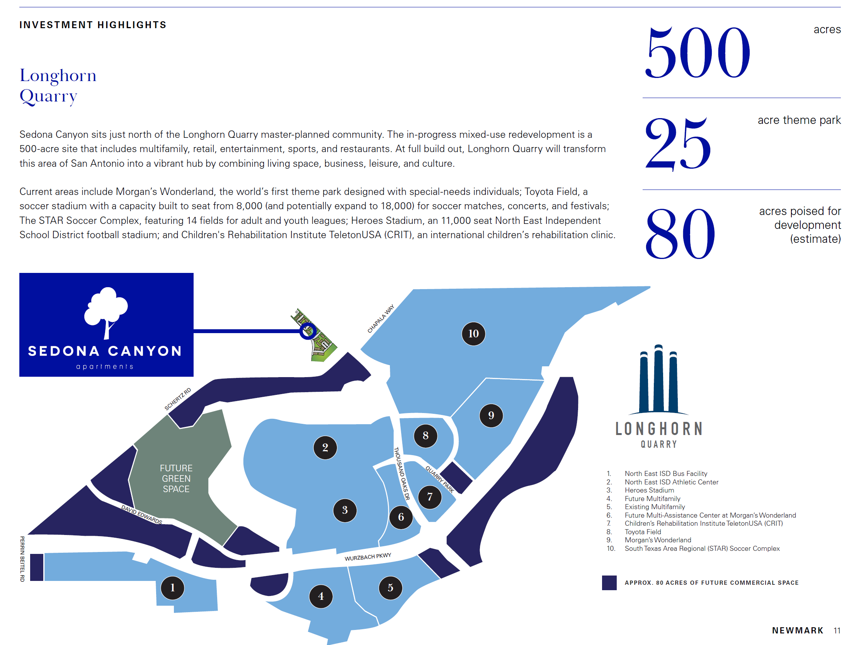
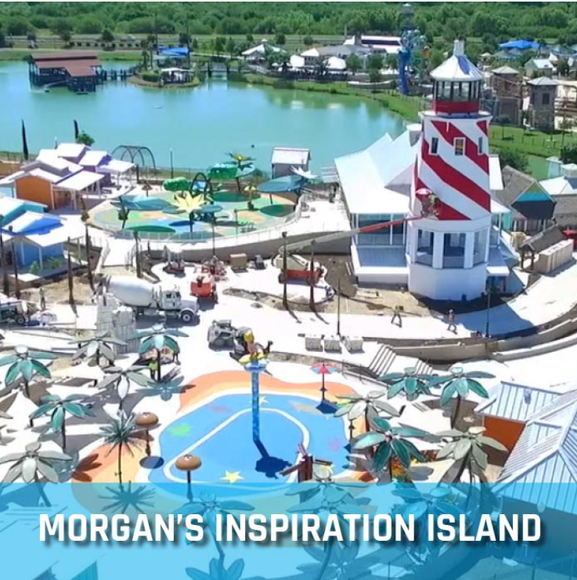
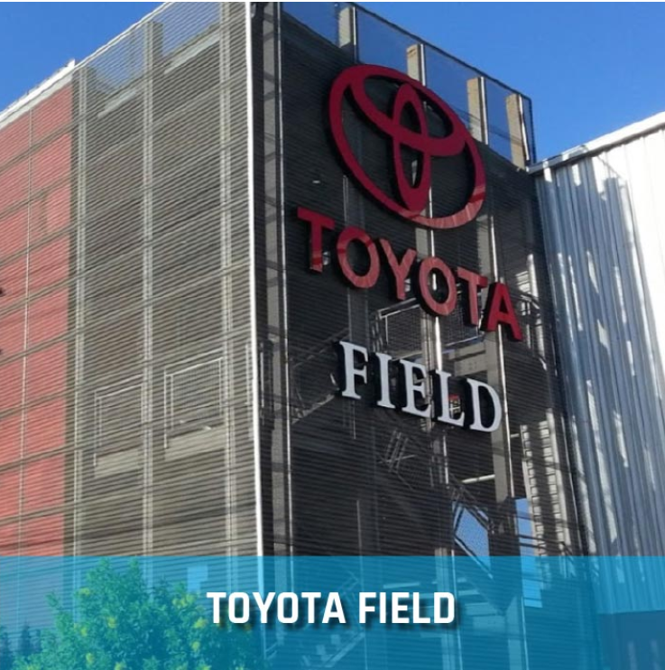

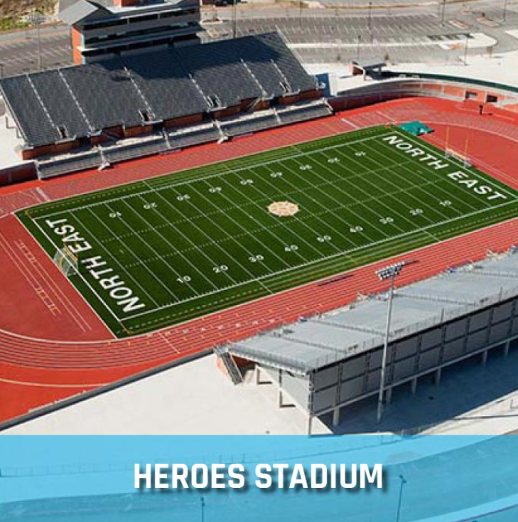
New Development
Longhorn Quarry
longhornquarrysa.com

Slide 39
Sponsor Team
Multifamily Investment Professionals

Slide 40

Experienced
Conservative
Diligent
With a combined 100+ years of experience and $300MM in closed multifamily transactions, we have the subject matter expertise, key relationships, and a proven track record to execute profitable deals.
We are opportunistic investors focused on creating long-term value. We stress test our deals and use leverage carefully to create sustainable cash flow and limit our risk.
Closing a deal, while challenging, is the easy part. Executing on the business plan is the hard part. It takes perseverance and persistence to achieve what we set out in our underwriting.

Slide 41
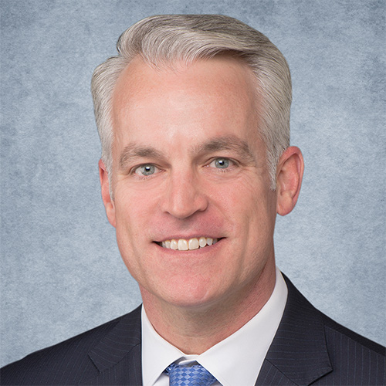



Lead Sponsors
Scott Holmes
Scott@CREECapital.com
CEO of CREE Capital
Rod Khleif
Rod@Rodkhleif.com
Investor Relations of CREE Capital
Co-Sponsors
Tom Mix Petreca
Tom@mixcre.com
CEO of MIX CRE

Slide 42
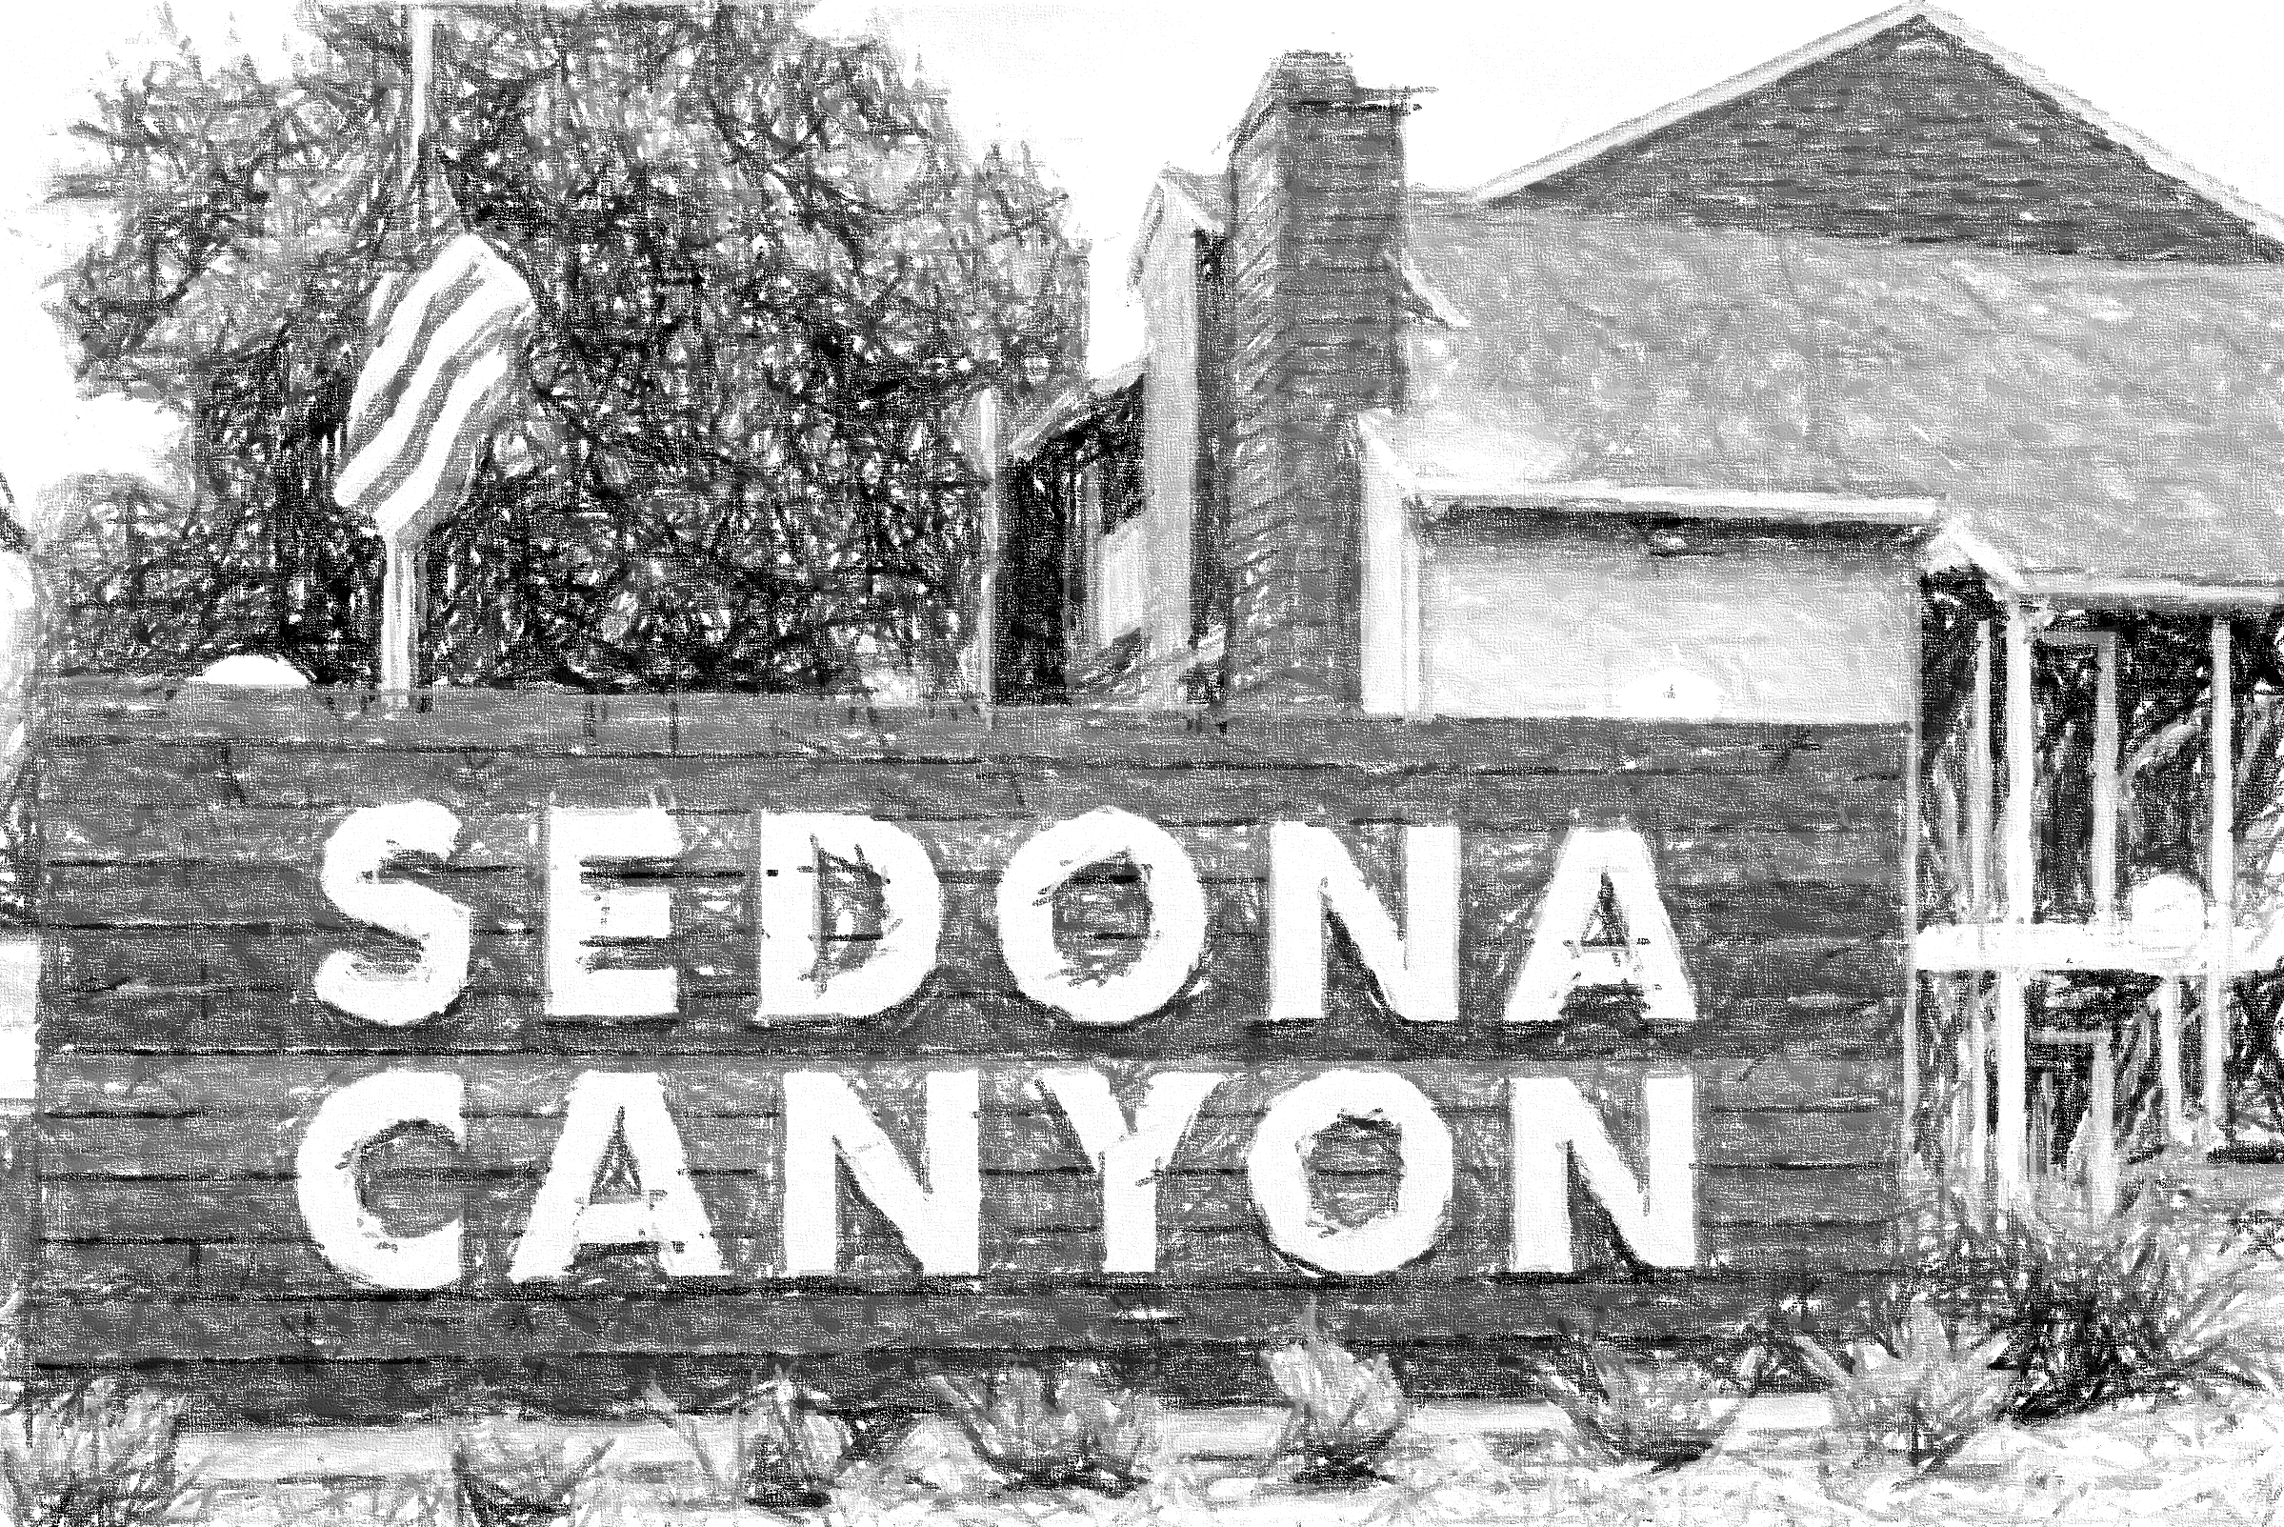
Scott Holmes
Scott@CREECapital.com
+1 (941) 225-2840
Contact Us
For more info visit our website and sign up to our
Investor Portal: https://investors.creecapital.com/
creecapital.com

Slide 43

COLOR Scheme
Background Dark Blue - #0d274c
Logo Blue - #4284be

