Slide 1
Preliminary Evaluation
What are We Looking for?
Higher Vacancy
Poor Management
Below Market Rents
Higher than Normal Expenses
Lots of Owner Paid Utilities/ability to bill back to tenants
High Turnover (usually highest expense)
Tired Landlord
Has Deferred Maintenance/needs repairs

Slide 2

Preliminary Evaluation & Research
Never work from Broker’s Proforma
Always work from “Actuals”
Get the Trailing-12 months income and expenses
Last two year’s P/L’s
Get the Rent Roll

Slide 3
Preliminary Evaluation & Research
Specific Property – First Questions:
  What is the property’s age?
  What is the occupancy?
  Is the property stabilized with at least 90% occupancy?
  What is the overall condition?

Slide 4
Preliminary Evaluation & Research
Specific Property – First Questions (cont’d):
  What is the expense ratio?
  Is the expense ratio greater than 45-50%?
  If expense ratio over 50%, why? Is there a specific reason the expenses are so high?
  Are there any value-add or reposition opportunities?
  Will the NOI be sufficient to cover the debt service? (DSCR)

Slide 5
Preliminary Evaluation & Research
Specific Property – First Questions (cont’d):
Questions about the area:
  How’s the location/area of the property?
  Area stores & amenities – brand names?
  Where do these tenants work – companies moving into the area or leaving?
  Crime Statistics?
  What is the condition of nearby similar properties?

Slide 6

Unit Mix
Rule of thumb: 1 one-bedroom for every 2 two-bedroom units
If all or mostly one-bedrooms, be sure you have larger unit sizes and/or at least two years historical low vacancies (90% occupied or better)
Average Unit sizes:
Studios 300-500 square feet
1 bedrooms 500-700 square feet
2 bedrooms 700-900 square feet
3 bedrooms 900 plus square feet

Slide 7


Determining Market Rents
Apartments.com, Rentbits, Rentometer, Zillow, Property-specific websites
Property Management Companies
Mystery Shop/call comparable competitors
Always Apples to Apples!
Measure Demand put an ad on Craigslist

Slide 8


  Check Google Maps for the aerial view
    Is the property surrounded by houses?
    Or is it all commercial / industrial?
  Also check Street View
    Use Street View to walk up and down the street
    What types of businesses are nearby?
    What kind of cars in apartment’s lot?
  Safety – does it feel like a safe area?

Slide 9

Evaluating Worst Case Scenario
What is the lowest monthly/yearly NOI the property has earned in the past 3-4 years?
In that worst month, would you still cash flow with your new debt?
What is DSCR?
What is Break-even Occupancy?

Slide 10

Unstabilized Property (Repair)
Riskiest type of deal
Occupancy will always go down before back up
Do careful, conservative break-even projections
These fail when people run out of money, or have the wrong project, or property management
If rehab is over $4k per door – you will pay supervisory oversight of approx. 10%.
Do too many of these and you will burn out.

Slide 11

Minor Repositioning a Property
C or B property in B or improving C area with below mkt rents
Upgrade:
Landscaping
Signage
Exterior Paint
Parking Lot
Cosmetic repairs to interiors of units
$3,000 - $5,000 per door
Typical turn around time 18 months
Ideal to try to use debt partners you can refi out and keep as a legacy property

Slide 12

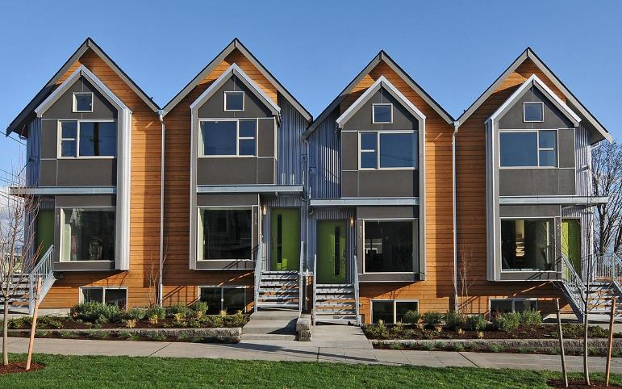
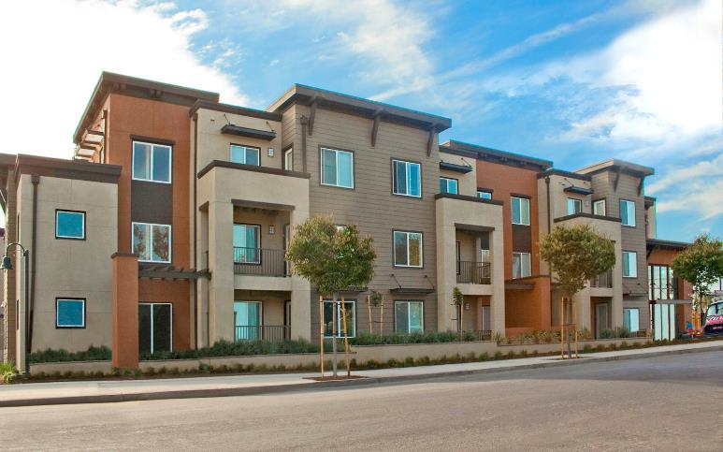
Types of Roofs
vs.
Pitched
Flat
Pitched
Much Better
Depending on Age
Less Desirable

Slide 13

Type of Construction
Skin or Exterior:
All brick
Vinyl
Wood (not great)
Hardiboard (much better)
Combination
Stucco
Masonite or T111 (re-skin)

Slide 14
Type of Construction
Three Biggest Issues:
Roof – What is the age and condition? How many years until it needs to be replaced?
HVAC – What type (Central, window/wall units, etc.)? Age and condition?
Parking Lots – Look for potholes, cracks, especially around trash dumpsters. Does it just need cosmetic improvement (slurry/restripe) or full asphalt/conctrete replacement?

Slide 15


Dealing With Sellers
Build rapport
Stay positive
Smile
Relax
Help them to relax as well
You want the seller to open up, let them talk
Why are they selling? (Important!)
Do not always assume that the sales price is the highest concern
  It may all have to do with timing

Slide 16

Dealing With Sellers – Questions to Ask
Where is your property located?
How many units do you have there?
What is your unit mix? How many one bedrooms and two bedroom units do you have?
What are the rental amounts?
How many are occupied?
Who pays the utilities, you or the tenants?
How much do you owe on the property?
Do you know if your loan is assumable?

Slide 17
Dealing With Sellers – Questions to Ask
How much are you asking for the property?
  If the seller refuses to answer reply by saying, “I need to have some sort of an idea from you so that I’m not wasting our time when I come out to look at the property. I am sure you can understand.”
  How soon are you looking to close?
Why are you selling?
What is your ultimate goal?
What are you going to do if the property doesn't sell?

Slide 18
Dealing With Sellers – Questions to Ask
Have you tried to sell it before?
What have you done to try to sell it?
How long has it been on the market?
Why do you think it hasn’t sold?
When you sell what do you plan to do with the proceeds?
Have you thought about carrying back?

Slide 19
The Important Question to Ask
“If I offer you all cash and close as quickly as absolutely possible, what would be the least amount that you would accept for the property?”
Regardless of answer,
  “Is that the best you can do?”
“When could I come by and see it with you?”

Slide 20

Seller Financing Strategies
Can often lower down payments
Can structure the deal very creatively
Seller financing allows you to purchase properties that wouldn’t be approved for traditional mortgages
  • Non-stabilized • Heavy repairs
Won’t show up on credit report

Slide 21

Seller Financing Strategies
Sending direct mail letters straight to mom
and pops are great
Great candidates own over 20 yrs.:
  High equity
  Tax benefits have gone dry
  Will only be able to keep 65-70% after taxes if fully depreciated
  Still want cash flow
  Retirees will not reinvest sales proceeds in another high risk investment
  Want to save thousands on broker commissions

Slide 22
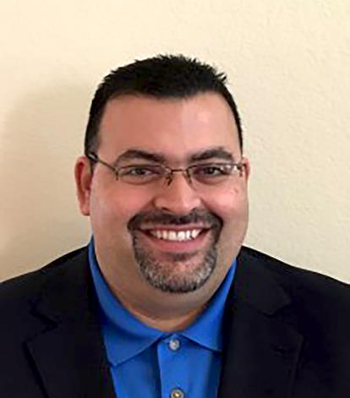
“I am now over 500 units!
I am very grateful for all of your help Rod!”
- Joseph Gozlan

Slide 23


