Slide 1

Filtering Deals Efficiently
How to look at more deals in less time

Slide 2

Analysis Hierarchy
Partnership
Market
Deal

Slide 3
Partnership
Rod’s Questions for partners resource
Alignment
Track record / Experience
Compatibility

Slide 4
Three Questions for Partners
Do they embody a growth / abundance mindset
Am I excited to do business with
Are they a problem solver

Slide 5
Market
LCA Online Course Module 3
census.gov/quickfacts/fact/table
bls.gov

Slide 6

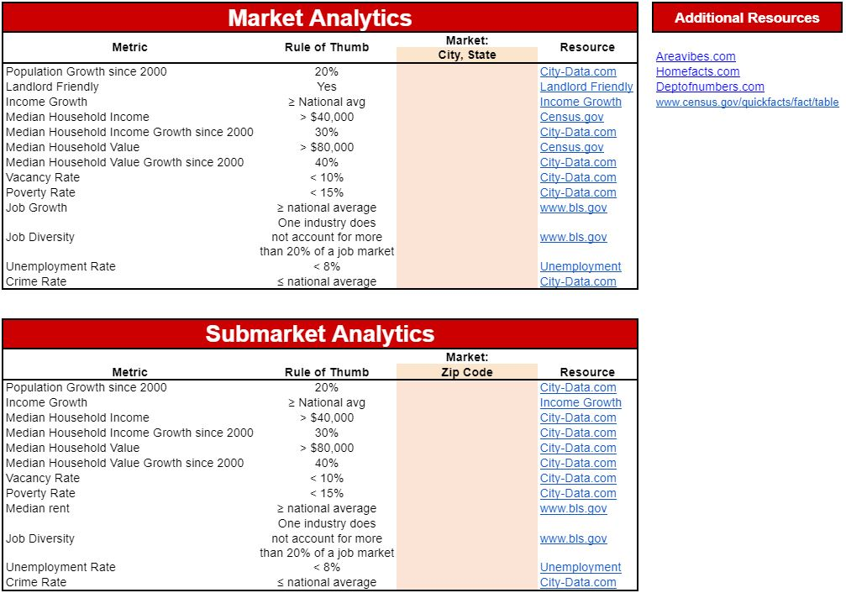

Slide 7
Preliminary Deal Analysis
Decide in 10 minutes or less if a deal is worth pursuing

