Slide 1

Orlando, FL
Market Overview - 2021

Slide 2
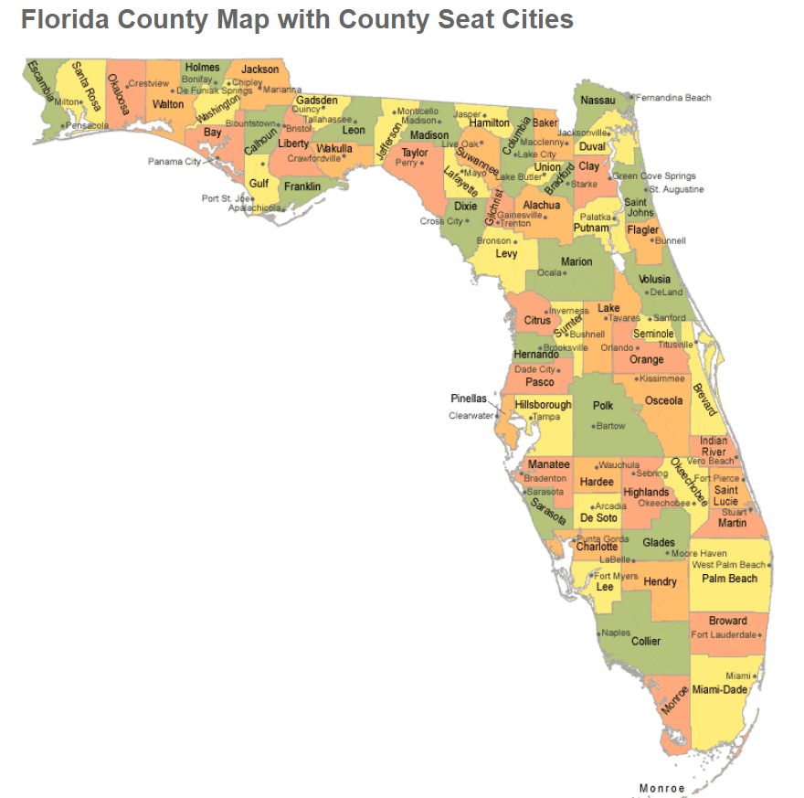
Central Florida - Counties

Slide 3
Key Performance Indicators
Population Growth (2000-2021)
+56%
Median House Value
Growth
(2000-2019)
+168%
Median Household Income Growth
(2000-2019)
+65%
Job Diversity
Job Growth
(YOY)
+5.5%
Low Unemployment
(8-2021)
5.1%
Adequate Renter Ratio
52.5%
Healthy Rent Growth
(5Y CAGR)
+2.8%
Adequate Median Rent to Median Income Ratio
(2019)
28.0%
Low Vacancy
(2019)
5.4%
Low Crime Index
(2019)
Under 500
Highly Ranked Regionally and Nationally
Source: City-Data.com; Bestplaces.net; Apartmentlist.com

Slide 4
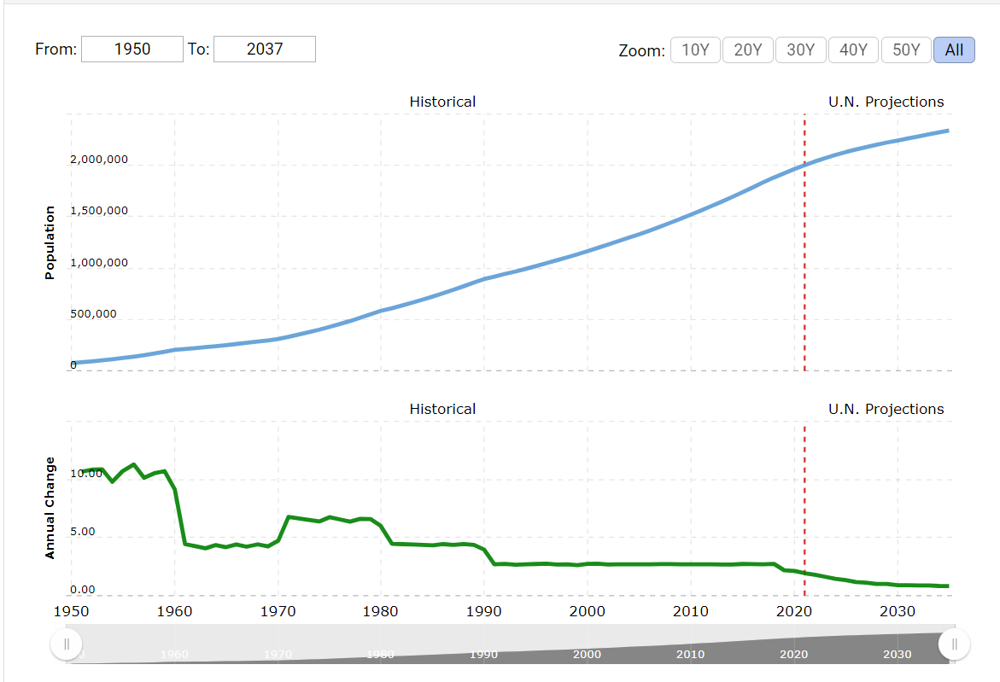
Continuous Population Growth
Source: Macrotrends.net

Slide 5
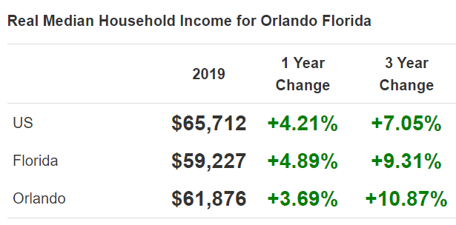
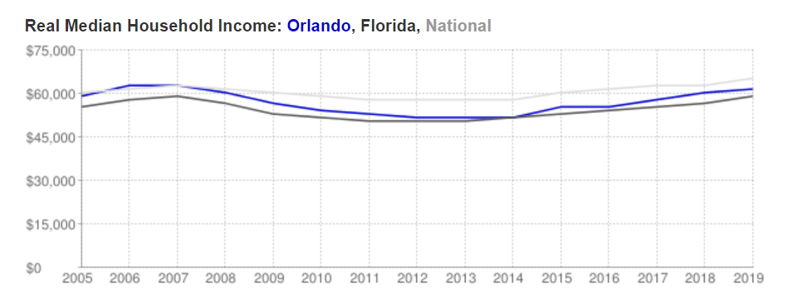
Steady Household Income Growth
Source: DeptOfNumbers.com

Slide 6
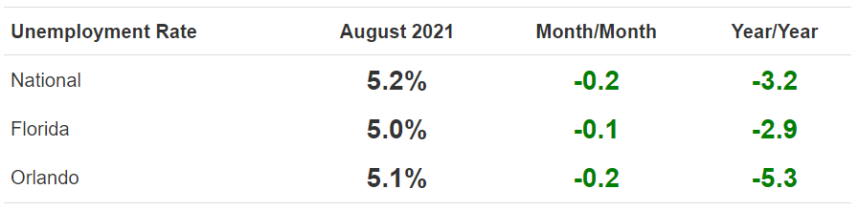
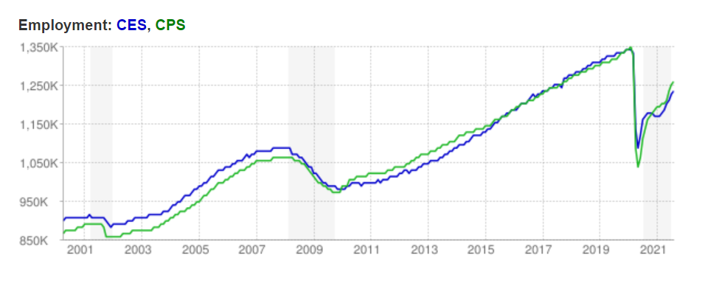
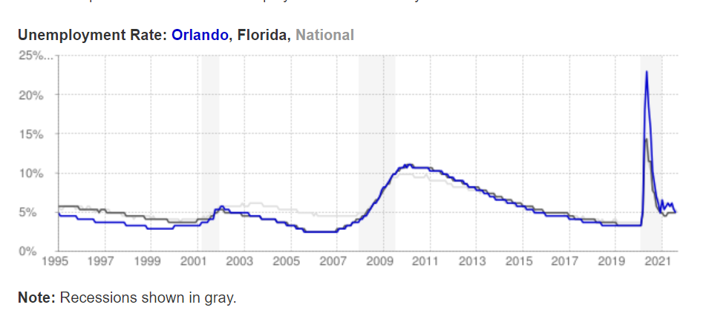
Improving Employment Trends
Source: DeptOfNumbers.com

Slide 7
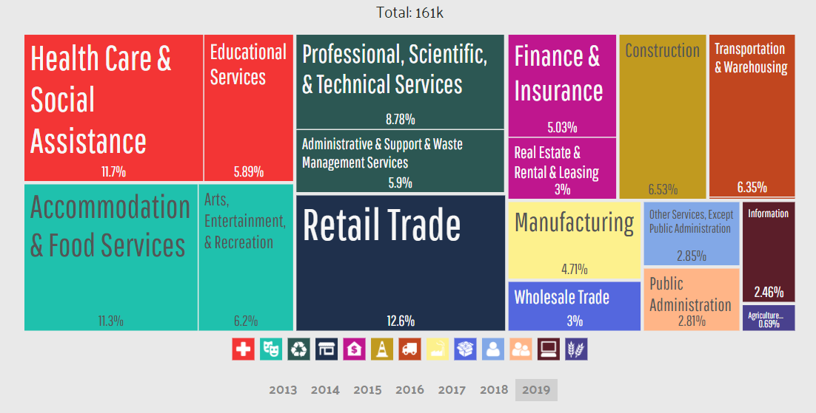
Diverse Employer Base
Source: Data-USA.io

Slide 8
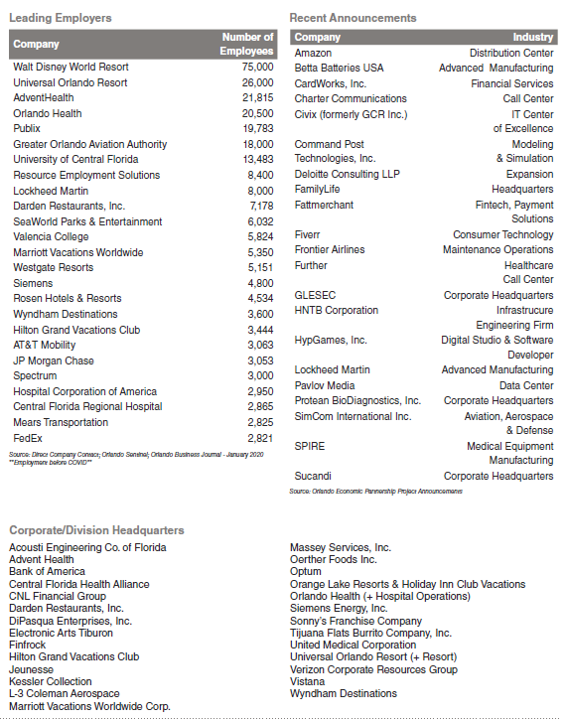
Top Employers
Source: Orlando Economic Partnership

Slide 9
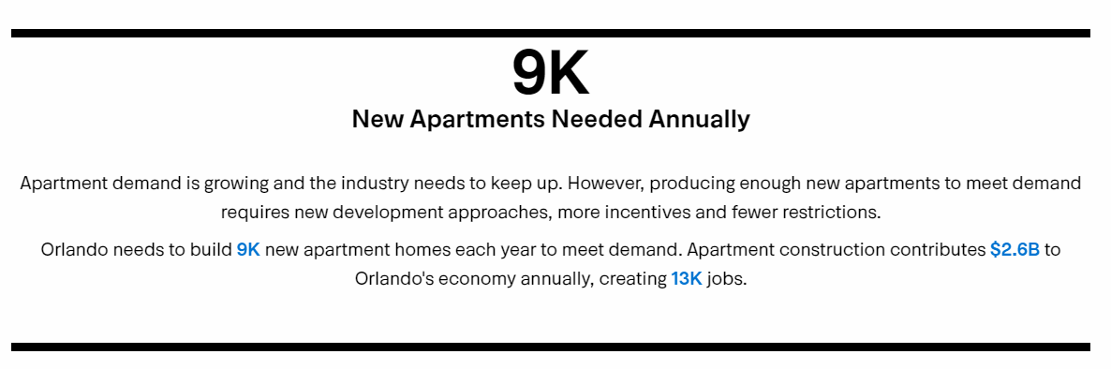
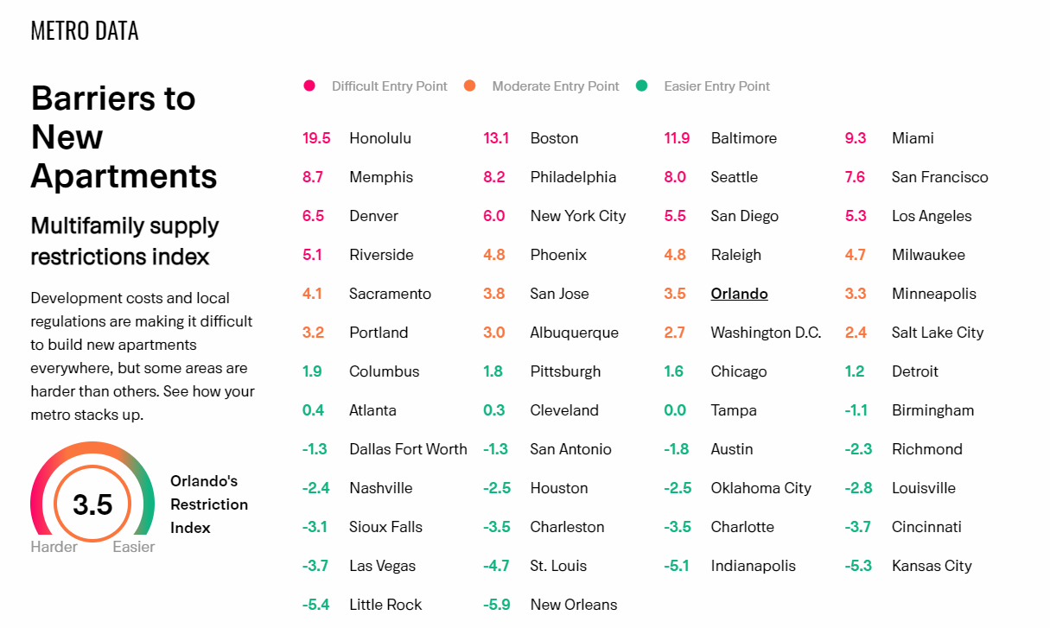
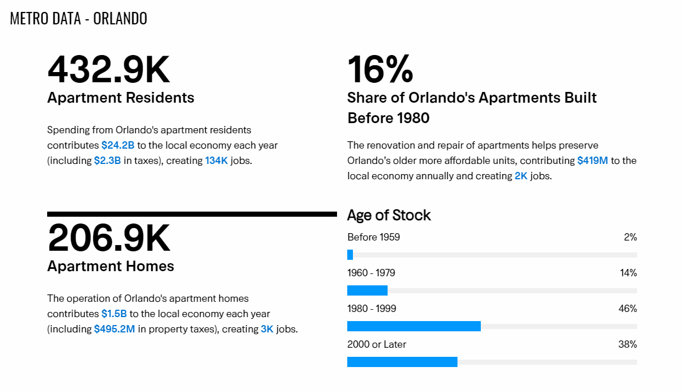
Continuous Demand For Apartments With Moderate Barriers To Entry Which Will Continue to Put Upward Pressure on Rent
Source: weareapartments.org

Slide 10
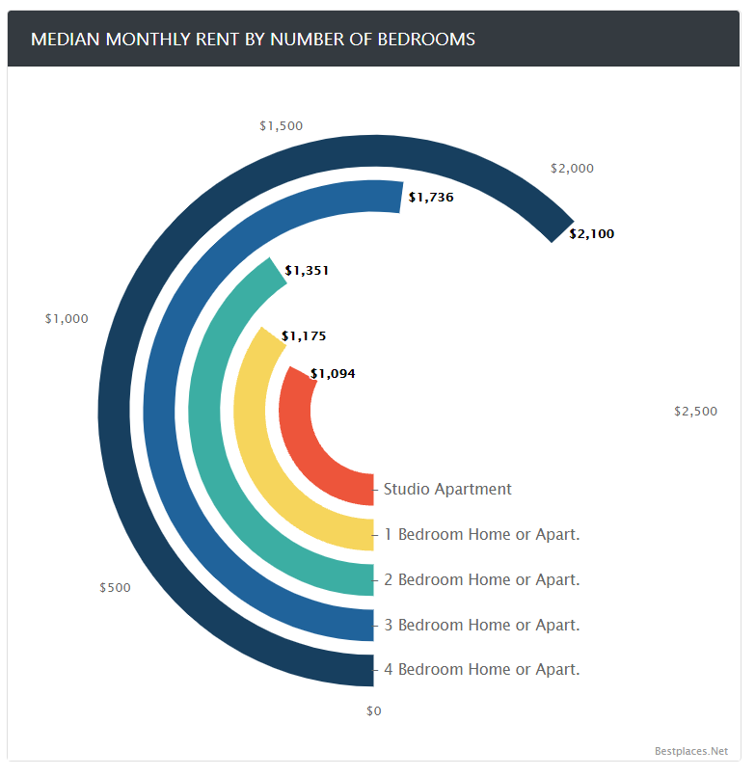
Rent Distribution and Rent Growth Trends
2.8%
5 YR CAGR
Source: Bestplaces.net; Apartmentlist.com

Slide 11
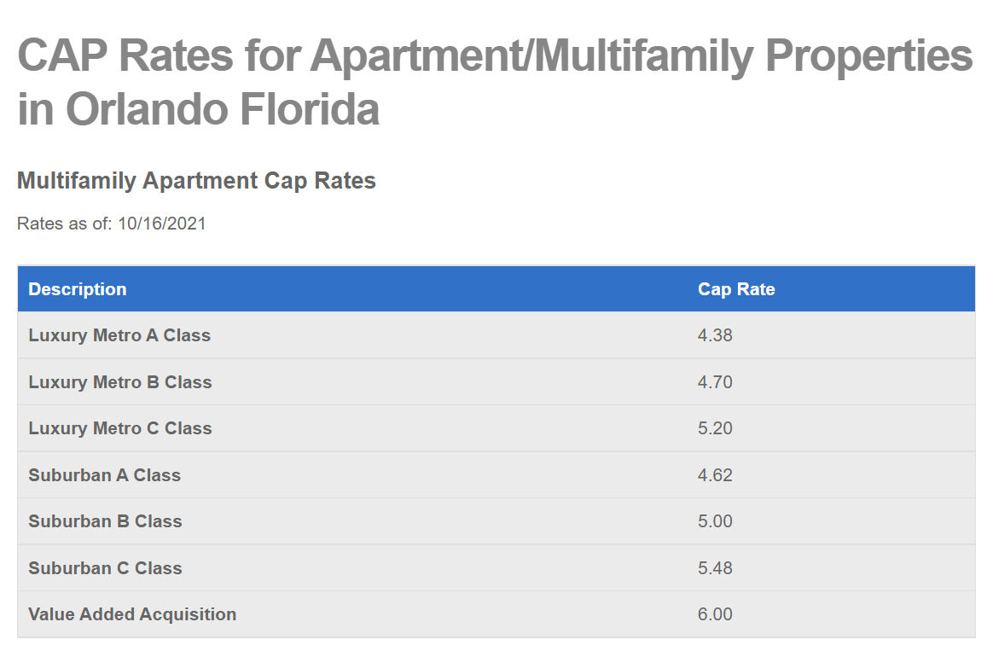
Compressing Cap Rates
Source: Apartmentloanstore.com

Slide 12
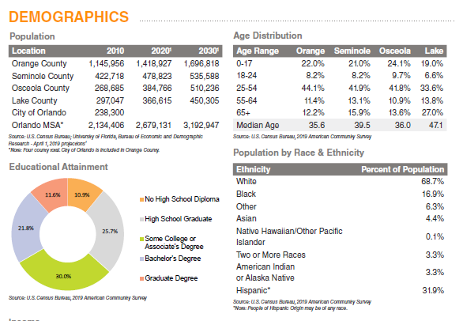
Diverse Population Base
Source: Orlando Economic Partnership

Slide 13
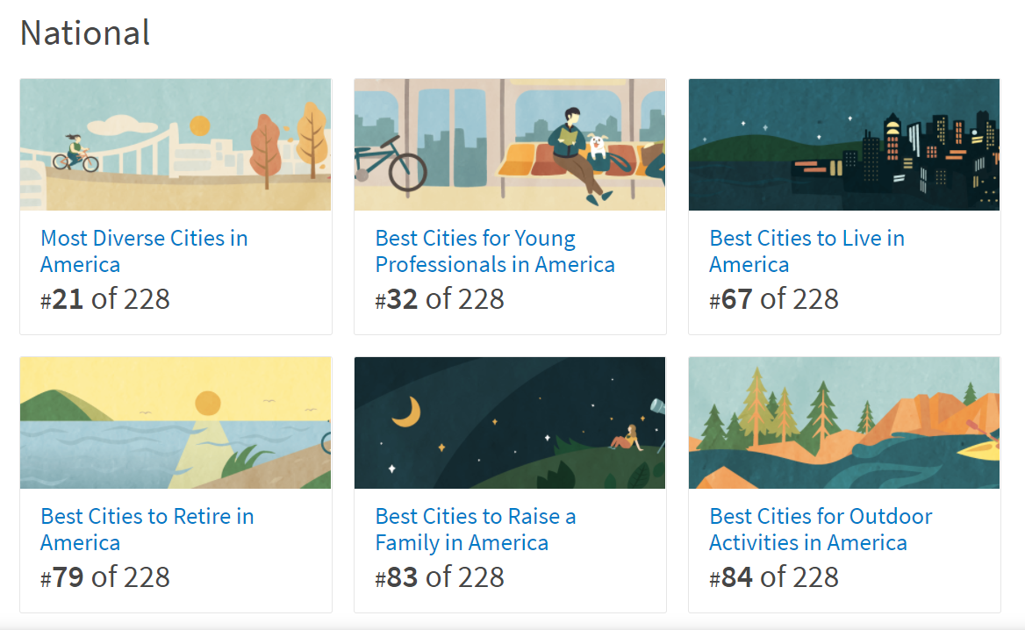
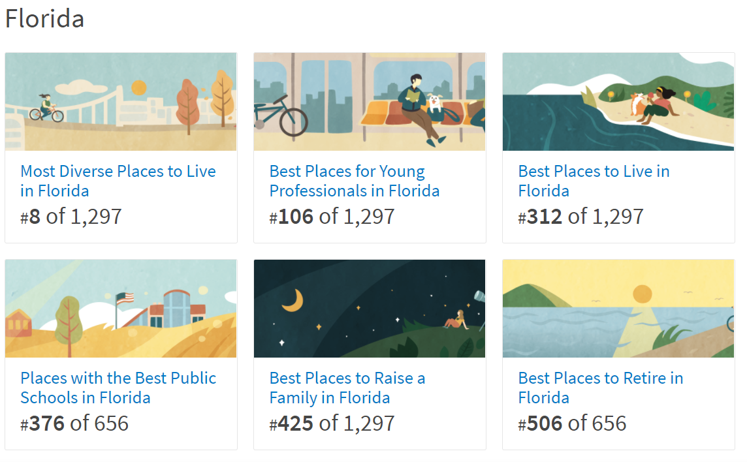
Highly Ranked – Nationally and Regionally
Source: Niche.com

Slide 14
Orlando, FL
Market Overview - 2021

