Slide 1

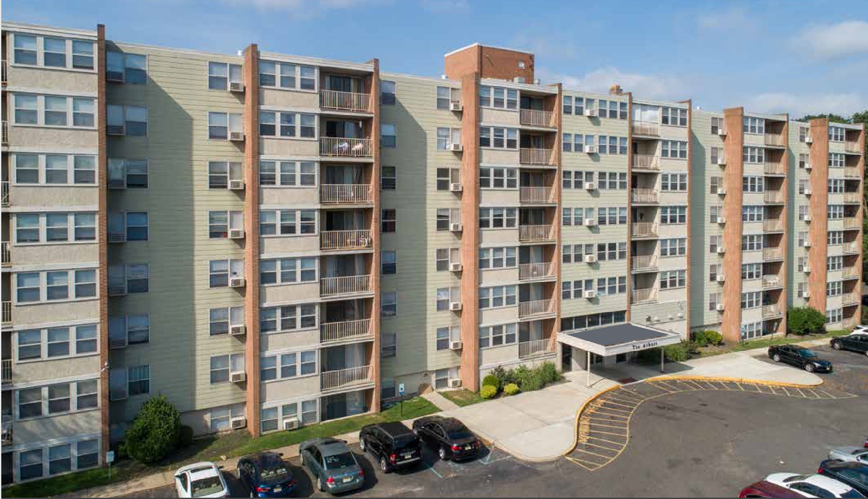
Multifamily Case Study:
Understanding the Basics

Slide 2
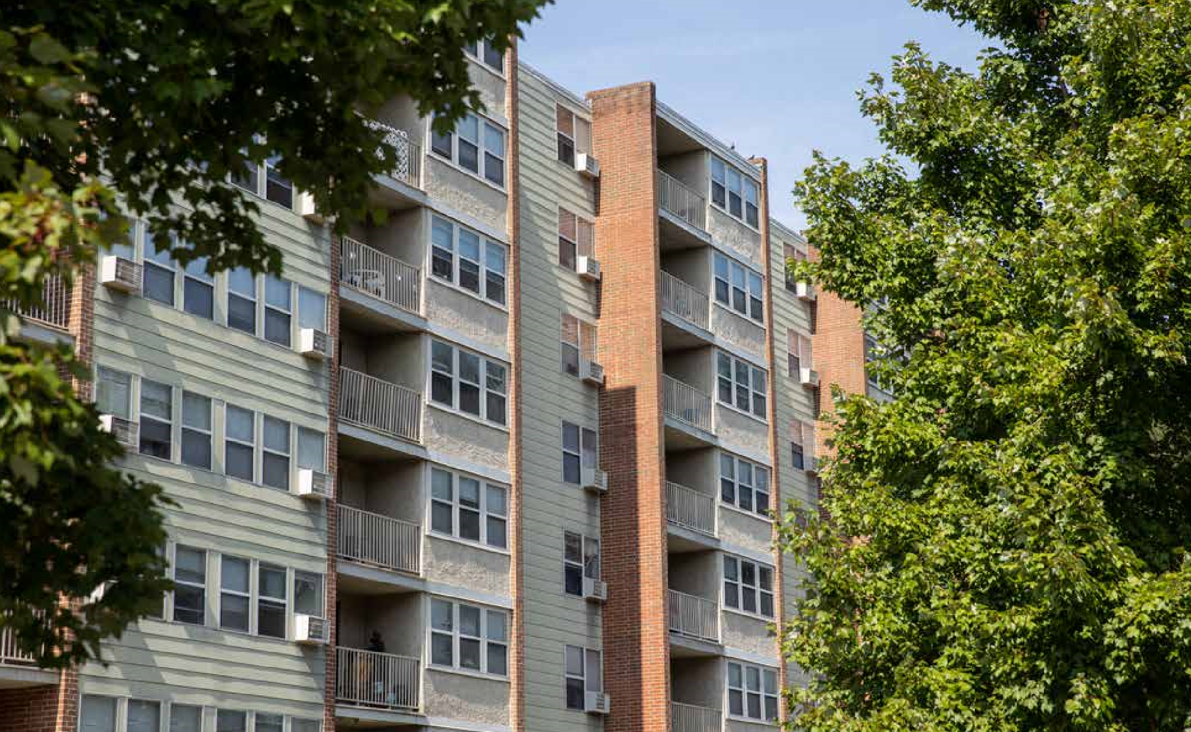
Executive Summary

Slide 3
To illustrate the basics of deal analysis, we’ve created a case study, based on the actual deal summarized below
Opportunity Summary
Property Overview
Property acquired by current owner in 2002
Intent was to convert rents from market rate to affordable
Owner obtained tax credits and deal financing in Dec. 2003
Affordable program required 72% of units to be leased to residents earning less than 60% of the local median income
Remaining units could be leased at a market rate
Tax credits expired in 2018 and owner has decided to sell
Property has a “three-year tail” where existing affordable residents can remain in their units
Given location and proximity to job centers, excellent opportunity for new owner to convert back to market rate
Historical tenant turnover is ~40%
Purchase Price: # | $32,000,000
Location: | Maple Shade, NJ 08052
Units: | 408
Layout: | Hi-Rise, 4 buildings
Year Completed: | 1969
Site: | 27.67 Acres
Amenities: | None
Occupancy | 86% (August 2019)
Avg. Monthly Rent: | $1,207
Parking: | 511 Spaces
Utilities: | Sub-metered

Slide 4



In this case study, we’re going to highlight the three stages of initial analysis that should be performed prior to writing an LOI
1. Location & Demographics
2. Market & Competition
3. Financial Analysis
Market vs. Submarket
Property type vs. surrounding population
Market stability & growth trends
Proximity to transportation, jobs, and amenities
Sub-market median home price vs. per unit sales price
Sub-market education, income, and unemployment
Employment composition
Property rent vs. market rent
Assessing the case for rent increases
Steady state rental increases
Vacancy and other income
Current vs. market proforma and expense targets
Estimating reserves
Creating a renovation budget
Sources and uses of financing
Identification of competitor properties
Creation of a matrix to compare rents, amenities, and finishes
Advertising and marketing efforts
Analysis of property pictures
Estimating renovation costs and ability to raise rents as a result

Slide 5
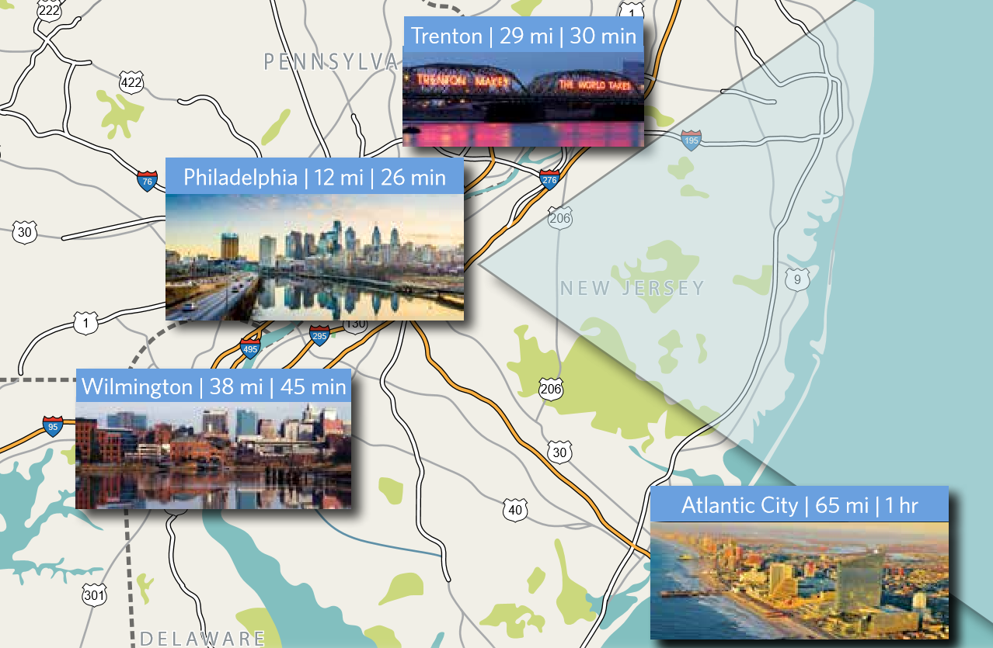
1. Location & Demographics

Slide 6
The first step is to determine if the local market is a place you’d like to invest. There are components to this analysis:
1
2
3
1. Get to know the Sub-Market
2. Study The Demographics
3. Study the Trends
Does the building type support the surrounding population?
Does surrounding retail indicate a growing market?
Is the property close to transportation options like bus, rail, highway, or major thoroughfares
Is the property close to non-retail sources of employment?
Is the median home price vs. property per unit price favorable for purchase?
Does the sub-market contain a high percentage of college graduates?
Is sub-market median income at least 3X the average annual property rent?
Is the percentage of sub-market residents below the poverty level <20%?
Is the sub-market unemployment percentage between 5% and 10%
Property rent vs. market rent
Assessing the case for rent increases
Steady state rental increases
Vacancy and other income
Current vs. market proforma and expense targets
Estimating reserves
Creating a renovation budget
Sources and uses of financing

Slide 7
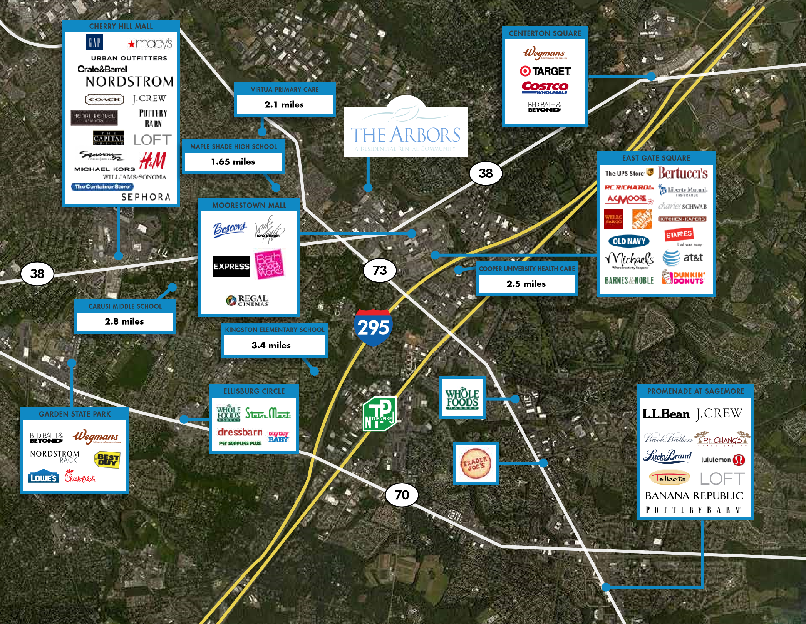
Get to know the submarket by entering the address into Google Maps and taking a virtual “tour”
Actions
Case Study Property¹
Go to Google.com/Maps
In the upper left-hand corner, enter the property address
Switch to “satellite” view and locate the target property
Zoom out and take note of:
Surrounding roads - including entry, exit, and proximity to highway
Surrounding businesses – including who they are and what they do
Shopping and dining options – Does the tenant mix fit the surrounding area?
Property
1
2
3
1 – Illustrative purposes only. Google Maps will not provide this view

Slide 8




Assess the property’s location and sub-market by answering four questions
Questions
Case Study
Result
Does the target property building type support the surrounding population? | Property has four buildings, two seven-story and two eight-story. Hi-rise configuration is consistent with sub-market population density and growth trends.
Does the surrounding major retail indicate a stable and/or growing sub-market? | Yes. Retailers like Lowes, Whole Foods, Costco, and Starbucks are good barometers of a growing market. All are located nearby.
Is the target property close to major roads, highway on-ramps, or public transportation? | Yes. Property is located adjacent to a bus stop and within close proximity to the interstate and rail options that provide access to the major metro areas of Philadelphia, Baltimore, and Trenton, NJ.
Is the target property close to non-retail sources of employment? | Yes. Surrounding the property is a high concentration of finance, insurance, healthcare, and manufacturing jobs
1
2
3

Slide 9
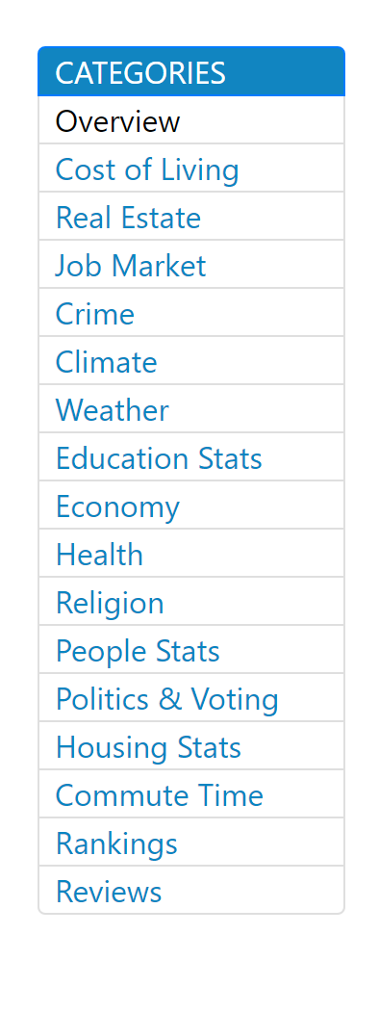
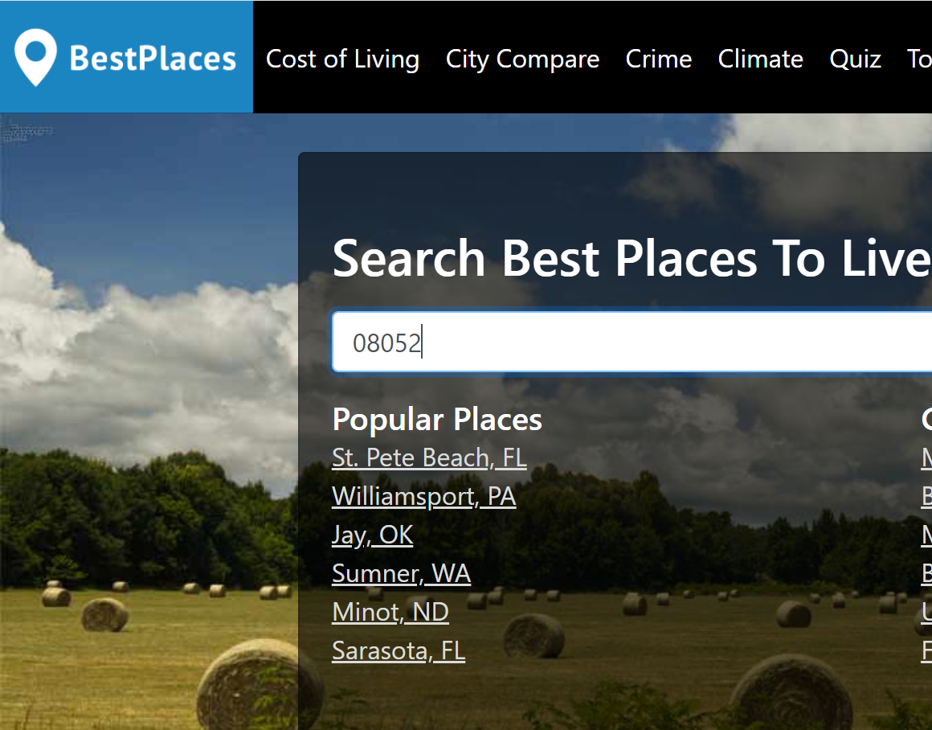
Next, utilize the internet to research sub-market income and employment demographics
Actions
Case Study Result¹
Go to bestplaces.net and/or city-data.com
Enter property zip code
Click through the links to study sub-market income and employment demographics
Take special note of:
Median single-family home price vs. per unit price of the property
Percentage of college graduates in the sub-market
Relationship between sub-market median income and avg. rent
Sub-market unemployment rate
Enter zip code here
Page links
1
2
3
1 – Illustrative only

Slide 10




Assess the property’s income and employment demographics against five questions
Question(s)
Target
Case Study
Result
Is the sub-market median home price vs. target property price per unit comparison favorable | Per Unit Price < Median Home Price | Median home price is $181,500 vs. per unit sales price of $80,000.
Does the sub-market contain a high percentage of college graduates | > 25% college graduates | 26.4% of 08052 residents have a 4-year college degree vs. 36.2% for Philly metro and 38.1% for New Jersey.
What is the relationship between sub-market median income and average annual rent? | Median income 3X average annual sub-market rent | Avg. household income is $57,460. Avg. annual 2-bedroom rent s $14,400. Ratio is 3.99X.
What is the percentage of sub-market residents below the poverty level? | < 20% residents below the poverty level | 8.9% of residents in the 08052 zip code have incomes below the poverty level
What is the current sub-market unemployment percentage? | Target range is 5% - 7% | Unemployment rate in the 08052 zip code is 3.30% vs. 3.70% nationally.
1
2
3

Slide 11
Next, study sub-market growth and income trends using the same websites
Actions
Case Study Result¹
Go to bestplaces.net and/or City-Data.com
Enter property zip code
Click through the available links to study sub-market growth and income trends and their relationship with the state and country.
Take special note of:
Population: Is it growing or shrinking?
Unemployment: Is the trend up or down?
Median Home Price: Is it up or down?
Jobs: Is local employment in recession proof industries?
Renters: Is the percentage of renters higher than the percentage of owners?
Enter zip code here
Page links
1
2
3

Slide 12






Assess the property against five income and employment trend questions
Questions
Target
Case Study
Result
Is the sub-market population growing or shrinking? | Growing | Population is flat over previous three decades. In 1990, it was 19,254. As of the 2010 census, it was 19,172.
Do employment trends indicate strength? | Job growth at or above state and national trends | Job growth is .26% annually vs. 1.59% nationally.
Is median single-family home price and median income growing? | Growth in median single-family home price and income. | Median income flat vs. national average. Median home price of $181,500 is below state and national averages.
Do sub-market unemployment trends outperform the MSA and state? | Unemployment below state and national averages | Unemployment rate is 3.30% vs. 3.7% nationally.
Are a high percentage of sub-market jobs in recession proof categories? | High concentration of jobs in finance, education, medicine, etc. | High concentration of jobs in the finance, insurance, manufacturing, and health care categories
Is the percentage of renters higher than the percentage of owners? | More renters than owners | 52% of population are renters
1
2
3

Slide 13
Summary: Location and demographics are good, but must be aware of the downside risks
Property Benefits
Property Weaknesses
Hi-rise construction is supported by sub-market population density
Property is surrounded by a significant number of retail bellwethers like Whole Foods and Costco
Good location close to major metro areas like Philadelphia, PA and Trenton, NJ
Numerous transportation options including bus, train, rail, and interstate highways
Diverse economy with a high concentration of jobs in recession-resistant industries such as finance and healthcare
Sub-market unemployment below the national average
Median home price compares favorably to the per unit asking price of the target
26% of zip code residents have a 4-year college degree, which is only slightly above target of 25%.
Population growth is relatively flat over the last 3 decades of census history
Historical job growth trends lag national averages with no catalysts on the horizon

Slide 14
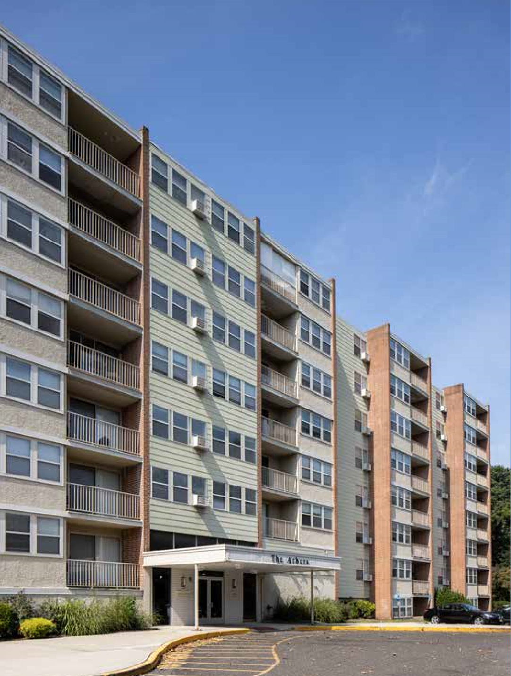
2. Market & Competition

Slide 15
If the property passes the location & demographics screen, the next step is to analyze the competition in four steps
1
2
3
4
Identify the Competition
Compare photos
Make a comparison matrix
Estimate renovation costs
Identify nearby properties with comparable construction, finishes, and amenities
Compare available photos of competitor properties to see how they stack up against the target
Create a matrix to compare all aspects of competitor properties to the subject
If needed, create an estimate of per unit renovation costs to bring the property up to competitor standards

Slide 16
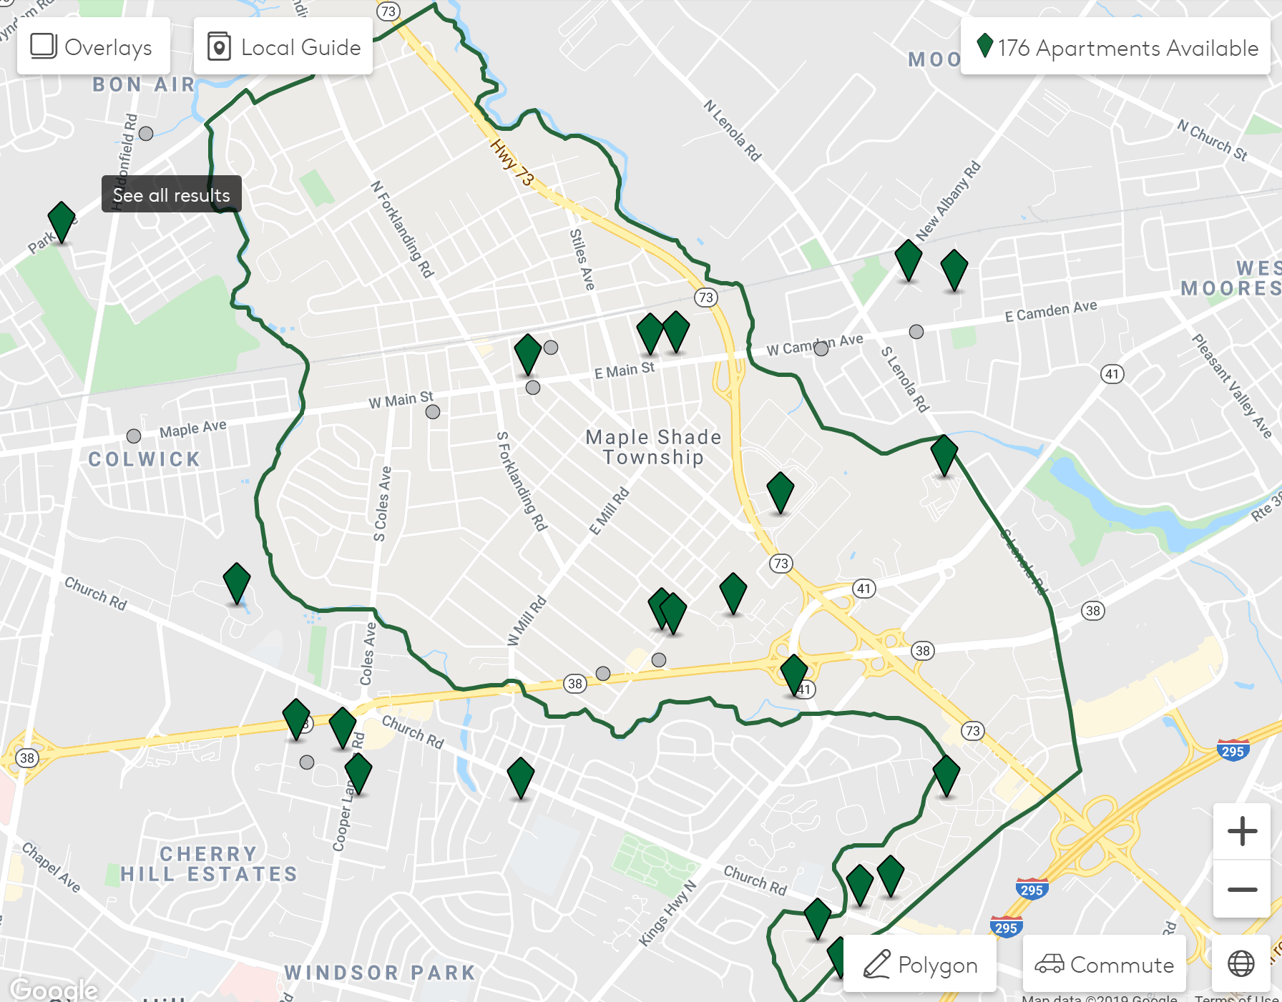
The first step in comparing the target property to the market is to identify the competition
Actions
Case Study Result
Go to Apartments.com and enter the address of the subject
Use the mapping tool to locate similar apartment buildings in the area
Narrow the choices to 3 - 4 properties whose construction, finish, and amenity packages are most similar to the target
OR
Request the broker’s Offering Memo on the property, which will usually list the competitors
Target Property
Competitor 1
Competitor 2
Competitor 3
1
2
3
4

Slide 17
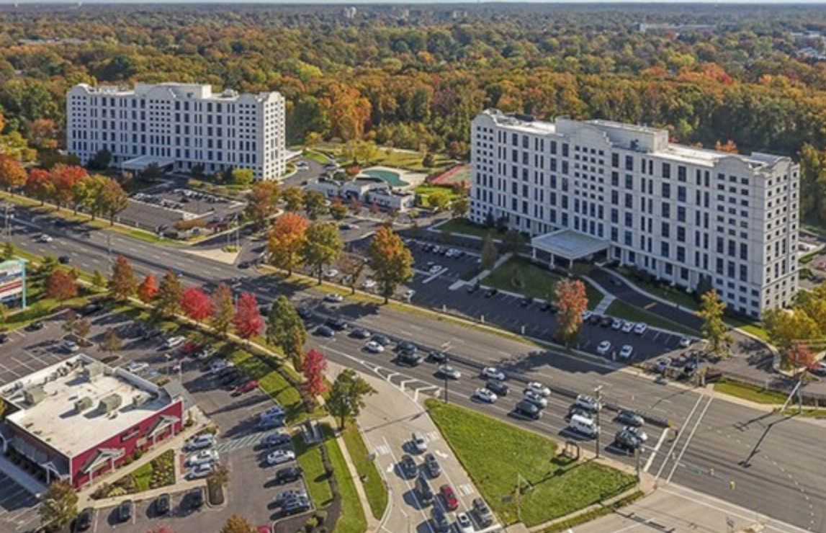
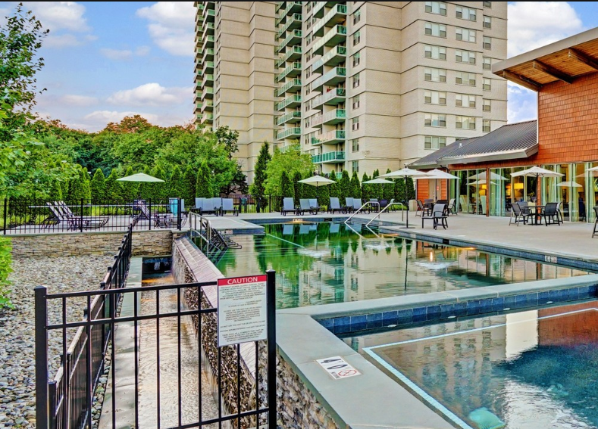
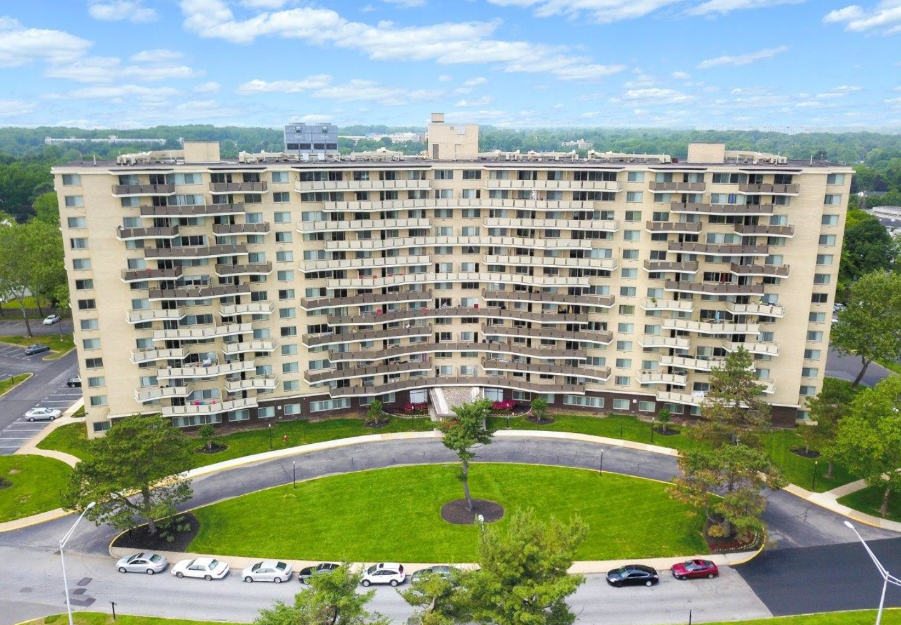
The target property has three hi-rise competitors¹
1. Cherry Hill Towers
2. The Grand at Cherry Hill
3. Towers of Windsor Park
Built: 1962
# Units: 434
Occupancy: 87%
Built: 1969
# Unit: 546
Occupancy: 93%
Built: 1966
# Units: 525
Occupancy: 95%
1
2
3
4
1 – There are more than 3 local competitors, but these three most closely resemble the target in construction, age, and size

Slide 18
With competitors identified, review the published pictures for each and compare them on similar dimensions
Actions
Case Study Result
Go to Apartments.com and enter the addresses (or name) of each competitor
Click through the published pictures for each with a particular focus on:
  Kitchens
  Bathrooms
  Property exterior / amenities / remaining interiors
Compare pictures of the target to competitors to see where they’re the same or different
Target Property
Competitor 1
Competitor 2
Competitor 3
1
2
3
4

Slide 19
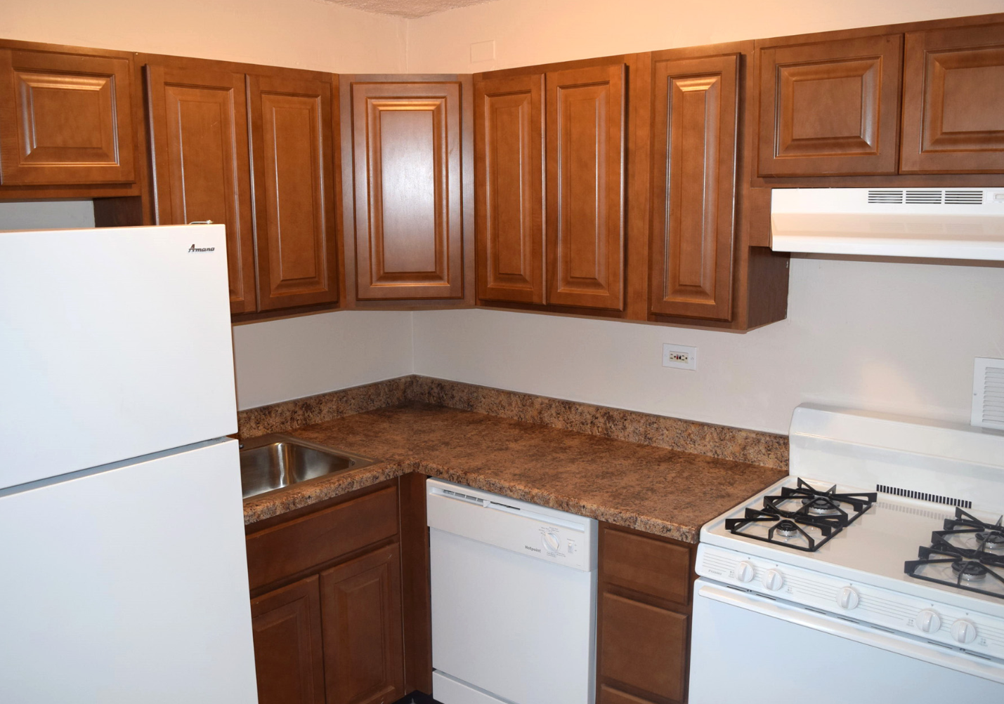
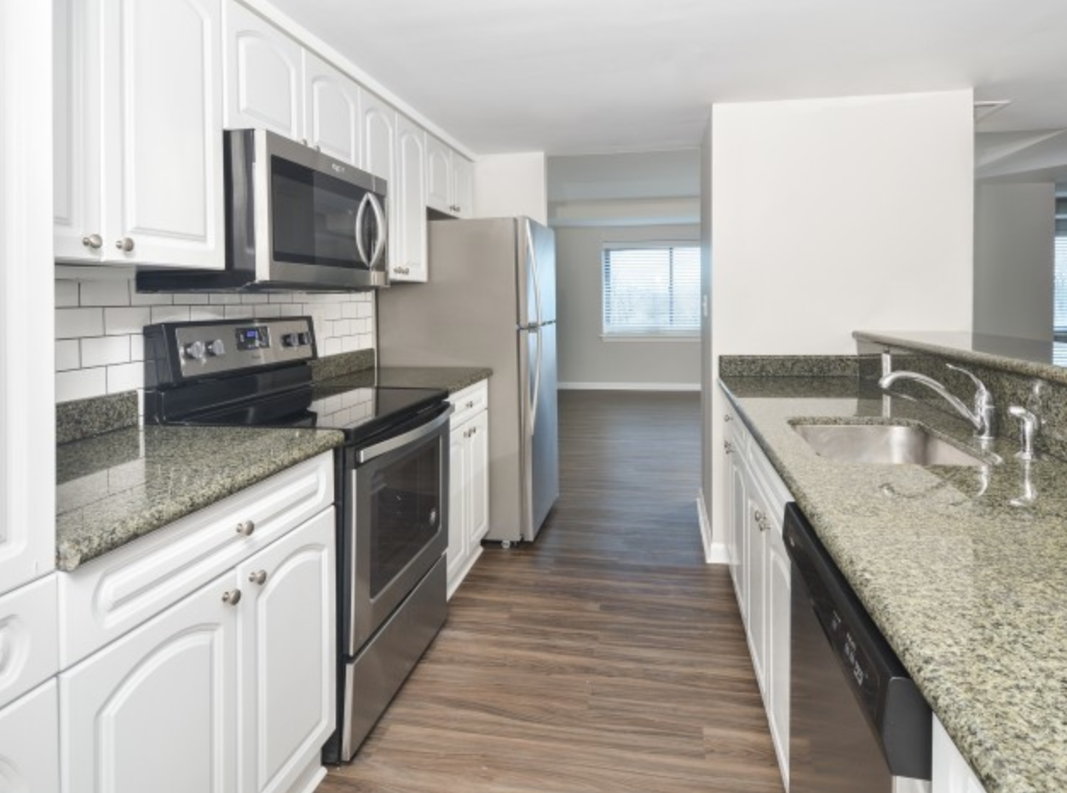
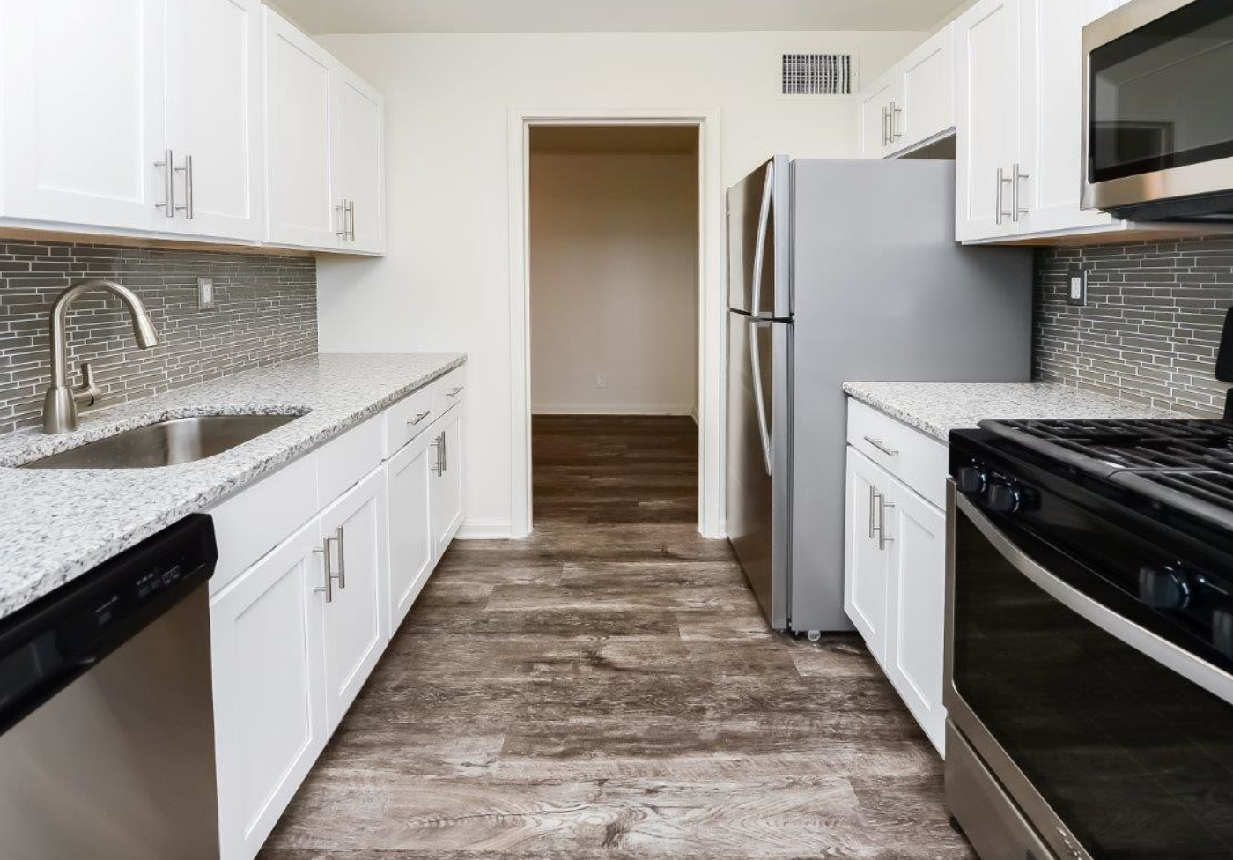
For example, here’s how the kitchens compare…¹
Target
Cherry Hill Towers
Towers of Windsor Park
Cabinets: Wood
Appliance Package: Regular
Backsplash: None
Cabinet Hardware: None
Countertops: Laminate
Cabinets: Wood
Appliance Package: Stainless
Backsplash: Tile
Cabinet Hardware: Stainless / Nickel
Countertops: Stone
Cabinets: Wood
Appliance Package: Stainless
Backsplash: Tile
Cabinet Hardware: Stainless / Nickel
Countertops: Stone
1
2
3
4
1 – Kitchen photos not available for The Grand Cherry Hill

Slide 20
After viewing the photos, create a matrix to compare all aspects of the target property to the competition
Actions
Case Study Result¹
Using all available photos, websites, and marketing materials, compare all aspects of the target property to the competition, including:
  Unit mix
  Interiors
  Exteriors
  Finishes
  Amenities
Create a matrix or “heat map” to determine where the target meets/exceeds the market and where it falls short
Target Property
Competitor 1
Competitor 2
Competitor 3
1
2
3
4

Slide 21
Here’s an example of the comparison matrix for the kitchen finishes¹
Kitchen | Potential Options | Target Property | Competitor 1 | Competitor 2 | Competitor 3
Appliances | "Regular" or Stainless | Regular | Stainless | N/A | Stainless
Backsplash | None, Tile, Marble | None | Tile | N/A | Tile
Cabinet Hardware | Present or Not Present | Not Present | Present | N/A | Present
Cabinets | Laminate or Wood | Wood | Wood | N/A | Wood
Ceiling | Popcorn; Knockdown; Skip Trowel, Swirl, Flat | Popcorn | Knockdown | N/A | Knockdown
Countertops | Tile, Laminate, Concrete, Marble, Quartz | Laminate | Marble | N/A | Marble
Flooring | Tile, Carpet, Laminate, Wood Plank | Tile | Tile | N/A | Laminate
Microwave | Present or Not Present | Not Present | Present | N/A | Present
Sink | Drop in, Undermount, Dual Mount, Farmhouse | Drop In | Undermount | N/A | Undermount
Stove | Gas or Electric | Gas | Electric | N/A | Gas
1
2
3
4
1 – For the complete matrix, see the Due Diligence checklist

Slide 22
For the items that are inferior to the competition, create a per unit renovation budget
Actions
Sample Kitchen Renovation Budget
Create an “inventory” of all unit finishes that need to upgraded to meet market conditions
Using the inventory, create a per unit renovation budget estimate to get a feel for the required investment to bring the property to market conditions
Repair | Cost Est.
Stainless Steel Appliances | ~$1,500 / Unit
Plank Flooring | $1.85 - $2.50 PSF
Faucets | $200 - $250 / Unit
Interior Painting | $1.00 PSF
1
2
3
4

Slide 23
Summary: Target property finishes lag the market and likely require significant renovation to justify market rents
Condition Notes
Renovations Needed
Target property constructed in 1969
Has undergone renovations, but no significant upgrades
Property has three hi-rise competitors that are most similar to the target
All three competitors were also constructed in the 1960s, but have undergone renovations to unit interiors
Based on review of available photos, significant renovations are needed upgrade the property to market standards, including:
  Upgraded appliance package
  Upgraded kitchen backsplash
  Addition of cabinet hardware
  Conversion of ceilings from popcorn to knockdown
  Upgrade countertops from laminate to stone
  Upgrade sink from drop-in to undermount
Based on these renovations and others, it’s estimated that the total cost of the renovation will be $10,000 per unit

Slide 24

3. Financial Analysis

Slide 25
If the property passes the market & competition screen, the last step is to perform financial analysis in four steps
1
2
3
4
Check Proforma Revenue
Analyze Vacancy & Other Income
Check Proforma Expenses
Perform Final Checks
Using current rent roll and market averages, perform a sanity check on proforma revenue
Using the rent roll and market averages perform sanity check on vacancy and other income
Using the trailing 12 months operating statement, perform sanity check on proforma expenses
Using operating statement and estimated financing terms and renovation budget, perform the final proforma checks

Slide 26
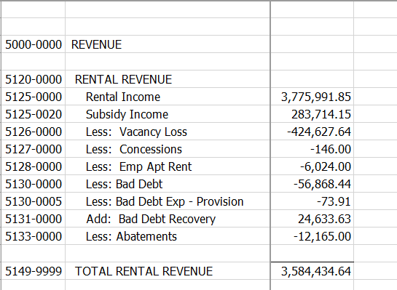
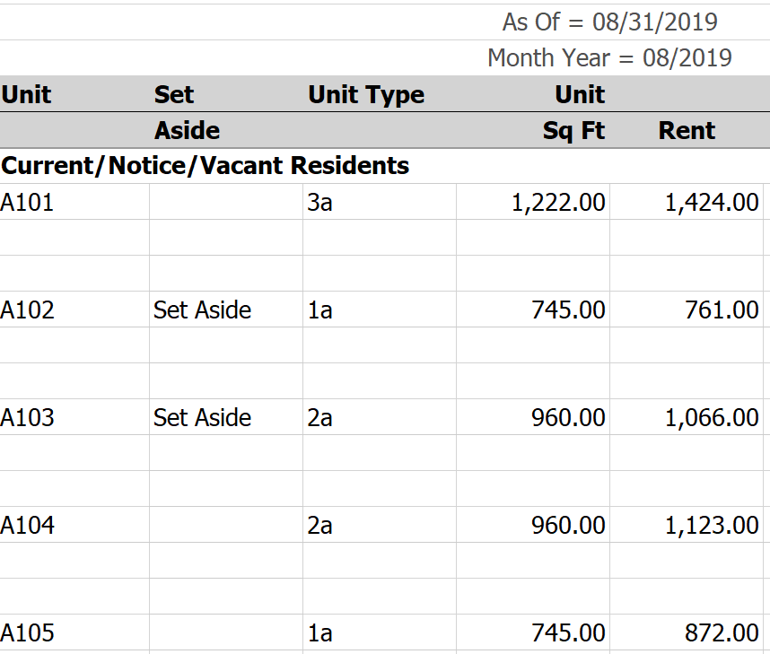
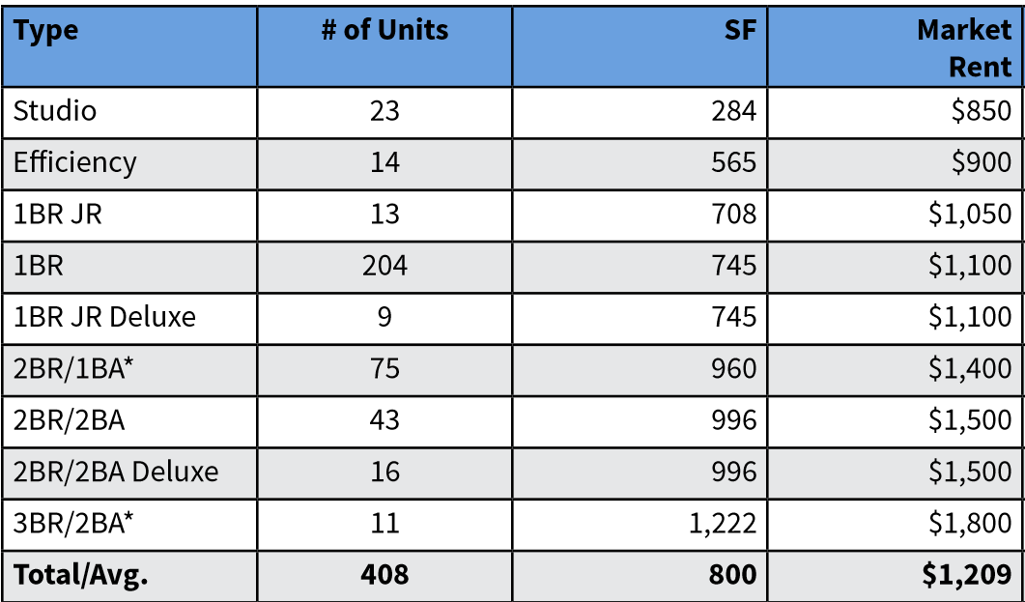
The first step in the financial analysis is to estimate property revenue. There are three sources to pull from:
Actions
Case Study Result¹
Compile the three sources used to estimate proforma revenue:
  Trailing 12 months operating statement
  Current Rent Roll
  Market Averages per the Broker Estimates
Calculate current property revenue
Calculate potential market revenue (using Broker estimates)
Compare current and potential rent to competitors
T-12 Op. Stmt.
Current Rent Roll
Broker Estimates
1
2
3
4

Slide 27
The trailing 12-months Operating Statement shows effective rental income of $4M and current rent roll shows $4.1M
T-12 Operating Statement
Rent Roll Summary
Unit Type | # Units | Avg. Rent / Unit | Total Rent
Studio | 23 | $503.20 | $138,883
1 Bed / 1 Bath | 240 | $753.12 | $2,168,995
2 Bed / 1 Bath | 75 | $916.98 | $825,282
2 Bed / 2 Bath | 59 | $997.41 | $706,166
3 Bed / 2 Bath | 11 | $1,301.29 | $171,770
TOTAL | 408 |  | $4,011,096
Unit Type | # Units | Avg. Rent / Unit | Total Rent
Studio | 23 | $493 | $136,092
Efficiency | 14 | $652 | $109,476
1 Bed Jr. | 13 | $764 | $119,232
1 Bed | 204 | $789 | $1,930,776
1 Bed Jr. Dlx. | 9 | $747 | $80,676
2 Bed / 1 Bath | 73 | $964 | $844,440
2 Bed / 2 Bath | 43 | $1,031 | $531,816
2 Bed / 2 Bath Dlx. | 16 | $1,145 | $219,888
3 Bed / 3 Bath | 10 | $1,303 | $156,336
TOTAL | 405¹ | $7,887 | $4,128,732
Total rent per T-12
Total per Rent Roll
1
2
3
4
1 – Three units set aside for models/management use

Slide 28
Compare rent roll rents to market averages to determine if there is room for rental increases
Rent Roll Summary
Market Averages
Unit Type | # Units | Avg. Rent / Unit | Total Rent
Studio | 23 | $493 | $136,092
Efficiency | 14 | $652 | $109,476
1 Bed Jr. | 13 | $764 | $119,232
1 Bed | 204 | $789 | $1,930,776
1 Bed Jr. Dlx. | 9 | $747 | $80,676
2 Bed / 1 Bath | 73 | $964 | $844,440
2 Bed / 2 Bath | 43 | $1,031 | $531,816
2 Bed / 2 Bath Dlx. | 16 | $1,145 | $219,888
3 Bed / 3 Bath | 10 | $1,303 | $156,336
TOTAL | 405¹ | $7,887 | $4,128,732
Unit Type | # Units | Rent Roll Rent | Market Rent | Total Rent
Studio | 23 | $493 | $850 | $19,550
Efficiency | 14 | $652 | $900 | $12,600
1 Bed Jr. | 13 | $764 | $1,050 | $13,650
1 Bed | 204 | $789 | $1,100 | $224,400
1 Bed Jr. Dlx. | 9 | $747 | $1,100 | $9,900
2 Bed / 1 Bath | 75 | $964 | $1,400 | $105,00
2 Bed / 2 Bath | 43 | $1,031 | $1,500 | $64,500
2 Bed / 2 Bath Dlx. | 16 | $1,145 | $1,500 | $24,000
3 Bed / 3 Bath | 11 | $1,303 | $1,800 | $19,800
TOTAL | 408 |  |  | $493,500
TOTAL X 12 |  |  |  | $5,920,800
Significant increases possible
1
2
3
4
1 – Three units set aside for models/management use

Slide 29
Before concluding that market averages are correct, compare them to the identified competitors
 | Target | Cherry Hill Towers | Grand at Cherry Hill | Towers of Windsor Park
Year Built | 1969 | 1962 | 1969 | 1966
Units | 408 | 434 | 564 | 525
Occupancy | 86.2% | 87% | 93% | 95%
Studio Avg. SF | 424 | -- | 529 | 604
Studio Avg. Rent | $572.36 | -- | $1,111 | $1,040
Studio Avg. Rent PSF | $1.35 | -- | $2.10 | $1.72
1 Bed Avg. SF | 733 | 748 | 966 | 1,030
1 Bed Avg. Rent | $766.67 | $1,338 | $1,455 | 1,165
1 Bed Avg. Rent PSF | $1.05 | $1.79 | $1.51 | $1.13
2 Bed Avg. SF | 984 | 1,047 | 1,254 | 1,196
2 Bed Avg. Rent | $1,046.62 | $1,634 | $1,881 | $1,513
2 Bed Avg. Rent PSF | $1.06 | $1.56 | $1.50 | $1.27
3 Bed Avg. SF | 1,222 | -- | 1,603 | 1,527
3 Bed Avg. Rent | $1,303 | -- | $2,840 | $2,195
3 Bed Avg. Rent PSF | $1.07 | -- | $1.77 | $1.44
Discussion
Target property is the smallest, has the lowest occupancy, and the smallest average unit size
Rent comparison confirms that target property rents are well below the current market
However, property condition is also inferior to the market with competitors having undergone significant renovations
To achieve full market rent, target will also need to undergo significant renovations
So, the key income question is trying to figure out, if I invest “XX” amount renovating each unit, how much can I raise the rent?
Or, put another way, how much do I need to invest per unit to achieve parity with the market?
Per unit investment should be repaid within ~36-48 months through rental increases
1
2
3
4

Slide 30
The next step in creating a proforma is to estimate vacancy and “other income”
Actions
Key Definitions
Compile the three sources used to estimate vacancy and other income:
  Trailing 12 months operating statement
  Current Rent Roll
  Market Averages
Calculate current property vacancy
Calculate other income per the T-12 Operating statement
Compare vacancy and “other income” estimates to the market
Vacancy: The percentage of a property’s total units that are unoccupied. Ex. A 100-unit property with 5 unoccupied units is 5% vacant.
“Other” Income: Property income that doesn’t come from rent. Examples include late fees, pet rent, parking rent, or application fees.
1
2
3
4

Slide 31
Vacancy can be calculated from the rent roll and Other Income can be pulled from the trailing 12-months operating statement
Vacancy Calculation
Other Income
Total # of Units: 408
# Vacant Units: 52 (Per Rent Roll)
Vacancy %: 52/408 = 12.74%
NOTES:
Vacancy is a point in time calculation and will likely vary over the course of a year
Property vacancy may be affected by several factors, including renovations
The amount of rent lost due to vacant units is known as “Economic Vacancy.”
Source | Amount
Legal Fee Income | $20,202.64
Damage Charges | $6,574.51
Late Charge | $37,257.64
Laundry Revenue | $54,130.74
NSF Charges | $625.00
Application Fee Income | $10,035.00
Cable Commissions | $5,747.66
Other Income | $4,110.00
Forfeited Sec. Deposit | $5,115.43
TOTAL Other Income | $143,798.62
1
2
3
4

Slide 32
To estimate proforma vacancy, compare vacancy per the rent roll to competitors
Vacancy Comparison¹
Vacancy Estimate
Target property vacancy is at the high end of the competition, which is logical because it also has inferior finishes
If purchasing, renovating, and increasing rents, vacancy will likely go up before it moves back down towards a stabilized number
Grand Cherry Hill and Towers of Windsor Park are likely indicators of where stabilized vacancy will end up
But, its also important to be realistic and to err on the side of being conservative
Given the facts, it’d likely make sense to model 15% vacancy in years 1 & 2 of ownership, during renovations and rent raises
Then, reduce vacancy to ~7% in year 3, before reducing to 5% on a stabilized basis
Target Property (Actual) | 12.74%
Cherry Hill Towers | 13.00%
Grand Cherry Hill | 7.00%
Towers of Windsor Park | 5.00%
Average | 9.43%
1
2
3
4
1 – Per broker Offering Memorandum

Slide 33
To estimate Other Income, use the T-12 and property business plan to inform proforma estimates
T-12 Other Income
Other Income Considerations
Proforma Other Income
Source | Amount
Legal Fee Income | $20,202
Damage Charges | $6,574
Late Charge | $37,257
Laundry Revenue | $54,130
NSF Charges | $625
Application Fee Income | $10,035
Cable Commissions | $5,747
Other Income | $4,110
Forfeited Sec. Deposit | $5,115
TOTAL Other Income | $143,798.62
If property is purchased, will fees go up or down?
Are there any items that appear likely to be different in future years?
Is it possible to bill utilities back to residents?
How do line items compare to the market and historically?
Source | Amount
Legal Fee Income | $20,000
Damage Charges | $6,000
Late Charge | $38,000
Laundry Revenue | $57,120
NSF Charges | $4,120
Application Fee Income | $15,000
Cable Commissions | $10,000
Other | $10,000
Forfeited Sec. Deposit | $5,000
Utility Reimbursements | $212,160
TOTAL Other Income | $377,400
Utilities Billed Back
1
2
3
4

Slide 34
Next, use the T-12 Operating Statement to estimate proforma expenses
Actions
Key Definitions
Compile the three sources used to estimate proforma expenses:
  Trailing 12 months operating statement
  Market Averages
  Expense “Guidelines”
Calculate T-12 expenses, compile into a series of preset expense categories
Compare T-12 expenses against proforma expense “guidelines.”
Using T-12 and guidelines, create “normalized” expenses for the proforma
Proforma Expenses: Expense line items used to create the future property proforma. Line items will likely be the same as the T-12, but amounts will be different.
Normalized Expenses: Estimates of expenses, based on a set of standards.
1
2
3
4

Slide 35
Compare T-12 expenses to a set of “guidelines” that will assist in developing normalized proforma expenses
T-12 Other Income
Expense Guidelines
Proforma Year 1
Source | Amount | Per Unit
Advertising | $22,336 | $55
Admin | $107,112 | $263
Contract Services | $24,201 | $59
Landscaping | $30,610 | $75
Trash Removal | $18,721 | $46
R&M | $250,000 | $613
CapEx | $0 | $0
Legal & Acct. | $38,900 | $95
Make Ready | $0 | $0
Utilities | $1,030,903 | $2,527
Payroll | $753,912 | $1,848
Property Insurance | $171,068 | $419
Real Estate Taxes | $316,043 | $775
Management Fees | $176,674 | $433
Total | $2,940,480 | $7,207
Source | Per Unit
Advertising | $100
Admin | $250
Contract Services | $75
Landscaping | $80
Trash Removal | $50
R&M | $500 - $800
CapEx | --
Legal & Accounting | $100
Make Ready | --
Utilities | As Billed
Payroll | $1,100 - $1,300
Property Insurance | $300
Real Estate Taxes | Equal to Tax Bill
Management Fees | 5% - 8% of Rent
Total | --
Source | Amount | Per Unit
Advertising | $40,800 | $100
Admin | $102,000 | $250
Contract Services | $30.600 | $75
Landscaping | $32,640 | $80
Trash Removal | $20,400 | $50
R&M | $265,200 | $650
CapEx | -- | --
Legal & Accounting | $40,800 | $100
Make Ready | -- | --
Utilities | $1,020,000 | $2,500
Payroll | $510,000 | $1,250
Property Insurance | $102,000 | $250
Real Estate Taxes | $624,571 | $1,531
Management Fees | $135,190 | $331
Total | $2,924,201 | $7,167
Utilities Billed Back
1
2
3
4

Slide 36
Finally, pull income and expenses together to create a full proforma
Actions
Key Metrics
Compile the sources needed to complete the proforma:
  Income
  Other Income & Vacancy
  Expenses
Pull together each item into a complete proforma for your desired holding period
Make income/expense increase assumptions
Perform final checks, calculate key return metrics, and compare them to your requirements
Cash on Cash Return: The ratio of annual before-tax cash flow to the total amount of cash invested, expressed as a percentage.
Debt Service Coverage Ratio: The ratio of annual before-tax cash flow to annual debt service.
1
2
3
4

Slide 37
Pull together income and expenses to create a full proforma
 | T-12 | 1 | 2 | 3 | 4 | 5
Gross Potential Rent | $4,011,096 | $5,035,292 | $6,059,492 | $6,180,682 | $6,364,328 | $6,555,528
Vacancy & Loss to Lease | ($569,880) | ($805,647) | ($969,519) | ($370,841) | ($381,860) | ($393,315)
Bad Debt & Concessions | ($12,856) | ($100,706) | ($90,892) | ($123,614) | ($127,287) | ($131,105)
Other Income | $364,513 | $377,400 | $379,828 | $391,222 | $402,959) | $415,048
Total Revenue | $3,792,870 | $4,506,339 | $5,378,908 | $6,077,450 | $6,258,141 | $6,445,885
Operating Expenses | $2,940,481 | $2,924,201 | $3,034,049 | $3,125,070 | $3,214,398 | $3,306,606
Net Operating Income | $852,389 | $1,582,138 | $2,344,860 | $2,952,380 | $3,042,643 | $3,137,280
Expense Ratio | 78.00% | 65.00% | 56.00% | 51.00% | 51.00% | 51.00%
Annual Debt Service | $1,816,384 | $1,410,178 | $1,410,178 | $1,410,178 | $2,591,369 | $2,591,369
Value @ 6% Cap Rate | $14,206,483 | $26,386,996 | $39,081,000 | $49,206,333 | $50,710,716 | $52,288,000
Cash on Cash Return |  | 1.9% | 10.1% | 16.6% | 47.8% | 57.8%
Debt Service Coverage | .47 | 1.12 | 1.66 | 2.09 | 1.17 | 1.21
Discussion
Rent assumes 2% annual rent bumps once stabilized
Vacancy increases in years 1 & 2 due to renovations, but then reduces slowly to 5% on a stabilized basis
Operating expenses assume 3% annual increases once stabilized
NOI rises quickly as renovations are completed and rents convert to market rate
Expense ratio in the T-12 is very high indicating opportunity for savings. Reduces slowly to 51% on an annualized basis
Debt service assumes 80% LTV, 5%, and 30-year amortization. Refinance in year 3.
Cash on Cash return assumes purchase price of $28M, with $9.4M in equity to close
Cap rate of 6% is based on recent sales and estimate of future exit.
CapEx reserves not shown
1
2
3
4

Slide 38
Lastly, check proforma and metrics against a series of metric targets
Metric | Calculation | Target | Case Study Actual
LTV | = Loan Amount / Value of Property | 70% - 75% | 80.00%
DSCR | = Net Operating Income / Debt Service | >1.25X (Stabilized) | ~1.20 (Stabilized)
Cash on Cash Return | = (Net. Op. Income – Debt Service)/Equity | > 10% (Stabilized) | ~20% (Stabilized)
Expense Ratio | = Total Expenses / Total Rent | ~50% (Stabilized) | 51% (Stabilized)
CapEx Reserves | -- | ~$250 per unit, per year | $250 per unit, per year
Closing Costs | -- | 5% - 7% of loan amount | 5.00% of the loan amount
Working Capital | = Est. Monthly Expense * 6 | ~6 Months of expenses | 6 Months of working capital
1
2
3
4

Slide 39
Summary: There are three steps to performing an initial deal review. If the property passes, proceed to the LOI phase
1
2
3
1. Get to know the Sub-Market
2. Study The Demographics
3. Study the Trends
Does the building type support the surrounding population?
Does surrounding retail indicate a growing market?
Is the property close to transportation options like bus, rail, highway, or major thoroughfares
Is the property close to non-retail sources of employment?
Is the median home price vs. property per unit price favorable?
Does the sub-market contain a high percentage of college graduates?
Is sub-market median income at least 3X the average annual rent?
Is the percentage of sub-market residents below the poverty level <20%?
Is the sub-market unemployment percentage between 5% and 10%?
Property rent vs. market rent
Assessing the case for rent increases
Steady state rental increases
Vacancy and other income
Current vs. market proforma and expense targets
Estimating reserves
Creating a renovation budget
Sources and uses of financing

