Slide 1


Slide 2

Direct Mail
Most well known marketing method
Best way to get mom and pops
It’s the most successful method for finding deals yourself

Slide 3

Direct Mail
Motivation
  Inherited property
  Management problems
  Divorce
  Retirement
  Out of state owner
  Pre foreclosure
  Poor health

Slide 4

Direct Mail – Your Lists
You can buy your list
  First American
  (firstam.com)
  Dunhill International List
  Co. (dunhills.com)
  Experian (experian.com)
  List Source (listsource.com)
  DM Database (dmdatabases.com)
  US Lead List (usleadlist.com)

Slide 5

Direct Mail – Your Lists
Build your own list
County assessors websites
Go to netronline.com
  Click on public records online
  This will give you a list of every
  county’s assessor site
Can also use Parlay 2.0
Paid software but worth its weight in gold

Slide 6


Direct Mail
Property size to search for at assessors
Duplexes
Triplexes
Quads
5-10 unit
10-15
15-20
20 and up

Slide 7
Direct Mail – Getting Around LLC’s and Corps.
Go to Secretary of State’s website
Locate online business search
Will bring up copies of filed Articles of Organization and annual reports
Find name(s) of managing members
Some LLC’s are managed by attorney
Search managing members names on free online searches such as White Pages or use paid skip tracing

Slide 8
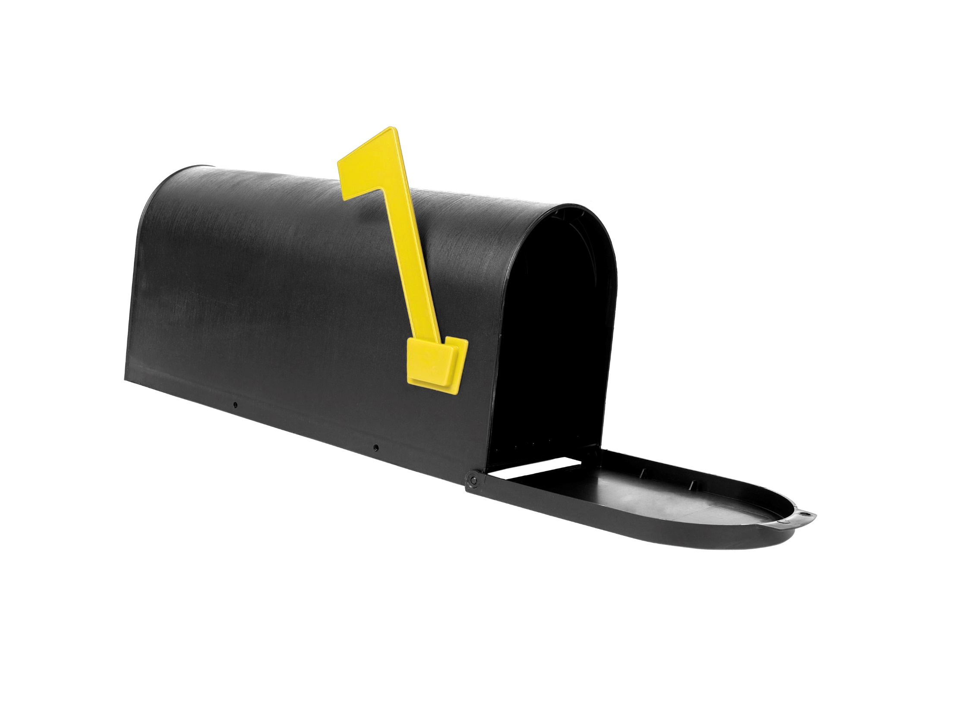
Direct Mail – The Letter
Typed
Can use mail merge
One page
Personalize by using owner name and address
Put property address in first paragraph
Put a picture of you and your spouse

Slide 9
Direct Mail – Points to put in your letters
You could say you need to purchase a property in 30 days
You could say you really love (town name) and want to buy there.
You can save them the real estate commission
You can save them thousands of dollars in taxes

Slide 10
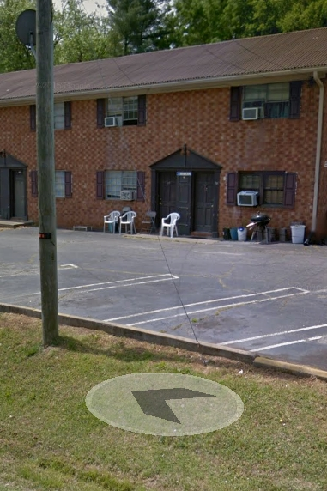
Direct Mail – The Letter
Might say you’ve seen the property
(Google Earth)
Give them multiple ways to respond. Phone, email, contact form on a website etc.

Slide 11
Sample Letter
Investor Needs to Purchase the Property Within the Next 30 Days
Dear “Owner Name”
I’d like to speak to you immediately to discuss your apartment building at “__” address. We are in the process of finding a building to acquire within the next 30 days, and yours is an ideal candidate.
We can save hundreds of thousands in taxes and real estate commissions. We can often pay full market price, and close quickly.
Time is limited, as we need to acquire a property within the next 30 days. If you have any interest please contact me at your earliest convenience.
I look forward to hearing from you!
Sincerely,
Investor Smith
Contact info:

Slide 12

Direct Mail – The Envelope
Hand write all of our envelopes
Hire someone from Craigslist
Stay at home moms or people from VA, or can run an add on Craigslist
Companies that will do this as well
  Click2Mail
  ITI Direct Mail
  Lob

Slide 13
Direct Mail:
Repetition
We mail lists every 3 months
We mail lists every 3 months
We mail lists every 3 months

Slide 14
“A Secret to Success in This or any
Business is Being Willing to do
What Other People Won’t”

Slide 15

Driving for Dollars: What to look for
  No cars or cars that have
  been parked a long time
  Boarded up windows
  Dirty and signs of vacancy
  Poor landscaping

Slide 16

Cold Calling
Better after sending letters
Script in document library
Do what other people are not willing to do
Hire stay-at-home to set appointments

Slide 17


"Before we met Rod we did not have any multifamily property. We now have over 1221 units!"
Jacob Blackett
Jacob Blackett
Sterling White

Slide 18

Other Ways to Find Deals
Classified of Newspaper
Mom and Pop Owners
Smaller Deals
We found a 19 unit that only 2 people called

Slide 19
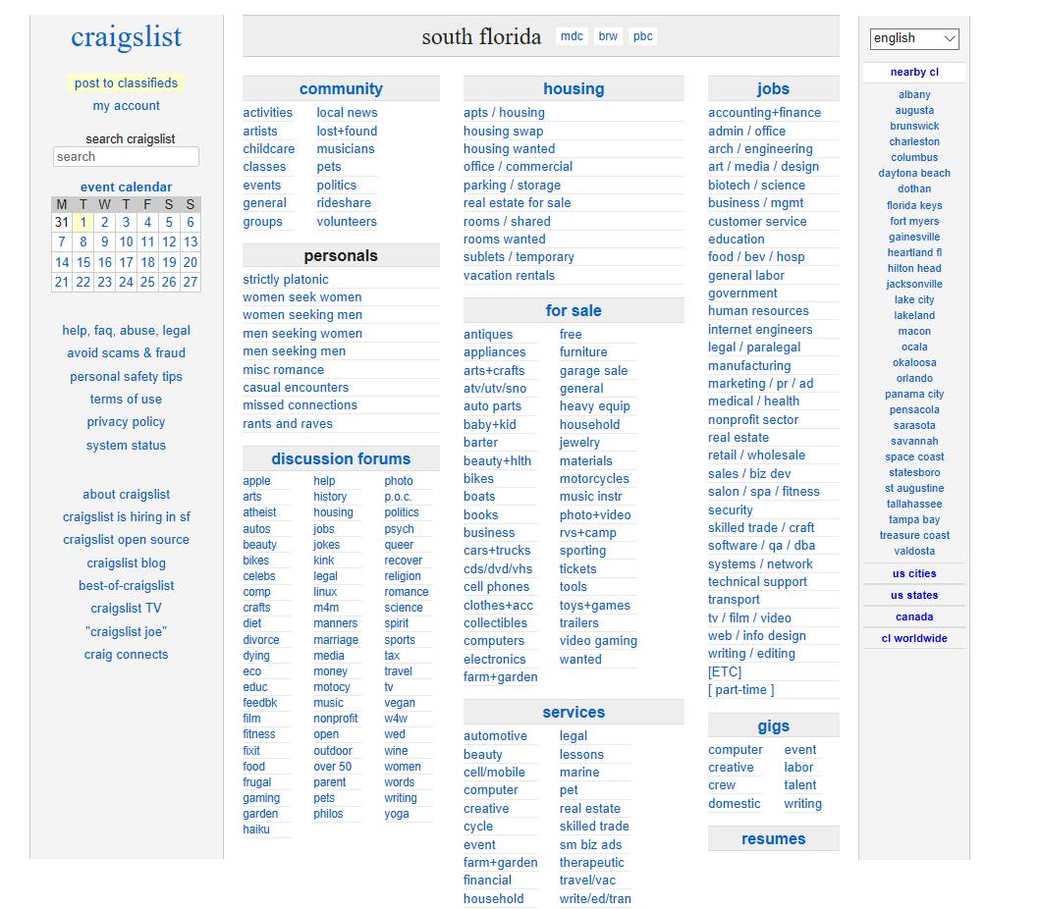
Craigslist

Slide 20
Craigslist is a Great Deal Source
The ability to find hundreds of leads in just a few hours
Only takes 10-15 minutes a day
High quantity of mom and pops on the site
Free!
Literally works in basically every market
Nobody looks for deals there anymore (except you)

Slide 21
3 Methods to Maximize Success on Craigslist
Reach out to properties in the for sale section
Post ads saying you buy multifamily properties
Cold call “for rents”

Slide 22

Reach out to Properties in the For Sale Section
Craigslist Email Script
Hi, my name is _____. I’m sending this message in regards to
your duplex for sale at ___________________.
I’m a local real estate investor, and buy properties very similar to yours in the area. I’m highly interested and would love to get some more information from you regarding the property. I would love to talk soon.
My contact info is:

Slide 23


Brian A I got my first deal off Craigslist! A 36 unit for around $1M. It works
There are strategies that work very well with Craigslist

Slide 24
MLS/Agents
A solid and reliable residential agent is a great resource
Set guidelines
  First, you’ll want to have them set up an alert for each multifamily property that hits the MLS.
  You’ll next want them sending you anything that fits your criteria.
  Make an offer:
    On all properties that fit your requirements for size, price range, number of units, etc.
    On any foreclosures, HUD properties, bank-owned, and short-sales
    On any multifamily properties that are labeled “as-is, vacant, and price reduction”

Slide 25

Properties WITH CODE VIOLATIONS Often Fly Under the Radar
These leads are often some of the most motivated sellers you can find
This strategy goes hand in hand with driving for dollars, as many properties with overgrown grass, are vacant, poorly taken care of etc. will have code violations as well

Slide 26

Target Owners Going Through Evictions
You ideally need to go to the courthouse to get a feel for the local eviction climate
Some information will be online, but most effective to have face time with the owners immediately after the case is finished
Typically, evictions take place on the same day each week or month
Attend the cases and start a conversation with the owner.

Slide 27

Networking with Probate Attorneys
Great way to get off-market deals
The best way to get the ball rolling with them is to call and ask if you can come in and have 10 minutes of their time

Slide 28

Buying from Banks
Banks don’t want properties on their books
They are not in the real estate management business
Set up relationships with local bankers
You’re a problem solver!
Become their go-to guy

Slide 29



Other Ways to Find Deals
Service Companies who work in industry
Pool guy, window repair, landscaper
Ask these guys if they know anyone who might be selling soon
Sellers will say “I’m going to sell soon, we’ve got to make the place look better”
Offer a finders fee

