Slide 1

Debt: Impact on Deals

Slide 2


Single Family vs. Multifamily
Loan Terms
Typical terms: 15 – 30 years
Available terms 5 – 30 years
Typical terms: 5 – 12 years
Available terms 3 – 40 years
10 years
20 years
30 years
40 years

Slide 3

Single Family vs. Multifamily
Amortization vs. Loan Terms
Typical terms: 15 – 30 years
Amortization typically matches loan term
Typical terms: 5 – 12 years
Typical amortization: 20-30 yrs
NOT matching loan term
10 years
20 years
30 years
40 years
Balloon payment requires sale or refinance!

Slide 4
Single Family vs. Multifamily
Leverage / LTV
100%
80%
Up to 97% available
70-80% typical
Up to 93% available
70-80% typical
60%
40%
20%

Slide 5


Single Family vs. Multifamily
Typical Loan Conditions
Floating or Fixed Interest Rate
Interest Only
Prepayment Penalty
Non-Recourse
Borrower/Sponsor Qualification | Sponsor’s “global” DTI Sponsor’s Credit Score | Property’s NOI Sponsor’s Net Worth Sponsor’s Liquidity

Slide 6

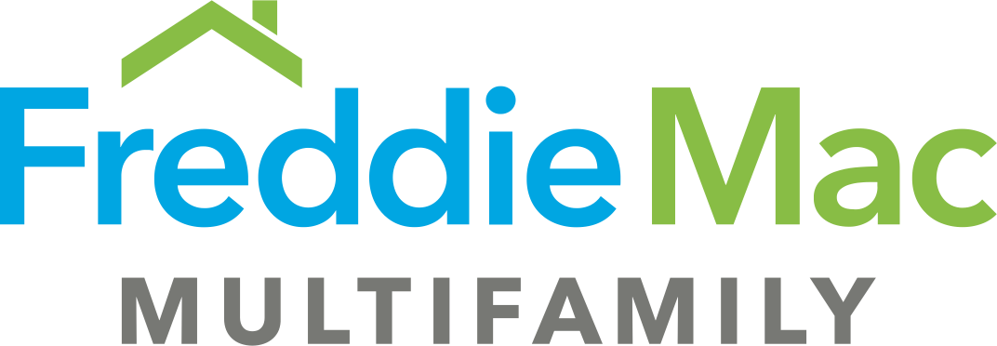

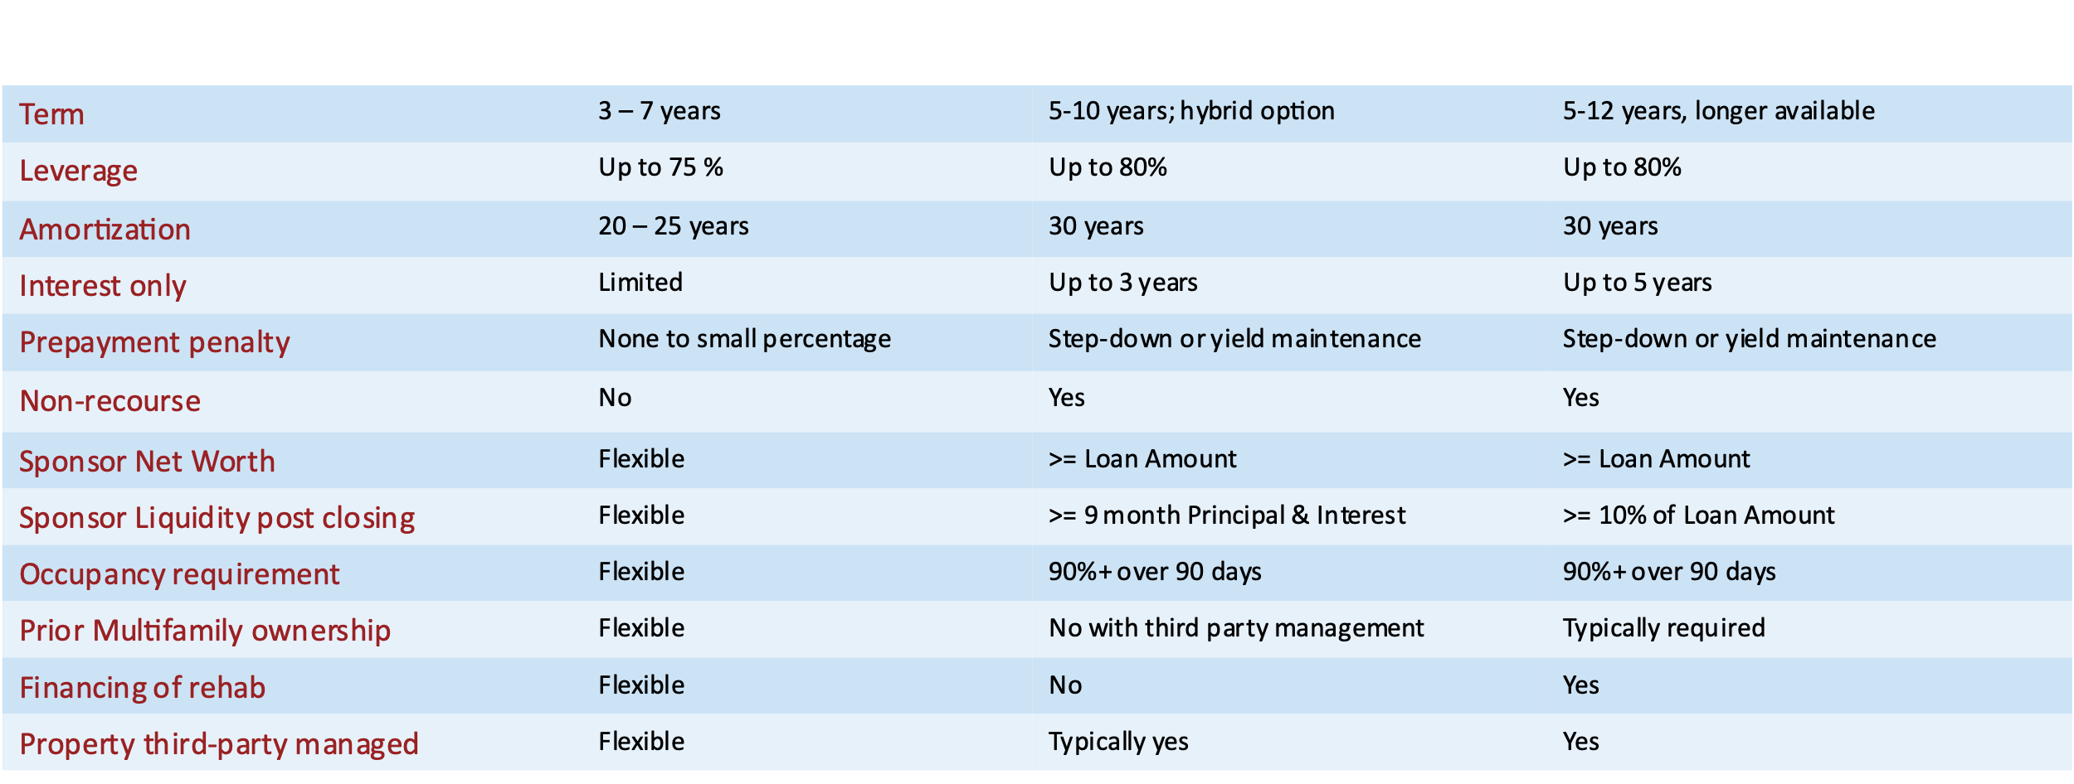
Typical Lender Conditions

Slide 7

Loan Terms – Impact on Deals
LTV / Leverage
Interest Rate
Amortization
DSCR
IRR & COC

