Slide 1


Today’s Lesson :
“6 Step Multi-Family Scope of Work Made Easy Framework”
How to successfully plan and manage your next renovation project!
With Van Sturgeon

Slide 2
I am confident in saying that I will help you learn today, how to save you 20% on the total cost of the renovation project, and decrease the renovation time with my “6 Step Multi-Family Scope of Work Made Easy Framework”.

Slide 3
Today, you will learn:

Slide 4
Today, you will learn:
What to renovate and repair.

Slide 5
Today, you will learn:
What to renovate and repair.
Creating a detailed SOW.

Slide 6
Today, you will learn:
What to renovate and repair.
Creating a detailed SOW.
Where to find good GC and tradespeople.

Slide 7
Today, you will learn:
What to renovate and repair?
Creating a detailed SOW.
Where to find good GC and tradespeople?
How to become a “MAGNET” for quotes!

Slide 8
Today, you will learn:
What to renovate and repair.
Creating a detailed SOW.
Where to find good GC and tradespeople.
How to become a “MAGNET” for quotes!
Create contracts that protect you!

Slide 9
Today, you will learn:
What to renovate and repair?
Creating a detailed SOW.
Where to find good GC and tradespeople?
How to become a “MAGNET” for quotes!
Create contracts that protect you!
YOU WILL BE LOOK AT RENOVATIONS DIFFERENTLY!

Slide 10
No more renovation projects where :
Go over budget!

Slide 11
No more renovation projects where :
Go over budget!
Renovation takes too long!

Slide 12
No more renovation projects where :
Go over budget!
Renovation takes too long!
Held “hostage and not in CONTROL!

Slide 13

Congrats! You are not a “fence sitter”!

Slide 14

How would you learn how to play the guitar?

Slide 15



Real estate investing isn’t easy!

Slide 16
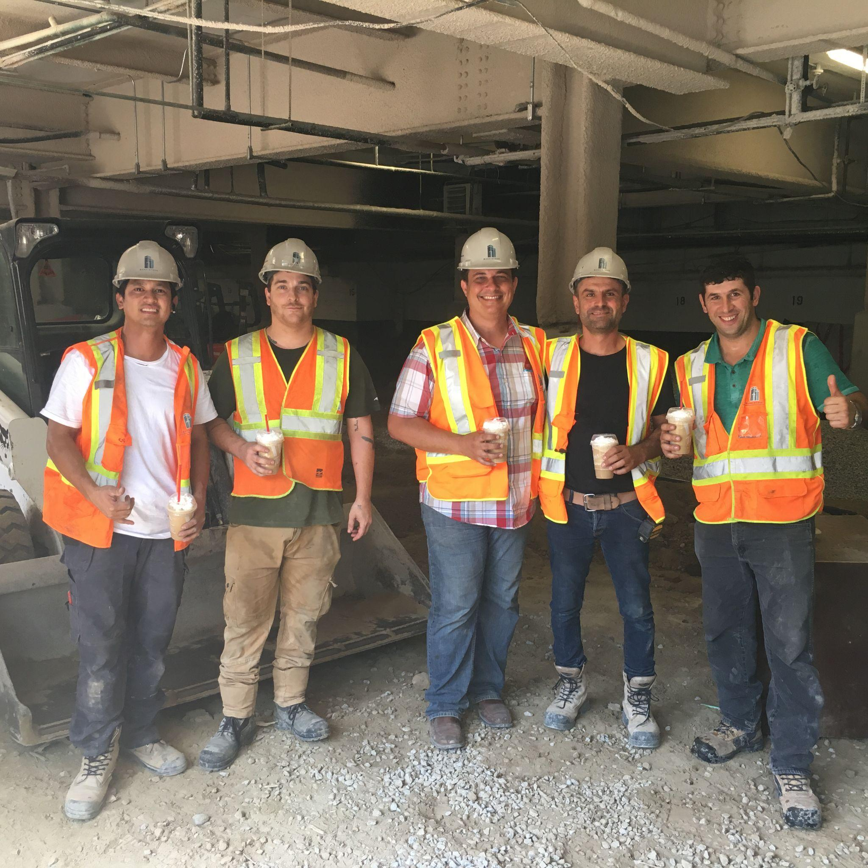

Slide 17
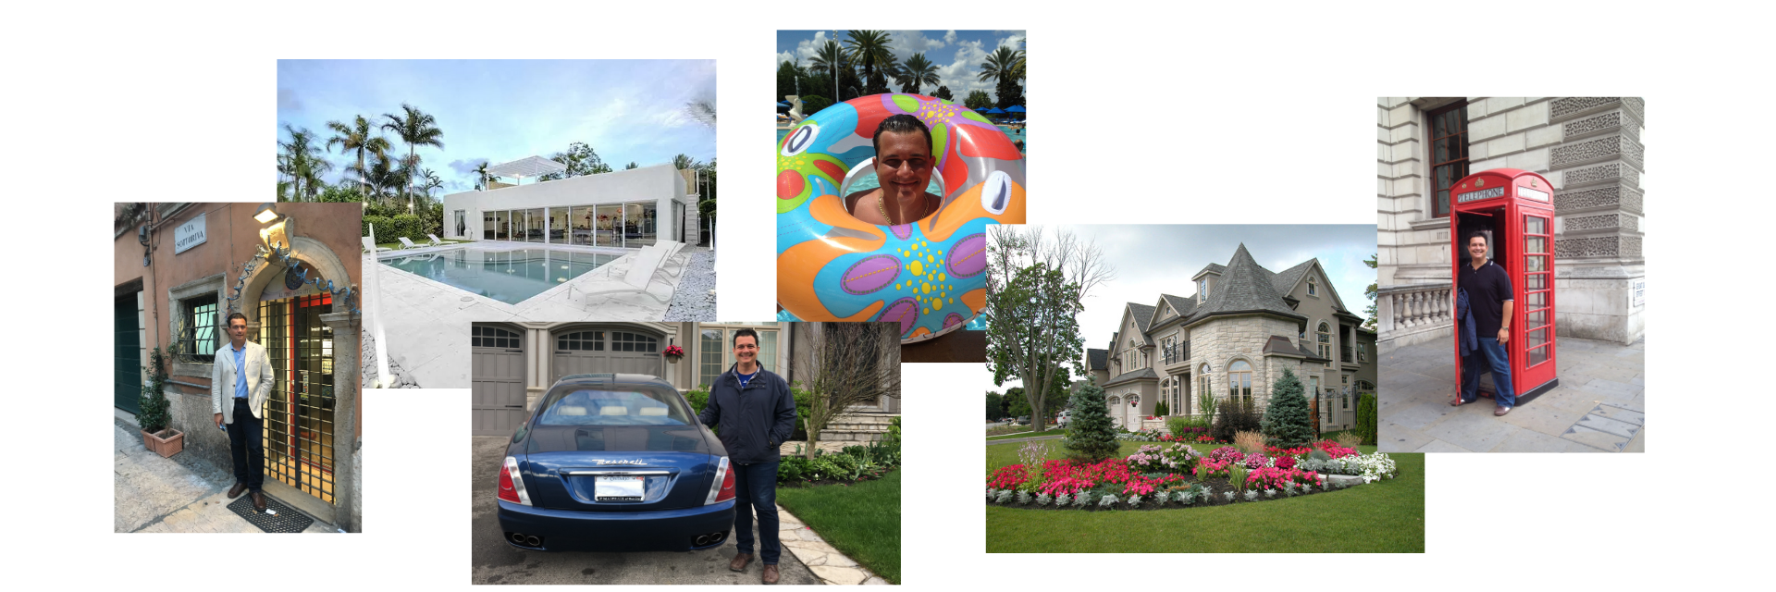
I have been BLESSED! Real estate has helped me!

Slide 18
Who are the cast of characters in the reno process?
Laborer
Handyman
Tradesperson
General Contractor

Slide 19
Who would you need to help plan a renovation?
Architect
Engineer
Interior Designer

Slide 20
Do you really need to hire a general contractor?

Slide 21
Every successful real estate investor needs to learn this very important skill set. You need to know how to evaluate renovation costs.

Slide 22
In this lesson, you will learn how to :
Establish GOALS and VALIDATE them
Identifying a BUDGET
Create a “NEEDS & WANTS” list
Detailed SCOPE OF WORK
Finding and Identifying the RIGHT GC or TRADES
TENDER and CONTRACTS

Slide 23
I am confident in saying that I will help you learn today, how to save you 20% on the total cost of the renovation project, and decrease the renovation time with my “6 Step Multi-Family Scope of Work Made Easy Framework”.

Slide 24

You will be EMPOWERED!

Slide 25

GOALS!

Slide 26

What goes down...will go up! (with some more money invested!)

Slide 27

WRITE down your GOALS!

Slide 28

You need to VALIDATE!

Slide 29

BUDGET! How much money do you have?

Slide 30

“Needs and Wants List”

Slide 31
Hmmm…
Where do you think that you get the highest ROI in renovation spend?
Common area improvements and amenities
OR
Renovation to the individual suites

Slide 32

“You can’t sell the steak without that sizzle!”

Slide 33

DETAILED Scope of Work (SOW)

Slide 34

Be as detailed as possible...

Slide 35

“The Devil is in the DETAILS…”

Slide 36

Let me be a general contractor for 1 second...

Slide 37

Hint :
Get all quotes to include “supply and installation”.

Slide 38

Where do you find good people?

Slide 39

Hint :
You are not going to find good people on :
Craigslist/Kijiji
Looking for garbage bins
6 am at Home Depot!

Slide 40

Start calling those General contractors and Trades!

Slide 41

Time to Quote!
Step #6
Tender & Contract

Slide 42

Hint :
Always put a deadline on receiving quotes.

Slide 43

Check the references of GC and Trades!

Slide 44

Contracts

Slide 45

Hints :
Progress schedule
Payment schedule

Slide 46

Hey Folks!
You want to stay in control of your project?
Money keeps you in control!

Slide 47

Don’t treat your GC and Trades like McDonald’s

Slide 48

GC and Trades are always juggling...

Slide 49

That’s it!
That’s my “6 Step Multi-family Scope Of Work Made Easy Framework.

Slide 50
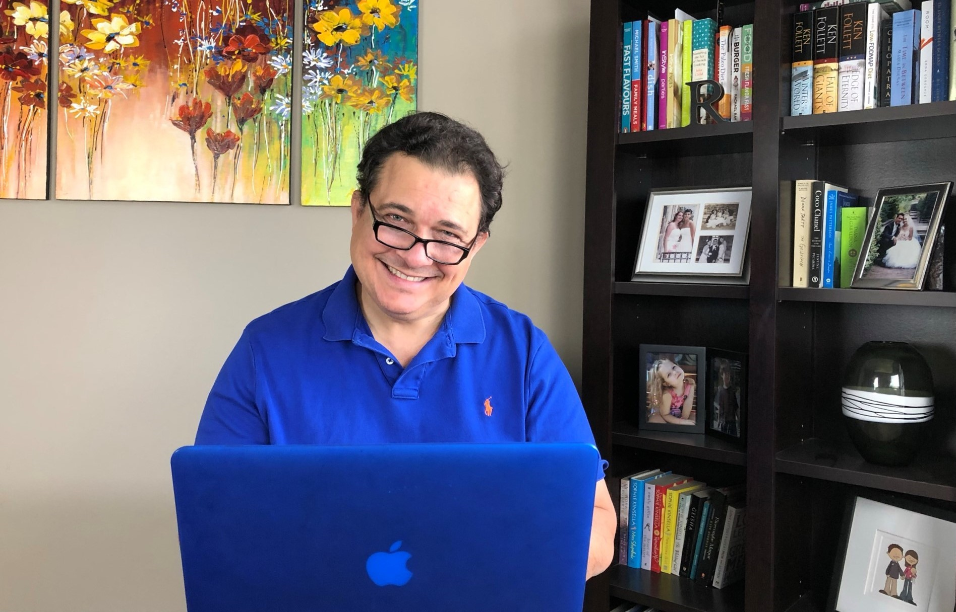
Online Scheduler:
https://go.oncehub.com/VanSturgeon
Email Address:
van@vansturgeon.com
Web site:
www.vansturgeon.com

