Slide 1
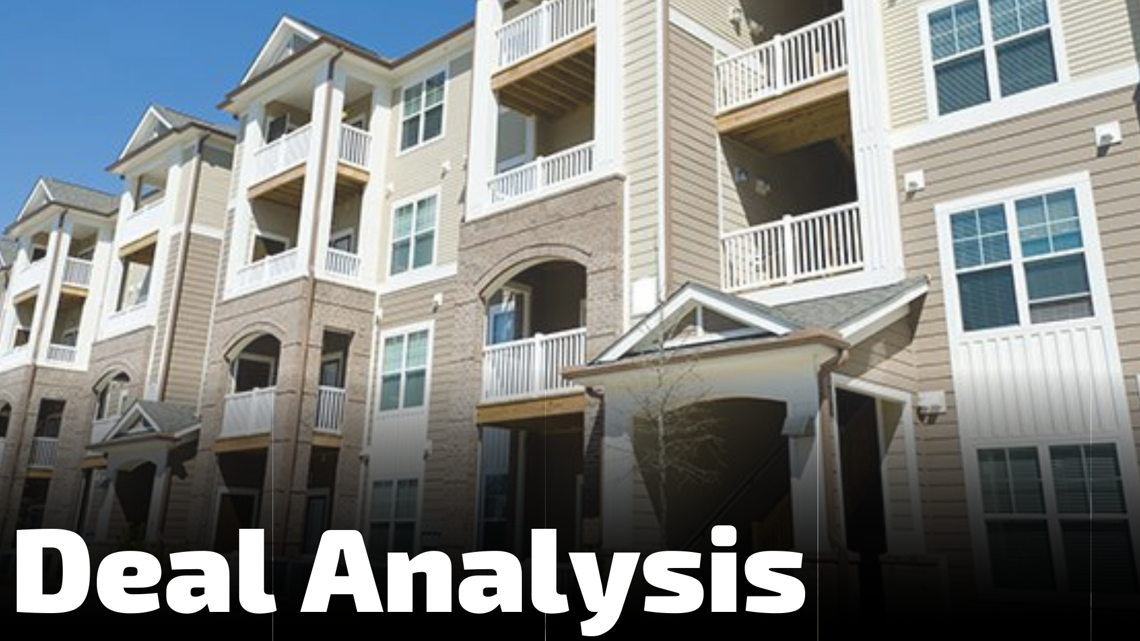
Case Studies
Manual
Page 96

Slide 2
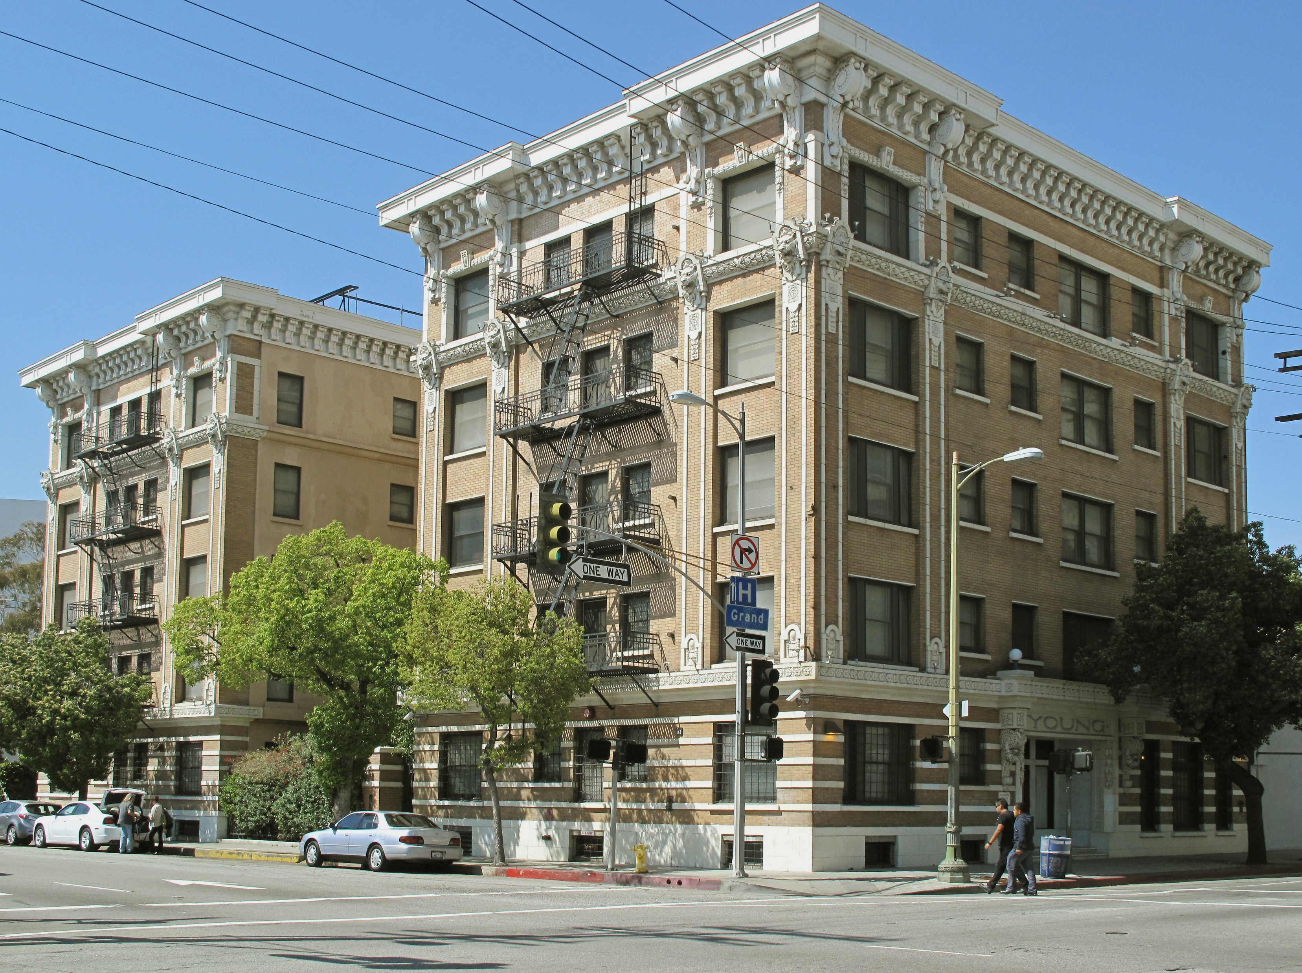
Multifamily
Deal Analysis:
5 Steps to a Quick Assessment

Slide 3




There are four assumptions required prior to starting the quick assessment of a deal
Know Your Targets
Know Basic Analysis
Have a Team in Place
Build Credibility
Analyzing deal specifics require that target criteria are known:
A quick assessment requires basic analysis skills including:
Deal limitations are partially based on the team in place:
Assessing a deal requires the ability to build creditability in the market:
Return requirements
Location
Property Type
Required Renovations
Number of Doors
How to research a market
How to calculate NOI
How to read a rent roll
Spotting expense anomalies
How to identify the cap rate
Experience
Liquidity
Balance sheet
Equity contribution
Knowing the right lingo
Deal team experience
Liquidity / Proof of Funds
Managing broker roadblocks

Slide 4







The goal of the quick assessment is to identify weak links in the deal and to adjust the assessment accordingly
Identifying the weak link allows for deal assumptions to be adjusted based on the expectation that more work or attention will be required for the property. Possibilities include:
Financial Weak Links
Property Weak Links
Number of Doors
Revenue
Expenses
Property Condition
Macroeconomic Conditions
Net Operating Income
Broker /
Seller Relationships

Slide 5
Completing a quick assessment is like creating a scatterplot graph of different possible valuations. There are 5 steps:
Step Name
Scatterplot Valuation Graph¹
1
Super Quick Assessment
1
4
2
Calculate Net Operating Income
2
3
5
Consider the number of doors
3
4
Evaluate the condition of the property
5
Apply macroeconomic Considerations
1 - For illustrative purposes only

Slide 6
Step 1: The “super quick assessment” provides the first value in the scatterplot
Assessment Criteria
Assessment Consideration(s)
Target Market?
Is the property located in the desired market and sub-market?
50% Expense Rule?
Are total expenses ~50% of income?
Do adjustments need to be made to the income statement?
Income Statement Adjustments
What is the cap rate’s relationship to the market? Is it realistic?
If the property passes muster, proceed to step #2. Otherwise decline.
Cap Rate?
Value = Income*50% / Cap Rate
Proceed to Step #2

Slide 7
Step Two: Calculating Net Operating Income provides a second frame of reference for value
Calculation Input | Calculation Considerations
Gross Income | Use the broker number for the trailing 3 months
Other Income | If there is a major source of “other income”, include it
Gross Potential Revenue | Equal to Gross Income plus Other Income
Total Operating Expenses | ~$4,500 per door. Make minor adjustments as needed
Net Operating Income | Equal to Gross potential revenue minus expenses
NOI / Cap Rate = Value #2

Slide 8




Step Three: Consider the number of doors within the context of your investment objectives. Adjust accordingly.
Value Calculation
Number of Door Considerations
 | Gross Potential Revenue
- | Operating Expenses
+/- | Exp. Adj. based on # of doors
= | Net Operating Income
/ | Cap Rate
Do the number of doors contribute to the ability to scale?
Are the number of doors in a new market or existing one?
Do you have a relationship with a property manager?
# Door Adjustments = Value #3
Are there cost savings or efficiencies to be gained?
Value #3

Slide 9





Step Four: Consider the property’s condition and required CapEx assumptions. Adjust value accordingly.
Value Calculation
Property Condition Considerations
 | Gross Potential Revenue
- | Operating Expenses
+/- | Exp. Adj. based on Property Cond.
= | Net Operating Income
/ | Cap Rate
What is the age of the property?
Is a site visit possible?
Have there been recent renovations?
Condition Adjustments = Value #4
Are major systems in working order?
Can renovation costs be repaid within 36-months?
Value #4

Slide 10




Step Five: Adjust property assumptions based on the economic forecast for local market conditions
Value Calculation
Economic Considerations
 | Gross Potential Revenue
- | Operating Expenses
+/- | Exp. Adj. based on Economic Cond.
= | Net Operating Income
/ | Cap Rate
What is the population of the sub-market?
Does job/population growth support rent bumps?
Does surrounding retail indicate growth?
Economic Adjustments = Value #5
Does median income support rent growth?
Value #5
Are the rent/buy economics in favor of renting?

Slide 11



By putting together a scatter plot, patterns start to emerge. Consider them within context of your broker relationship
Scatterplot Valuation Graph¹
Broker Relationship Considerations
Is the broker experienced with multifamily deals?
Have you worked with the broker before?
1
4
Within
10% - 15%?
Is the deal on market or off?
2
5
3
Avg. of Values vs. Asking price?
1 - For illustrative purposes only

