Slide 1


CLASSIFICATION OF PROPERTIES

Slide 2

Class A Properties
Premier/Luxury
Most Expensive
  Typically $100,000 or up a unit
Newest and most modern
  Constructed within past 10 years
  Properties over 10 years have been substantially renovated and updated
High quality and modern construction
Energy efficient
Excellent Location
Amenities: pool, gym, attractive office

Slide 3
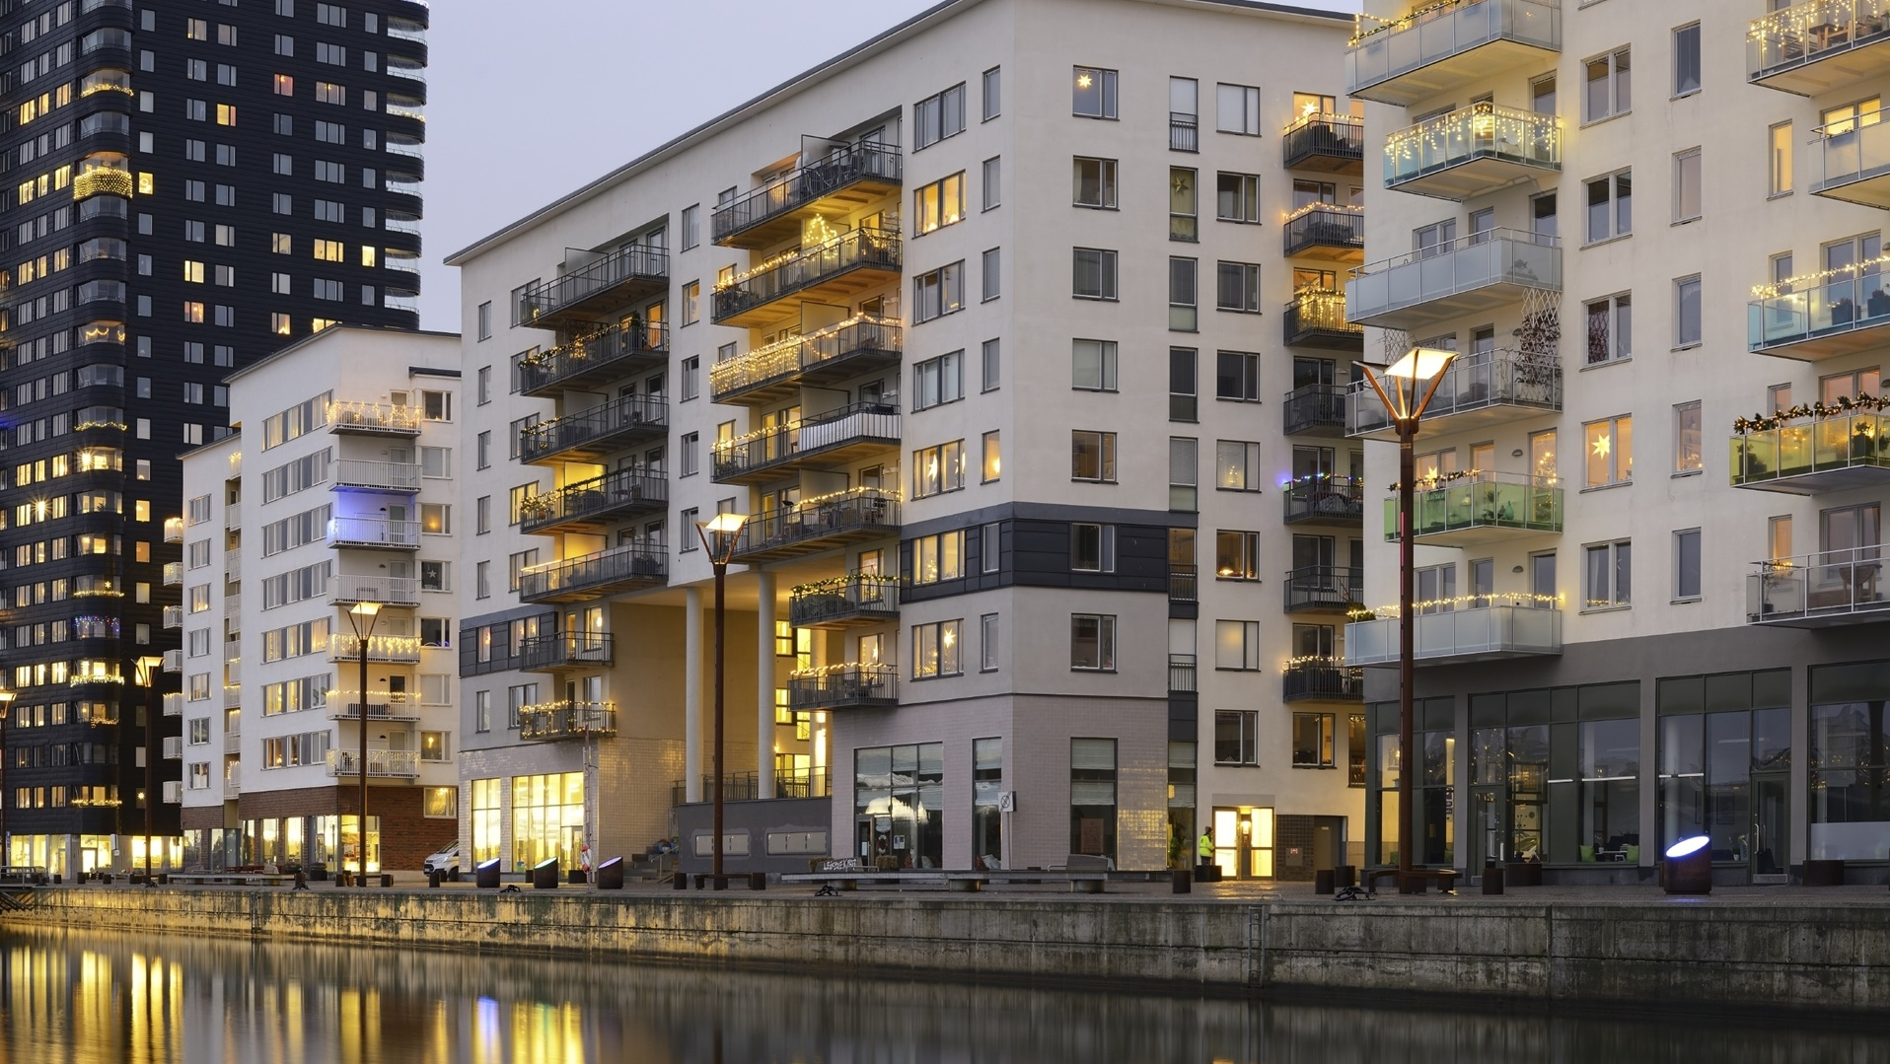

Slide 4

Class B Properties
Serves middle income tenants
Can vary greatly
Constructed within last 15-30 years
Very good functionality
Little deferred maintenance
Good quality modern construction
Good quality landscaping
Located in stable neighborhoods
Often has amenities

Slide 5

Class C Properties
Constructed within last 30-50 years
Average to low functionality
Typically outdated and in need of remodel
Limited, if any, amenities
Location could be in stable or declining area
Typically good rental rates
Average vacancy
Average appreciation

Slide 6
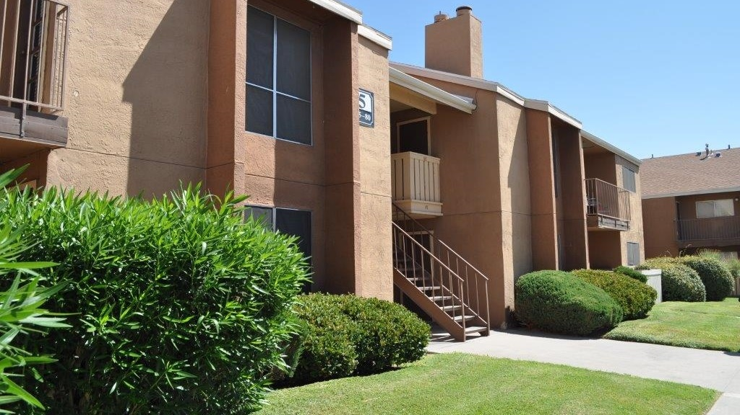

Slide 7

Class D Properties
Roughest properties
Violence, drugs, prostitution
Constructed in last 30-100 years
Extreme functional obsolescence
Poor construction with poor materials
Poor condition
Bad location in roughest parts of town
No amenities

Slide 8
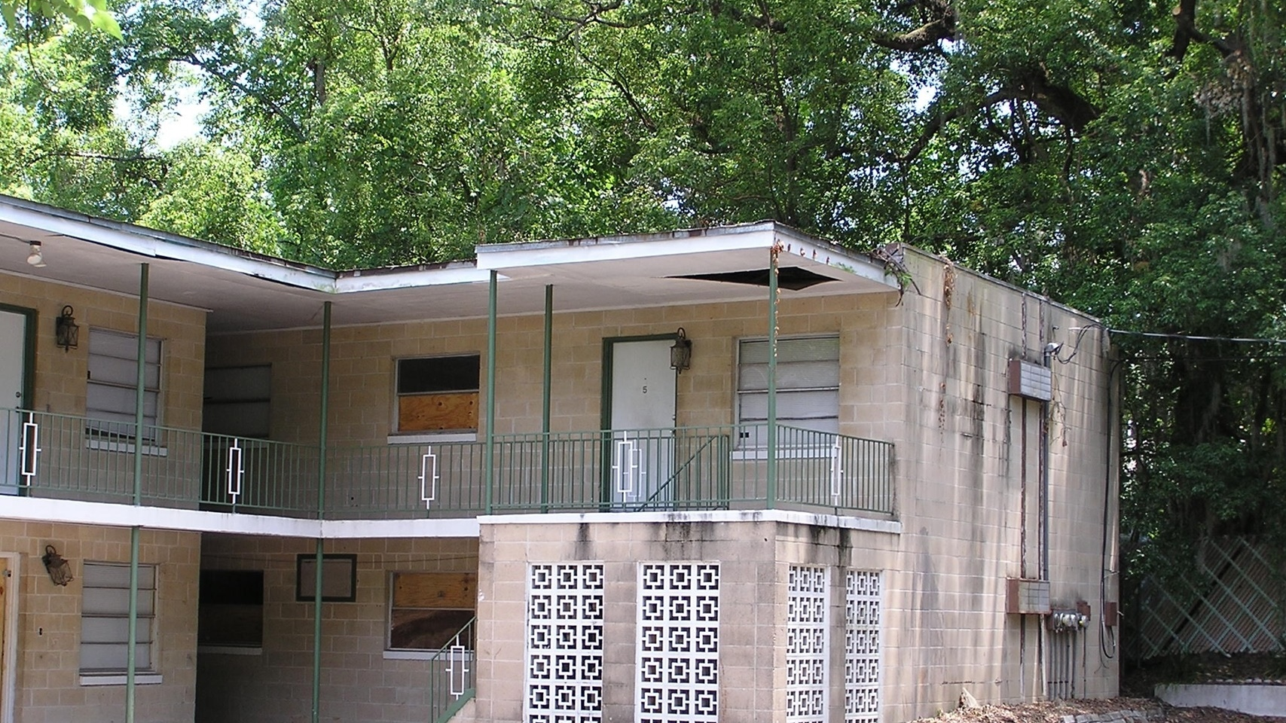

Slide 9
What We Target
        We like C properties in B areas
          Or
        We like B properties in A areas

Slide 10

SELECTING YOUR INITIAL
MARKETS TO EVALUATE

Slide 11

4 Initial Markets to Consider
Your backyard (2-hour drive any direction)
A place you know well, often where you grew up
A place with boots on the ground
A place you want to retire

Slide 12

What to Look for in a Market
Population Growth
Income Growth
Job/Employment Growth

Slide 13
Additional Market Considerations
Median home price ($80,000+)
Vacant housing
(Less than 20%)
Multiple large employers
No one-horse towns

Slide 14
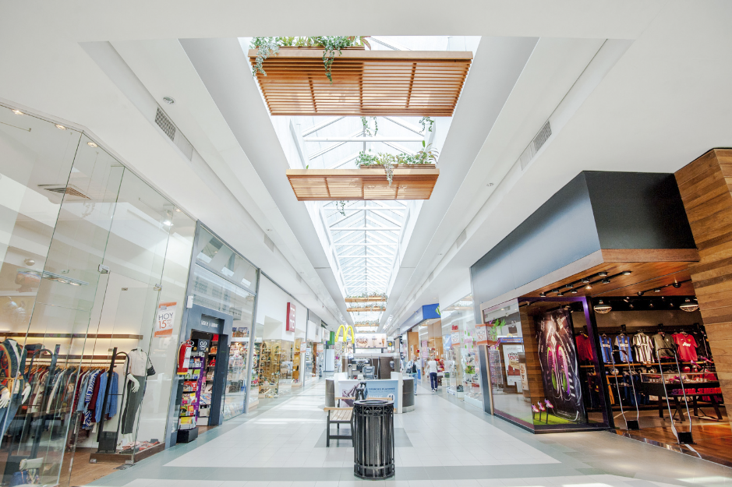


City Infrastructure
Ideally minimum 100k population
Like an airport with one major carrier
Has a highway that runs through it.
Shopping Hub area

Slide 15

Four Websites to Check Demographics
www.Census.gov
www.City-Data.com
www.BestPlaces.net
www.DataUSA.IO

Slide 16
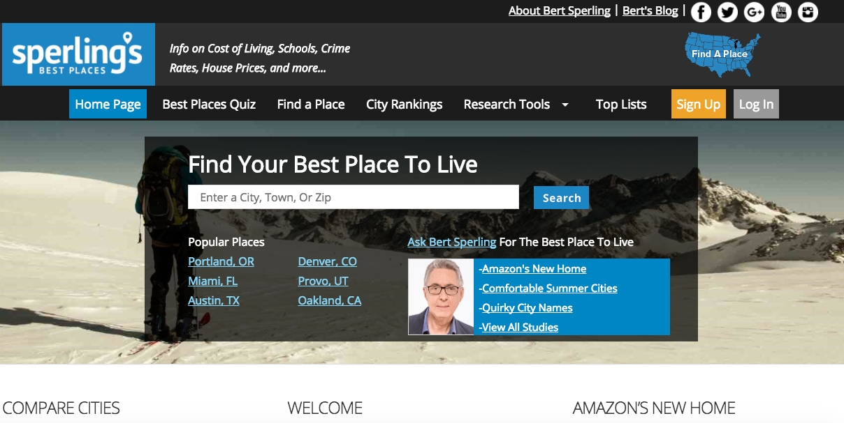

Slide 17
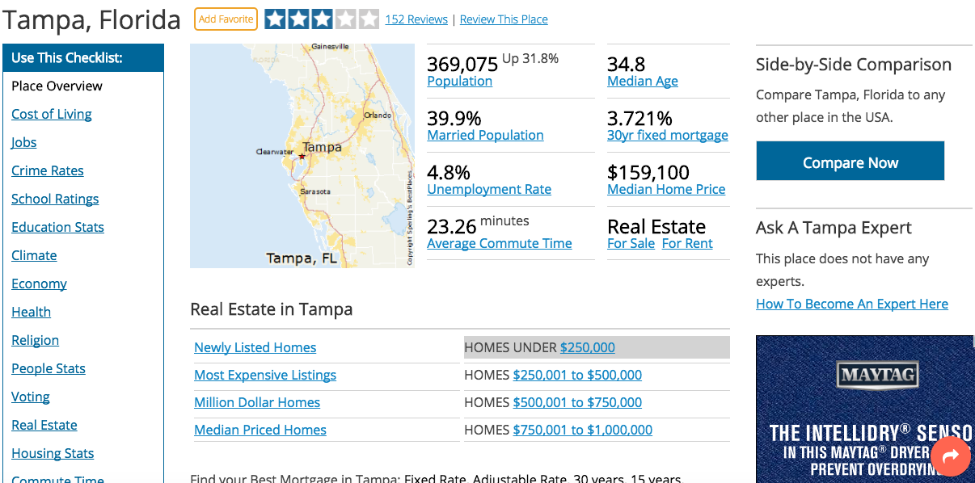

Slide 18
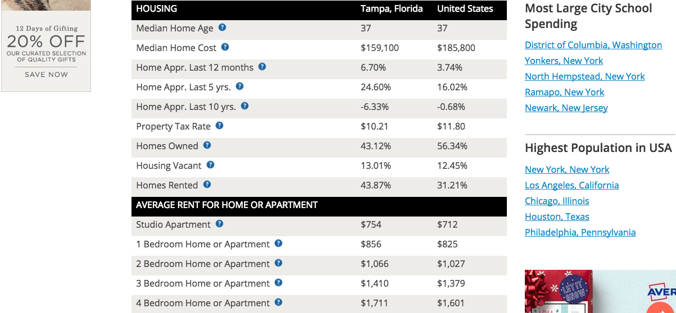

Slide 19
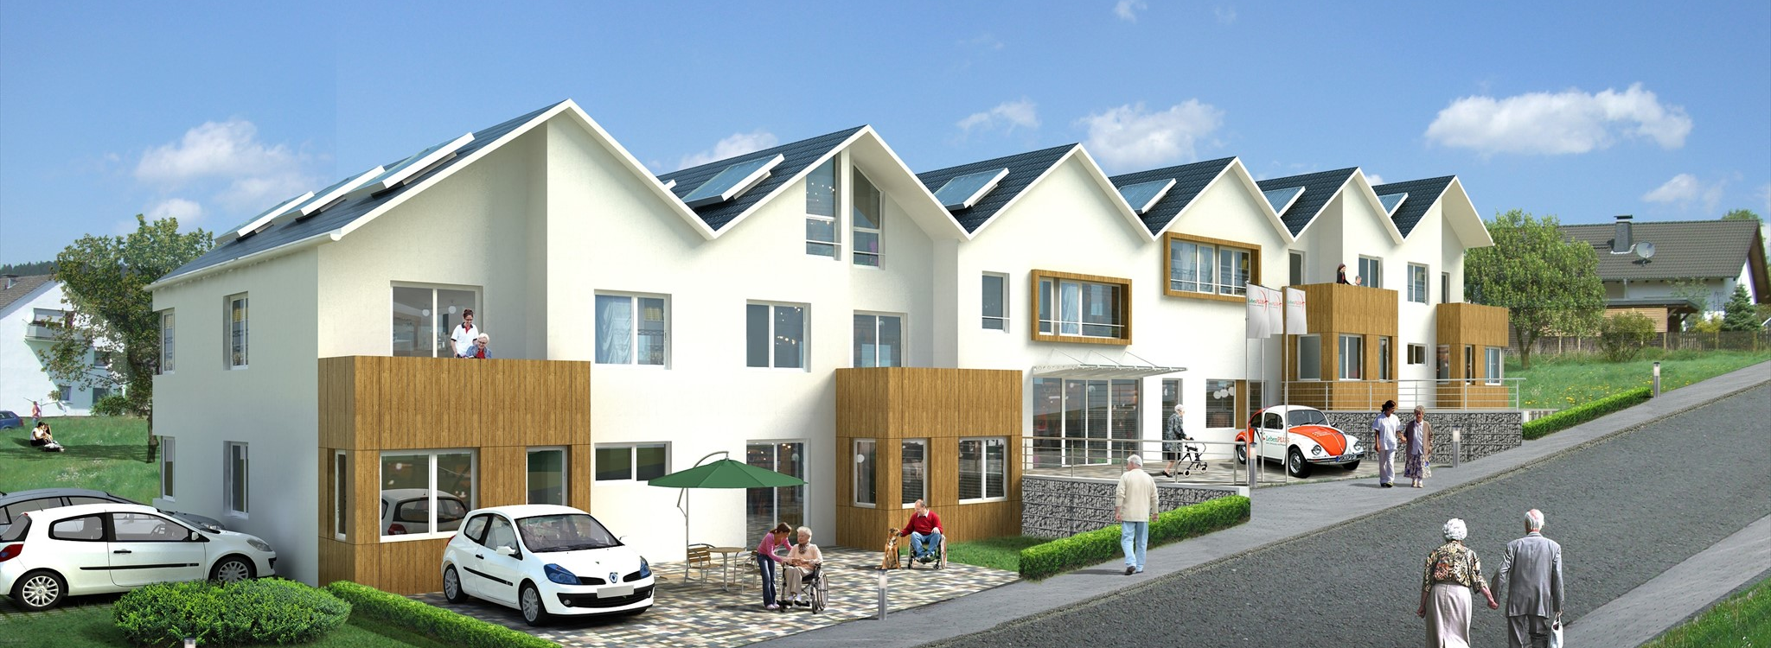
MASTERING CONSISTENT DEAL FLOW

Slide 20

“Be A Problem Solver and Entrepreneur, Not Just an Investor”
-Rod Khleif

Slide 21

The Importance of Building Relationships
Real estate is a relationship
driven business
It’s impossible to do it alone and unnecessary
This is a team sport

Slide 22
You Need Relationships With:
Sellers
Investors
Bankers & Lenders
Brokers
Service Providers
Insurance Agents
Property Management Companies or your Onsite Staff

Slide 23
Foundation of a
Successful
Business
Relationship
Rapport
Commonality
Trust
Respect
Overall “I like this person”
People only do business with those they like

Slide 24

Utilizing Brokers
One good broker can make you wealthy
Focus only on multifamily brokers
Ask the good ones to refer you to other team members

Slide 25

Finding Brokers - LoopNet
Multifamily for sale
  Find a broker who has several properties for sale
  You’re calling “in regards to one of their LoopNet listings”
  Broker Script

Slide 26

Script
Hello, my name is _____, and I’m an investor out of “your city”, how are you today?
I’m calling in regards to one of your LoopNet listings. It’s “Shady Oaks”…Is that property still available?
Great, I definitely want to see some more information on that. Before you send that, I do have a few quick questions.
What’s the story on this property? Why’s it for sale?
Interesting, this sounds like it has potential. Here is my contact info:
Also, do you typically list properties similar to this one?
My partners and my criteria is “_____”, and we’re currently looking
to acquire several properties within the next year. Feel free
to send anything similar, I’ll be sure to get back
to you as soon as possible.

Slide 27

Valuing Brokers – Following Up
Most people never follow up
Say why the deal didn't work for you with specifics from your analysis
Refresh their memory on your exact investment criteria
Respect the broker’s time
Set yourself apart

Slide 28

Brokers – Consistent Communication
Every few weeks email or call your broker(s)
Maintaining the relationship is key
How do you set yourself apart?
Goal is to get off market deals

Slide 29

Online Sites
“LoopNet is the place deals go to die”
(not true)
Look for what others have missed
  Could you increase income or decrease expenses?
  What expenses are high?
  Management overpriced?
  Are the rents at the current market rate?
  What’s the area’s vacancy percentage?

Slide 30
Example: 24 unit near Tampa, FL
Listed on LoopNet for almost 3 years
Was being sold at a 6 Cap
Didn’t have any info or even rent amounts listed
Very little info because sellers were in their 90’s
Determined rents were $150 below market
Expenses were very high
  Being overcharged on landscaping and maintenance
Huge value opportunity overlooked by thousands

Slide 31

Other Online Sites
Other listing sites include
  City Feet (cityfeet.com)
  NAI Global (naiglobal.com)
  The Commercial Investment Multiple
  Listing Service (cimls.com)
Broker sites that have a high volume of properties
  Marcus & Millichap (marcusmillichap.com)
  CBRE (cbre.us)
  Cushman and Wakefield (cushmanwakefield.com)
  Coldwell Banker Commercial (cbcworldwide.com)

Slide 32

Be on the Lookout for:
Abnormally low rents
Abnormally high or low
expense ratio
Expenses missing
Seller that has become increasingly motivated due to “stale” listing
Very little information available
The market’s vacancy percentage compared to subject property’s %
Overpriced management

Slide 33
Property Management Companies
Property management companies speak with their multifamily owners at least once a month
They also know the property better than anyone, including the owner
  The problem tenants
  The most common maintenance problems
  The best contractors
  When the owner wants to sell
  Know the “situation” of every owner and property
    They know who wants to sell now
    They know who wants to sell soon
    (6 months – 2 years)
    They know who will always sell if the price is right

Slide 34

Auctions
Always listed significantly below market value
Usually below replacement value
This is by design to entice you to bid
Few things to be aware of:
Properties sold as is
Sellers can hide defects
No contingencies
Need financing lined up prior
Must have money ready prior
Online and Onsite auctions and sometimes webcast

Slide 35
Auction Houses
Biggest nationwide auction houses
Auction.com / Ten-X (ten-x.com)
Tranzon (tranzon.com)
Treasury.gov/auctions
Williams and Williams (williamsauction.com)
Hudson and Marshall (hudsonandmarshall.com)
Albert Burney (albertburney.com)
Bill Fair & Company (billfair.com)
J.P. King (jpking.com)
Joe Roebuck (roebuckauctions.com)

Slide 36
Two Categories of Auctions
Reserve auctions
  Minimum bid amount must be met
Absolute auctions
  Property will sell for whatever highest bid is
Does highest bidder always win?
Yes, in absolute auctions
In reserve auctions the seller can refuse to sell if the bidding doesn't reach their minimum price

