Slide 1


Bridge and Transitional Financing

Slide 2
When To Use a Bridge Loan
Improvement Budget is High
Property Is Under Performing
DSCR Cannot Support Agency/ Other
Rents are significantly under market
You have a 2-3 Year period before capital event
Contractors/ Other Construction is lined up in the area

Slide 3
When to Not Use a bridge loan
DSCR doesn’t work because of PRICE
Cannot predict renovation budget
No supporting stabilized value comps
Short timeline forced by broker
Out of town/ no local management of contractors
Exit strategy is 10+ years

Slide 4
Basic Bridge Loan Definitions
Target Loan Amount
Initial Advance
As Is Loan to Value
As Stabilized Loan to Value
Future Funding
Term/ Extension Options
Amortization on Extension
Prepayment

Slide 5
Achieving Maximum Leverage
#1 Loan Cut – As Stabilized Value Stip
Market Cap Rate on Costar/ Others
Market Rents Post Renovation
Market Expenses Post Renovation
Business Plan Timeline
Draw Schedule

Slide 6
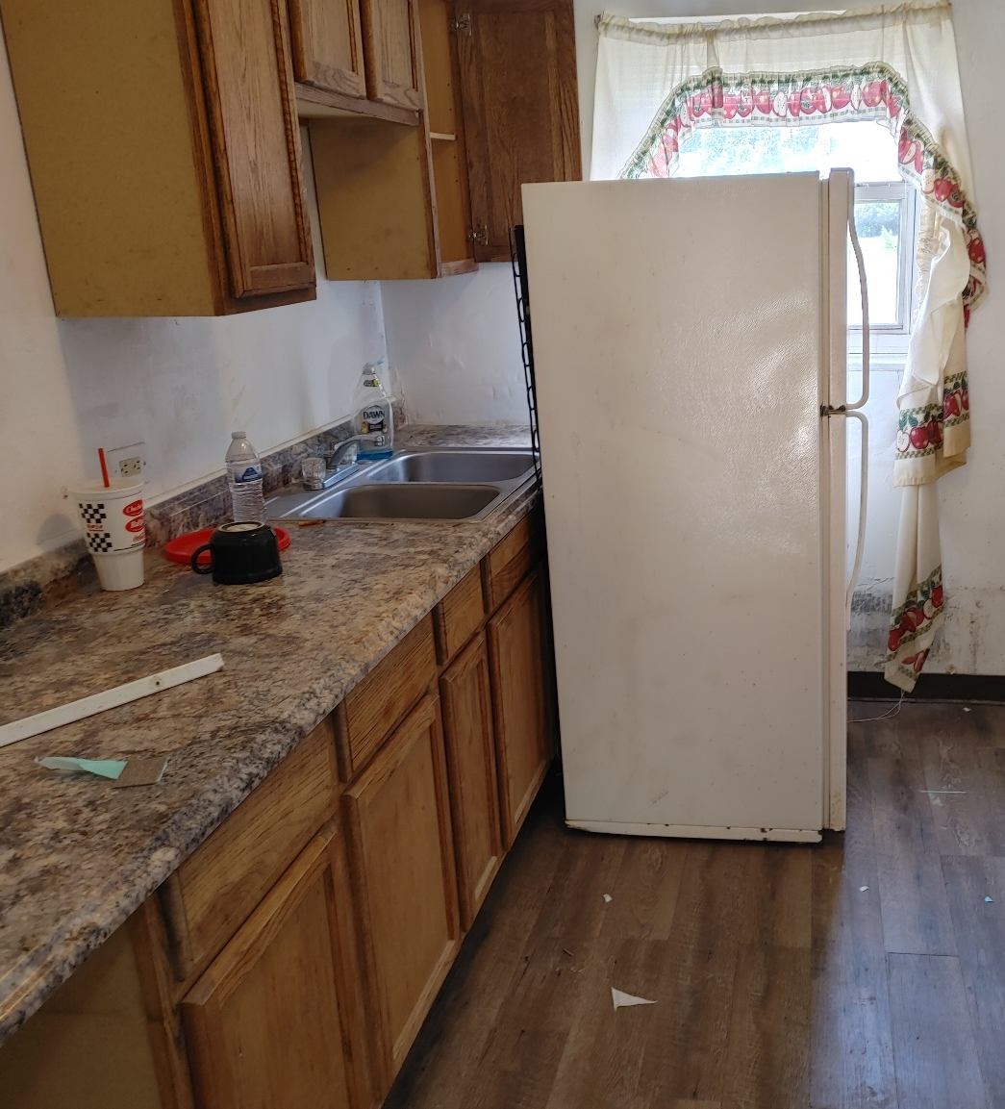
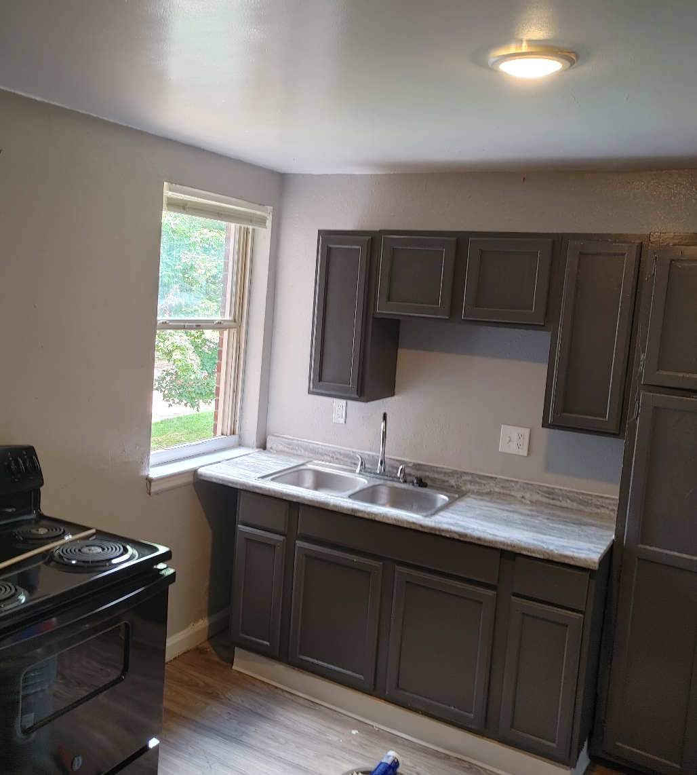
Before and After

Slide 7
Example Rent Proforma
Unit Type |  | Count | Avg SF | Avg Rent | Avg Stab. Rent
1 x 1 |  | 20 | 750 | 610 | 730
2 x 1 Small |  | 8 | 850 | 672 | 825
2 x 1 Large |  | 24 | 1000 | 717 | 850
2 x 1.5 Townhome |  | 28 | 1100 | 748 | 910
Average |  | 80 | 958 | $ 697 | $ 839

Slide 9
Key Details
Springing Recourse
Cash Management
Springing Lockbox Soft/ Hard
Independent Directors
Force Funding
Ongoing Inspections
Minimum Interest
Cash Sweeps

Slide 10
Interest Rate Caps
Insurance Policy on floating rate debt
Many bridge lenders require
SOFR vs. LIBOR
Notional
Duration
Strike Rate
Key Rate
Interest rate volatility

Slide 11
Predicting Interest Rates
Predicting Future almost Impossible
10 Year T different than “Fed” Rate Hikes
Short End vs. Long End of Curve
Take in all factors
Model Cashflow
Where would rates have to go to wish?
Present Value Savings
Relationships > Rate (Especially on Bridge)

Slide 13
Contact
Tyler Carney-DeBord
Principal
Atlas Real Estate Capital
tyler@atlasrecap.com
740-513-9492
Atlasrecap.com

