Slide 1


Slide 2

Bookkeeping & Accounting
This varies based upon how big your portfolio is
Bookkeeping
Can outsource
Virtual Bookkeeping
QuickBooks
Realize that time is money

Slide 3

Bookkeeping & Accounting
Accounting
Find an accountant who has commercial real estate experience
Find an accountant who understands cost-segregation

Slide 4

Hiring Onsite Staff
Maintenance Men
1 full time for every 75 - 100 units
Add another full time maintenance man every 60 – 80 units
If units are old and poorly maintained you may need more
You may also add a make ready person every additional 60 – 80 units

Slide 5
Hiring Onsite Staff
Community Manager
75 units is usually the bare minimum for a full time onsite manager (depending on class)
150 unit complex or more, typically need a full time onsite manager plus 2 leasing agents
200 plus units, you need manager, assistant manager, and 2 leasing agents
300 plus units you would likely add a collections person
When you get to 150 units you can afford everyone you need

Slide 6

Focus on the NOI
Even small improvements can have a huge impact
For example a $20 a month rent increase on a 100 unit building creates a $24,000 increase in the NOI
At a 6 cap, you just increased value $400,000
$24,000 / .06
What if you not only increased income $20, but also decreased the expenses $20?

Slide 7



Strategies to Increase Your Income-NOI
Add storage units in basements or on extra land
Paid Parking (if competition charges for parking)
Covered Parking
Pet Rent
Valet Trash service
Charge for Extermination monthly
Billboards
Cellular Towers
Vending Machines
Laundry

Slide 8

Strategies to Decrease Expenses

Slide 9


RUBS
Rubs = Ratio Utility Billing System
You divide the water/sewer costs among all the residents and bill them accordingly
Be sure to check and see if the competition has instituted RUBS
If not, you can get some vacancies

Slide 10

RUBS
The legality of this varies state to state. We recommend using a RUBS provider:
American Conservation & Billing Solutions
http://www.amcobi.com/index.php/utility-billing-services/ratio-utility-billing-services-rubs
Multifamily Utility Company, Inc.
http://www.multifamilyutility.com/rubs.html
United Utility Services
http://www.unitedutilityservices.com/service/ratio-utility-billing-system/

Slide 11
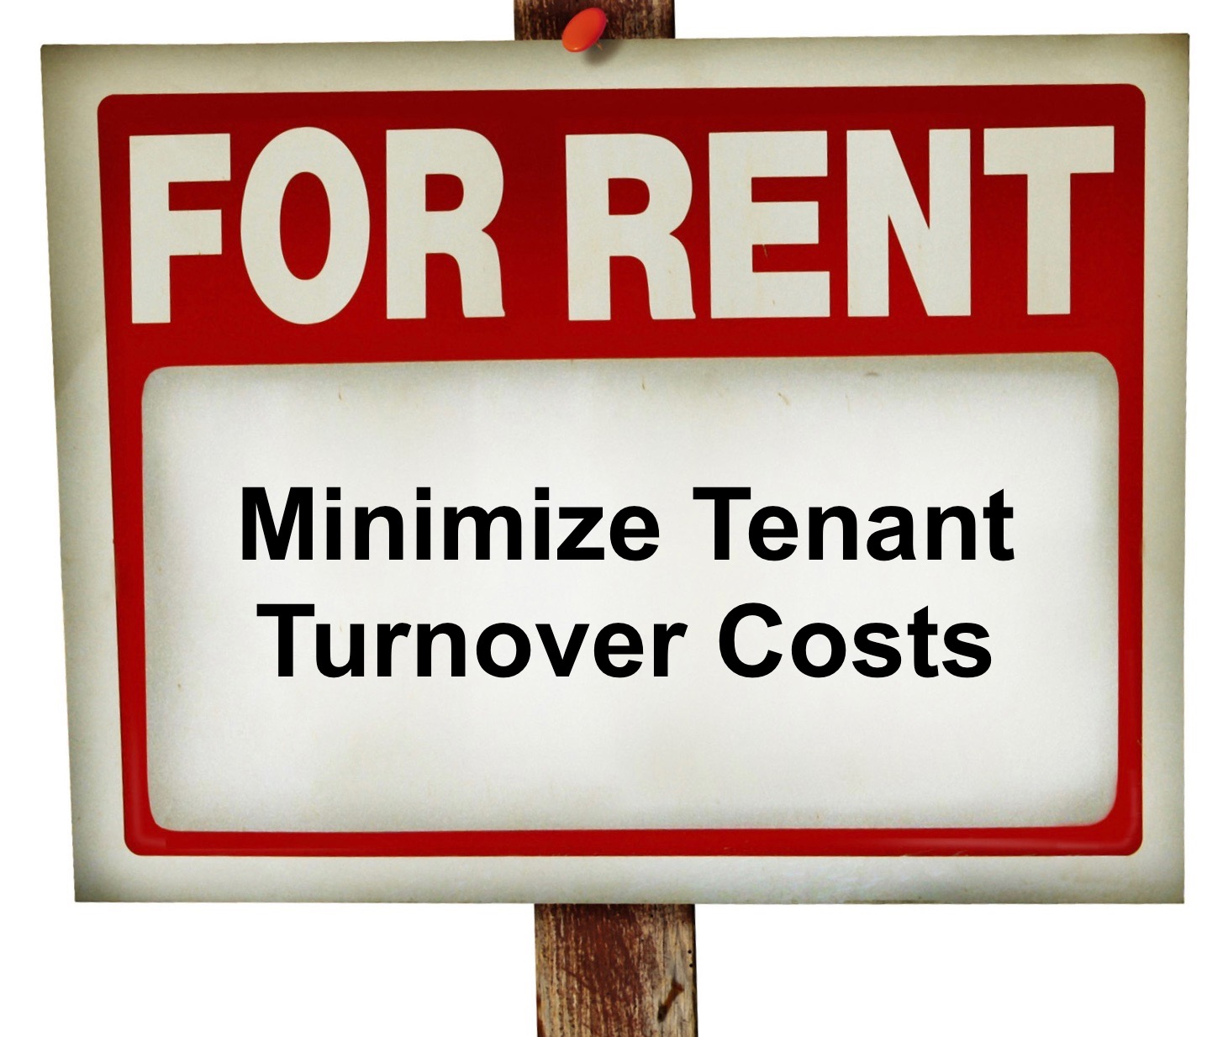
Reduce Unit Turn Time
For example:
2 vacancies a month
Rent is $1,000
It takes you 1 month to fill them
That’s $24,000 of lost income a year
A tighter turn around time:
2 vacancies a month
Rent is $1,000
It takes 2 weeks to fill them
You cut your losses in half, and dropped turnover expenses to $12,000 a year

Slide 12

Decreasing Expenses
Install motion lighting in common areas or put on timers
Use fluorescent lighting in hallways
Install water-saving faucets and showerheads
Install water saving toilets or put a brick or other container in the tank (reduces amt of water to fill)
Charge tenants for all repairs that they caused AT TIME OF REPAIR
Challenge tax assessment
Put the insurance out to bid yearly

