Slide 1

Tic dst dst oh my

Slide 2
Ways to defer capital gains in real estate
1031 exchange
Defer them
Way to raise capital for deals
1031 exchange

Slide 3
What does a property owner who has made a bunch of money on a property do to avoid giving much of that profit to the IRS?
Short term or long term gains
Passive investor

Slide 4
Vehicles to accomplish a 1031 exchange
TIC (tenant in common)
DST (Delaware statutory trust)
Vehicle for deferring taxes
DST (deferred sales trust)

Slide 5
Tenant In Common Structure
Co-owners of the property
Equal voting
Use same entity
Safe harbor (intermediary)
PE doesn’t work

Slide 6
Syndication TIC org chart

Slide 7
Delaware Statutory Trust
Entity for doing business (similar to LLC, corp, etc)
Asset manager
Investors purchase “shares”
Passsive investment for investors
PE works

Slide 8
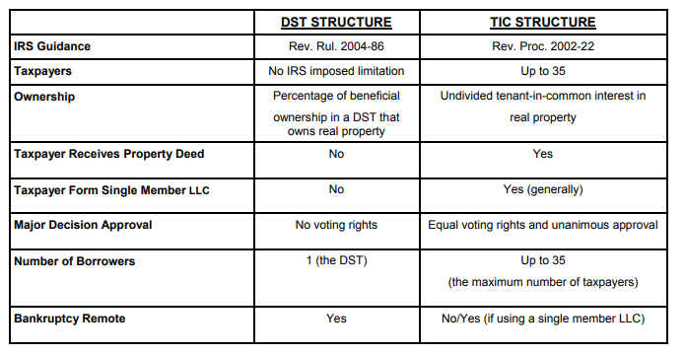

Slide 9
Delaware Statutory Trust
Available for all asset classes
Defer taxes in passive environment
No new funds once closed (!!)
Payout same – distribution and capital
More costly to create

Slide 10
Deferred Sales Trust
Move asset to third party trust and trust sells property
Sales held in trust and distributed over pre-determined time frame.
Taxes deferred until distributions paid

Slide 11
Deferred Sales Trust
Must use independent trustee
Investor/owner is issued a note
Ownership transferred just prior to sale
Can be a backstop for failed 1031

Slide 12
Questions?

