Slide 1
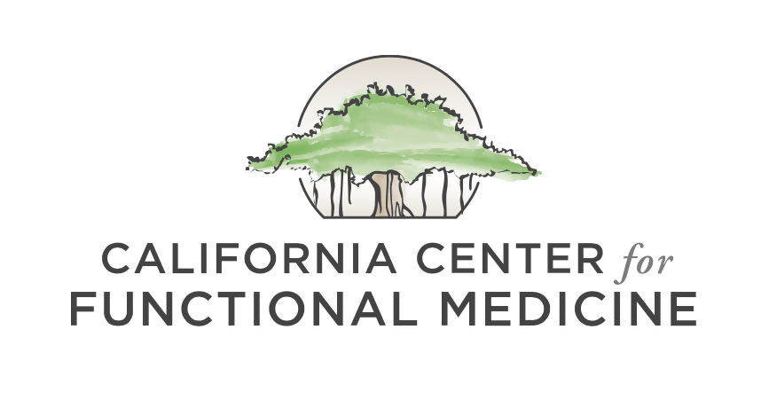
COVID-19 UPDATE
Looking Forward at Nutrition, Metabolic Health, and COVID-19
Lindsay Christensen, MS, CNS
May 22, 2020
©2020 All Rights Reserved, California Center for Functional Medicine

Slide 2
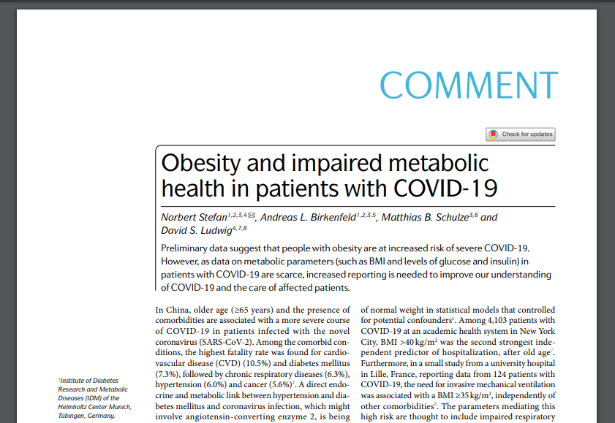
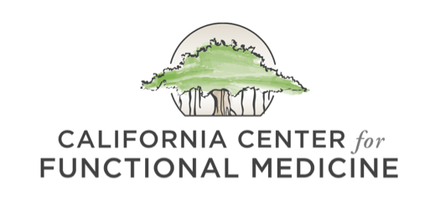
In the Time of COVID-19, Metabolic Health is Essential
Nutrition talk around COVID is transitioning from discussions of acute immune support towards long-term prevention.
A growing body of research suggests that being metabolically unhealthy significantly increases one’s risk of contracting COVID-19 and suffering a severe course of infection
Only 12% of American adults are metabolically healthy, without the need for medications (1)
Blood glucose
Triglycerides
HDL cholesterol
Blood pressure
Waist circumference
Looking forward, optimizing metabolic health may be essential for protecting yourself from future waves of COVID

Slide 3
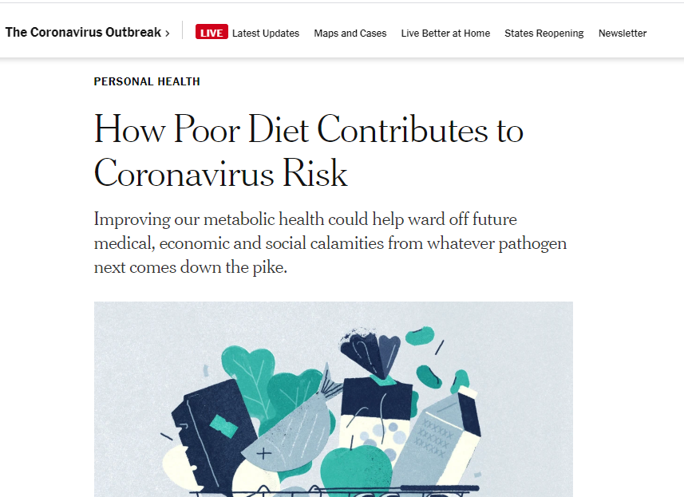
Ways to Improve Metabolic Health with Nutrition
Cut out the junk food!
Eat a nutrient-dense, Paleo template diet.
A Paleo diet has been shown time and time again to improve cardiometabolic risk factors (2, 3)
Improve waist circumference, triglycerides, blood pressure, HDL cholesterol, and fasting blood sugar.
Consider incorporating intermittent fasting.
Fasting has been shown to rejuvenate populations of immune cells (4)
It also reduces inflammation and improves cardiometabolic risk factors (5)
A 16:8 time window is a good option
The Zero app is a helpful tool for tracking fasting
One interesting study showed that fasting helped in bacterial infections but not in viral infections. While this was only one study, it may be better to avoid longer multi-day fasts at this time and stick with daily IF.

Slide 4
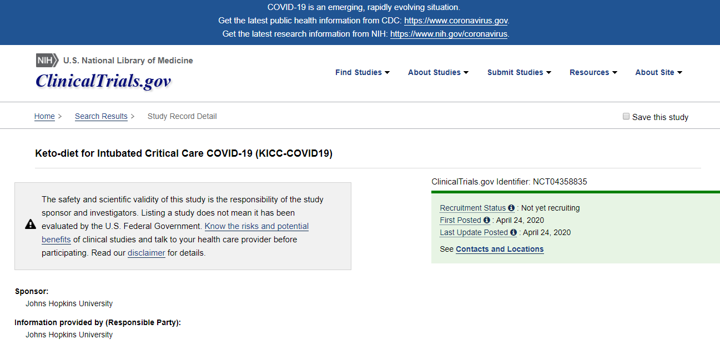
Possible Benefits of a Ketogenic Diet in COVID-19?
A clinical trial is under way that will investigate the applications of a ketogenic diet in COVID-19 critical care patients. (6)
In sick individuals, it is possible that a ketogenic diet could improve gas exchange, reduce inflammation, and reduce the duration of mechanical ventilation.
Does this mean you should go automatically go on a keto diet?
No, not necessarily! There are many factors that may impact whether or not keto is right for you.
In some people, keto may improve metabolic risk factors that contribute to the risk of catching COVID.
“High fat, low carbohydrate diets have been shown to reduce duration of ventilator support and partial pressure carbon dioxide in patients with acute respiratory failure. In addition, metabolic ketosis reduces systemic inflammation. This mechanism could be leveraged to halt the cytokine storm characteristic of COVID-19 infection.”

Slide 5
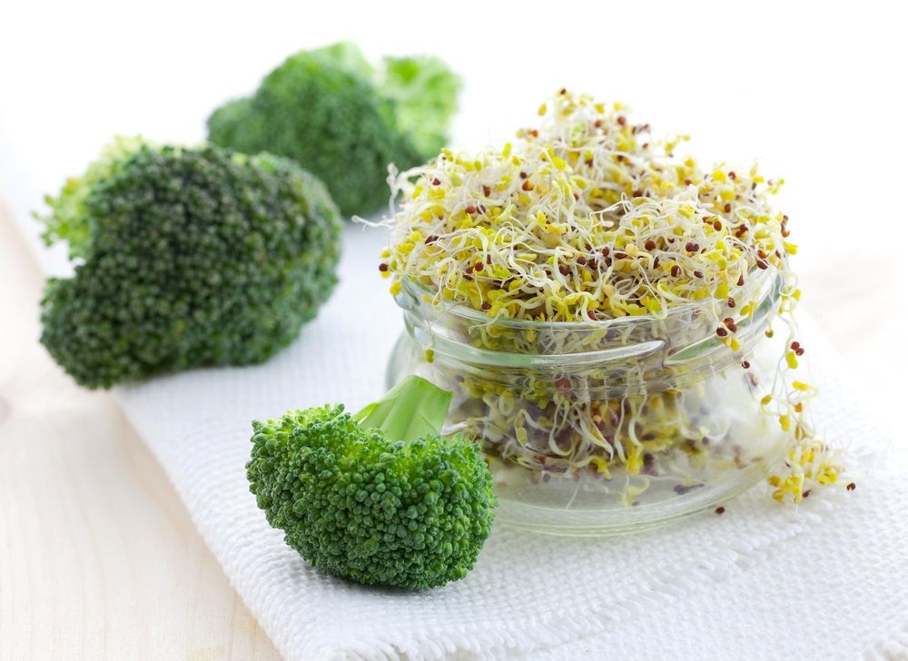
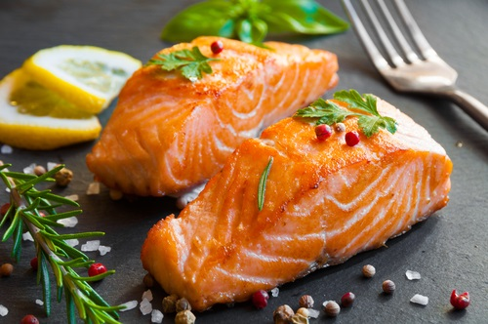
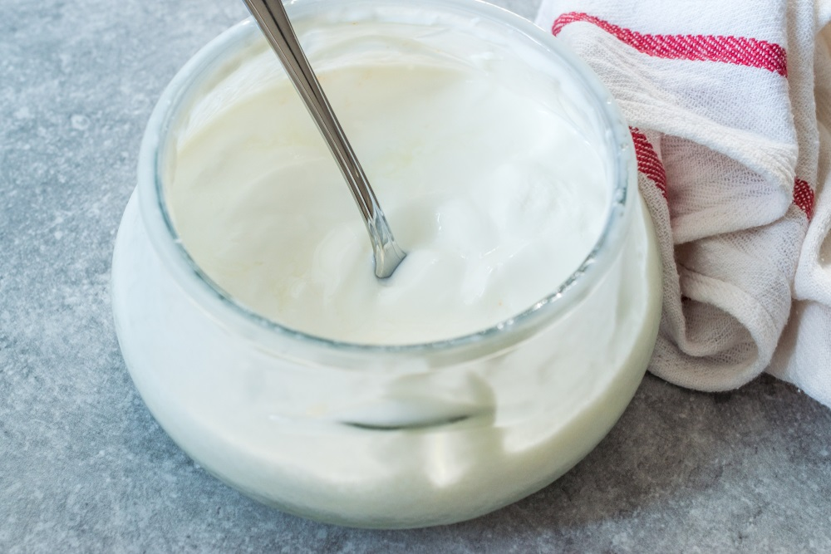
Foods for Cardiometabolic Support
Blackberries and blueberries (7)
Wild seafood: Contains omega-3 fatty acids from seafood and astaxanthin have beneficial effects on cardiometabolic risk factors (8, 9)
Sulforaphane: Found in cruciferous vegetables, particularly broccoli sprouts (10)
Nuts (11)
Fermented full-fat dairy products, if tolerated (12)

Slide 6
References
Araujo J, et al. Prevalence of optimal metabolic health in American adults: National Health and Nutrition Examination Survey 2009-2016. 2019; Metab Syndr Relat Disord. 2019; 17(1): 46-52.
Markofski MM, et al. Single-arm 8-week ad libitum self-prepared Paleo diet reduces cardiometabolic disease risk factors in overweight adults. Am J Lifestyle Med. 2019; [online].
Manheimer EW, et al. Paleolithic nutrition for metabolic syndrome: systematic review and meta-analysis. Am J Clin Nutr. 2015; 102(4): 922-932.
Cheng CW, et al. Prolonged fasting reduces IGF-1/PKA to promote hematopoietic-stem-cell-based regeneration and reverse immunosuppression. Cell Stem Cell. 2014; 14(6): P810-823.
Sutton EF, et al. Early time-restricted feeding improves insulin sensitivity, blood pressure, and oxidative stress even without weight loss in men with prediabetes. Cell Metab. 2018; 27(6): 1212-1221.
Keto-diet for Intubated Critical Care COVID-19 (KICC-COVID19). Clinical Trials.gov. 2020; https://clinicaltrials.gov/ct2/show/NCT04358835.
Stote KS, et al. Effect of blueberry consumption on cardiometabolic health parameters in men with type 2 diabetes: An 8-week, double-blind, randomized, placebo-controlled trial. Curr Dev Nutr. 2020; 4(4): nzaa030.
Rimm EB, et al. Seafood long-chain n-3 polyunsaturated fatty acids and cardiovascular disease: A Science Advisory From the American Heart Association. Circulation. 2018; 138(1): e35-347.
Urakaze M, et al. Clinical study of astaxanthin on glucose tolerance in nondiabetic subjects. Diabetes. 2018; 67(Suppl 1): [online].
Patel B, et al. Concerted redox modulation by sulforaphane alleviates diabetes and cardiometabolic syndrome. Free Radic Biol Med. 2018; 122: 150-160.
Kim Y, et al. Does Nut Consumption Reduce Mortality and/or Risk of Cardiometabolic Disease? An Updated Review Based on Meta-Analyses. Int J Environ Res Public Health. 2019; 16(24): 4957.
Astrup A, et al. Effects of Full-Fat and Fermented Dairy Products on Cardiometabolic Disease: Food Is More Than the Sum of Its Parts. Adv Nutr. 2019; 10(5): 924S-930S.

