Slide 1
Building a Diversity, Equity & Inclusion Curriculum That Works

Slide 2
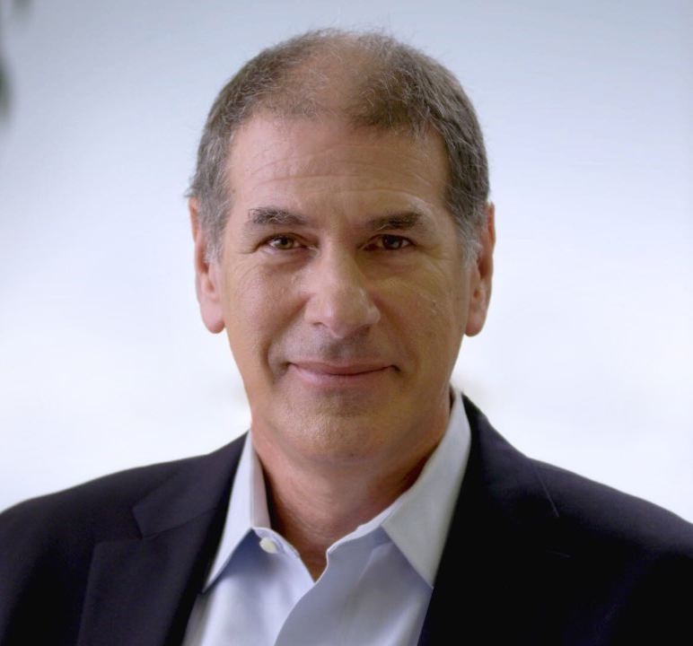
ABOUT TODAY
PRESENTOR
KEY TOPICS WE WILL COVER
Discuss how diversity, equity, inclusion training along with prevention of sexual harassment training is fundamentally different from all other types of training
Demonstrate how to curate a collection of courses into a coherent and effective program.
Provide a framework for structuring your own program, including key topics to cover.
Provide insight and share proven techniques that any training you are considering should include.
Andrew Rawson
Co-Founder & Chief Learning Officer at Traliant

Slide 3
WHAT PEOPLE THINK
Survey results from over three million completed courses

Slide 4
EFFECTIVENESS FEEDBACK
It’s not what you Know, its what you Do.
True effectiveness is measured by employees who say they will apply what they learned to their day-to-day work—not by the number of course completions.

Slide 5
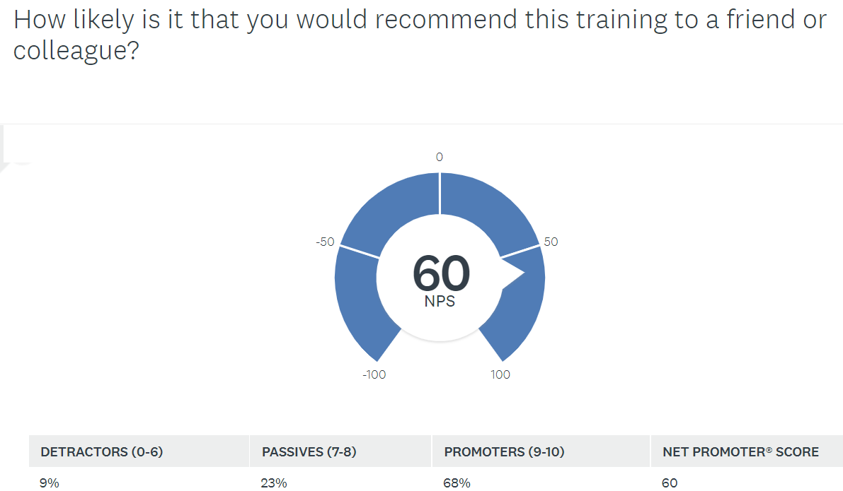
SURVEY DATA
NPS or Net Promoter Score
Anything over 50 is considered “best-in-class”.
National Brands NPS
Apple – 47
Bose – 78
Best Buy – 31
Microsoft – 45
Zoom - 62

Slide 6
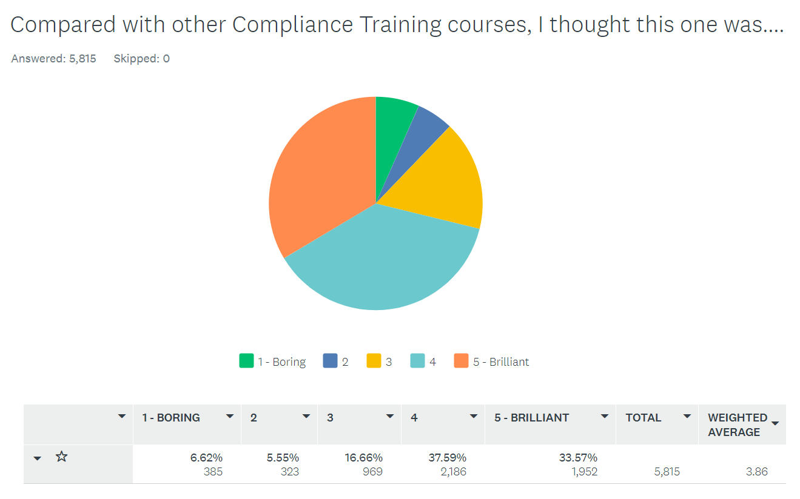
SURVEY DATA
At a .5% participation rate, this is just over 1.1 million course completions in past nine months.
Over 70% rate a 4 or 5

Slide 7
Key Concepts
Foundational Principals of Successful Compliant Training

Slide 8
KEY CONCEPTS
People remember stories, not facts
Knowledge transfer does not correlate to behavior
Avoid the dreaded, “When I finished the training, I didn’t know what to do.”
Focus on what you need people to DO, less than testing on what they KNOW
Good stories have tension (ie: Drama) so show the consequences of the right and wrong behavior
Notes:
Must do either by

Slide 9
KEY CONCEPTS
Prevention of Sexual Harassment & Discrimination = What you must do
Diversity, Equity and Inclusion = What you should do
The changing work environment is moving and expanding these circles:
Returning to work
Respectful remote workplace
Transitioning to a hybrid environment
Prevention of Discrimination and Harassment Suite
Diversity, Equity & Inclusion Suite
Risk Management
Enrichment Topics
Must have
(legally req., Best practice)
Should have
Nice to have
Notes:
Must do either by

Slide 10
KEY CONCEPTS
Start with a Strong Foundation
Core Topics (the Must haves):
Preventing Discrimination & Harassment
Workplace Diversity, Inclusion & Sensitivity
Enrichment Content:
Unconscious Bias
Microaggressions in the Workplace
Bystander Intervention
Cultural Competency

Slide 11
AN INTEGRATED APPROACH
Don’t think courses and assignments. Think communications.

Slide 12
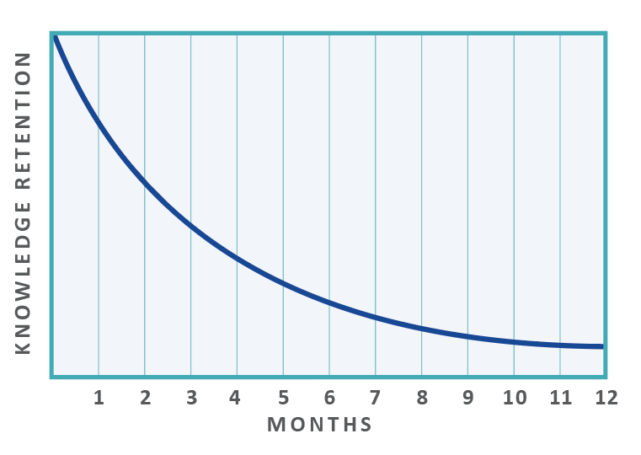
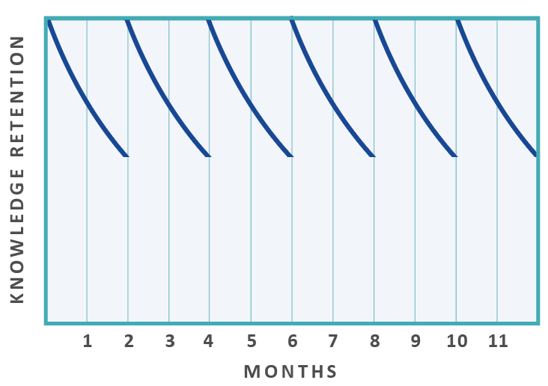
AN INTEGRATED APPROACH
A Program rolled out over time addresses the “Forgetting Curve”
“Once-a-year” and done
TRAINING
TRAINING
TRAINING
TRAINING
TRAINING
TRAINING
MONTHS
MONTHS
Knowledge retention with annual training only
Knowledge retention with reinforced training

Slide 13
AN INTEGRATED APPROACH
The right messages at the right frequency
The cadence itself is part of the message
Communication over time is reinforcing
Get management and supervision on board first so they can support
LISTEN and adjust!!

Slide 14
AN INTEGRATED APPROACH
Align the “Deed from the Top” with the “Tone from the Top”
If you just train once each year, what message does that send?
Training, Communications and Program Calendar
MONTHLY SCHEDULE | MONTH 1 | MONTH 2 | MONTH 3 | MONTH 4 | MONTH 5 | MONTH 6 | MONTH 7 | MONTH 8
CORE TOPICS | Preventing Discrimination & Harassment |  | Workplace Diversity, Inclusion & Sensitivity
ENRICHMENT TOPICS |  | Microaggressions |  | Unconscious Bias |  | Cultural Competency |  | Bystander Intervention
YOUR COMMUNICATIONS (Newsletters, etc.) | ? |  | ? |  | ? |  | ?
YOUR PROGRAMS (ERG, Workshops, etc.) |  | ? |  | ? |  | ? |  | ?

Slide 15
EXAMPLE OF EFFECTIVE TECHNIQUES
A look behind the curtain

Slide 16
KEY TOPICS IN THE KEY COURSES
Workplace Diversity, Inclusion & Sensitivity
Unconscious Bias
Bystander Intervention
Cultural Competency & Humility
Microaggressions in the Workplace

Slide 17
KEY TOPICS IN THE KEY COURSES
Workplace Diversity, Sensitivity and Inclusion
Key points
Talks about what they are thinking about
Doesn’t insult learners intelligence
Doesn’t ‘oversell’ the impact of the training

Slide 18
KEY TOPICS IN THE KEY COURSES
Unconscious Bias
Key Concepts
Buzz word is “Unconscious” but in reality, it is both
This one is a journey not a destination

Slide 19
KEY TOPICS IN THE KEY COURSES
Bystander Intervention
Key Concepts
Behavior most likely to be influenced since it is a form of group behavior
There is science around the techniques taught
Disrupt, Confront & Support – All work in the appropriate situation

Slide 20
KEY TOPICS IN THE KEY COURSES
Cultural Competency and Humility
Key Concepts
Walking the fine line as “Competency” is a buzz word but a bit condescending!
“Humility” is the more human term and approach

Slide 21
KEY TOPICS IN THE KEY COURSES
Microaggressions in the Workplace
Key Concepts
Acknowledges that “you might already know this”
Defines jargon
Like reality TV, cringeworthy is good when watched from afar!

Slide 22
VERTICALIZING THE MESSAGING
Hospitality, Healthcare and Industrial

Slide 23
HANDLING A CREEPY CUSTOMER | Hospitality

Slide 24
HANDLING A CREEPY CUSTOMER | Financial Services

Slide 25
INDUSTRY-SPECIFIC TRAINING | Hospitality, Industrial & Healthcare
Words (& Images!) Matter
Underlying message of verticalization:
“We understand some of the challenges you face, and we are working to address them internally and provide you with tools to address these situations as well.”

Slide 26
SUMMARY

Slide 27
SUMMARY
Key Concepts
Remember that in most cases you are speaking to a less-than-willing audience therefore you have to do a ‘better job’.
Focus on the Behavior, not the Facts
The Golden Rule is teach your learners the way you want learn!

Slide 28
Q & A

Slide 29
7,000 +
Happy Customers
3,000,000 +
Course Completions

