Slide 1
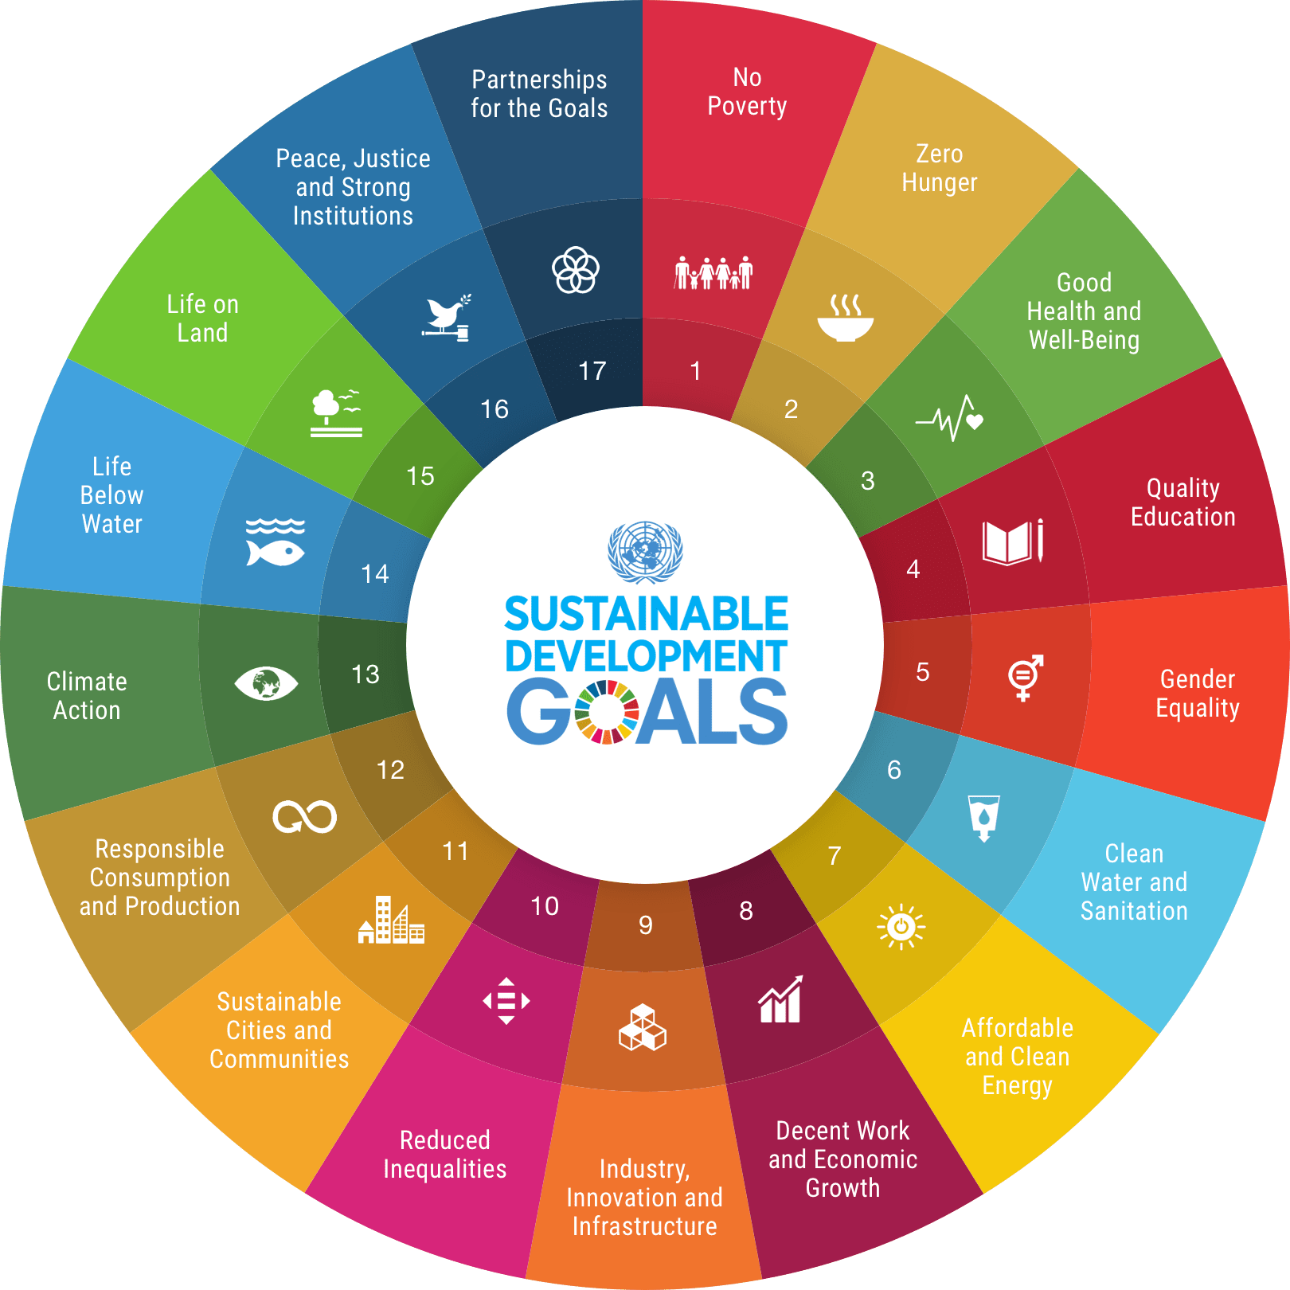
Report of the U21 UN SDG Initiative
Dr Cliona O’Sullivan, co-chair, University College Dublin, Ireland
Key activities 2020/2022:
Student SDG Awareness Week. March 2021 – 5 Universities, 14 speakers, 3 events daily across 4 time zones, SDG Infographics
Global Learning Partnership. Summer 2021- Online programme in partnership with Kathmandu University, Nepal. Students from 8 U21 Universities, 8 different health disciplines supported by project mentors from U21 network
SDG case studies. New case study published on Gender Based Violence, all available online
Articles and publications. ‘ The role of university education in driving equality and sustainability’ , Article published in September 2021. Authors (academics and students) from 7 U21 universities, across four continents.
Annual Forum. 13th September 2021
Keynote: ‘Global Vaccine Inequity- Impact on SDGs’. Professor Refilwe Mafuya-Phaswana, University of Johannesburg & Professor Manuel Perez, Tec de Monterray
Student led session- ‘Students as advocates for the SDGs’
Members session- ‘The impact of the COVID 19 pandemic on how we teach and facilitate learning about the SDGs’

