Slide 1
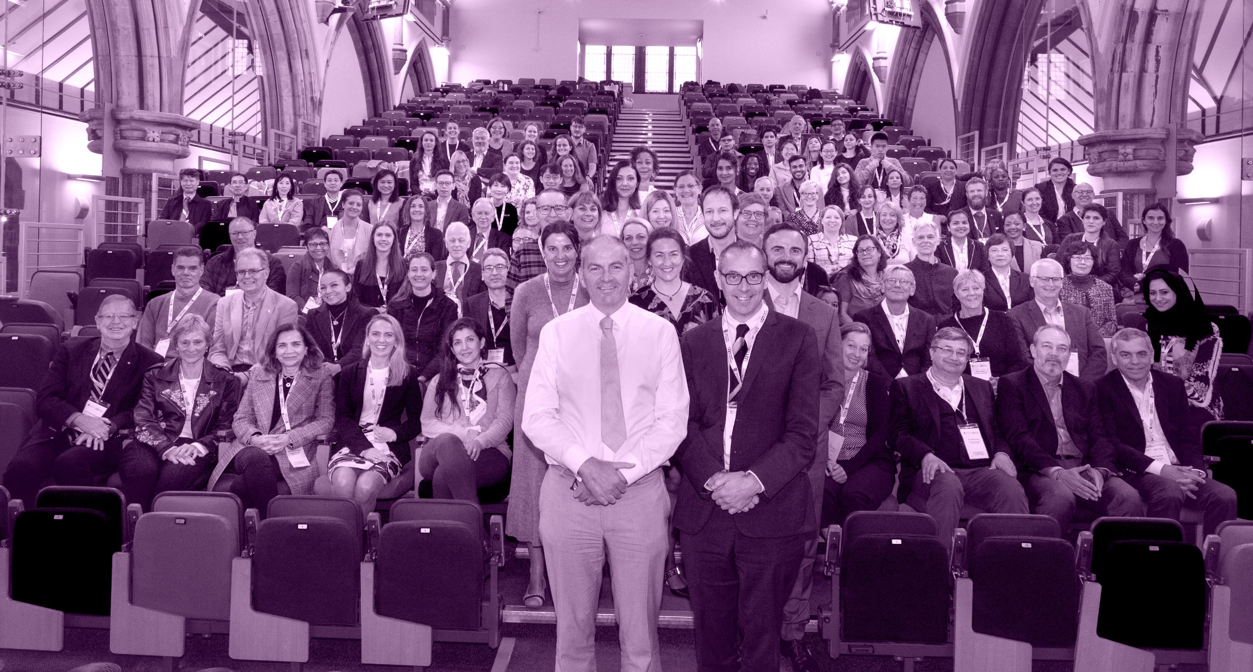
U21 HSG Executive Committee Report 2021

Slide 2
Composition of the U21 HSG Executive Committee
(Sept 2021 – Sept 2022)
Name | University | Position
Manuel Pérez Jiménez (Chair) | Tecnólogico de Monterrey | Chair/Host University 2021
John Fraser | University of Auckland | Chair Elect/Deputy Chair/Host University 2022
Patrick Felle | University College Dublin | Past Chair/Host University 2020
Tracy Roberts | University of Birmingham | Host of Secretariat
Rodrigo Marino | University of Melbourne | Dentistry
Allison Mandrusiak | University of Queensland | Health & Rehabilitation Sciences
Manuel Pérez Jiménez | Tecnólogico de Monterrey | Medicine
Julia Slark | University of Auckland | Nursing & Midwifery
Anthony Cox | University of Birmingham | Pharmacy
Martin Stafstrom | Lund University | Public Health
John Curnow | University of Birmingham | Biomedical Sciences
Corrina Greenwood | University of Birmingham | U21 HSG Operations Manager

Slide 3
Membership
U21 Health Sciences Group
The U21 HSG network remains at 19 members in 2021
U21 Network
The U21 network remains at 27 members in 2021

Slide 4
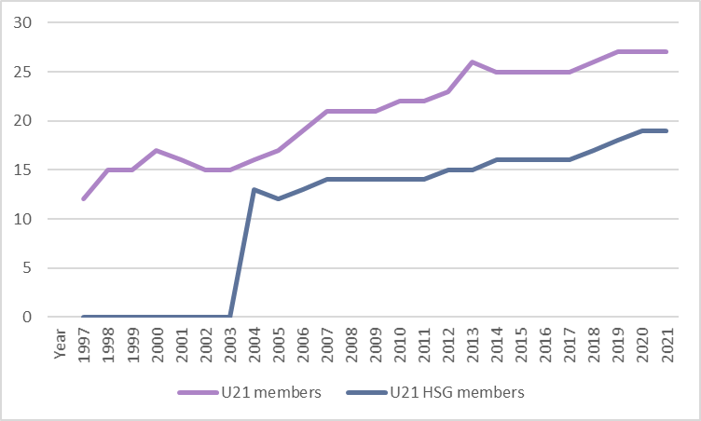
U21 and U21 HSG Membership

Slide 5
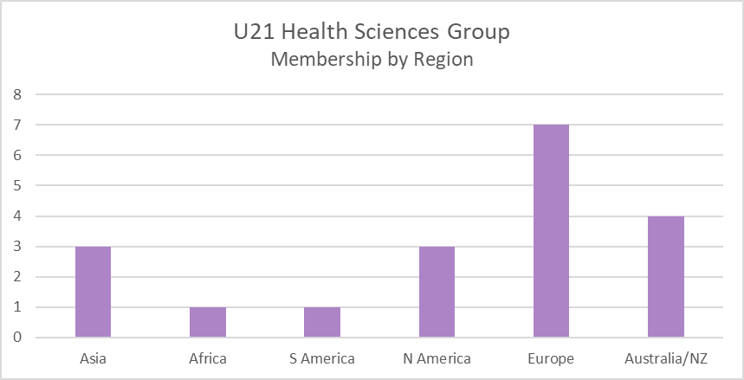
U21 and U21 HSG Membership

Slide 6
U21 HSG Membership
U21 HSG Member Institution | 2021 | 2020 | 2019 | 2018 | 2017 | 2016 | 2015
University of Queensland
University of Melbourne
Fudan University
The University of Hong Kong
University College Dublin
Korea University
Technologico de Monterrey
The University of Auckland
Lund University
University of Nottingham
University of Birmingham
University of Glasgow
Pontificia Universidad Catolica de Chile
University of Johannesburg
University of Edinburgh
University of New South Wales
McMaster University
Amsterdam University
University of Connecticut
University of British Columbia
 | 19 | 19 | 18 | 18 | 16 | 16 | 16

Slide 7
Key highlights of last 12 months
SDG Online Awareness Week in March involving 6 U21 HSG universities
Fifth Global Learning Partnership in March involving 18 U21 HSG Member students
Another successful Teaching Excellence Award nomination process with 8 applications
Increased number and scale of online events for both students and staff
16 applications for this year’s U21 HSG project funding
Introduction of the new Early Career Researcher Fund
Over 50 applications for this year’s Doctoral Student Forum
Successful U21 HSG Annual Meeting hosted by University College Dublin

Slide 8
Key Projects for 2021/22
Student Mobility Programme – restart or virtual
Summer School
Medical Clinical Placement Programme/other exchanges
Global Learning Partnership
U21 University Mental Health Project
Embedding the principles including the rollout of the Student Project
Improved communications for the network
Website development

Slide 9
Newly funded projects
A multidisciplinary educational course to improve the integrated care of inherited retinal diseases (Universities of Melbourne, Birmingham and Auckland)
Clinical informatics training modules, a gateway to a learning healthcare system (Pontificia Universidad Católica de Chile, Melbourne and Monterrey)
Vivian: exploring the role of a graphic novel in nursing education on gender and palliative care (Universities of Auckland, Birmingham and Lund)

