Slide 1
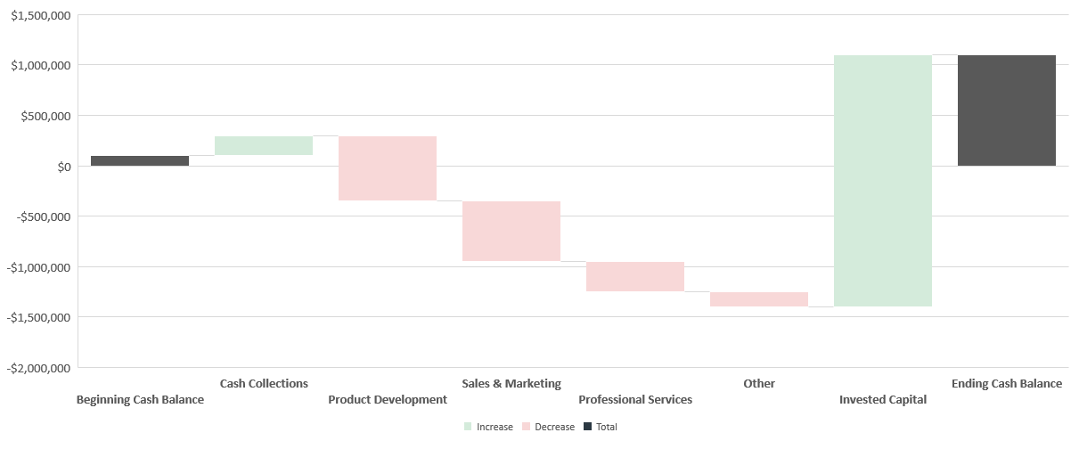
Cash Waterfall - Startup

Slide 2
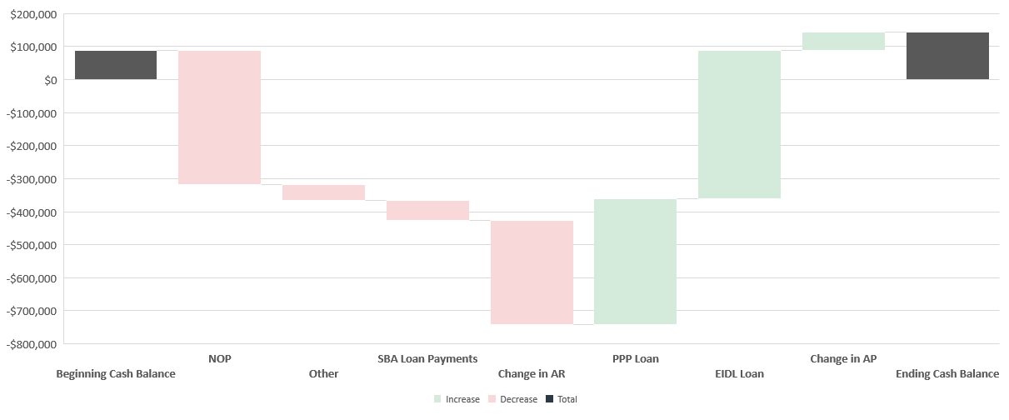
Cash Waterfall – Operating

