Slide 1

Chapter 15
Low-Pressure Fuel Systems

Slide 2

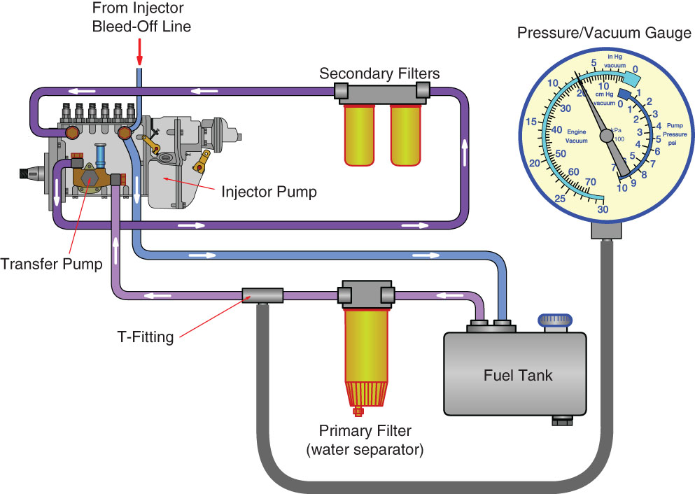
Performing a Primary Fuel Filter Suction-Side Pressure Test
Obtain an accurate, high quality pressure-vacuum gauge capable of measuring pressure in inches (millimeters) of Hg and psi in tenths of inches, or a Magnehelic gauge that measures in

Slide 3
Performing a Primary Fuel Filter Suction-Side Pressure Test
inches (millimeters) of water (H 2 O). An electronic pressure transducer or a mechanical vacuum-pressure gauge are best.

Slide 4
Performing a Primary Fuel Filter Suction-Side Pressure Test
Connect the gauge to the outlet side of the primary filter using a quick-connect fitting, which may need to be installed in the system if one was not equipped by the OEM. A T-fitting may also

Slide 5
Performing a Primary Fuel Filter Suction-Side Pressure Test
be used in the fuel line between the primary filter and transfer pump, but there is usually a test port and plug in the fi lter system.

Slide 6
Performing a Primary Fuel Filter Suction-Side Pressure Test
Start the engine and run it at high-idle (full throttle, no load). Observe and record the pressure reading. A slight negative pressure is normal, but a high negative pressure means the filter

Slide 7
Performing a Primary Fuel Filter Suction-Side Pressure Test
is restricted or there is a suction-side restriction before the filter. Generally, if the negative pressure is less than 8–10″ (203–254 mm) Hg or 4–5 psi (28–34 kPa), the filter is operating satisfactorily and

Slide 8
Performing a Primary Fuel Filter Suction-Side Pressure Test
still has service life remaining. If the restriction is between 12–18″ (305–457 mm) Hg, recommend that the filter be replaced. Always refer to manufacturer’s specifications.

Slide 9
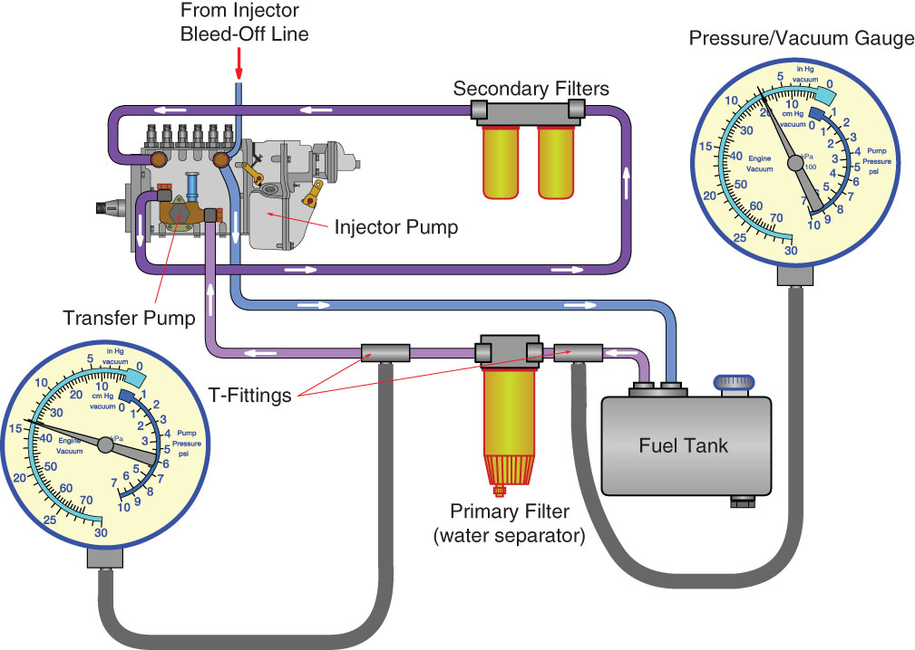
Measuring Primary Filter Restriction
Install quick-connect fittings and attach pressure vacuum gauges to both the inlet and outlet sides of the primary filter. An electronic pressure transducer can be used. Alternately, use the

Slide 10
Measuring Primary Filter Restriction
same gauge and take measurements on both sides of the filter during two separate sequences.

Slide 11
Measuring Primary Filter Restriction
Start the engine and operate it at rated speed.

Slide 12
Measuring Primary Filter Restriction
Observe and record the pressure difference between the two gauges. Most clean filters will have less than 0.1 psi (0.7 kPa) difference between the two readings.

Slide 13
Measuring Primary Filter Restriction
If the filter restriction is approaching 5–8″ (127–203 mm) Hg or 2.5–4 psi (17–28 kPa), recommend filter replacement.

Slide 14
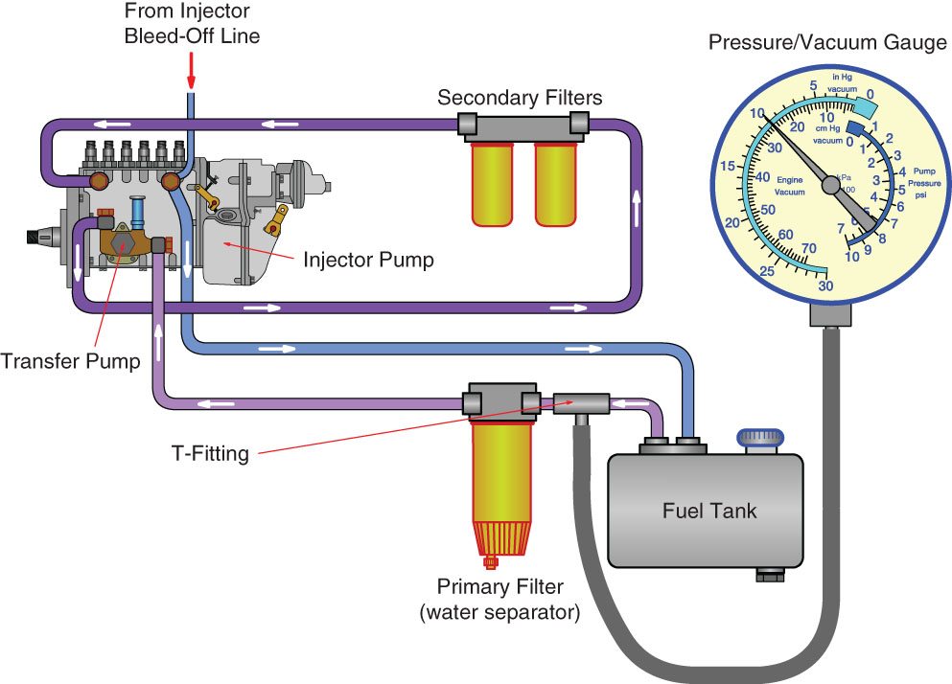
Performing a Primary Fuel Filter Suction-Side Restriction Test
Install a quick-connect fitting and attach a pressure-vacuum gauge to the inlet side of the primary filter. An electronic pressure transducer can be used.

Slide 15
Performing a Primary Fuel Filter Suction-Side Restriction Test
Start the engine and operate it at rated speed.
Observe and record the pressure reading. A pressure lower than 10″ (254 mm) Hg or 5 psi (34 kPa) is too low and the suction line to the primary filter should be inspected for problems.

Slide 16
Performing a Primary Fuel Filter Suction-Side Restriction Test
Recommend that the fuel tank pickup tube be inspected for restrictions.

Slide 17
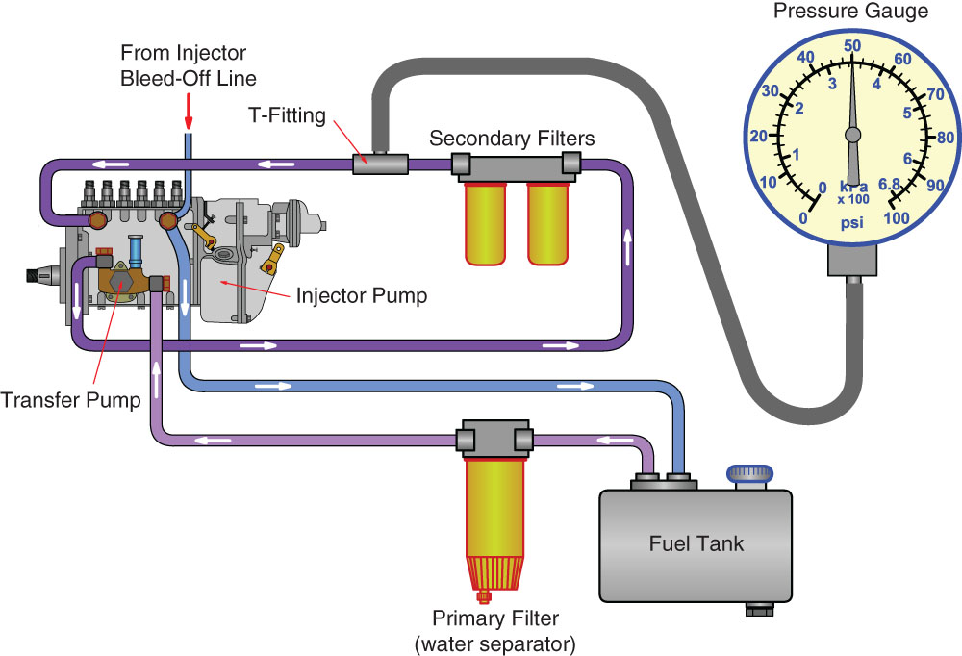
Measuring Secondary Filter Output Pressure
Obtain an accurate, high-quality pressure gauge capable of measuring pressure in psi (kPa). An electronic pressure transducer or a mechanical pressure gauge are best.

Slide 18
Measuring Secondary Filter Output Pressure
Connect the gauge to the outlet side of the secondary filter using a quick-connect fitting, which may need to be installed in the system if one was not equipped by the OEM. There is always a

Slide 19
Measuring Secondary Filter Output Pressure
test port or plug to access measurement of the secondary fuel pressure.

Slide 20
Measuring Secondary Filter Output Pressure
Start the engine and run it at high-idle (full throttle, no load). Observe and record the pressure reading. Most secondary filters

Slide 21
Measuring Secondary Filter Output Pressure
operate at pressures of 50–80 psi (345–552 kPa). Compare the observed pressures with the manufacturer’s specifications.

Slide 22
Measuring Secondary Filter Output Pressure
Make a service recommendation to replace the secondary filter if the output pressures are approaching or below the manufacturer’s specifications.

Slide 23
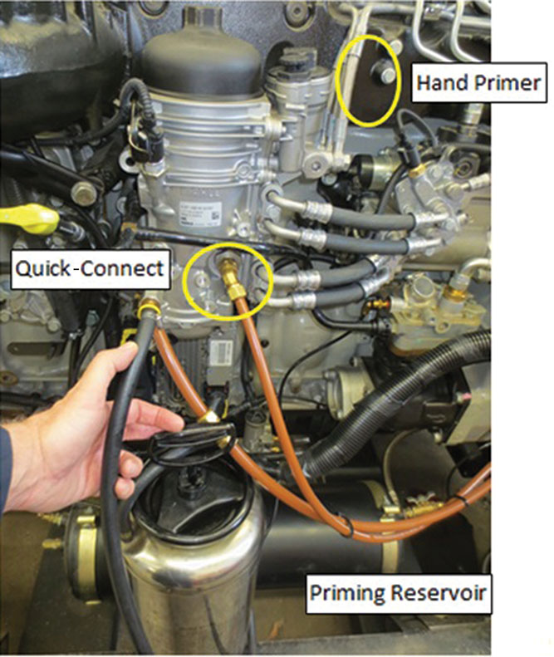
Replacing a Fuel Filter and Priming a Fuel System
Remove the filter cap covers with the appropriate wrench or socket.
Remove the filters and inspect the housings for large pieces of contaminants. Clean as necessary.
Install new filter media for the filters; there are usually two or three depending on the system. Some cartridges will install by turning the filter until a click is

Slide 24
Replacing a Fuel Filter and Priming a Fuel System
heard, which indicates that the filter is locked in place.
Lubricate the sealing O-rings for the canister caps. Install and torque the caps.
A purpose-made priming reservoir is needed to fi ll the canisters with fuel. Fill the canister with fuel and pump the priming tool with the integrated hand pump until the reservoir is pressurized.

Slide 25
Replacing a Fuel Filter and Priming a Fuel System
Connect the priming reservoir to the quick-connect coupling on the filter housing. Open a shut-off valve on the priming reservoir’s fuel line and allow the fuel to fill the filter housing; this should take approximately 30 seconds.
Close the fuel shut-off valve in the priming reservoir line and disconnect.

Slide 26
Replacing a Fuel Filter and Priming a Fuel System
Use the hand primer pump on the fuel module to finish pressurizing the fuel system. Pumping for close to 1 minute should increase the filter housing pressure enough that significant resistance will be felt when operating the hand primer.
Start the engine and run it until the oil pressure has reached approximately 15 psi (103 kPa).

Slide 27
Replacing a Fuel Filter and Priming a Fuel System
Run the engine for 1 more minute. Check the filter housing for leaks.
Increase the engine speed to 1800 rpm for 3 minutes and then return the engine to idle. Allow the engine to idle for approximately 1 minute.
Shut down the engine and recheck for leaks.

