Slide 1
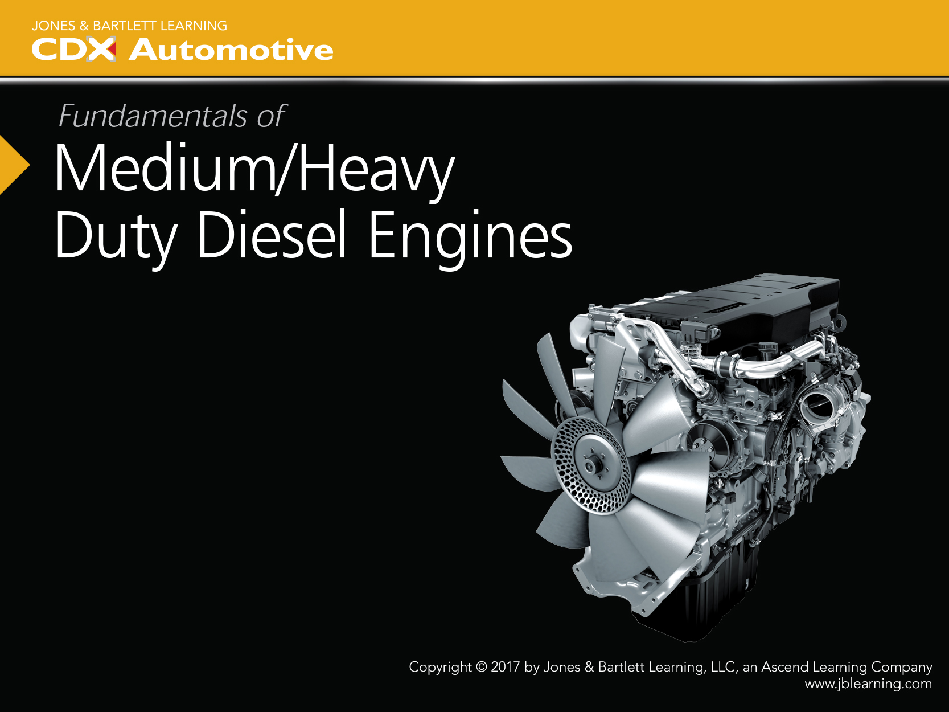
Chapter 15
Low-Pressure Fuel Systems

Slide 2
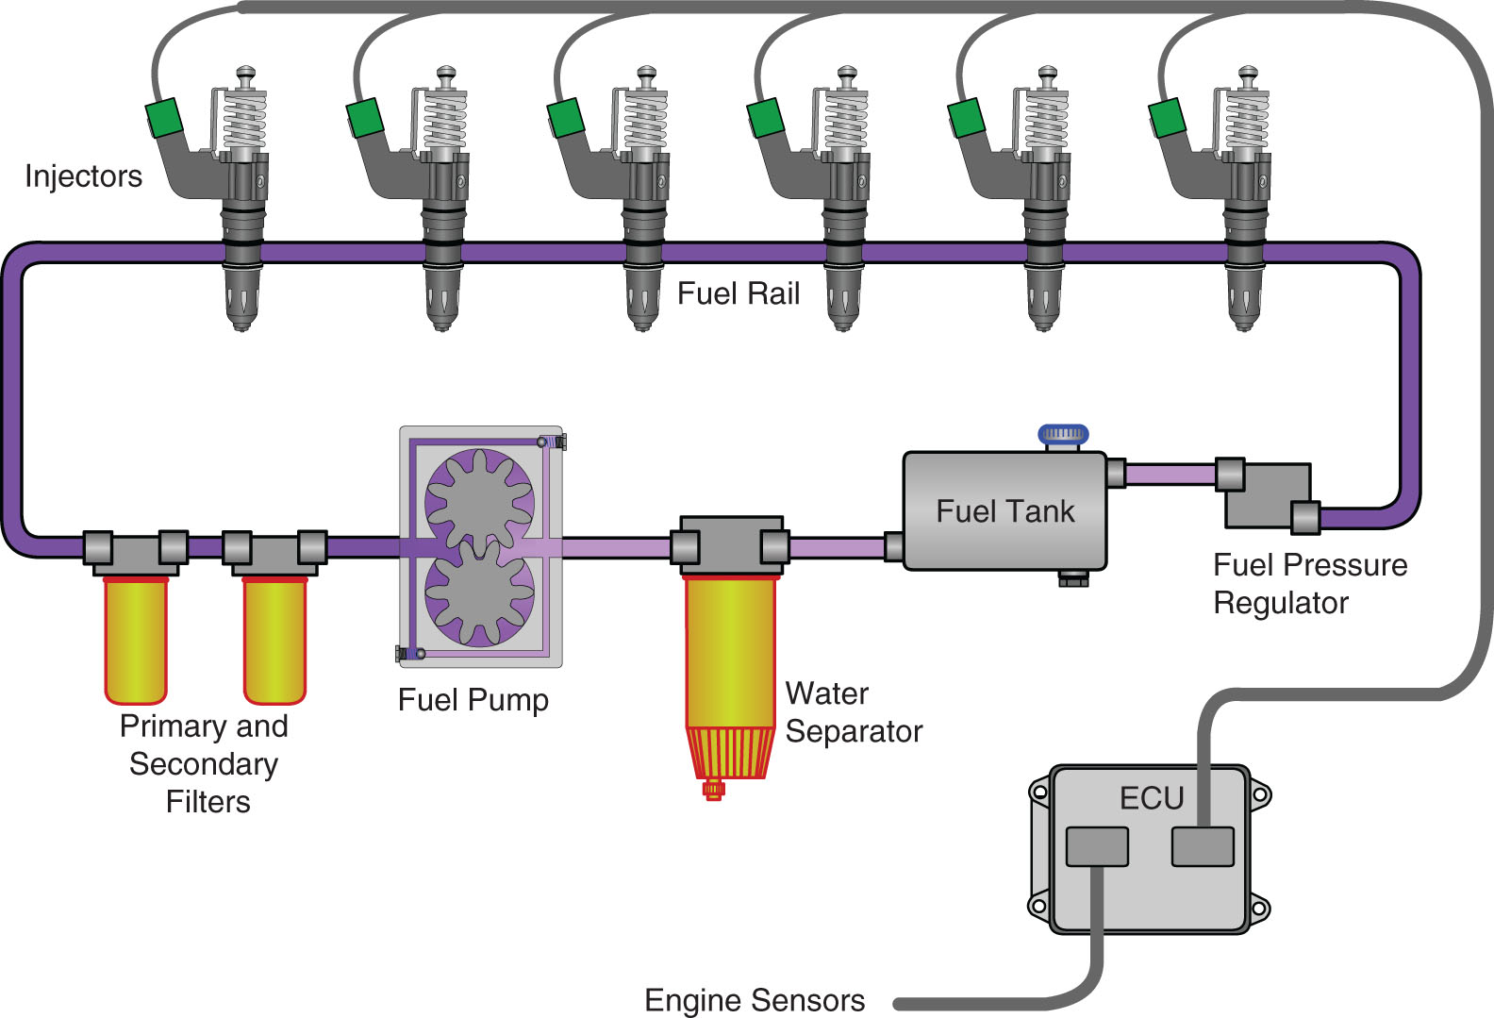
Introduction
(1 of 2)
Diesel engines need low-pressure fuel systems to supply clean, cool, and air-free fuel to the high-pressure fuel system.

Slide 3
Introduction
(2 of 2)
Proper operation of low-pressure fuel system is critical to proper engine performance.

Slide 4
Fundamentals of Low-Pressure
Fuel Systems
(1 of 3)
Requirements of Low-Pressure Fuel Systems
  Store and supply fuel free of contaminants and vapor
  Supply adequate fuel volume at the correct pressure to the high-pressure injection system
  Remove water contamination
  Prevent wax gelling
  Regulate fuel temperature

Slide 5
Fundamentals of Low-Pressure
Fuel Systems
(2 of 3)
Fuel Temperature
  Changes in fuel temperature can affect engine power output and cause fuel to gel

Slide 6
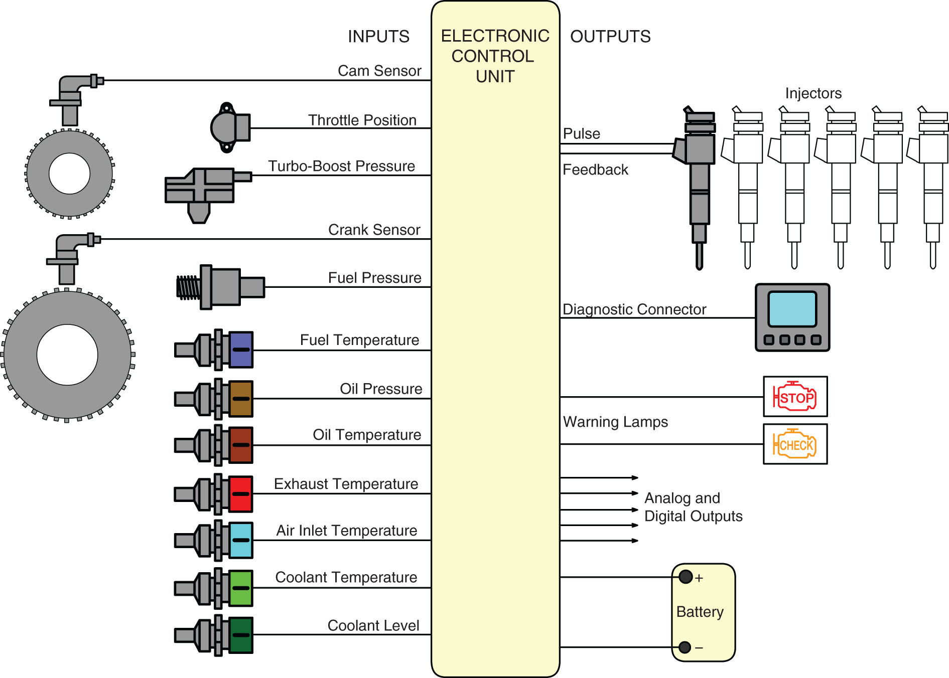
Fundamentals of Low-Pressure
Fuel Systems
(3 of 3)

Slide 7
Components of Low-Pressure
Fuel Systems
(1 of 65)
Fuel Tanks
  Must store an adequate supply of fuel and allow it to cool
  Fuel that is too hot loses viscosity and density, reducing engine power
  2% power loss for every 10°F of fuel temperature above 115°F (46°C)

Slide 8
Components of Low-Pressure
Fuel Systems
(2 of 65)
Fuel Tanks
  Tank Materials
    Aluminum, plastic, and steel alloys are most common
    Must meet minimum safety standards for on highway vehicles as set by federal authorities

Slide 9
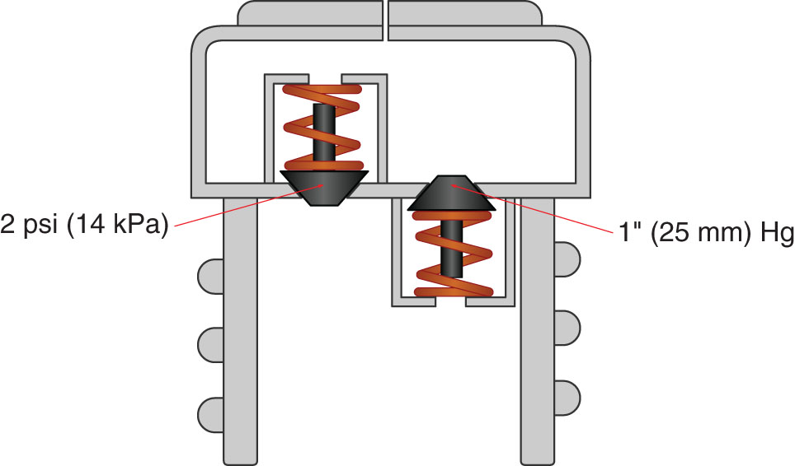
Components of Low-Pressure
Fuel Systems
(3 of 65)
Fuel Tank Ventilation
  Return fuel may need to release air and as level drops in tank air must replace void
  Fuel tank cap can incorporate relief valve and vacuum relief

Slide 10
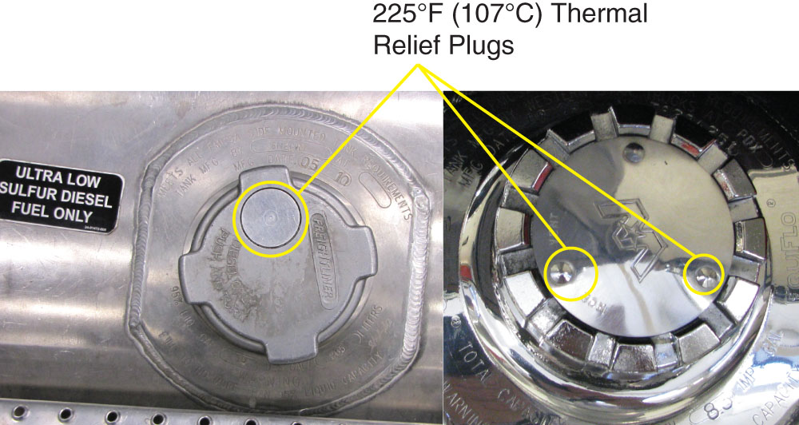
Components of Low-Pressure
Fuel Systems
(4 of 65)
Fuel Tank Ventilation
  Thermal plugs can be used to vent the tank when exposed to fire

Slide 11
Components of Low-Pressure
Fuel Systems
(5 of 65)
Fuel Tank Ventilation
  Rollover protection valves prevent leakage
  Tanks must allow for expansion of fuel as it warms

Slide 12
Components of Low-Pressure
Fuel Systems
(6 of 65)
Fuel Lines
  Fuel lines connect all low-pressure components
  Can be braided steel, steel tube, rubber, or nylon plastic (Synflex)
  All diesel fuel compatible
  Must be routed away from damage and allow for some movement

Slide 13
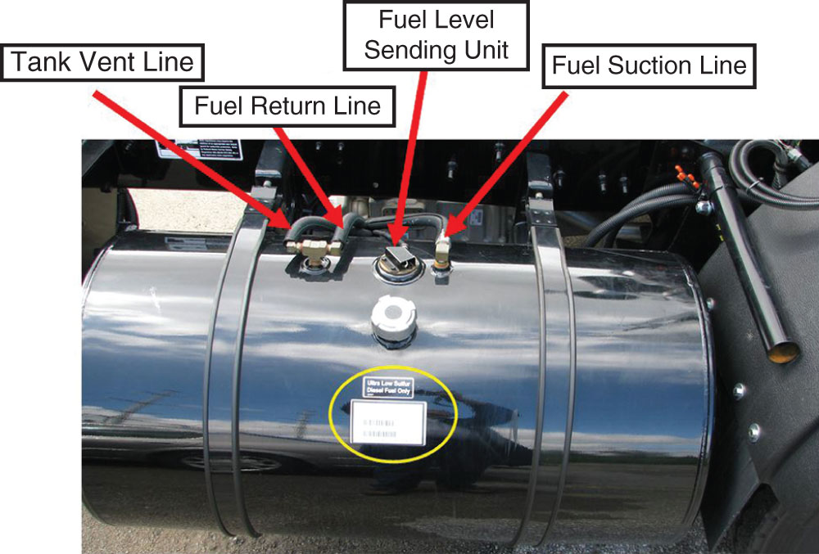
Components of Low-Pressure
Fuel Systems
(7 of 65)
Fuel Tank Pickup and Sending Unit
  Integrated with a level sensing device

Slide 14
Components of Low-Pressure
Fuel Systems
(8 of 65)
Fuel Tank Pickup and Sending Unit
  May include filters, regulators, pumps, and reservoirs

Slide 15
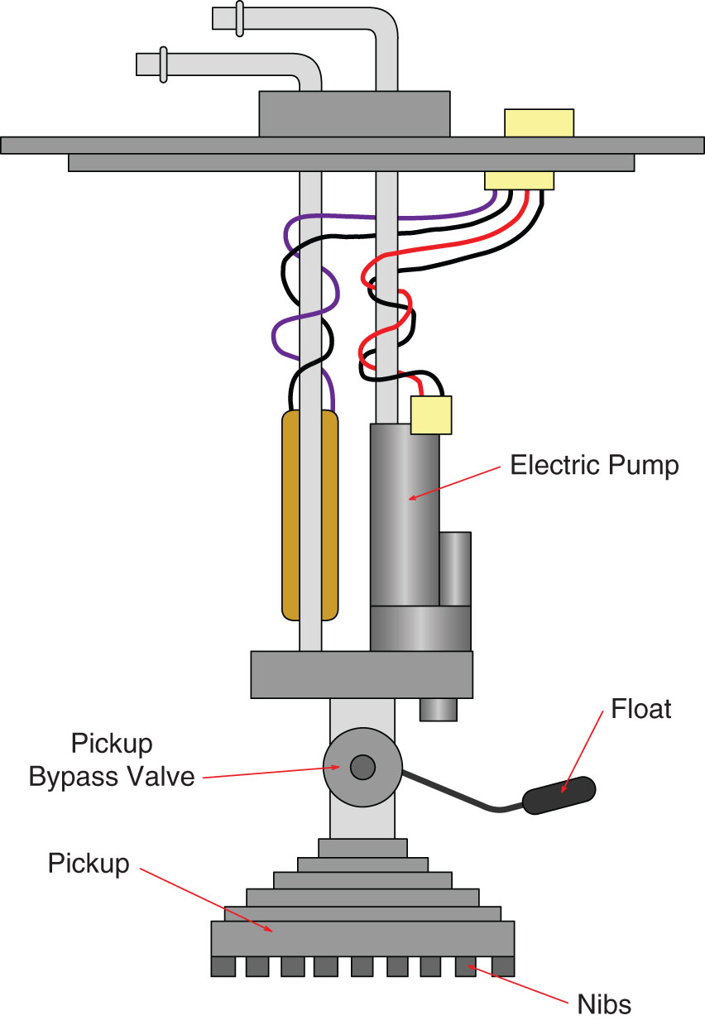
Components of Low-Pressure
Fuel Systems
(9 of 65)
Tank Pickup
  Place just above bottom of tank to prevent contamination

Slide 16
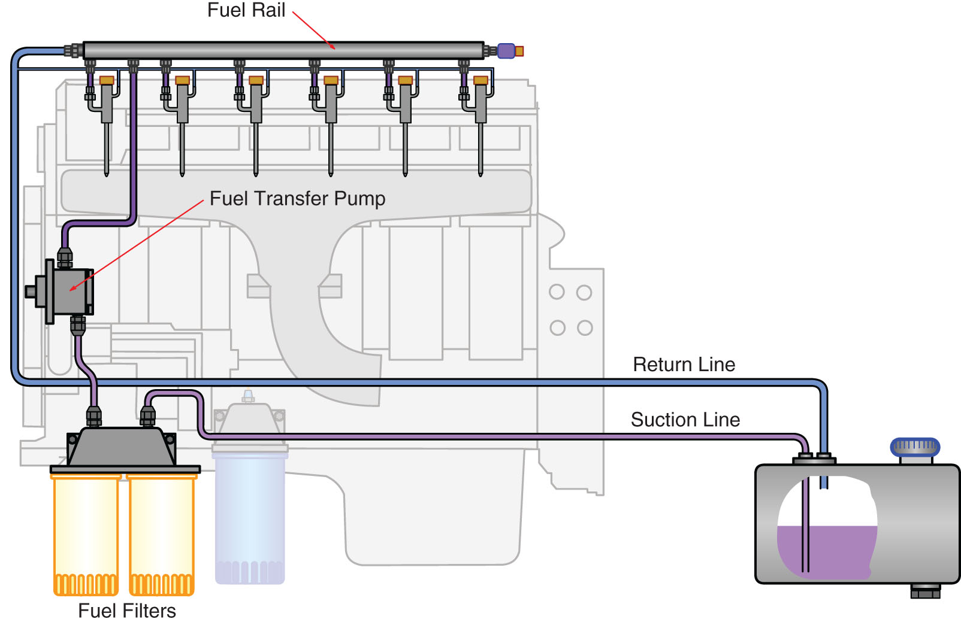
Components of Low-Pressure
Fuel Systems
(10 of 65)
Tank Pickup
  Heavy-duty vehicle tanks use pickups located at top

Slide 17
Components of Low-Pressure
Fuel Systems
(11 of 65)
Tank Pickup
  Large tanks will have a tank drain located at the lowest point of tank

Slide 18
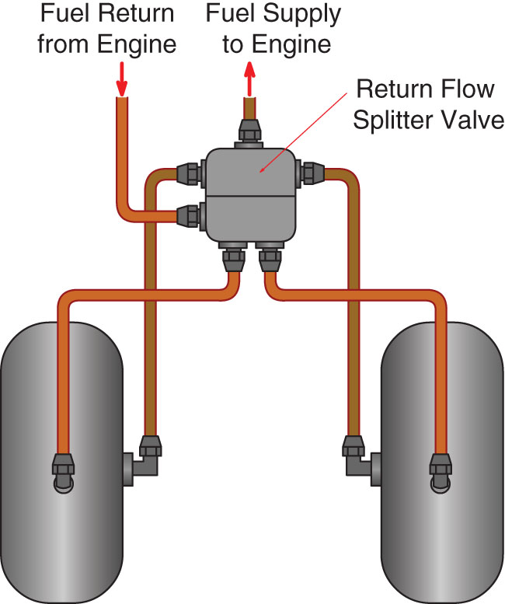
Components of Low-Pressure
Fuel Systems
(12 of 65)
Dual Fuel Tank Pickups
  Heavy-duty vehicles may have dual tanks with pickups

Slide 19
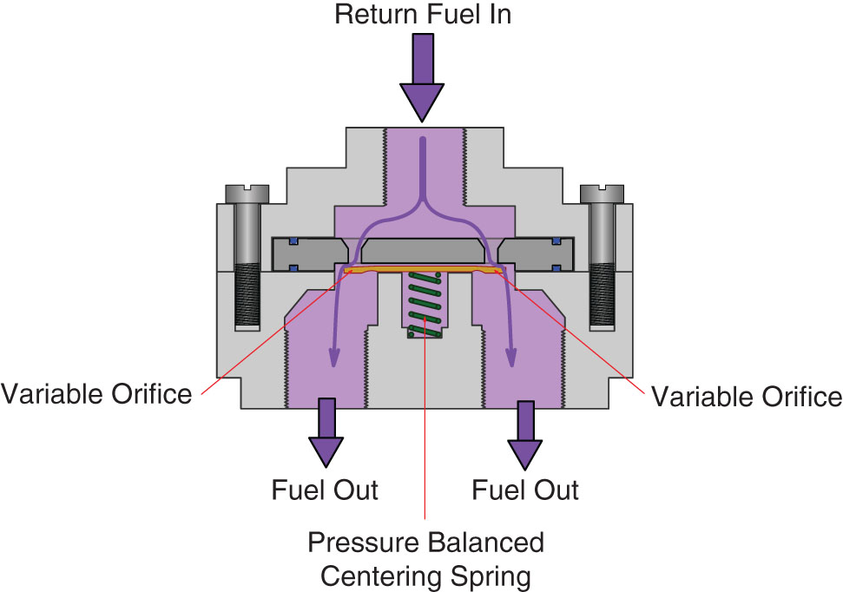
Components of Low-Pressure
Fuel Systems
(13 of 65)
Dual Fuel Tank Pickups
  Return flow splitter valve keeps level in tanks; eliminates crossover line

Slide 20
Components of Low-Pressure
Fuel Systems
(14 of 65)
Fuel Return Circuits
  Most fuel systems circulate fuel through the high-pressure system to lubricate and cool components
  Newer systems reduce amount of fuel circulated

Slide 21
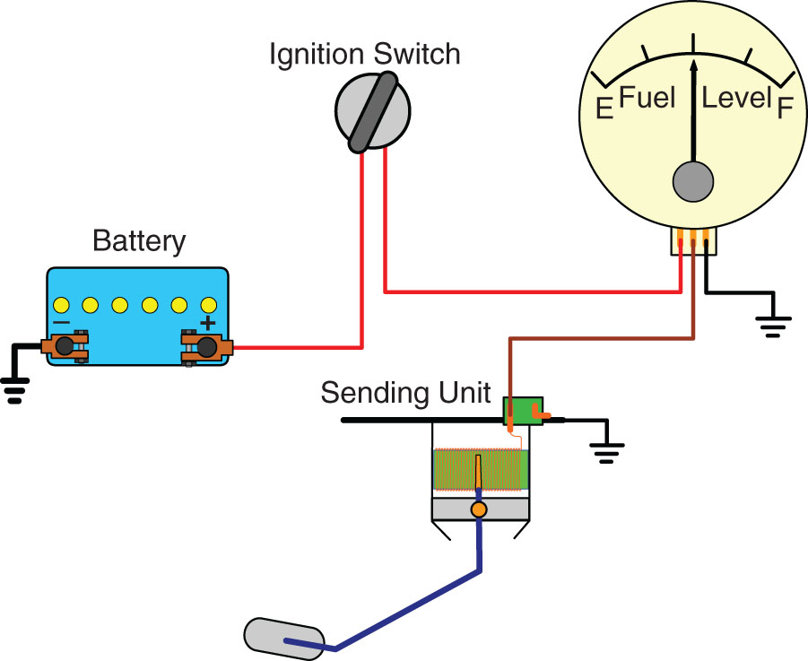
Components of Low-Pressure
Fuel Systems
(15 of 65)
Sending Units
  Transmit electrical signal for fuel level to a dash gauge

Slide 22
Components of Low-Pressure
Fuel Systems
(16 of 65)
Sending Units
  Most common type is variable resistance: float moves with fuel level and gauge circuit resistance changes

Slide 23
Components of Low-Pressure
Fuel Systems
(17 of 65)
Sending Units
  Can be part of HD-ODB system to help diagnose low power problems
  Can be part of CAN bus system

Slide 24
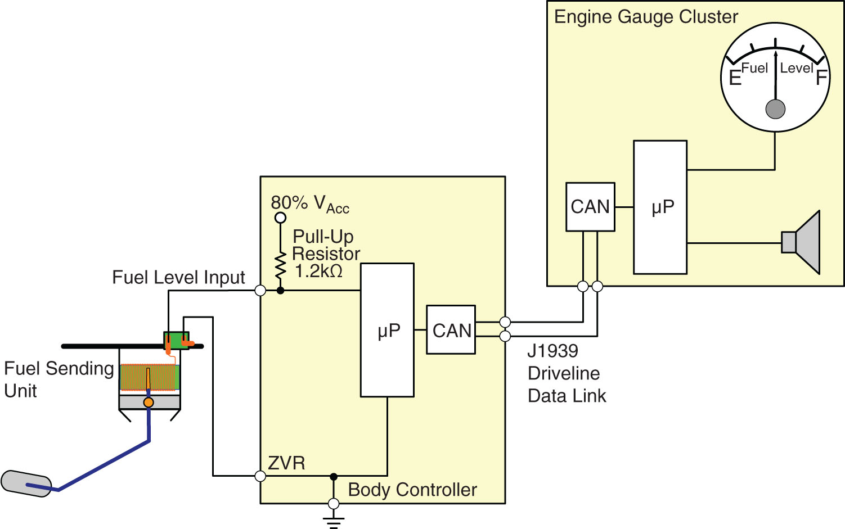
Components of Low-Pressure
Fuel Systems
(18 of 65)

Slide 25
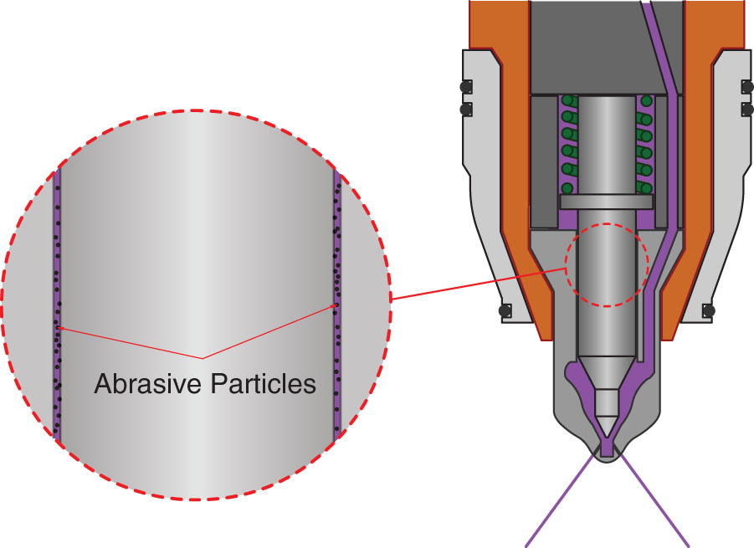
Components of Low-Pressure
Fuel Systems
(19 of 65)
Fuel Filters
  Requirements
  Fuel quality is key to reliability and durability of fuel system components

Slide 26
Components of Low-Pressure
Fuel Systems
(20 of 65)
Fuel Filters
  Requirements
    Fine abrasive wear caused by contamination
    Particles 5–7 microns in size cause most damage
    Fuel system wear can cause high fuel, consumption,­ hard starting, rough idle, reduced engine power, increased smoke, and other exhaust emissions

Slide 27
Components of Low-Pressure
Fuel Systems
(21 of 65)
Fuel Filters
  Contamination Sources
    Asphaltenes
      Soft particles that occur naturally in 2-D diesel fuel
      High heat and oxidation increases content
      1.5–2 microns in diameter

Slide 28
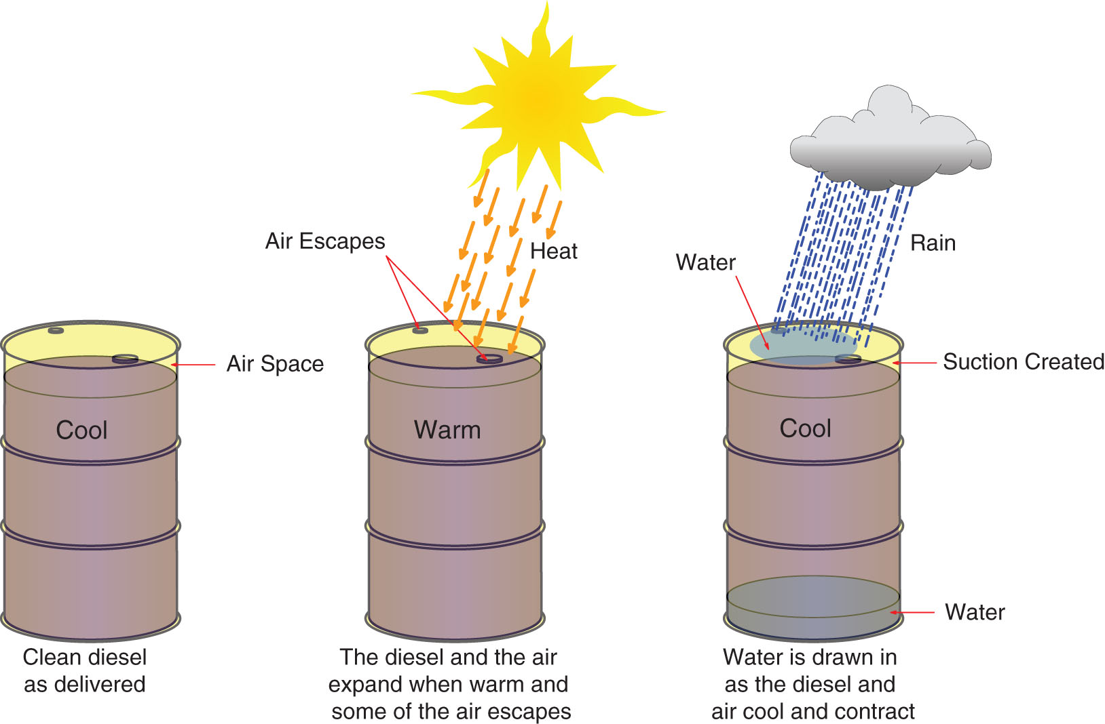
Components of Low-Pressure
Fuel Systems
(22 of 65)
Fuel Filters
  Contamination Sources
    Water—most destructive contaminant

Slide 29
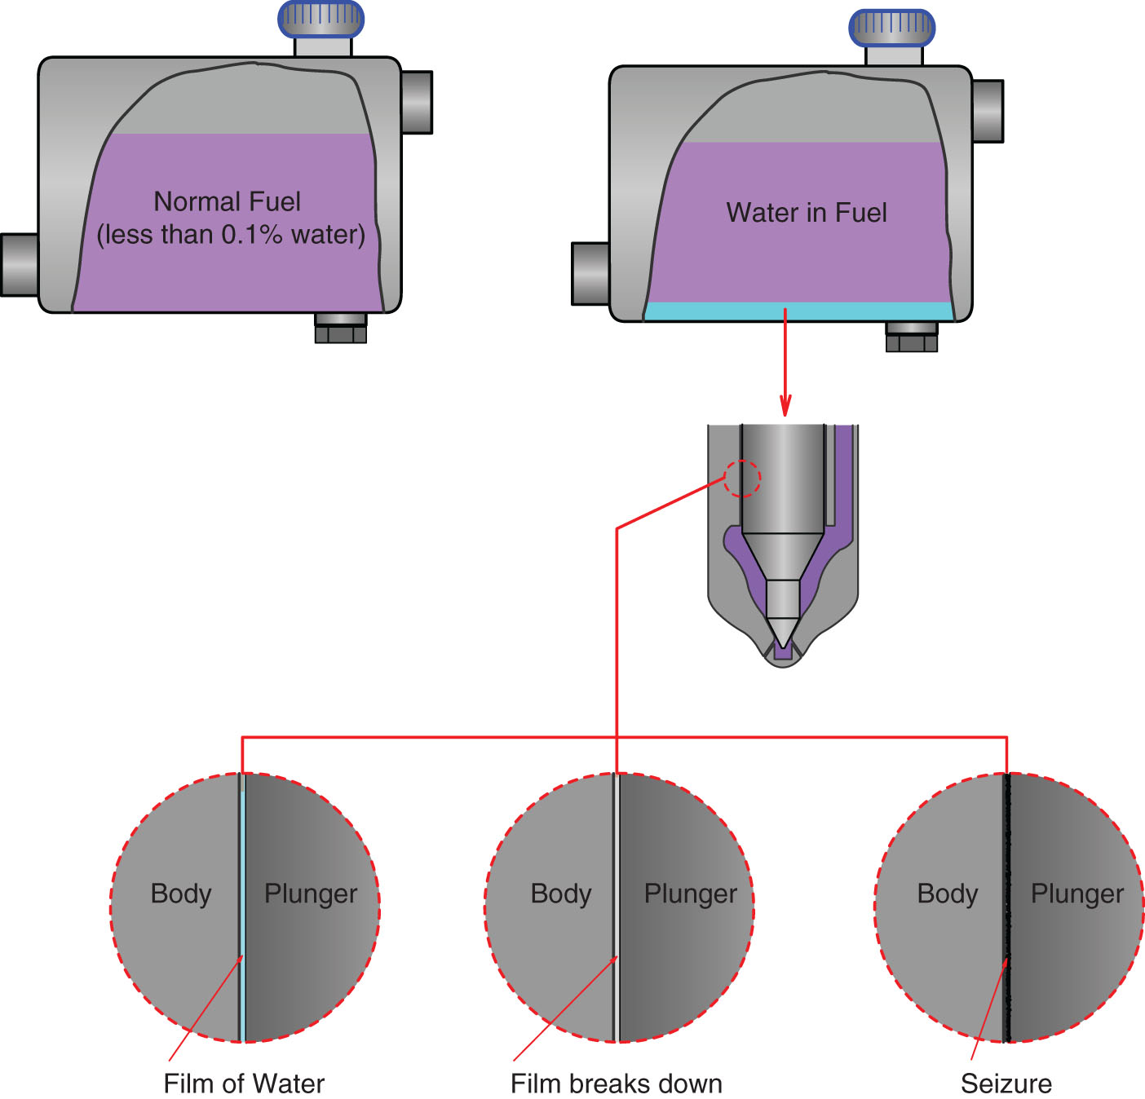
Components of Low-Pressure
Fuel Systems
(23 of 65)
Fuel Filters
  Contamination Sources
    Water—can seize injectors

Slide 30
Components of Low-Pressure
Fuel Systems
(24 of 65)
Fuel Filters
  Contamination Sources
    Water
      Causes loss of film strength of diesel fuel; loss of lubricity
      Helps form acid
      Causes rust
      Helps microorganism growth
      Fuel filters can separate water and fuel via coalescences or centrifugal methods

Slide 31
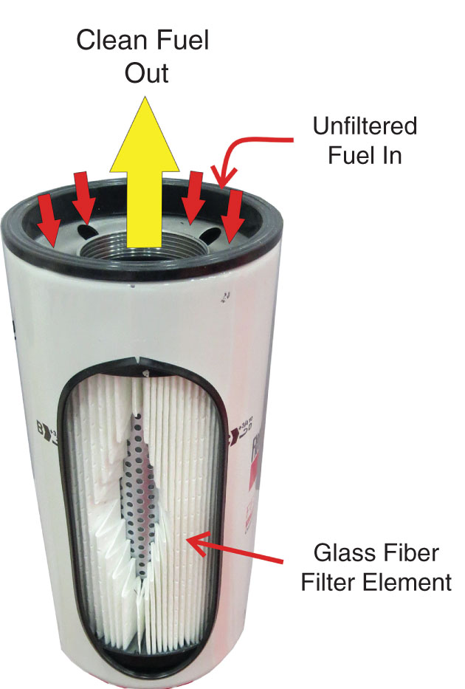
Components of Low-Pressure
Fuel Systems
(25 of 65)

Slide 32
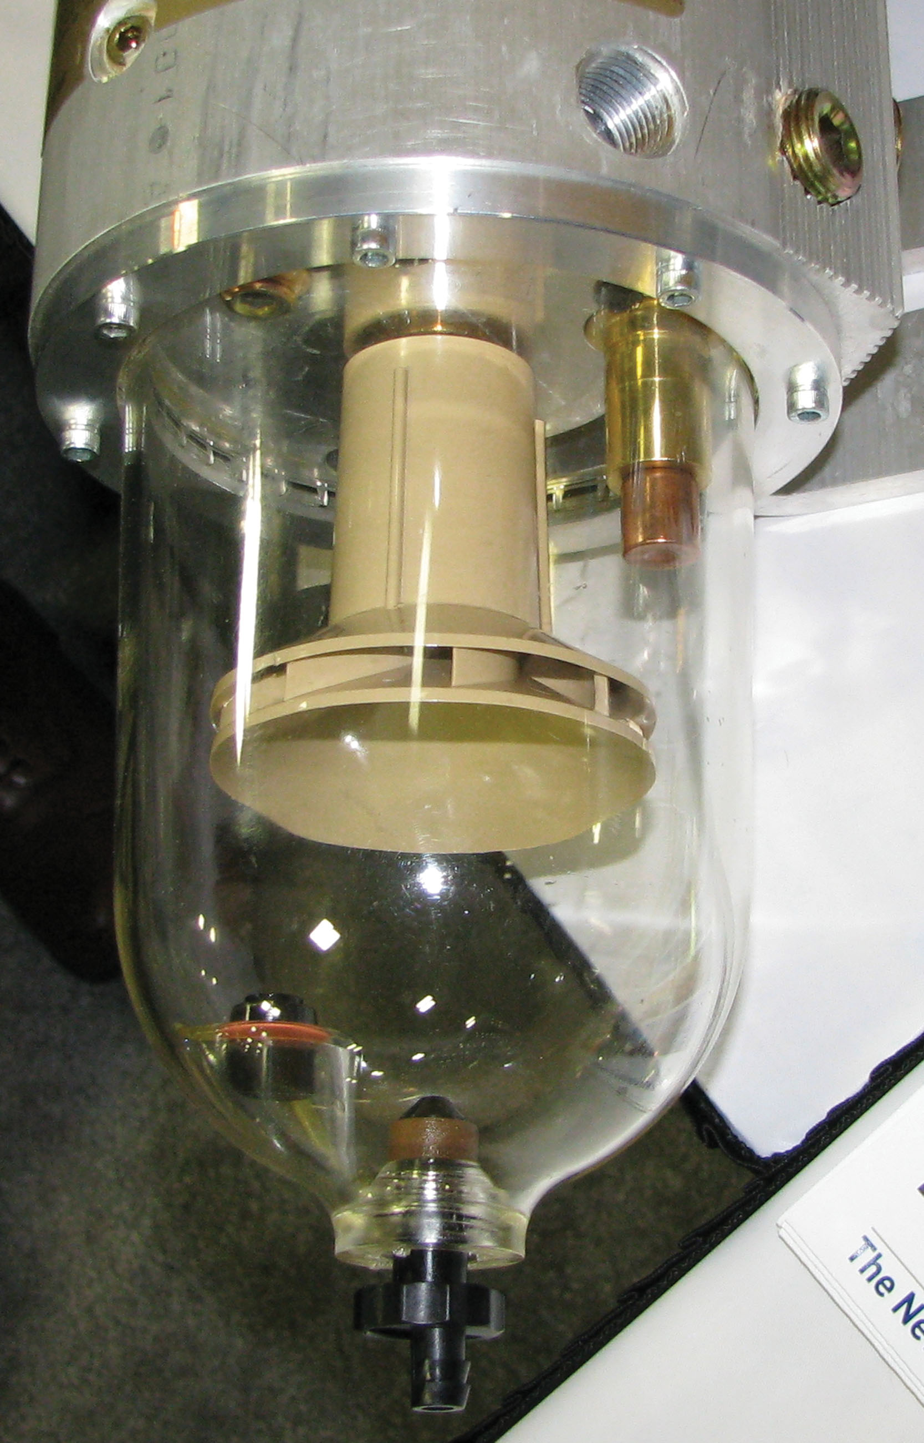
Components of Low-Pressure
Fuel Systems
(26 of 65)

Slide 33
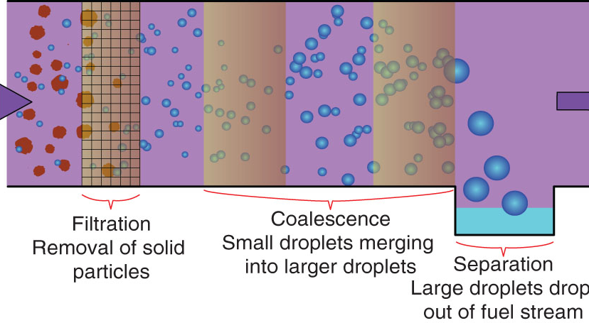
Components of Low-Pressure
Fuel Systems
(27 of 65)

Slide 34
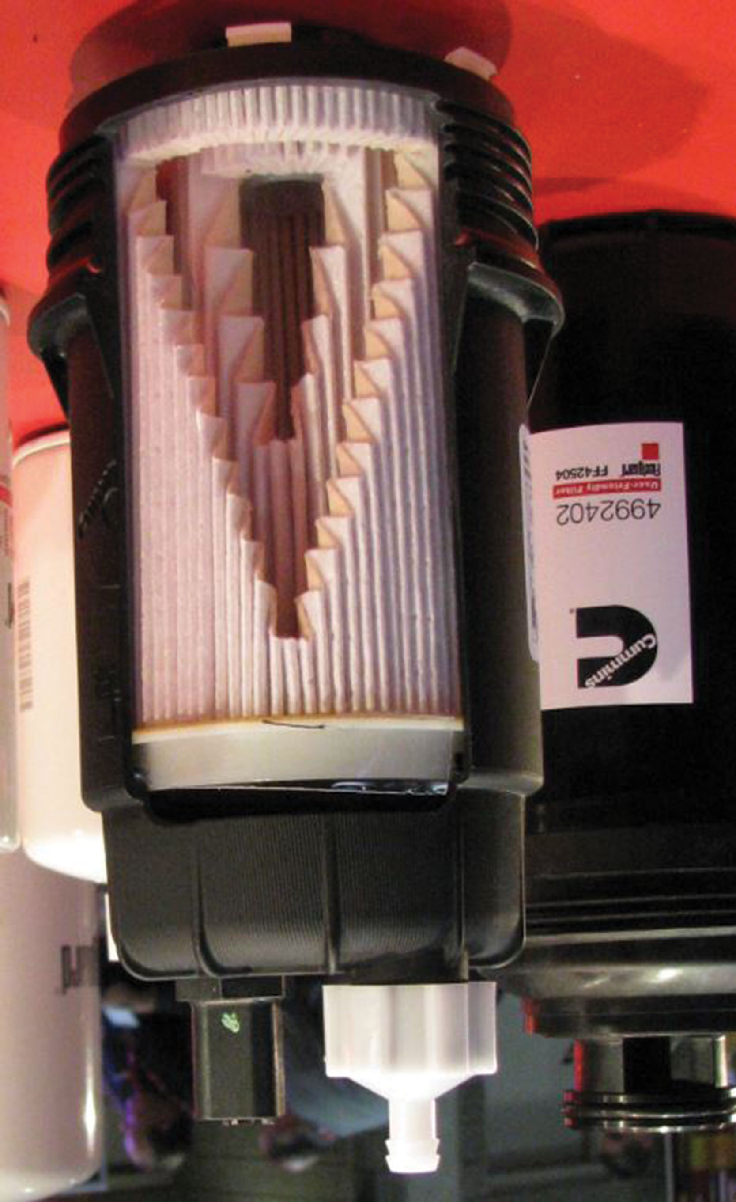
Components of Low-Pressure
Fuel Systems
(28 of 65)

Slide 35
Components of Low-Pressure
Fuel Systems
(29 of 65)
Fuel Filters
  Contamination Sources
    Water
      Filter drain valves allow draining of water from filter housing
      WIF sensors alert operator to water in fuel by either float or electrical conductivity difference

Slide 36
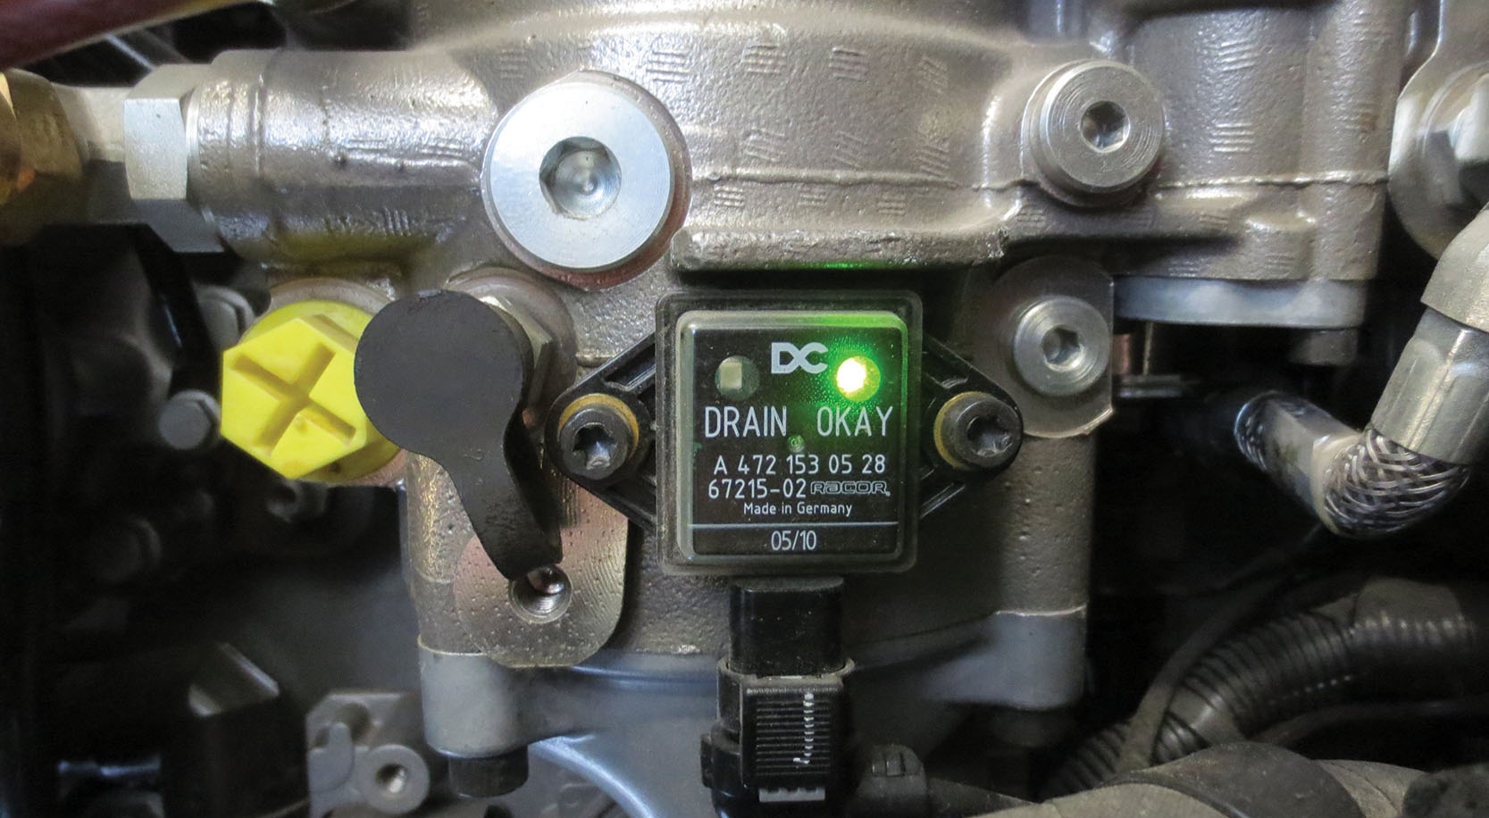
Components of Low-Pressure
Fuel Systems
(30 of 65)

Slide 37
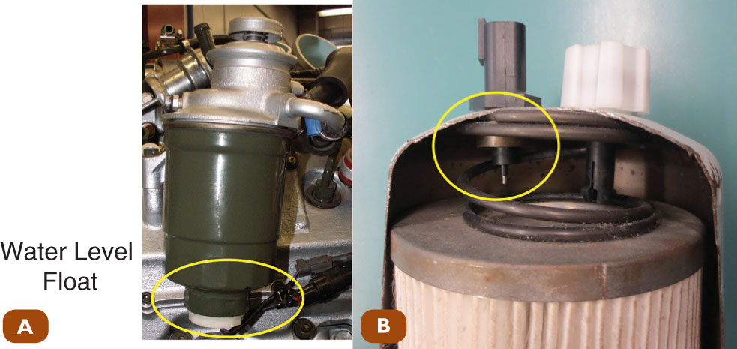
Components of Low-Pressure
Fuel Systems
(31 of 65)

Slide 38
Components of Low-Pressure
Fuel Systems
(32 of 65)
Fuel Filters
  Contamination Sources
    Bacteria and Fungi
      Grow in fuel under the right conditions and if fuel is left stagnant
      Fuel can be treated with biocide

Slide 39
Components of Low-Pressure
Fuel Systems
(33 of 65)
Fuel Filters
  Contamination Sources
    Wax
      Solidifies at cold temperature
      At 32*F, 2-D becomes cloudy (cloud point)
      Fuel should be blended for seasonal and regional conditions

Slide 40
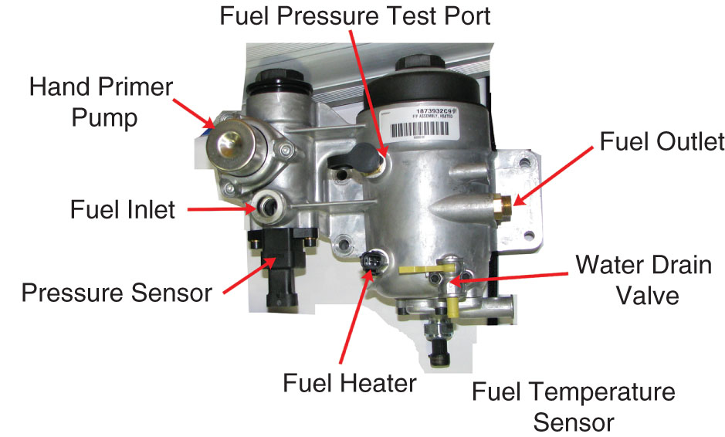
Components of Low-Pressure
Fuel Systems
(34 of 65)
Fuel Filters
  Contamination Sources
    Wax
      Fuel heaters can be in filter housing and electric

Slide 41
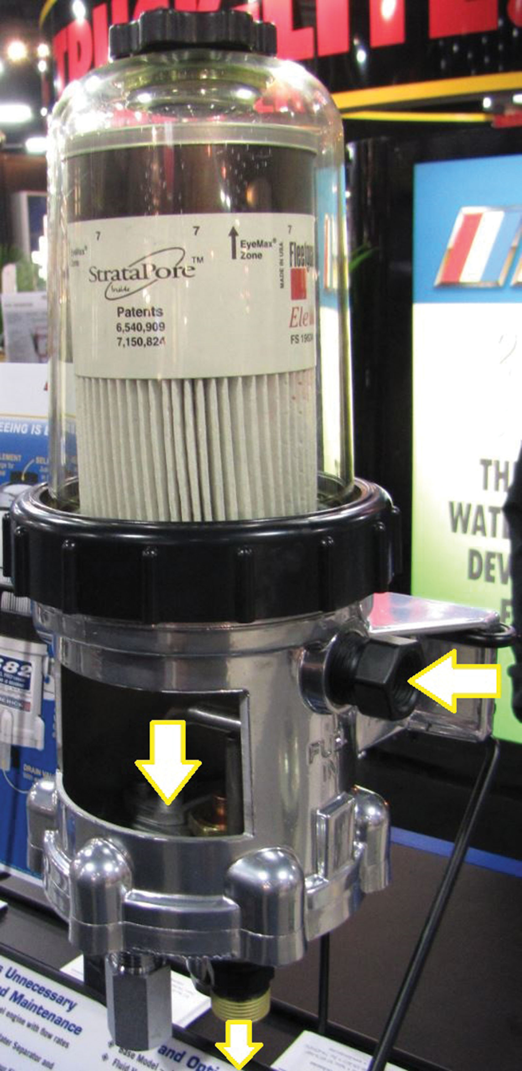
Components of Low-Pressure
Fuel Systems
(35 of 65)
Fuel Filters
  Contamination Sources
    Wax
      Fuel heaters can use coolant

Slide 42
Components of Low-Pressure
Fuel Systems
(36 of 65)
Fuel Filters
  Filter Media
    Paper (cellulose), microglass, cotton, felt, wood
    Openings allow fuel through but trap small particles
    Surface area holds contaminants for one service interval

Slide 43
Components of Low-Pressure
Fuel Systems
(37 of 65)
Fuel Filters
  Filter Media
    Paper (cellulose), microglass, cotton, felt, wood
    Openings allow fuel but trap small particles
    Surface area holds contaminants for one service interval
    Paper: least expensive
    Microglass: most effective, most common

Slide 44
Components of Low-Pressure
Fuel Systems
(38 of 65)
Fuel Filters
  Efficiency
    Absolute micron rating determines percentage of largest particle sizes a filter will allow to pass through

Slide 45
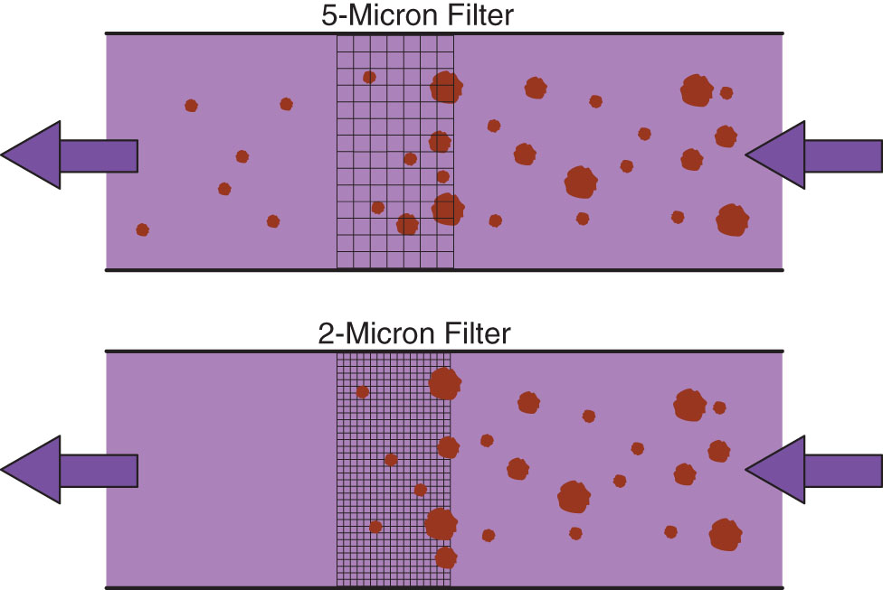
Components of Low-Pressure
Fuel Systems
(39 of 65)

Slide 46
Components of Low-Pressure
Fuel Systems
(40 of 65)
Fuel Filters
  Primary and Secondary Filters
    Primary filter located between tank and transfer pump inlet; 95-98% efficient at 10-100 microns
    Secondary filter located between transfer pump outlet and high-pressure fuel system components

Slide 47
Components of Low-Pressure
Fuel Systems
(41 of 65)
Fuel Filters
  Cartridge Filter
    Spin on filters are not environmentally friendly and make cartridge filters more popular
    Can prevent engine from starting if filter not in place

Slide 48
Components of Low-Pressure
Fuel Systems
(42 of 65)
Fuel-Water Separators and Heaters
  Fuel Heaters
    Reduce and eliminate fuel gelling, which clogs filters and causes hard starting or no starting
    Can be electric or use engine coolant to warm fuel

Slide 49
Components of Low-Pressure
Fuel Systems
(43 of 65)
Fuel-Water Separators and Heaters
  Fuel-Water Separators
    Water removal from fuel is critical for fuel system longevity
    Use coalescence to remove water
    Centrifugal filters can assist with water removal

Slide 50
Components of Low-Pressure
Fuel Systems
(44 of 65)
Fuel-Water Separators and Heaters
  Water-in-Fuel Sensors
    Use an electrical conductivity probe
    Signal sent triggers a dash light

Slide 51
Components of Low-Pressure
Fuel Systems
(45 of 65)
Fuel-Water Separators and Heaters
  Fuel-Water Separator and Heater Modules
    One module can combine one or more filters, fuel-water separators, water-in-fuel sensors, fuel heaters

Slide 52
Components of Low-Pressure
Fuel Systems
(46 of 65)
Fuel Transfer Pumps
  Move fuel from tank to high-pressure system
    Gear Pumps
      Positive displacement pump with two gears

Slide 53
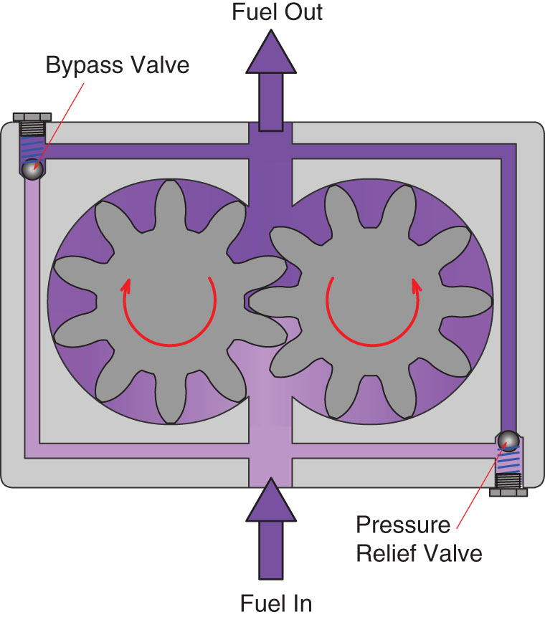
Components of Low-Pressure
Fuel Systems
(47 of 65)

Slide 54
Components of Low-Pressure
Fuel Systems
(48 of 65)
Fuel Transfer Pumps
  Gear Pumps
    Fuel is carried around outside of teeth from pump inlet to outlet
    Fuel flow is proportional to pump rpm
    Check valves at inlet allow priming pump to bypass gear pump

Slide 55
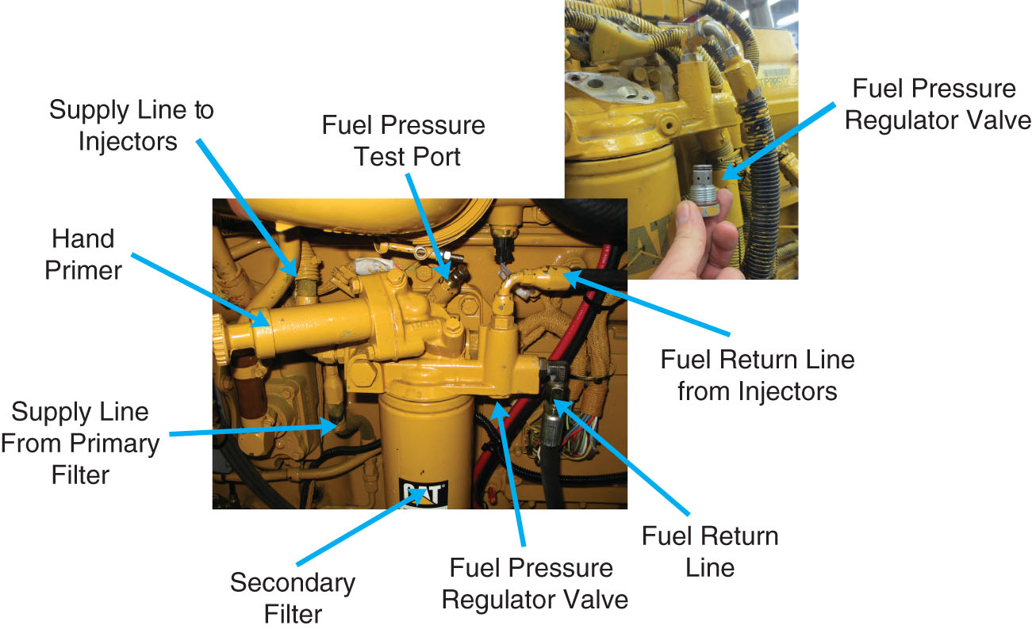
Components of Low-Pressure
Fuel Systems
(49 of 65)

Slide 56
Components of Low-Pressure
Fuel Systems
(50 of 65)
Fuel Transfer Pumps
  Gear Pumps
    Return restriction will regulate system pressure

Slide 57
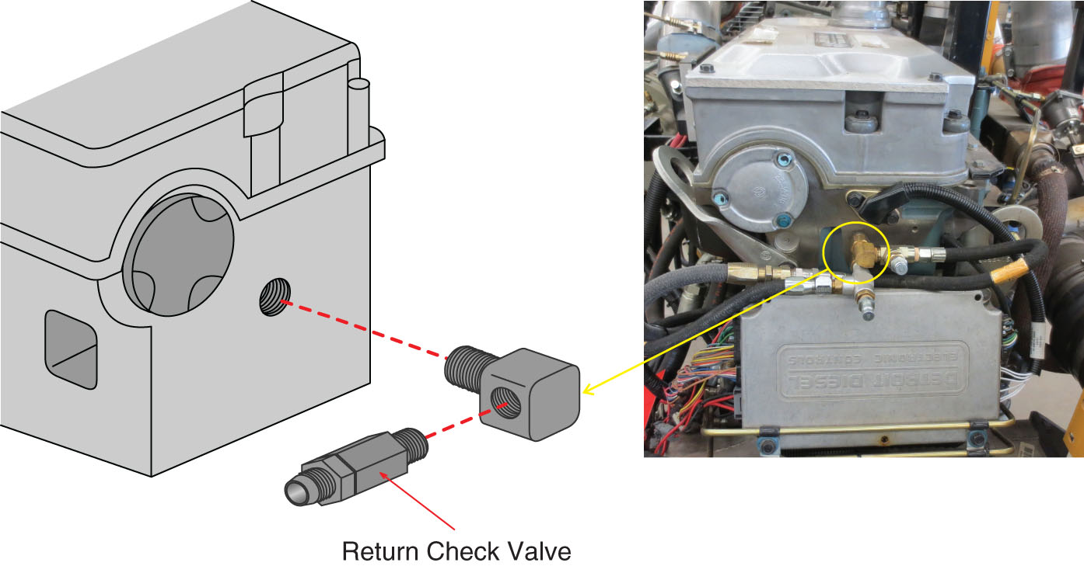
Components of Low-Pressure
Fuel Systems
(51 of 65)

Slide 58
Components of Low-Pressure
Fuel Systems
(52 of 65)
Fuel Transfer Pumps
  Gear Pumps
    Can incorporate electric priming pump to eliminate gear pump starvation

Slide 59
Components of Low-Pressure
Fuel Systems
(53 of 65)
Fuel Transfer Pumps
  Mechanical Diaphragm Pump
    Common type of low-pressure pump

Slide 60
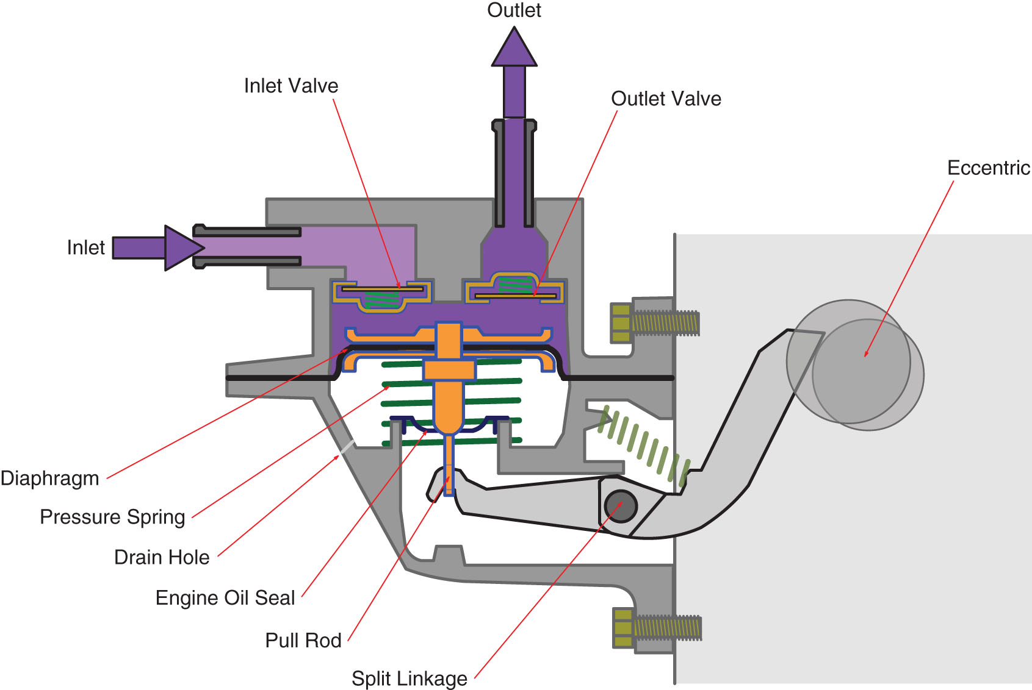
Components of Low-Pressure
Fuel Systems
(54 of 65)

Slide 61
Components of Low-Pressure
Fuel Systems
(55 of 65)
Fuel Transfer Pumps
  Mechanical Diaphragm Pump
    Cam-actuated arm moves diaphragm against spring pressure
    Movement of diaphragm creates pressure differential to move fuel from tank to pump inlet

Slide 62
Components of Low-Pressure
Fuel Systems
(56 of 65)
Mechanical Diaphragm Pump
  Variable Displacement in a Diaphragm Pump
    As volume output exceeds demand linkage, diaphragm remains stationary and does not pump fuel
    Most pumps incorporate hand-lever prime pump

Slide 63
Components of Low-Pressure
Fuel Systems
(57 of 65)
Piston-Type Pumps
  Use a piston to create pressure differential

Slide 64
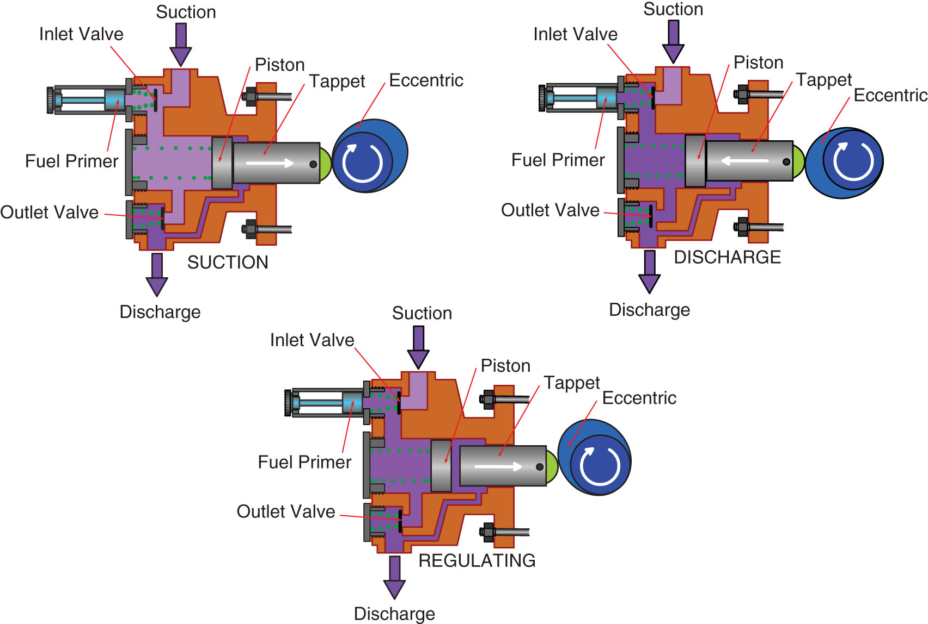
Components of Low-Pressure
Fuel Systems
(58 of 65)

Slide 65
Components of Low-Pressure
Fuel Systems
(59 of 65)
Piston-Type Pumps
  Used for higher pressure applications

Slide 66
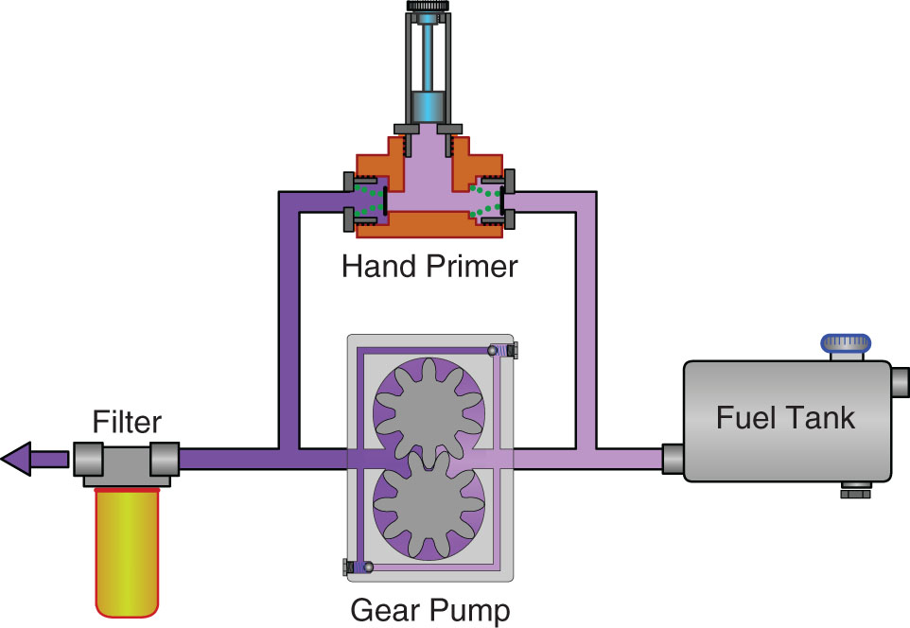
Components of Low-Pressure
Fuel Systems
(61 of 65)

Slide 67
Components of Low-Pressure
Fuel Systems
(62 of 65)
In-Tank Electric Pumps
  Medium-duty vehicles will use in-tank pumps
  Pressurizes entire system
  Makes priming system easy

Slide 68
Components of Low-Pressure
Fuel Systems
(63 of 65)
Fuel Coolers
  Pressurizing diesel fuel heats it up
  Coolers are needed to keep fuel below flash point of 140*F
  Detroit Diesel DD series use coolant-cooled coolers

Slide 69
Components of Low-Pressure
Fuel Systems
(64 of 65)
Roller Vane Pumps
  Most in-tank pumps are driven by permanent magnet motors
  Vanes are carried around pump housing and move fuel past check valves to pump outlet

Slide 70
Components of Low-Pressure
Fuel Systems
(65 of 65)
Vane-Type Pumps
  Some injection pumps have mechanical vane pumps; some pumps are electrically driven
  Can be electronically controlled to prevent over-pressurization

Slide 71
Maintenance of Low-Pressure
Fuel Systems
(1 of 22)
Evaluating engine performance problems often leads to checking low-pressure fuel system operation
Pressure and flow can be measured

Slide 72
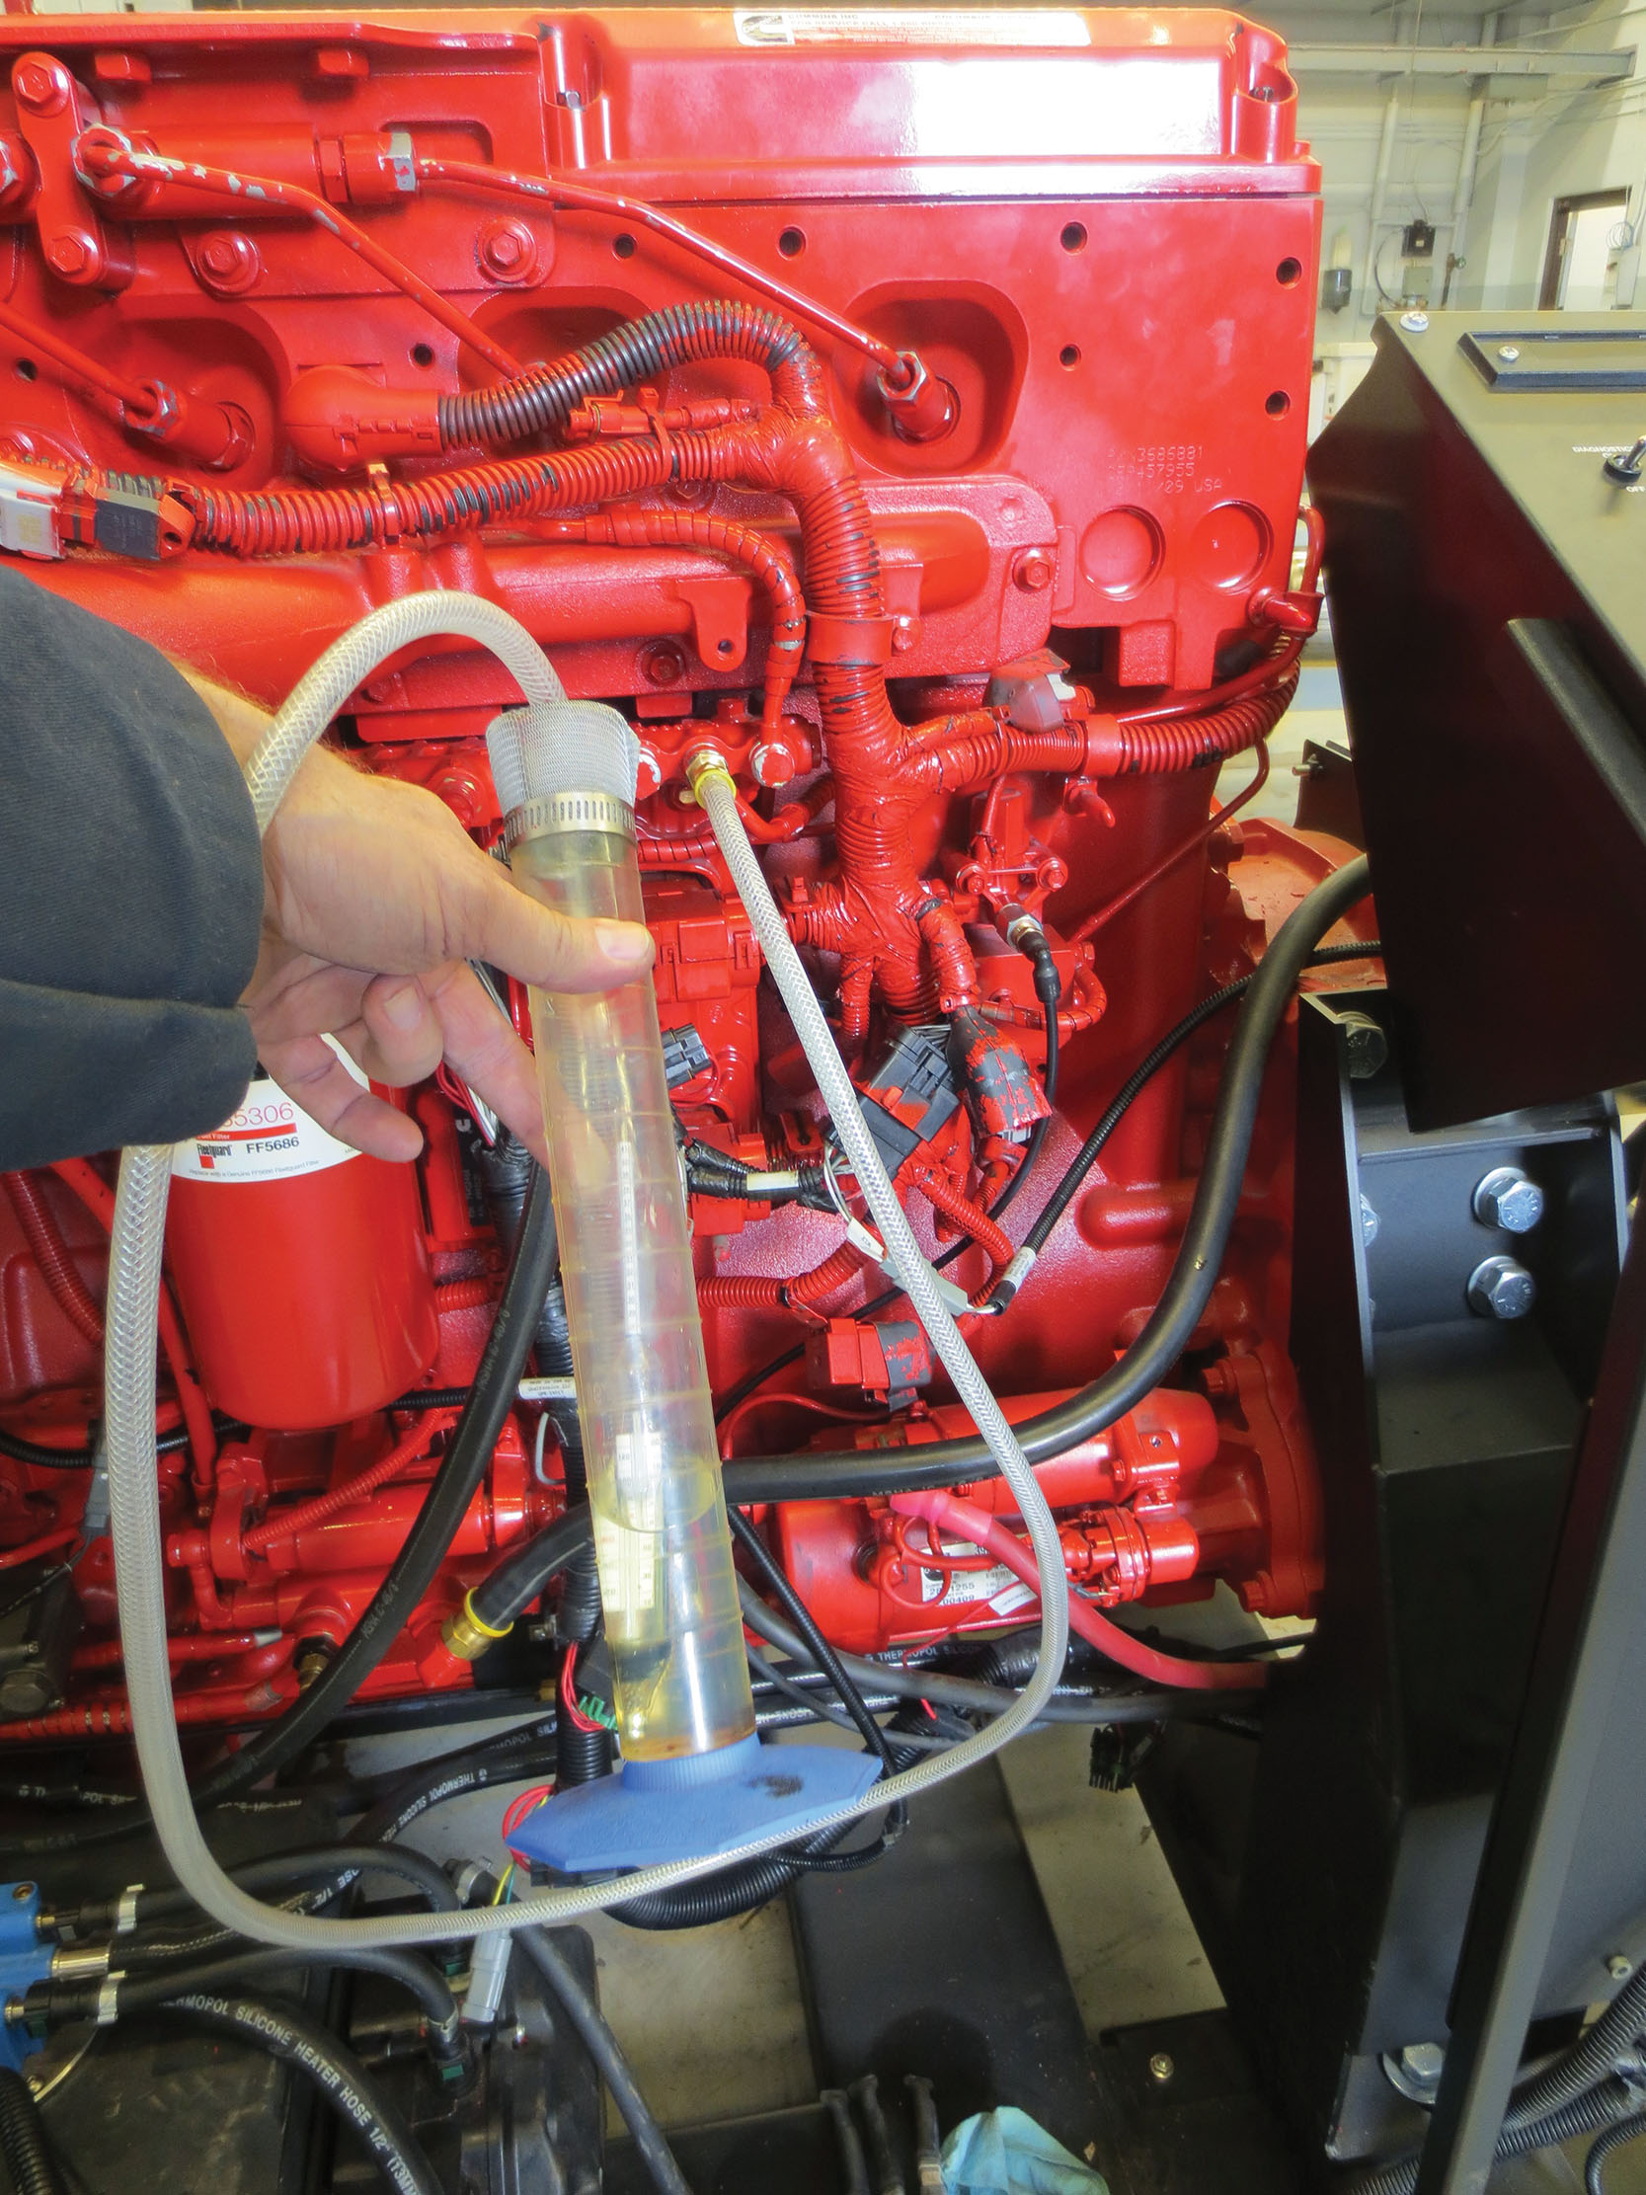
Maintenance of Low-Pressure
Fuel Systems
(2 of 22)

Slide 73
Maintenance of Low-Pressure
Fuel Systems
(3 of 22)
Checking for air in fuel is common practice

Slide 74
Maintenance of Low-Pressure
Fuel Systems
(4 of 22)
Filter restrictions can be measured using gauges or by viewing electronic data

Slide 75
Maintenance of Low-Pressure
Fuel Systems
(5 of 22)
Filter restrictions can be measured using gauges or by viewing electronic data

Slide 76
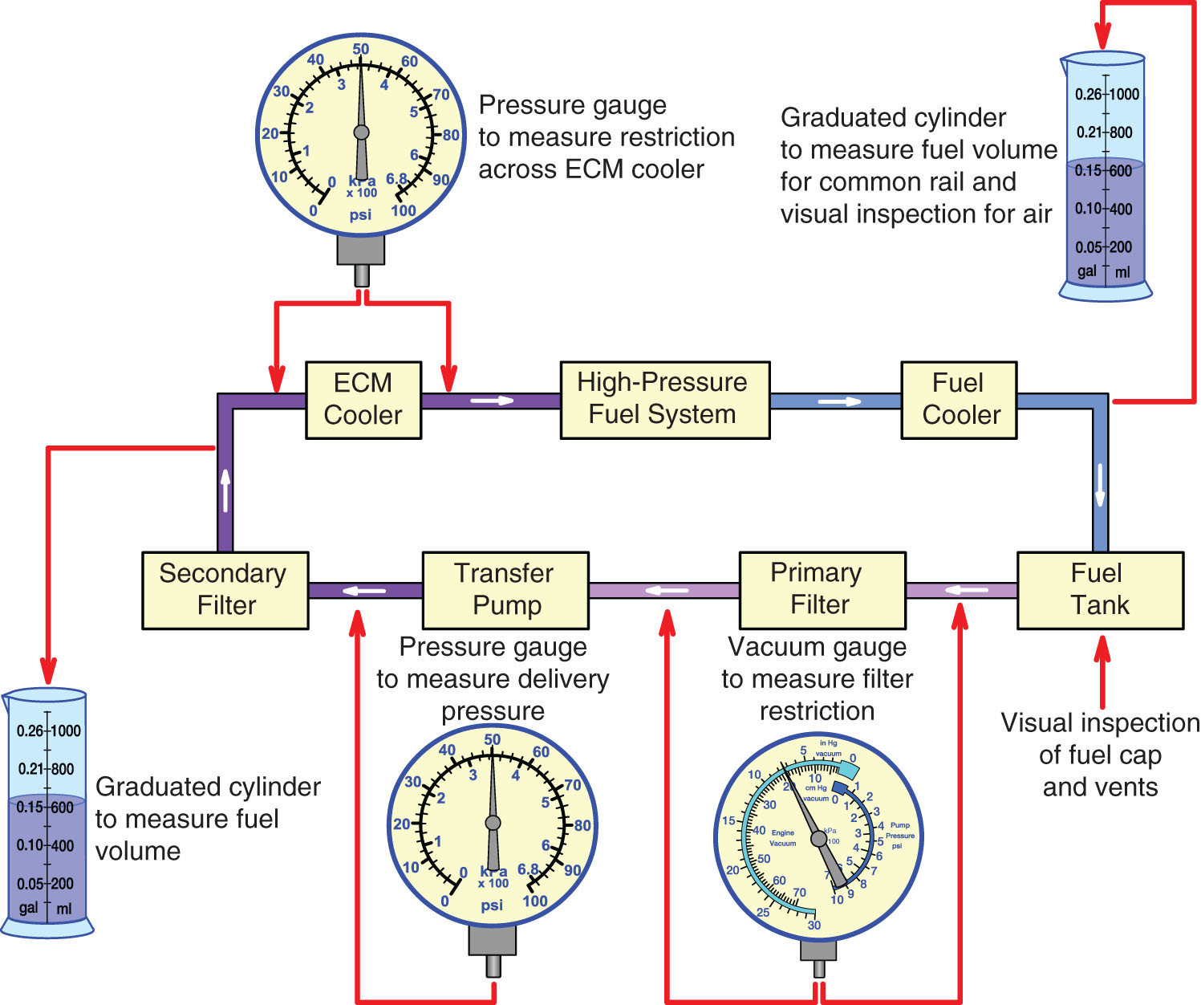
Maintenance of Low-Pressure
Fuel Systems
(6 of 22)

Slide 77
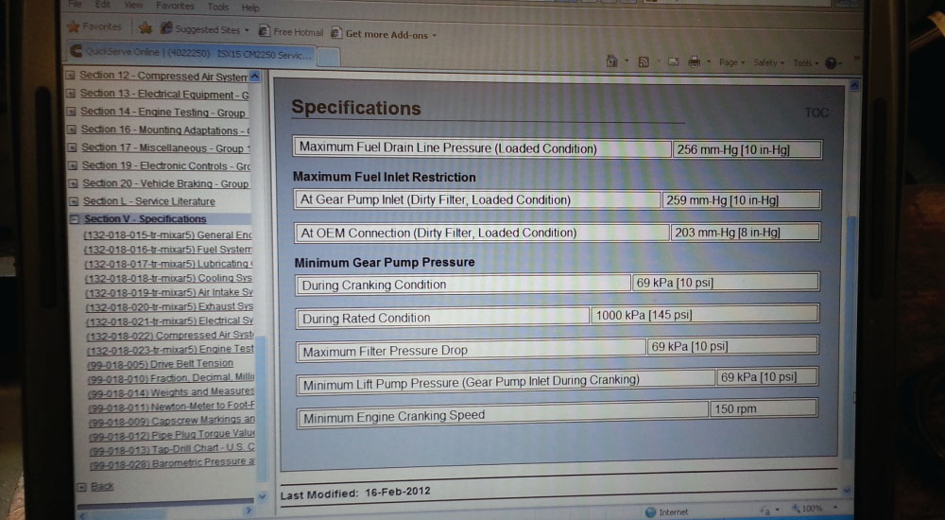
Maintenance of Low-Pressure
Fuel Systems
(7 of 22)

Slide 78
Maintenance of Low-Pressure
Fuel Systems
(8 of 22)
Detroit Diesel FSIC Test
  FSIC (fuel system integrity check) is used to identify fuel system problems
  A laptop and diagnostic software is needed
Malfunctioning Fuel Tank Vent
  Can lead to negative tank pressure and fuel starvation

Slide 79
Maintenance of Low-Pressure
Fuel Systems
(9 of 22)
Air Leaks on Suction Lines
  Lines that connect the tank to transfer pump inlet are at negative pressure when engine is running
  Air can be drawn into these lines and lead to low power or damaged components

Slide 80
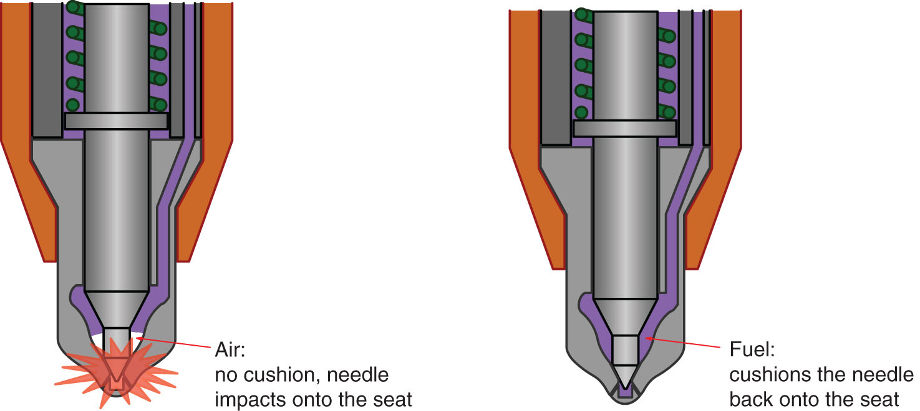
Maintenance of Low-Pressure
Fuel Systems
(10 of 22)

Slide 81
Maintenance of Low-Pressure
Fuel Systems
(11 of 22)
Filter Service
  Filter efficiency increases as filters capture contamination
  Fuel filters don’t have bypass valves; plugged filters will affect engine performance

Slide 82
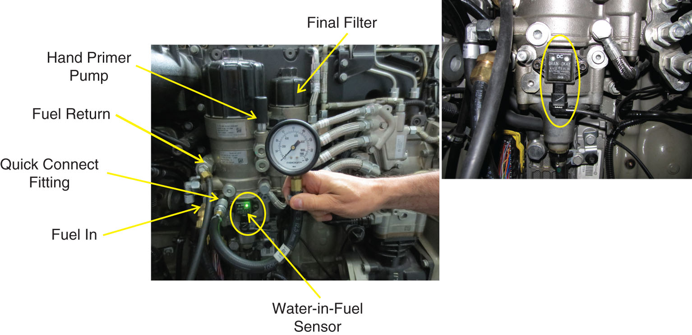
Maintenance of Low-Pressure
Fuel Systems
(12 of 22)

Slide 83
Maintenance of Low-Pressure
Fuel Systems
(13 of 22)
Common Fuel System Problems
  Filters should be replaced at recommended intervals
  Measured in inches of water or mercury

Slide 84
Maintenance of Low-Pressure
Fuel Systems
(14 of 22)
Performing a Primary Fuel Filter Suction-Side Pressure Test
  Should not provide excessive restriction to transfer pump
  Install vacuum gauge at filter outlet and run engine at high idle

Slide 85
Maintenance of Low-Pressure
Fuel Systems
(15 of 22)
Measuring Primary Filter Restriction
  Install gauges on both sides of primary filter and compare
Performing a Primary Fuel Filter Suction-Side Restriction Test
  Can indicate a restriction in line between primary filter and tank
  Install vacuum gauge at filter inlet and run engine at rated speed
  10” maximum allowable

Slide 86
Maintenance of Low-Pressure
Fuel Systems
(16 of 22)
Measuring Secondary Filter Output Pressure
  Low reading will indicate plugged filter
  Install pressure gauge at filter outlet and run engine at high idle
  50-80 psi acceptable

Slide 87
Maintenance of Low-Pressure
Fuel Systems
(17 of 22)
Diaphragm Pump Problems
  Check valves can deteriorate, reducing pump flow
  Can result in hard starting and low power
  Springs can break
  External oil or fuel leaks

Slide 88
Maintenance of Low-Pressure
Fuel Systems
(18 of 22)
Oil Contamination of Fuel
  Can come from transfer pumps, HEUI injectors
  Can be detected with paper towel test or oil sample

Slide 89
Maintenance of Low-Pressure
Fuel Systems
(19 of 22)
Priming Fuel Systems
  Must be done when an engine runs out of fuel or after servicing or rebuild
  Priming pump is used with bleeder screw open

Slide 90
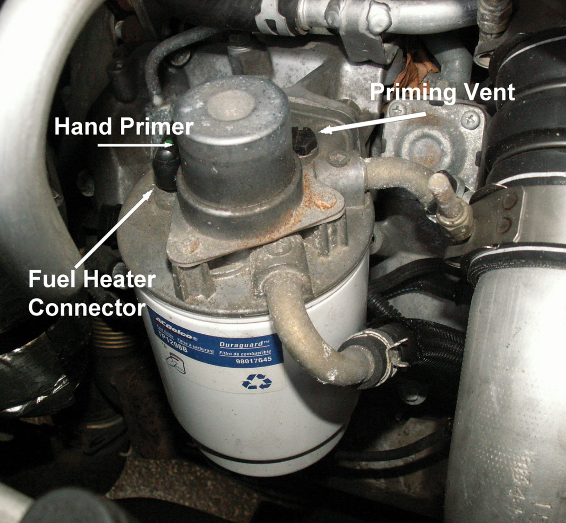
Maintenance of Low-Pressure
Fuel Systems
(20 of 22)

Slide 91
Maintenance of Low-Pressure
Fuel Systems
(21 of 22)
Replacing a Fuel Filter and Priming a Fuel System
  Carefully replace filter according to engine service information
  Prime fuel system using recommended procedures

Slide 92
Maintenance of Low-Pressure
Fuel Systems
(22 of 22)
Hard Starting Problems
  Can include fuel leak back to the tank, air in the fuel system, low or no fuel pressure, inadequate fuel delivery volume
  Check for loose, kinked, cracked lines, plugged filters, defective pump, and/or valve

Slide 93
Summary
(1 of 8)
Diesels need a low-pressure fuel supply to transfer fuel from the fuel tank with adequate volume and pressure to the high-pressure injection stage of the fuel system.
Proper operation and service of the low-pressure fuel supply system is critical to quick starting, engine durability, and reliable, trouble-free operation of diesel- powered vehicles.

Slide 94
Summary
(2 of 8)
The functions of the low-pressure fuel system include storing and supplying fuel free of contaminants and vapor at the correct pressure to the high-pressure injection system, removing water contamination, preventing fuel wax from gelling, and regulating fuel temperature.

Slide 95
Summary
(3 of 8)
While the most obvious function of the fuel tank is to store an adequate supply of fuel for the engine’s application, a secondary function is to allow fuel returned from the engine to cool after absorbing heat from the engine and fuel injectors.

Slide 96
Summary
(4 of 8)
Low-pressure fuel transfer lines connect the fuel circuits of the low-pressure transfer system.
Fuel tank pickups can be integrated with a fuel level– sending unit and fuel transfer pump; these modules may include several components that may or may not be separately serviceable.

Slide 97
Summary
(5 of 8)
Fuel filters remove dirt contamination from fuel that could cause abrasive wear of injection components.
The most common contaminants found in today’s fuels are asphaltene, air, water, microorganisms, and wax.

Slide 98
Summary
(6 of 8)
To prepare fuel for cold weather use and avoid operating difficulties, the low-pressure supply system is oft en equipped with a variety of devices to condition the fuel by removing water and dissolving wax.
Fuel transfer pumps are used to move fuel from the fuel tanks to the high-pressure fuel system; the fuel must be supplied with adequate volume at the correct pressure for every operating condition.

Slide 99
Summary
(7 of 8)
A variety of pump types exist to match the unique requirements of each high-pressure fuel system.
Evaluating the operation of the low-pressure supply system is indicated when investigating complaints regarding low power, hard or prolonged starting, rough engine operation, and failures of high-pressure injection components.

Slide 100
Summary
(8 of 8)
Whenever fuel filters are replaced, or if an engine has run out of fuel, the system usually needs to have air purged from the filter and lines in order to start.

