Slide 2
Chapter 13
Vehicle Maintenance Inspection

Slide 3
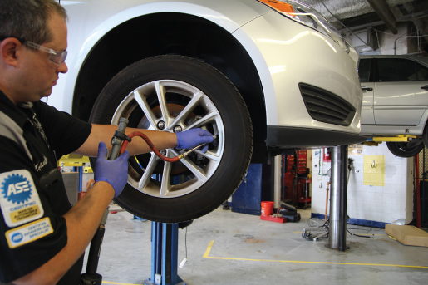
Introduction
Regular inspection and maintenance
Allows for safe and reliable operation
Common types of inspection
Basic inspection
In-depth inspection
State safety inspection
Certified used car inspection
Vehicle prepurchase inspection

Slide 4
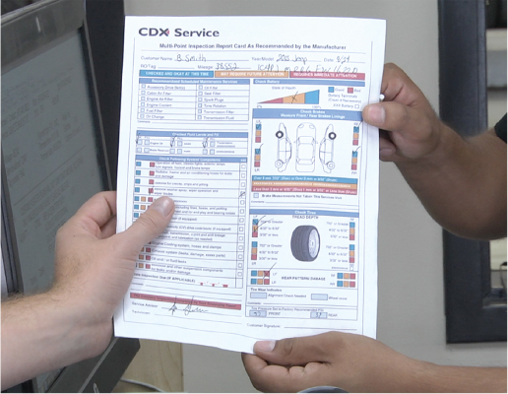
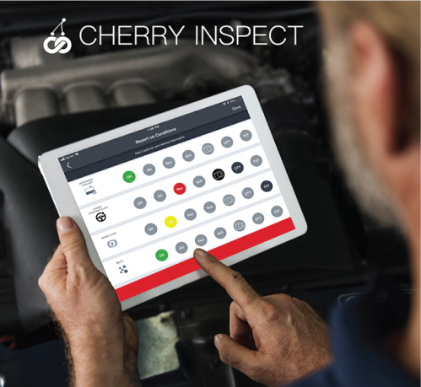
Introduction
Document inspection process
Paper forms
Electronic forms
Technicians need to:
Take detailed notes/pictures
Follow manufacturers’ procedures and specifications
Courtesy of John Griffin, CEO of Drive Cherry.

Slide 5
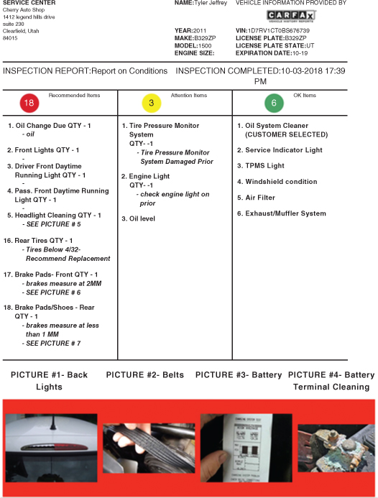
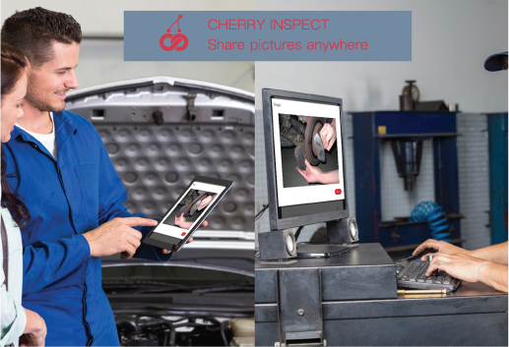
Introduction
Cherry Inspect
www.drivecherry.com
Electronic inspection system
Can be 40% more efficient than paper inspection forms
Can include notes and pictures
Evidence for decisions made
Courtesy of John Griffin, CEO of Drive Cherry.
Courtesy of John Griffin, CEO of Drive Cherry.

Slide 6
LO 13-1: Perform in-vehicle inspection.
In-vehicle concerns
Many drivers overlook
Others ignore
Driving vehicle into service bay, check:
Instrument cluster
Warning lights
How pedals feel
Engine sounds
Illuminated malfunction indicator lamp (MIL) = need to check for any diagnostic trouble codes (DTCs) with scan tool

Slide 7
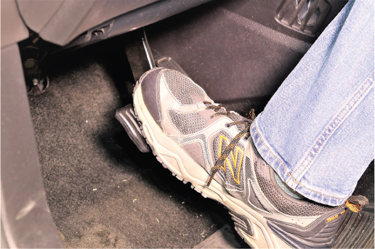
LO 13-1: Perform in-vehicle inspection.
Brake pedal
Any changes to the resistance can indicate a problem
If the pedal is low or hard, do not drive the vehicle.
Unusual brake sounds
High-pitched scrape noise
Grinding noise
Could indicate brake problems

Slide 8
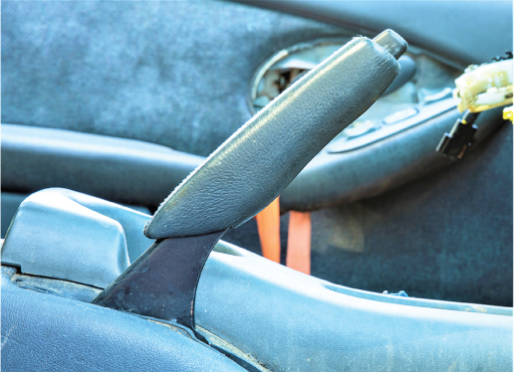
LO 13-1: Perform in-vehicle inspection.
Service/parking brake
Holds vehicle in position when parked
Should be checked during routine inspections
Checking parking brake
Apply brake and observe how far vehicle travels
Going all the way/near its stop = brake needs further attention
Do not test parking brake in below-freezing temperatures

Slide 9
LO 13-1: Perform in-vehicle inspection.
Instrument panel warning lamps
Indicate faults with various systems
Warning lamp per system
A MIL will be illuminated when a fault is detected.
Starting the vehicle
Observe the lights
MILs often turn on briefly while checking for faults, then turn off
On-board diagnostics generation II (OBD-II) does the same
No DTCs stored = light will go off within a few seconds

Slide 10
LO 13-1: Perform in-vehicle inspection.
OBD-II system
Tests and analyzes engine’s systems
While vehicle is being operated
Will set and store DTC if a fault is detected
During in-vehicle inspection
Retrieve DTCs if any MILs are illuminated
The code will help you diagnose any faults

Slide 11
LO 13-1: Perform in-vehicle inspection.
Horn
Operated by a relay or by vehicle body control module (BCM)
Located in front of vehicle
Behind grill or bumper
Some cars have two horns
One has a lower pitch than the other
Check horn quickly before driving vehicle into the shop

Slide 12
LO 13-1: Perform in-vehicle inspection.
Interior lights
Courtesy lights
Turn on with use of key or after opening driver’s door
Dome lights
Turn on with use of key or after opening driver’s door
Can be switched on when door is closed
Vanity lights
Usually on back of visor; switched on
Map lights
Usually turn on when moved into a position in which they can be used

Slide 13
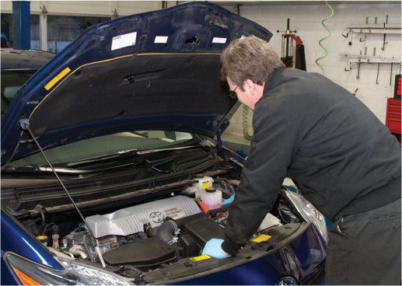
LO 13-2: Perform fluid inspection.
Underhood inspection
Perform at manufacturer’s recommended intervals or prior to a long driving trip
Check for low fluid level, torn belt
Can prevent many future problems

Slide 14
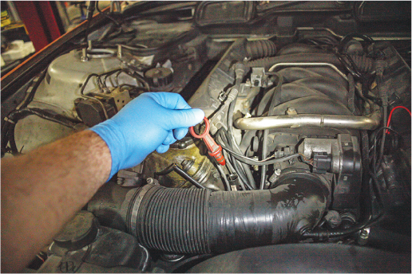
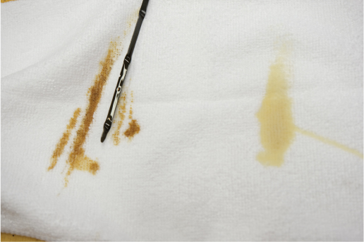
LO 13-2: Perform fluid inspection.
Vehicle fluids
All must be at right level
Use manufacturer’s recommended type
Nearly all fluids get old and wear out
Except some automatic transmission/transaxle fluids
Replacement is necessary
Different fluids show age differently.

Slide 15
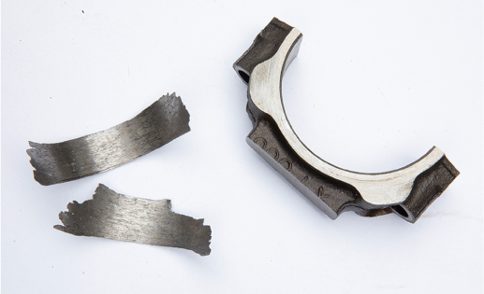
LO 13-2: Perform fluid inspection.
Engine oil levels
Too low: oil pump starves for oil
Too high: crankshaft churns oil to foam
Both cause lack of lubrication
Leads to damage throughout engine

Slide 16
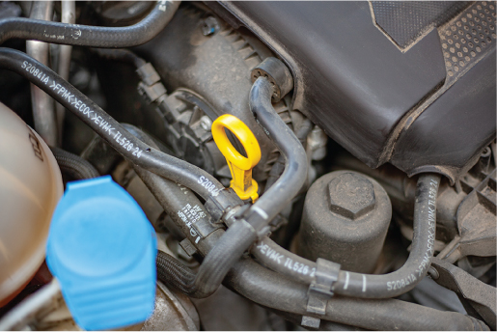
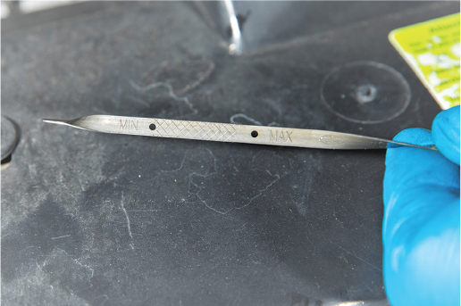
LO 13-2: Perform fluid inspection.
Checking engine oil levels
Vehicle must be on level surface
Engine OFF
Use a dipstick
Full/add or min/max levels marked
Difference between full and add marks
Differs by vehicle
Usually 1 quart (0.9 liter)
Can reach 2 quarts (1.9 liters)

Slide 17
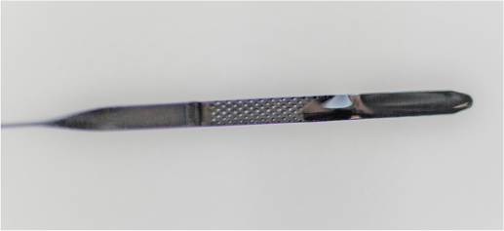
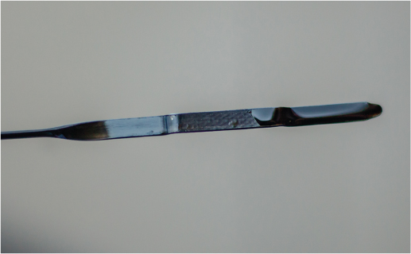
LO 13-2: Perform fluid inspection.
Dipstick
Read horizontally
Check both sides
Lower level usually more accurate

Slide 18
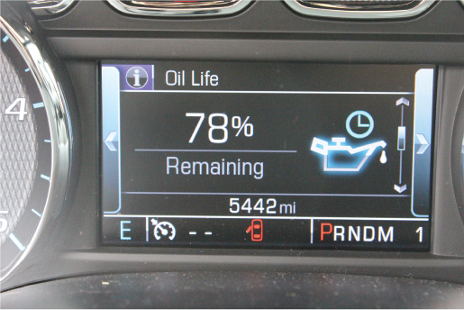
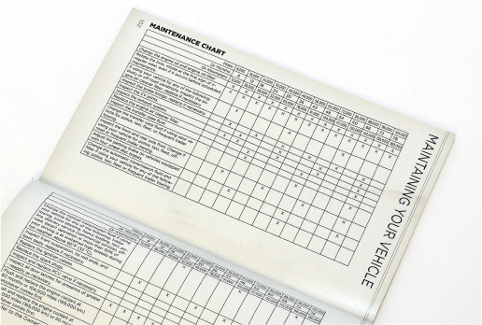
LO 13-2: Perform fluid inspection.
Oil-life monitoring (OLM) system
Check to determine if time for oil change
Indicates remaining % of oil life
Vehicles without OLMs
Consult service information
Recommended mileage/time interval between changes

Slide 19
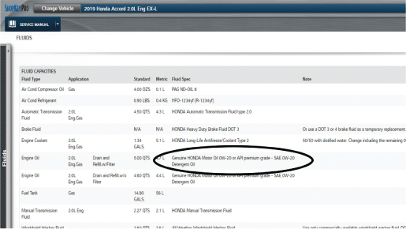
LO 13-2: Perform fluid inspection.
If engine oil needs to be changed
Still check oil level with dipstick
Low reading could = leak or engine is using oil
Both situations require further investigation
Refer to Chapters 18 and 19 for more information on engine lubrication.

Slide 20
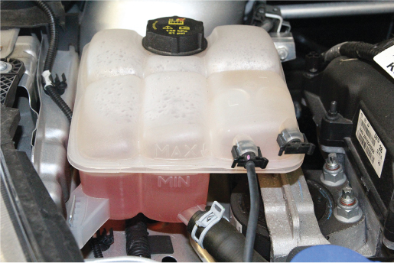
LO 13-2: Perform fluid inspection.
Coolant
Transfers excessive heat
From engine → radiator
Check whenever checking engine oil
Checking coolant levels
Some vehicles have tank with hot/cold markings
Allows for check without having to remove the cap

Slide 21
LO 13-2: Perform fluid inspection.
Coolant level check, cont’d
Other vehicles have a transparent overflow tank
Can view fluid hot/cold levels
Older vehicles
May require removing radiator cap
Confirm coolant level is about 1.5 inches (38.1 millimeters) below filler neck

Slide 22
LO 13-2: Perform fluid inspection.
Checking coolant freeze point
Insufficient antifreeze can → coolant freezing → cooling system components expanding and cracking
Measured with antifreeze hydrometer or refractometer

Slide 23
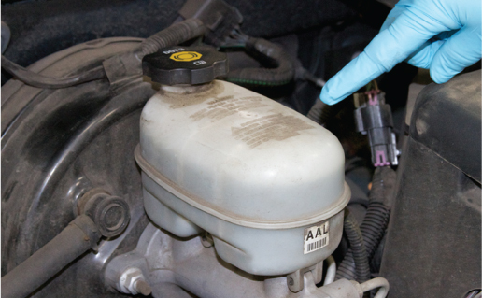
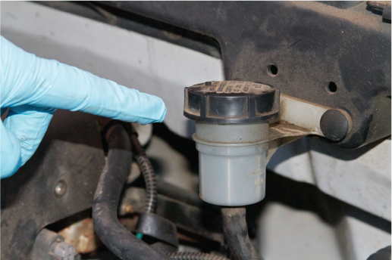
LO 13-2: Perform fluid inspection.
Brake fluid
Check level when oil level is checked
Hygroscopic and hydraulic braking systems depend on it
Hygroscopic brake fluids absorb water from atmosphere
Change every 2 to 4 years
Brake fluid tester or brake fluid test strips
Check brake master cylinder reservoir or separate fluid reservoir

Slide 24
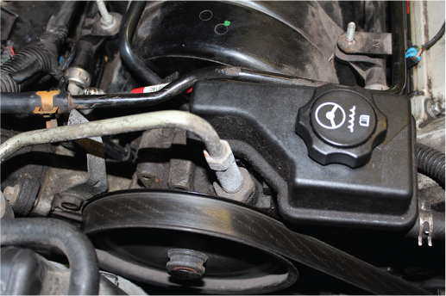
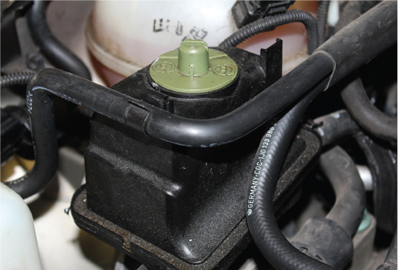
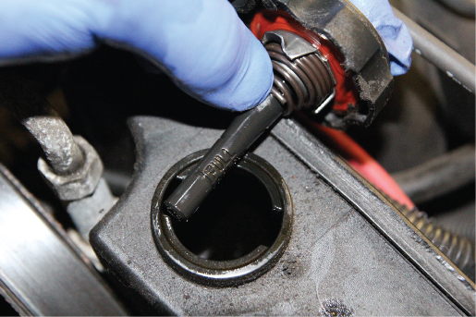
LO 13-2: Perform fluid inspection.
Power steering fluid
Engine should be idling
Fluid should be hot
Fluid reservoir or separate container
Check
Appearance
Dark fluid = needs to be changed
Level with dipstick
Connected to filler cap

Slide 25
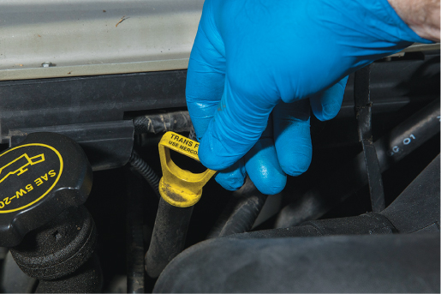
LO 13-2: Perform fluid inspection.
Automatic transmission/transaxle fluid
Too low = slipping and shift timing faults
Too high = fluid churns and aerates
Checking levels
Engine running
Transmission fully warmed
Vehicle in Park or Neutral
Use dipstick located under the hood, near front of the transmission

Slide 26
LO 13-2: Perform fluid inspection.
Always use the specified type of transmission fluid
Use a funnel to add the fluid
Through dipstick tube
Add only small amounts at a time

Slide 27
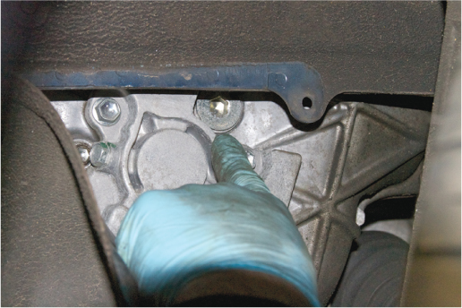
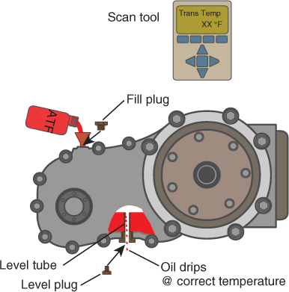
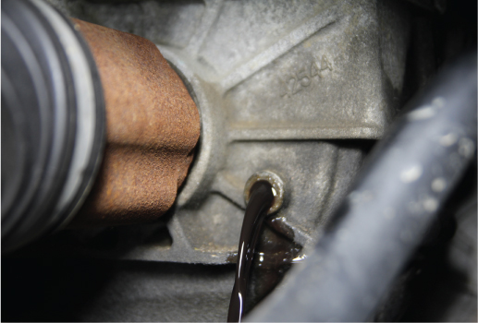
LO 13-2: Perform fluid inspection.
Vehicles without dipsticks
Follow service information
Some have a fill plug (or “level plug”)
On side of transmission

Slide 28
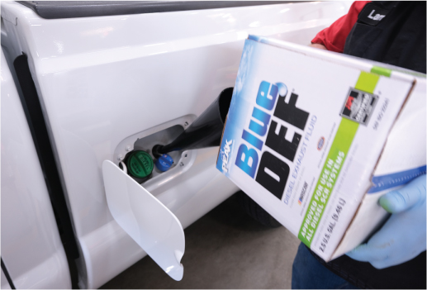
LO 13-2: Perform fluid inspection.
Diesel exhaust fluid (DEF)
Used by some diesel-powered vehicles
Helps reduce nitrogen oxides in exhaust
Consumed over time → replenished periodically
Filler cap
Often located under the hood
Usually blue

Slide 29
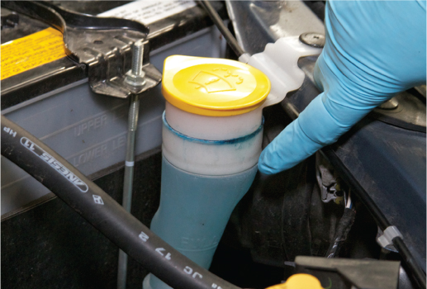
LO 13-2: Perform fluid inspection.
Windshield washer fluid
Important for the safety of the driver.
Reservoir is usually under the hood
May have separate rear reservoir for rear window
Usually somewhere in rear hatch or trunk
Check level at each vehicle service

Slide 30
LO 13-3: Perform belt, hose, and air filter/cabin air filter inspection.
Engine drive belts
Operate engine accessories
Example: water pump, alternator
Broken belts/belts that come off = engine quickly overheats

Slide 31
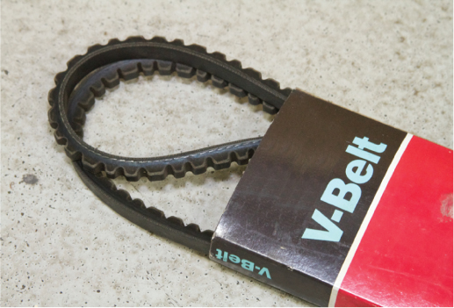
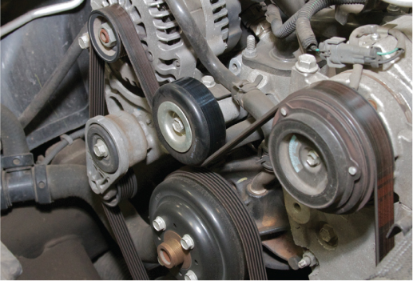
LO 13-3: Perform belt, hose, and air filter/cabin air filter inspection.
Two belt types
V-belts
Inside V-shaped groove in pulley
Wedge into its sides
Serpentine-type belts
Have grooves that are exact reverse of grooves in pulley’s outer diameter
Usually recommend also replacing tensioner

Slide 32
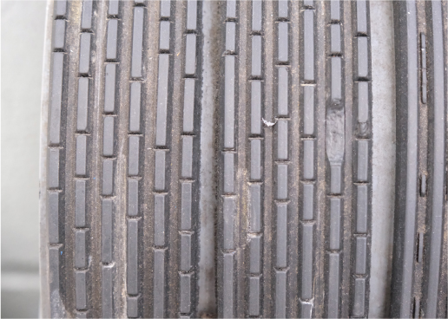
LO 13-3: Perform belt, hose, and air filter/cabin air filter inspection.
Visually inspect driver belts whenever you are under the hood
Check for:
Cracks
Oil soaking
Glazing
Tears
Bottoming out

Slide 33
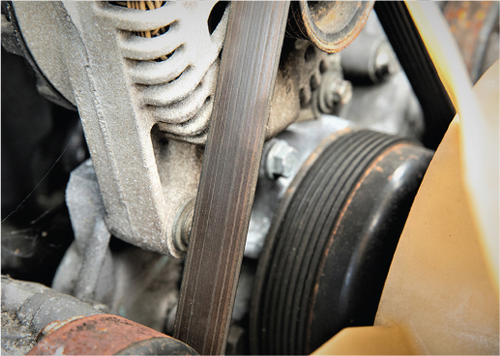
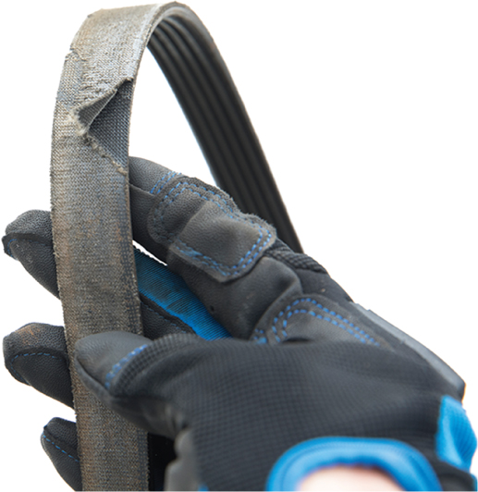
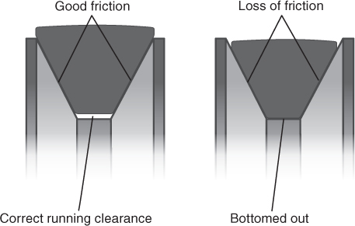
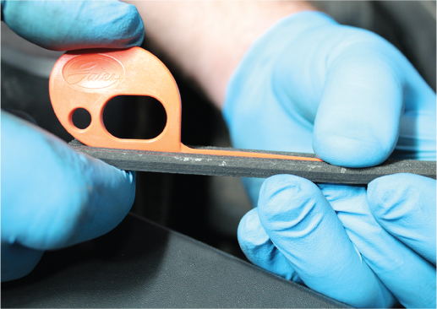
LO 13-3: Perform belt, hose, and air filter/cabin air filter inspection.

Slide 34
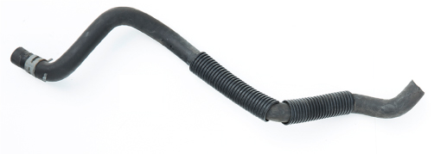
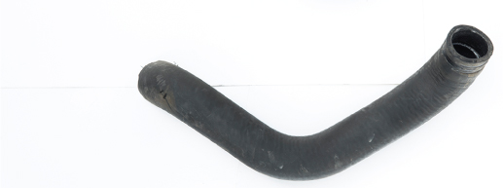
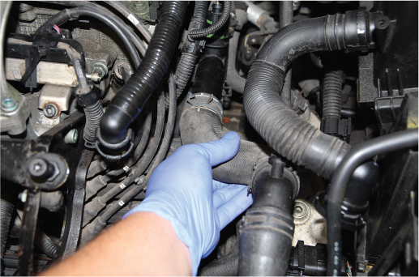
LO 13-3: Perform belt, hose, and air filter/cabin air filter inspection.
Hoses
Usually two large radiator hoses
Upper and lower
Some smaller heater hoses
Inspection
Engine should be cool
Feel hoses for consistent firmness
Not too soft or hard
If hot, look for bulging in hoses

Slide 35
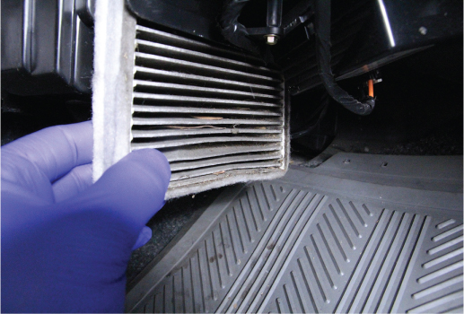
LO 13-3: Perform belt, hose, and air filter/cabin air filter inspection.
Air filter
Protects engine from dust, grit, etc.
Location varies by fuel system type
Check service information
Inspection
Check air cleaner housing and ductwork
Look for cracks or holes
Remove filter, hold up to light
No light = clogged, needs replacement

Slide 36
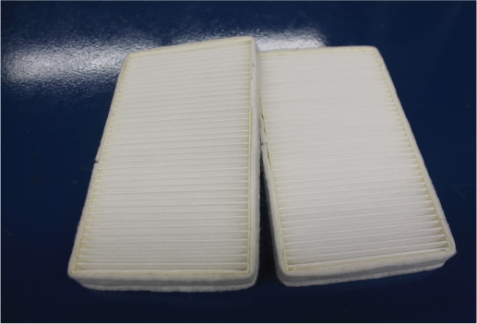
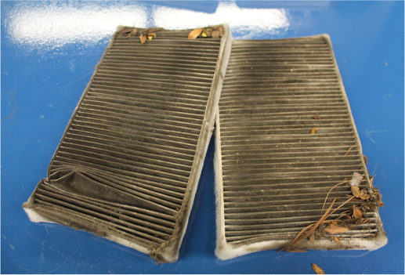
LO 13-3: Perform belt, hose, and air filter/cabin air filter inspection.
Cabin air filter
Part of HVAC system, in air box
Access point differs by vehicle
Inspection
During every service
Replacement interval according to manufacturer
Hold up to light as with air filter
Also check for cracks, tears, etc.

Slide 37
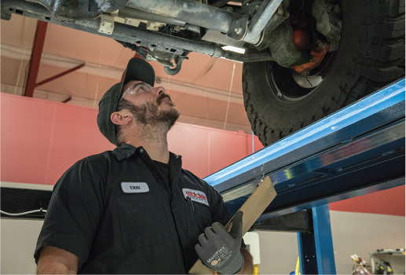
LO 13-4: Perform under-vehicle inspection.
Under-vehicle inspection
Visual inspection of major systems
Vehicle on hoist
Observable problems
Tire issues, leaks, worn parts, structural damage
Document inspection results

Slide 38
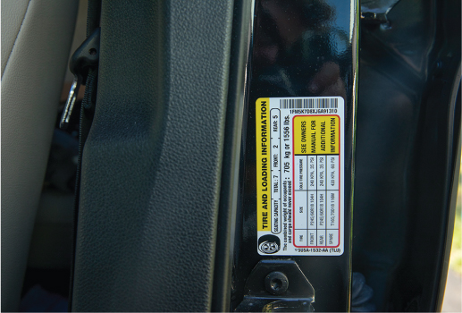
LO 13-4: Perform under-vehicle inspection.
Tire inspection
Checked for pressure, wear patterns, cuts, and tread depth
Tire air pressure
Check every 3 months or every oil change
Under- and over-inflated tires wear out sooner
Normal pressure varies by vehicle
Check tire placard

Slide 39
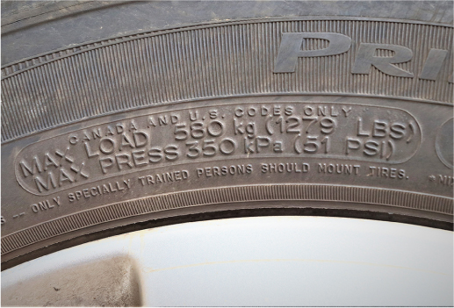
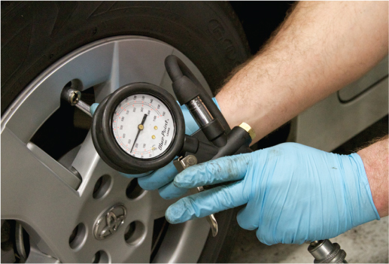
LO 13-4: Perform under-vehicle inspection.
Maximum tire pressure
For that tire
Not the vehicle
Never go over the maximum
Inflated with compressed air or nitrogen

Slide 40
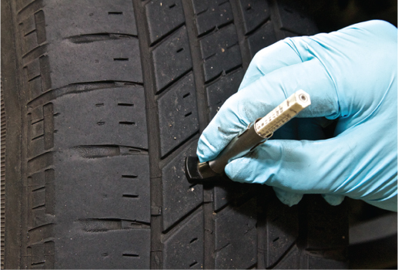
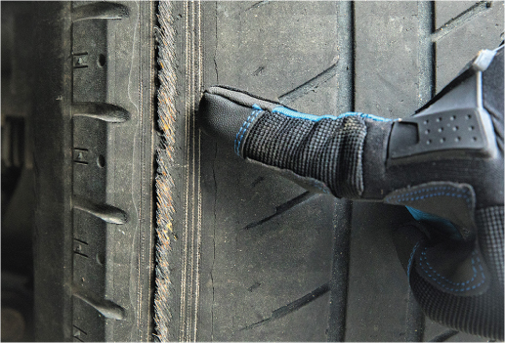
LO 13-4: Perform under-vehicle inspection.
Tread depth and wear
Inspect for wear
Measure depth at least three places per tire
Identifies uneven wear in tread
Inspect tire
Look for damage, bulges
Plug patches only work if hole diameter is < 0.25 in. (6 mm)
Feel tire for bulges, be wary of steel cords

Slide 41
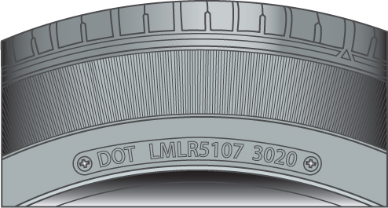
LO 13-4: Perform under-vehicle inspection.
Tire age
Usually 6- to 10-year life
Locate DOT tire date code
Tire’s sidewall
First two digits = week of manufacture
Last two digits = year
E.g., 3020 = 30th week of 2020
Refer to Chapter 41 for more on tires

Slide 42
LO 13-4: Perform under-vehicle inspection.
Manual transmission/transaxle/ transfer case fluid
Preventative check
Fill plug usually on side of transmission/ transaxle
Remove plug, if fluid comes out, reinsert
If no fluid, use finger to feel for level
Above 0.25 in. (6 mm) from bottom is OK
Lower = add until fluid is even with bottom of fill hole

Slide 43
LO 13-4: Perform under-vehicle inspection.
Differential/transfer case fluid level
Similar to checking transmission fluid
Refer to service information for differences/vehicle specifics
Differentials and transfer cases
Often no drain plug
Specific bolts/covers may need to be removed

Slide 44
LO 13-4: Perform under-vehicle inspection.
Checking for fluid leaks
Clean shop floor before driving vehicle in, makes leaks clear
Become familiar with each fluid’s color, feel, and smell
Brake fluid
Clear or light amber (DOT 3/DOT 4), purple (DOT 5)
Slippery, has slight acidic smell
Automatic transmission fluid
Reddish (normally) or clear/amber (some manufacturers)
Slippery, oily, has oily smell

Slide 45
LO 13-4: Perform under-vehicle inspection.
Power steering fluid
Red if uses automatic transmission fluid
Clear if uses power steering fluid
Coolant
Normally green, orange, yellow (GM uses red/light red)
Slippery, has sweet/syrupy smell
Engine oil
Clear, brown, or black
Very slippery, thick, has oily smell

Slide 46
LO 13-4: Perform under-vehicle inspection.
Gear oil
Light brown
Very slippery, has oily smell
Gasoline
Clear
Evaporates easily, has distinct odor
Diesel
Dirty clear
Thin, has oily smell

Slide 47
LO 13-4: Perform under-vehicle inspection.
Checking for leaks
Ask customer about any smells
Ideally with vehicle on lift, engine off
Use flashlight to look for drips/wetness
Always look to top of wet are for leak source
Some leaks can send fluids far away from source
If none found, start engine and wait a few minutes
Inspect, keeping away from hot and moving parts
Shut down engine and check again

Slide 48
LO 13-4: Perform under-vehicle inspection.
Steering system inspection
Best if vehicle is on lift
Look for wear and damage
Wiggle each wheel while someone else feels for any play in steering joints

Slide 49
LO 13-4: Perform under-vehicle inspection.
Check suspension system for:
Worn or torn parts
Tears or displacement in dust boots
Leaks in shock absorbers
Cracks/bulging in brake hoses
Kinks/rust in brake lines
Excessive play in wheel bearings

Slide 50
LO 13-4: Perform under-vehicle inspection.
Check drive axles and driveshafts for:
Worn out joints
Bent/damaged axles
Cracked, torn, or leaking dust boots/CV joints
Excessive movement, dents, or bends, in the driveshaft
Leaks around the differential
Check rear shock absorbers, leaf springs, brake hoses, and lines

Slide 51
LO 13-4: Perform under-vehicle inspection.
Engine inspection
Torn or cracked motor mounts, coolant hoses, belts
Transmission inspection
Torn or cracked mounts
Faults/looseness in clutch mechanism
Shift linkage

Slide 52
LO 13-4: Perform under-vehicle inspection.
Exhaust system inspection
Look for signs of leaks, corrosion, or deteriorations
Check heat shields
Check exhaust pipe’s integrity
Squeeze with arc joint pliers
Squishy = needs replacing

Slide 53
LO 13-4: Perform under-vehicle inspection.
Parking brake inspection
Check for rusted, frozen, broken, or crushed cables
Fuel tank inspection
Filler tube and hose
Vent and fuel delivery lines
Straps
Protective shields
Smell of gasoline = leak

Slide 54
LO 13-5: Perform exterior vehicle inspection.
Exterior vehicle inspections
Perform whenever a vehicle is in the shop
Work in a systematic manner
Use an inspection sheet to avoid missing anything

Slide 55
LO 13-5: Perform exterior vehicle inspection.
Shock absorbers
Often tested when there is unusual tire wear (appear cupped)
Absorbers might bind up, causing stiff ride
If adjustable absorbers, check that both sides are the same
Uneven ride could mean some gas has leaked
Modern and conventional shock absorbers
Bounce test
Visually inspect mounting points
Look for possible leaks

Slide 56
LO 13-5: Perform exterior vehicle inspection.
Exterior lights inspection
Done periodically to look for burnout
Headlights, taillights, turn signals, side markers, brake lights, license plate lights, and backing lights
Cornering lights, driving lights, or fog lights (in some vehicles)
Check all rear light bulbs

Slide 57
LO 13-5: Perform exterior vehicle inspection.
Wiper blades
Missing, torn, worn could result in failed state inspection
Usually replaced after a year
Never operate when dry
Never bend the arms
Avoid broken windshield
Never let arm slip
Place folded fender cover on windshield

Slide 58
LO 13-5: Perform exterior vehicle inspection.
Windshield
Inspect when checking wiper blades
Polish may fix any scratches or pits
Resin may repair small chips and cracks
Otherwise replacement is needed

Slide 59
Skill Drills

Slide 60
Skill Drill 13-1: Checking Instrument Panel Warning Lamps

Slide 61
Skill Drill 13-1: Checking Instrument Panel Warning Lamps
Perform an instrument panel self-test. When the key is switched on (before starting the engine), most of the dash warning lamps will light up as a bulb check. Note any that do not light up as expected.

Slide 62
Skill Drill 13-1: Checking Instrument Panel Warning Lamps
Perform an engine running check. Start the engine and observe the warning lamps. All should go off after a few seconds as the related control module runs a self-check and then commands the lamp to go off.

Slide 63
Skill Drill 13-2: Retrieving and Recording DTCs

Slide 64
Skill Drill 13-2: Retrieving and Recording DTCs
Select the scan tool to provide the best coverage for the type and make of vehicle.

Slide 65
Skill Drill 13-2: Retrieving and Recording DTCs
2. Locate the DLC and connect the scan tool.

Slide 66
Skill Drill 13-2: Retrieving and Recording DTCs
3. Power on the scan tool.

Slide 67
Skill Drill 13-2: Retrieving and Recording DTCs
4. Turn on the vehicle’s ignition. This should establish scan tool communication with the vehicle’s computer.

Slide 68
Skill Drill 13-2: Retrieving and Recording DTCs
5. Retrieve and record the DTCs.

Slide 69
Skill Drill 13-2: Retrieving and Recording DTCs
6. Power off the scan tool, turn off the ignition, and disconnect the scan tool.

Slide 70
Skill Drill 13-3: Performing a Horn Check

Slide 71
Skill Drill 13-3: Performing a Horn Check
Check the vehicle horn. Turn on the ignition and press the horn button. The horn should sound.
If the horn is not working, locate it under the hood with the help of the manufacturer’s service information. Check the wiring to make sure that it is connected securely.

Slide 72
Skill Drill 13-4: Checking the Interior Lights

Slide 73
Skill Drill 13-4: Checking the Interior Lights
1. Using the remote key fob or door key, unlock the doors. On most vehicles, this causes the interior lights to come on. Check that each light works as intended. On some vehicles, the lights do not come on until the door is opened. Check each door on the vehicle.

Slide 74
Skill Drill 13-4: Checking the Interior Lights
Enter the vehicle and close the door. Wait to see that the lights go off after a time. Repeat this check with each door on the vehicle.

Slide 75
Skill Drill 13-4: Checking the Interior Lights
Operate the courtesy lights from any other switches. Check the vanity lights and map lights, if equipped.

Slide 76
Skill Drill 13-5: Using a Hydrometer to Measure the Freeze Protection Level

Slide 77
Skill Drill 13-5: Using a Hydrometer to Measure the Freeze Protection Level
Select a hydrometer that is designed for use with the type of antifreeze being tested.

Slide 78
Skill Drill 13-5: Using a Hydrometer to Measure the Freeze Protection Level
Draw enough coolant into the hydrometer to bring it up to the fill line.

Slide 79
Skill Drill 13-5: Using a Hydrometer to Measure the Freeze Protection Level
Hold the hydrometer vertically and read the freeze protection level.

Slide 80
Skill Drill 13-6: Using a Refractometer to Measure the Freeze Protection Level of Coolant

Slide 81
Skill Drill 13-6: Using a Refractometer to Measure the Freeze Protection Level of Coolant
Remove the radiator cap and draw out a few drops of coolant.

Slide 82
Skill Drill 13-6: Using a Refractometer to Measure the Freeze Protection Level of Coolant
Place a drop or two of the coolant on the sample plate.

Slide 83
Skill Drill 13-6: Using a Refractometer to Measure the Freeze Protection Level of Coolant
Close the diffuser plate, hold the refractometer level, look through the viewfinder, and read the scale.

Slide 84
Skill Drill 13-7: Checking Automatic Transmission Fluid Using a Dipstick

Slide 85
Skill Drill 13-7: Checking Automatic Transmission Fluid Using a Dipstick
1. When checking transmission fluid, first wipe off the dipstick.

Slide 86
Skill Drill 13-7: Checking Automatic Transmission Fluid Using a Dipstick
Observe the markings.

Slide 87
Skill Drill 13-7: Checking Automatic Transmission Fluid Using a Dipstick
3. Reinsert the dipstick fully, remove it again, hold it horizontal, and read it.

Slide 88
Skill Drill 13-7: Checking Automatic Transmission Fluid Using a Dipstick
4. Turn over the dipstick and read the back side. The lowest reading between the front and the back is likely the most accurate reading.

Slide 89
Skill Drill 13-8: Checking and Refilling Windshield Washer Fluid

Slide 90
Skill Drill 13-8: Checking and Refilling Windshield Washer Fluid
Locate the front windshield wiper fluid container.

Slide 91
Skill Drill 13-8: Checking and Refilling Windshield Washer Fluid
Check the windshield washer fluid level. If the level is low, refill the reservoir with the appropriate washer fluid.

Slide 92
Skill Drill 13-8: Checking and Refilling Windshield Washer Fluid
If equipped, check and fill the rear window washer reservoir.

Slide 93
Skill Drill 13-9: Inspecting and Changing an Air Filter

Slide 94
Skill Drill 13-9: Inspecting and Changing an Air Filter
On fuel-injected engines, unlatch or unscrew the filter housing fasteners to remove the air filter. It may be necessary to loosen the clamps and hoses on the induction tubing to remove the filter housing cover.

Slide 95
Skill Drill 13-9: Inspecting and Changing an Air Filter
On carbureted or throttle body-injected engines, remove the top of the air filter by unscrewing the wing nut, and remove the air filter.

Slide 96
Skill Drill 13-9: Inspecting and Changing an Air Filter
Inspect the air cleaner element by holding the filter element up to light and looking through it. If it is bright with no tears or cracks, it can be reused. If it is dark or damaged in any way, it needs to be replaced.

Slide 97
Skill Drill 13-9: Inspecting and Changing an Air Filter
Clean the inside of the air filter housing, and inspect it and any ducts for cracks. If the air filter is being replaced, obtain a new air filter and compare it with the old one to ensure that they are exactly the same.

Slide 98
Skill Drill 13-9: Inspecting and Changing an Air Filter
Place the new air filter inside the filter housing, making sure that it is aligned correctly on both sides.

Slide 99
Skill Drill 13-9: Inspecting and Changing an Air Filter
Replace the cover of the air filter housing and tighten the latches, screws, or wing nut until completely closed. Reinstall any induction tubing or clamps.

Slide 100
Skill Drill 13-10: Checking the Fluid Level of a Manual Transmission/Transaxle

Slide 101
Skill Drill 13-10: Checking the Fluid Level of a Manual Transmission/Transaxle
1. Safely raise and support the vehicle on the lift so that it is level. Inspect the transmission for leaks. Remove the filler plug using the proper tool. Inspect the filler plug and fill hole for thread damage, and replace or repair if necessary.

Slide 102
Skill Drill 13-10: Checking the Fluid Level of a Manual Transmission/Transaxle
2. If the gearbox fluid begins to run out as the filler plug is removed, let the gearbox fluid seek its own level before reinstalling the filler plug. The gearbox fluid level should be at the bottom of the fill plug hole.

Slide 103
Skill Drill 13-10: Checking the Fluid Level of a Manual Transmission/Transaxle
3. If the fluid level is low, refill with the specified fluid, reinstall the filler plug, and wipe the area around the filler plug hole with a clean shop towel. Tighten the filler plug to the specified torque.

Slide 104
Skill Drill 13-11: Checking and Adjusting the Differential Fluid Level

Slide 105
Skill Drill 13-11: Checking and Adjusting the Differential Fluid Level
Safely raise and support the vehicle. Inspect the differential and transfer case for leaks. Position a clean drain pan under the filler plug. Using the correct tool, remove the filler plug. Inspect the filler plug threads for damage, and replace if necessary.

Slide 106
Skill Drill 13-11: Checking and Adjusting the Differential Fluid Level
2. If the fluid begins to run out as the filler plug is removed, let the fluid seek its own level before reinstalling the filler plug. The fluid level should be at the bottom of the filler plug hole.

Slide 107
Skill Drill 13-11: Checking and Adjusting the Differential Fluid Level
3. If the fluid level is low, refill with the specified fluid, reinstall the filler plug, and wipe the area around the filler plug hole with a clean shop towel. Tighten the filler plug to the specified torque.

Slide 108
Skill Drill 13-12: Locating and Identifying Fluid Leaks

Slide 109
Skill Drill 13-12: Locating and Identifying Fluid Leaks
1. Safely raise and support the vehicle on a lift. Use a light to check for fluid leaks at any place that fluids can leak.

Slide 110
Skill Drill 13-12: Locating and Identifying Fluid Leaks
2. Once leaky fluid is found, follow it to its source.

Slide 111
Skill Drill 13-12: Locating and Identifying Fluid Leaks
3. If it is hard to identify exactly where the leak is coming from, you may need to make it leak by pressurizing the cooling system, applying the brakes, or operating the leaking system.

Slide 112
Skill Drill 13-12: Locating and Identifying Fluid Leaks
4. If you still cannot make it leak, try releasing the pressure or turning off the system. Sometimes leaks happen only when the system is shut off. This is a leak from the water pump weep hole.

Slide 113
Skill Drill 13-13: Performing an Under-Vehicle Inspection

Slide 114
Skill Drill 13-13: Performing an Under-Vehicle Inspection
Safely raise and secure the vehicle at a comfortable working height. Work systematically. Pay particular attention to any fluid leaks.

Slide 115
Skill Drill 13-13: Performing an Under-Vehicle Inspection
Check the steering parts. Grasp the front and rear of the tire and pivot it to detect wear in the steering components. Grasp the tire at the top and bottom and pivot it to detect movement in the wheel bearings or ball joints. Look for missing or torn rubber boots around the tie-rod ends and steering rack. Inspect the rack bushings and other rubber suspension bushings.

Slide 116
Skill Drill 13-13: Performing an Under-Vehicle Inspection
3. Inspect all four shock absorbers for signs of damage or leaks. Check the brake hoses and lines for signs of cracking, abrasions, or bulging.

Slide 117
Skill Drill 13-13: Performing an Under-Vehicle Inspection
Check the front-wheel drive axles. On vehicles with front-wheel drive, examine the inner and outer CV boots for cracks or tears.

Slide 118
Skill Drill 13-13: Performing an Under-Vehicle Inspection
5. Check the transmission area. Trace and record the source of fluid leaks. Check the mount. With a manual transmission, check the clutch operating mechanism for damage. For an automatic transmission, check the shift linkage for any damage. If the transmission is electronically controlled, check the wiring for damage.

Slide 119
Skill Drill 13-13: Performing an Under-Vehicle Inspection
6. Check the exhaust system. Examine the catalytic converter, muffler, and resonator for signs of corrosion or deterioration. Inspect the heat shields. Check the tailpipe for corrosion, and check for damaged or missing hangers.

Slide 120
Skill Drill 13-13: Performing an Under-Vehicle Inspection
Check the parking brake cables. Inspect the parking brake cable to make sure it is not frayed, damaged, or binding. Look for rusted or swollen cable housings. Pull on the cables, and check that the parking brake applies. Lubricate the cable if specified.

Slide 121
Skill Drill 13-13: Performing an Under-Vehicle Inspection
8. Check the driveshaft. On rear-wheel drive vehicles, inspect the driveshaft universal joints for signs of excess movement or rust. To check for wear, rotate the shaft and flange in opposite directions (there should be no up-and-down or side-to-side movement). On four-wheel drive vehicles, inspect the front driveshaft universals.

Slide 122
Skill Drill 13-13: Performing an Under-Vehicle Inspection
Check the differential and rear suspension area. Inspect the pinion shaft oil seal for any signs of leakage. Inspect the suspension mounting bushings for signs of deterioration or damage. If the vehicle is fitted with leaf springs, inspect them for any cracks or misalignment. Inspect the brake hoses for signs of cracking, abrasion, and bulges.

Slide 123
Skill Drill 13-13: Performing an Under-Vehicle Inspection
Check the fuel tank area. Check all the fuel lines and brake lines for signs of damage, abrasions, leaks, or rust.

Slide 124
Skill Drill 13-14: Performing a Visual Inspection of the Vehicle’s Exterior

Slide 125
Skill Drill 13-14: Performing a Visual Inspection of the Vehicle’s Exterior
Prepare the vehicle. Park the vehicle in a well-lit area. Turn off the engine and unlock the doors and trunk or rear hatch.

Slide 126
Skill Drill 13-14: Performing a Visual Inspection of the Vehicle’s Exterior
Walk around the vehicle, observing any obvious items that need attention. Check the body condition.

Slide 127
Skill Drill 13-14: Performing a Visual Inspection of the Vehicle’s Exterior
Check exterior component and system operation.

Slide 128
Skill Drill 13-14: Performing a Visual Inspection of the Vehicle’s Exterior
Open and close doors to check that they are operating correctly.

Slide 129
Skill Drill 13-14: Performing a Visual Inspection of the Vehicle’s Exterior
Push and pull on the bumpers and fenders to ensure that they are secure.

Slide 130
Skill Drill 13-14: Performing a Visual Inspection of the Vehicle’s Exterior
Inspect the external mirrors to ensure that they are secure and not broken.

Slide 131
Skill Drill 13-15: Checking Shock Absorbers

Slide 132
Skill Drill 13-15: Checking Shock Absorbers
Place your weight on a bumper, and begin to bounce the vehicle until it reaches its maximum amount of travel produced by your weight. Stop bouncing at the bottom of the bounce. If the shock absorbers are performing well, the vehicle will rebound once and then return to its original position.

Slide 133
Skill Drill 13-15: Checking Shock Absorbers
Pay particular attention to the top strut mounting during the bounce test. Place your hand on top of the mounting during the bounce test. Any noise or looseness in the mounting could indicate the need to replace the mount.

Slide 134
Skill Drill 13-15: Checking Shock Absorbers
Visually inspect the shock absorber mounting points for security and corrosion, and note any wet-looking patches on the sides of the shock absorbers. Slight dampness on the shock is typically normal, but a drip on the shock indicates leaking.

Slide 135
Skill Drill 13-16: Checking the Exterior Lights

Slide 136
Skill Drill 13-16: Checking the Exterior Lights
Have someone sit in the vehicle, turn the ignition on, and switch the light switch to the park light position. Check that the taillights, side markers, and rear license plate lights come on.

Slide 137
Skill Drill 13-16: Checking the Exterior Lights
Put the turn signal switch in the left-turn and then in the right-turn position, and check that the signals flash equally on each side.

Slide 138
Skill Drill 13-16: Checking the Exterior Lights
With the ignition key on and the engine off, place the transmission in reverse and observe the backup lights.

Slide 139
Skill Drill 13-16: Checking the Exterior Lights
Depress the brake pedal to make sure the brake lights work. Check that the third (center) brake light works.

Slide 140
Skill Drill 13-16: Checking the Exterior Lights
Make sure that the high and low headlight beams work properly.

Slide 141
Skill Drill 13-16: Checking the Exterior Lights
Make sure that the park lights, side markers, turn indicators, and daytime running lamps (if equipped) are all working correctly.

Slide 142
Skill Drill: 13-17: Checking and Replacing the Windshield Wiper Blades

Slide 143
Skill Drill: 13-17: Checking and Replacing the Windshield Wiper Blades
Check the windshield wiper blades. Lift the wiper arm away from the windshield and inspect the condition of the blades. Look for damage or loss of resilience in the material.

Slide 144
Skill Drill: 13-17: Checking and Replacing the Windshield Wiper Blades
Wet the windshield with a hose or with the washers and switch the wipers on. If the windshield is being wiped cleanly, do not replace the wiper blades. If the wiper blades are not wiping the glass evenly or are smearing, replace the blades.

Slide 145
Skill Drill: 13-17: Checking and Replacing the Windshield Wiper Blades
Place a folded up fender cover under the wiper blade you are working on to protect the windshield.

Slide 146
Skill Drill: 13-17: Checking and Replacing the Windshield Wiper Blades
Remove the blade assembly.

Slide 147
Skill Drill: 13-17: Checking and Replacing the Windshield Wiper Blades
Obtain and install the appropriate replacement blades.

Slide 148
Skill Drill: 13-17: Checking and Replacing the Windshield Wiper Blades
Once the wiper blades are installed, test them for proper operation.

Slide 149
Skill Drill 13-18: Inspecting the Windshield

Slide 150
Skill Drill 13-18: Inspecting the Windshield
Prepare the windshield. First, use glass cleaner to clean the windshield thoroughly.

Slide 151
Skill Drill 13-18: Inspecting the Windshield
Inspect the glass. Look closely at the surface of the glass. It may help to use a flashlight or trouble light at an angle while inspecting.

Slide 152
Skill Drill 13-18: Inspecting the Windshield
Look for any delamination conditions present.

Slide 153
Credits
Unless otherwise indicated, all photographs and illustrations are under copyright of Jones & Bartlett Learning.

