Slide 1
Color VDT
advanced training
October 2021

Slide 2
Agenda slide
Retroactively entering registration and vaccination data
Scribe workaround
Mobile registration/vaccination
Applications of secondary calendars
Registration deep dive
Q & A

Slide 3
01
Retroactively entering registration and vaccination data

Slide 4
Reasons for retroactively adding data
Loom video
Loss of or limited/no wifi in service area
Need to maintain high throughput and insufficient clinicians to assist with registration/check-in process
Proprietary and Confidential — Not for distribution.

Slide 5
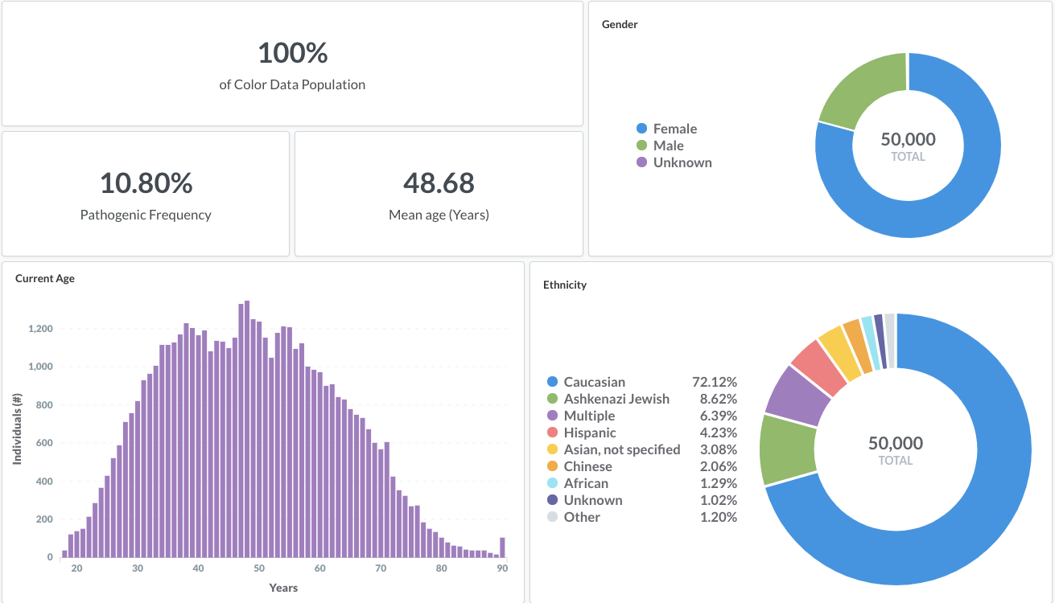
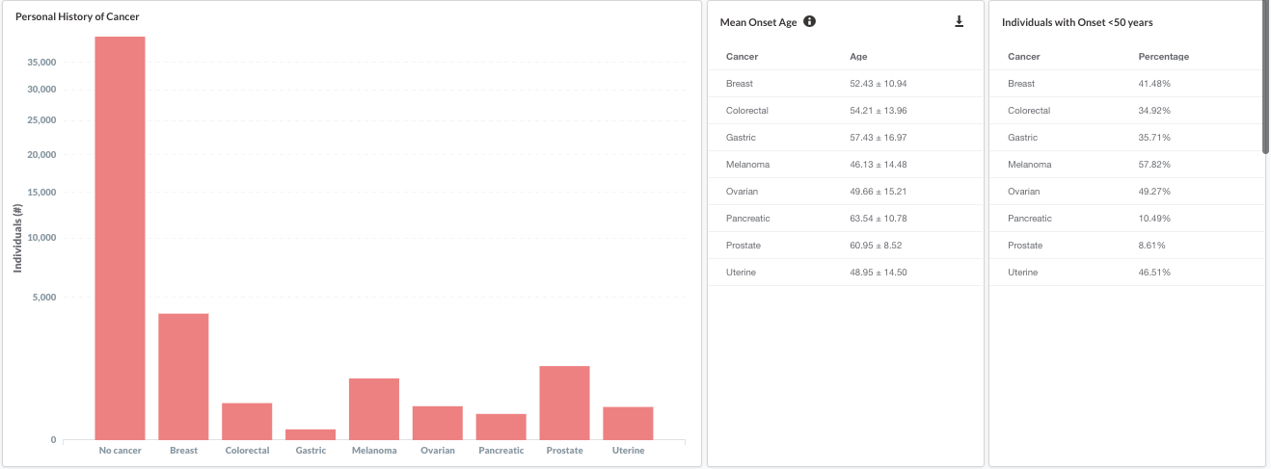
Steps for retroactively adding data
Use the “Add patient” functionality in the Vaccination section of the Onsite tool to add patient details and vaccinate
Edit patient details to correspond to actual date of vaccination

Slide 6
Steps for retroactively adding data
Use the “Add patient” functionality in the Vaccination section of the Onsite tool to add patient details and vaccinate

Slide 7
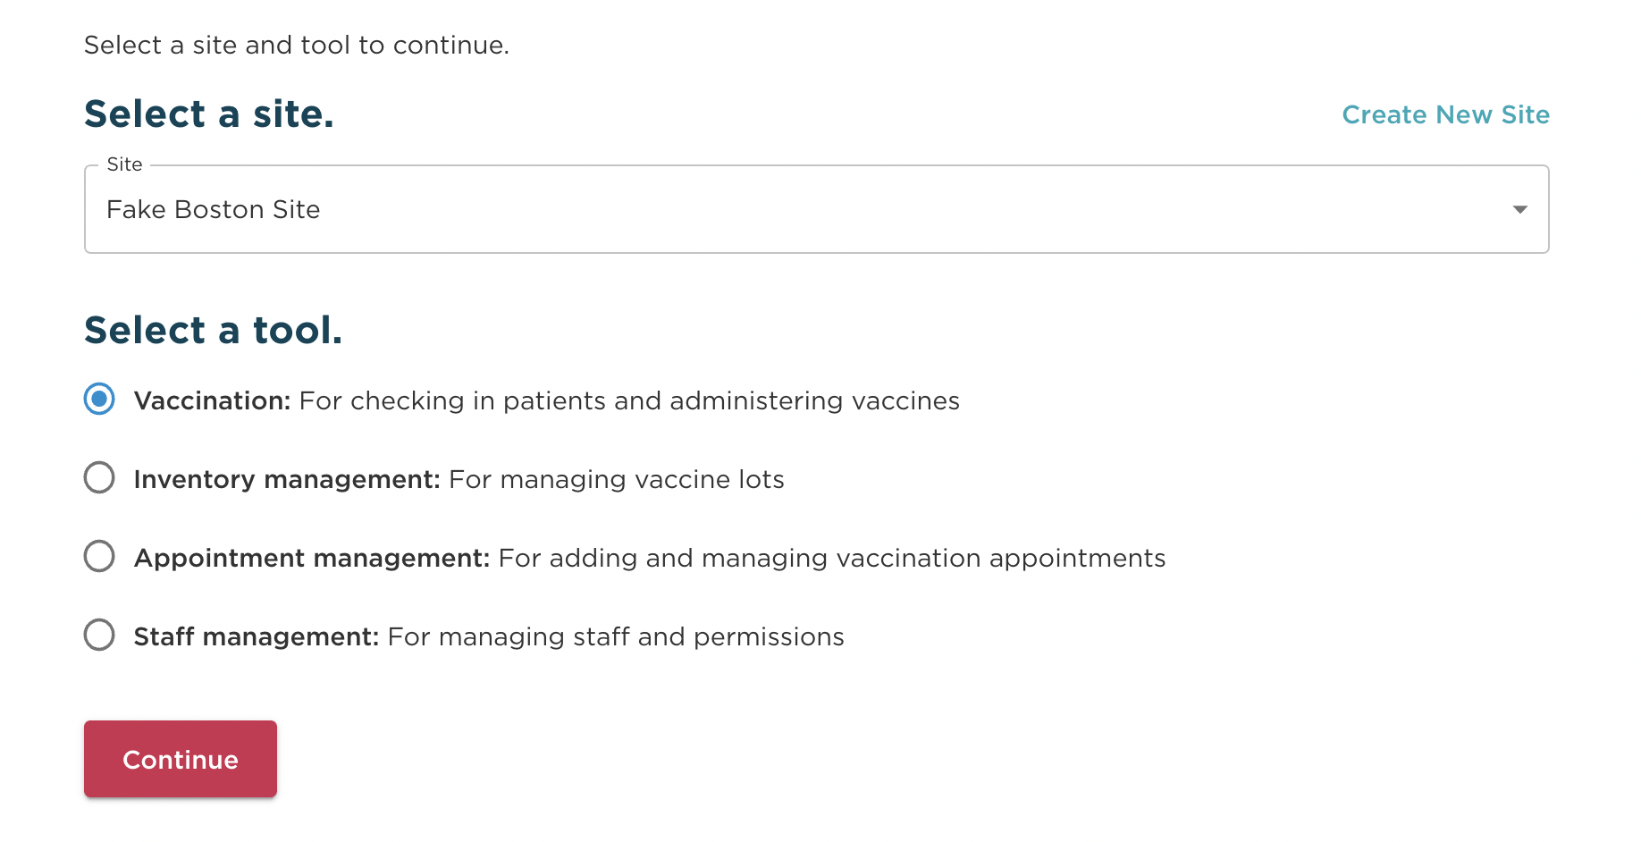
Adding a patient
Select the vaccination tool within the Onsite tool

Slide 8
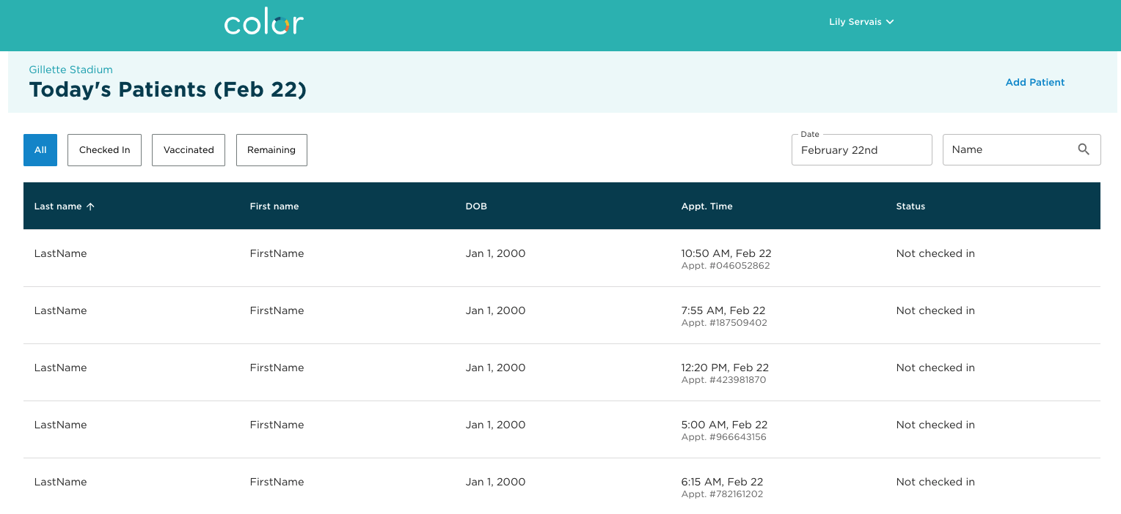
Adding a patient
Adding a patient: click on add patient
Selecting the “Add Patient” link will initiate the process for adding a new patient.
This will not pull from scheduled appointments.

Slide 9
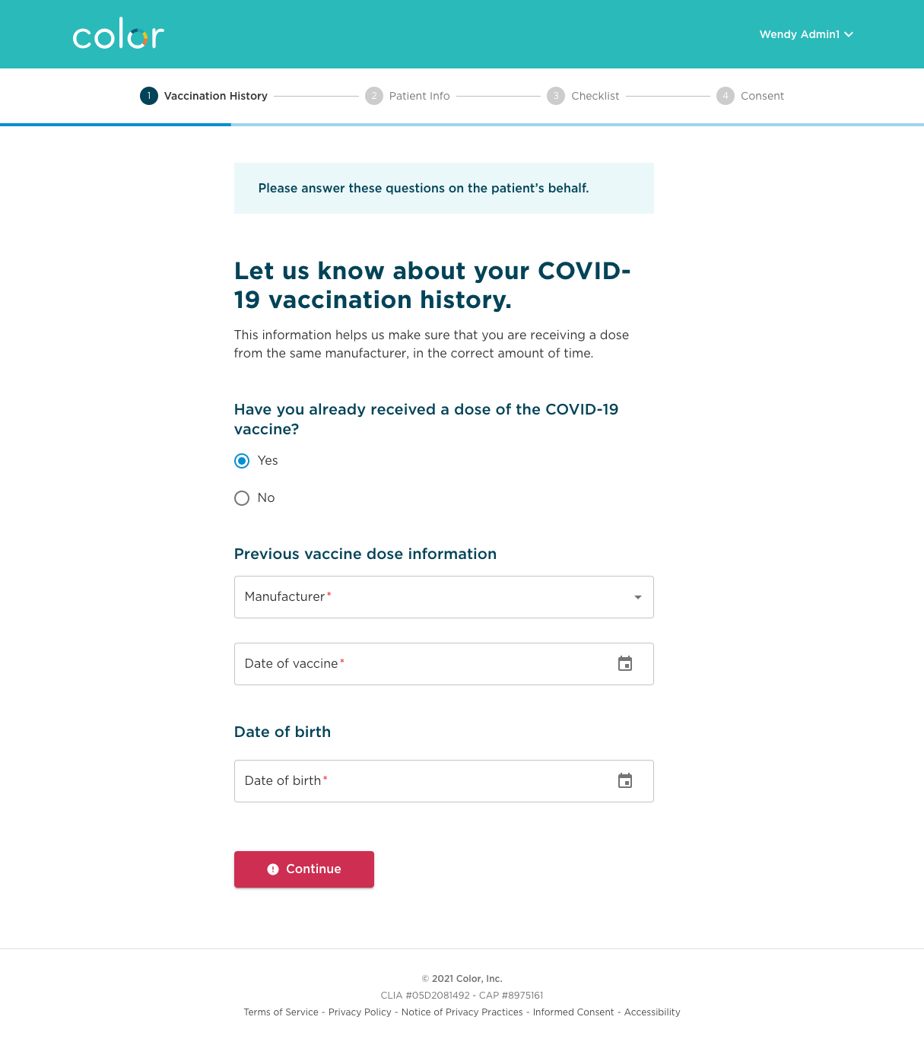
Adding a patient
Adding a patient: provide vaccination history
If patient has had a previous vaccination, ask them for the manufacturer and dose.
If any of the following are true, stop adding the patient:
If the site doesn’t have the appropriate manufacturer
If it hasn’t been the appropriate number of days since their first dose.

Slide 10
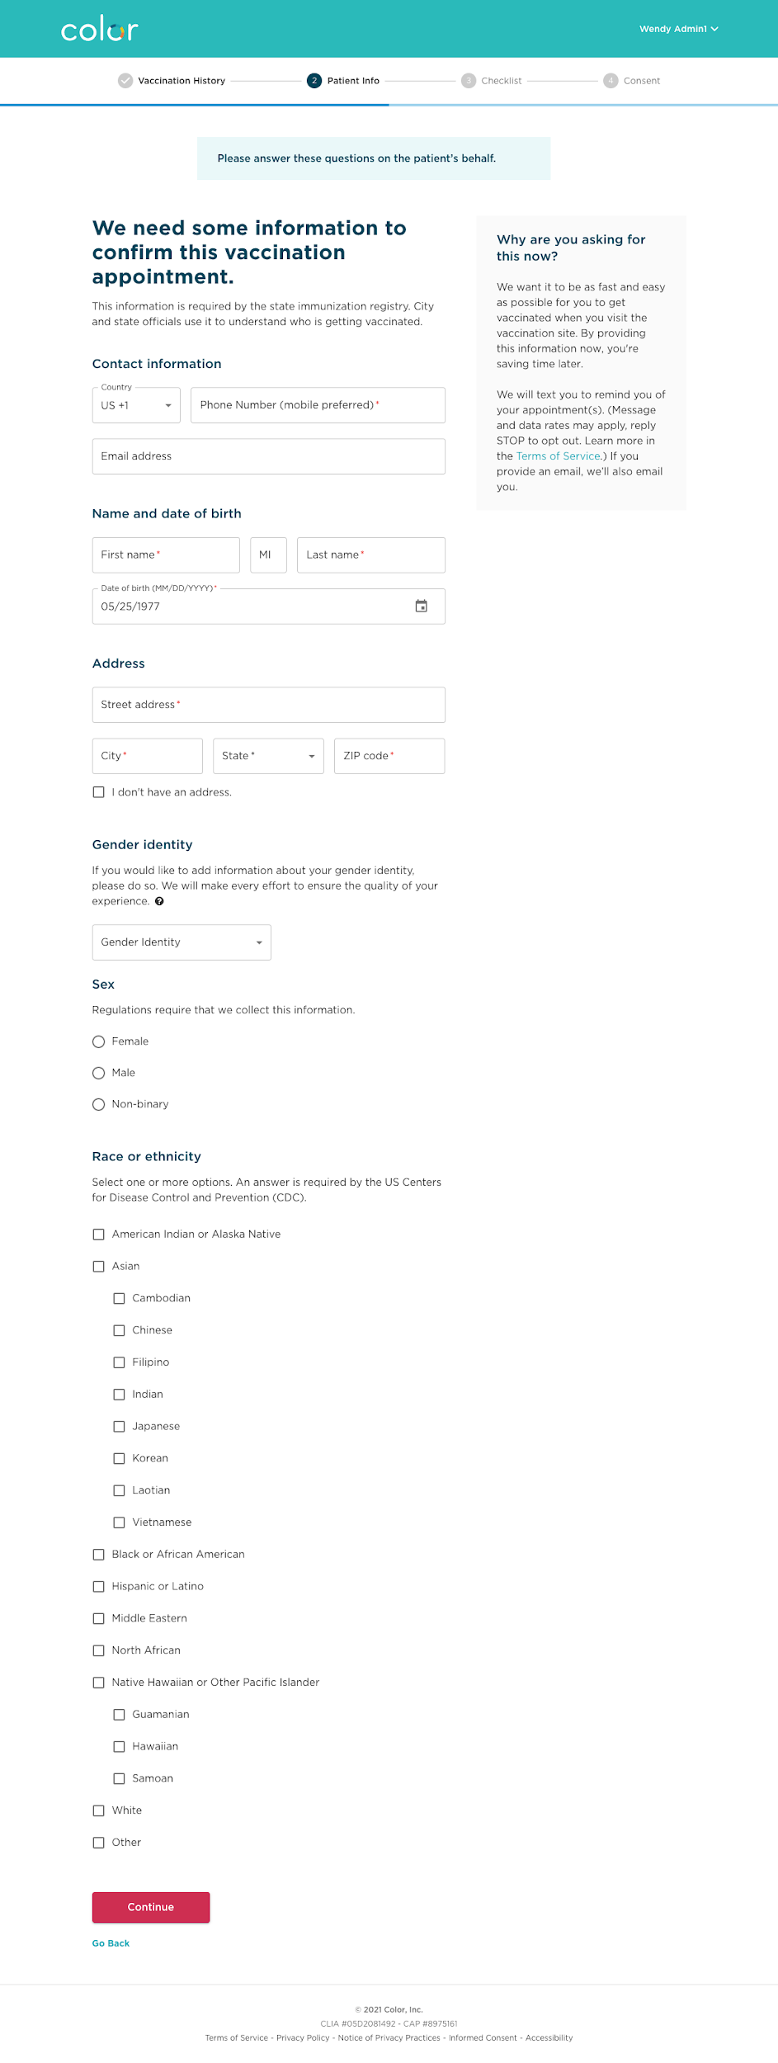
Adding a patient
Adding a patient: collect patient information
Collect required patient information.

Slide 11
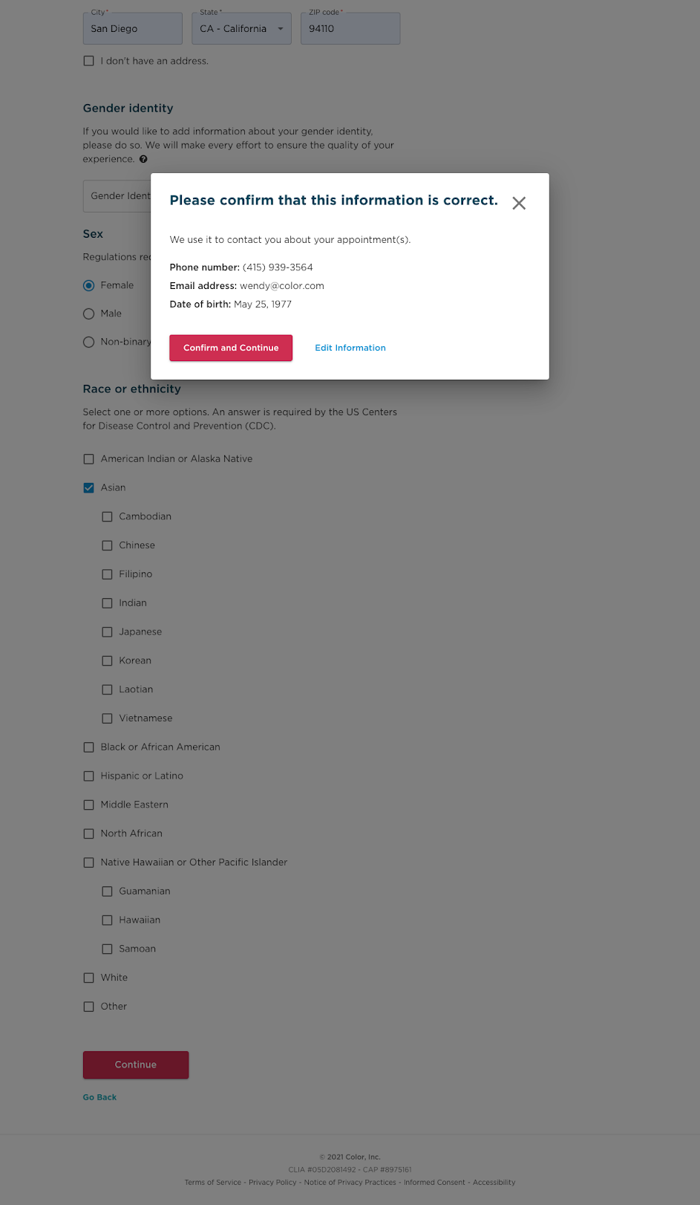
Adding a patient
Adding a patient: confirm patient contact information
Make sure the information entered is correct, as contact info and DOB will be used for scheduling reminders and access to booking their second dose appointment.

Slide 12
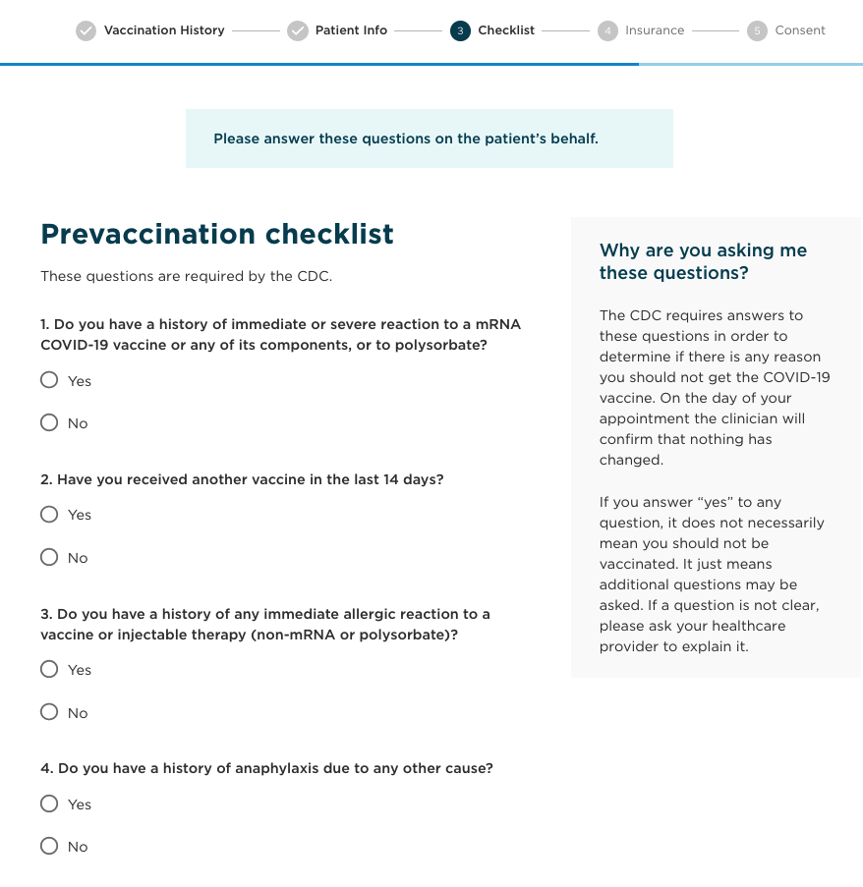
Adding a patient
Adding a patient: complete the prevaccination checklist with the patient
This will make the vaccination step with the clinician more efficient.

Slide 13
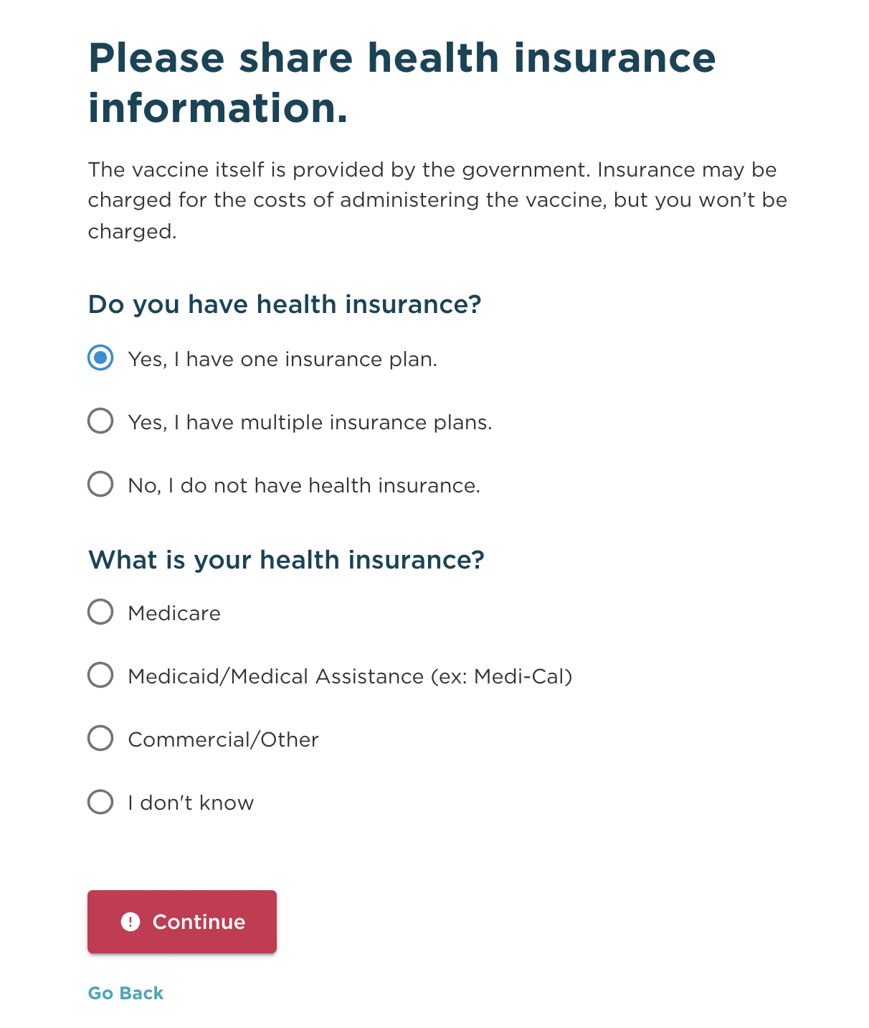
Adding a patient
Adding a patient: Collect their health insurance
Depending on the vaccination type, the patient may not be charged for the vaccination. This will be listed at the top.
Now have the ability to add a primary and secondary insurance with “Yes, I have multiple insurance plans”

Slide 14
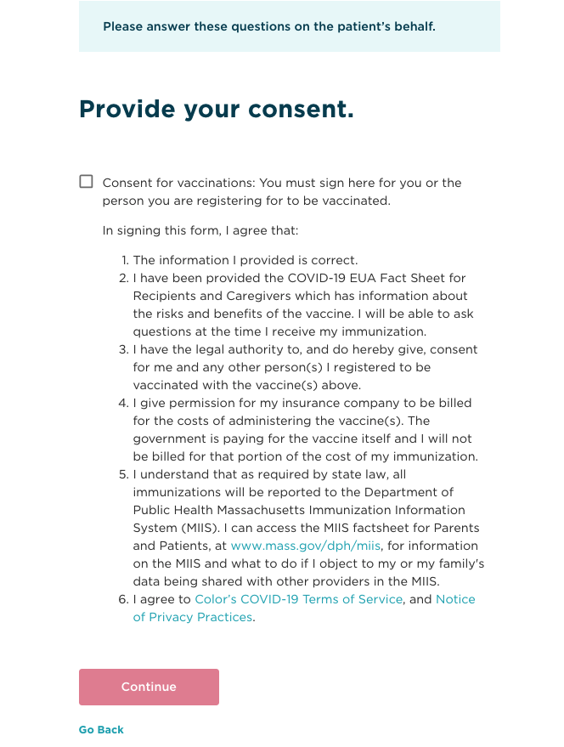
Adding a patient
Adding a patient: Obtain consent from the patient
Hand the device to the patient for them to sign. They should hand it back to you without submitting the screen.
Currently, we only show the consent in the following languages: English, Spanish, Haitian Creole, Khmer, Portuguese, Simplified Chinese, Vietnamese

Slide 15
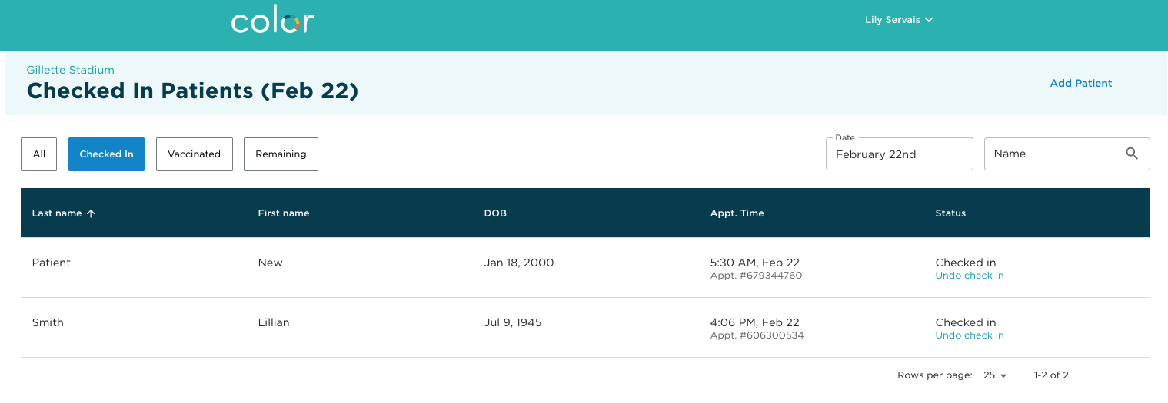
Adding a patient
Adding a patient: patient is now added and checked in
After you’ve added the patient, you will need to go through and vaccinate them as you would during a live clinic

Slide 16
Steps for retroactively adding data
Edit patient details to correspond to actual date of vaccination

Slide 17
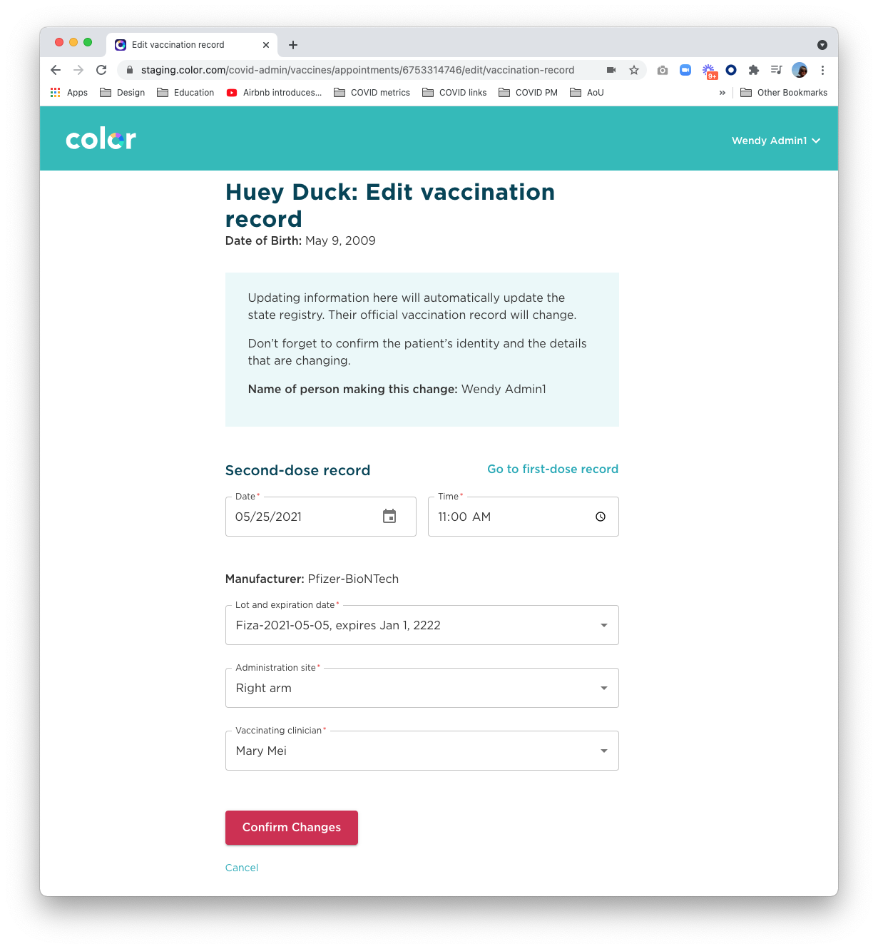
Overview
Editing a record
Site Staff or Vaccine Clinicians will be able to edit a patient's vaccination record after a vaccine has occurred
Because this will trigger an update to immunization records, it is important site staff are well informed of this feature.
The software also reinforces this.
Brief Overview video
Detailed overview/documentation

Slide 18
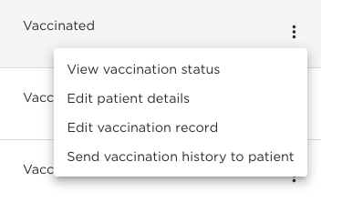
Making an Edit
Editing a record
Select participant under vaccinated tab
First and Second Dose Record
This tool allows staff members to edit either first and second dose vaccination records
Modifiable Fields
Date of Vaccination
Time of Vaccination
Lot/Expiration Date
Administration Site
Vaccinating Clinician
Vaccine Manufacturer cannot be changed
2. Click the three dots and select from the menu. Note: the ‘send vaccination history’ will only appear if someone has completed the second dose.

Slide 19
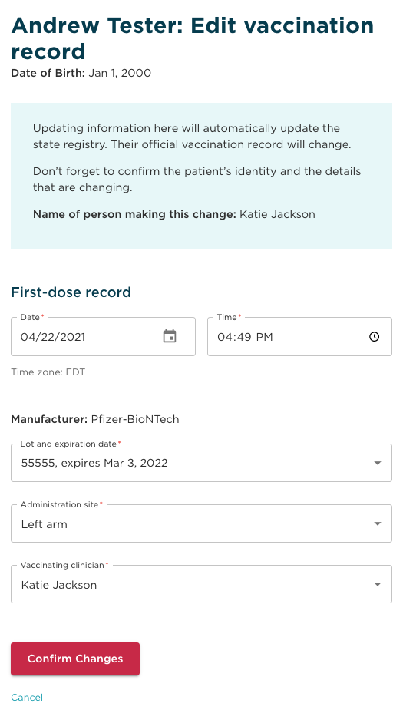
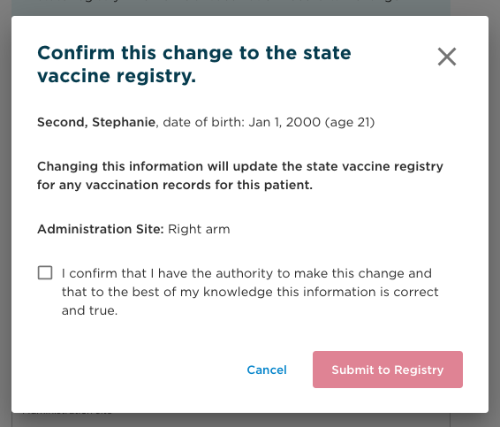
Making an Edit
Editing a record
3. Edit the vaccination record
4. Review and confirm changes

Slide 20
02
Scribe workaround

Slide 21
Reasons for scribe workaround
Loom video
Need to use scribes during clinical workflow but correctly reflect the vaccinating clinician in MIIS
Proprietary and Confidential — Not for distribution.

Slide 22
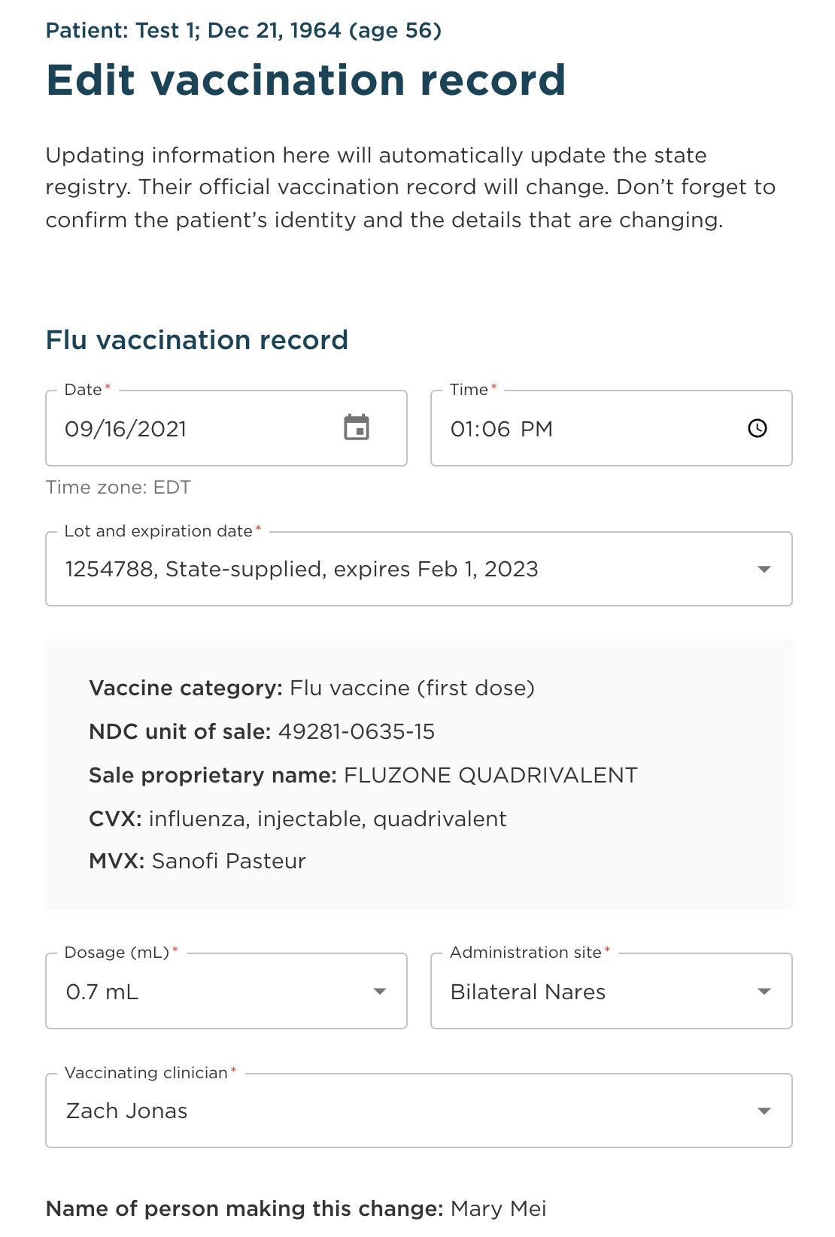
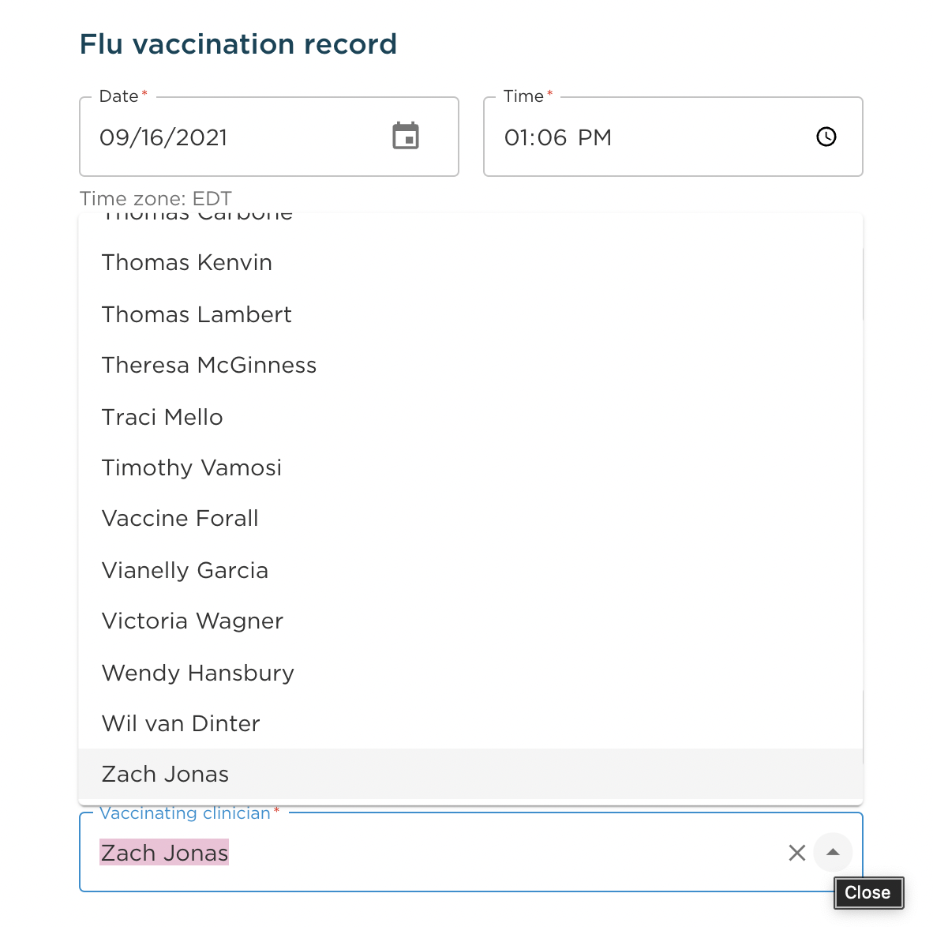
Editing a record
Editing a vaccinator
1. Within the “Edit vaccination record” view, select the correct vaccinating clinician from the drop-down

Slide 23
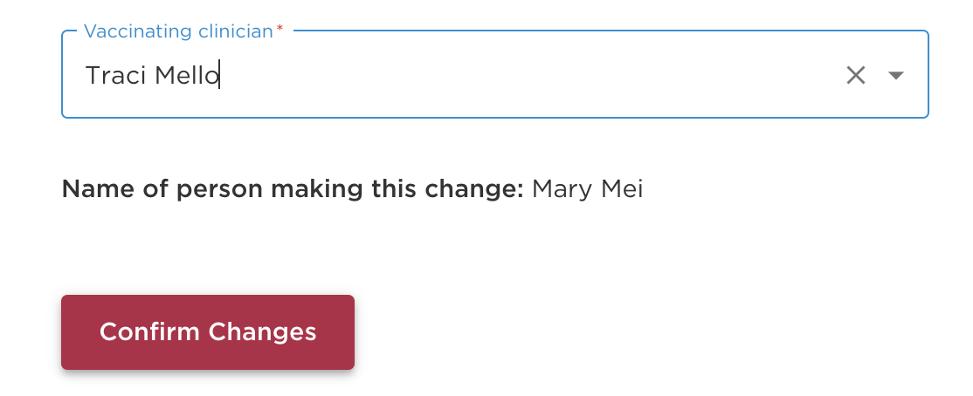
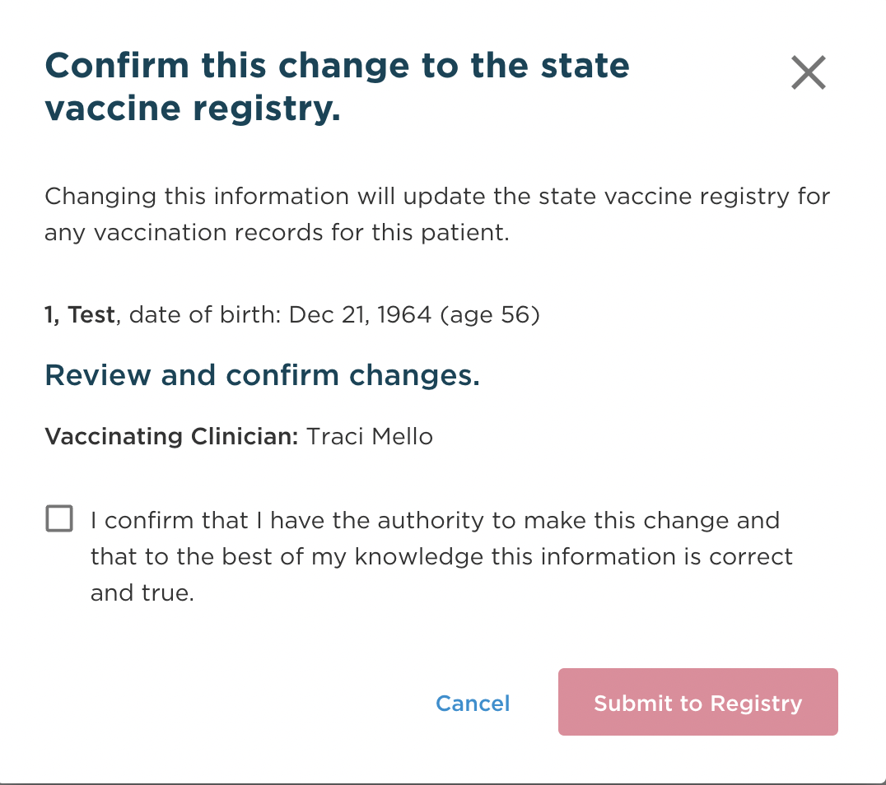
Editing a record
Editing a vaccinator
2. Once you have selected the correct vaccinating clinician, click “Confirm Changes” and re-confirm in the pop-up screen to update the submission in MIIS

Slide 24
03
Mobile registration/
vaccination

Slide 25
Reasons for mobile registration/
vaccination
Clinic conducts vaccinations of homebound individuals where it does not make sense to bring a laptop/tablet
Clinic does not have access to laptops/tablets onsite
Proprietary and Confidential — Not for distribution.

Slide 26
Using mobile registration
Works in the same way as laptop/tablet registration
To vaccinate homebound patients, you can use the “Add patient” functionality

Slide 27
Adding a patient
Select the vaccination tool within the Onsite tool

Slide 28
Adding a patient
Adding a patient: click on add patient
Selecting the “Add Patient” link will initiate the process for adding a new patient.
This will not pull from scheduled appointments.

Slide 29
Adding a patient
Adding a patient: provide vaccination history
If patient has had a previous vaccination, ask them for the manufacturer and dose.
If any of the following are true, stop adding the patient:
If the site doesn’t have the appropriate manufacturer
If it hasn’t been the appropriate number of days since their first dose.

Slide 30
Adding a patient
Adding a patient: collect patient information
Collect required patient information.

Slide 31
Adding a patient
Adding a patient: confirm patient contact information
Make sure the information entered is correct, as contact info and DOB will be used for scheduling reminders and access to booking their second dose appointment.

Slide 32
Adding a patient
Adding a patient: complete the prevaccination checklist with the patient
This will make the vaccination step with the clinician more efficient.

Slide 33
Adding a patient
Adding a patient: Collect their health insurance
Depending on the vaccination type, the patient may not be charged for the vaccination. This will be listed at the top.
Now have the ability to add a primary and secondary insurance with “Yes, I have multiple insurance plans”

Slide 34
Adding a patient
Adding a patient: Obtain consent from the patient
Hand the device to the patient for them to sign. They should hand it back to you without submitting the screen.
Currently, we only show the consent in English and don’t have a way of showing it in different languages. It might be useful to have it printed out at sites.

Slide 35
Adding a patient
Adding a patient: patient is now added and checked in
After you’ve added the patient, you will need to go through and vaccinate them as you would during a live clinic

Slide 36
04
Applications of secondary calendars

Slide 37
Reasons for secondary calendars
Loom video
Need to reserve appointment availability for a certain group (e.g., community group)
Need to differentiate between different doses of a vaccine (e.g., high-dose v. regular dose flu)
Proprietary and Confidential — Not for distribution.

Slide 38
What a secondary calendar is
What a secondary calendar is not
Protected availability only accessible via a private URL
Those accessing appointment availability via a secondary calendar link also have access to primary calendar availability
Configurable with dose-specific appointments
Hidden vaccination site that only those with the private URL can see
Reserved availability for multiple doses of a multi-dose vaccine (e.g., COVID)

Slide 39
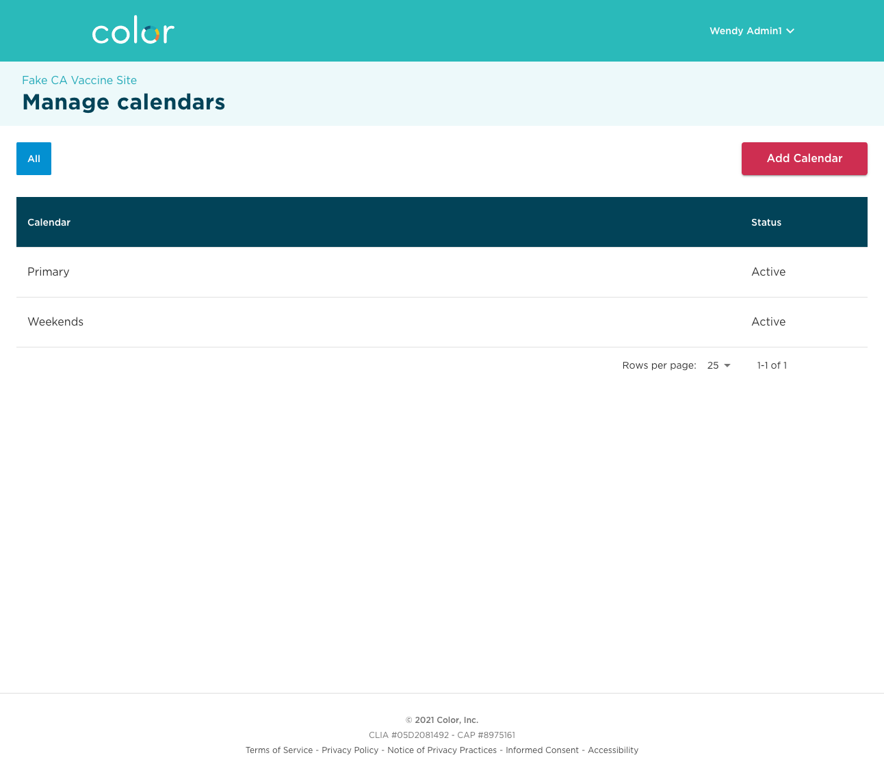
Add a secondary calendar
In addition to the default “Primary” calendar, Site Schedulers can choose to create additional secondary calendars.

Slide 40
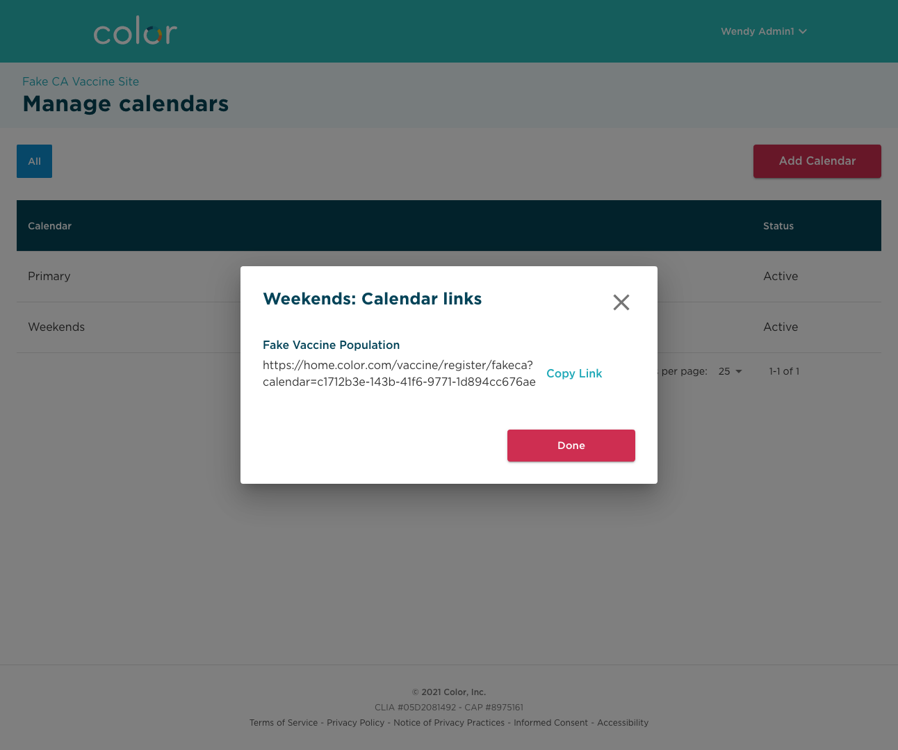
Secondary calendars have a private URL
The URL for this calendar can be shared with others, at the discretion of the customer.
Appointments added here are not available for booking through the primary registration path.

Slide 41
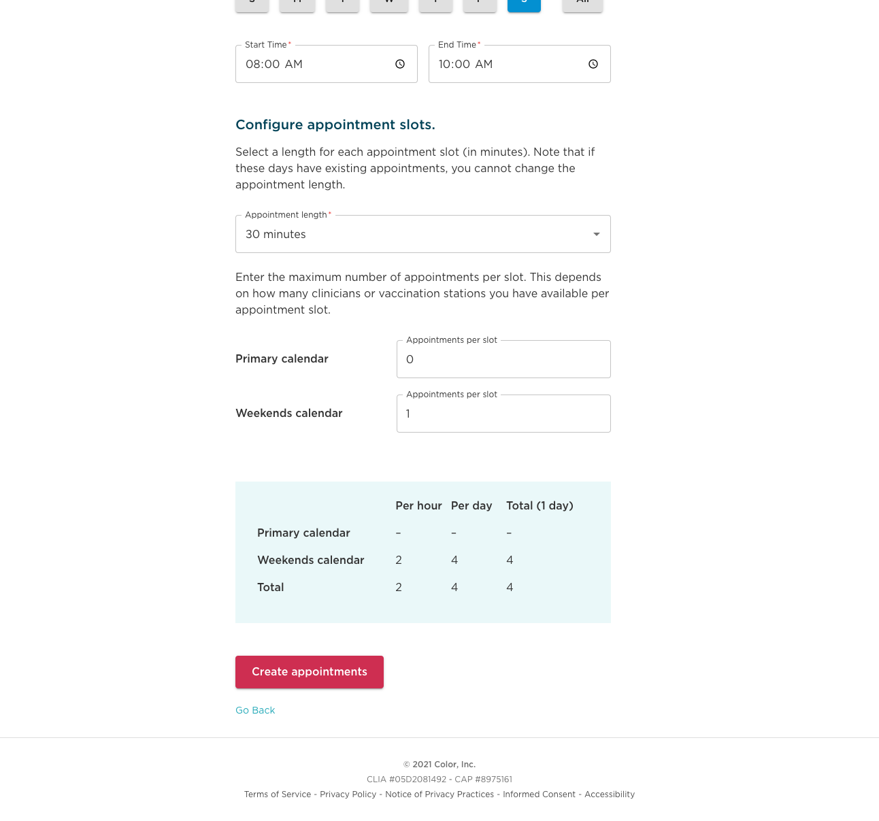
Add appointments to secondary calendar
Site Scheduler can add appointments to a secondary calendar. These appointments will be available for anyone booking through the registration flow using the private URL.
NOTE: Appointments must be added to the correct secondary calendar.
Rescheduling and 2nd dose appointments reserved for current patients will be handled through the primary calendar.

Slide 42
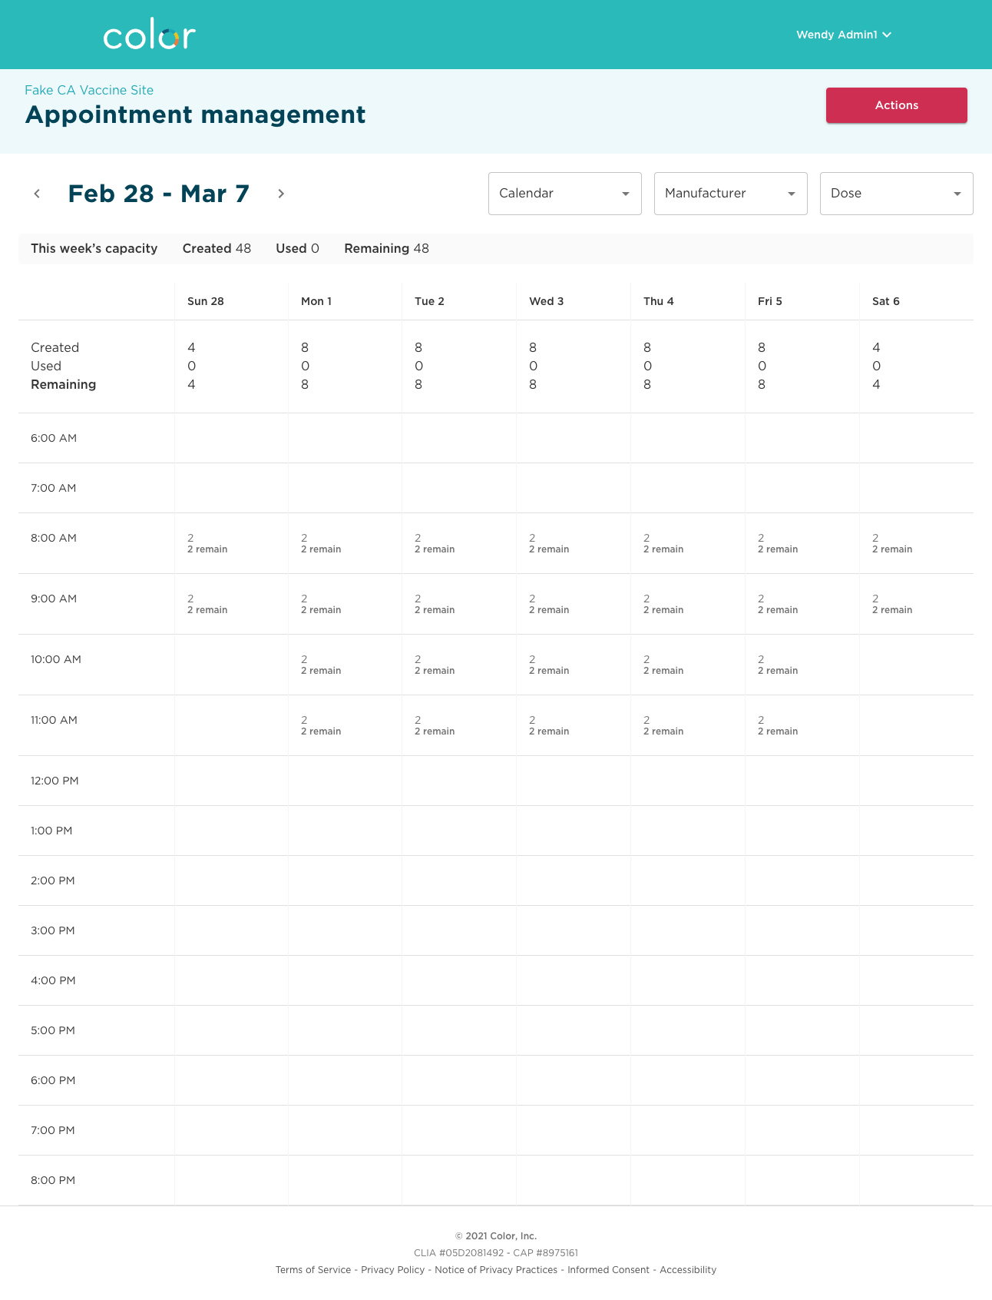
View summary information
You can filter the calendar view to see week / day / hour summary information just for a specific secondary calendar.

Slide 43
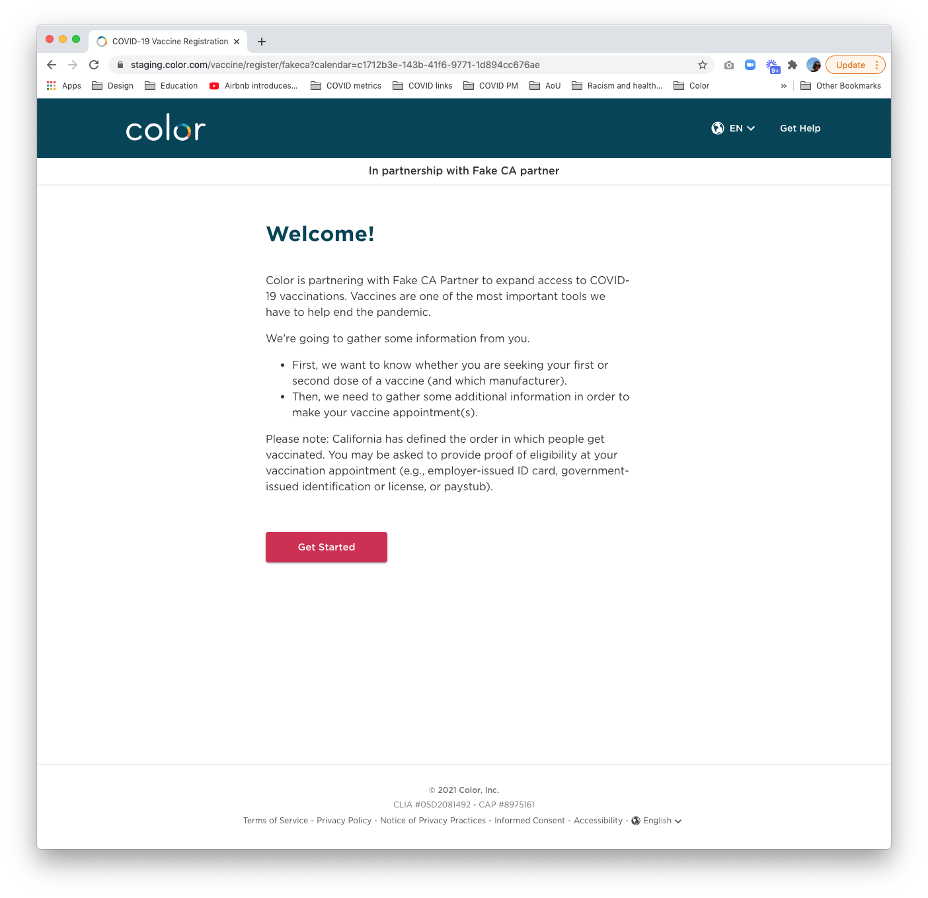
Enter the private URL into a browser
The registration flow that the secondary site’s private URL leads to is the same as that of the primary calendar.

Slide 44
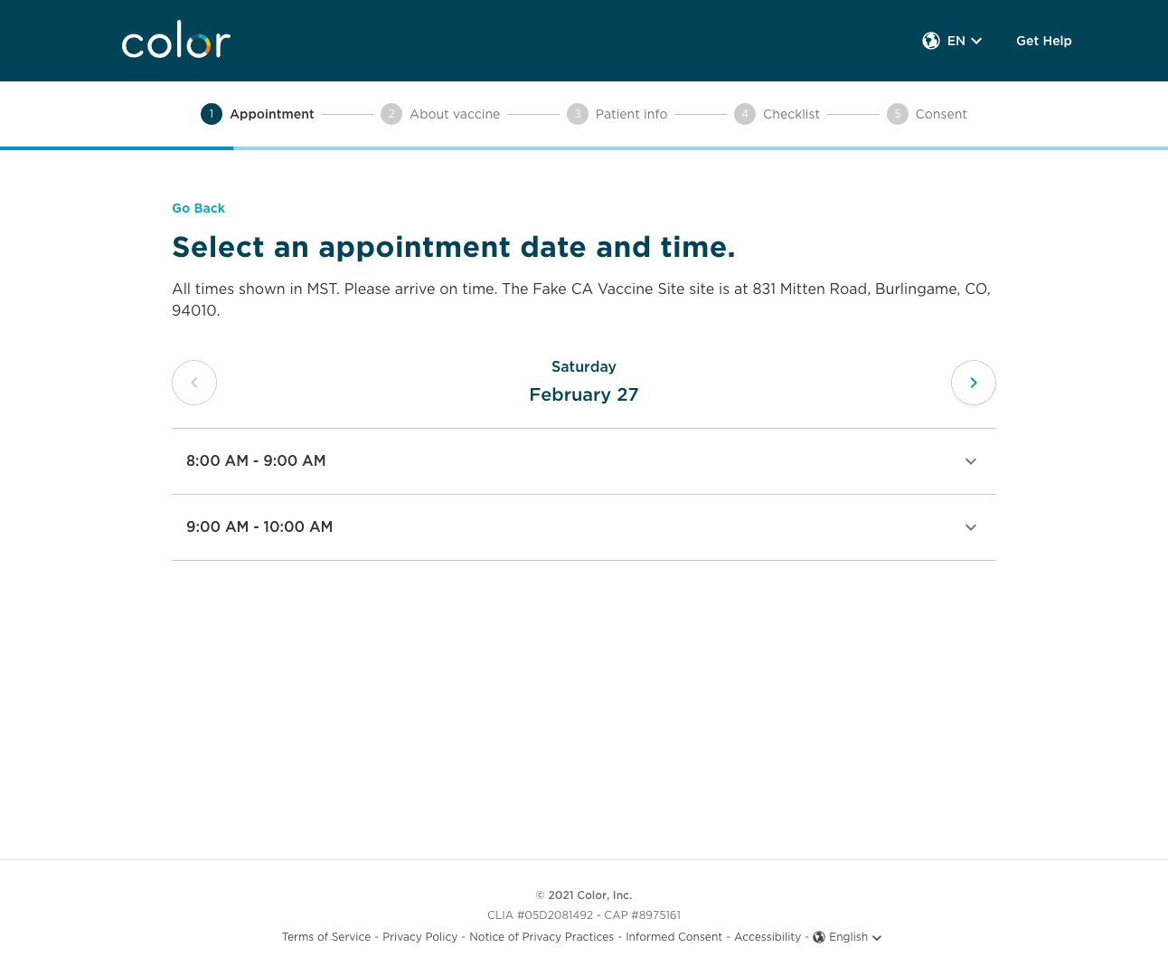
Only access reserved appointments
The only difference is that only appointments from the secondary calendar are surfaced.
Rescheduling and 2nd dose appointments reserved for current patients will be handled through the primary calendar.

Slide 45
05
Registration deep dive

Slide 46
Color offers several ways to register a patient
Loom video
Pre-registration links via primary/secondary calendars allow patients to register in advance
Walk-up URL allows patients to self-register for same-day appointments
On-the-spot appointment scheduling allows clinicians to register patients for same-day appointments
Proprietary and Confidential — Not for distribution.

Slide 47
Color offers several ways to register a patient
Pre-registration links via primary/secondary calendars allow patients to register in advance, including the following use cases:
Distribute through a school email blast
Post to a town page
Create your own QR code and create pre-registration fliers
Share it w/ a senior center staff to either fully or partially register patients in-person/over phone
Proprietary and Confidential — Not for distribution.

Slide 48
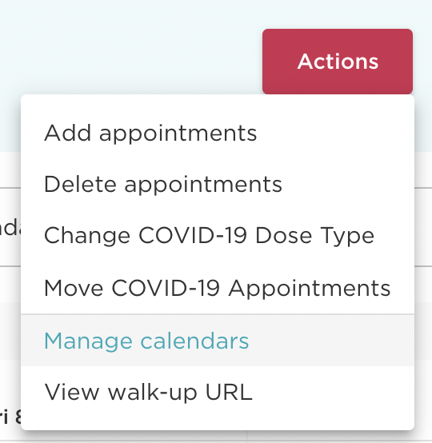
Accessing calendars
URL links are accessible in Appointment management
1. Within Appointment management, click “Actions” in the top right-hand corner
2. Then click on “Manage calendars” from the drop-down view

Slide 49
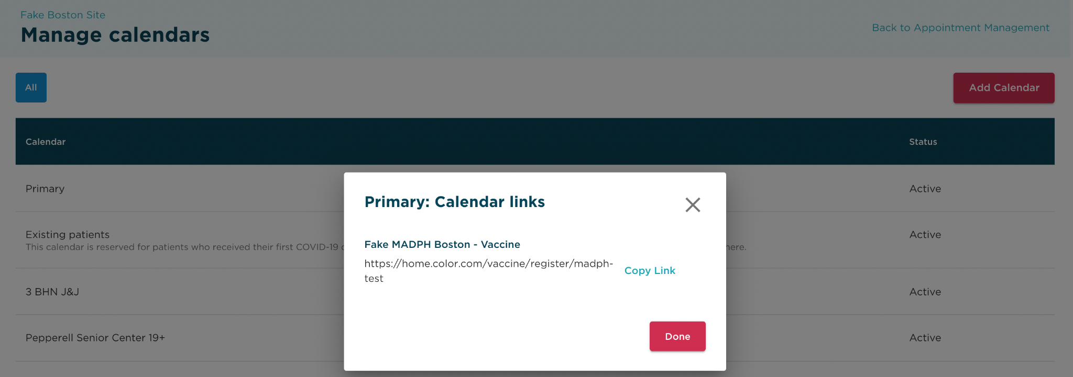
Accessing calendars
URL links are accessible in Appointment management
3. Clicking on the calendar name will bring up a pop-up with that particular calendar’s URL link. If you click “Copy Link” you’ll be able to copy/paste the link to your mobile browser

Slide 50
Color offers several ways to register a patient
Walk-up URL allows patients to self-register for same-day appointments
Copy QR code from Color and post it at clinic entrance
Print out walk-up URL and post at clinic entrance
Proprietary and Confidential — Not for distribution.

Slide 51
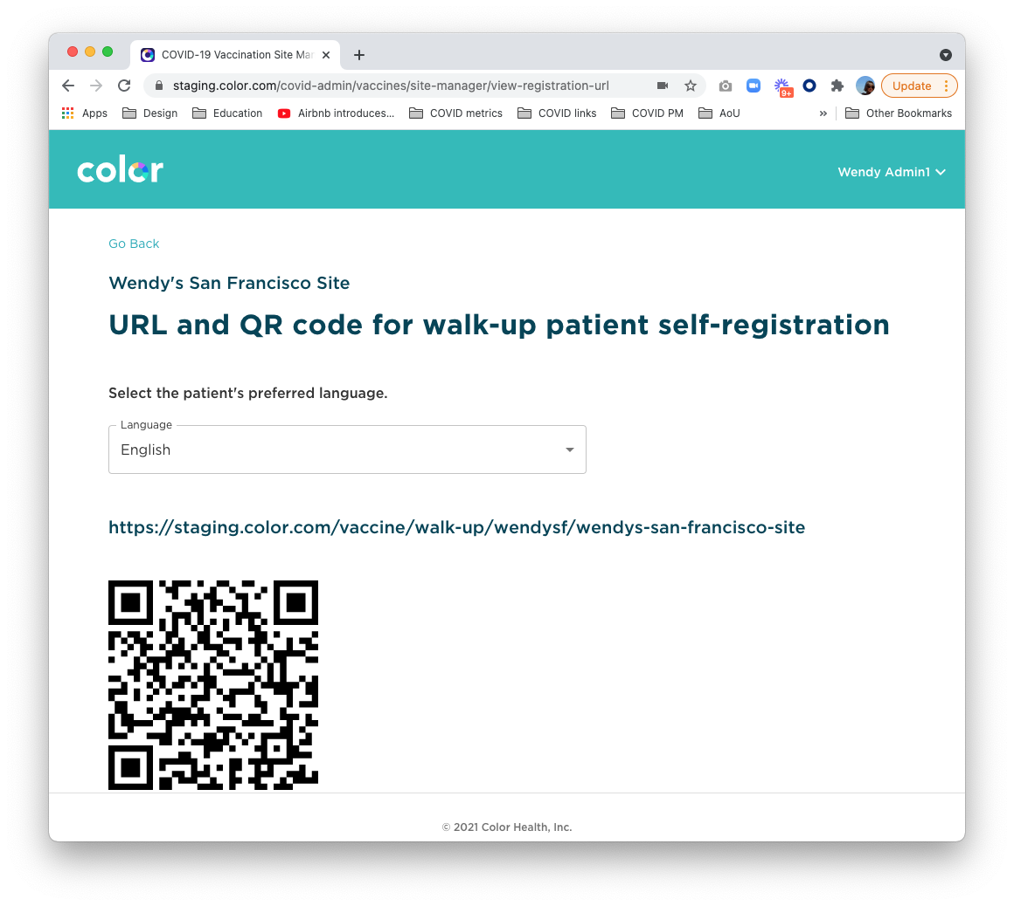
Walk-up self registration
Another way to add a patient
Go to appointment manager
Under actions, click ‘view walk-up URL’
Select language
Share or print URL or QR code
Patient will get dropped into regular scheduling flow from either
Once patient has completed registration, they will show up in the onsite tool to be checked in and vaccinated.
Video

Slide 52
Color offers several ways to register a patient
On-the-spot appointment scheduling allows clinicians to register patients for same-day appointments
Proprietary and Confidential — Not for distribution.

Slide 53
Adding a patient
Adding a patient: click on add patient
Selecting the “Add Patient” link will initiate the process for adding a new patient.
This will not pull from scheduled appointments.

Slide 54
Adding a patient
Adding a patient: provide vaccination history
If patient has had a previous vaccination, ask them for the manufacturer and dose.
If any of the following are true, stop adding the patient:
If the site doesn’t have the appropriate manufacturer
If it hasn’t been the appropriate number of days since their first dose.

Slide 55
Adding a patient
Adding a patient: collect patient information
Collect required patient information.

Slide 56
Adding a patient
Adding a patient: confirm patient contact information
Make sure the information entered is correct, as contact info and DOB will be used for scheduling reminders and access to booking their second dose appointment.

Slide 57
Adding a patient
Adding a patient: complete the prevaccination checklist with the patient
This will make the vaccination step with the clinician more efficient.

Slide 58
Adding a patient
Adding a patient: Collect their health insurance
Depending on the vaccination type, the patient may not be charged for the vaccination. This will be listed at the top.
Now have the ability to add a primary and secondary insurance with “Yes, I have multiple insurance plans”

Slide 59
Adding a patient
Adding a patient: Obtain consent from the patient
Hand the device to the patient for them to sign. They should hand it back to you without submitting the screen.
Currently, we only show the consent in English and don’t have a way of showing it in different languages. It might be useful to have it printed out at sites.

Slide 60
Adding a patient
Adding a patient: patient is now added and checked in

Slide 61
06
Q & A

