Slide 1
Using ISO 27001 to Protect Your Data Annex A Explained
Craig Thornton & Nathan Cottom

Slide 2
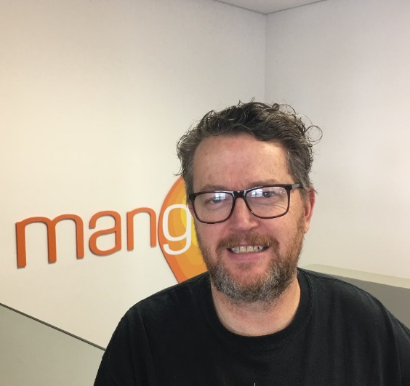
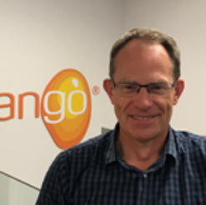
Presenters
Craig Thornton, Part-Owner, Mango Limited
craig@mangolive.com
Nathan Cottom, Operations Manager, Mango Limited
nathan@mangolive.com

Slide 3
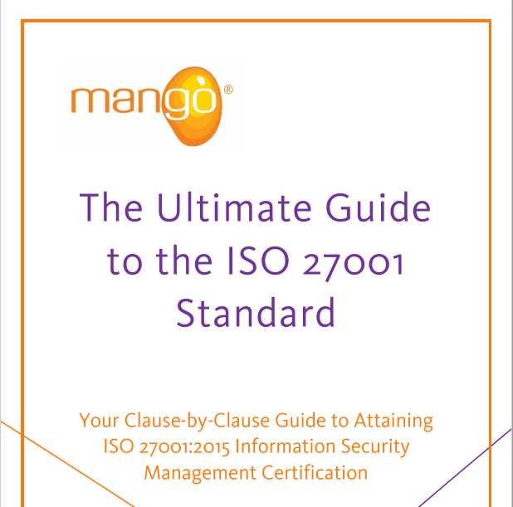
eBook
https://www.mangolive.com/resources

Slide 4
The Equation
ISO 27001 = ISO 27001 + Annex A
(Clauses 4-10) (108 controls)

Slide 5
Annex A – Objectives and Controls
A.5 Information Security Policies
A.6 Organisation of Information Security
A.7 Human Resource Security
A.8 Asset Management
A.9 Access Control
A.10 Cryptography
A.11 Physical and Environmental Security
A.12 Operations Security
A.13 Communications Security
A.14 System acquisition, development and maintenance
A.15 Supplier Relationships
A.16 Information Security Incident Management
A.17 Business Continuity
A.18 Compliance

Slide 6
A.5 Information Security Policies
Example:
Mango Limited:
We are committed to:
meeting all current legislation as well as a variety of regulatory and contractual requirements.
continually improvement of the information security management system.
meeting the security needs and expectations of interested parties

Slide 7
A.6 Organisation of Information Security
Examples
Individual Employment Agreement
Job descriptions
Mobile device use policy
Remote working policy

Slide 8
A.7 Human Resource Security
Examples
Recruitment – screening
Police checks
Induction
Termination

Slide 9
A.8 Asset Management
Examples
Asset register
Classification
Labelling
Handling and disposal of media

Slide 10
A.9 Access Control
Examples
User access
Networks
Services (Utilities)
Privileges
2FA
Passwords – complex
Source code

Slide 11
A.10 Cryptography
Examples
Keys
Encryption/de-encryption

Slide 12
A.11 Physical and Environmental Security
Examples
Boundaries (physical location)
Office access – alarms, PIN codes
Equipment – maintenance, cabling, utilities
Clean desk/whiteboards

Slide 13
A.12 Operations Security
Examples
Patching
Malware
Backup
Logs
Phishing
Credential harvesting

Slide 14
A.13 Communications Security
Examples
Network security
Transferring data
Team comms

Slide 15
A.14 System acquisition, dev and maintenance
Examples
Purchasing
Design and Development processes
Testing
Support

Slide 16
A.15 Supplier Relationships
Examples
Contractor performance
Supplier reviews
Consider lawyers, accountants etc

Slide 17
A.16 Incident Management
Examples
Incident reporting
Corrective action
Preventive action
Reviews

Slide 18
A.17 Business Continuity
Examples
Business continuity planning
Emergency preparedness
Testing

Slide 19
A.18 Compliance
Examples
Legal registers
Compliance registers

Slide 20
Q&A

