Slide 1

43 things
I wish I had known about Slate when I started using it

Slide 2


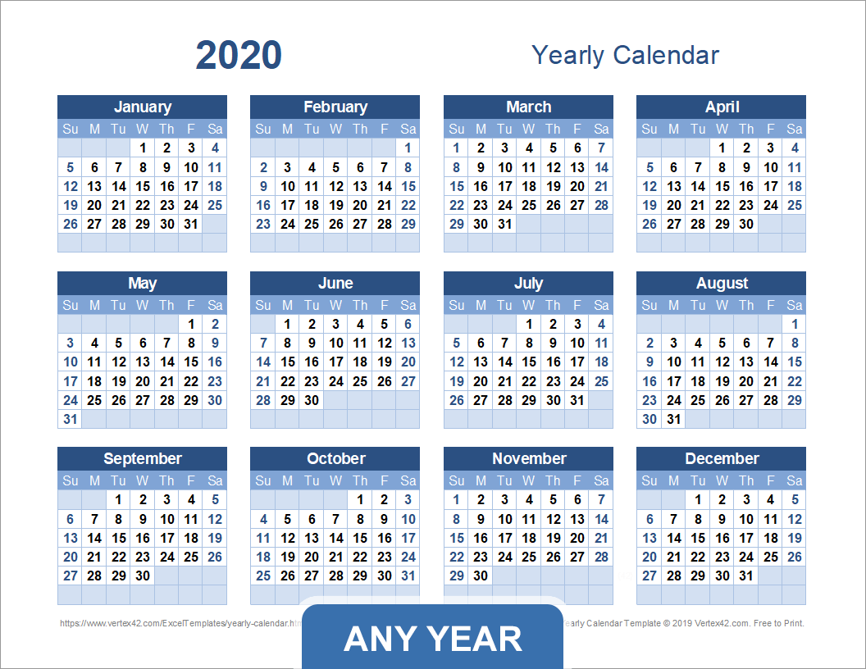

So who’s here?
How do I log in?
(+/- 0 days)
Just Getting Started
(Less than 3 months)
Solidly Slating
(Less than a year)
Been There, Done That
(More than a year)

Slide 3

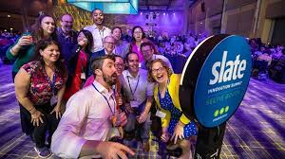


A few things about me…
I believe in ugly slide decks
Not a Slate fanboy
Cut, paste and pray coder
Strategically lazy

Slide 4

A few things about Wheaton…
Small liberal arts college
Located in Norton MA
~1,800 students
3 years using Slate
3 core Slate team members

Slide 5
OK, let’s dive into this…
Deep thoughts
🤔
Best practices
👍
Tactics and details
🔩

Slide 6
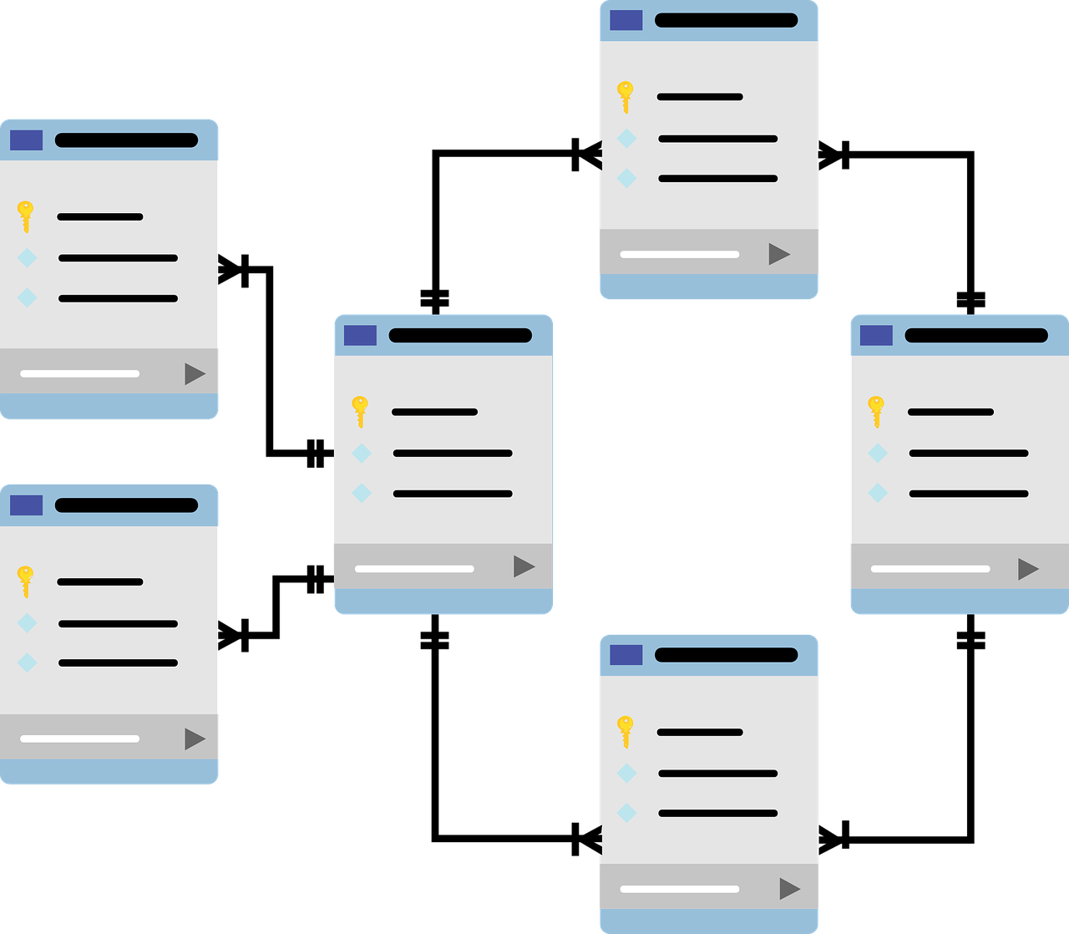
Slate is a relational database—duh
SET UP
Notes:
A couple good explanations of databases:
Youtube: https://youtu.be/wR0jg0eQsZA
Articles:
https://www.digitalocean.com/community/tutorials/understanding-relational-databases
https://www.omnisci.com/technical-glossary/relational-database

Slide 7
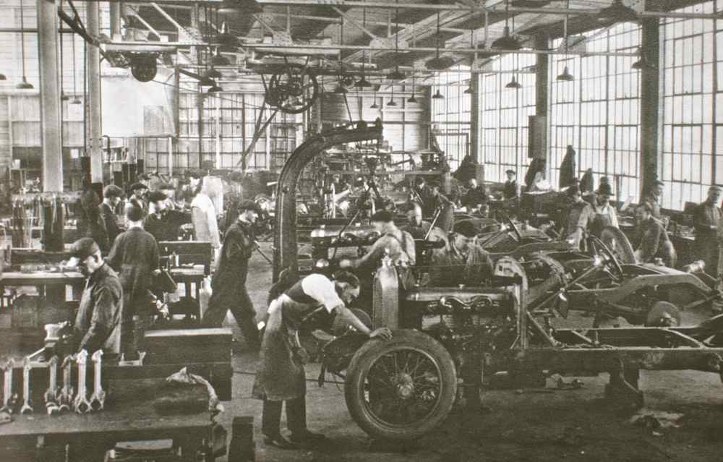
“We’ve always done it this way.” 😨
SET UP
Notes:
Start with the goal
Research how Slate is built to achieve that end
Don’t try and replicate current processes using Slate
Avoid square pegs and round holes

Slide 8

Rowing with admissions
SET UP
Notes:
What worked for us:
Find the pain points
Use Slate to solve those pain points

Slide 9

What’s the ROI?
SET UP

Slide 10

Let’s call it the “Knowledge” Base
RESOURCES
Notes:
Beware of the comments that don’t have positive feedback or are followed by other users saying they can’t get the proposed solution to work.

Slide 11

Service Desk: not always servicey
RESOURCES
Notes:
Sometimes (not always) it can help expedite your responses to service desk requests to show your efforts. Provide links and screenshots to the attempts you’ve made.

Slide 12
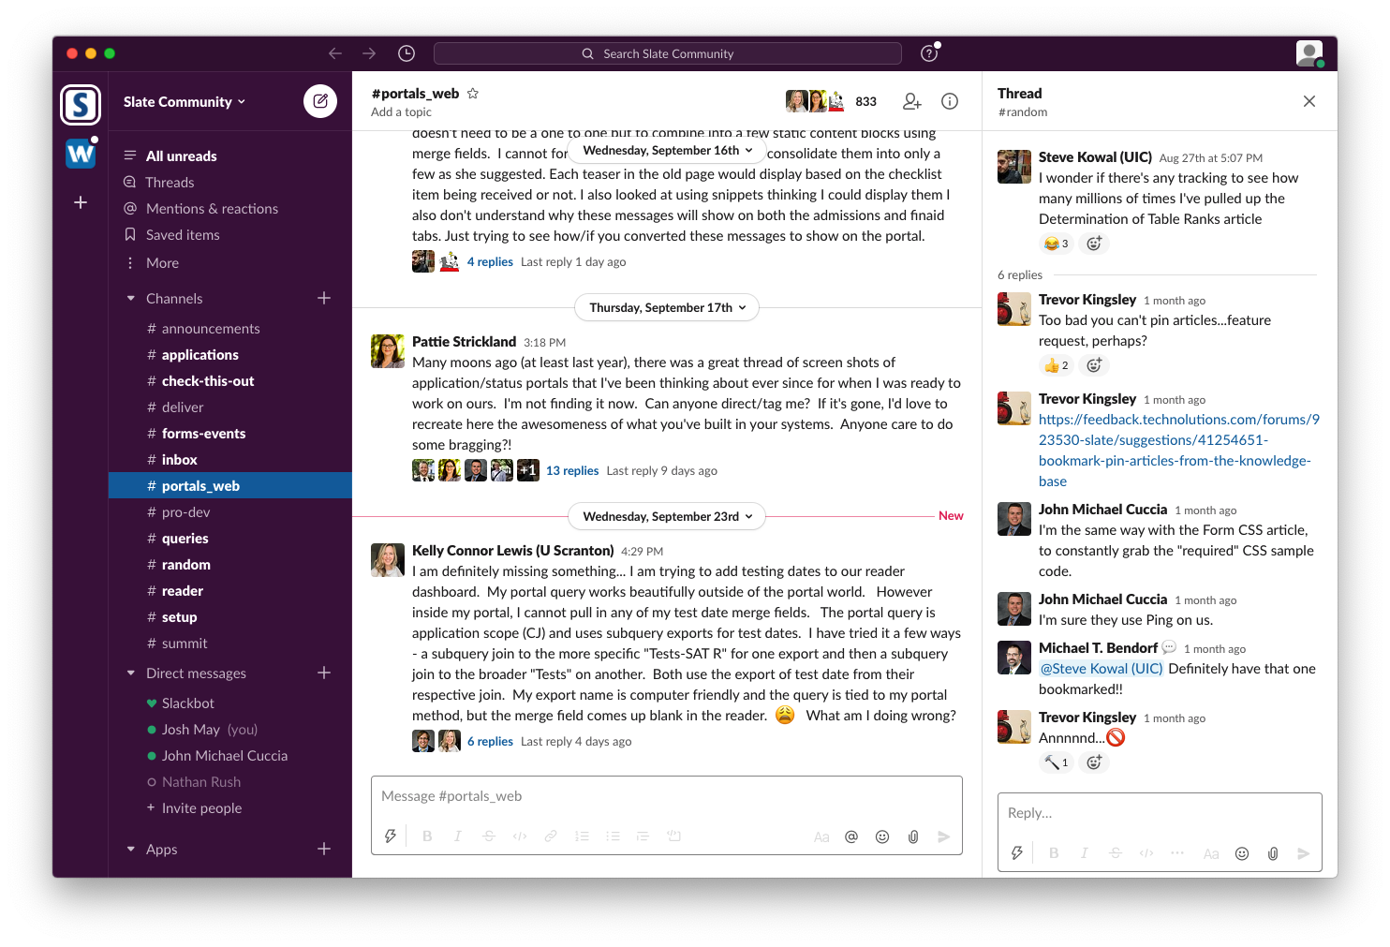
But the Slack Slate channel is 🔥
RESOURCES
Notes:
Definitely join:
Slate Community
slate-users.slack.com

Slide 13
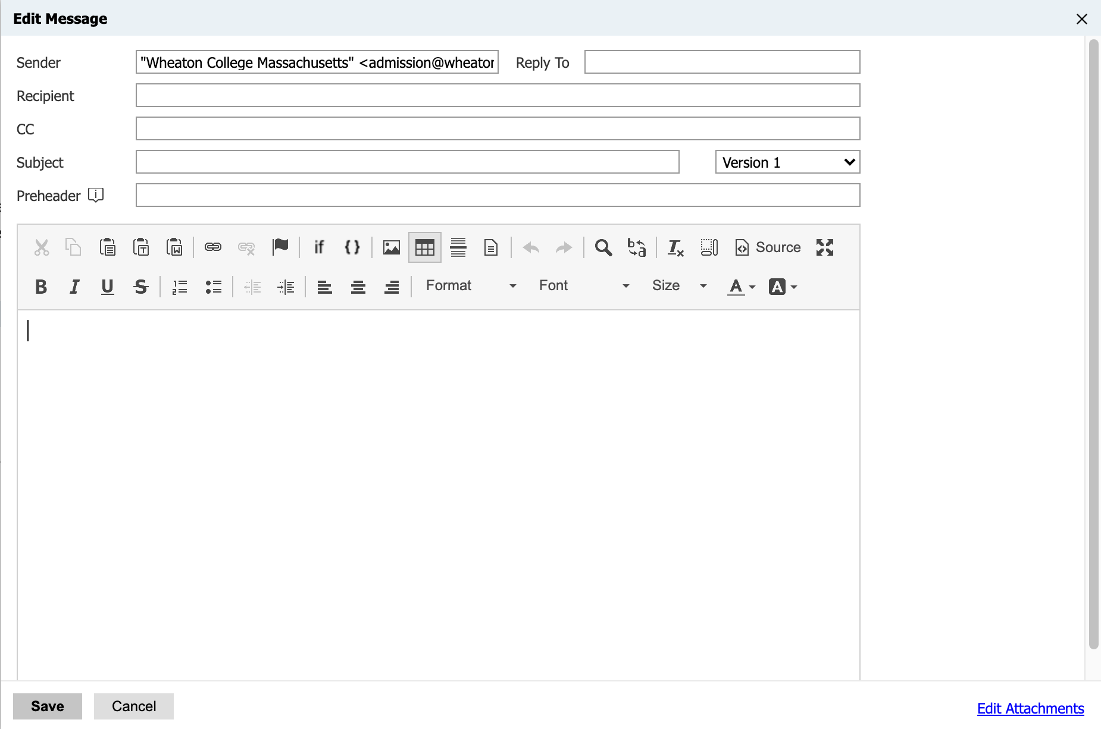


WYS(isn’t always)WYG
DELIVER
Notes:
Bee: https://beefree.io/bee-pro/
Email on Acid: https://www.emailonacid.com/

Slide 14

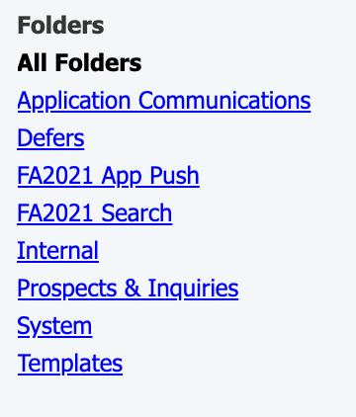
Good folder structure = 😀
DELIVER

Slide 15
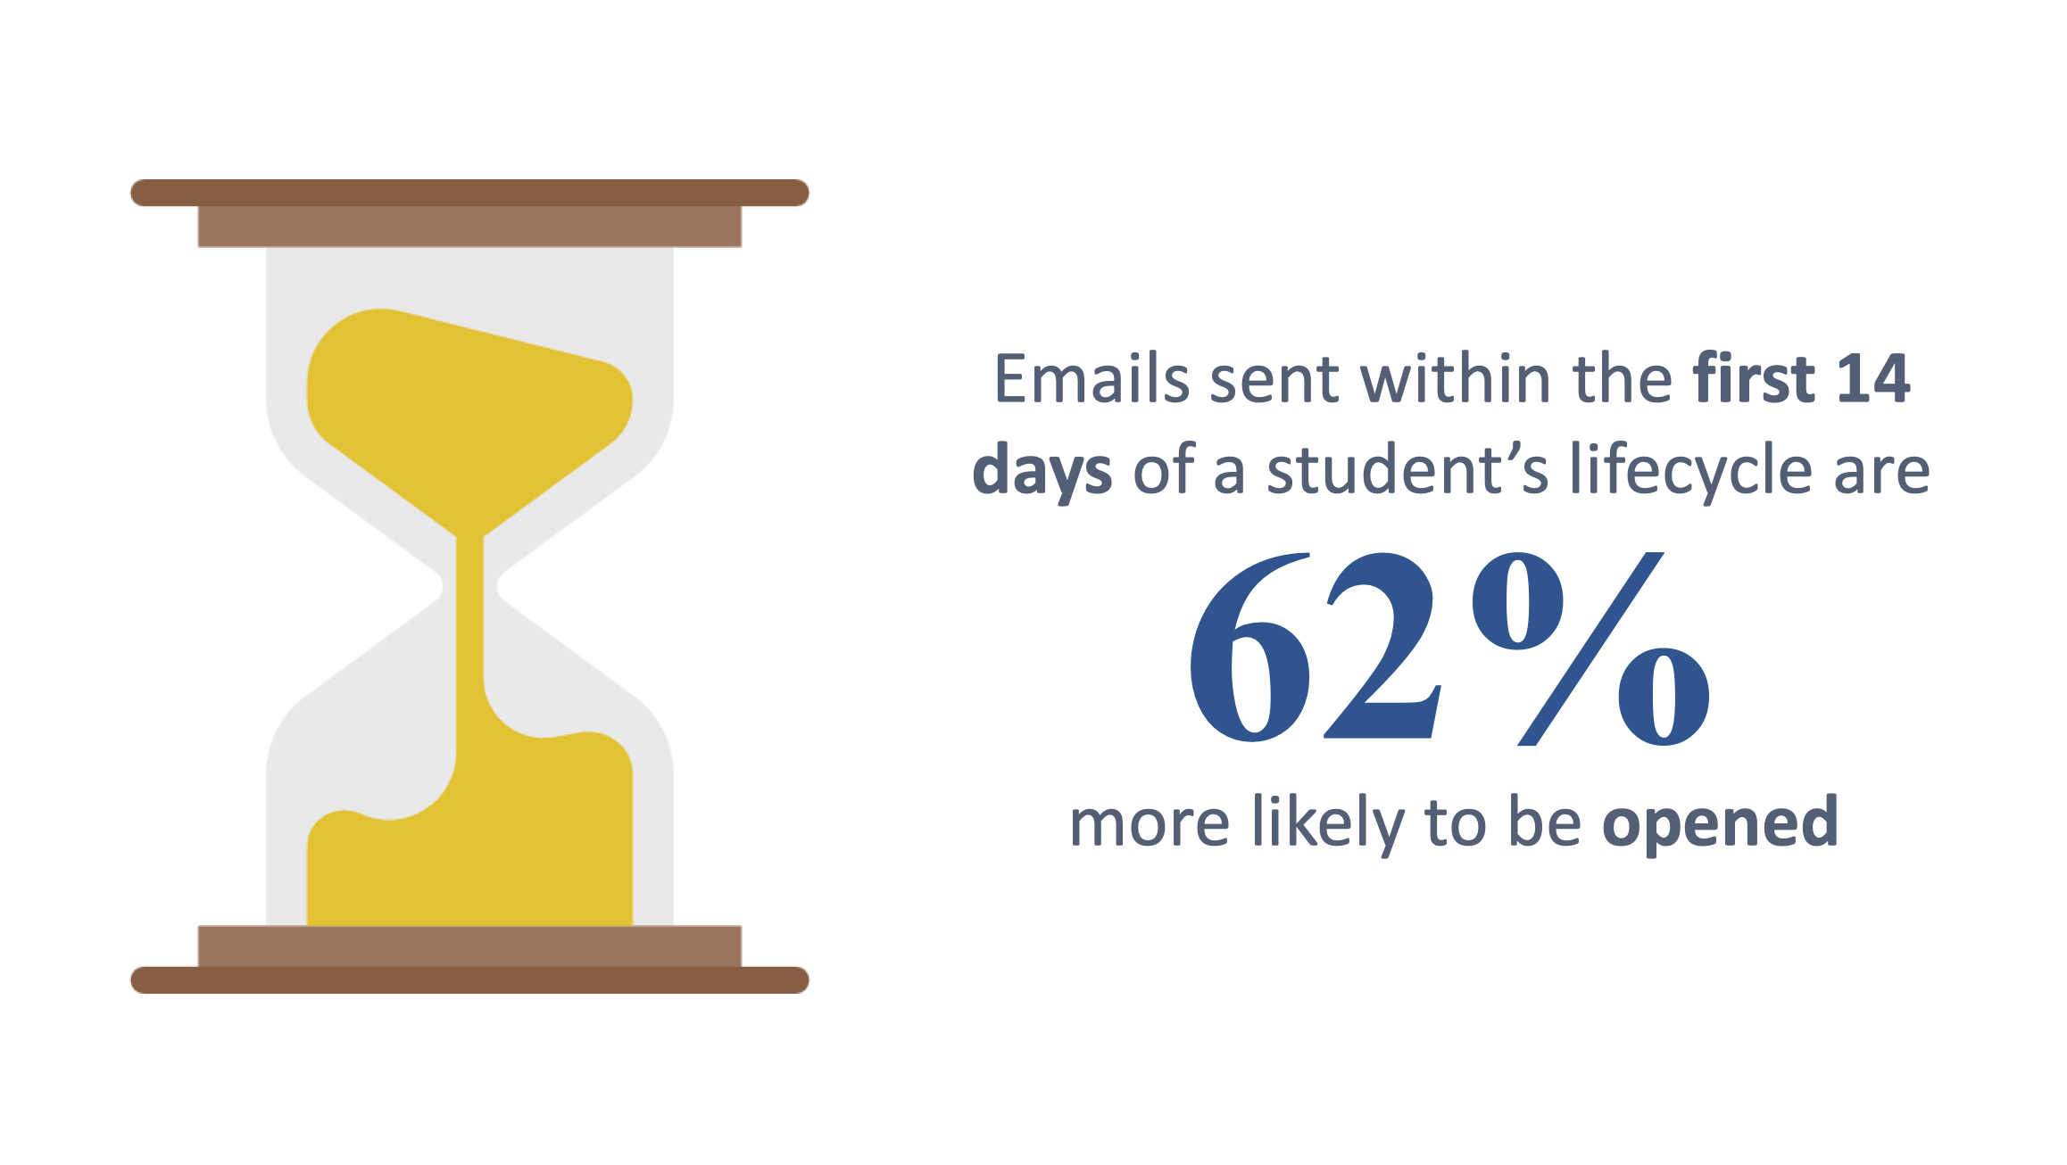
Short campaigns + 2 week rule
DELIVER
Don’t try and build a year long campaign
Campaigns of 2 months or less are easier to manage
Dynamic campaigns are possible—but tricky
(See Kris Hardy’s Slate Summit presentation—it’s good.)
Notes:
Kris Hardy’s Slate Summit Presentation: Predictive Modeling and Email Analytics: https://technolutions.zendesk.com/hc/en-us/articles/360007259051-Slate-Innovation-Summit-2018-Presentation-Slides
Dynamic drip campaigns—link to Knowledge Base article: https://technolutions.zendesk.com/hc/en-us/community/posts/360013239312-Dynamic-Drip-Marketing-Filter-from-Deliver-ing-the-Message-
Presentation about dynamic campaigns: Deliver-ing the Message: Engaging Populations Through Drip Marketing https://technolutions.zendesk.com/hc/en-us/articles/360007259051-Slate-Innovation-Summit-2018-Presentation-Slides

Slide 16

Help the lazy—?person={{Prospect-ID}}
DELIVER
Pre-filling forms via parameters—survey says, “Yes, please.”
Add “Prospect ID” to the email query
Make sure your fields on the form are mapped
Append: admission.ohou.edu/register/event?person={{Prospect-ID}}
Notes:
Prepopulating or Prefilling Forms Using Query String Parameters
https://technolutions.zendesk.com/hc/en-us/articles/360032795252-Prepopulating-or-Prefilling-Forms-Using-Query-String-Parameters

Slide 17
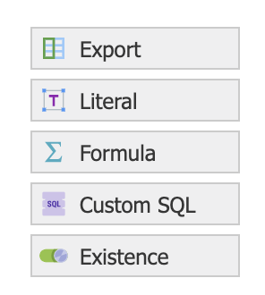
Learn to love liquid markup
DELIVER
{% if {{presentation_feedback}} == 'This is boring' %}Well, feel free to log off{% endif %}
Notes:
From the Slate KB:
Fundamental Liquid Markup and Conditional Logic
https://technolutions.zendesk.com/hc/en-us/articles/360033284052-Fundamental-Liquid-Markup-and-Conditional-Logic
The Joy of Liquid Markup
https://technolutions.zendesk.com/hc/en-us/articles/360033024171--The-Joy-of-Liquid-Markup

Slide 18
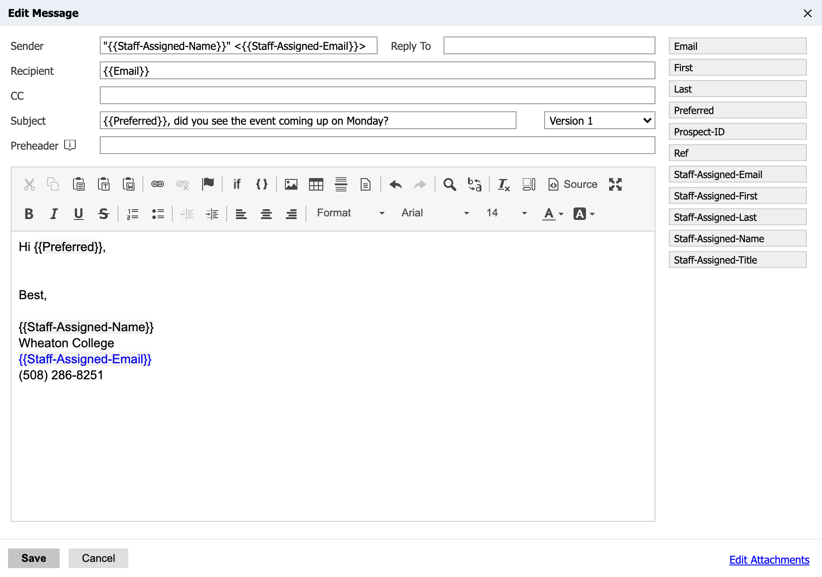
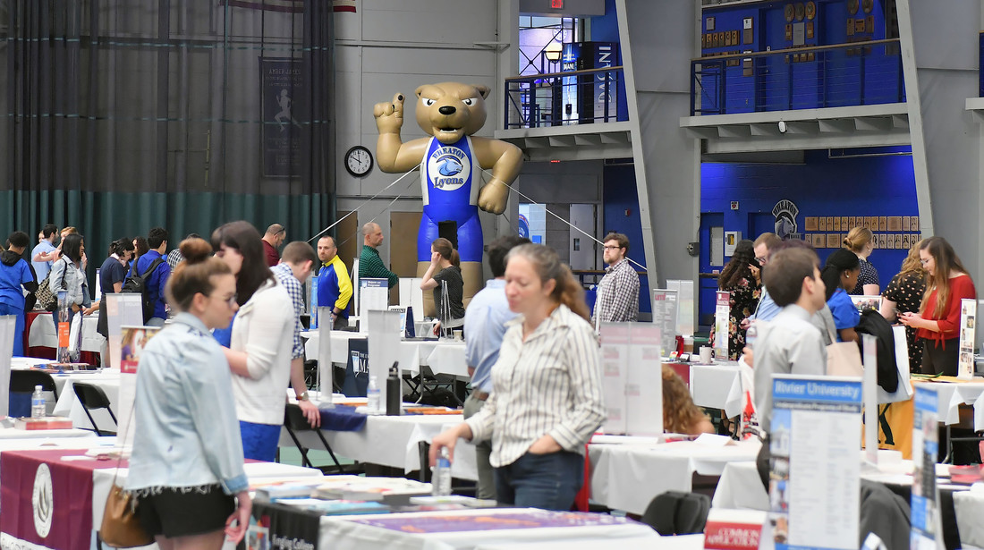
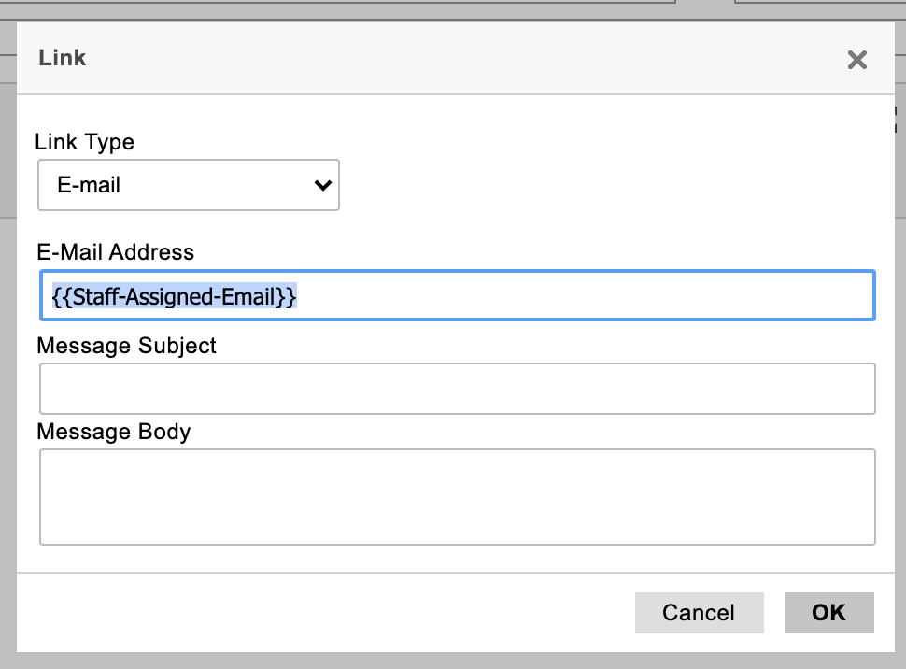
The kids love {{staff-assigned}}
DELIVER
Who wouldn’t want to hear from these folks?

Slide 19
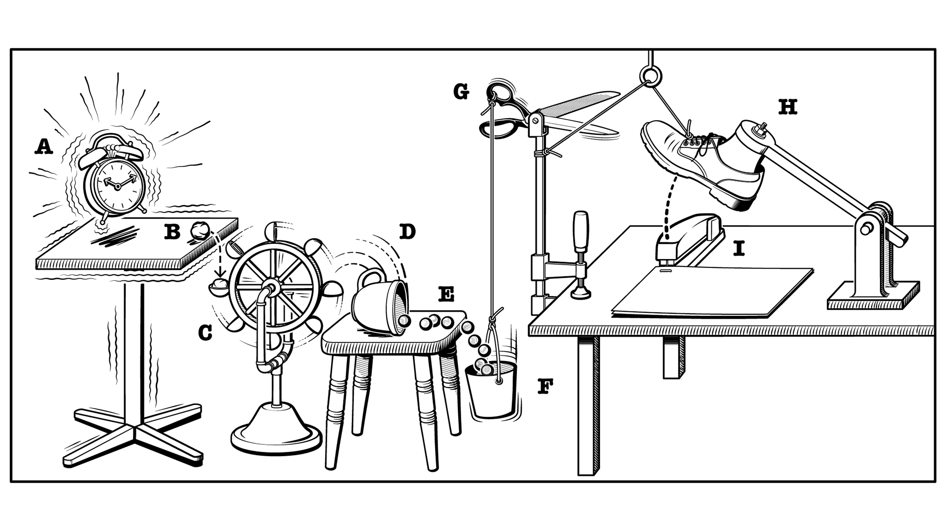
Send {{this}} when {{this}}…
DELIVER

Slide 20

Don’t go crazy with populations
DELIVER
Notes:
Don’t create too many populations. Filters + populations will save time and keep you more organized than having a population for each use case.

Slide 21

Everyone wants to review emails
DELIVER
Notes:
Test email + Google mailing list = not the most elegant, definitely the most effective

Slide 22
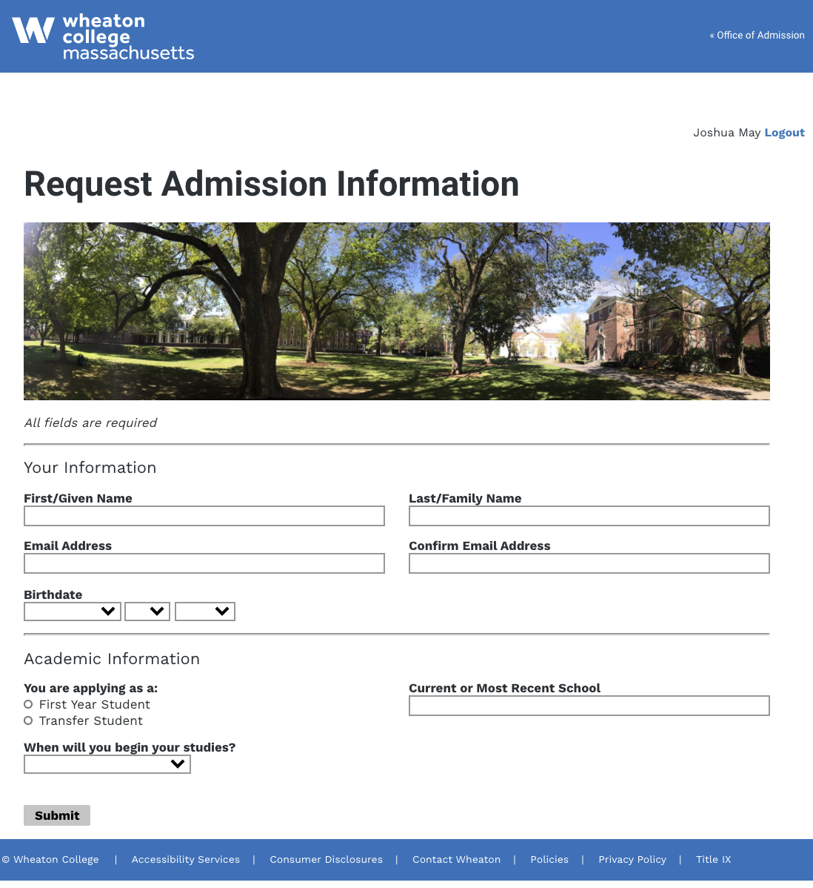
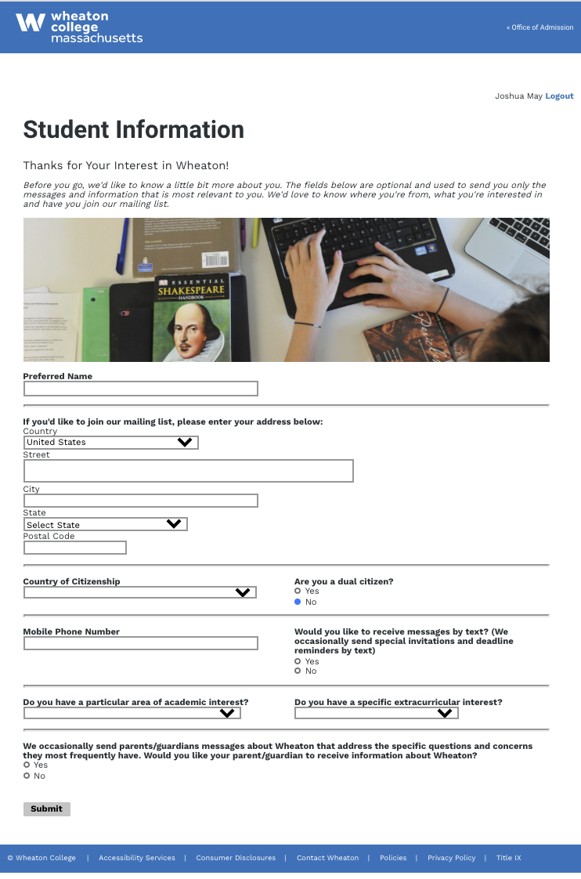
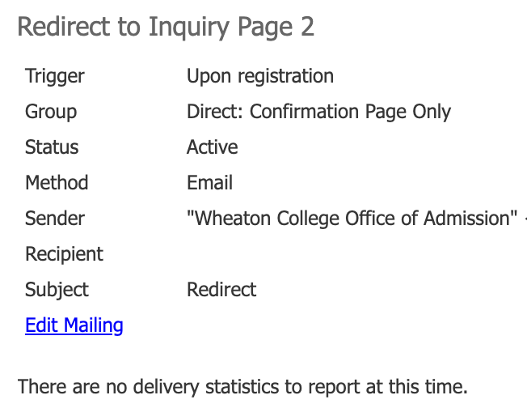
Multi-page forms FTW
FORMS
First do this
Then do this
Get this
31%+
RFI Conversions
85%+
Page 2 Completions
Next do this
Notes:
Knowledge Base: (this Slate user generated content, not official Slate documentation) https://technolutions.zendesk.com/hc/en-us/community/posts/217866587-Multi-page-form
The set up I use is:
Build form 1
Build form 2
On form 1, create a form communication
Trigger: Upon Registration
Group: Direct: Confirmation Page Only
Edit the message
Go into Source
Replace the HTML there with this, replacing the URLs with the one for your form 2:
<html xmlns="http://www.w3.org/1999/xhtml">
<head>
<title></title>
</head>
<body>
<script type="text/javascript">window.location = "https://youruniversity.edu/register/form2?person={{Form-Person-ID}}";</script>
<h3>
Processing...
</h3>
<p>
If this page doesn't automatically advance, <a href="https://youruniversity.edu/register/form2?person={{Form-Person-ID}}">click here</a>.
</p>
</body>
</html>

Slide 23
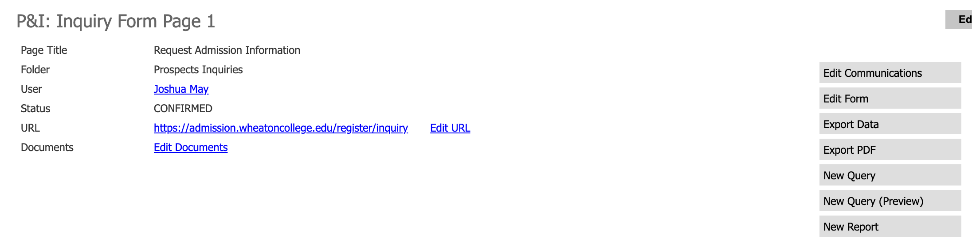
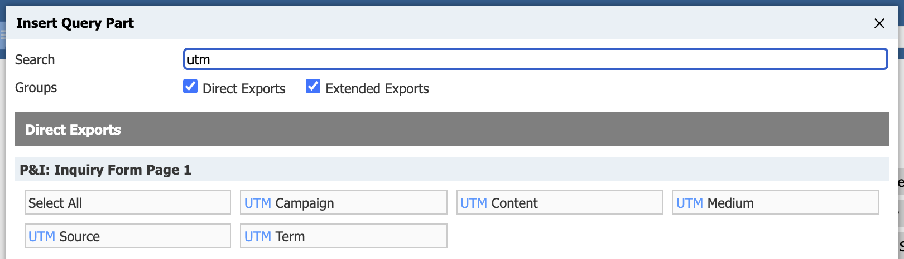
Where are my UTMs?
FORMS
Notes:
Slate KB info:
Capturing UTM Parameters in Forms
https://technolutions.zendesk.com/hc/en-us/articles/360033019851-Capturing-UTM-Parameters-in-Forms

Slide 24
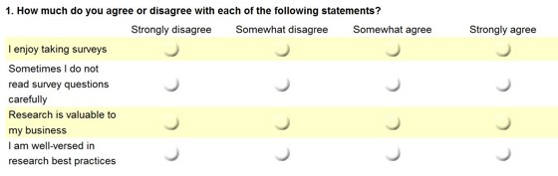
Survey says… not too pretty
FORMS
Please indulge this brief rant…

Slide 25
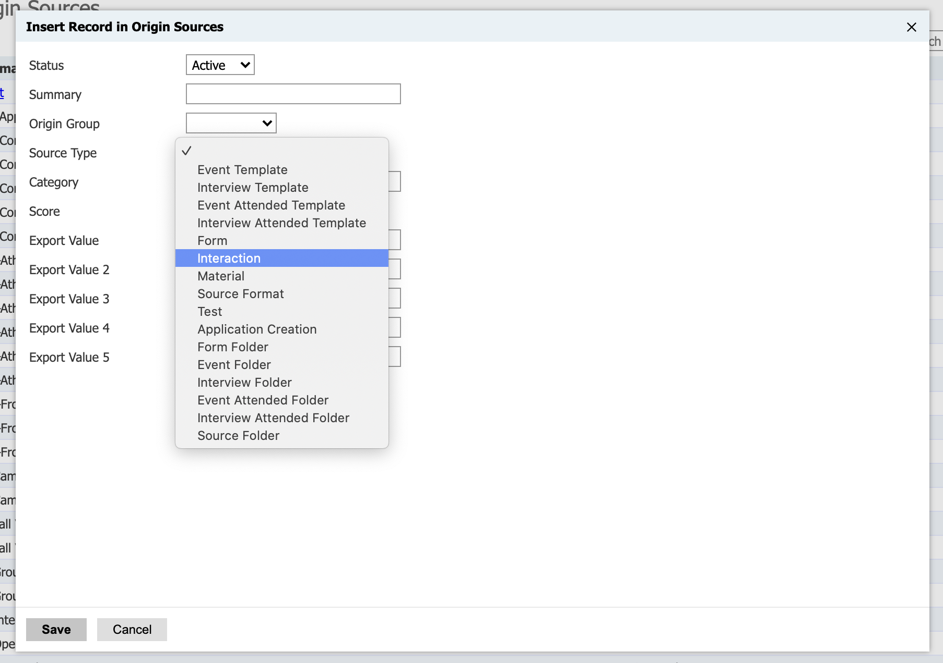
Tricky to set up—totally worth it
SOURCES
Start with 1 source from each Source Type
Let it run overnight
Tweak, rinse, repeat
Once they’re working correctly, then add ALL of your sources
Notes:
Slate KB on sources:
Origin Sources
https://technolutions.zendesk.com/hc/en-us/articles/360033234272-Origin-Sources
Training Lesson: Origin Groups & Sources
https://technolutions.zendesk.com/hc/en-us/articles/360032721752--Training-Lesson-Origin-Groups-Sources

Slide 26

Loading historical data? Call Slate
SOURCES

Slide 27

Making the most of first sources
SOURCES
First Source Report:
Briefcase ID included
Warning: First Source ≠ Lead Source
Customer acquisition costs by source
When do applicants and enrolls show up on your radar?
Notes:
As promised: Briefcase ID for our First Source Report: ee79611c-e9a3-206c-36b6-a58109b78b10@whc

Slide 28






Going beyond first sources
SOURCES
Paid Sources Report
Popular Sources
Attribution Model?

Slide 29
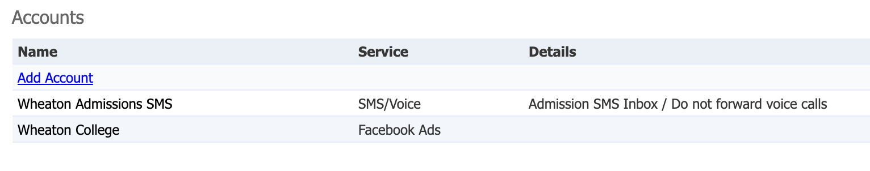
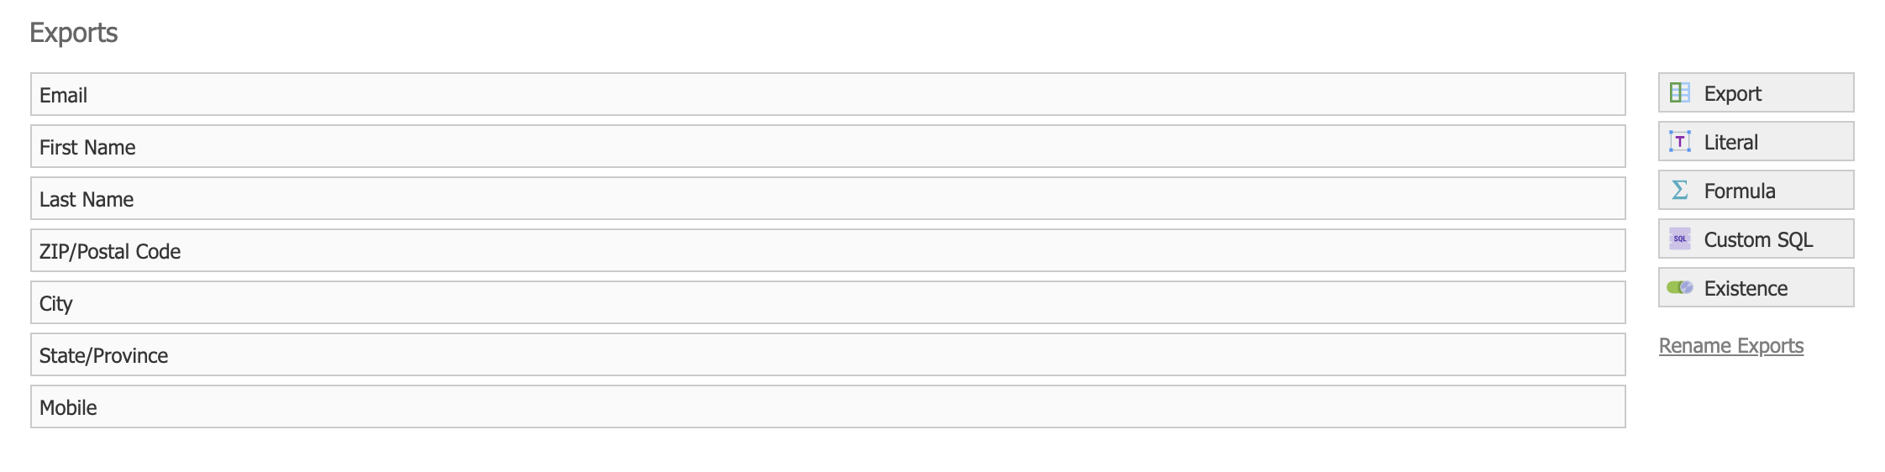
FB audiences: Exports = Headers
QUERIES
First link Slate and FB via Deliver Configuration
Then build your query and rename the exports to match FB’s headers
Notes:
Knowledge Base: https://technolutions.zendesk.com/hc/en-us/articles/360032977352-Facebook-Custom-Audiences

Slide 30
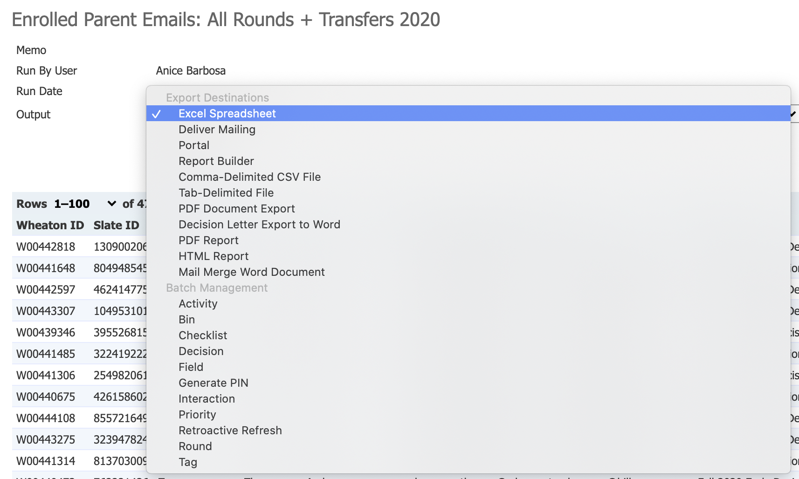
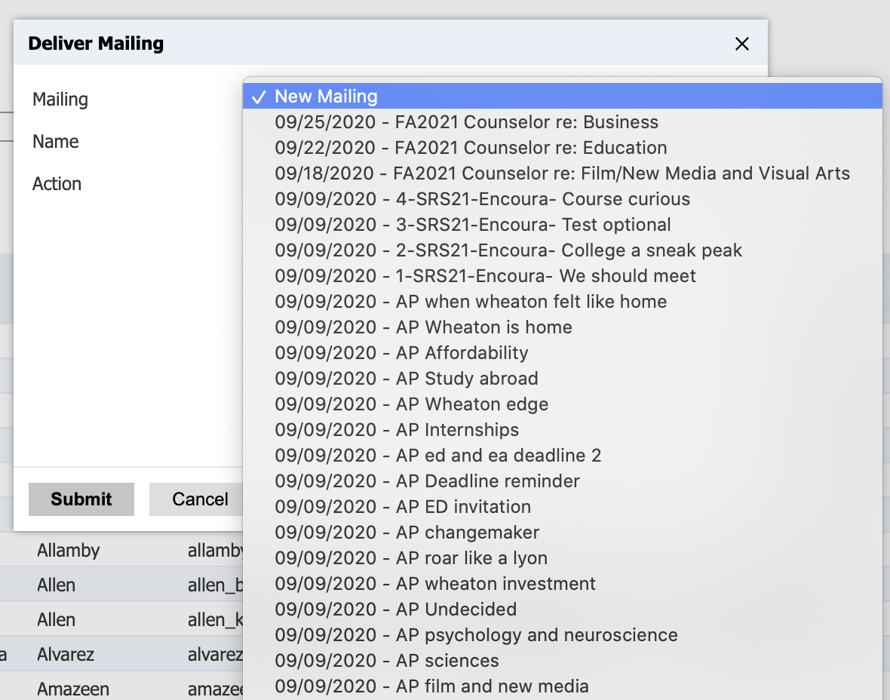
Adding queries to emails
QUERIES
Notes:
Run the query
From the Output drop down select “Deliver Mailing”
Either create new mailing or add the query to an existing mailing

Slide 31
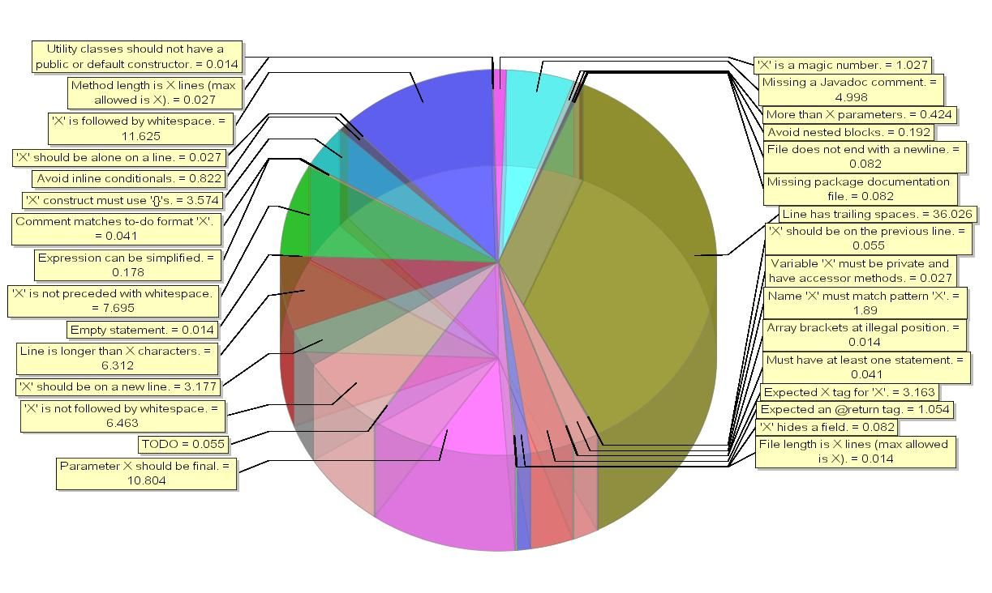
Usually reliable, rarely pretty
REPORTS

Slide 32
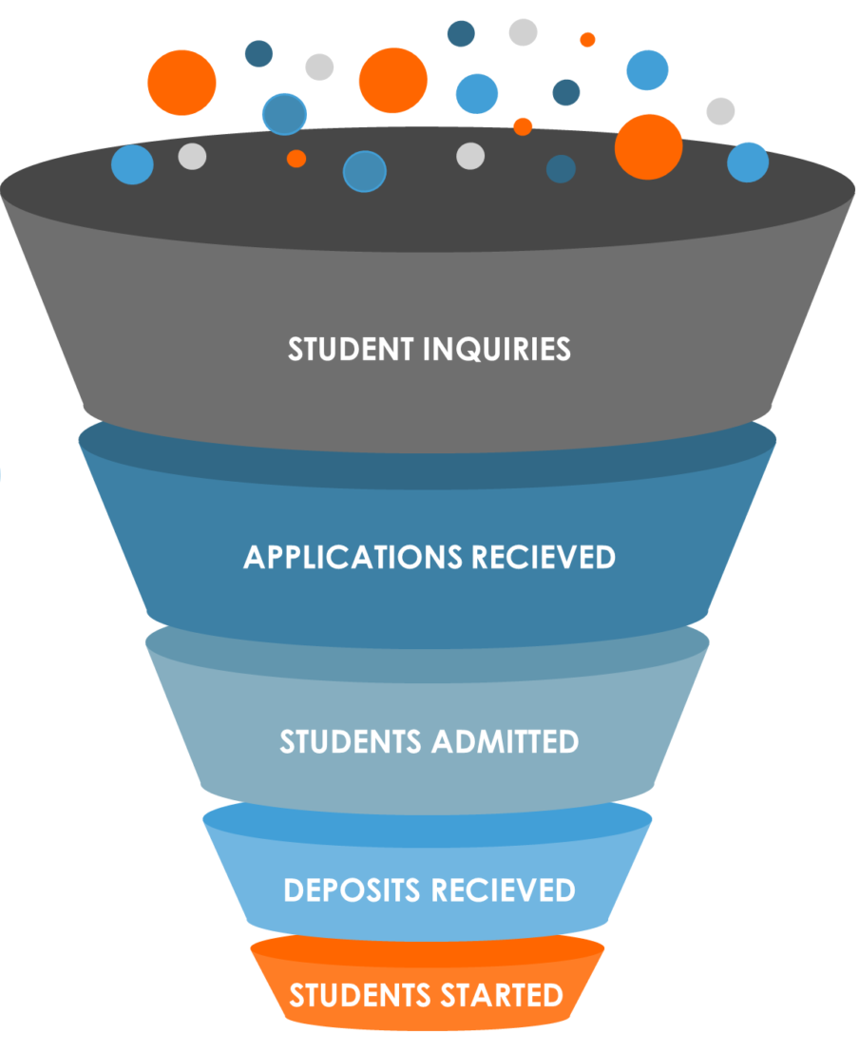
Favs: Funnels and email tracking
REPORTS
Slate’s out-of-the-box funnel—start there
Email Tracking:
Briefcase ID included
What we focus on:
  Deliverability
  Open rate
  CTOR
Notes:
Email Tracking Report Briefcase ID: b5b3803b-7af9-226e-4633-52b4f097228b@whc

Slide 33
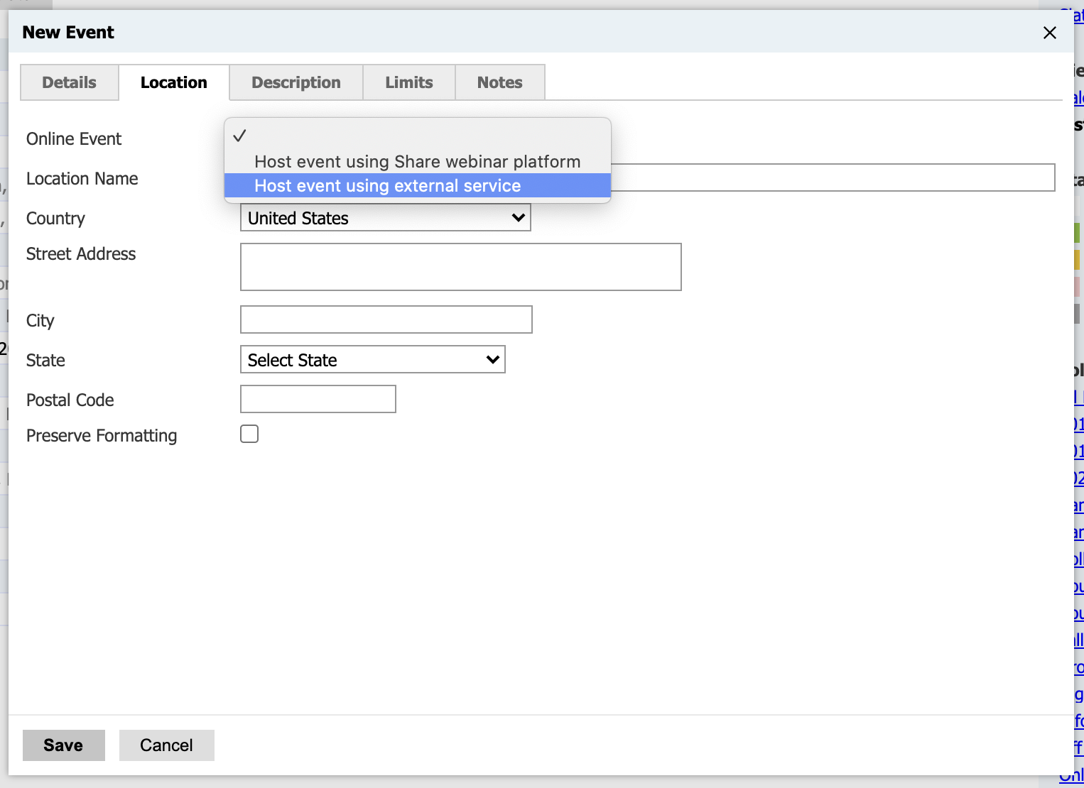
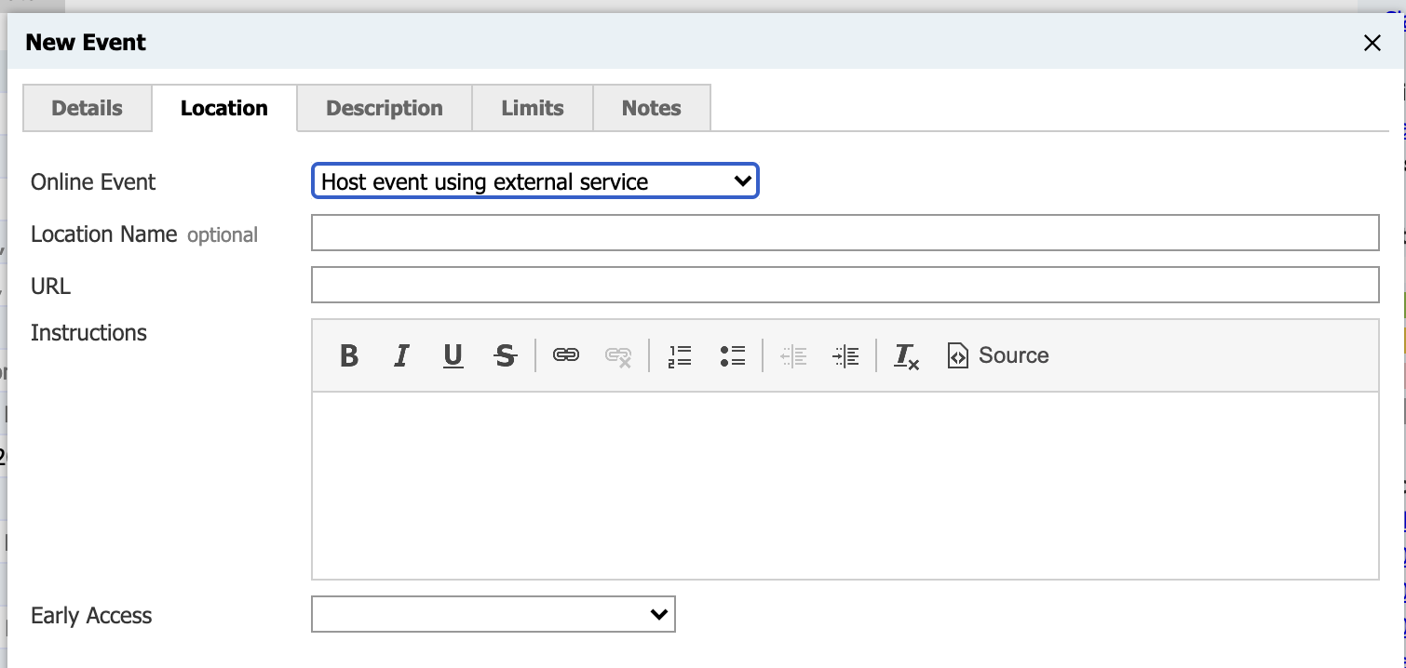
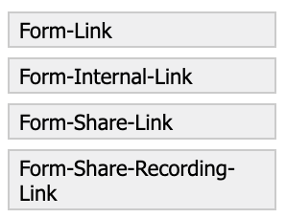
They’re almost virtually flawless
EVENTS
Same set up as any other event except…
Add your meeting or webinar URL
Use this merge field
for any comms
**Set your registration deadline to the end of the event

Slide 34

Strengths and weaknesses
PING
Strengths
Identity
Insight
Engagement
Stealth apps
Weaknesses
Reliability
Ease of use

Slide 35
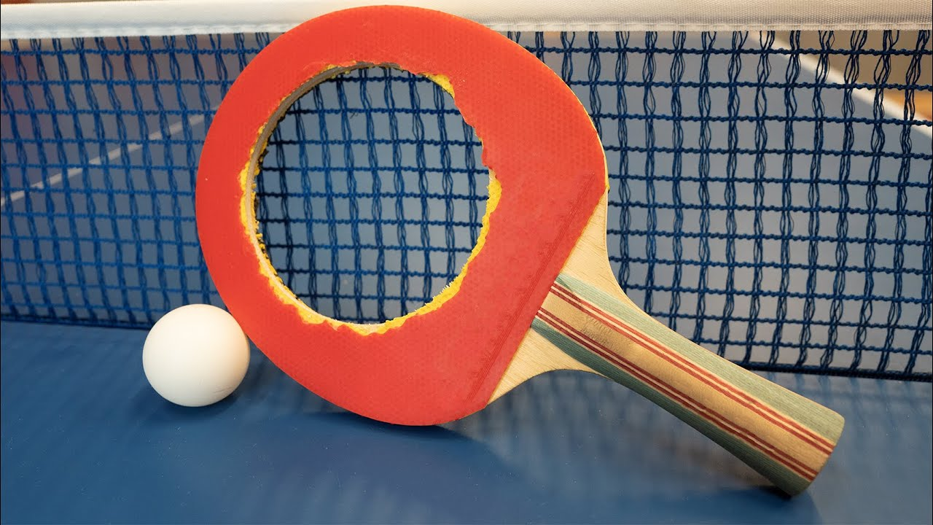
Ping doesn’t really pong
PING

Slide 36

Unlocking lead sources?
PING
Ping + Rules + Interactions
UTM via Ping as filter
Rule setting interaction based on UTM
Interactions based on ad campaign or agency
Queries and reports based on those interactions
Notes:
Slate KB:
Rule Configurations & General Use Cases
https://technolutions.zendesk.com/hc/en-us/articles/360033687111-Rule-Configurations-General-Use-Cases

Slide 37
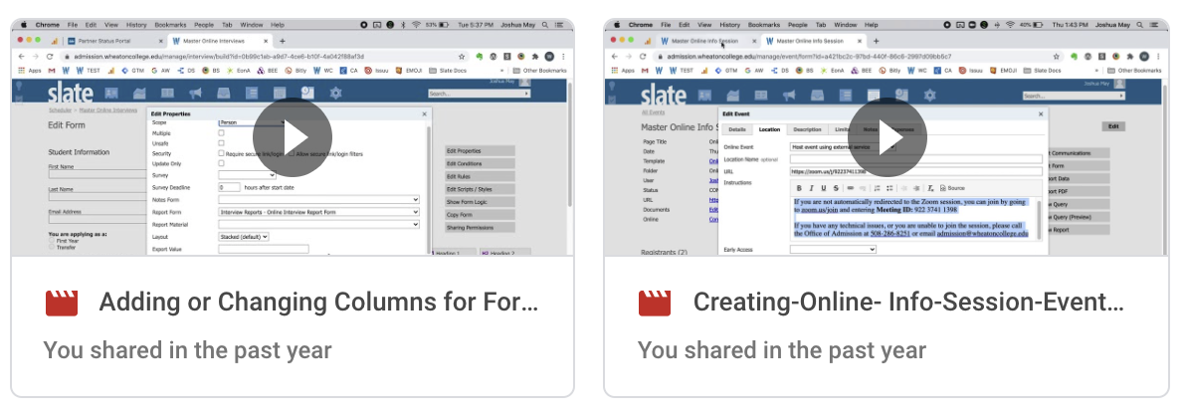
Videos are a great way to document
RANDOM

Slide 38
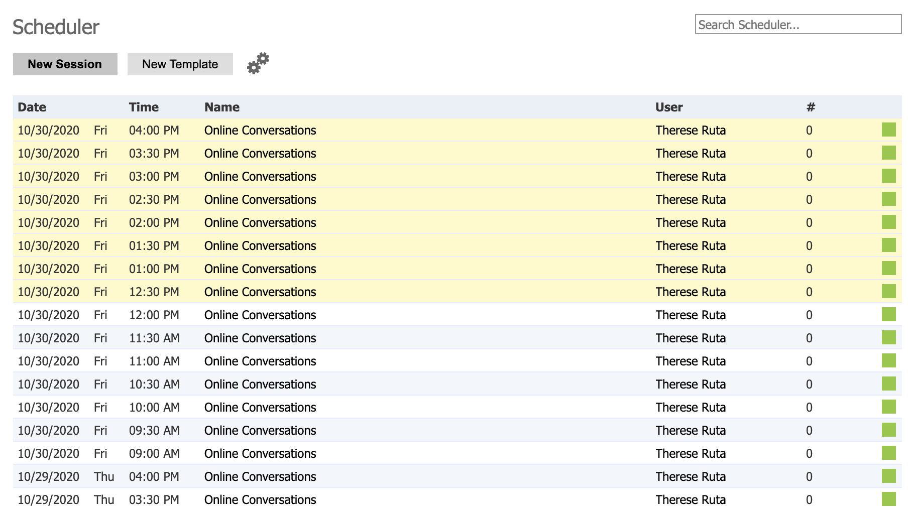
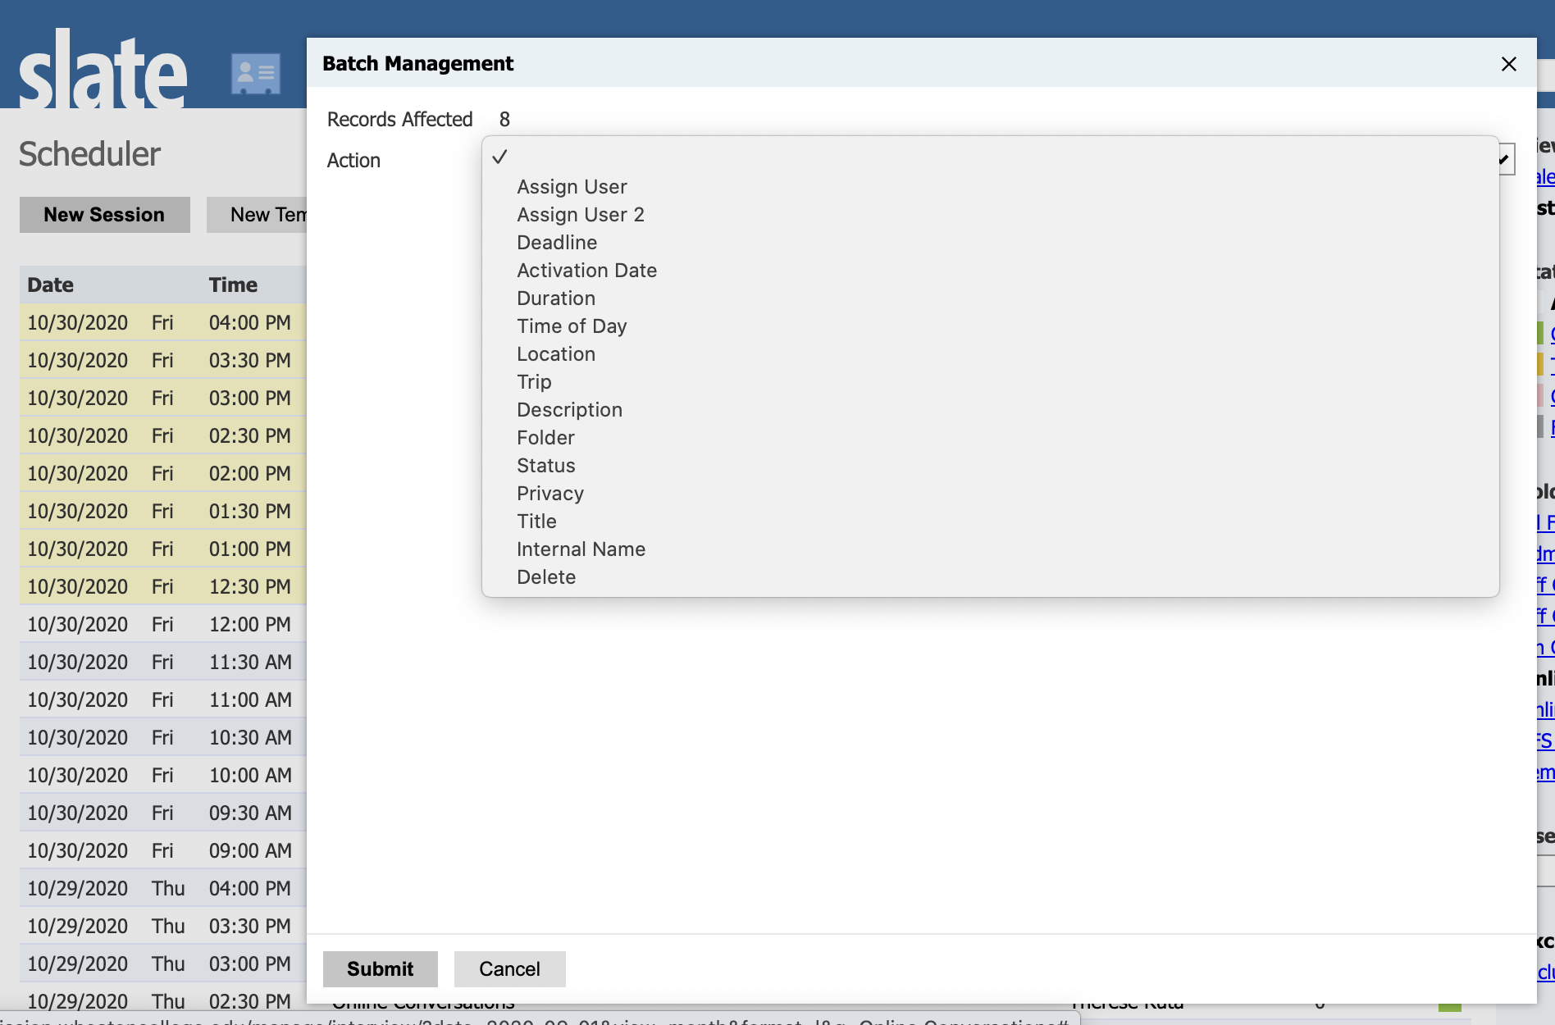
Oops: batch management
RANDOM
Notes:
Slate KB
Batch Managing Resources
https://technolutions.zendesk.com/hc/en-us/articles/360033173711-Batch-Managing-Resources

Slide 39
4 final thoughts
RANDOM
• Pin your favorite/most frequently used exports and filters for each query base—huge time saver • The Application query base doesn’t automatically suppress email sends to students who have opted out of comms—don’t forget to add the Tag filter + Not In + Opt Out • In Relationships, Parent 1 is always the father—just the way the table works—so be careful not to annoy moms by only CCing Parent 1 • And be careful CCing parents—if the parent opts out of messages it will also opt the student out—use the relationship base for parent queries and emails •
Was that 43 total?
Notes:
If you still have questions, give me a holler on Slack or email: may_joshua@wheatoncollege.edu

