Slide 1
Password Boss Business: Hacked
Partner To Customer Campaign - Social Assets
Facebook
LinkedIn
Twitter

Slide 2
Guidance for usage
Ready to go social ads to get started fast
Use only what you need, when you need it
Grow your business with Password Boss
Learn more
Follow these steps:
Banners may be used as-is, or you may insert your own logo as shown above.
Images are included as full size images. To copy an image, first enlarge the image in PowerPoint and then right-click the image and choose Save as Picture and select the format you need.
Copy has been provided for each asset; use accordingly.

Slide 3



Facebook
1200x628
  Copy:
  Weak passwords put your business at risk
  81% of security breaches use weak or stolen passwords. Saving passwords in spreadsheets and email is putting your business at risk. Password Boss make is simple to protect your business with strong passwords.
  Click here to learn more.
Password security made simple
Password security made simple

Slide 4


Facebook
1200x628
  Copy:
  81% of security breaches use weak or stolen passwords.
  The #1 security threat faced by most small businesses is poor password security. Password Boss shows you who is using hacked passwords. Strong password security, made simple.
  Click here to learn more.
Employees using hacked passwords?
Employees using hacked passwords?

Slide 5


LinkedIn
1200x627
  Copy:
  Weak passwords put your business at risk
  81% of security breaches use weak or stolen passwords. Saving passwords in spreadsheets and email is putting your business at risk. Password Boss make is simple to protect your business with strong passwords.
  Click here to learn more.
Password security made simple
Password security made simple

Slide 6


LinkedIn
1200x627
  Copy:
  81% of security breaches use weak or stolen passwords.
  The #1 security threat faced by most small businesses is poor password security. Password Boss shows you who is using hacked passwords. Strong password security, made simple.
  Click here to learn more.
Employees using hacked passwords?
Employees using hacked passwords?

Slide 7


Twitter
1200x675
  Copy:
  Weak passwords put your business at risk
  81% of security breaches use weak or stolen passwords. Saving passwords in spreadsheets and email is putting your business at risk. Password Boss make is simple to protect your business with strong passwords.
  Click here to learn more.
Password security made simple
Password security made simple

Slide 8

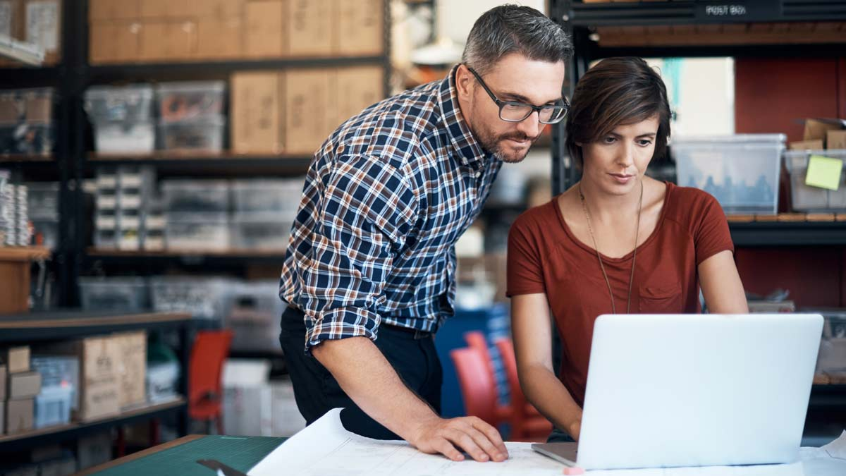
Twitter
1200x675
  Copy:
  81% of security breaches use weak or stolen passwords.
  The #1 security threat faced by most small businesses is poor password security. Password Boss shows you who is using hacked passwords. Strong password security, made simple.
  Click here to learn more.
Employees using hacked passwords?
Employees using hacked passwords?

