Slide 1
Value Propositions that Sell
Abdul Rastagar
www.linkedin.com/in/rastagar

Slide 2
Notes:
“millions of tracks for the price of one CD / month”
“$29,700 spent using iTunes. would have paid only $15/mo with Zune” (cost of filling 120GB iPad with music = $29.7)

Slide 3
About Me
I leverage unique leadership of strategery while optimizing action-oriented and dynamic alignment of business synergies to achieve maximized growth hacking
yields using flexible and sustainable ideation, innovating mission critical value-add competencies.

Slide 4
“Words are free; it’s how you use them that may cost you.”

Slide 5
Most Value Propositions Suck
“Star schema for query handling”
“Wizard-based application”
“Intelligent, scalable database”
“Meets your complex business needs”
“End-to-end machine learning platform”
“Broad SQL server engine compatibility”
Notes:
“millions of tracks for the price of one CD / month”
“$29,700 spent using iTunes. would have paid only $15/mo with Zune” (cost of filling 120GB iPad with music = $29.7)

Slide 6
MILLIONS OF TRACKS FOR THE PRICE OF
ONE CD A MONTH
EXPLORE NOW
Notes:
“millions of tracks for the price of one CD / month”
“$29,700 spent using iTunes. would have paid only $15/mo with Zune” (cost of filling 120GB iPad with music = $29.7)

Slide 7
Sell the problem you solve, not the product you make.
Notes:
https://www.pexels.com/photo/man-sitting-on-a-concrete-bench-373914/

Slide 8
4 Steps to Reframing
Context
Customers
Business Benefit
Differentiate
Understand market trends
Recognize pain points
Don’t talk features
Know your competition
Notes:
“millions of tracks for the price of one CD / month”
“$29,700 spent using iTunes. would have paid only $15/mo with Zune” (cost of filling 120GB iPad with music = $29.7)

Slide 9
Value Propositions done Right
“Increase customer satisfaction
through consistent data, simplified processes and accurate billing.”
“Maximize revenues
with a more efficient and productive sales organization.”
“Reduce risk and deployment time
via a standards-based integration.”
X%
$Y
Z%
Notes:
“millions of tracks for the price of one CD / month”
“$29,700 spent using iTunes. would have paid only $15/mo with Zune” (cost of filling 120GB iPad with music = $29.7)

Slide 10
Customers do not buy products Customers buy solved problems
Notes:
https://www.pexels.com/photo/dark-darkness-loneliness-mystery-1446948/

Slide 11
If it’s so easy... why doesn’t everyone do it?
Notes:
https://www.pexels.com/photo/people-wearing-denim-jeans-1353361/

Slide 12
Value propositions require differentiation
You
Market needs
Competitors

Slide 13
Case Study: Differentiated Value Proposition
Notes:
https://www.pexels.com/photo/person-holding-magnifying-glass-712786/

Slide 14
Understand the Context
R&D Spend vs. Innovation
50
50
Rising cost
40
40
Limited innovation
30
30
New products introduced
US$ Invested
Patent expiry
20
20
10
10
Greater compliance
0
0
Year 0
Year 10
Year 20
Year 30
Year 40

Slide 15
Understand the Competition
Vendor Differentiation

Slide 16
Value Proposition Workshop
Sales Consultants
Sales
Product
External validation
Alliances
Strategy
Marketing
Notes:
https://www.pexels.com/photo/people-on-sidewalk-selective-focal-photo-1687093/

Slide 17
Buying Committee
Procurement
VP of Business
Business Operations
End User
Information Technology

Slide 18
Know your customer
Procurement
Head of Business
Business Operations
End User
Information Technology
Cost
Compliance
Vendor Reputation
Features
Usability
Productivity
Effectiveness
Technology

Slide 19
Know the competition
 | Us | COMPETITOR A | COMPETITOR B | COMPETITOR C
Cost | -1 | 0 | 1 | 0
Compliance | 1 | 0 | 0 | -1
Vendor | -1 | 1 | -1 | -1
Features | 1 | 0 | 1 | 0
Usability | 1 | 0 | 1 | 0
Efficiency | 1 | 0 | 1 | 1
Effectiveness | 0 | -1 | 0 | 0
Technology | 1 | 1 | -1 | 0
Overall | 3 | 1 | 2 | -1

Slide 20
Differentiate
 | Us | COMPETITOR A | COMPETITOR B | COMPETITOR C
Cost | -1 | 0 | 1 | 0
Compliance | 1 | 0 | 0 | -1
Vendor | -1 | 1 | -1 | -1
Features | 1 | 0 | 1 | 0
Usability | 1 | 0 | 1 | 0
Efficiency | 1 | 0 | 1 | 1
Effectiveness | 0 | -1 | 0 | 0
Technology | 1 | 1 | -1 | 0
Community | 1 | 0 | 0 | 0
Overall | 4 | 1 | 2 | -1

Slide 21
Our Differentiated Value proposition
More Productive
Built-in Compliance
Unrivaled Network
27%
100%
400+
Notes:
“millions of tracks for the price of one CD / month”
“$29,700 spent using iTunes. would have paid only $15/mo with Zune” (cost of filling 120GB iPad with music = $29.7)

Slide 22
Win with Differentiated Value propositions
You
Market needs
Competitors

Slide 23
3x3 Value proposition Matrix
Greater Productivity
Avg. 27% productivity increase relative to incumbent system
Highly flexible workflows enable efficient processes
Fast user adoption and time to value
Built-in Compliance
100% compliant with all relevant regulations
Technology advisors to regulatory authority
Advisory council of industry thought leaders
Customer-centric benefit
Proof points
Unrivaled Network
Industry’s only professional peer networking community
Roadmap informed by broad set of users and partners
Extensive partnerships to maximize your investment
Notes:
“millions of tracks for the price of one CD / month”
“$29,700 spent using iTunes. would have paid only $15/mo with Zune” (cost of filling 120GB iPad with music = $29.7)

Slide 24
Value propositions inform your messaging
Sales pitch
PR & Comms
Presentations
Battle cards
Talking points
Thought leadership
Website
Collateral
Notes:
https://www.pexels.com/photo/group-of-people-holding-message-boards-1059116/

Slide 25
#Protip: your own value propositions
Human Resources
CEO
Boss
Direct Reports
Peers

Slide 26
Your Personal 3x3 Matrix
Reason #1
Reason #2
Reason #3
- Accomplishment A
- Accomplishment B
- Accomplishment C
- Accomplishment A
- Accomplishment B
- Accomplishment C
- Accomplishment A
- Accomplishment B
- Accomplishment C

Slide 27
My heart belongs to my children,
but my opinions are my own.
Abdul Rastagar
www.linkedin.com/in/rastagar

Slide 28
Appendix

Slide 29
Tech-talk to avoid
“Best of Breed”
“Scalable”
“Cloud”
“Integrated”
Feature-talk
“Technology”
“Innovative”
“Leading”

Slide 30
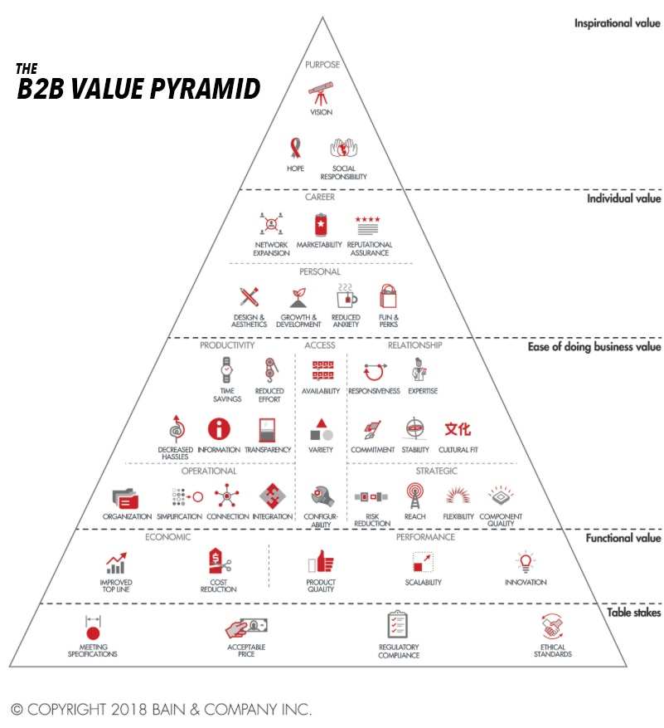
Notes:
Source: www.marketingjournal.org/the-elements-of-value-an-interview-with-jamie-cleghorn/

Slide 31
