Slide 1
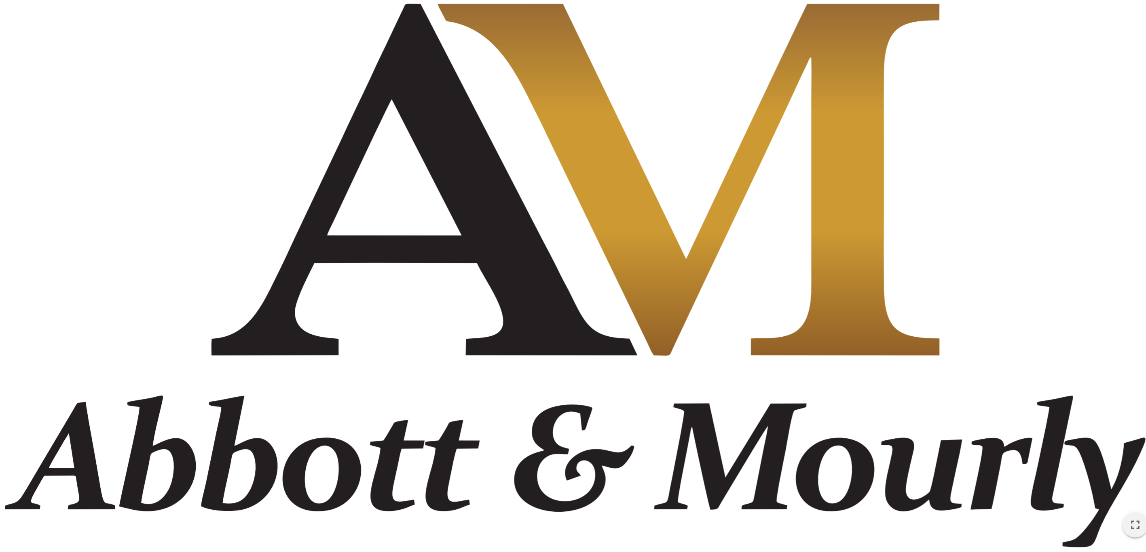


Estate Planning 101 Training
With Grant Abbott BEc LLM and Tony Anamourlis LLM

Slide 2
“If you die without a Will, you die intestate and all of your worldly assets are to be divided up according to each State’s intestacy laws. Generally it goes to the spouse, de facto, children and then parents – depending on who is alive. There are formulas in each state on who gets what but the big problem is the administration of the intestate estate is usually done by the Public Trustee and can cost many thousands of dollars.
So for all clients it is important to complete a Will and ideally at the same time an Enduring Power of Attorney. The Will may include a discretionary Testamentary Trust. Plus don’t forget about superannuation whether it is in a retail super fund or a SMSF. It is not called planning for no reason.
www.abbottmourly.com.au

Slide 3
Learning Outcomes
The Key to a Perfect Estate Plan
Common terms and what is a Will
Why is the Accountant and Financial Planner so important
The use of LightYear Docs for the build of a Will. The importance of the data capture
Abbott & Mourly can provide legal advice and legal professional privilege to your client for a set fee of $495 per person
Who can be an Executor and Trustee?
Specific bequests v Primary/Secondary/Tertiary Beneficiaries
The use and benefits of a Testamentary Trust
What is a Special Disability Trust
What to do with Super
What are Family Provisions Claims
www.abbottmourly.com.au

Slide 4

THE KEY TO A PERFECT ESTATE PLAN
Determine what is important to a person about looking after their family and loved ones when they die;
Create a blueprint to deliver the desired estate planning goals using the right combination of vehicles and life insurance if need be;
Make sure the plan is simple, certain and easy for all parties to understand before the person dies;
Ensure the person or persons left in charge of implementing the plan on behalf of the deceased know what they are doing or use experienced advisers to deliver the plan;
Ensure it is tax effective; and
Ensure it complies with the laws and any chance of legal disputation is minimised.
www.abbottmourly.com.au

Slide 5
Key Terms
Will – a legally valid document that details how a deceased’s estate is to be distributed amongst their family and charities
Executor – the person who administers the management of the deceased’s estate
Administrator – if there is no Executor and generally the Public Trustee
Beneficiary – a person designated to receive a gift (known as a bequest) from the deceased
Probate – the Executor applies to the Supreme Court to prove the Will is the last Will and Testament of the deceased
Initial Administration – Once probate is approved the Executor will pay off any debts, pay taxes, funeral expenses and do all things necessary to get the estate in order for payments
www.abbottmourly.com.au

Slide 6
Key Terms
Specific Gifts – these are the most important and are to be paid first by the Executor
Residual Estate – what is left over after the payment of the specific gifts
Main or Principal Beneficiary – After the specific gifts one or more principal beneficiaries are to take the remainder of the estate
Secondary Beneficiary – a person designated to receive the remainder of the estate in the event that there is no Principal Beneficiary
Renunciation – the beneficiary renounces their entitlement for tax or social security reasons
Testamentary Trust – a trust established out of the Will by the Executor to hold a specific gift or part/whole of the residual estate for beneficiaries nominated as beneficiaries of the trust. Need a trustee which is usually the Executor.
www.abbottmourly.com.au

Slide 7

THE IMPORTANCE OF THE ACCOUNTANT AND PLANNER
Accountant
Abbott Mourly
Planner
UNITY
Client Needs and Requirements
TRANSPARENCY
www.abbottmourly.com.au

Slide 8
Review of the Law - Tony Anamourlis from Abbott & Mourly
Actions that are legal services and the provision of legal advice
  drawing and drafting documents of a legal nature;
  giving legal advice
  appearing in Court
  drafting a Will from scratch; or
  using the name of barrister, solicitor, Australian legal practitioner or any other name used to describe someone who is qualified to engage in legal practice.
www.abbottmourly.com.au

Slide 9
Review of the Law
Actions that are NOT legal services nor legal advice
Undertaking work in association with the law will not necessarily constitute engaging in legal practice. Examples may include:
  clerical or administrative tasks such as inserting parties’ names in a document;
  preparing Wills from a data capture
  selling of legal documents; or
  advising of incidental legal requirements by a person in the pursuit of an occupation other than law - tax agents advising on the requirements of tax legislation.
www.abbottmourly.com.au

Slide 10
Wills Case Study
John Smith has a house which is jointly owned with his wife Sally Smith
John has $200,000 in share investments in his own name and $550,000 in a SMSF super fund pension which has a reversion to Sally
He also owns personally a commercial property valued at $500,000 that his son Max uses for his spray painting business
Max is 40 and John’s favourite child and John wants to give him the property outright while his two daughters Sarah and Jody are to receive $100,000 each. Sally gets the house and the super pension
If Sally dies or is not alive her pension is to go to Max’s disabled child William.
If one of the children dies their share is to be given to their children and if there are no children then to be shared to John’s remaining children. At this time only Max has two children, Ben and William who are early teenagers with William being disabled
www.abbottmourly.com.au

Slide 11
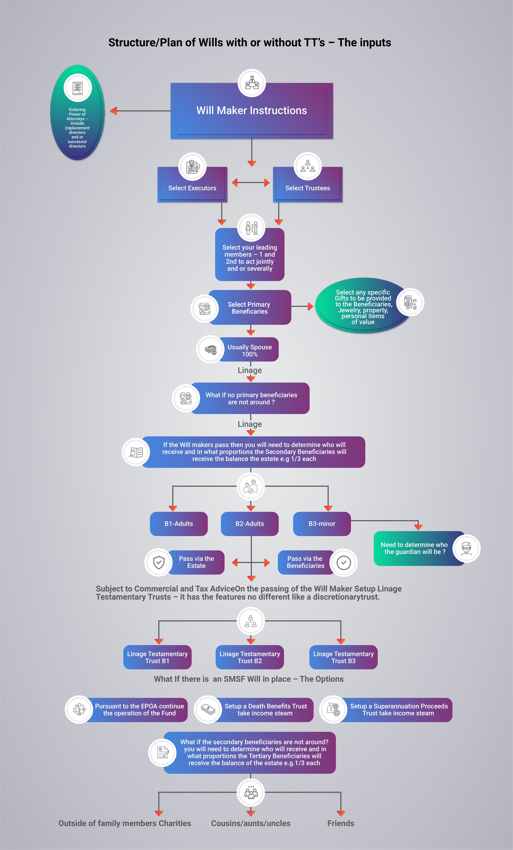
Building an Estate Plan - Flowchart
www.abbottmourly.com.au

Slide 12
Most Important – The Executor’s Role
In making a Will, it is necessary to appoint at least one executor and trustee.
The executors role is to administer the estate in accordance with the terms of the will. Which includes:
  locating the will and arranging the funeral
  obtaining probate
  ascertaining the assets and liabilities
  discharging the liabilities
  distributing the balance of the estate and preparation of a distribution report for the beneficiaries
  lodging tax returns and pay the applicable taxes
www.abbottmourly.com.au

Slide 13
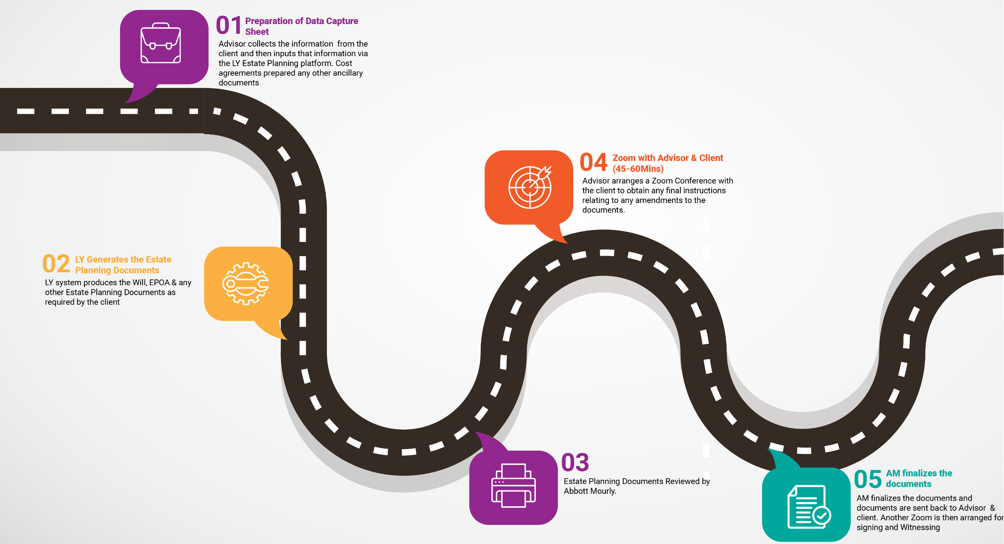
The Steps involved in getting Abbott & Mourly Legal Advice
www.abbottmourly.com.au

Slide 14
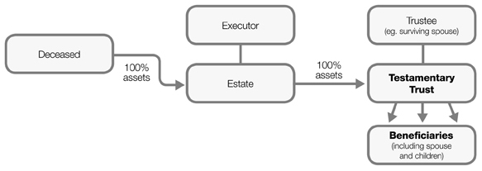
A Simple Testamentary Trust
lightyeardocs.com
www.abbottmourly.com

Slide 15
Correctly building a Testamentary Trust
Trustee of a testamentary trust can be your surviving spouse or child (as the case may be). If flexibility is desired the trustee will control the gift as if they own the assets in the trust but will enjoy the protection afforded by the trust
If you wish to restrict the control your spouse or child has over the trust assets you can:
Use a third party as trustee, but still retain a discretionary trust.
Add a third party as a joint trustee along with your spouse or child, but still use a discretionary trust.
Regardless of who the trustee is, restrict access to the capital in the trust by only allowing access to income and/or a percentage of the capital as determined by you (i.e. use a capital protected trust rather than a discretionary trust)
Other special forms of trust (some with special taxation relief) are available and we can discuss these if appropriate. For example, trusts set up for a disabled person or to fund education of children may qualify for special taxation treatment.
lightyeardocs.com
www.abbottmourly.com

Slide 16
The principal advantages of incorporating Testamentary Trusts in Wills
A testamentary trust is designed to provide maximum flexibility and allow for tax-effective distribution of capital and income as well as providing possible protection of your beneficiaries from third parties such as creditors.
Trusts allow for optimum allocation of income and capital, which in turn may permit beneficiaries to qualify for aged, disability and sole parent pensions, Austudy or the like, for which they would otherwise not have qualified under a normal inheritance.
The incorporation of testamentary trusts into a Will is not relevant to every situation but, in many cases, they offer valuable advantages over simple Wills. Testamentary trusts – which can be discretionary trusts, capital protected trusts or tailored to the client’s requirements, are similar in many respects to trusts created by deed whilst you are alive.
www.abbottmourly.com

Slide 17
Why Discretionary Testamentary Trusts
Allows the beneficiary to use, invest, change and control assets freely
Generally the beneficiary is also the trustee of their own trust. A third party can be appointed trustee in place of, or in addition to, the beneficiary where there is good reason. Examples include where the beneficiary is facing bankruptcy, matrimonial problems or has limited capacity to manage their own finances
Generally few restrictions are placed on how the trustee is to manage or maintain the assets. The trustee can dispose of all assets as he or she sees fit. Once you leave the assets to a beneficiary by way of this type of trust, the trustee/beneficiary will have total control, unless restricted through the intervention of a third party trustee whose consent is required. This type of trust provides maximum flexibility for tax purposes
It also provides protection of assets for your beneficiaries from third parties in the event of bankruptcy or family breakdown
The nature and extent of the available protection varies and is subject to changes that may occur in the law from time to time. If this is an important aspect of your estate planning the issue of protection should be specifically addressed. For example assets in a testamentary trust are often treated as a ‘resource’ available to a party to a marriage.
lightyeardocs.com
www.abbottmourly.com

Slide 18
Asset Protection Issues for Beneficiaries
Testamentary Trusts – In leaving equity in the business, or any other assets to the children who maybe directors of the business or otherwise exposed to personal liability, it would be recommended to make provision in the Will for Testamentary Trusts.
Wills may provide that individual testamentary trusts may be established for each child as primary beneficiaries. This would provide some asset protection for those children in at risk occupations or positions and may quarantine assets from the jurisdiction of the Family Court.
Although the Family Court has become more inclined to treat trust assets as assets of the marriage and, while they are unlikely to be required to be transferred to a spouse, they could well be included in the value of the matrimonial assets, resulting in the spouse receiving a larger share of non-trust assets. (See Essex v Essex 209 Fam CAFC 236, there the court found that the assets of a discretionary trust were a financial resource of the husband even though the trust was controlled by the husbands brother.
lightyeardocs.com
www.abbottmourly.com

Slide 19
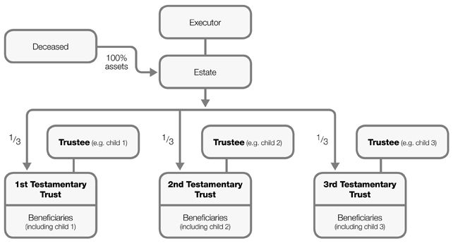
Testamentary Trust Will for three children
lightyeardocs.com
www.abbottmourly.com

Slide 20
Why use Multiple Testamentary Trusts
Trustee of each testamentary trust is one of the children. If flexibility is desired, the trustee will control the gift as if they own the assets in the trust but will enjoy the protection afforded by the trust.
If you wish to restrict the control a child has over the trust assets you can:
  Use a third party as trustee, but still retain a discretionary trust
  Add a third party as a joint trustee along with your spouse or child, but still use a discretionary trust
Regardless of who the trustee is, restrict access to the capital in the trust by only allowing access to income and/or a percentage of the capital as determined by you (i.e. use a capital protected trust rather than a discretionary trust)
Other special forms of trust (some with special taxation relief) are available and we can discuss these if appropriate. For example, trusts set up for a disabled person or to fund education of children may qualify for special taxation treatment
www.abbottmourly.com

Slide 21
Different outcomes by Incorporating a Testamentary Trust
Protecting your wealth from unjust claims
When assets pass directly to one of your beneficiaries the assets immediately become available to any person who makes a claim against them. This includes their creditors if they are in financial difficulty, or an estranged spouse or other relatives if they are going through relationship troubles. If instead your assets pass into a testamentary trust, the assets benefit from a higher level of protection from such claims.
Keeping your assets within your bloodline
When your asset pass directly to your spouse, it is not ordinarily possible for you to ensure (“from the grave”) that your children are provided for – particularly if your spouse remarries and has other children. A testamentary trust can be used to give your spouse control over the annual income from the assets (and possibly some capital), but at the same time provide for the assets to ultimately pass to your children (and in turn your grandchildren, i.e. down you blood line). At the least a testamentary trust will ensure that your children will have a say in how and when the assets are disposed of, and what happens to the cash.
www.abbottmourly.com

Slide 22
Different outcomes by Incorporating a Testamentary Trust
Marginal rates of tax for kids – turn kids into adults for tax purposes
Income that is distributed to children under 18 from an ordinary trust is subject to what is termed the “kiddie tax”. This tax applies at the flat rate of 46.5%, i.e. the child does not get the benefit of the tax-free threshold and the graduated marginal rates of tax.
However, children under 18 do qualify for these tax concessions on income that they receive from a testamentary trust. This can potentially save a large amount of tax over the life of the testamentary trust, although care must be taken about how the testamentary trust is administered, and how the income distributions to your children is recorded.
Capital gains tax and stamp duty flexibility
  When you die and an asset passes to directly to one of your beneficiaries, a transfer of all or part of that asset to another person will trigger CGT and stamp duty for that beneficiary. This is because the beneficiary has a “fixed interest” in the asset from the time of your death.
  For example, if you have two children and each is given an equal share in two houses – and if they decide to take one house each – CGT will be triggered on 50% of each house. (In some states there are also stamp duty consequences.) This is because each child is transferring a half interest in each house to the other child. However, if both houses pass into a testamentary trust, each child can usually take a single house without triggering CGT (or stamp duty). This can greatly reduce the cost of restructuring entitlements under an Estate.
www.abbottmourly.com

Slide 23
Different outcomes by Incorporating a Testamentary Trust
Giving assets to your kids over time (the “second chance trust”)
It is well recognised that giving a child significant money at an early age is not good for them. However, it is ordinarily difficult to prevent a child beneficiary getting their hands on an asset when they reach 18. A testamentary trust can provide a high level of control and certainty as to when your children gain access to particular assets – and for what purpose.
It is possible to stagger the gifting of your assets over time (for example, when your children reach 21, 25, 30, etc), or to tie the release of your assets to particular events or uses. For example, it is possible to tie a gift to the purchase of a house, education or overseas travel.
Staggering when your children receive assets also gives them a “second chance” if they make financial mistakes earlier in life. They don’t have to lose their inheritance all at once.
Income flexibility – reduce as well as spread the burden of tax
When an asset passes directly to one of your beneficiaries, that person then becomes taxable on all the income from that asset. Whereas, if the asset passes to the trustee of a testamentary trust, the trustee can choose how to distribute that income from year to year. This enables the trustee to take advantage of the lower marginal rates of tax of one or more potential beneficiaries.
www.abbottmourly.com

Slide 24
Special Disability Trust
What is a Special Disability Trust and why would you need one?
  A trust is a legal relationship between a trustee and a beneficiary. The nature of the legal obligation requires a trustee to look after trust property and funds for the benefit of another.
  A Special Disability Trust (SDT) is a special type of trust that allows parents and immediate family members to plan for current and future needs of a person with severe disability. If an immediate family member transfers assets into the SDT, generous concessions are available to benefit both the contributor and the beneficiary. Tax and social security concessions are intended to encourage family members to make future arrangements for a beneficiary with a severe disability.
www.abbottmourly.com

Slide 25
Key Benefits of a Special Disability Trust
The key benefits of an SDT are:
  Forward planning: Legal planning can ensure that the ongoing needs of a beneficiary continue to be met, even in circumstances where family members or a primary carer can no longer provide assistance.
  Control of assets: A trustee has a legal obligation to safeguard and hold the assets for the benefit of the beneficiary.
  Social security:
  A gifting concession of up to $500,000 (combined) is available for eligible immediate family members of the principal beneficiary; and
  An assets test assessment exemption of up to $$694,000 (current as at the 2020/21 financial year and indexed each year on 1 July) is available to the principal beneficiary
Taxation benefits and exemptions:
  Net income on the trust’s assets is taxed at a lower personal income tax rate; and
  Capital Gains Tax exemptions.
www.abbottmourly.com

Slide 26
Superannuation
How to plan for superannuation will depend on whether it is a SMSF or retail super fund
For retail super fund you can pay directly to a dependant which includes a spouse, child or financial dependant. If the Fund Trustee allows a child dependant can take a pension if they are under 25 and financially dependant but only until age 25. A dependant who is not a child can take a pension. Alternatively death benefits can be paid to the deceased’s legal estate. Important to secure with a binding death benefit nomination (BDBN laws only apply to retail super funds)
If in a SMSF, it is the same as retail fund with the addition of:
  A SMSF Will as a broader and more secure set of binding directions for the Trustee of the Fund
  Can be paid to bloodline only
  Multi-generational pensions can be offered to dependants (subject to child dependant exclusions)
  A lump sum can be paid to a dependant for payment to a trust, company or int a SMSF Testamentary Trust outside of the Will
www.abbottmourly.com

Slide 27
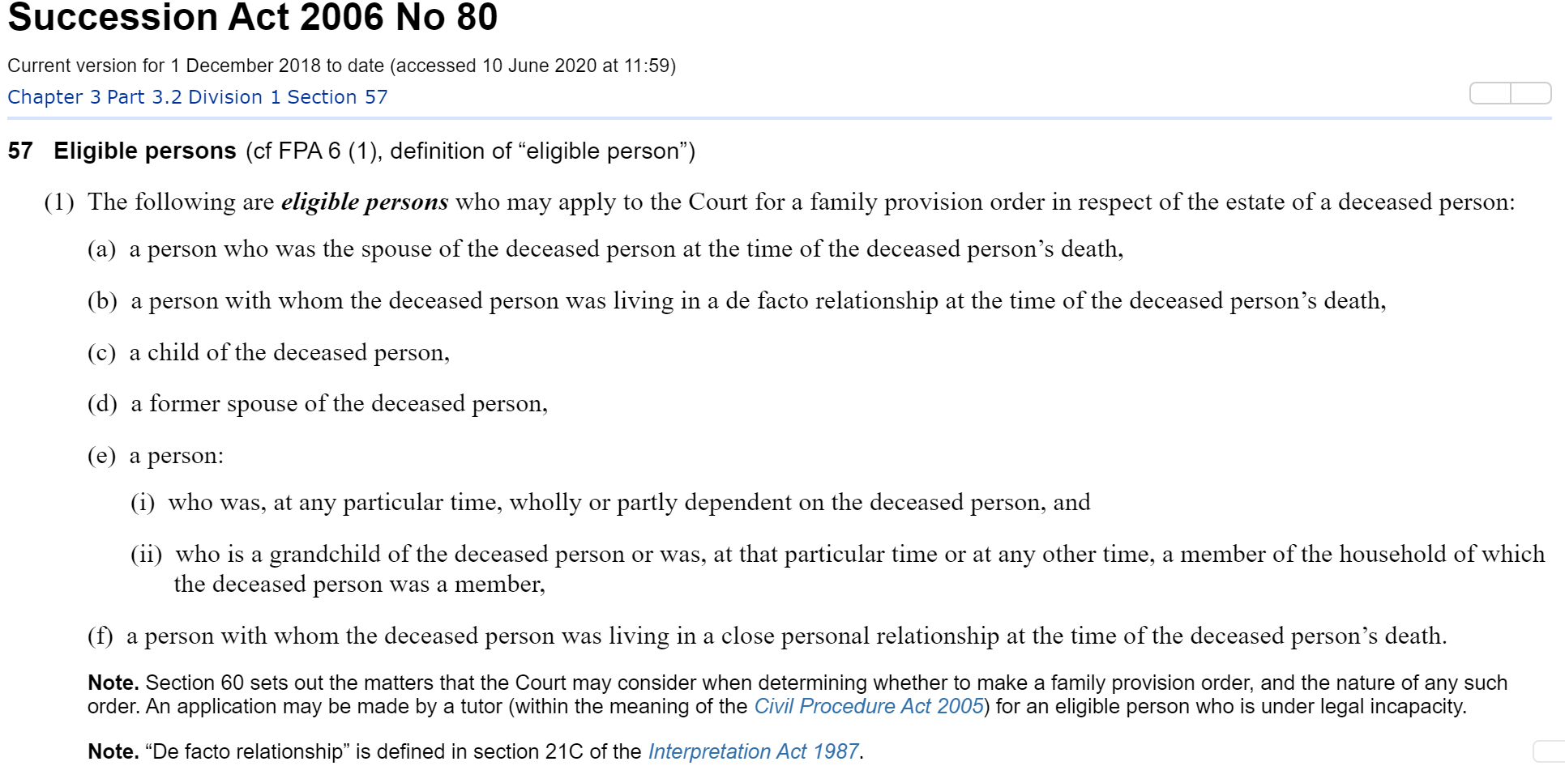
Watch out for Family Provisions claims
For lawyers they are a gold mine as it means long term, fully paid fee work with no real chance of a settlement
Only need to find an eligible person which includes:

