Slide 1
Prospects for International and Reserve Currencies
(and the dollar’s prospects)
Barry Eichengreen
October 21, 2021

Slide 2
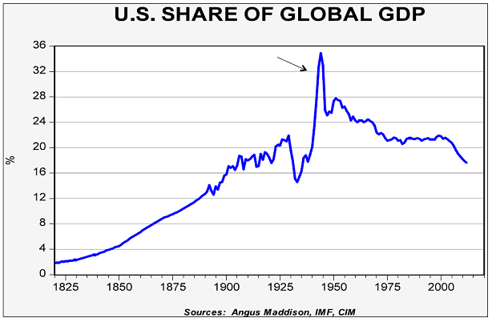
Clearly, a multipolar system is coming

Slide 3
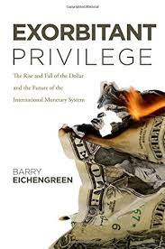
I argued this a decade ago
I’ll keep arguing this until I’m right…

Slide 4
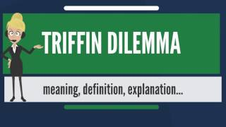
But the logic for the argument, at least, remains intact

Slide 5
But what form of multipolarity?
The Euro?
The RMB?
SDRs?
Stablecoins?
CBDCs?

Slide 6
Factors holding back the euro
Shortage of AAA-rated government securities to be held as reserves by corporate treasurers and central bank reserve managers.
  Because European finance is bank based.
  Because only a handful of European sovereigns are AAA rated.
  Because most of those securities are held to meet capital requirements by European banks or have been hoovered up by the ECB.
  Although a greatly scaled up European Recovery Fund could change this, the existing ERF is peanuts.
    Will it in fact be scaled up, or is it a one-off?

Slide 7
In the case of the euro, the obstacle is dearth of AAA-rated public-label assets

Slide 8

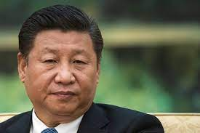
Factors holding back the RMB
Residual capital controls
Fears that the rules of the game can be changed arbitrarily.
  Lots of rules have in fact been changed recently.
  How I like to put this when I visit China…

Slide 9
Evergrande?
A meltdown of the Chinese financial system wouldn’t be good for the RMB’s prospects.
  To put an understated gloss…
But such a meltdown is unlikely: the PBOC recognizes its LLR responsibilities (having injected some $14 b. into the financial system through reverse repos last month).
It can compel the big banks to continue to provide essential funding while gradually selling off Evergrande’s remaining assets (land).
Recall how the dollar’s role was not significantly tarnished by the Subprime Crisis.
  So I don’t see this as significantly changing the picture.

Slide 10
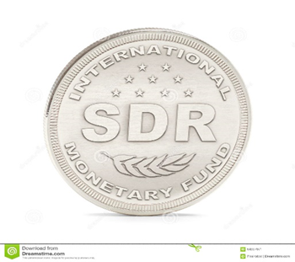
SDRs
Little commercial use means that there is little incentive to hold reserves in this form.
And little commercial use will remain the case because the SDR is no one’s natural habitat.
  (Think of Facebook’s initial Libra design.)
Moreover, there is no SDR lender of last resort to backstop the market.
  Which will remain the case so long as (because) there is no global government.

Slide 11
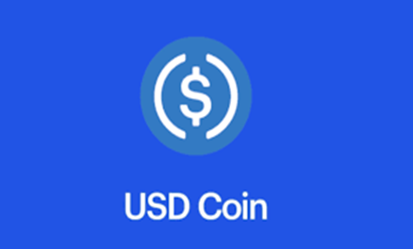
Stablecoins
One can imagine a basket- or dollar- based stablecoin that comes into widespread private use globally.
It starts with use in payments. Those who use it in payments then begin borrowing and lending it. This is how the evolution of international currencies has worked historically.
In which case central banks will also want to hold it in order to intervene in markets and use it in LLR operations.
But will stablecoins really be stable?
  (And if 100% reserve backed, will they scale?)
And won’t central banks, reluctant to lose control of the payments system, regulate them out of business?
  Hello Alipay…

Slide 12
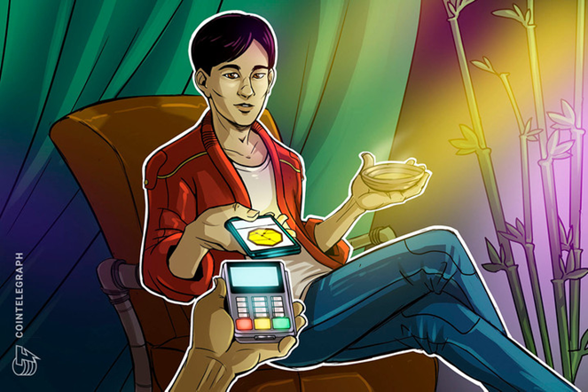
Will an e-RMB make a difference?
Not when it is used only for retail payments.
Not when it can be used only when resident in China.
Not when there are doubts about confidentiality and anonymity.

Slide 13
And digital currencies more generally?
Every currency would be as easy to use internationally as every other.
First in payments, and then generally.
But interoperability is a hard nut to crack.
  Create a corridor as in the HK-Thailand experiment?
  Allow multiple CBDCs to run on a single blockchain?
  In your dreams…

Slide 14
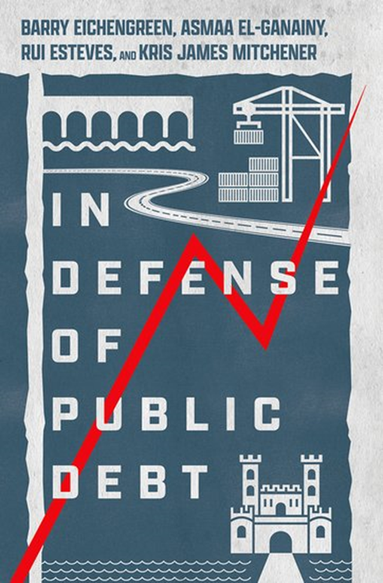
Could flight from the dollar force the pace of reserve and payments diversification?
With r-g = -4% and a debt/GDP ratio of 100%, US can run primary deficits of 4% of GDP without the debt rising.
Primary deficit is 14% of GDP this year, forecast to be 6% next year (on current law – more with 2 infrastructure packages).
So some, but not an overwhelming amount of fiscal effort will be required.
A bit more as growth slows (due to fiscal drag) and if (when) interest rates rise.
Can a polarized political system deliver this?

Slide 15
The debt ceiling imbroglio
We’ve had government shutdowns without significantly damaging the role of the dollar.
But we’ve always averted debt defaults in the past.
My best guess is that the Dems will attach a debt ceiling increase to the reconciliation bill and vote it through on a strictly partisan basis in December to again avert this. But will they succeed in doing so in time? Will the Senate parliamentarian let them? If not:
  Fed has said it will continue to purchase defaulted debt and accept it as collateral.
  But investors (including reserve managers) will surely take note.
  Countries have succeeded in recovering from the financial consequences of default only on putting significant reforms in place (as we describe in the book). Can a polarized US polity succeed in doing this?

Slide 16
Thank you.

