Slide 1
Stealthy Wealth
Which ETF Should I Invest In?
This is not financial advice – just my approach
www.stealthywealth.co.za
@stealthy_wealth

Slide 2
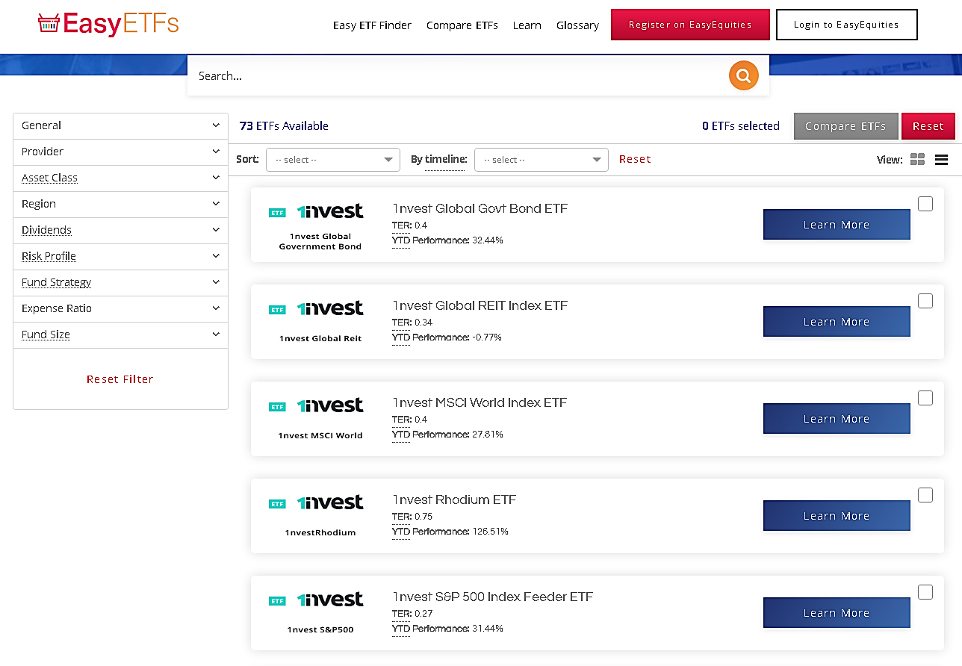
Available ETFs

Slide 3
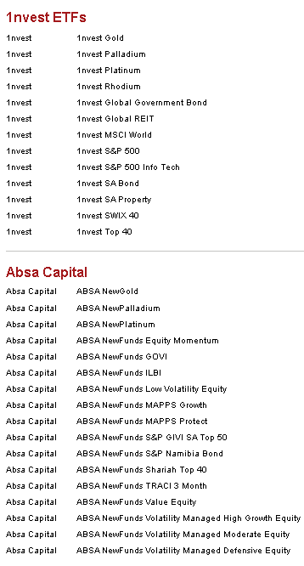
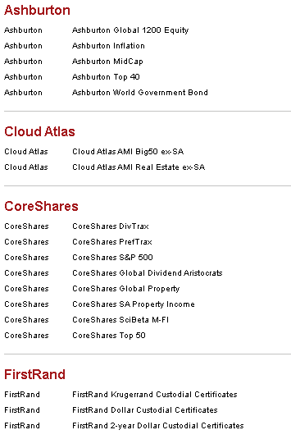
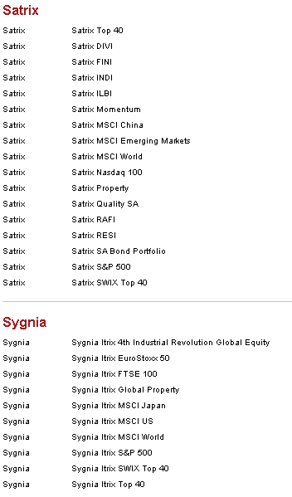
Available ETFs

Slide 4
Which ETF Should You Invest In?
…
…
IT DEPENDS
It’s a decision only you can make – no one can choose for you

Slide 5
My Approach
Long before I decide on what products I want to invest in, I take a big step back.
I ask myself two questions:
Which asset classes are best suited to me and my goals?
How much local exposure, and how much offshore exposure do I want?
Only after I am comfortable with the above two answers, do I ask the question:
3. Which products/ETFs should I be investing in?

Slide 6
Your Time Frame
This is probably the most important factor
When do you need the money?
The longer your time-frame, the more risk you can afford to take
Drives what is known as your “asset allocation”

Slide 7
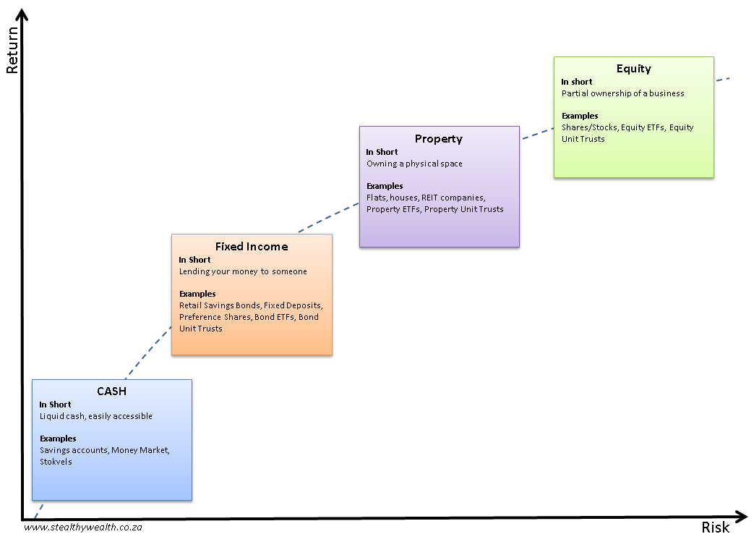
Your Time Frame

Slide 8
Your Time Frame
My decision:
I have a long term view - 10 Years +
I understand the risks of investing in equities
80% Equities
20% Listed Property

Slide 9
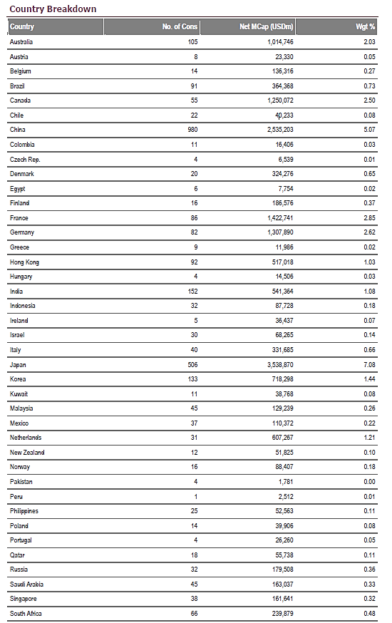
Local Or International?
Two schools of thought:
You earn in Rands, you spend in Rands, you probably going to retire in Rands => Invest in Rands.
Not very diversified
South Africa makes up less than 1% of the World’s economy – why should you have more than 1% of your investment in South Africa?
Spreading your investments reduces your risk

Slide 10
Local Or International?
My decision:
50% Local
50% International

Slide 11
Putting It All Together
My decisions:
80% Equities
20% Listed Property
50% Local
50% International
40% Local Equities
40% Offshore Equities
10% Local Property
10% Offshore Property
But this is over my whole portfolio. Don’t forget about
Pension Funds
RA’s
TFSA’s
etc
There’s an ETF for that!
There’s an ETF for that!
There’s an ETF for that!
There’s an ETF for that!

Slide 12
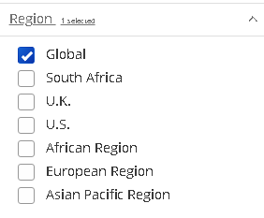
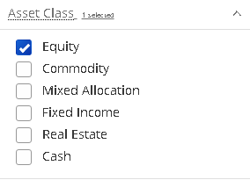
Putting It All Together
Once I know my asset allocation and geographic exposure, I use ETFs as building blocks
Global Equities

Slide 13
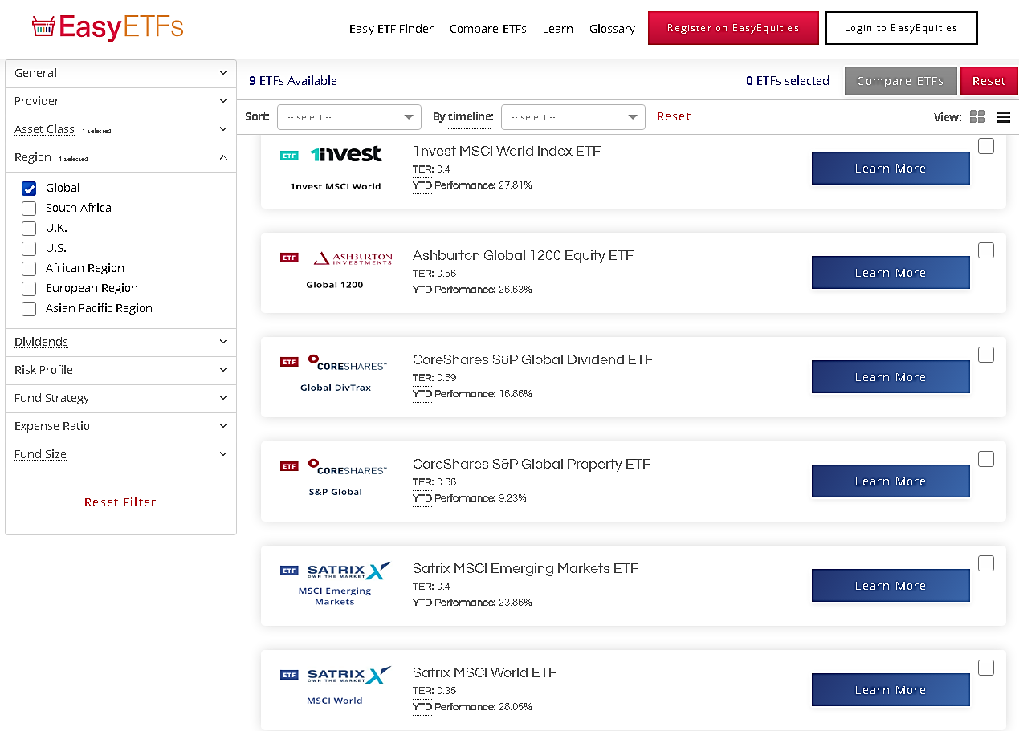
Putting It All Together

Slide 14
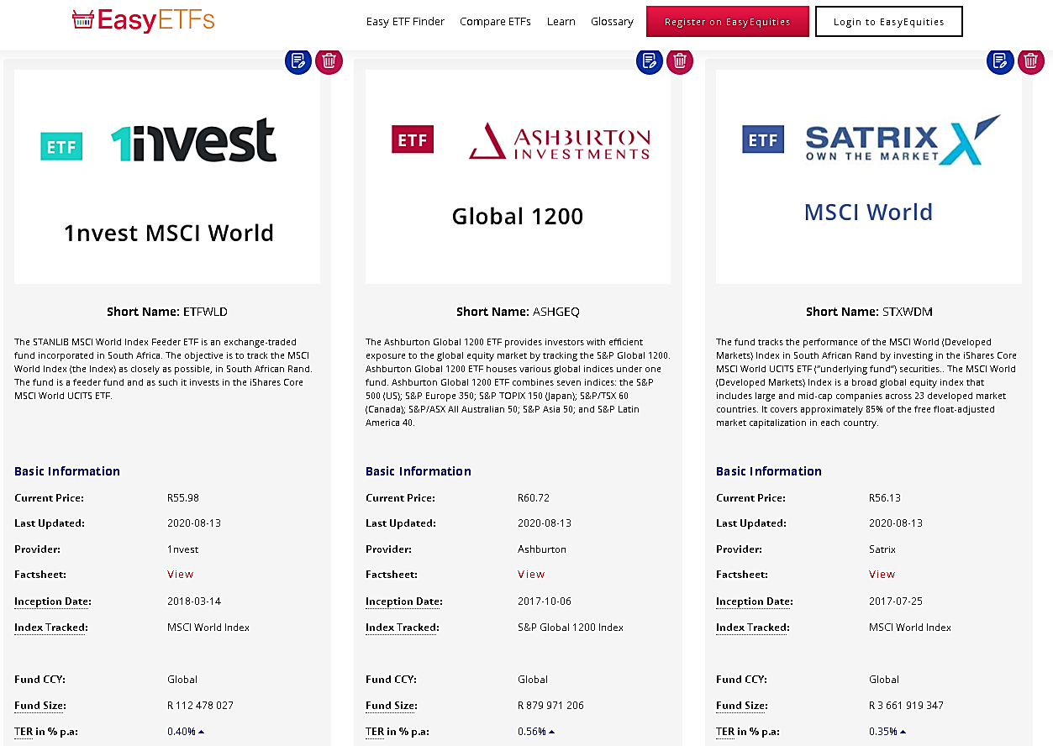
Putting It All Together

Slide 15
Putting It All Together – My Preferred ETFs
(NOT A RECOMMENDATION TO INVEST IN THESE)
Local Equities – Satrix 40
Invests in 40 of the biggest companies on the JSE
Naspers, Woolworths, Standard Bank, BHP Billiton, Discovery
TER – 0.1%
Global Equities – Satrix MSCI World
Invests in over 1600 different companies across 23 different countries
Apple, Microsoft, Amazon, Facebook, Johnson & Johnson
TER – 0.35%
Local Property – Satrix Property
Invests in the biggest listed property companies on the JSE
TER – 0.28%
Global Property – Sygnia Itrix Global Property
Invests in 40 leading global property companies in 8 different countries
TER – 0.26%

Slide 16
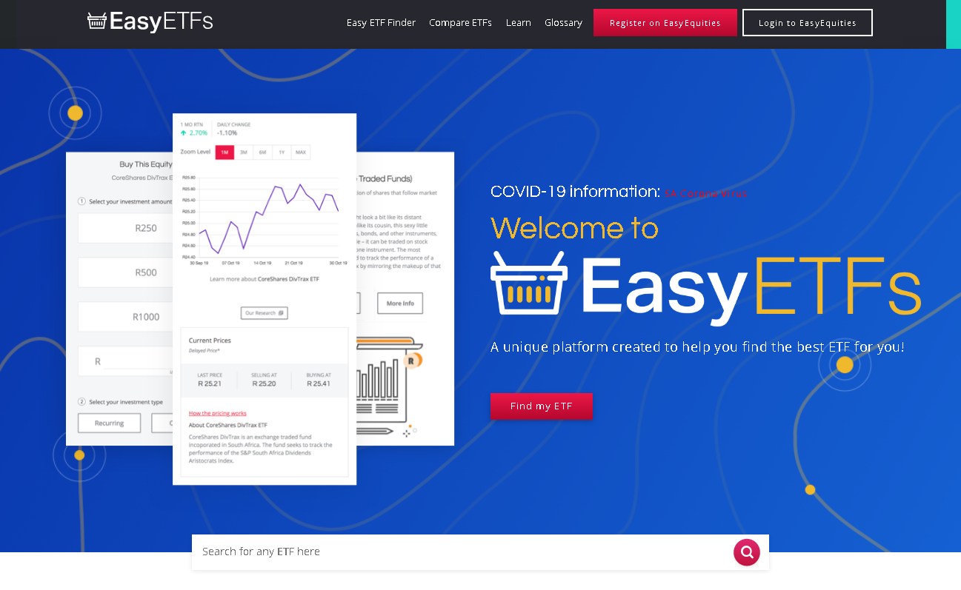
ETF Resources
EasyETFs https://etfs.easyequities.co.za/

Slide 17
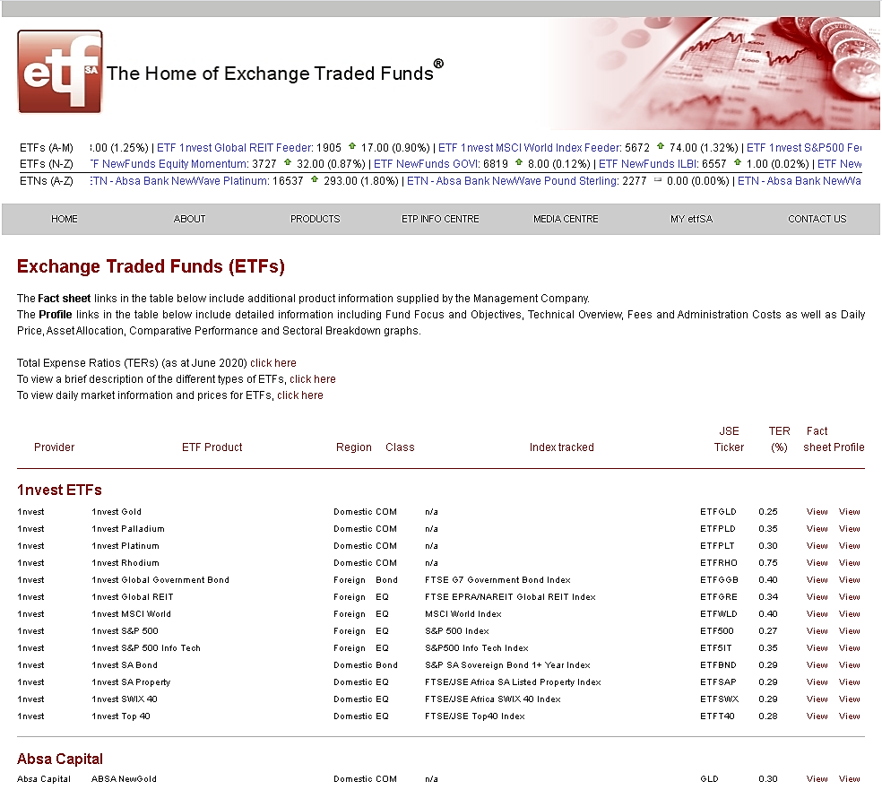
ETF Resources
ETFSA http://www.etfsa.co.za/ETFs.htm

Slide 18
Questions?

