Slide 1
Stealthy Wealth
ETFs Inside a TSFA
This is not financial advice, and I am not a Tax expert
www.stealthywealth.co.za
@stealthy_wealth

Slide 2
ETFs and TSFAs = Awesome

Slide 3
ETFs

Slide 4
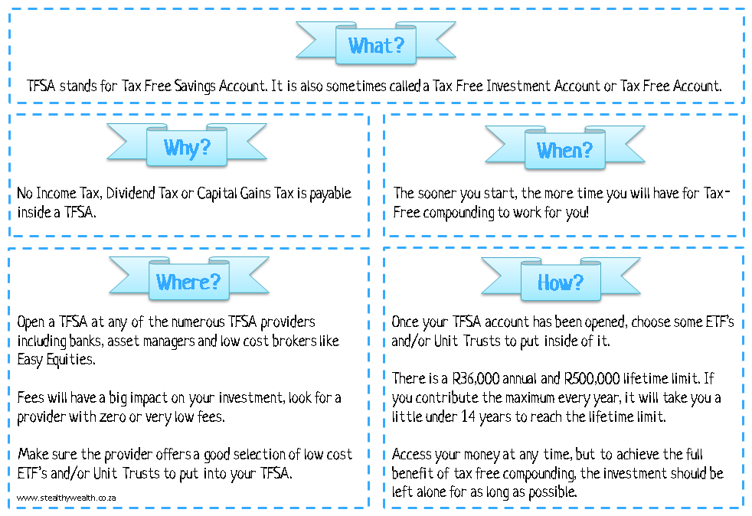
TFSAs

Slide 5
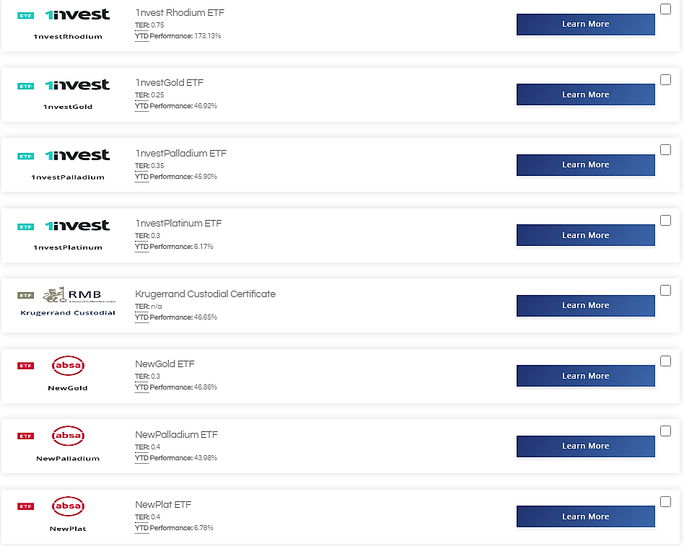
Which ETFs?
Not allowed – Commodity ETFs

Slide 6
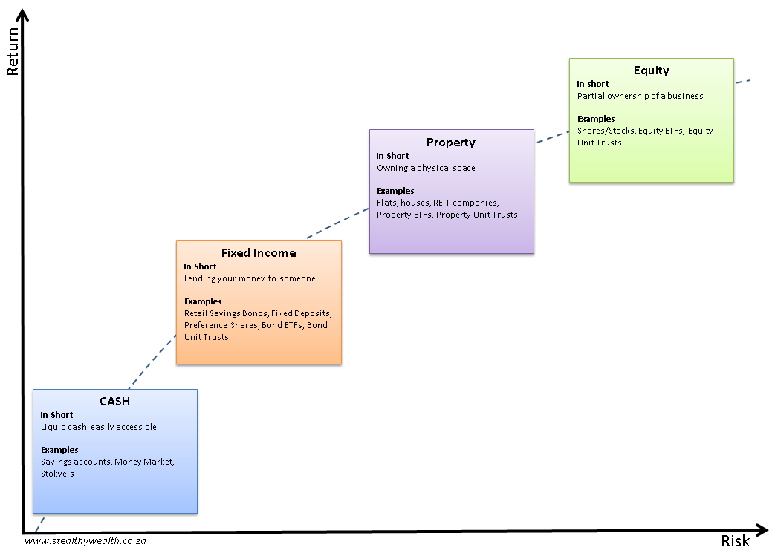
Which ETFs?
Decide on your overall asset allocation
Local vs Offshore?
Equities, Property, Bonds, Cash
Check this webinar
https://blogs.easyequities.co.za/which-etf-should-i-invest-in?hsLang=en-za
Don’t view your TFSA in isolation
Company pension fund
RAs
Investment Property

Slide 7
Which ETFs?
Keep in mind that your companies pension, your RA, preservation funds are all Regulation 28
Locally biased
May be less aggressive
You may want to consider that your TFSA should be
Orientated toward offshore
Contain more growth assets

Slide 8
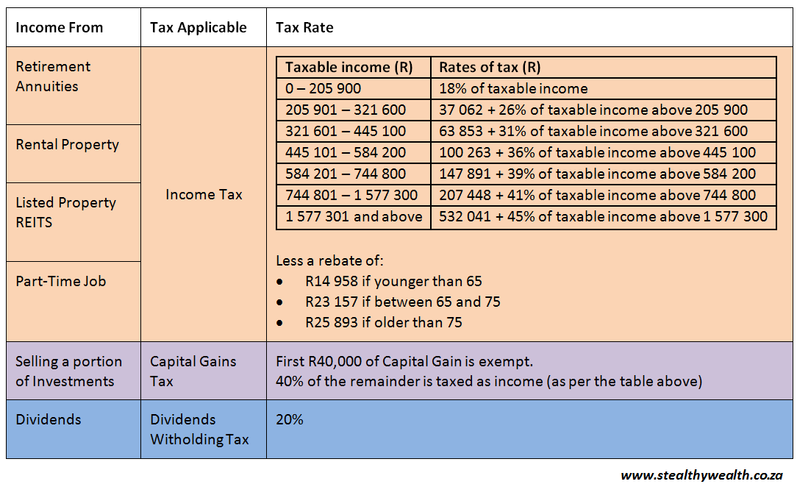
Saving Tax

Slide 9
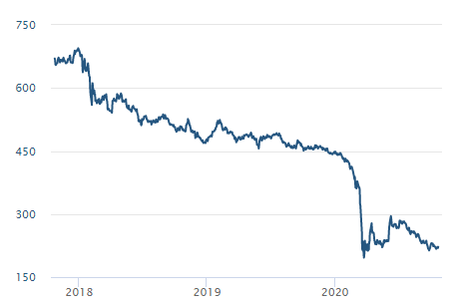
Saving Tax
Don’t let Tax be the starting point when choosing what to put into your TFSA
REIT dividends is taxed as income – likely to be a high tax rate (up to 45%)
~ -70%
OUCH!
Source – www.sharenet.co.za

Slide 10
Saving Tax
TFSA = no tax payable to SARS
But…
International Dividends Withholding Tax
Offshore ETFs hold offshore companies
When those companies pay dividends, they are taxed

Slide 11
Cash In A TFSA?
Under 65 – You do not pay tax on the first R23,800 of interest
@5% Interest – no tax until your balance exceeds R476,000
Source – SARS

Slide 12
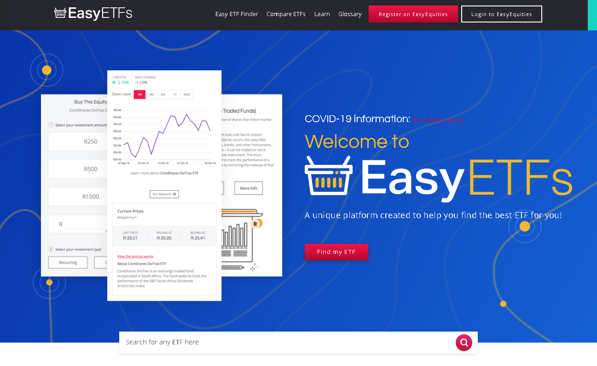
ETF Resources
EasyETFs https://etfs.easyequities.co.za/

Slide 13
Questions?

